Slide 1
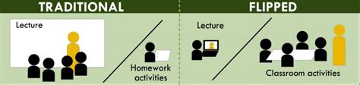

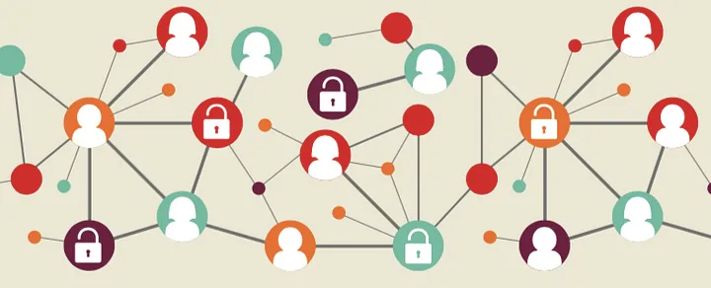
Evolution of a Flipped Classroom: From Prototype to Personalized Learning
Autar Kaw, University of South Florida
Renee Clark, University of Pittsburgh
ASEE-SE 2023
George Mason University, Fairfax, VA
Source: Washington State University, CTL; https://medium.com/learning-matters/what-is-adaptive-learning-64a95513cfce

Slide 2
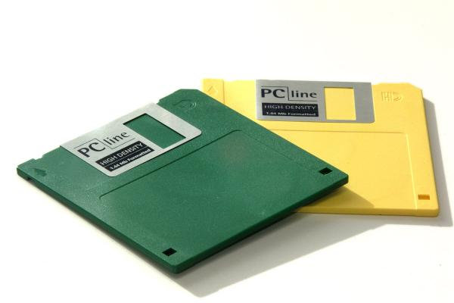
Crazy Idea (1987-1991)

Slide 3
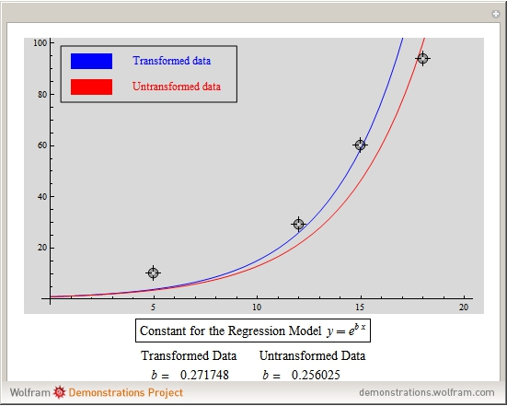
What happens if?

Slide 4
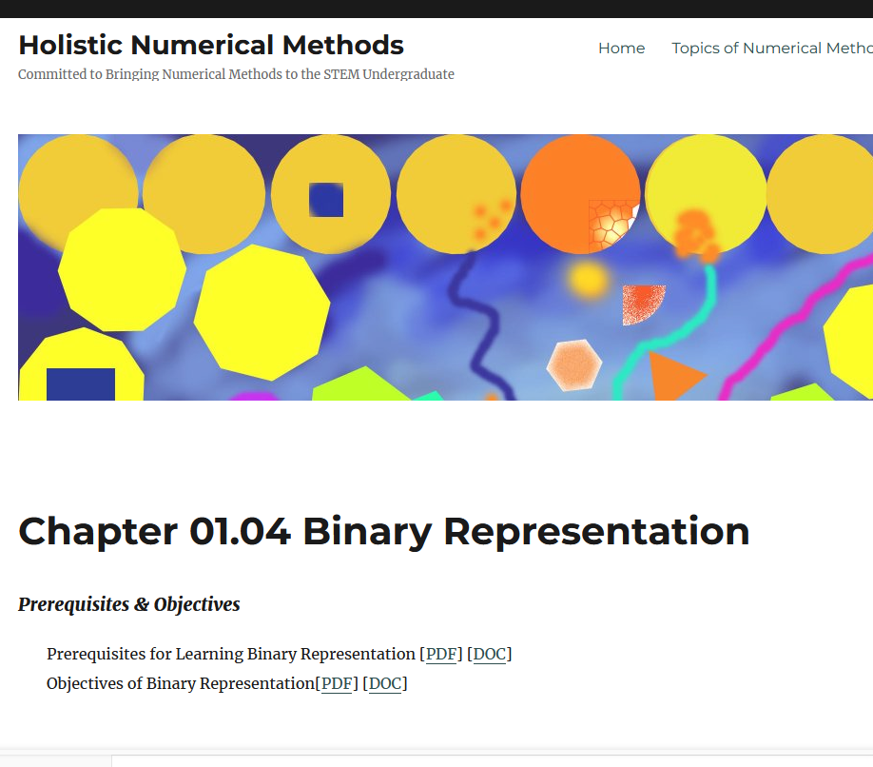
Open Education Resources
(2001-2012)
The project received four grants (2004-2012)
Compared traditional and web-enhanced classroom
Partnered with ODU, ASU, MVSU, FAMU and MSOE

Slide 5
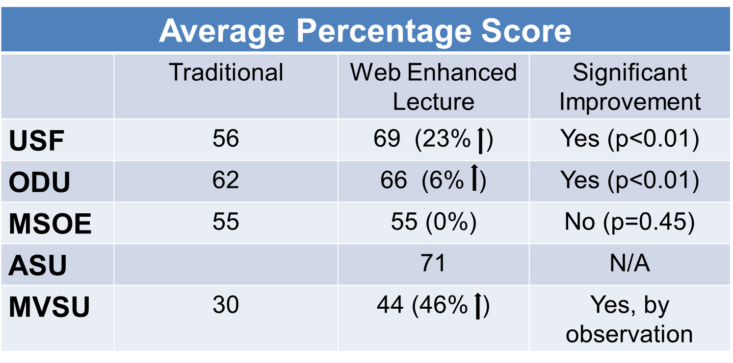
Blended vs Traditional
PRE-CLASS
No prep
IN-CLASS
Lecture, Socratic
POST-CLASS
Problem sets from textbook, projects
Traditional
PRE-CLASS
Learn pre-requisites from the web
IN-CLASS
Lecture, use web-based resources, active learning
POST-CLASS
Some content online, Problem sets from textbook, projects
Blended

Slide 6
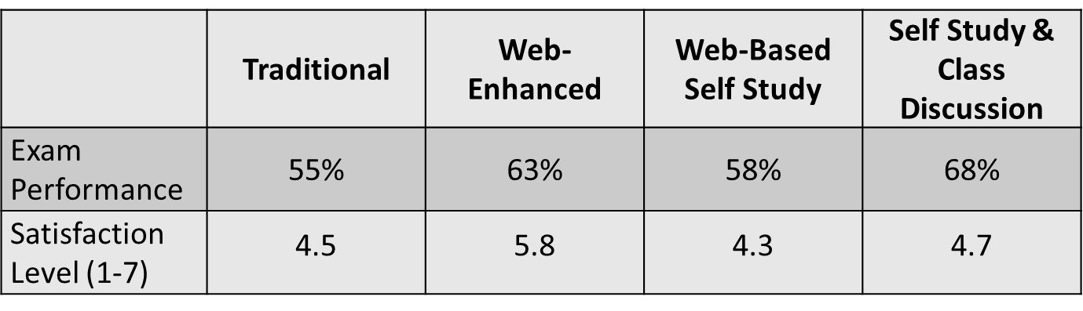
Summers
2002-05
Traditional Lecture (Summer 2002)
Web Enhanced Class Lecture (Summer 2003)
Web-Based Self-Study (Summer 2004)
Web-Based Self-Study & Class Discussion (Flipped Classroom) (Summer 2005)

Slide 7
Flipped Classroom (2013-16)
PRE-CLASS
Introductory video and textbook content, graded online LMS quizzes
IN-CLASS
Personal Response Systems, Think-Pair activities, Minilectures
POST-CLASS
Problem sets from textbook, projects
 | Modality |  |  |  | Sample Size
 | Blended | Flipped | Quade’s p | Effect Size | Blended | Flipped
Multiple Choice Final Exam | 63% | 65% | 1.0 | 0.14 | 126 | 88
Free Response Final Exam | 45% | 42% | 1.0 | -0.12 | 126 | 88

Slide 8
Flipped Classroom with Prototype Adaptive Lessons (2016-19)
PRE-CLASS
Adaptive learning platform lessons for half the course based on videos, text and assessment
IN-CLASS
Personal Response Systems, Think-Pair activities, Minilectures
POST-CLASS
Problem sets from textbook, projects
 | Modality |  |  |  | Sample Size
 | Flipped Not Adaptive | Flipped Adaptive | p | Effect Size | Flipped Not Adaptive | Flipped Adaptive
Final Exam Multiple Choice | 65% | 60% | 0.025 | -0.32 | 88 | 146
Final Exam Free Response | 38% | 44% | 0.057 | 0.34 | 88 | 146

Slide 9
Flipped Classroom - The COVID years (2020-21)
PRE-CLASS
Introductory video and textbook content, graded online LMS quizzes
REMOTE CLASS
Microsoft Forms, Break out Rooms, Online Minilectures
POST-CLASS
Problem sets from textbook, projects
 | Modality |  |  |  | Sample Size
 | Flipped F2F | Flipped Remote | p | Effect Size | Flipped F2F | Flipped Remote
Final Exam | 40% | 54% | <0.01 | 0.73 | 88 | 86

Slide 10
Flipped Classroom with Adaptive Learning (2021-23)
PRE-CLASS
Adaptive learning platform lessons based on videos, text and assessment
IN-CLASS
Cloud-based polling, Think-Pair activities, Minilectures
POST-CLASS
Problem sets from textbook, projects
Also using data analytics from the adaptive learning to identify low performing students for tutoring support.

Slide 11
QUESTIONS?
Evolution of a Flipped Classroom: From Prototype to Personalized Learning
Autar Kaw | Renee Clark
Autar Kaw
kaw@usf.edu
https://AutarKaw.com
@numericalguy

Slide 14
Does flipped class take more time?
Traditional Lecture
3 hours in class equates to 6 hours out of class””
Current
Pre-work
Reading
Direct
Teaching
In-class lecture
Engaged Learning without Instructor
Homework, project, study…
Source: PK Imbrie & Mary Besterfield-Sacre flipped classroom workshop given on CIRTL

Slide 15
Does flipped class take more time?
Flipped Class
3 hours in class equates to 6 hours out of class””
FlipModel
Pre-work
Quiz
Pre-HW
Reading
Continued Engaged Learning
without Instructor
Homework, project, study…
Direct
Teaching
Video
Engaged Learning
with Instructor
Source: PK Imbrie & Mary Besterfield-Sacre flipped classroom workshop given on CIRTL

Slide 16
Flipped vs Traditional
Is the flipped class better than the traditional lecture?
Yes!
http://www.pnas.org/content/111/23/8410.abstract
“The results raise questions about the continued use of traditional lecturing as a control in research studies”

Slide 17
Before, In, and After
Before Class
In Class
After Class

Slide 18
What happens BEFORE class?

Slide 19
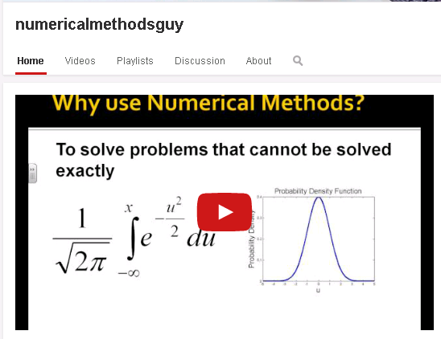
Assign video lectures

Slide 20
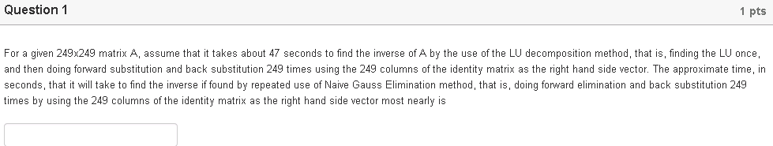
Assign automatically graded quizzes

Slide 21
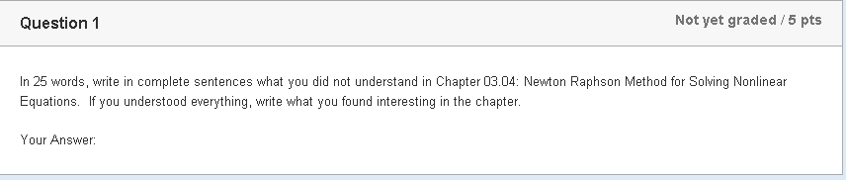
What did you not understand about the assigned chapter?

Slide 22
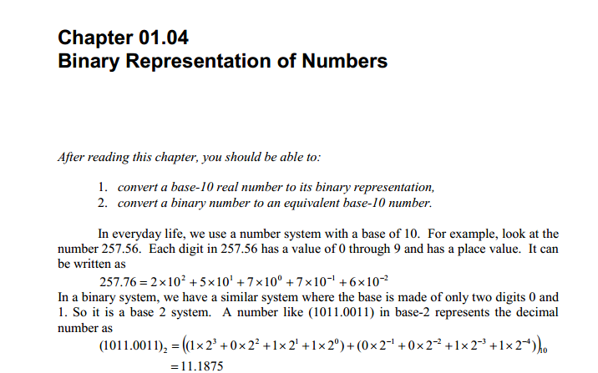
Do reading assignment, if needed

Slide 23
What happens IN class?

Slide 24
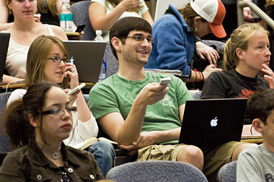
Ask clicker questions
10 minutes: Clicker questions

Slide 25
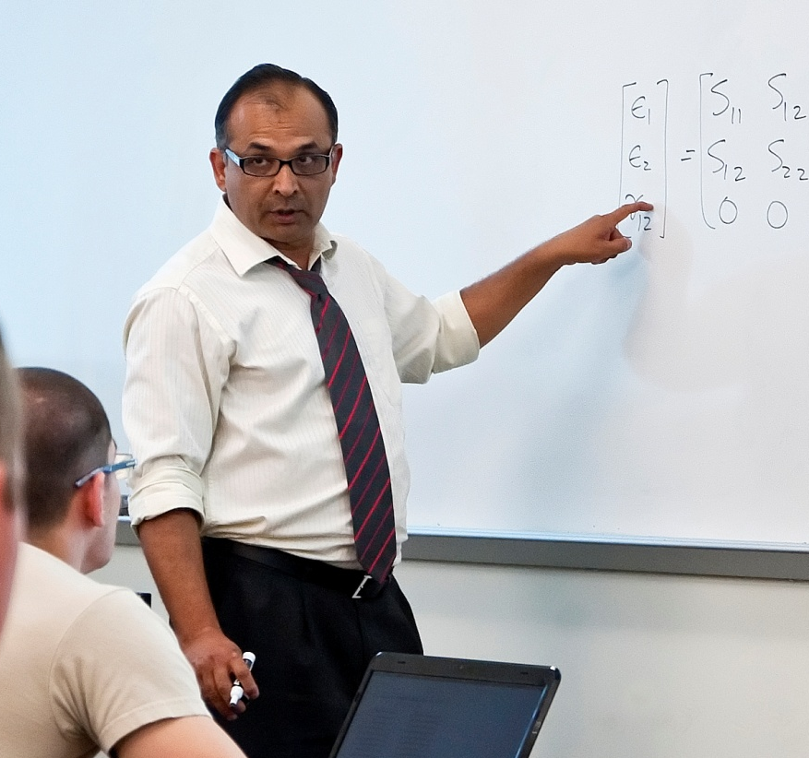
Give micro-lectures
10 minutes: Micro-lectures are based on the questions asked.

Slide 26
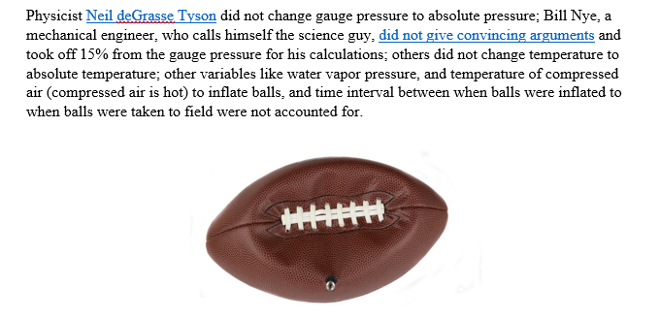
In-class exercises
55 minutes: Problem sets; application problems

Slide 27
What happens AFTER class?

Slide 28
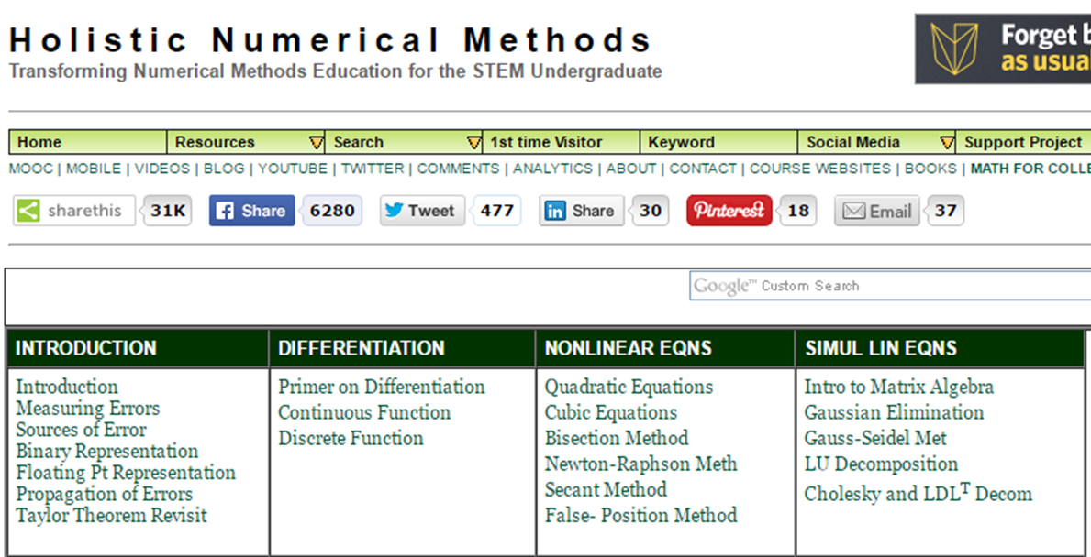
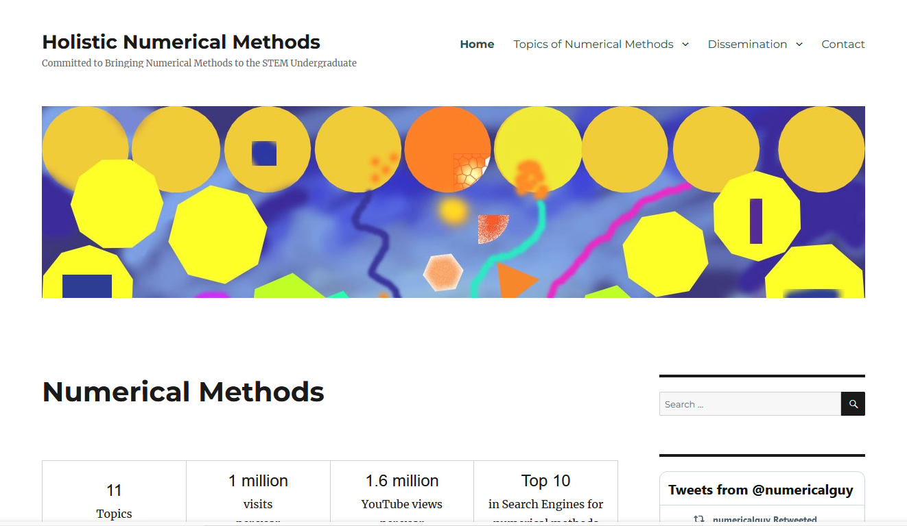
Where it is now
1,600,000+ page views per year
1,400,000+ YouTube views per year and 63,000+ subscribers
100,000 blog views per year
MOOCs on Matrix Algebra and Numerical Methods
Tested extensively in 6 universities in USA and used in 40 universities world-wide

Slide 29
Assignments and help!
Take another automatically graded algorithmic quiz on LMS
Complete and submit higher-order thinking exercise for grading.
Continue discussion. Answers are given by instructor via blog, videos, links.

Slide 30
Results

Slide 31
Three instruments
Concept inventory test
Final Exam
Classroom environment survey
Flipped mode evaluation survey

Slide 32
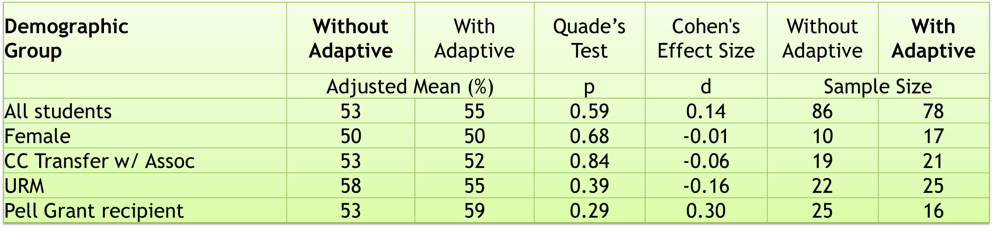
Concept Test
Concept Question Score Comparison Between Without and With Adaptive Learning

Slide 33
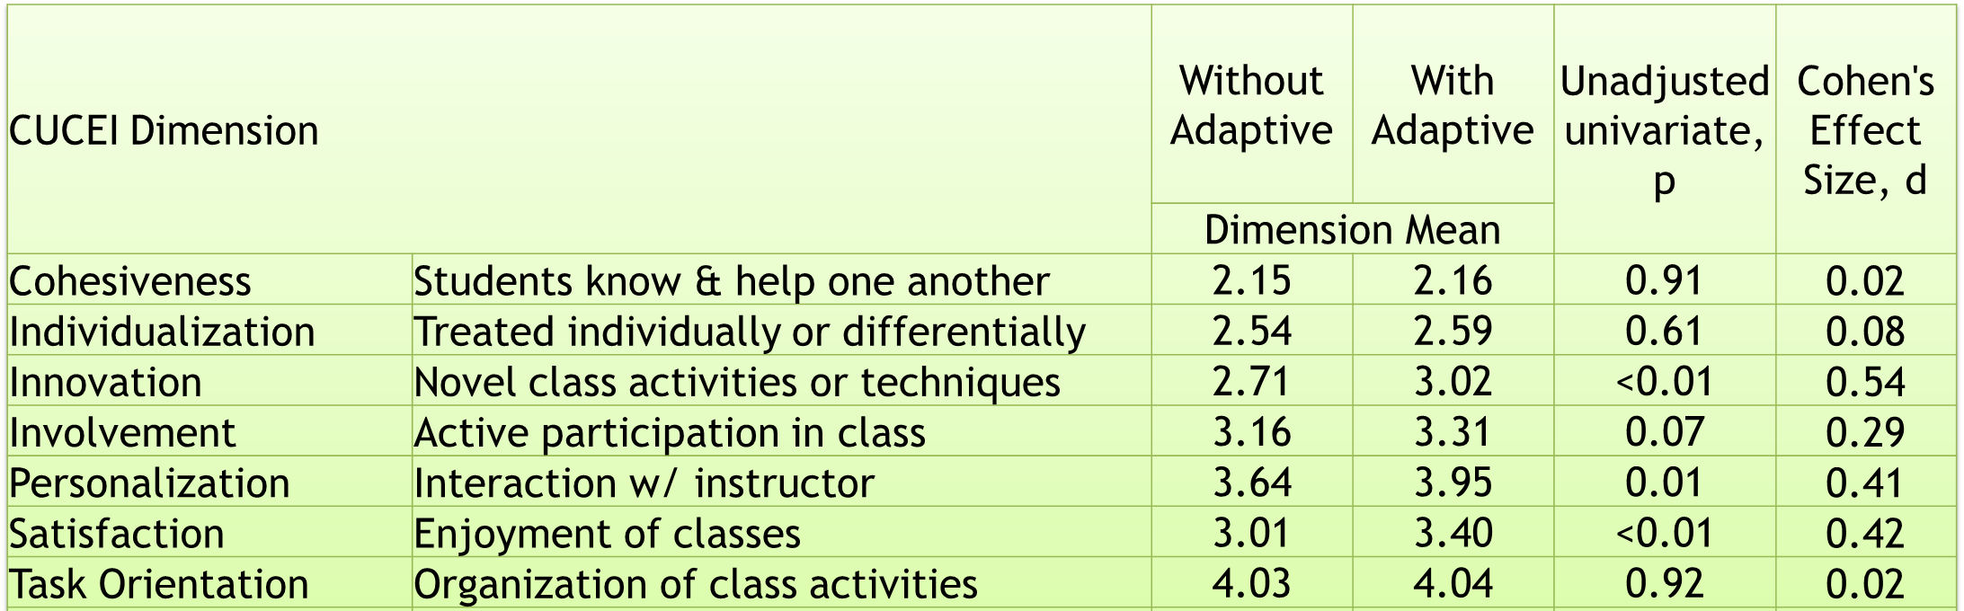
Classroom Environment Survey

Slide 34
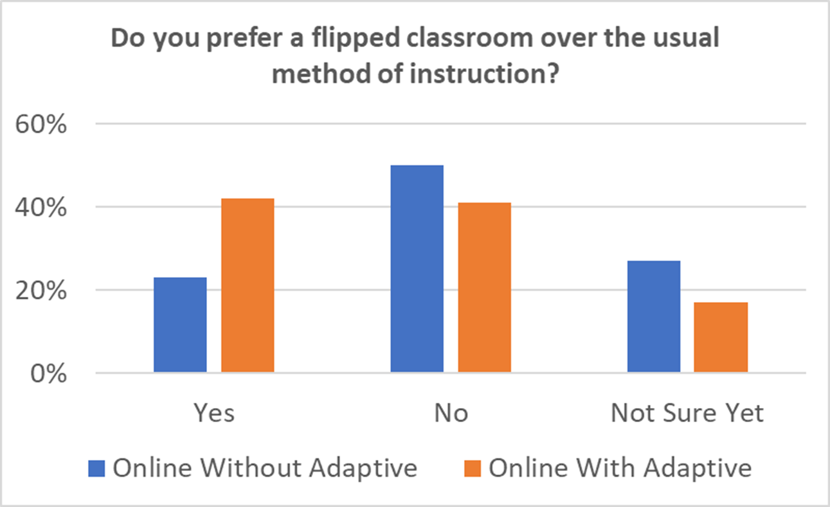
Flipped Mode Survey
More students (42% vs 23%) preferred flipped modality (versus traditional instruction) when adaptive learning lessons were part of the pre-class learning (p=0.01 based on test of proportions).

Slide 35
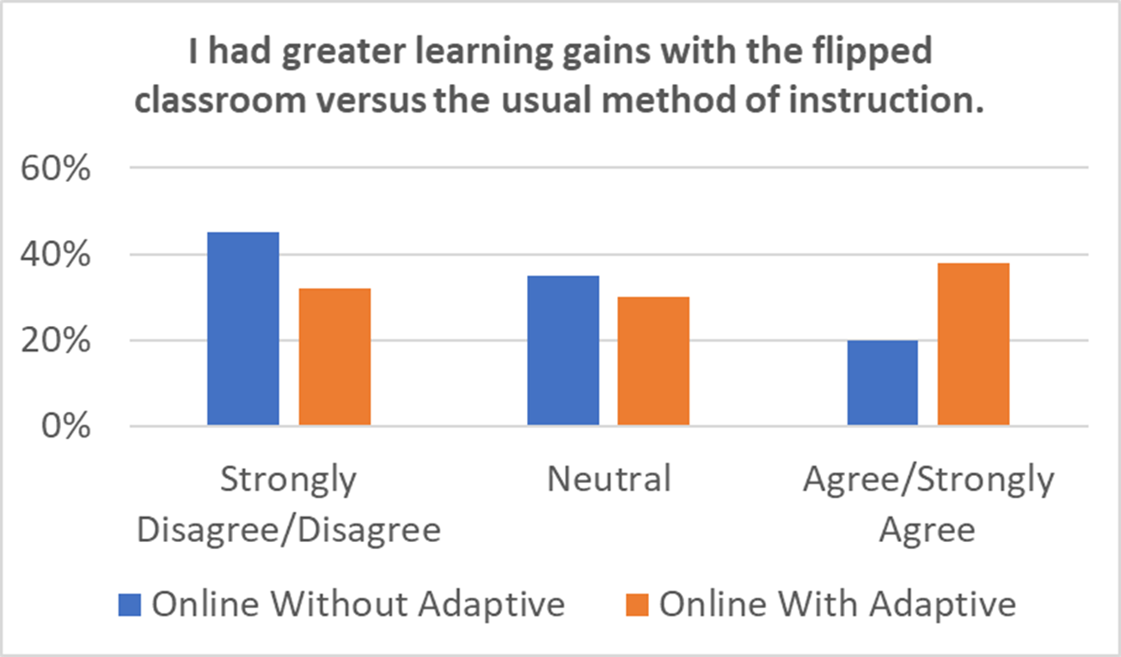
Flipped Mode Survey
More students (38% vs 19%) perceived higher learning gains when adaptive learning was used in flipped modality compared to traditional methods of instruction (p=0.01 based on test of proportions).

Slide 36
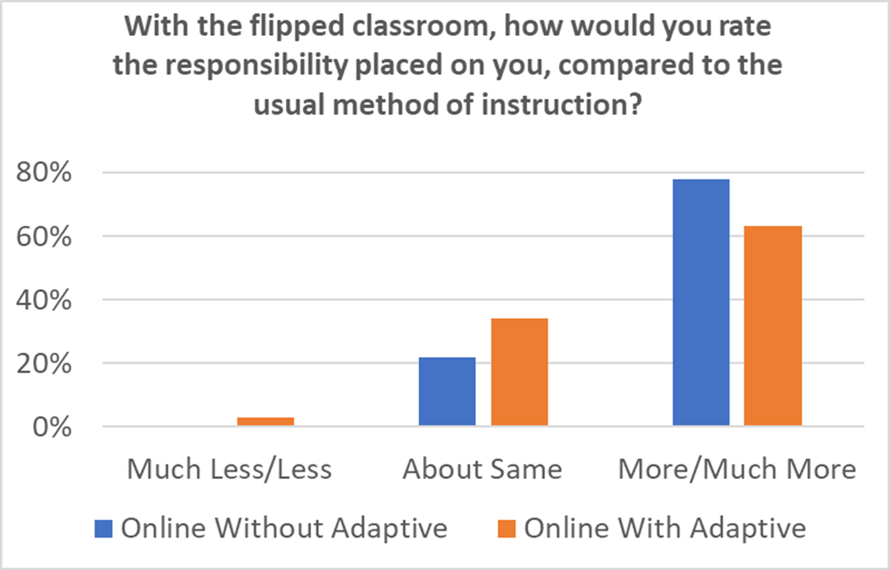
Flipped Mode Survey
Although still high, fewer students (63% vs. 78%) perceived more responsibility with flipped instruction when the adaptive lessons were available versus not (p=0.04 based on test of proportions).

Slide 37
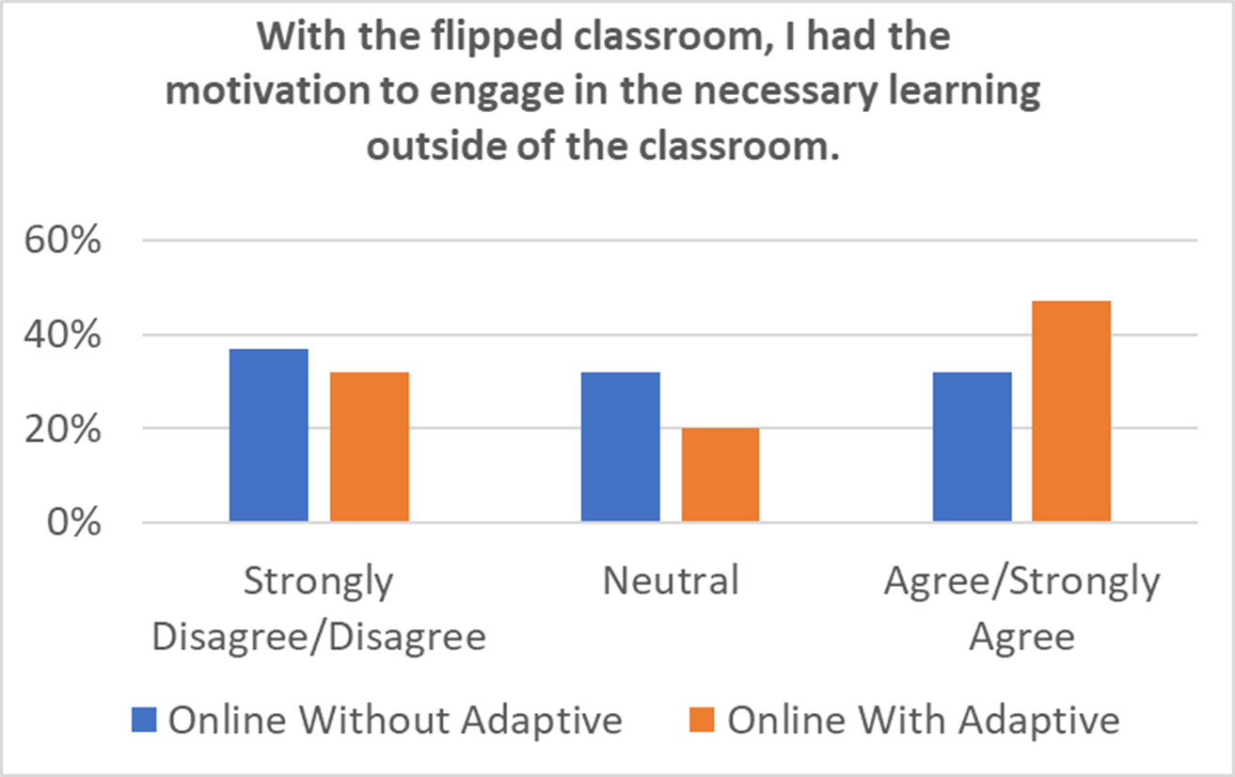
Flipped Mode Survey
More students (47% vs 32%) were motivated when adaptive learning was introduced in a flipped modality (p=0.04 based on test of proportions)

Slide 38
Conclusions
Flipped instruction in a numerical methods course during the remote instructional period of the COVID19 pandemic was conducted with and without the use of adaptive learning lessons.
Regarding the direct assessment of student learning, concept‐inventory results were higher when the adaptive lessons were available versus when they were not (d=0.14).
Results using ALP lessons (vs. without) in the flipped online classroom were promising, with an increase in all seven of the CUCEI classroom environment dimensions.
A significant decline was observed in the proportion of students who perceived more responsibility with flipped instruction when the adaptive lessons were available versus not.

Slide 39
A LIFETIME WARRANTY and QUESTIONS?
Adaptive learning: Helpful to the flipped classroom in the online environment of COVID?
Renee Clark | Autar Kaw | Rafael Braga Gomes
Autar Kaw
kaw@usf.edu
https://AutarKaw.com
@numericalguy

