Slide 1
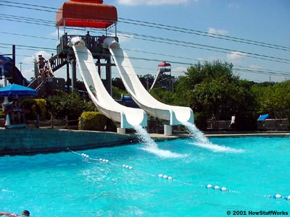
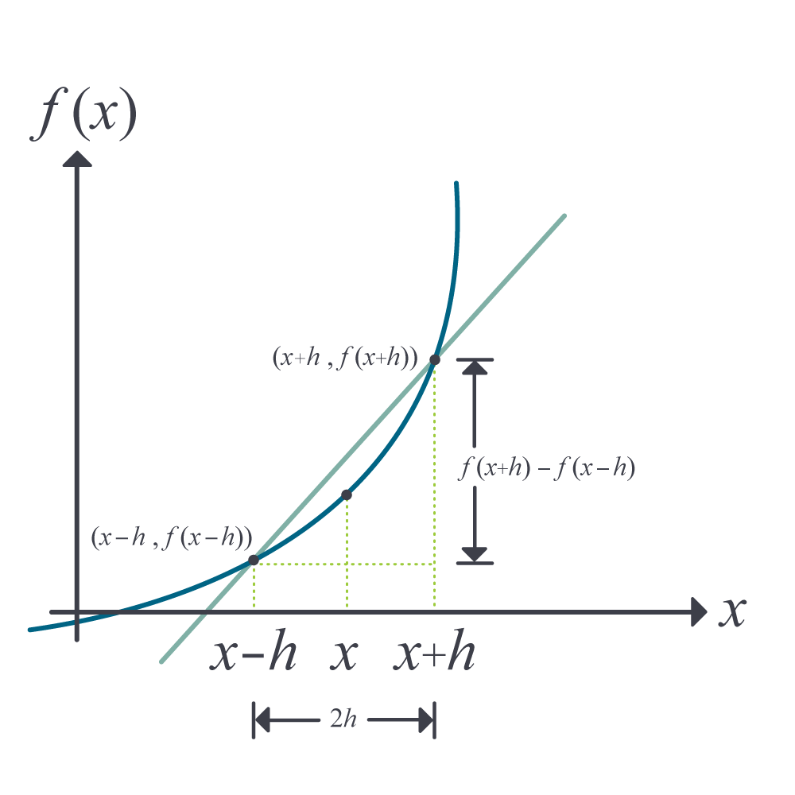
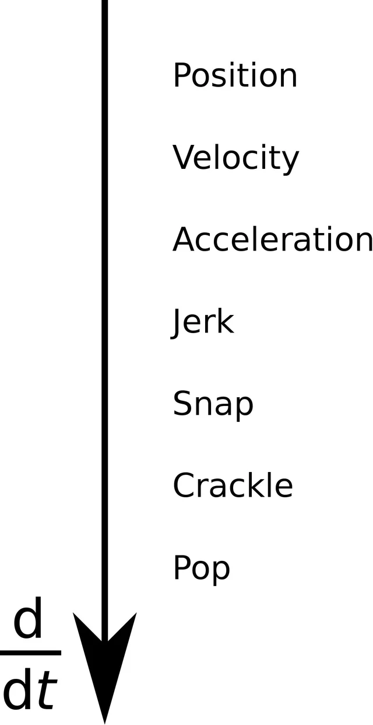
Differentiation
A Slippery Slope - Jerks You Around - Accelerates Your Mind

Slide 2

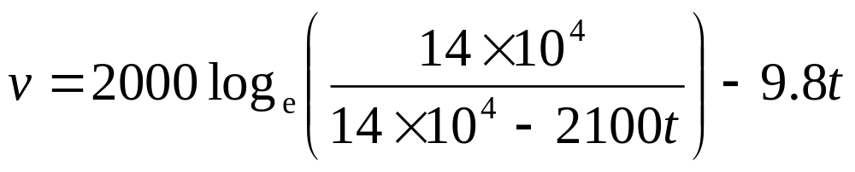
Acceleration of a rocket

Slide 3
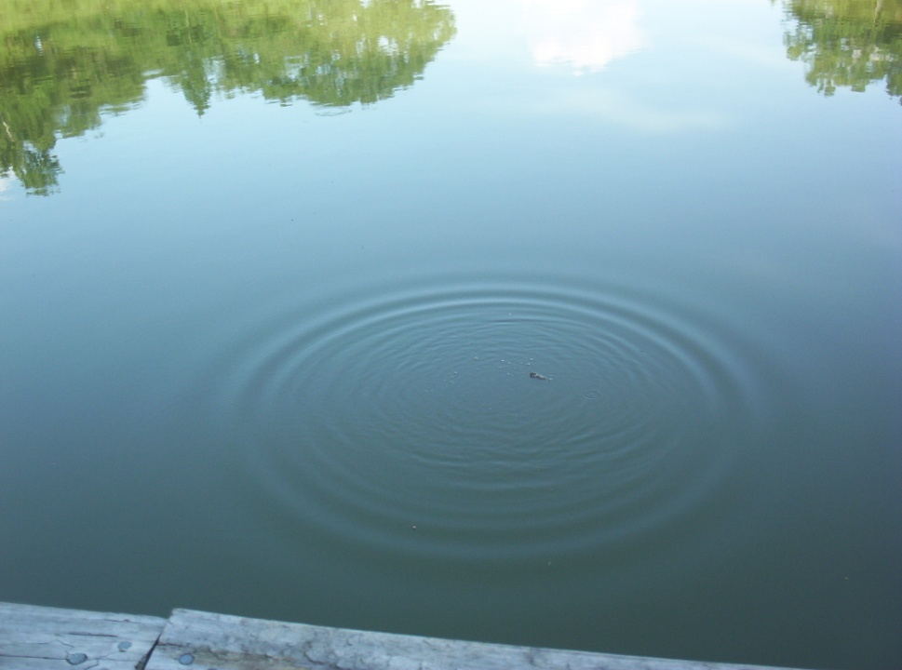
Oil Spill
Time (s) | 0 | 0.5 | 1.0 | 1.5 | 2.0 | 2.5 | 3.0 | 3.5 | 4.0 | 4.5 | 5.0
Radius(m) | 0 | 0.236 | 0.667 | 1.225 | 1.886 | 2.635 | 3.464 | 4.365 | 5.333 | 6.364 | 7.454

Slide 4
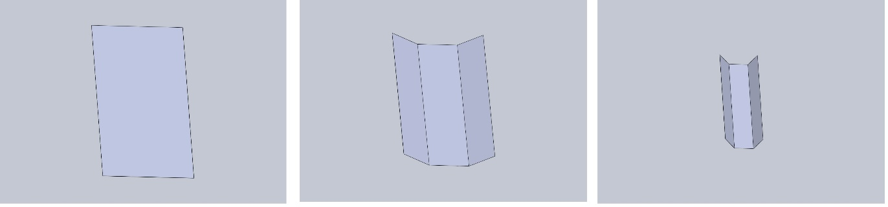
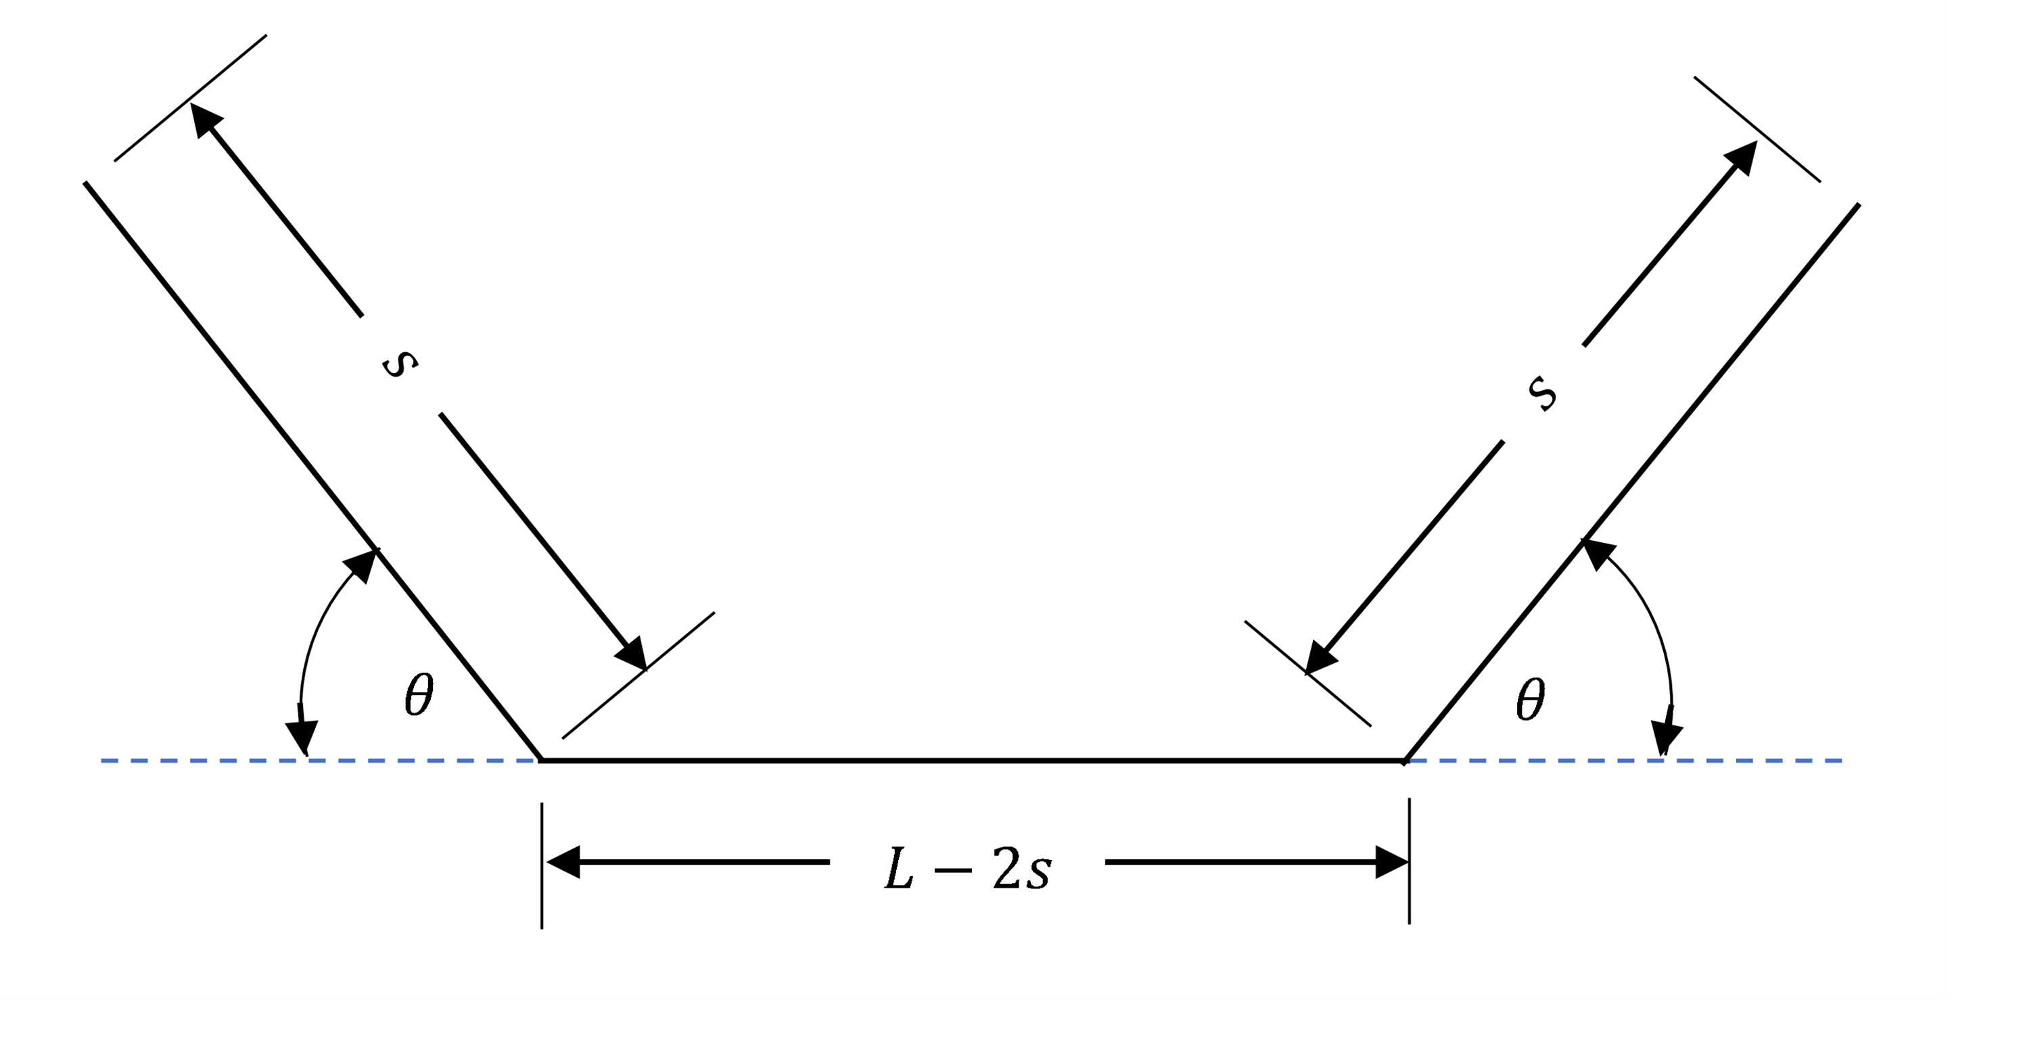

Optimum Angle of a Gutter
$$A\left(s,θ\right)=\left[\left(L−2s\right)+s\cos{θ}\right]s\sin{θ}$$
$$L=0.21, s=\frac{L}{3}$$
$$A\left(θ\right)=0.0049\left[1+cos\left(θ\right)\right] sin\left(θ\right)$$

Slide 5
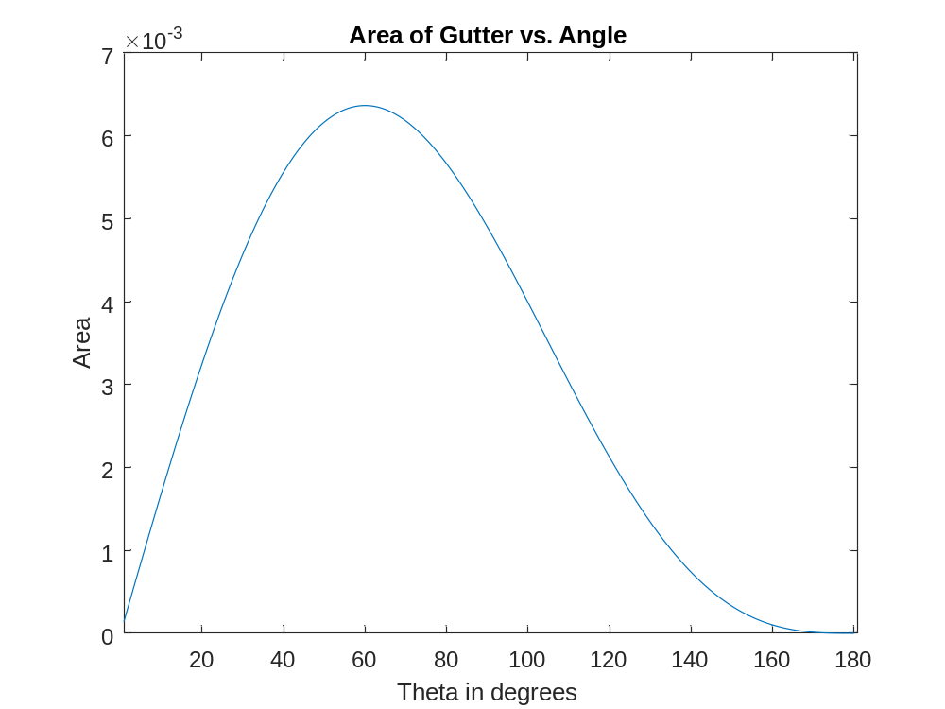
Area vs Angle of Gutter

