Slide 1
Gaussian Elimination with Partial Pivoting
http://nm.MathForCollege.com
Transforming Numerical Methods Education for STEM Undergraduates

Slide 2

Notes:
Poll Title: Do not modify the notes in this section to avoid tampering with the Poll Everywhere activity.
More info at polleverywhere.com/support
You know Lady Gaga; Who is Shady Gaga
https://www.polleverywhere.com/multiple_choice_polls/AX48BQeL0lsKRxVUJFCoP?state=opened&flow=Default&onscreen=persist

Slide 3
Naive Gauss Elimination Pitfalls

Slide 4
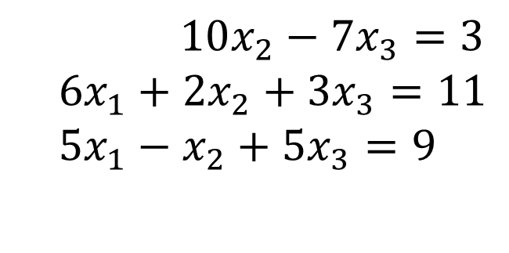
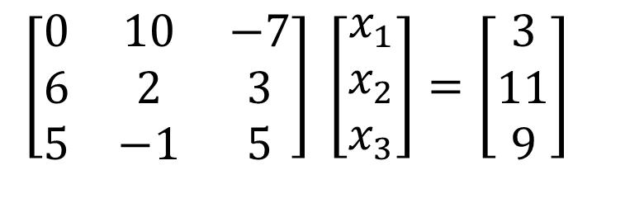
Pitfall#1. Division by zero
$10x_{2}−7x_{3}=3$
$$6x_{1}+2x_{2}+3x_{3}=11 \\ 5x_{1}−x_{2}+5x_{3}=9$$
$$\left[\begin{matrix}0 & 10 & −7 \\ 6 & 2 & 3 \\ 5 & −1 & 5\end{matrix}\right] \left[\begin{matrix}x_{1} \\ x_{2} \\ x_{3}\end{matrix}\right]=\left[\begin{matrix}3 \\ 11 \\ 9\end{matrix}\right]$$

Slide 5
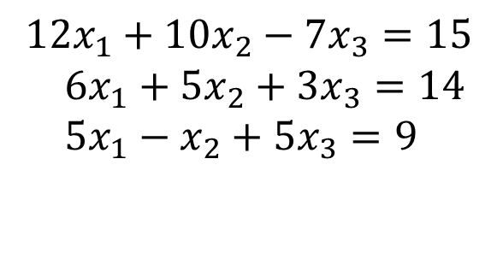
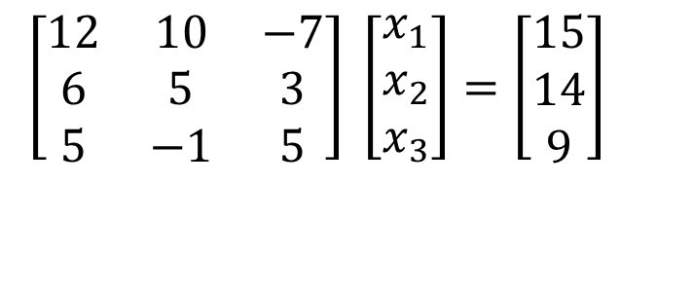
Is division by zero an issue here?
$$12x_{1}+10x_{2}−7x_{3}=15 \\ 6x_{1}+5x_{2}+3x_{3}=14 \\ 5x_{1}−x_{2}+5x_{3}=9$$
$$\left[\begin{matrix}12 & 10 & −7 \\ 6 & 5 & 3 \\ 5 & −1 & 5\end{matrix}\right] \left[\begin{matrix}x_{1} \\ x_{2} \\ x_{3}\end{matrix}\right]=\left[\begin{matrix}15 \\ 14 \\ 9\end{matrix}\right]$$

Slide 6
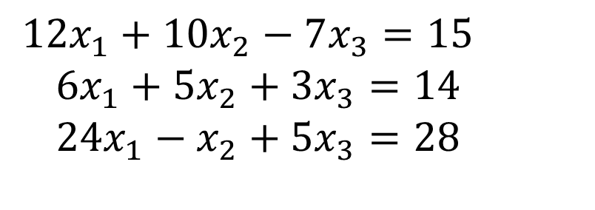
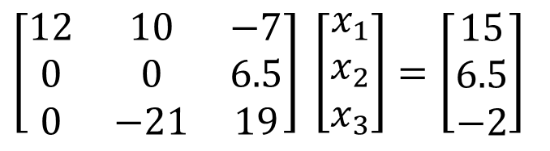
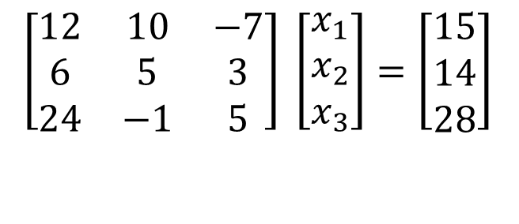
Is division by zero an issue here? YES
$$12x_{1}+10x_{2}−7x_{3}=15 \\ 6x_{1}+5x_{2}+3x_{3}=14 \\ 24x_{1}−x_{2}+5x_{3}=28$$
$$\left[\begin{matrix}12 & 10 & −7 \\ 6 & 5 & 3 \\ 24 & −1 & 5\end{matrix}\right] \left[\begin{matrix}x_{1} \\ x_{2} \\ x_{3}\end{matrix}\right]=\left[\begin{matrix}15 \\ 14 \\ 28\end{matrix}\right]$$
$$\left[\begin{matrix}12 & 10 & −7 \\ 0 & 0 & 6.5 \\ 0 & −21 & 19\end{matrix}\right] \left[\begin{matrix}x_{1} \\ x_{2} \\ x_{3}\end{matrix}\right]=\left[\begin{matrix}15 \\ 6.5 \\ −2\end{matrix}\right]$$
Division by zero is a possibility at any step of forward elimination

Slide 7
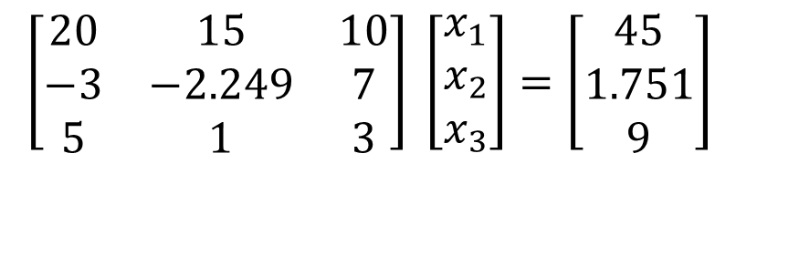
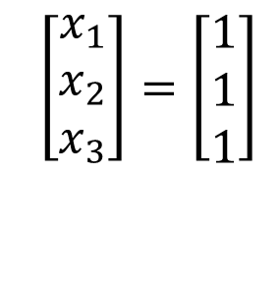
Pitfall#2. Large Round-off Errors
$$\left[\begin{matrix}20 & 15 & 10 \\ −3 & −2.249 & 7 \\ 5 & 1 & 3\end{matrix}\right] \left[\begin{matrix}x_{1} \\ x_{2} \\ x_{3}\end{matrix}\right]=\left[\begin{matrix}45 \\ 1.751 \\ 9\end{matrix}\right]$$
Exact Solution
$$\left[\begin{matrix}x_{1} \\ x_{2} \\ x_{3}\end{matrix}\right]=\left[\begin{matrix}1 \\ 1 \\ 1\end{matrix}\right]$$

Slide 8
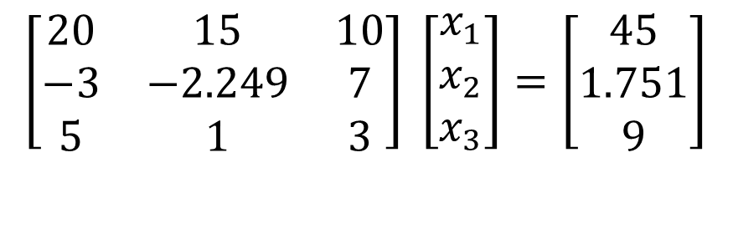
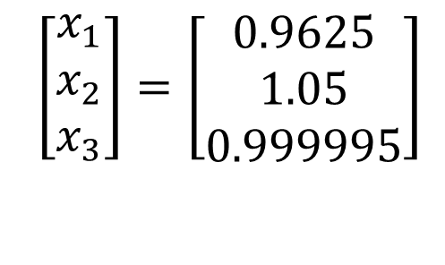
Pitfall#2. Large Round-off Errors
$$\left[\begin{matrix}20 & 15 & 10 \\ −3 & −2.249 & 7 \\ 5 & 1 & 3\end{matrix}\right] \left[\begin{matrix}x_{1} \\ x_{2} \\ x_{3}\end{matrix}\right]=\left[\begin{matrix}45 \\ 1.751 \\ 9\end{matrix}\right]$$
Solve it on a computer using 6 significant digits with chopping
$$\left[\begin{matrix}x_{1} \\ x_{2} \\ x_{3}\end{matrix}\right]=\left[\begin{matrix}0.9625 \\ 1.05 \\ 0.999995\end{matrix}\right]$$

Slide 9
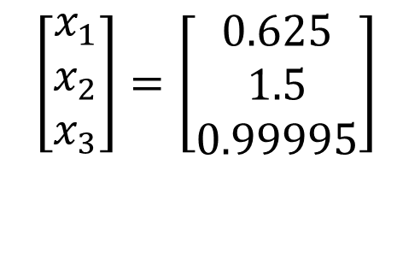
Pitfall#2. Large Round-off Errors
$$\left[\begin{matrix}20 & 15 & 10 \\ −3 & −2.249 & 7 \\ 5 & 1 & 3\end{matrix}\right] \left[\begin{matrix}x_{1} \\ x_{2} \\ x_{3}\end{matrix}\right]=\left[\begin{matrix}45 \\ 1.751 \\ 9\end{matrix}\right]$$
Solve it on a computer using 5 significant digits with chopping
$$\left[\begin{matrix}x_{1} \\ x_{2} \\ x_{3}\end{matrix}\right]=\left[\begin{matrix}0.625 \\ 1.5 \\ 0.99995\end{matrix}\right]$$
Is there a way to reduce the round off error?

Slide 10
Avoiding Pitfalls
Increase the number of significant digits
Decreases round-off error
Does not avoid division by zero

Slide 11
Avoiding Pitfalls
Use Gaussian Elimination with Partial Pivoting
    Avoids division by zero
    Reduces round off error

Slide 12
THE END

Slide 13
Gauss Elimination with Partial Pivoting

Slide 14
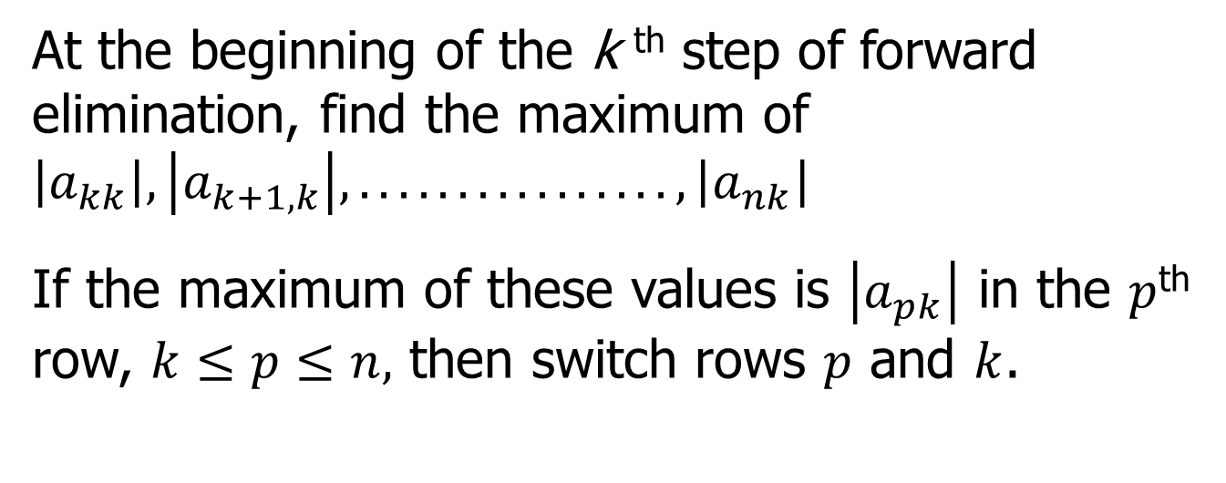
What is Different About Partial Pivoting?
At the beginning of the k ^{th} step of forward elimination, find the maximum of $\left|a_{kk}\right|,\left|a_{k+1,k}\right|,................,\left|a_{nk}\right|$
If the maximum of these values is $\left|a_{pk}\right|$ in the $p$^{th} row, $k≤p≤n,$ then switch rows $p$ and $k$.

Slide 15
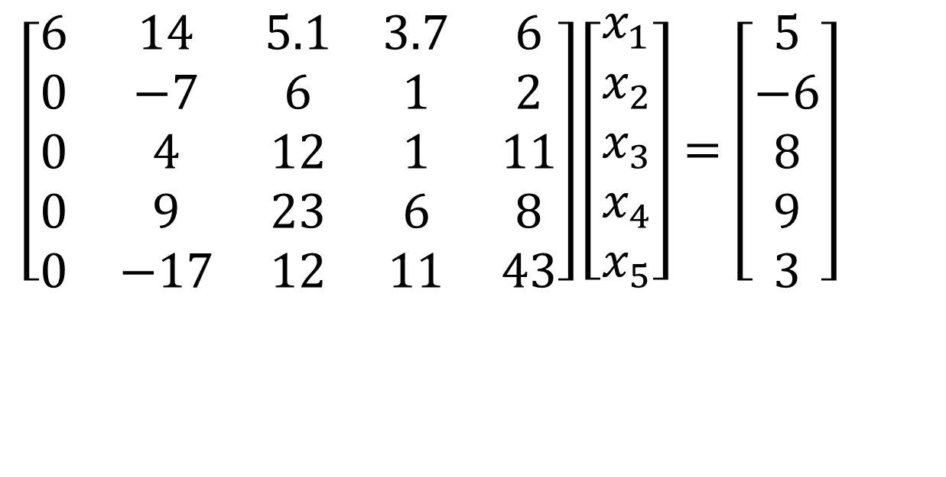
Example (2nd step of FE)
$$\left[\begin{matrix}6 & 14 & 5.1 & 3.7 & 6 \\ 0 & −7 & 6 & 1 & 2 \\ 0 & 4 & 12 & 1 & 11 \\ 0 & 9 & 23 & 6 & 8 \\ 0 & −17 & 12 & 11 & 43\end{matrix}\right]\left[\begin{matrix}x_{1} \\ x_{2} \\ x_{3} \\ x_{4} \\ x_{5}\end{matrix}\right]=\left[\begin{matrix}5 \\ −6 \\ 8 \\ 9 \\ 3\end{matrix}\right]$$
Which two rows would you switch?

Slide 16
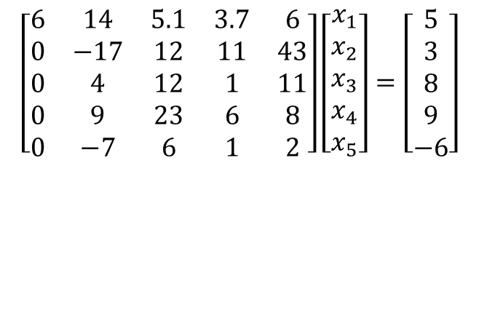
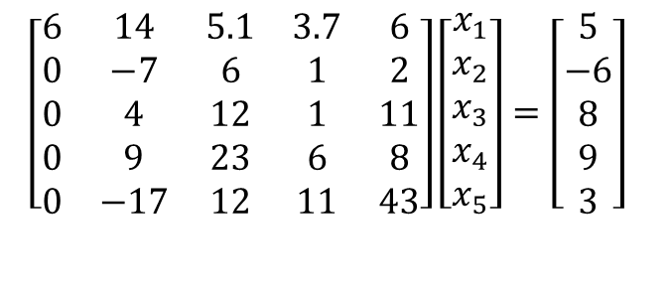
Example (2nd step of FE)
$$\left[\begin{matrix}6 & 14 & 5.1 & 3.7 & 6 \\ 0 & −7 & 6 & 1 & 2 \\ 0 & 4 & 12 & 1 & 11 \\ 0 & 9 & 23 & 6 & 8 \\ 0 & −17 & 12 & 11 & 43\end{matrix}\right]\left[\begin{matrix}x_{1} \\ x_{2} \\ x_{3} \\ x_{4} \\ x_{5}\end{matrix}\right]=\left[\begin{matrix}5 \\ −6 \\ 8 \\ 9 \\ 3\end{matrix}\right]$$
$$\left[\begin{matrix}6 & 14 & 5.1 & 3.7 & 6 \\ 0 & −17 & 12 & 11 & 43 \\ 0 & 4 & 12 & 1 & 11 \\ 0 & 9 & 23 & 6 & 8 \\ 0 & −7 & 6 & 1 & 2\end{matrix}\right]\left[\begin{matrix}x_{1} \\ x_{2} \\ x_{3} \\ x_{4} \\ x_{5}\end{matrix}\right]=\left[\begin{matrix}5 \\ 3 \\ 8 \\ 9 \\ −6\end{matrix}\right]$$

Slide 17
Gaussian Elimination with Partial Pivoting
A method to solve simultaneous linear equations of the form [A][X]=[C]
Two steps
1. Forward Elimination
2. Back Substitution

Slide 18
THE END

Slide 19
Gauss Elimination with Partial Pivoting Example

Slide 20
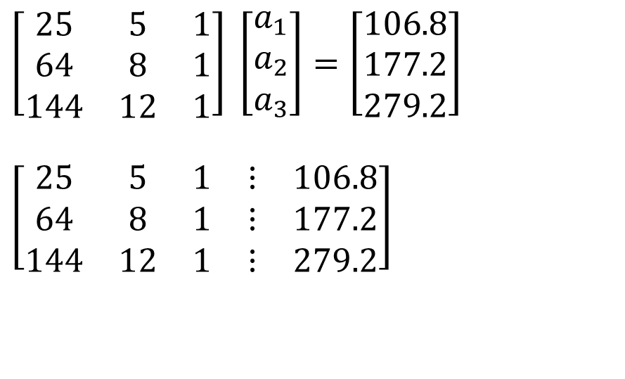
Solve the following set of equations by Gaussian elimination with partial pivoting
$$\left[\begin{matrix}25 & 5 & 1 \\ 64 & 8 & 1 \\ 144 & 12 & 1\end{matrix}\right] \left[\begin{matrix}a_{1} \\ a_{2} \\ a_{3}\end{matrix}\right]=\left[\begin{matrix}106.8 \\ 177.2 \\ 279.2\end{matrix}\right]$$
$$\left[\begin{matrix}25 & 5 & 1 & ⋮ & 106.8 \\ 64 & 8 & 1 & ⋮ & 177.2 \\ 144 & 12 & 1 & ⋮ & 279.2\end{matrix}\right]$$
Notes:
20

Slide 21
Forward Elimination
Notes:
21

Slide 22
Number of Steps of Forward Elimination
Number of steps of forward elimination part is
(n−1)=(3−1)=2

Slide 23
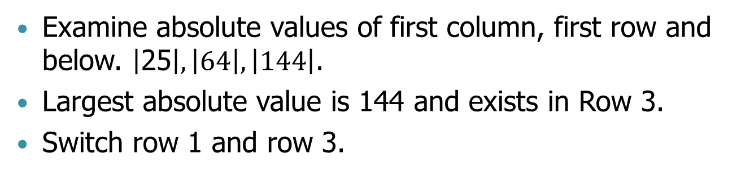
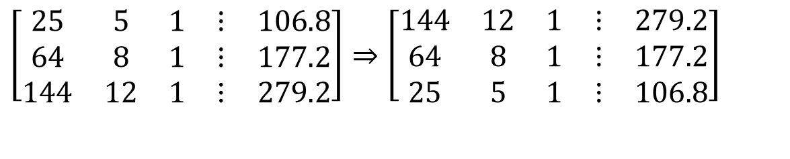
Forward Elimination: Step 1
Examine absolute values of first column, first row and below. $\left|\text{25}\right|,\left|64\right|,\left|144\right|$.
Largest absolute value is 144 and exists in Row 3.
Switch row 1 and row 3.
$$\left[\begin{matrix}25 & 5 & 1 & ⋮ & 106.8 \\ 64 & 8 & 1 & ⋮ & 177.2 \\ 144 & 12 & 1 & ⋮ & 279.2\end{matrix}\right]⇒\left[\begin{matrix}144 & 12 & 1 & ⋮ & 279.2 \\ 64 & 8 & 1 & ⋮ & 177.2 \\ 25 & 5 & 1 & ⋮ & 106.8\end{matrix}\right]$$

Slide 24
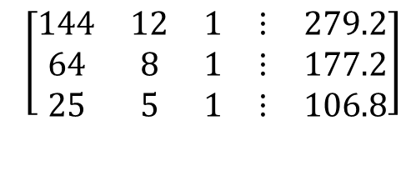
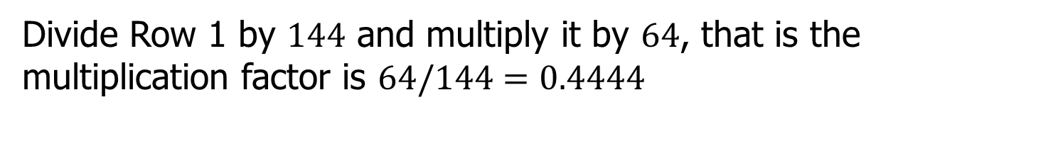
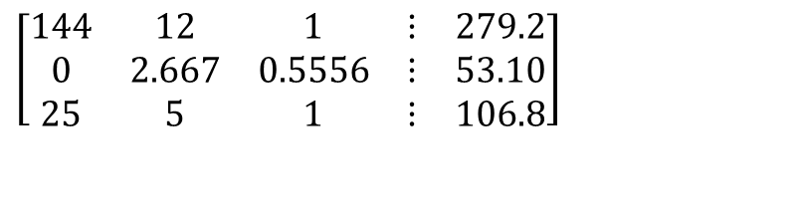
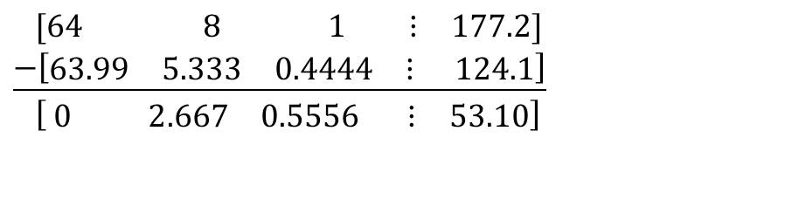
Forward Elimination: Step 1 (cont.)
$$\left[\begin{matrix}144 & 12 & 1 & ⋮ & 279.2 \\ 64 & 8 & 1 & ⋮ & 177.2 \\ 25 & 5 & 1 & ⋮ & 106.8\end{matrix}\right]$$
Divide Row 1 by $144$ and multiply it by $64$, that is the multiplication factor is $64/144=0.4444$
$\left[\begin{matrix}144 & 12 & 1 & ⋮ & 279.2\end{matrix}\right]×0.4444$ $=\left[\begin{matrix}63.99 & 5.333 & 0.4444 & ⋮ & 124.1\end{matrix}\right]$
Subtract the result from Row 2
$$\left[\begin{matrix}\text{64} & \text{ 8} & _{ }\text{ 1} & ⋮ & \text{177.2}\end{matrix}\right] \\ \underline{−\left[\begin{matrix}\text{63.99} & \text{5.333} & \text{0.4444} & ⋮ & \text{ 124.1}\end{matrix}\right]} \\ \left[ \begin{matrix}0 & 2.667 & 0\text{.5556} & ⋮ & 53.10\end{matrix}\right]$$
.
Substitute new row for Row 2
$$\left[\begin{matrix}144 & 12 & 1 & ⋮ & 279.2 \\ 0 & 2.667 & 0.5556 & ⋮ & 53.10 \\ 25 & 5 & 1 & ⋮ & 106.8\end{matrix}\right]$$
Notes:
24

Slide 25
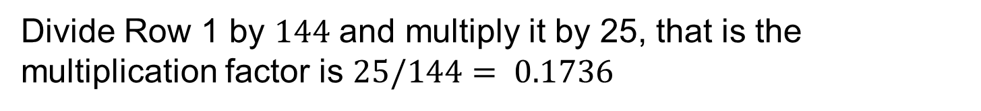
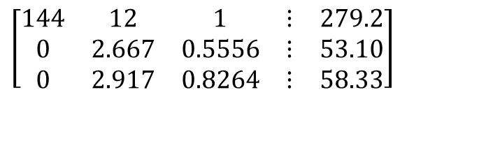
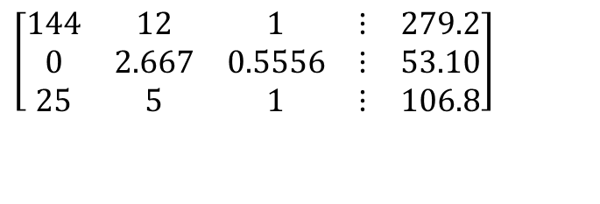
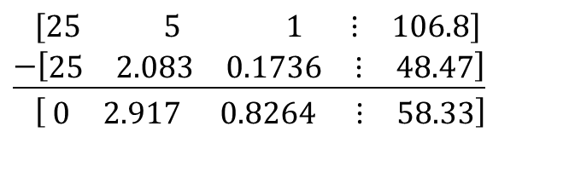
Forward Elimination: Step 1 (cont.)
$$\left[\begin{matrix}144 & 12 & 1 & ⋮ & 279.2 \\ 0 & 2.667 & 0.5556 & ⋮ & 53.10 \\ 25 & 5 & 1 & ⋮ & 106.8\end{matrix}\right]$$
Divide Row 1 by $144$ and multiply it by 25, that is the multiplication factor is $25/144= 0.1736$
$$\left[\begin{matrix}\text{144} & 12 & 1 & ⋮ & \text{279.2}\end{matrix}\right]×0.1736=\left[\begin{matrix}25.00 & 2.083 & 0.1736 & ⋮ & 48.47\end{matrix}\right]$$
Subtract the result from Row 3
$$\left[\begin{matrix}\text{25} & \text{ 5} & _{ }\text{ 1} & ⋮ & \text{106.8}\end{matrix}\right] \\ \underline{−\left[\begin{matrix}\text{25} & \text{2.083} & \text{0.1736} & ⋮ & \text{48.47}\end{matrix}\right]} \\ \left[ \begin{matrix}0 & 2.917 & 0.8264 & ⋮ & 58.33\end{matrix}\right]$$
.
Substitute new equation for Row 3
$$\left[\begin{matrix}144 & 12 & 1 & ⋮ & 279.2 \\ 0 & 2.667 & 0.5556 & ⋮ & 53.10 \\ 0 & 2.917 & 0.8264 & ⋮ & 58.33\end{matrix}\right]$$
Notes:
25

Slide 26
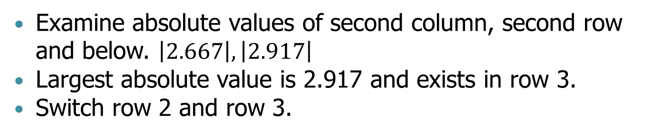
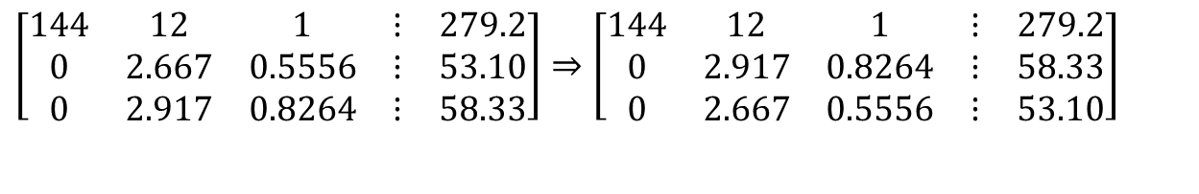
Forward Elimination: Step 2
Examine absolute values of second column, second row and below. $\left|2.667\right|,\left|\text{2.917}\right|$
Largest absolute value is 2.917 and exists in row 3.
Switch row 2 and row 3.
$$\left[\begin{matrix}144 & 12 & 1 & ⋮ & 279.2 \\ 0 & 2.667 & 0.5556 & ⋮ & 53.10 \\ 0 & 2.917 & 0.8264 & ⋮ & 58.33\end{matrix}\right]⇒\left[\begin{matrix}144 & 12 & 1 & ⋮ & 279.2 \\ 0 & 2.917 & 0.8264 & ⋮ & 58.33 \\ 0 & 2.667 & 0.5556 & ⋮ & 53.10\end{matrix}\right]$$

Slide 27
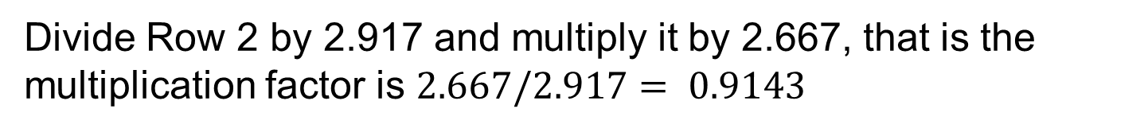
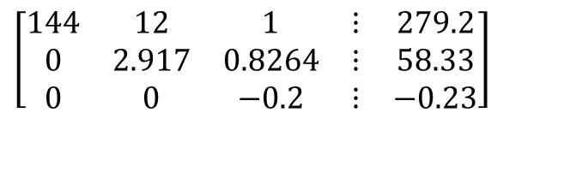
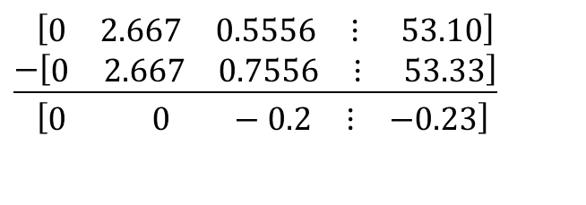
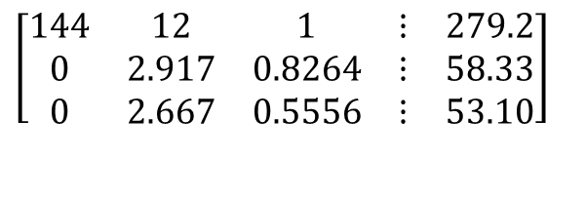
Forward Elimination: Step 2 (cont.)
$$\left[\begin{matrix}144 & 12 & 1 & ⋮ & 279.2 \\ 0 & 2.917 & 0.8264 & ⋮ & 58.33 \\ 0 & 2.667 & 0.5556 & ⋮ & 53.10\end{matrix}\right]$$
Divide Row 2 by 2.917 and multiply it by 2.667, that is the multiplication factor is $2.667/2.917= 0.9143$
$$\left[\begin{matrix}0 & \text{2.917} & \text{0.8264} & ⋮ & \text{58.33}\end{matrix}\right]×0.9143=\left[\begin{matrix}0 & 2.667 & 0.7556 & ⋮ & 53.33\end{matrix}\right]$$
Subtract the result from Equation 3
$$\left[\begin{matrix}0 & \text{2.667} & \text{0.5556} & ⋮ & \text{ 53.10}\end{matrix}\right] \\ \underline{−\left[\begin{matrix}0 & \text{2.667} & \text{0.7556} & ⋮ & \text{ 53.33}\end{matrix}\right]} \\ \left[\begin{matrix}0 & 0 & −0.2 & ⋮ & −0.23\end{matrix}\right]$$
.
$$\left[\begin{matrix}144 & 12 & 1 & ⋮ & 279.2 \\ 0 & 2.917 & 0.8264 & ⋮ & 58.33 \\ 0 & 0 & −0.2 & ⋮ & −0.23\end{matrix}\right]$$
Substitute new equation for Equation 3
Notes:
27

Slide 28
Back Substitution
Notes:
28

Slide 29
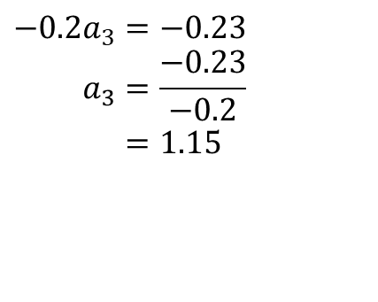
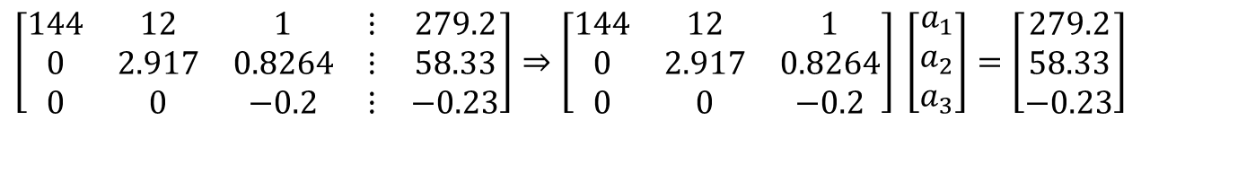
Back Substitution
$$\left[\begin{matrix}144 & 12 & 1 & ⋮ & 279.2 \\ 0 & 2.917 & 0.8264 & ⋮ & 58.33 \\ 0 & 0 & −0.2 & ⋮ & −0.23\end{matrix}\right]⇒\left[\begin{matrix}144 & 12 & 1 \\ 0 & 2.917 & 0.8264 \\ 0 & 0 & −0.2\end{matrix}\right] \left[\begin{matrix}a_{1} \\ a_{2} \\ a_{3}\end{matrix}\right]=\left[\begin{matrix}279.2 \\ 58.33 \\ −0.23\end{matrix}\right]$$
Solving for a₃
$$−0.2a_{3}=−0.23 \\ a_{3}=\frac{−0.23}{−0.2} \\ =\text{1.15}$$
Notes:
29

Slide 30
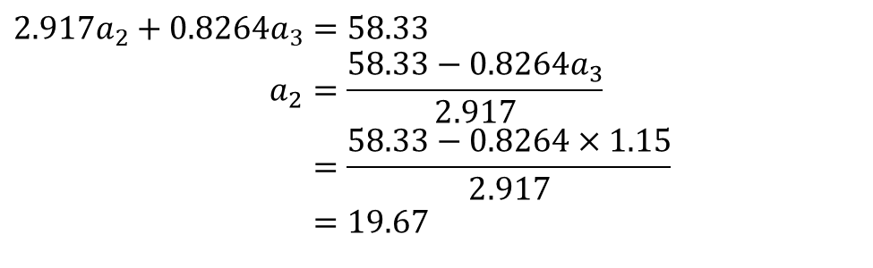
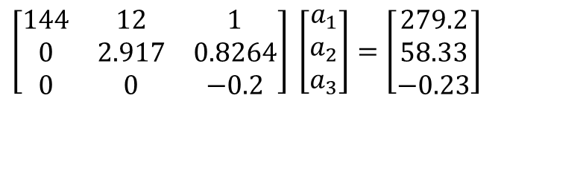
Back Substitution (cont.)
$$\left[\begin{matrix}144 & 12 & 1 \\ 0 & 2.917 & 0.8264 \\ 0 & 0 & −0.2\end{matrix}\right] \left[\begin{matrix}a_{1} \\ a_{2} \\ a_{3}\end{matrix}\right]=\left[\begin{matrix}279.2 \\ 58.33 \\ −0.23\end{matrix}\right]$$
Solving for a₂
$$2.917a_{2}+0.8264a_{3}=58.33 \\ a_{2}=\frac{58.33−0.8264a_{3}}{2.917} \\ =\frac{58.33−0.8264×1.15}{2.917} \\ =\text{19.}67$$
Notes:
30

Slide 31
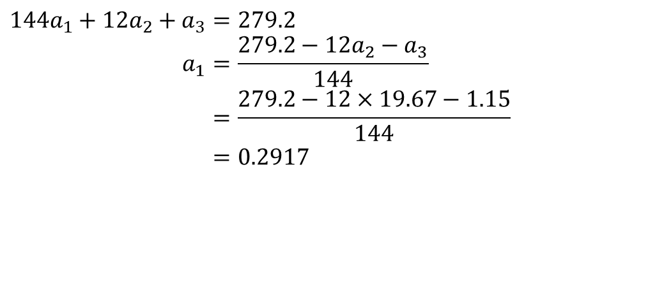
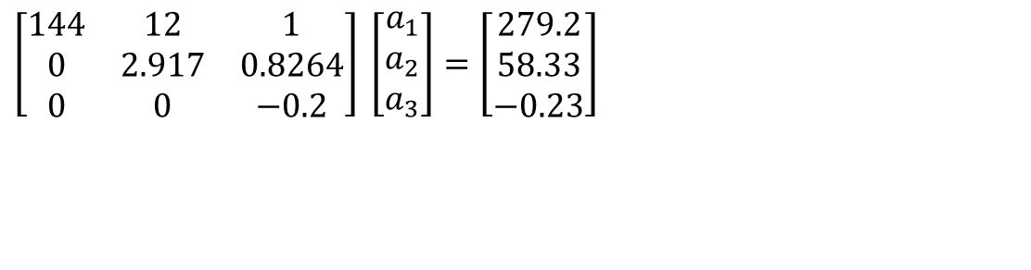
Back Substitution (cont.)
$$\left[\begin{matrix}144 & 12 & 1 \\ 0 & 2.917 & 0.8264 \\ 0 & 0 & −0.2\end{matrix}\right] \left[\begin{matrix}a_{1} \\ a_{2} \\ a_{3}\end{matrix}\right]=\left[\begin{matrix}279.2 \\ 58.33 \\ −0.23\end{matrix}\right]$$
$$144a_{1}+12a_{2}+a_{3}=279.2 \\ a_{1}=\frac{279.2−12a_{2}−a_{3}}{144} \\ =\frac{279.2−12×19.67−1.15}{144} \\ =0.2917$$
Notes:
31

Slide 32
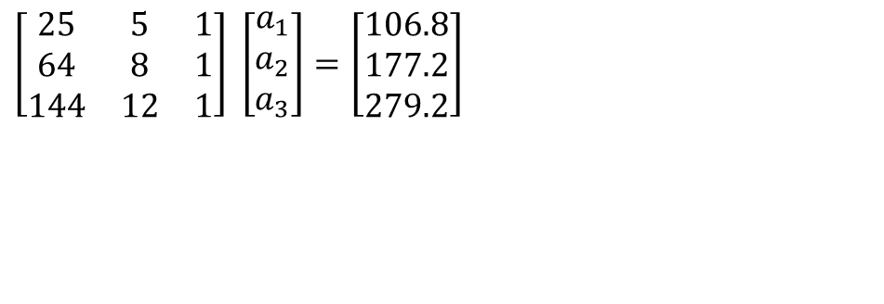
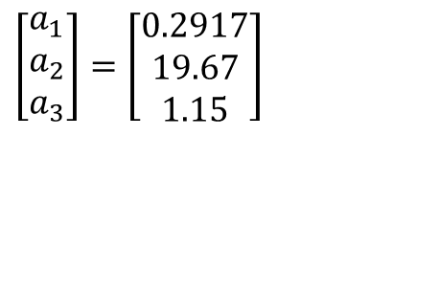
Gaussian Elimination with Partial Pivoting Solution
$$\left[\begin{matrix}25 & 5 & 1 \\ 64 & 8 & 1 \\ 144 & 12 & 1\end{matrix}\right] \left[\begin{matrix}a_{1} \\ a_{2} \\ a_{3}\end{matrix}\right]=\left[\begin{matrix}106.8 \\ 177.2 \\ 279.2\end{matrix}\right]$$
$$\left[\begin{matrix}a_{1} \\ a_{2} \\ a_{3}\end{matrix}\right]=\left[\begin{matrix}0.2917 \\ 19.67 \\ 1.15\end{matrix}\right]$$
Notes:
32

Slide 33


