Slide 1
Chapter 4. Simultaneous Linear Equations and Matrix Algebra

Slide 2

Notes:
Poll Title: Do not modify the notes in this section to avoid tampering with the Poll Everywhere activity.
More info at polleverywhere.com/support
Who is this artist?
https://www.polleverywhere.com/multiple_choice_polls/armHsYuftdMGw3TigOLq8?display_state=chart&activity_state=opened&state=opened&flow=Default&onscreen=persist

Slide 3
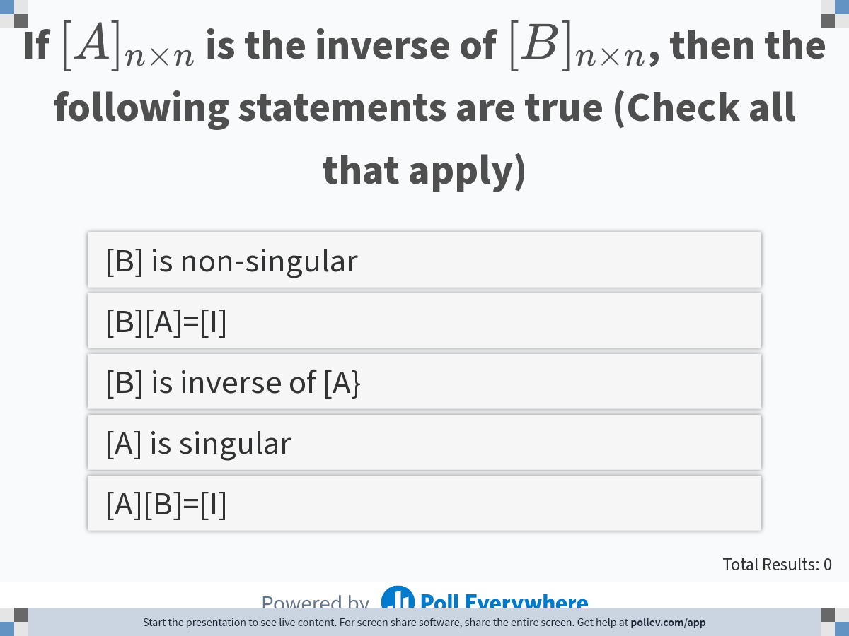
Notes:
Poll Title: Do not modify the notes in this section to avoid tampering with the Poll Everywhere activity.
More info at polleverywhere.com/support
If $$[A]_{n \\times n}$$ is the inverse of $$[B]_{n \\times n}$$, then the following statements are true
https://www.polleverywhere.com/multiple_choice_polls/8RFP8BnffnhviYGYP6AmU?display_state=instructions&activity_state=opened&state=opened&flow=Engagement&onscreen=persist

Slide 4
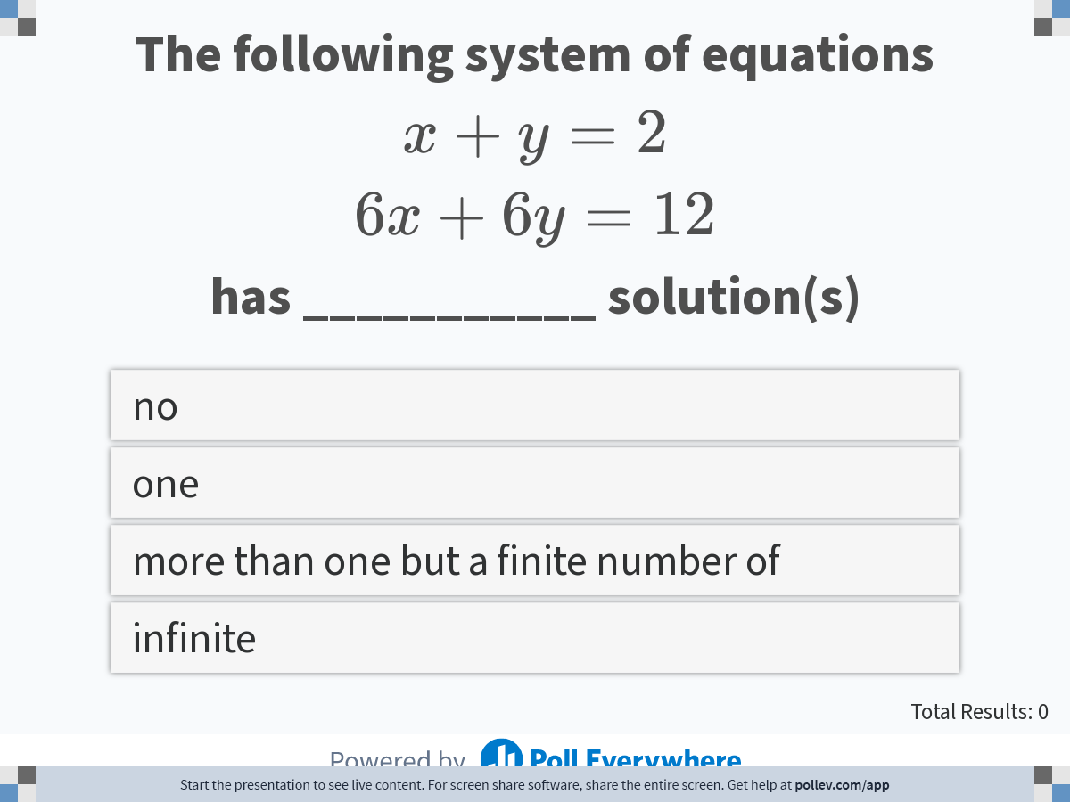
Notes:
Poll Title: Do not modify the notes in this section to avoid tampering with the Poll Everywhere activity.
More info at polleverywhere.com/support
The following system of equations $$x+y=2$$ $$6x+6y=12$$ has ___________ solution(s)
https://www.polleverywhere.com/multiple_choice_polls/wfMi5kdKs7eCjv2R9Vrow?display_state=instructions&activity_state=opened&state=opened&flow=Engagement&onscreen=persist

Slide 5
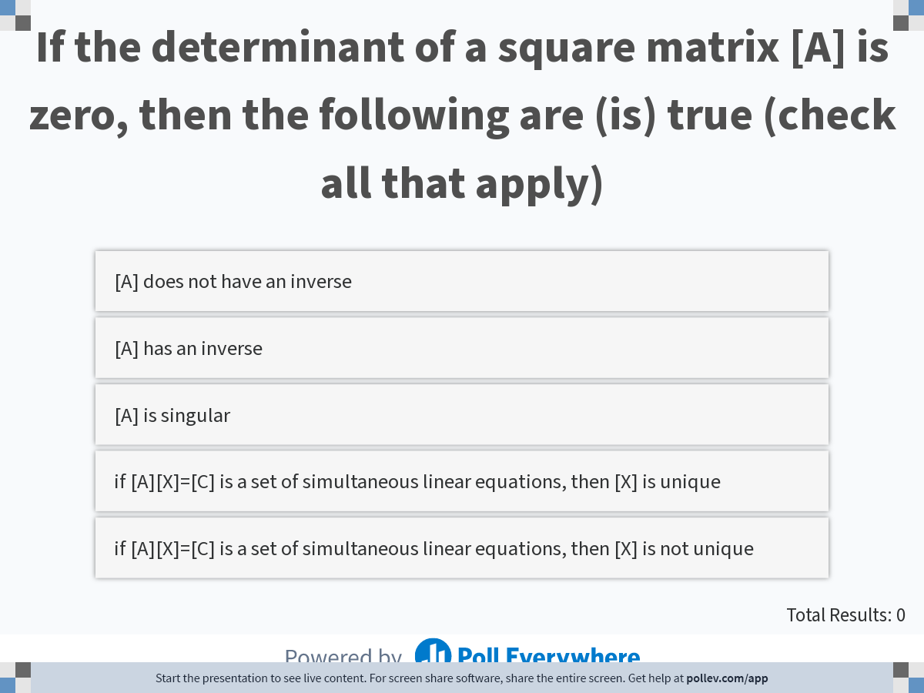
Notes:
Poll Title: Do not modify the notes in this section to avoid tampering with the Poll Everywhere activity.
More info at polleverywhere.com/support
If the determinant of a square matrix [A] is zero, then the following are (is) true
https://www.polleverywhere.com/multiple_choice_polls/RWQ04p4p0WXmfWIHYDscS?display_state=instructions&activity_state=opened&state=opened&flow=Engagement&onscreen=persist

Slide 6
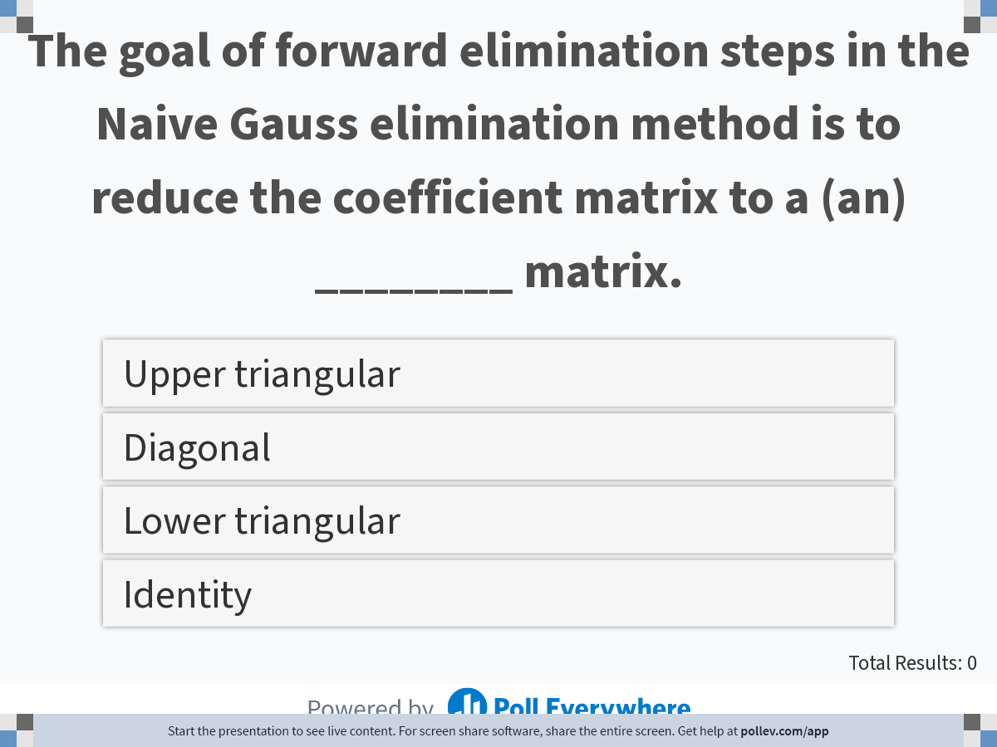
Notes:
Poll Title: Do not modify the notes in this section to avoid tampering with the Poll Everywhere activity.
More info at polleverywhere.com/support
The goal of forward elimination steps in the Naive Gauss elimination method is to reduce the coefficient matrix to a (an) ________ matrix.
https://www.polleverywhere.com/multiple_choice_polls/hRYAJ3zanqGJs2tjKOlD9?display_state=instructions&activity_state=opened&state=opened&flow=Engagement&onscreen=persist

Slide 7
LU Decomposition Method
Major: All Engineering Majors
Author(s): Autar Kaw
http://nm.MathForCollege.com
Transforming Numerical Methods Education for STEM Undergraduates

Slide 8
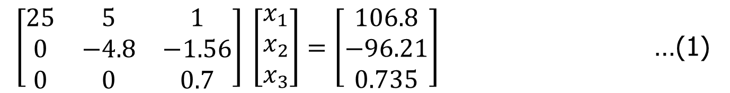
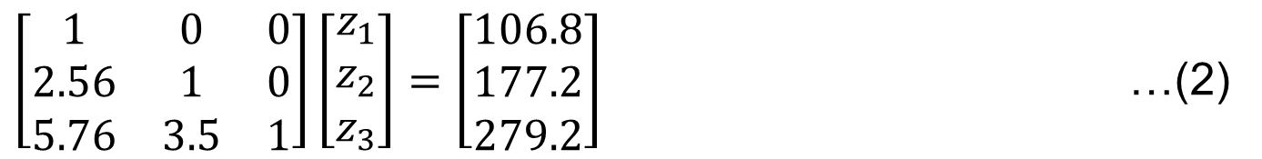
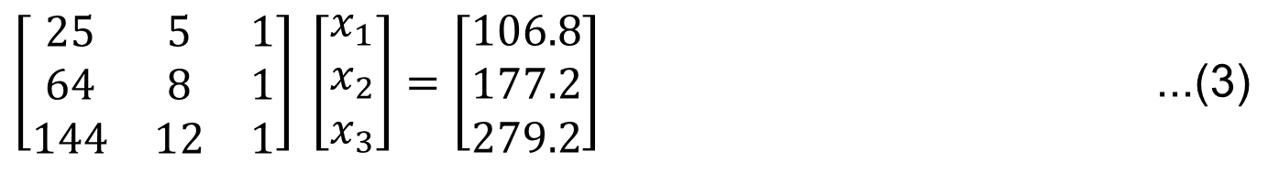
What makes equation sets (1) and (2) easier to solve than set (3)?
$\left[\begin{matrix}25 & 5 & 1 \\ 0 & −4.8 & −1.56 \\ 0 & 0 & 0.7\end{matrix}\right] \left[\begin{matrix}x_{1} \\ x_{2} \\ x_{3}\end{matrix}\right]=\left[\begin{matrix}106.8 \\ −96.21 \\ 0.735\end{matrix}\right]$ …(1)
$\left[\begin{matrix}1 & 0 & 0 \\ 2.56 & 1 & 0 \\ 5.76 & 3.5 & 1\end{matrix}\right]\left[\begin{matrix}z_{1} \\ z_{2} \\ z_{3}\end{matrix}\right]=\left[\begin{matrix}106.8 \\ 177.2 \\ 279.2\end{matrix}\right]$ …(2)
$\left[\begin{matrix}25 & 5 & 1 \\ 64 & 8 & 1 \\ 144 & 12 & 1\end{matrix}\right] \left[\begin{matrix}x_{1} \\ x_{2} \\ x_{3}\end{matrix}\right]=\left[\begin{matrix}106.8 \\ 177.2 \\ 279.2\end{matrix}\right]$ ...(3)

Slide 9
LU Decomposition Method
[A][X] = [C]
Decompose [A] into [L] and [U]
Solve [L][Z] = [C] for [Z] by using forward substitution
Solve [U][X] = [Z] for [X] by using back substitution

Slide 10
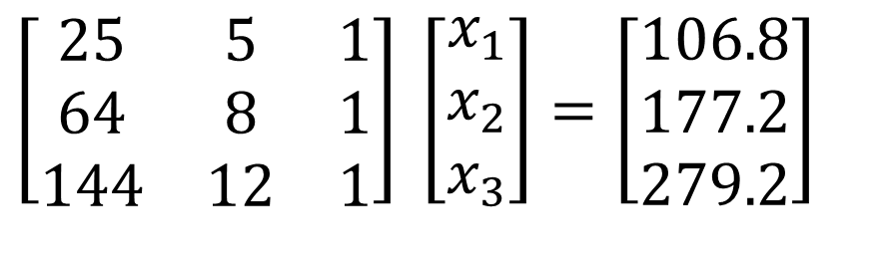
Using LU Decomposition to solve SLEs
Solve the following set of linear equations using LU Decomposition Method.
$$\left[\begin{matrix}25 & 5 & 1 \\ 64 & 8 & 1 \\ 144 & 12 & 1\end{matrix}\right] \left[\begin{matrix}x_{1} \\ x_{2} \\ x_{3}\end{matrix}\right]=\left[\begin{matrix}106.8 \\ 177.2 \\ 279.2\end{matrix}\right]$$

Slide 11
1. Decomposing [A] to [L][U] form

Slide 12
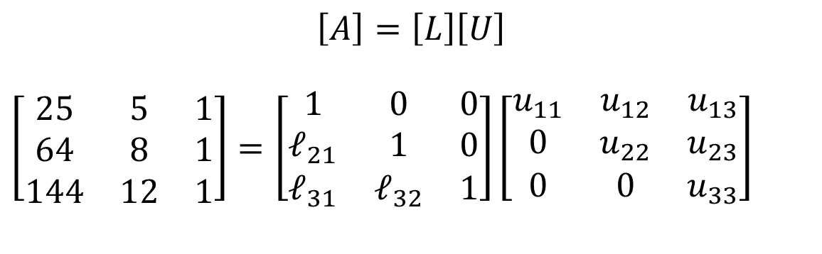
L U Form
$$\left[A\right]=\left[L\right]\left[U\right]$$
$$\left[\begin{matrix}25 & 5 & 1 \\ 64 & 8 & 1 \\ 144 & 12 & 1\end{matrix}\right]=\left[\begin{matrix}1 & 0 & 0 \\ ℓ_{21} & 1 & 0 \\ ℓ_{31} & ℓ_{32} & 1\end{matrix}\right]\left[\begin{matrix}u_{11} & u_{12} & u_{13} \\ 0 & u_{22} & u_{23} \\ 0 & 0 & u_{33}\end{matrix}\right]$$
[U] is the same as the coefficient matrix at the end of the forward elimination part of Naïve Gauss Elimination method.
[L] is obtained using the multipliers that were used in the forward elimination part of Naïve Gauss Elimination method to make the corresponding elements to be zero.

Slide 13
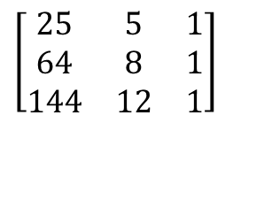
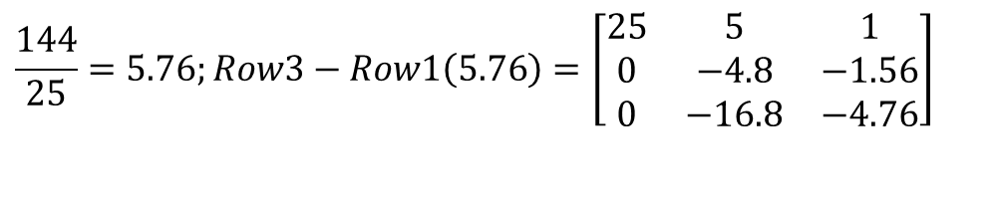
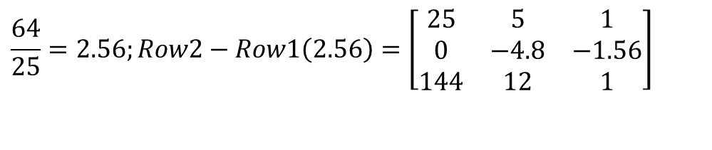
Finding the [U] matrix
Using the Forward Elimination Procedure of Gauss Elimination
$$\left[\begin{matrix}25 & 5 & 1 \\ 64 & 8 & 1 \\ 144 & 12 & 1\end{matrix}\right]$$
$$\frac{64}{25}=2.56;Row2−Row1\left(2.56\right)=\left[\begin{matrix}25 & 5 & 1 \\ 0 & −4.8 & −1.56 \\ 144 & 12 & 1\end{matrix}\right]$$
Step 1:
$$\frac{144}{25}=5.76;Row3−Row1\left(5.76\right)=\left[\begin{matrix}25 & 5 & 1 \\ 0 & −4.8 & −1.56 \\ 0 & −16.8 & −4.76\end{matrix}\right]$$

Slide 14
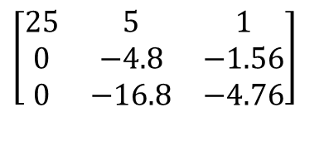
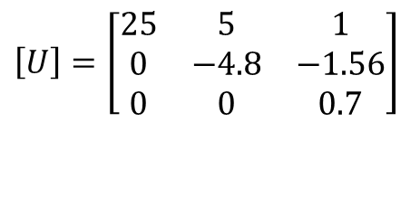
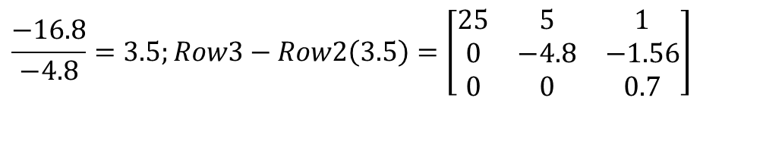
Finding the [U] Matrix
$$\left[\begin{matrix}25 & 5 & 1 \\ 0 & −4.8 & −1.56 \\ 0 & −16.8 & −4.76\end{matrix}\right]$$
Matrix after Step 1:
Step 2:
$$\frac{−16.8}{−4.8}=3.5;Row3−Row2\left(3.5\right)=\left[\begin{matrix}25 & 5 & 1 \\ 0 & −4.8 & −1.56 \\ 0 & 0 & 0.7\end{matrix}\right]$$
$$\left[U\right]=\left[\begin{matrix}25 & 5 & 1 \\ 0 & −4.8 & −1.56 \\ 0 & 0 & 0.7\end{matrix}\right]$$

Slide 15
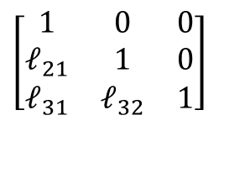
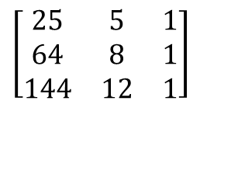
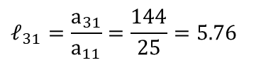
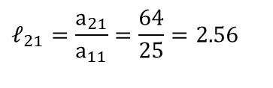
Finding the [L] matrix
$$\left[\begin{matrix}1 & 0 & 0 \\ ℓ_{21} & 1 & 0 \\ ℓ_{31} & ℓ_{32} & 1\end{matrix}\right]$$
Using the multipliers used during the forward elimination part
From the first step of forward elimination
$$\left[\begin{matrix}25 & 5 & 1 \\ 64 & 8 & 1 \\ 144 & 12 & 1\end{matrix}\right]$$
$$ℓ_{21}=\frac{a_{21}}{a_{11}}=\frac{64}{25}=2.56$$
$$ℓ_{31}=\frac{a_{31}}{a_{11}}=\frac{144}{25}=5.76$$

Slide 16
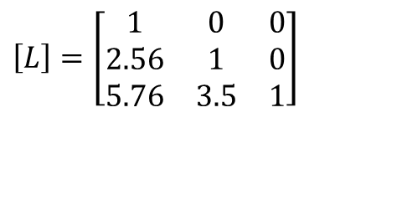
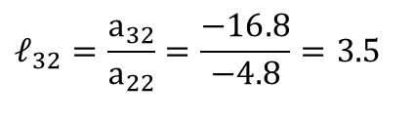
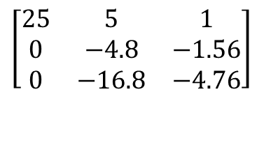
Finding the [L] Matrix
From the second step of forward elimination
$$\left[\begin{matrix}25 & 5 & 1 \\ 0 & −4.8 & −1.56 \\ 0 & −16.8 & −4.76\end{matrix}\right]$$
$$ℓ_{32}=\frac{a_{32}}{a_{22}}=\frac{−16.8}{−4.8}=3.5$$
$$\left[L\right]=\left[\begin{matrix}1 & 0 & 0 \\ 2.56 & 1 & 0 \\ 5.76 & 3.5 & 1\end{matrix}\right]$$

Slide 17
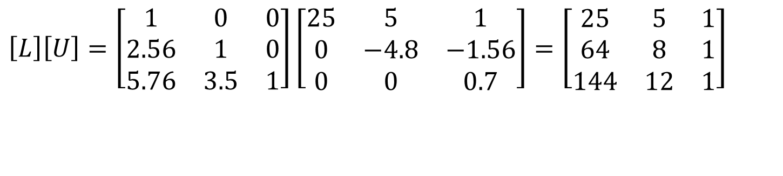
Does [L][U] = [A]?
$$\left[L\right]\left[U\right]=\left[\begin{matrix}1 & 0 & 0 \\ 2.56 & 1 & 0 \\ 5.76 & 3.5 & 1\end{matrix}\right]\left[\begin{matrix}25 & 5 & 1 \\ 0 & −4.8 & −1.56 \\ 0 & 0 & 0.7\end{matrix}\right]=\left[\begin{matrix}25 & 5 & 1 \\ 64 & 8 & 1 \\ 144 & 12 & 1\end{matrix}\right]$$

Slide 18
2. Solving [L][Z]=[C]

Slide 19
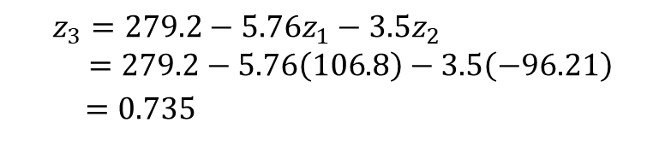
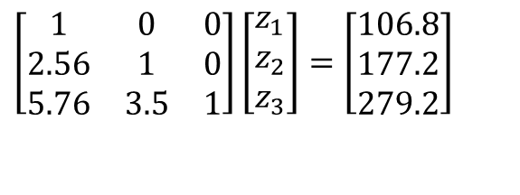
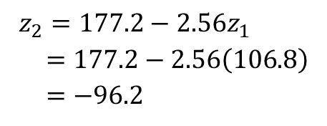

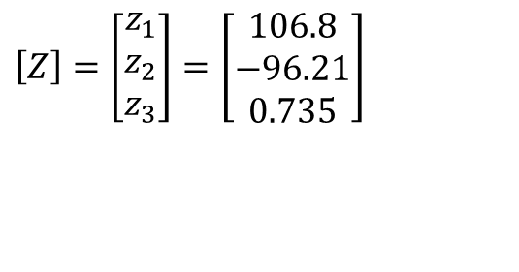
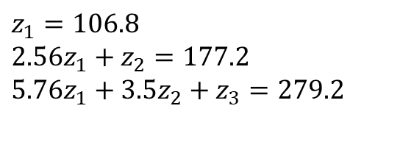
Solving [L][Z]=[C]
$$\left[\begin{matrix}1 & 0 & 0 \\ 2.56 & 1 & 0 \\ 5.76 & 3.5 & 1\end{matrix}\right]\left[\begin{matrix}z_{1} \\ z_{2} \\ z_{3}\end{matrix}\right]=\left[\begin{matrix}106.8 \\ 177.2 \\ 279.2\end{matrix}\right]$$
$$z_{1}=106.8 \\ 2.56z_{1}+z_{2}=177.2 \\ 5.76z_{1}+3.5z_{2}+z_{3}=279.2$$
$$z_{1}=106.8$$
$$z_{2}=177.2−2.56z_{1} \\ =177.2−2.56\left(106.8\right) \\ =−96.2$$
$$z_{3}=279.2−5.76z_{1}−3.5z_{2} \\ =279.2−5.76\left(106.8\right)−3.5\left(−96.21\right) \\ =0.735$$
$$\left[Z\right]=\left[\begin{matrix}z_{1} \\ z_{2} \\ z_{3}\end{matrix}\right]=\left[\begin{matrix}106.8 \\ −96.21 \\ 0.735\end{matrix}\right]$$

Slide 20
3. Solving [U][X]=[Z]

Slide 21
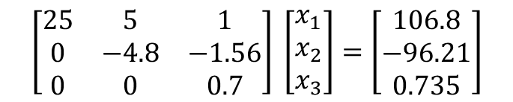
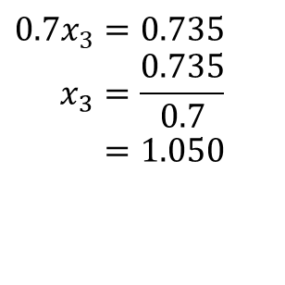

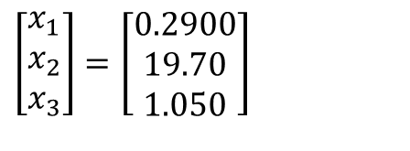
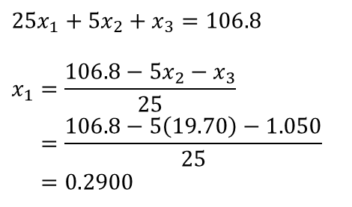
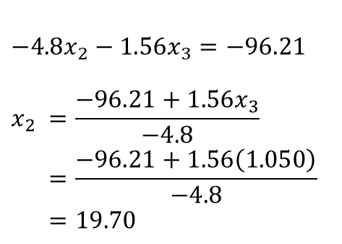
Solving [U][X]=[Z]
$$\left[\begin{matrix}25 & 5 & 1 \\ 0 & −4.8 & −1.56 \\ 0 & 0 & 0.7\end{matrix}\right] \left[\begin{matrix}x_{1} \\ x_{2} \\ x_{3}\end{matrix}\right]=\left[\begin{matrix}106.8 \\ −96.21 \\ 0.735\end{matrix}\right]$$
$$25x_{1}+5x_{2}+x_{3}=106.8 \\ −4.8x_{2}−1.56x_{3}=−96.21 \\ 0.7x_{3}=0.735$$
$$−4.8x_{2}−1.56x_{3}=−96.21$$
$$x_{2} =\frac{−96.21+1.56x_{3}}{−4.8} \\ =\frac{−96.21+1.56\left(1.050\right)}{−4.8} \\ =19.70$$
$$0.7x_{3}=0.735 \\ x_{3}=\frac{0.735}{0.7} \\ =1.050$$
$$25x_{1}+5x_{2}+x_{3}=106.8$$
$$x_{1}=\frac{106.8−5x_{2}−x_{3}}{25} \\ =\frac{106.8−5\left(19.70\right)−1.050}{25} \\ =0.2900$$
$$\left[\begin{matrix}x_{1} \\ x_{2} \\ x_{3}\end{matrix}\right]=\left[\begin{matrix}0.2900 \\ 19.70 \\ 1.050\end{matrix}\right]$$

Slide 22
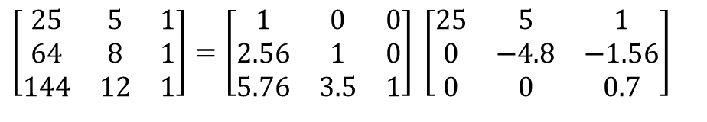
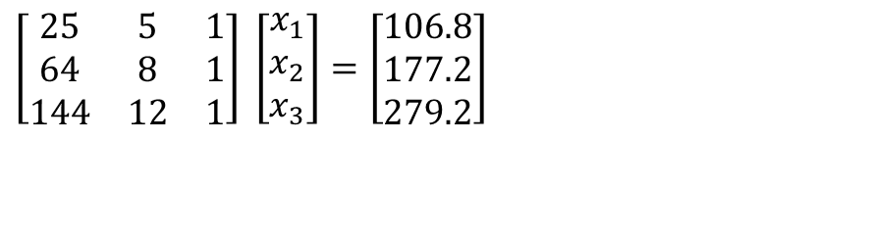
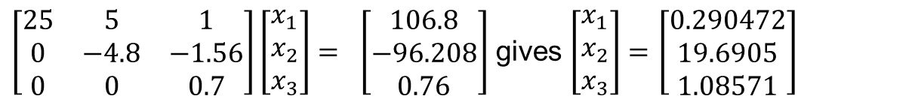
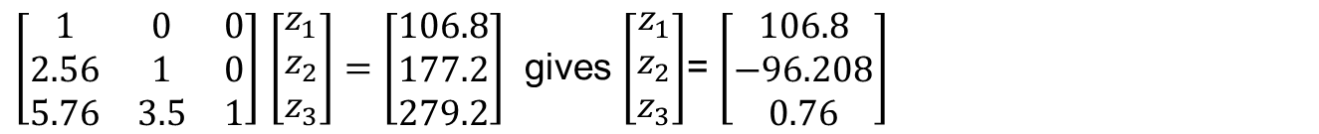
Reviewing the LU Decomposition example
$$\left[\begin{matrix}25 & 5 & 1 \\ 64 & 8 & 1 \\ 144 & 12 & 1\end{matrix}\right] \left[\begin{matrix}x_{1} \\ x_{2} \\ x_{3}\end{matrix}\right]=\left[\begin{matrix}106.8 \\ 177.2 \\ 279.2\end{matrix}\right]$$
$$\left[\begin{matrix}25 & 5 & 1 \\ 64 & 8 & 1 \\ 144 & 12 & 1\end{matrix}\right]=\left[\begin{matrix}1 & 0 & 0 \\ 2.56 & 1 & 0 \\ 5.76 & 3.5 & 1\end{matrix}\right] \left[\begin{matrix}25 & 5 & 1 \\ 0 & −4.8 & −1.56 \\ 0 & 0 & 0.7\end{matrix}\right]$$
$\left[\begin{matrix}1 & 0 & 0 \\ 2.56 & 1 & 0 \\ 5.76 & 3.5 & 1\end{matrix}\right]$ $\left[\begin{matrix}z_{1} \\ z_{2} \\ z_{3}\end{matrix}\right]=$ $\left[\begin{matrix}106.8 \\ 177.2 \\ 279.2\end{matrix}\right]$ gives $\left[\begin{matrix}z_{1} \\ z_{2} \\ z_{3}\end{matrix}\right]$= $\left[\begin{matrix}106.8 \\ −96.208 \\ 0.76\end{matrix}\right]$
$\left[\begin{matrix}25 & 5 & 1 \\ 0 & −4.8 & −1.56 \\ 0 & 0 & 0.7\end{matrix}\right]\left[\begin{matrix}x_{1} \\ x_{2} \\ x_{3}\end{matrix}\right]= \left[\begin{matrix}106.8 \\ −96.208 \\ 0.76\end{matrix}\right]$ gives $\left[\begin{matrix}x_{1} \\ x_{2} \\ x_{3}\end{matrix}\right]=$ $\left[\begin{matrix}0.290472 \\ 19.6905 \\ 1.08571\end{matrix}\right]$

Slide 23
THE END
http://nm.mathforcollege.com

Slide 24
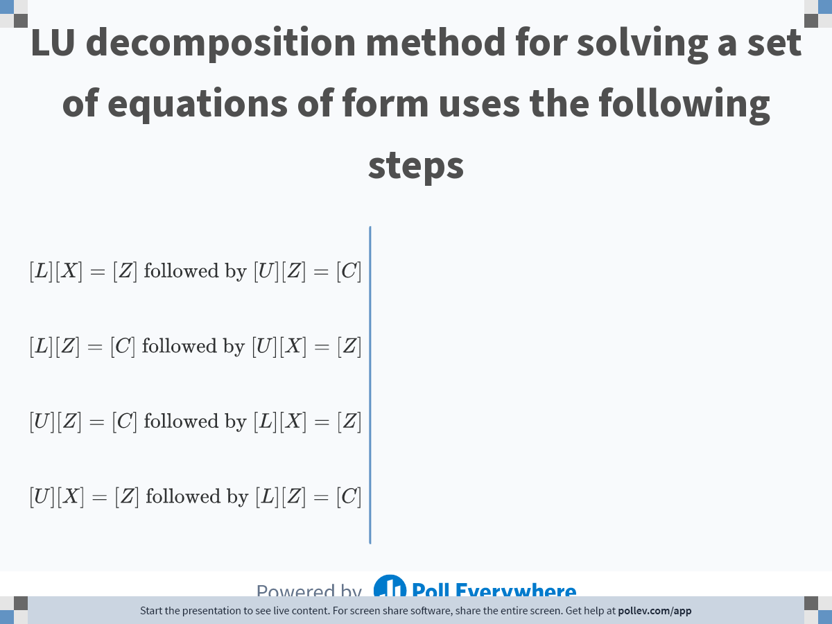
Notes:
Poll Title: Do not modify the notes in this section to avoid tampering with the Poll Everywhere activity.
More info at polleverywhere.com/support
LU decomposition method for solving a set of equations of form uses the following steps
https://www.polleverywhere.com/multiple_choice_polls/8Z56PI8udv3AtbsY7cdIF

Slide 25
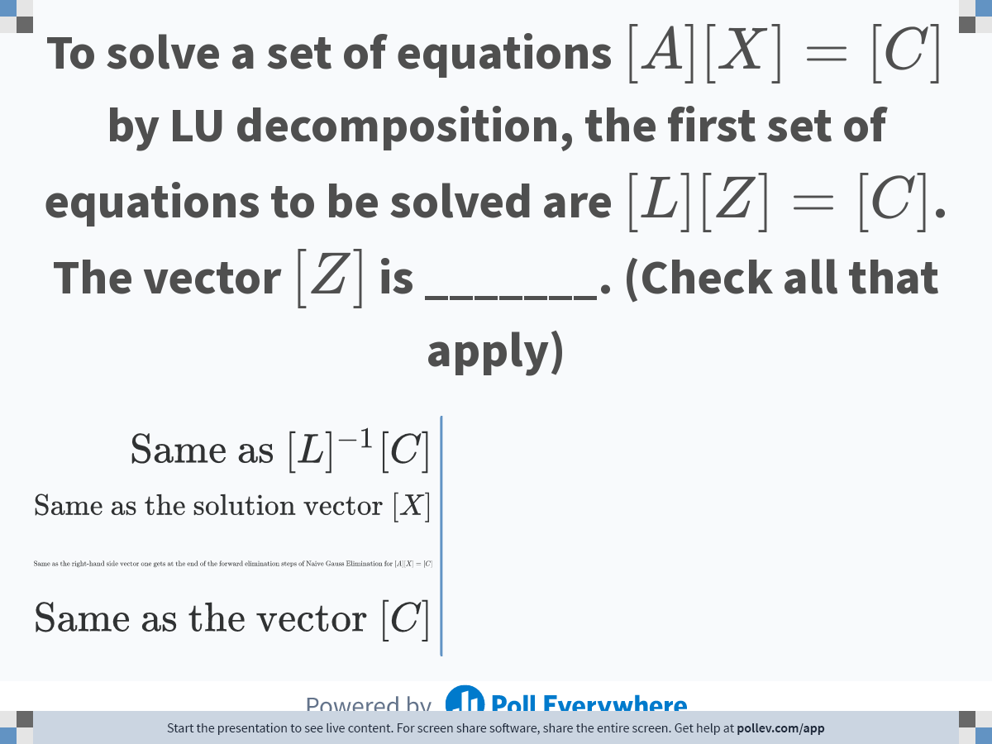
Notes:
Poll Title: Do not modify the notes in this section to avoid tampering with the Poll Everywhere activity.
More info at polleverywhere.com/support
To solve a set of equations $$[A][X]=[C]$$ by LU decomposition, the first set of equations to be solved are $$[L][Z]=[C]$$. The vector $$[Z]$$ is _______. (Check all that apply)
https://www.polleverywhere.com/multiple_choice_polls/BWclx8LhHGTai5o7D3Nmk

Slide 26
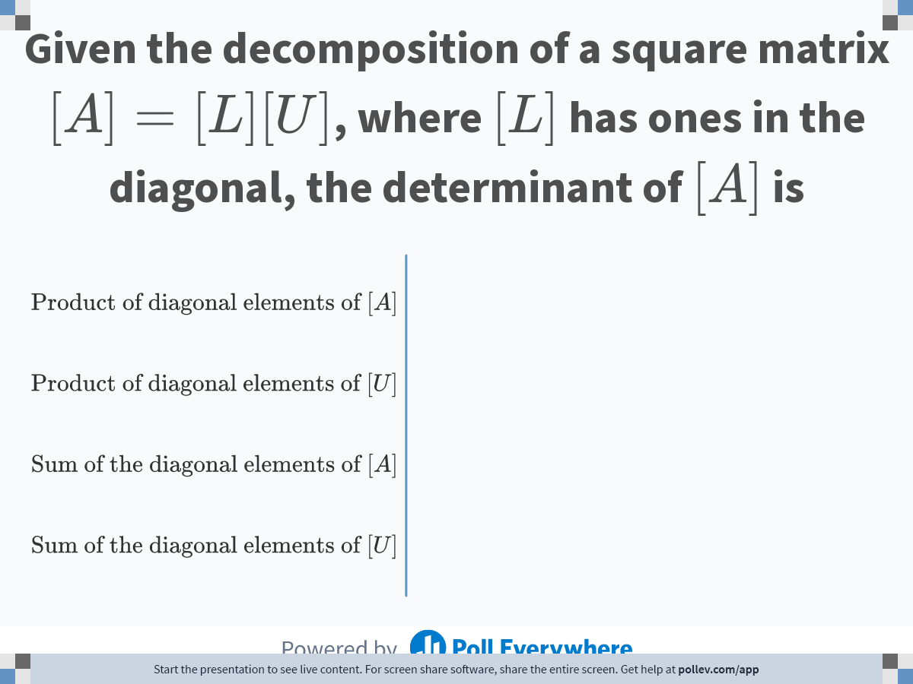
Notes:
Poll Title: Do not modify the notes in this section to avoid tampering with the Poll Everywhere activity.
More info at polleverywhere.com/support
Given the decomposition of a square matrix $$[A]=[L][U]$$, where $$[L] $$ has ones in the diagonal, the determinant of $$[A]$$ is
https://www.polleverywhere.com/multiple_choice_polls/eVvYJRmIJTdIm12MQwZQM

Slide 27
THE END

Slide 28
Comparing Naïve Gauss Elimination Method with LU Decomposition

Slide 29
Naïve Gaussian Elimination
[A][X] = [C]
Conduct forward elimination to get
[U][X] = [Z]
2. Conduct back substitution to solve
[U][X] = [Z] for [X]

Slide 30
LU Decomposition Method
[A][X] = [C]
Decompose [A] into [L] and [U], [A]=[L][U]
Solve [L][Z] = [C] for [Z] by using forward substitution
Solve [U][X] = [Z] for [X] by using back substitution

Slide 31

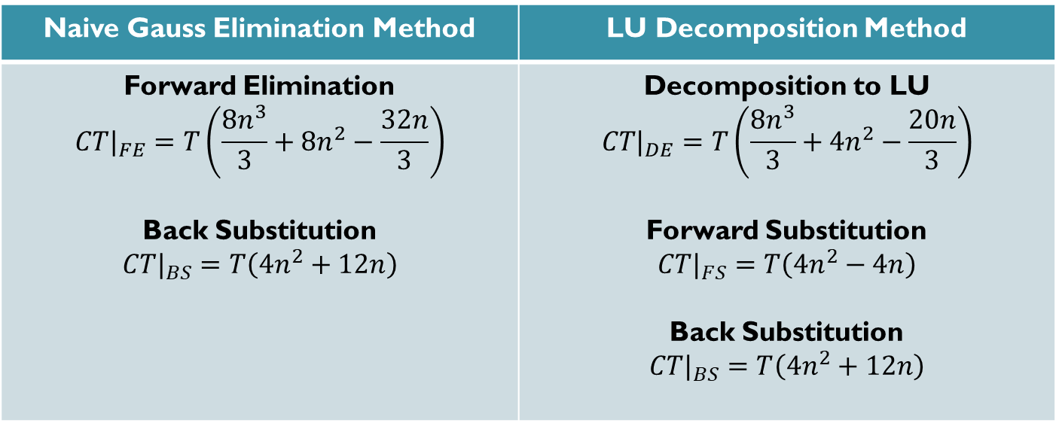

Is LU Decomposition Method better than Gaussian Elimination Method?
Solve $[A][X]=[B]$
$T$ = clock cycle time (s)
$n×n$ = size of the matrix
$CT$= computational time (s)
Naive Gauss Elimination Method | LU Decomposition Method
Forward Elimination $$CT|_{FE}=T\left(\frac{8n^{3}}{3}+8n^{2}−\frac{32n}{3}\right)$$ Back Substitution $$CT|_{BS}=T\left(4n^{2}+12n\right)$$ | Decomposition to LU $$CT|_{DE}=T\left(\frac{8n^{3}}{3}+4n^{2}−\frac{20n}{3}\right)$$ Forward Substitution $$CT|_{FS}=T\left(4n^{2}−4n\right)$$ Back Substitution $$CT|_{BS}=T\left(4n^{2}+12n\right)$$

Slide 32
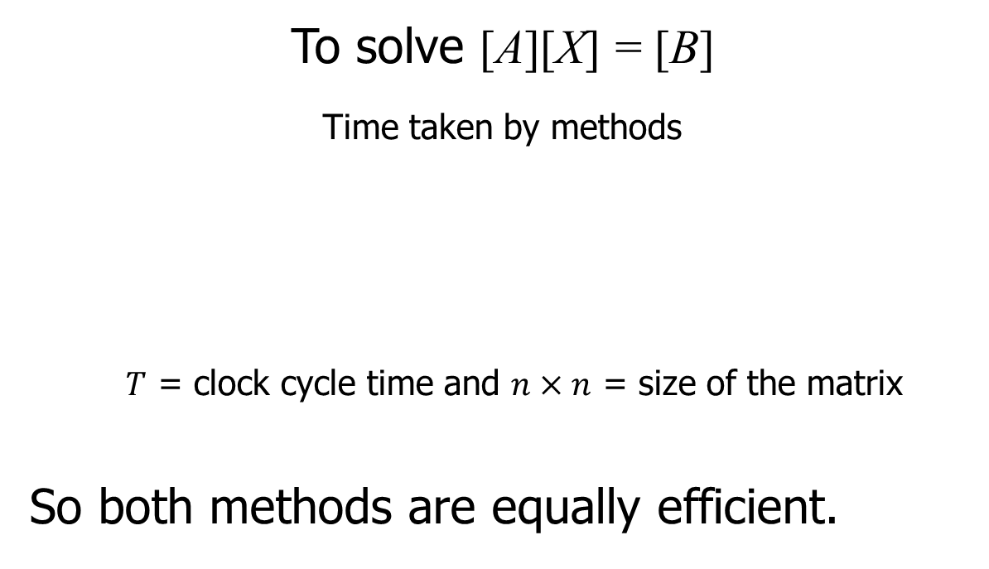
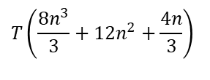
Is LU Decomposition better than Gaussian Elimination?
To solve [A][X] = [B]
Time taken by methods
$T$ = clock cycle time and $n×n$ = size of the matrix
So both methods are equally efficient.
Gaussian Elimination | LU Decomposition
$$T\left(\frac{8n^{3}}{3}+12n^{2}+\frac{4n}{3}\right)$$
$$T\left(\frac{8n^{3}}{3}+12n^{2}+\frac{4n}{3}\right)$$

Slide 33
THE END

Slide 34
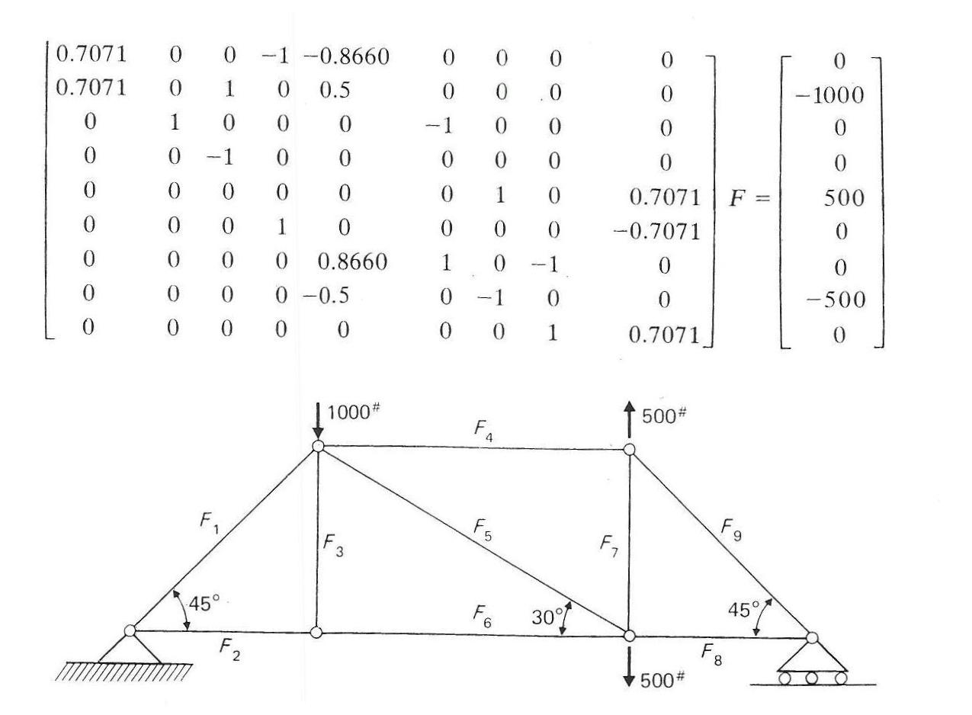

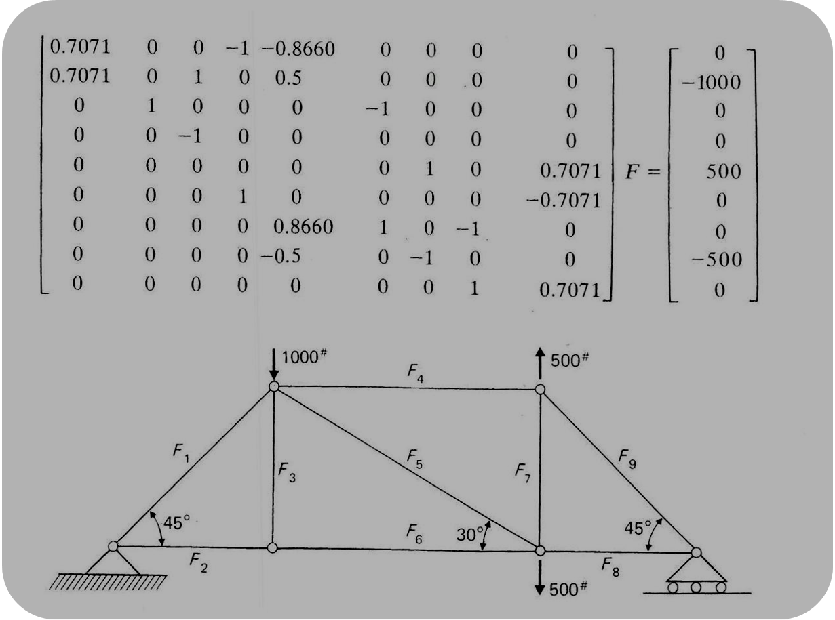
Truss Problem

Slide 35
Finding the inverse of a square matrix
[B] is inverse of a square matrix [A] if
[A][B] = [I] OR [B][A] = [I]

Slide 36
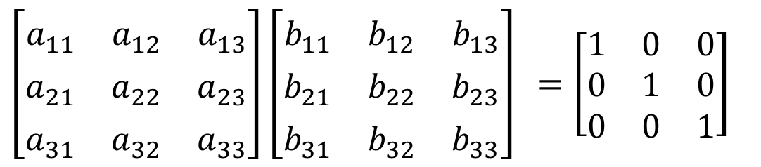
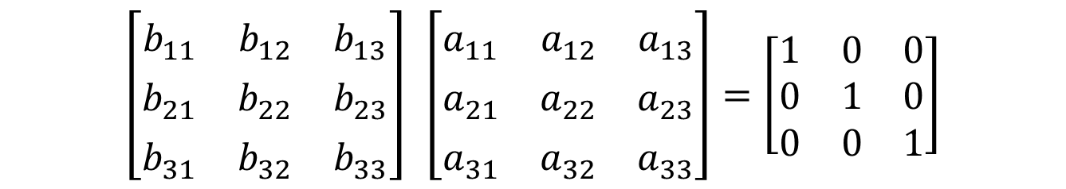
Two ways to show what inverse means?
$$\left[\begin{matrix}b_{11}^{} & b_{12}^{} & b_{13}^{} \\ b_{21}^{} & b_{22}^{} & b_{23}^{} \\ b_{31}^{} & b_{32}^{} & b_{33}^{}\end{matrix}\right] \left[\begin{matrix}a_{11}^{} & a_{12}^{} & a_{13}^{} \\ a_{21}^{} & a_{22}^{} & a_{23}^{} \\ a_{31}^{} & a_{32}^{} & a_{33}^{}\end{matrix}\right]=\left[\begin{matrix}1 & 0 & 0 \\ 0 & 1 & 0 \\ 0 & 0 & 1\end{matrix}\right]$$
$\left[\begin{matrix}a_{11}^{} & a_{12}^{} & a_{13}^{} \\ a_{21}^{} & a_{22}^{} & a_{23}^{} \\ a_{31}^{} & a_{32}^{} & a_{33}^{}\end{matrix}\right]\left[\begin{matrix}b_{11}^{} & b_{12}^{} & b_{13}^{} \\ b_{21}^{} & b_{22}^{} & b_{23}^{} \\ b_{31}^{} & b_{32}^{} & b_{33}^{}\end{matrix}\right]$ $=\left[\begin{matrix}1 & 0 & 0 \\ 0 & 1 & 0 \\ 0 & 0 & 1\end{matrix}\right]$

Slide 37
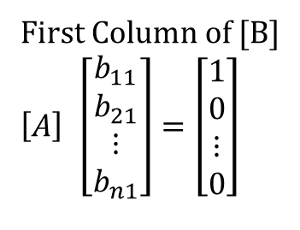
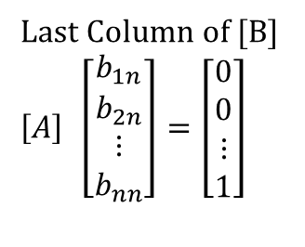
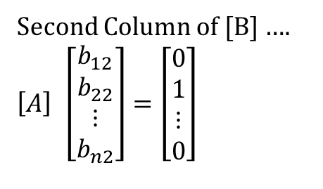
Finding the inverse of a square matrix
How can LU Decomposition be used to find the inverse?
[A][B] = [I]
First Column of [B]
$$\left[A\right] \left[\begin{matrix}b_{11} \\ b_{21} \\ ⋮ \\ b_{n1}\end{matrix}\right]=\left[\begin{matrix}1 \\ 0 \\ ⋮ \\ 0\end{matrix}\right]$$
Second Column of [B] ….
$$\left[A\right] \left[\begin{matrix}b_{12} \\ b_{22} \\ ⋮ \\ b_{n2}\end{matrix}\right]=\left[\begin{matrix}0 \\ 1 \\ ⋮ \\ 0\end{matrix}\right]$$
Last Column of [B]
$$\left[A\right] \left[\begin{matrix}b_{1n} \\ b_{2n} \\ ⋮ \\ b_{nn}\end{matrix}\right]=\left[\begin{matrix}0 \\ 0 \\ ⋮ \\ 1\end{matrix}\right]$$

Slide 38


Example: Inverse of a Matrix
Find the inverse of a square matrix [A]
$$\left[A\right]=\left[\begin{matrix}25 & 5 & 1 \\ 64 & 8 & 1 \\ 144 & 12 & 1\end{matrix}\right]$$
Using the decomposition procedure, the [L] and [U] matrices are found to be
$$\left[A\right]=\left[L\right]\left[U\right]=\left[\begin{matrix}1 & 0 & 0 \\ 2.56 & 1 & 0 \\ 5.76 & 3.5 & 1\end{matrix}\right] \left[\begin{matrix}25 & 5 & 1 \\ 0 & −4.8 & −1.56 \\ 0 & 0 & 0.7\end{matrix}\right]$$
Solving for each column of [B] requires two steps
Solve [L] [Z] = [C] for [Z]
Solve [U] [X] = [Z] for [X]

Slide 39





Finding 1st column of inverse: LZ=C
$\left[\begin{matrix}25 & 5 & 1 \\ 64 & 8 & 1 \\ 144 & 12 & 1\end{matrix}\right]$ $\left[\begin{matrix}b_{11} \\ b_{21} \\ b_{31}\end{matrix}\right]$= $\left[\begin{matrix}1 \\ 0 \\ 0\end{matrix}\right]$
Step 1: $\left[L\right]\left[Z\right]=\left[C\right]→\left[\begin{matrix}1 & 0 & 0 \\ 2.56 & 1 & 0 \\ 5.76 & 3.5 & 1\end{matrix}\right]\left[\begin{matrix}z_{1} \\ z_{2} \\ z_{3}\end{matrix}\right]=\left[\begin{matrix}1 \\ 0 \\ 0\end{matrix}\right]$
$$z_{1}=1 \\ z_{2}= 0−2.56z_{1} \\ =0−2.56\left(1\right) \\ =−2.56 \\ z_{3}=0−5.76z_{1}−3.5z_{2} \\ =0−5.76\left(1\right)−3.5\left(−2.56\right) \\ =3.2$$
$$z_{1}=1 \\ 2.56z_{1}+z_{2}=0 \\ 5.76z_{1}+3.5z_{2}+z_{3}=0$$
$$\left[Z\right]=\left[\begin{matrix}z_{1} \\ z_{2} \\ z_{3}\end{matrix}\right]=\left[\begin{matrix}1 \\ −2.56 \\ 3.2\end{matrix}\right]$$

Slide 40




Finding 1st column of inverse: UX=Z
$$Step 2: \left[U\right]\left[X\right]=\left[Z\right]→\left[\begin{matrix}25 & 5 & 1 \\ 0 & −4.8 & −1.56 \\ 0 & 0 & 0.7\end{matrix}\right] \left[\begin{matrix}b_{11} \\ b_{21} \\ b_{31}\end{matrix}\right]= \left[\begin{matrix}1 \\ −\text{2.56} \\ \text{3.2}\end{matrix}\right]$$
$$b_{31}=\frac{3.2}{0.7}$$
$$=4.571 \\ b_{21}=\frac{−2.56+1.560b_{31}}{−4.8} \\ =\frac{−2.56+1.560\left(4.571\right)}{−4.8}$$
$=−0.9524$
$$b_{11}=\frac{1−5b_{21}−b_{31}}{25} \\ =\frac{1−5\left(−0.9524\right)−4.571}{25}$$
$=0.04762$
$$25b_{11}+5b_{21}+b_{31}=1 \\ −4.8b_{21}−1.56b_{31}=−2.56 \\ 0.7b_{31}=3.2$$
$$\left[\begin{matrix}b_{11} \\ b_{21} \\ b_{31}\end{matrix}\right]=\left[\begin{matrix}0.04762 \\ −0.9524 \\ 4.571\end{matrix}\right]$$

Slide 41







Inverse of a Matrix
$\left[\begin{matrix}25 & 5 & 1 \\ 64 & 8 & 1 \\ 144 & 12 & 1\end{matrix}\right]$ $\left[\begin{matrix}b_{11}^{} & b_{12}^{} & b_{13}^{} \\ b_{21}^{} & b_{22}^{} & b_{23}^{} \\ b_{31}^{} & b_{32}^{} & b_{33}^{}\end{matrix}\right]$ $=\left[\begin{matrix}1 & 0 & 0 \\ 0 & 1 & 0 \\ 0 & 0 & 1\end{matrix}\right]$
First Column Second Column Third Column
$$\left[\begin{matrix}25 & 5 & 1 \\ 64 & 8 & 1 \\ 144 & 12 & 1\end{matrix}\right]\left[\begin{matrix}b_{11} \\ b_{21} \\ b_{31}\end{matrix}\right]=\left[\begin{matrix}1 \\ 0 \\ 0\end{matrix}\right]$$
$$\left[\begin{matrix}25 & 5 & 1 \\ 64 & 8 & 1 \\ 144 & 12 & 1\end{matrix}\right]\left[\begin{matrix}b_{12} \\ b_{22} \\ b_{32}\end{matrix}\right]=\left[\begin{matrix}0 \\ 1 \\ 0\end{matrix}\right]$$
$$\left[\begin{matrix}25 & 5 & 1 \\ 64 & 8 & 1 \\ 144 & 12 & 1\end{matrix}\right] \left[\begin{matrix}b_{13} \\ b_{23} \\ b_{33}\end{matrix}\right]=\left[\begin{matrix}0 \\ 0 \\ 1\end{matrix}\right]$$
$$\left[\begin{matrix}b_{11} \\ b_{21} \\ b_{31}\end{matrix}\right]=\left[\begin{matrix}0.04762 \\ −0.9524 \\ 4.571\end{matrix}\right]$$
$$\left[\begin{matrix}b_{12} \\ b_{22} \\ b_{32}\end{matrix}\right]=\left[\begin{matrix}−0.08333 \\ 1.417 \\ −5.000\end{matrix}\right]$$
$$\left[\begin{matrix}b_{13} \\ b_{23} \\ b_{33}\end{matrix}\right]=\left[\begin{matrix}0.03571 \\ −0.4643 \\ 1.429\end{matrix}\right]$$

Slide 42




Example: Inverse of a Matrix
$$\left[\begin{matrix}b_{11} \\ b_{21} \\ b_{31}\end{matrix}\right]=\left[\begin{matrix}0.04762 \\ −0.9524 \\ 4.571\end{matrix}\right]$$
$$\left[\begin{matrix}b_{12} \\ b_{22} \\ b_{32}\end{matrix}\right]=\left[\begin{matrix}−0.08333 \\ 1.417 \\ −5.000\end{matrix}\right]$$
$$\left[\begin{matrix}b_{13} \\ b_{23} \\ b_{33}\end{matrix}\right]=\left[\begin{matrix}0.03571 \\ −0.4643 \\ 1.429\end{matrix}\right]$$
$${\left[A\right]}^{−1}=\left[\begin{matrix}0.04762 & −0.08333 & 0.03571 \\ −0.9524 & 1.417 & −0.4643 \\ 4.571 & −5.000 & 1.429\end{matrix}\right]$$
To check your work, check the following
[A][A]⁻¹ = [I] = [A]⁻¹[A]

Slide 43


To find inverse of [A]
Time taken by Gaussian Elimination Time taken by LU Decomposition
$$=n\left(CT|_{FE}+CT|_{BS}\right)$$
= $n× T\left(\frac{8n^{3}}{3}+8n^{2}−\frac{32n}{3}\right)$
+$n× T\left(4n^{2}+12n\right)$
$$=T\left(\frac{8n^{4}}{3}+12n^{3}+\frac{4n^{2}}{3}\right)$$
$$=CT|_{DE}+n×CT|_{FS}+n×CT|_{BS}$$
= $1×T\left(\frac{8n^{3}}{3}+4n^{2}−\frac{20n}{3}\right)$
$$+ n×T\left(4n^{2}−4n\right)$$
+$n×T\left(4n^{2}+12n\right)$
$$=T\left(\frac{32n^{3}}{3}+12n^{2}−\frac{20n}{3}\right)$$

Slide 44



To find inverse of [A]
Time taken by Gaussian Elimination Time taken by LU Decomposition
$$T\left(\frac{8n^{4}}{3}+12n^{3}+\frac{4n^{2}}{3}\right)$$
$$T\left(\frac{32n^{3}}{3}+12n^{2}−\frac{20n}{3}\right)$$
Table 1 Comparing computational times of finding inverse of a matrix using LU decomposition and Naive Gauss elimination.
$$n$$ | 10 | 100 | 1000 | 10000
$$\frac{{CT}_{inverse GE}}{{CT}_{inverse LU}}$$ | 3.288 | 25.84 | 250.8 | 2501
For large n, $\frac{{CT}_{inverse GE}}{{CT}_{inverse LU}}≈\frac{n}{4}$

Slide 45




Time Taken by Back Substitution
n = length(B);
X(n)=B(n)/A(n,n)
for i=n-1:-1:1
X(i) = B(i);
for j=(i+1):1:n
X(i) = X(i) - A(i, j)*X(j);
end
X(i) = X(i)/A(i, i);
end
$$\left[\begin{matrix}a_{11} & a_{12} & a_{13} & ⋯ & a_{1n} \\ 0 & a_{22}^{′} & a_{23}^{′} & ⋯ & a_{2n}^{′} \\ 0 & 0 & a_{33}^{"} & ⋯ & a_{3n}^{"} \\ ⋮ & ⋮ & ⋮ & ⋯ & ⋮ \\ 0 & 0 & 0 & 0 & a_{nn}^{(n−1)}\end{matrix}\right]\left[\begin{matrix}x_{1} \\ x_{2} \\ x_{3} \\ ⋮ \\ x_{n}\end{matrix}\right]=\left[\begin{matrix}b_{1} \\ b_{2}^{′} \\ b_{3}^{"} \\ ⋮ \\ b_{n}^{(n−1)}\end{matrix}\right]$$
$$x_{n}=\frac{b_{n}^{(n−1)}}{a_{nn}^{(n−1)}}$$
$$x_{i}=\frac{b_{i}^{\left(i−1\right)}−\sum_{j=i+1}^{n}{a_{ij}^{\left(i−1\right)}x_{j}}}{a_{ii}^{\left(i−1\right)}}\text{for} i=n−1,...,1$$
Back Substitution CT
$$CT|_{BS}=T\left(4n^{2}+12n\right)$$

Slide 46

Notes:
Poll Title: Do not modify the notes in this section to avoid tampering with the Poll Everywhere activity.
More info at polleverywhere.com/support
How many times does the variable 'a' get assigned the value of 2?
https://www.polleverywhere.com/multiple_choice_polls/Xz7Xf9vuqkTGmaGfwUpnF

Slide 47

Notes:
Poll Title: Do not modify the notes in this section to avoid tampering with the Poll Everywhere activity.
More info at polleverywhere.com/support
How many times does the variable 'a' get assigned the value of 2?
https://www.polleverywhere.com/multiple_choice_polls/2S9eoggdmAodoocfDaL9W

Slide 48

Notes:
Poll Title: Do not modify the notes in this section to avoid tampering with the Poll Everywhere activity.
More info at polleverywhere.com/support
How many times does the variable 'a' get assigned the value of 2?
https://www.polleverywhere.com/multiple_choice_polls/jXdhrtLu0pUL0yiOYRHoC

Slide 49

Notes:
Poll Title: Do not modify the notes in this section to avoid tampering with the Poll Everywhere activity.
More info at polleverywhere.com/support
What is the sum of 5+6+7+...+122?
https://www.polleverywhere.com/free_text_polls/PlXzT1GiGrvOv46Jpz16k

Slide 50


Time Taken by Back Substitution
n = length(B);
X(n)=B(n)/A(n,n)
for i=n-1:-1:1
X(i) = B(i);
for j=(i+1):1:n
X(i) = X(i) - A(i, j)*X(j);
end
X(i) = X(i)/A(i, i);
end
$$\left[\begin{matrix}a_{11} & a_{12} & a_{13} & ⋯ & a_{1n} \\ 0 & a_{22}^{′} & a_{23}^{′} & ⋯ & a_{2n}^{′} \\ 0 & 0 & a_{33}^{"} & ⋯ & a_{3n}^{"} \\ ⋮ & ⋮ & ⋮ & ⋯ & ⋮ \\ 0 & 0 & 0 & 0 & a_{nn}^{(n−1)}\end{matrix}\right]\left[\begin{matrix}x_{1} \\ x_{2} \\ x_{3} \\ ⋮ \\ x_{n}\end{matrix}\right]=\left[\begin{matrix}b_{1} \\ b_{2}^{′} \\ b_{3}^{"} \\ ⋮ \\ b_{n}^{(n−1)}\end{matrix}\right]$$
$$x_{n}=\frac{b_{n}^{(n−1)}}{a_{nn}^{(n−1)}}$$
$$x_{i}=\frac{b_{i}^{\left(i−1\right)}−\sum_{j=i+1}^{n}{a_{ij}^{\left(i−1\right)}x_{j}}}{a_{ii}^{\left(i−1\right)}}\text{for} i=n−1,...,1$$
Back Substitution CT
$$CT|_{BS}=T\left(4n^{2}+12n\right)$$

Slide 51


Slide 52
THE END

Slide 53

Notes:
Poll Title: Do not modify the notes in this section to avoid tampering with the Poll Everywhere activity.
More info at polleverywhere.com/support
Increasing the precision of numbers from single to double in the Naïve Gaussian elimination method (check all that apply).
https://www.polleverywhere.com/multiple_choice_polls/LoPNE2ZDfBcguD4O7THWv

Slide 54

Notes:
Poll Title: Do not modify the notes in this section to avoid tampering with the Poll Everywhere activity.
More info at polleverywhere.com/support
Someone is asking you to use LU decomposition method to solve $$m$$ sets of ($$n$$ equations, $$n$$ unknowns) of the form [A][X]=[C]. If the coefficient matrix [A] stays the same in all sets, how many times does one need to decompose the matrix [A]?
https://www.polleverywhere.com/multiple_choice_polls/evWFJTvpCxbwGhGzhnFl8?state=opened&flow=Default&onscreen=persist

Slide 55

Notes:
Poll Title: Do not modify the notes in this section to avoid tampering with the Poll Everywhere activity.
More info at polleverywhere.com/support
There are two steps in Naive Gaussian Elimination - forward elimination and back substitution. If we are solving n equations for n unknowns, how many steps are in the forward elimination part.
https://www.polleverywhere.com/multiple_choice_polls/yK11NupI5TLwo8POpNCZ3

Slide 56

Notes:
Poll Title: Do not modify the notes in this section to avoid tampering with the Poll Everywhere activity.
More info at polleverywhere.com/support
Naive Gaussian elimination has these inherent numerical methods errors (Check all that apply)
https://www.polleverywhere.com/multiple_choice_polls/5DeQp9Nghv6QGmFutEJgh

Slide 57

Notes:
Poll Title: Do not modify the notes in this section to avoid tampering with the Poll Everywhere activity.
More info at polleverywhere.com/support
LU decomposition method is computationally more efficient than Naïve Gauss elimination for solving
https://www.polleverywhere.com/multiple_choice_polls/fwb3mbnfT4qwuSYwgdQxL

Slide 58

Notes:
Poll Title: Do not modify the notes in this section to avoid tampering with the Poll Everywhere activity.
More info at polleverywhere.com/support
Using 3 significant digits with chopping at all stages, the result for the following calculation is $$x_1 = \\displaystyle \\frac{6.095-3.456 \\times 1.99}{8}$$
https://www.polleverywhere.com/multiple_choice_polls/yRqNbh096TpJTFcp1mM9s

Slide 59

Notes:
Poll Title: Do not modify the notes in this section to avoid tampering with the Poll Everywhere activity.
More info at polleverywhere.com/support
Division by zero during forward elimination steps in Naïve Gaussian elimination for [A][X]=[C] implies the coefficient matrix [A].
https://www.polleverywhere.com/multiple_choice_polls/YemBA8Gf5W2l3UVCQSqc2

Slide 60

Every A matrix that has inverse can be decomposed to LU or PLU

Slide 61
THE END

Slide 62


