Slide 1
Interpolation
Reading Between the Lines

Slide 2
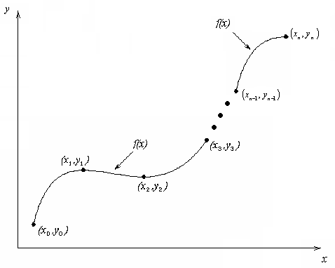
What is Interpolation ?
Given $(x0,y0), (x1,y1), …… (xn,yn)$, find the value of $y$ at a value of $x$ that is not given.
Figure Interpolation of discrete data.

Slide 3
APPLIED PROBLEMS

Slide 4

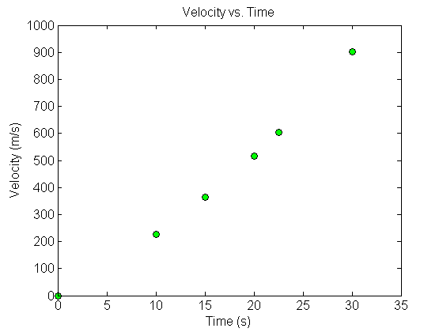


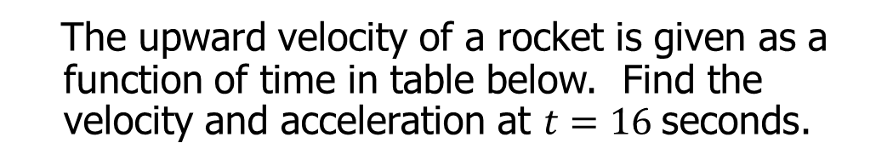
Fly Rocket Fly, Fly Rocket Fly
The upward velocity of a rocket is given as a function of time in table below. Find the velocity and acceleration at $t=16$seconds.
Table Velocity as a function of time.
0 | 0
10 | 227.04
15 | 362.78
20 | 517.35
22.5 | 602.97
30 | 901.67
$$t, \left(s\right)$$
$$v\left(t\right)\text{, }\left(\text{m}\text{/}\text{s}\right)$$
Velocity vs. time data for the rocket example

Slide 5
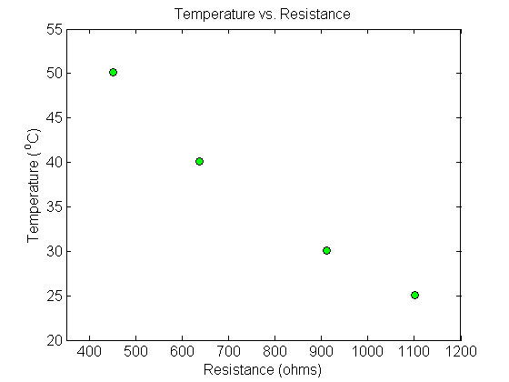
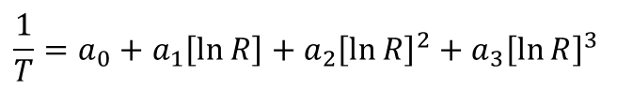
Thermistor Calibration
Thermistors are based on change in resistance of a material with temperature. A manufacturer of thermistors makes the following observations on a thermistor. Determine the calibration curve for thermistor.
$$\frac{1}{T}=a_{0}+a_{1}\left[\ln{R}\right]+a_{2}{\left[\ln{R}\right]}^{2}+a_{3}{\left[\ln{R}\right]}^{3}$$
R (Ω) | T(°C)
1101.0 911.3 636.0 451.1 | 25.113 30.131 40.120 50.128

Slide 6
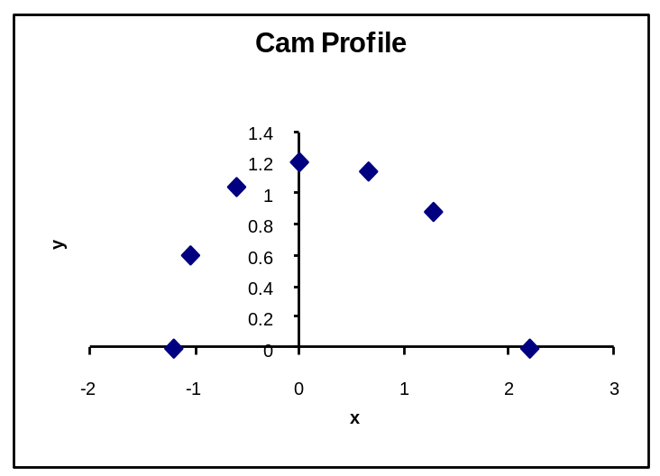
Following the Cam
A curve needs to be fit through the given points to fabricate the cam.
4
3
5
2
6
Y
1
7
X
Point | x (in.) | y (in.)
1 | 2.20 | 0.00
2 | 1.28 | 0.88
3 | 0.66 | 1.14
4 | 0.00 | 1.20
5 | –0.60 | 1.04
6 | –1.04 | 0.60
7 | –1.20 | 0.00

Slide 7
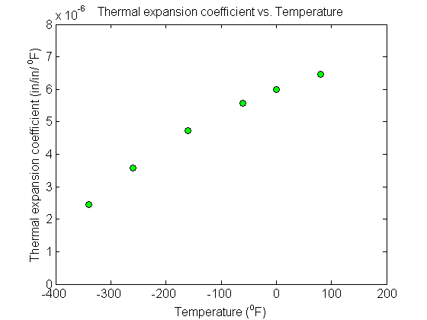
Thermal Expansion Coefficient Profile
A trunnion is cooled 80°F to − 108°F. Given below is the table of the coefficient of thermal expansion vs. temperature. Determine the coefficient of thermal expansion profile as a function of temperature.
Temperature (ºF) | Thermal Expansion Coefficient (in/in/ºF)
80 | 6.47 × 10⁻⁶
0 | 6.00 × 10⁻⁶
−60 | 5.58 × 10⁻⁶
−160 | 4.72 × 10⁻⁶
−260 | 3.58 × 10⁻⁶
−340 | 2.45 × 10⁻⁶

Slide 8
INTRODUCTION

Slide 9
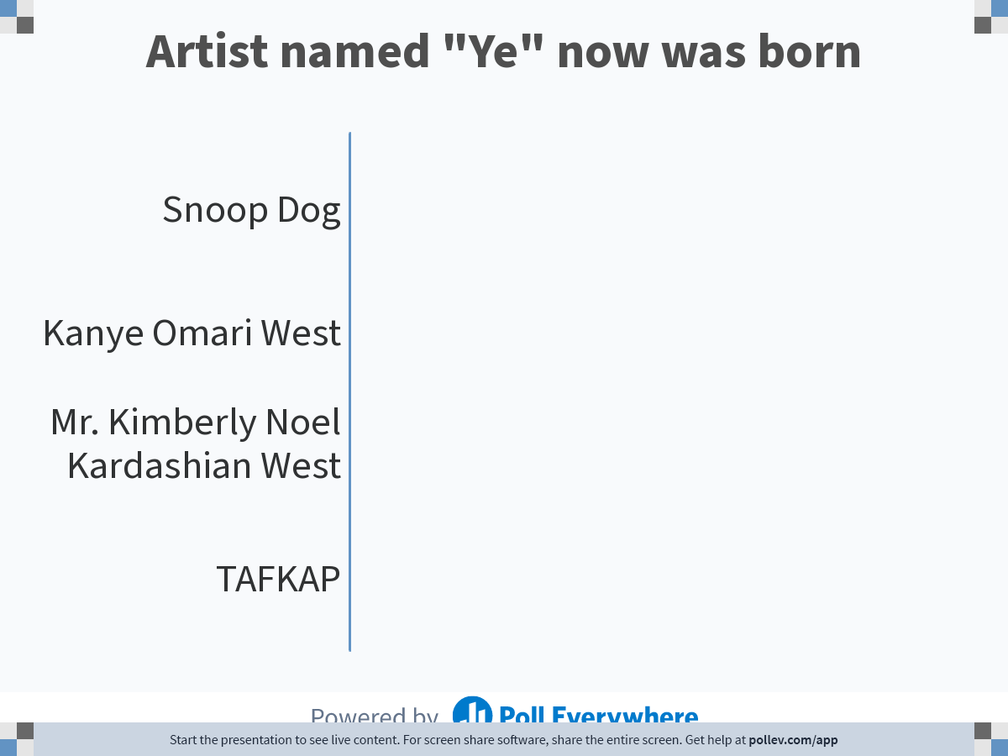
Notes:
Poll Title: Do not modify the notes in this section to avoid tampering with the Poll Everywhere activity.
More info at polleverywhere.com/support
Artist named "Ye" now was born
https://www.polleverywhere.com/multiple_choice_polls/cIPBI4m5Qs1ePDc7hk1Y2?state=opened&flow=Default&onscreen=persist

Slide 10
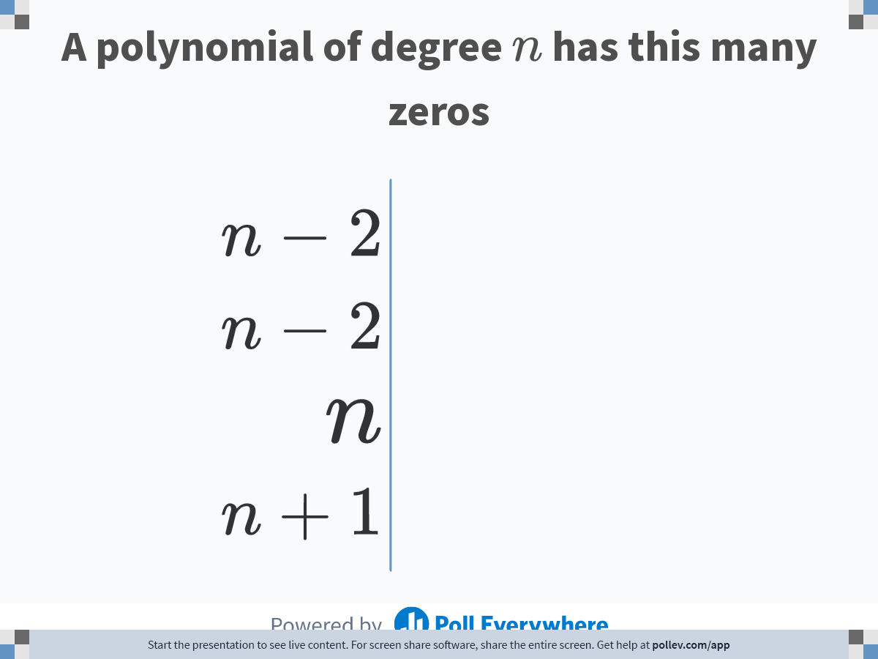
Notes:
Poll Title: Do not modify the notes in this section to avoid tampering with the Poll Everywhere activity.
More info at polleverywhere.com/support
A polynomial of degree $$n$$ has this many zeros
https://www.polleverywhere.com/multiple_choice_polls/SaflxPb2VzyxpVOtOAFSG?state=opened&flow=Default&onscreen=persist

Slide 11
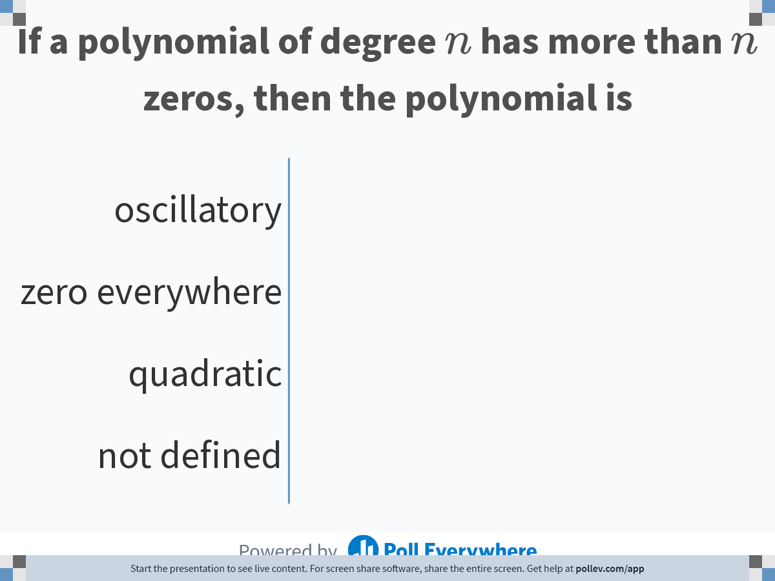
Notes:
Poll Title: Do not modify the notes in this section to avoid tampering with the Poll Everywhere activity.
More info at polleverywhere.com/support
3If a polynomial of degree n has more than n zeros, then the polynomial is
https://www.polleverywhere.com/multiple_choice_polls/BlN3VKB1lq0DgZhdQXhLC?state=opened&flow=Default&onscreen=persist

Slide 12
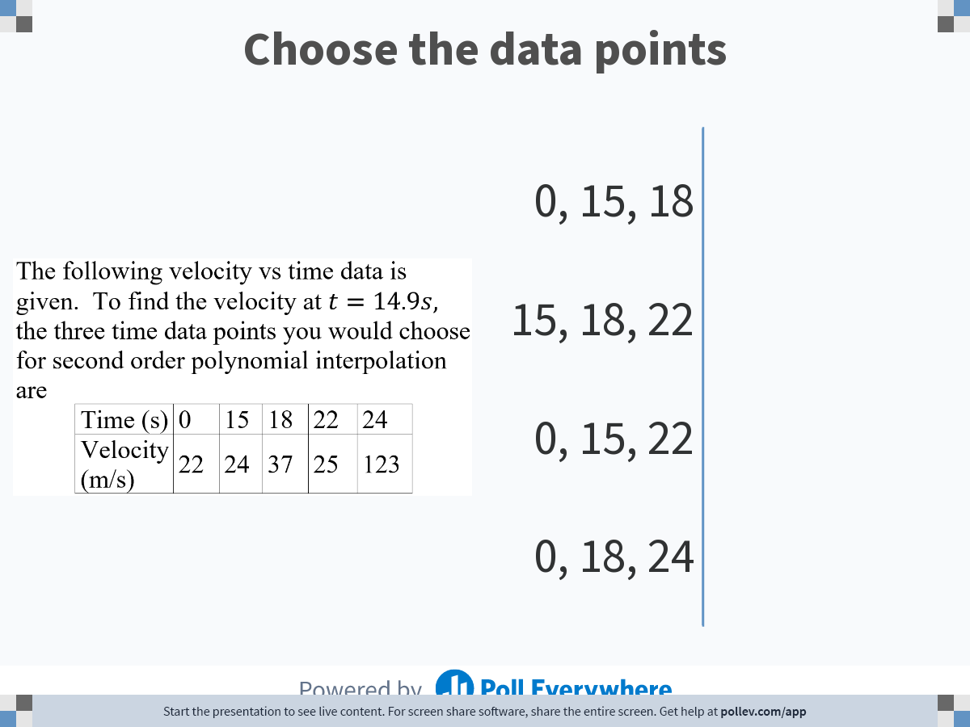
Notes:
Poll Title: Do not modify the notes in this section to avoid tampering with the Poll Everywhere activity.
More info at polleverywhere.com/support
Choose the data points
https://www.polleverywhere.com/multiple_choice_polls/Kn57jFSiO0sUJuHEMhxoI?state=opened&flow=Default&onscreen=persist

Slide 13
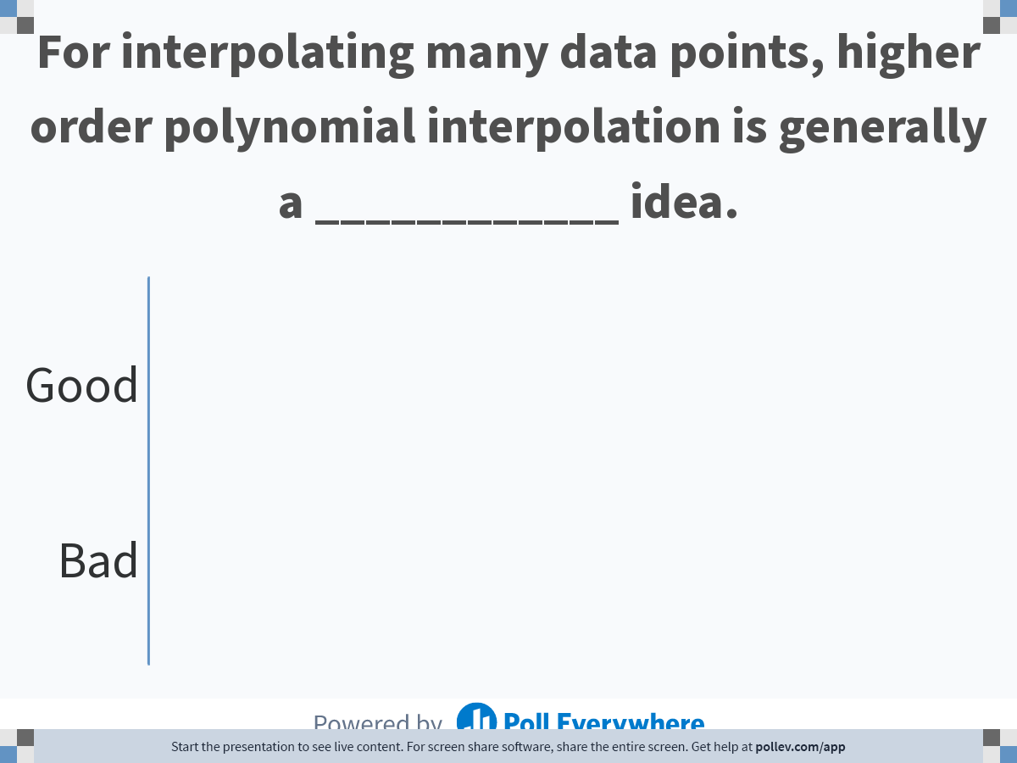
Notes:
Poll Title: Do not modify the notes in this section to avoid tampering with the Poll Everywhere activity.
More info at polleverywhere.com/support
For interpolating many data points, higher order polynomial interpolation is generally a ____________ idea.
https://www.polleverywhere.com/multiple_choice_polls/Tcj5tL17bBcZv5r8u3TJD

Slide 14
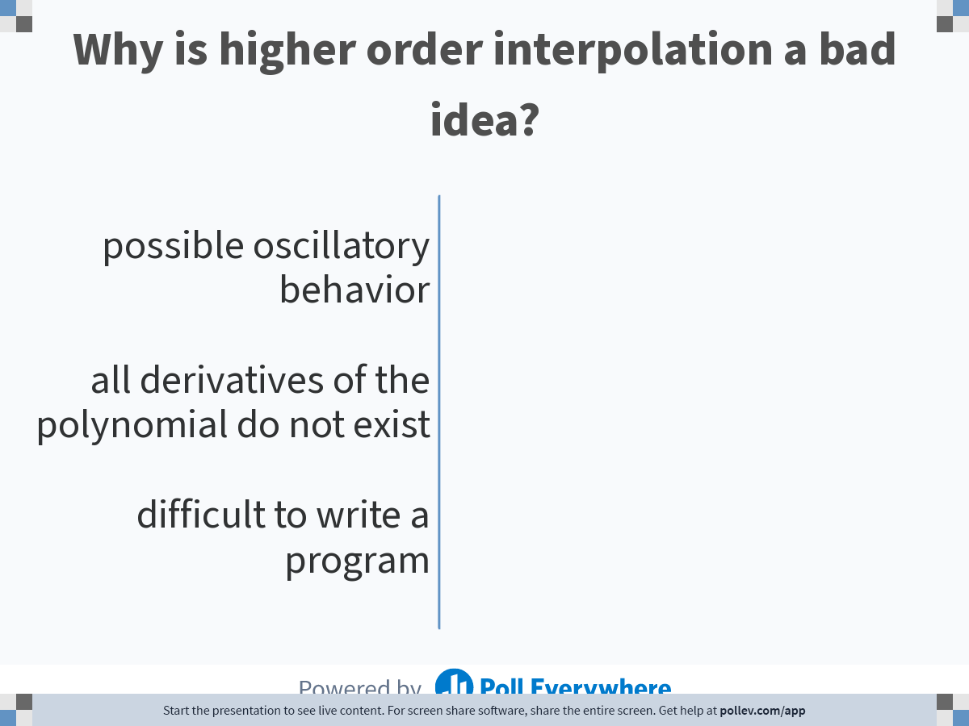
Notes:
Poll Title: Do not modify the notes in this section to avoid tampering with the Poll Everywhere activity.
More info at polleverywhere.com/support
Why is higher order interpolation a bad idea?
https://www.polleverywhere.com/multiple_choice_polls/ge3jySWnrnxVRWdYUkRah

Slide 15
SPLINE INTERPOLATION

Slide 16
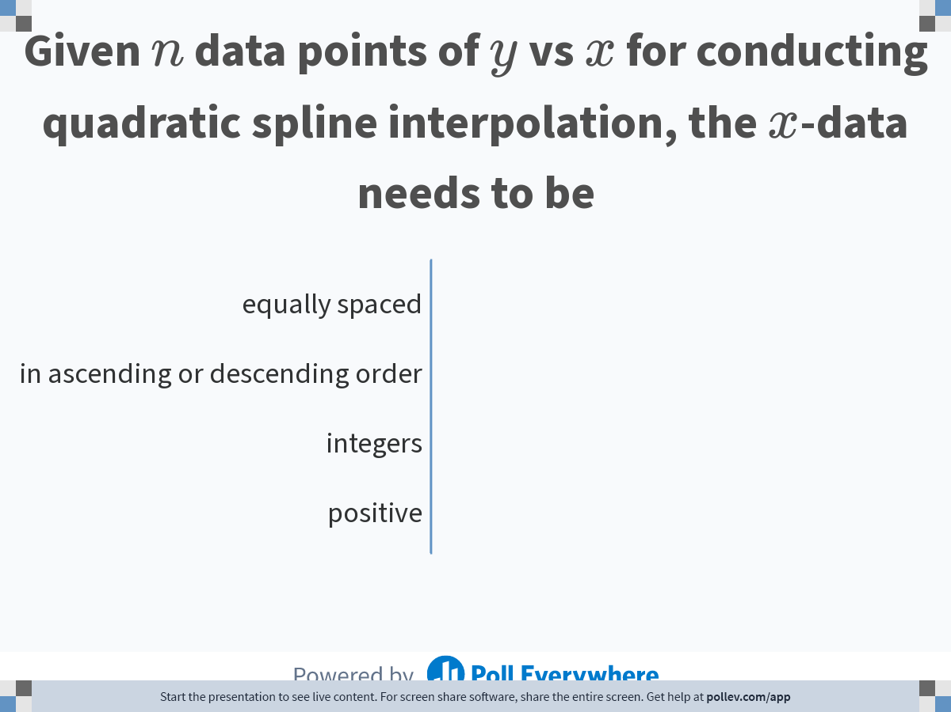
Notes:
Poll Title: Do not modify the notes in this section to avoid tampering with the Poll Everywhere activity.
More info at polleverywhere.com/support
Given n data points of y vs x for conducting quadratic spline interpolation, the x-data needs to be
https://www.polleverywhere.com/multiple_choice_polls/hMTPU8FLL7qpZkdQg3z4f

Slide 17
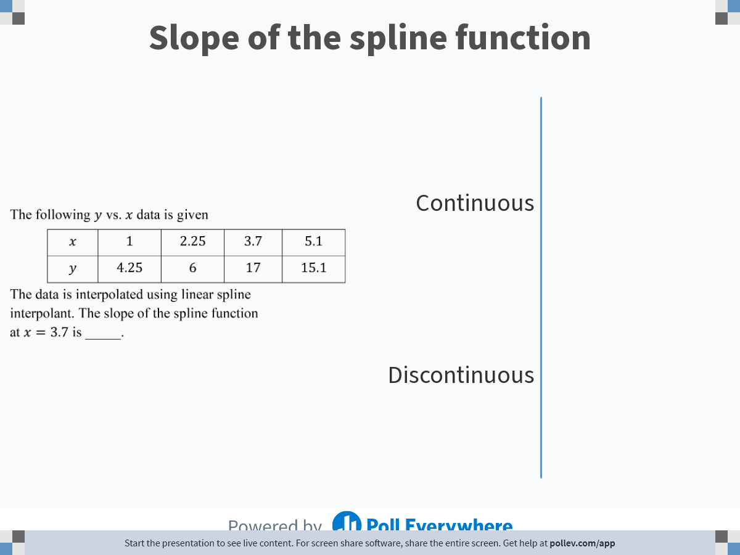
Notes:
Poll Title: Do not modify the notes in this section to avoid tampering with the Poll Everywhere activity.
More info at polleverywhere.com/support
Slope of the spline function
https://www.polleverywhere.com/multiple_choice_polls/keQNJKfAuxKRc57BQIciC

Slide 18
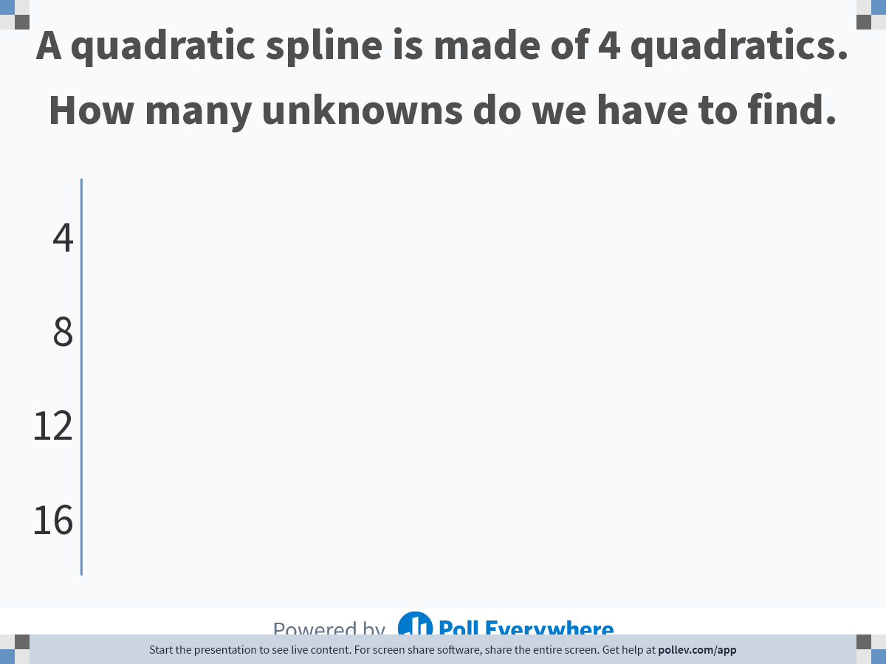
Notes:
Poll Title: Do not modify the notes in this section to avoid tampering with the Poll Everywhere activity.
More info at polleverywhere.com/support
A quadratic spline is made of 4 quadratics. How many unknowns do we have to find.
https://www.polleverywhere.com/multiple_choice_polls/K5mgUgjnBjGSrajKKs2RN?state=opened&flow=Default&onscreen=persist

Slide 19
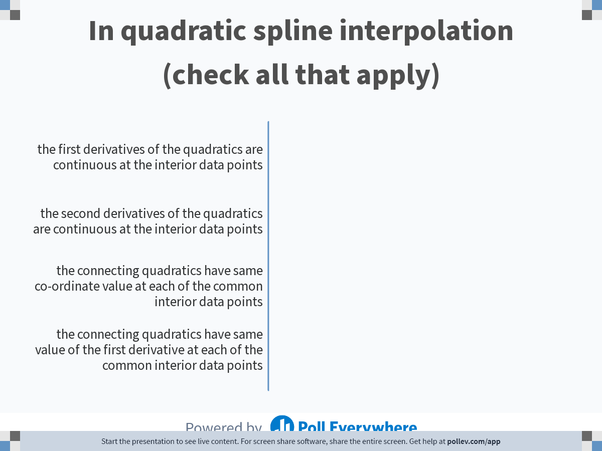
Notes:
Poll Title: Do not modify the notes in this section to avoid tampering with the Poll Everywhere activity.
More info at polleverywhere.com/support
In quadratic spline interpolation (check all that apply)
https://www.polleverywhere.com/multiple_choice_polls/mTYoi6UKud69dD46rqDgA

Slide 20
Notes:
Poll Title: Do not modify the notes in this section to avoid tampering with the Poll Everywhere activity.
More info at polleverywhere.com/support
For interpolating many data points, higher order polynomial interpolation is generally a ____________ idea.
https://www.polleverywhere.com/multiple_choice_polls/Tcj5tL17bBcZv5r8u3TJD

Slide 21
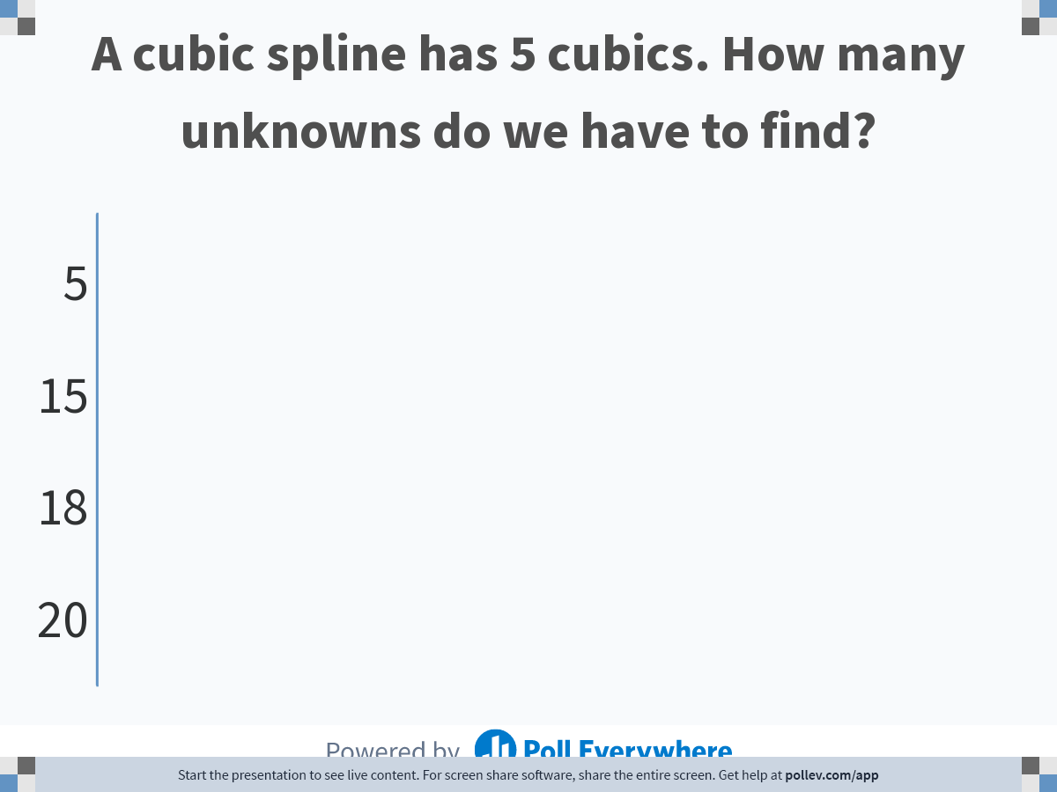
Notes:
Poll Title: Do not modify the notes in this section to avoid tampering with the Poll Everywhere activity.
More info at polleverywhere.com/support
A cubic spline has 5 cubics. How many unknowns do we have to find?
https://www.polleverywhere.com/multiple_choice_polls/YiLeMn278s4zEuOg6D0b6?state=opened&flow=Default&onscreen=persist

Slide 22
LENGTH OF CURVE

Slide 23
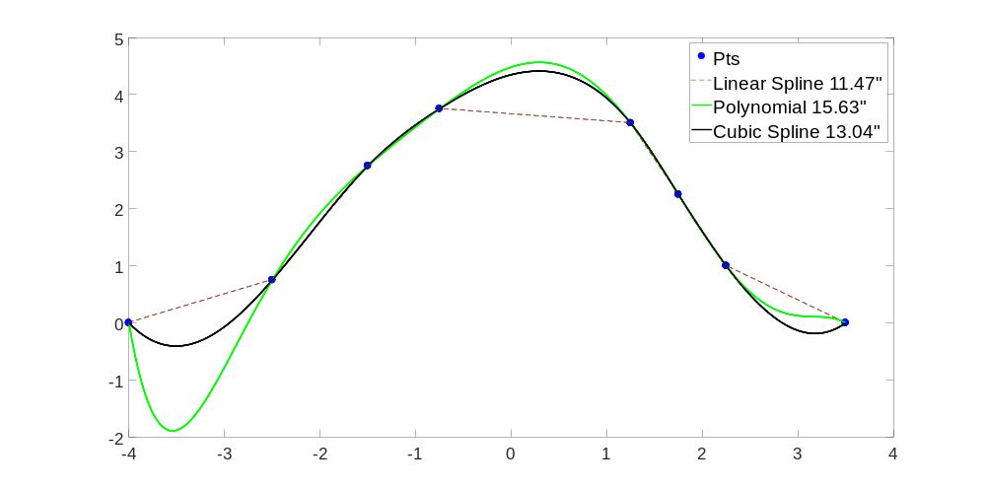
Length of interpolants

Slide 24
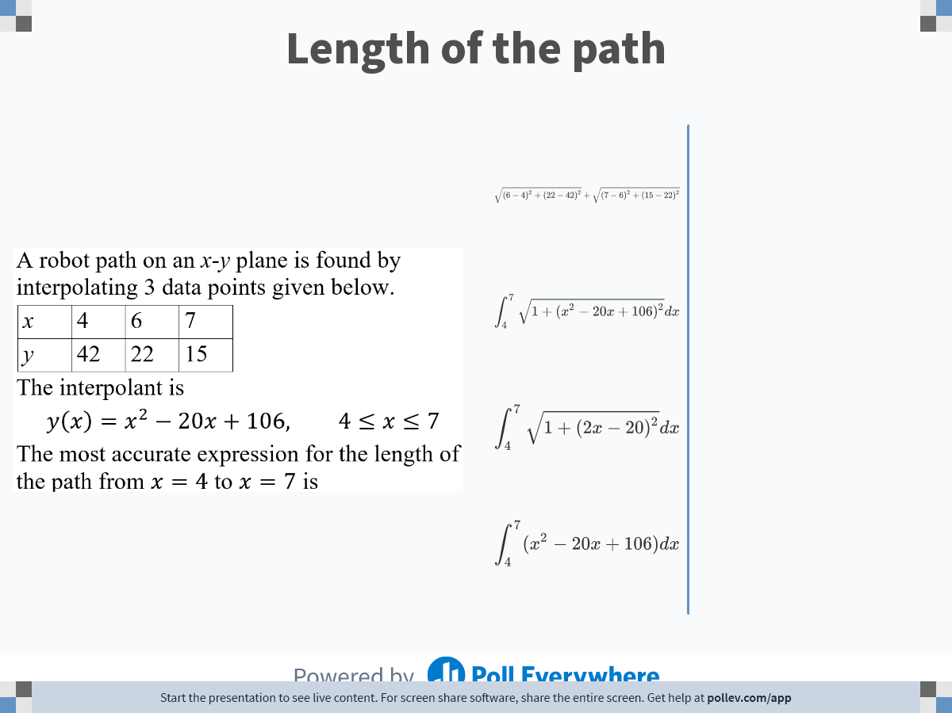
Notes:
Poll Title: Do not modify the notes in this section to avoid tampering with the Poll Everywhere activity.
More info at polleverywhere.com/support
Length of the path
https://www.polleverywhere.com/multiple_choice_polls/fsJcayq2Ym52czEgsxobH

Slide 25
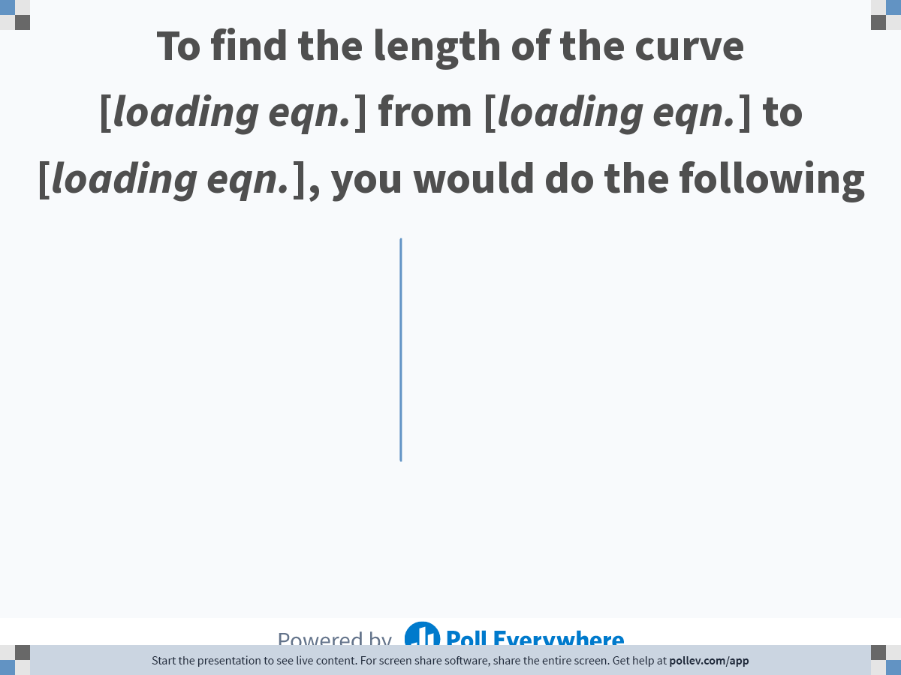
Notes:
Poll Title: Do not modify the notes in this section to avoid tampering with the Poll Everywhere activity.
More info at polleverywhere.com/support
To find the length of the curve $$3\\sin(2x) +5\\ln(7x)$$ from $$x=2$$ to $$x=5$$, you would do the following
https://www.polleverywhere.com/multiple_choice_polls/MaWHCTWvNtHFpD5h9tgHy

