Slide 1
Regression
Reading While Skimming the Lines

Slide 2
Applications

Slide 3
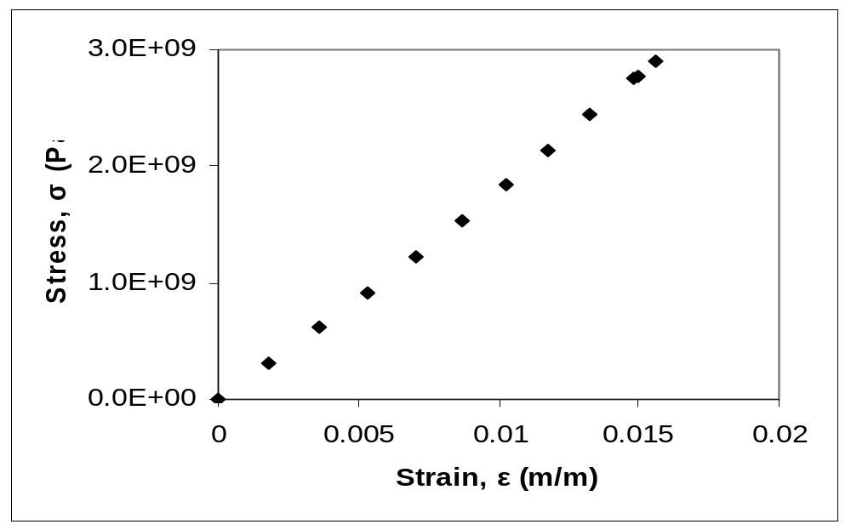
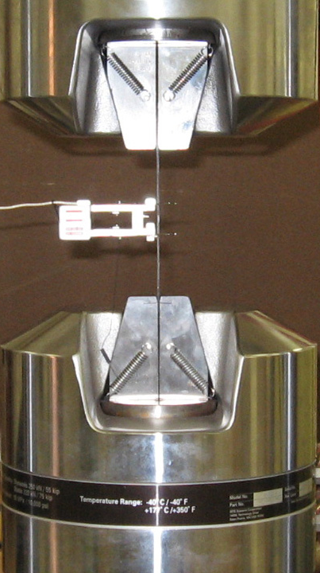
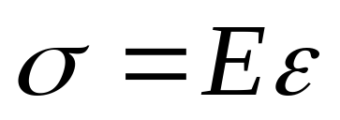
Stress vs Strain in a Composite Material

Slide 4
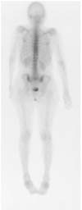
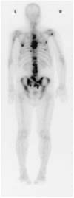
A Bone Scan

Slide 5
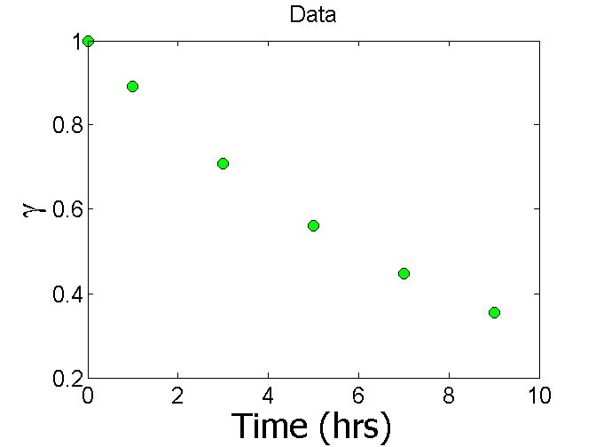
Radiation intensity from Technitium-99m

Slide 6
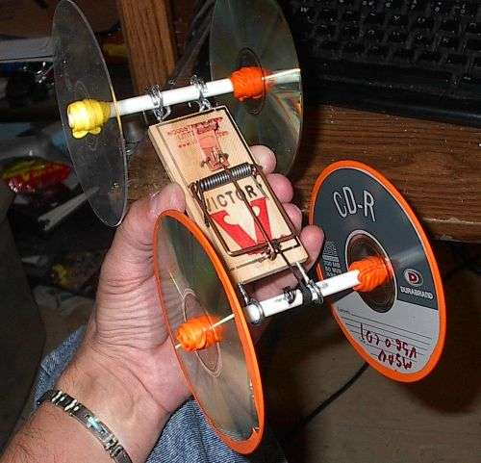
Mousetrap Car

Slide 7
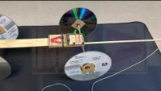
Mousetrap car demo

Slide 8
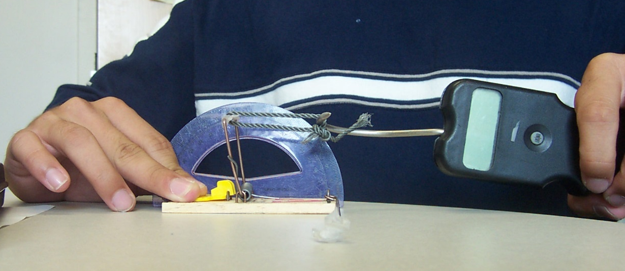
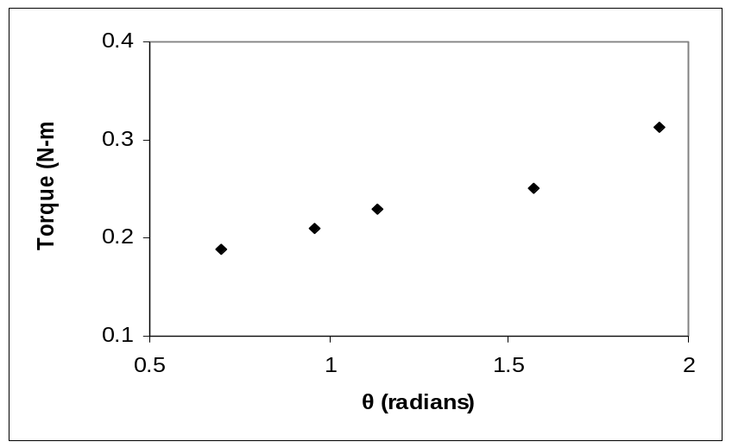
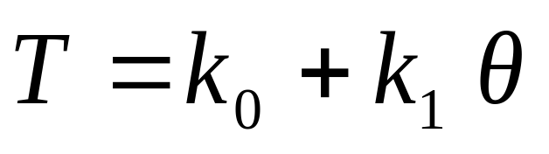
Torsional Stiffness of a Mousetrap Spring

Slide 9

Trunnion-Hub Assembly

Slide 10
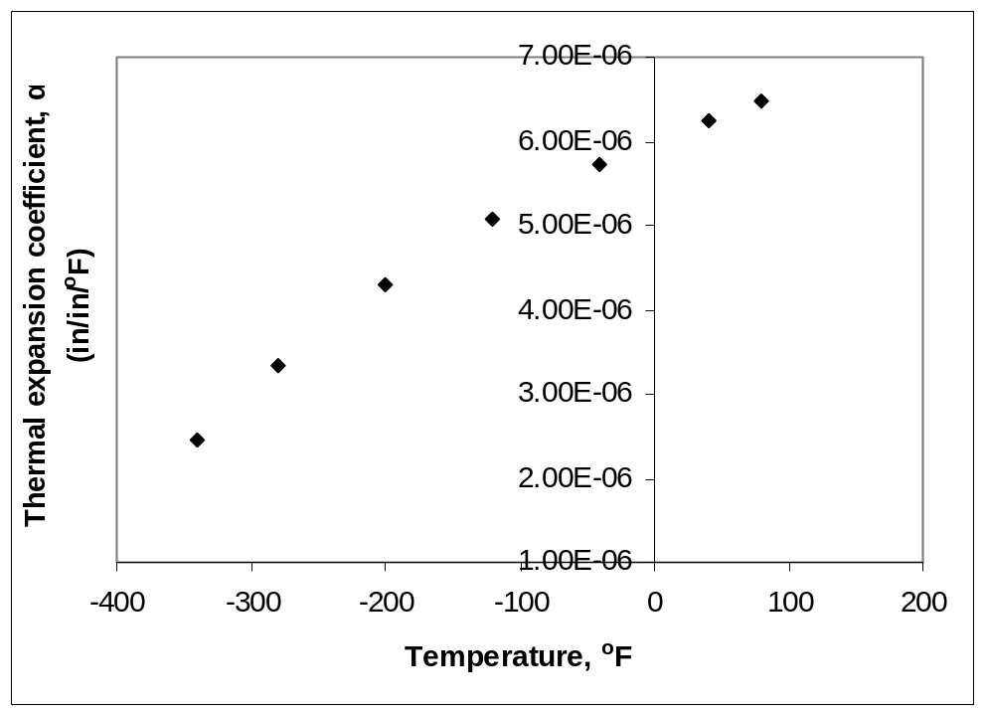
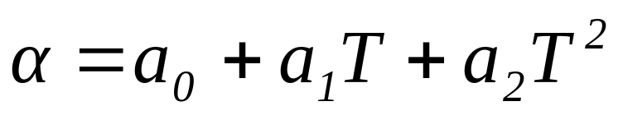
Thermal Expansion Coefficient Changes with Temperature?

Slide 11
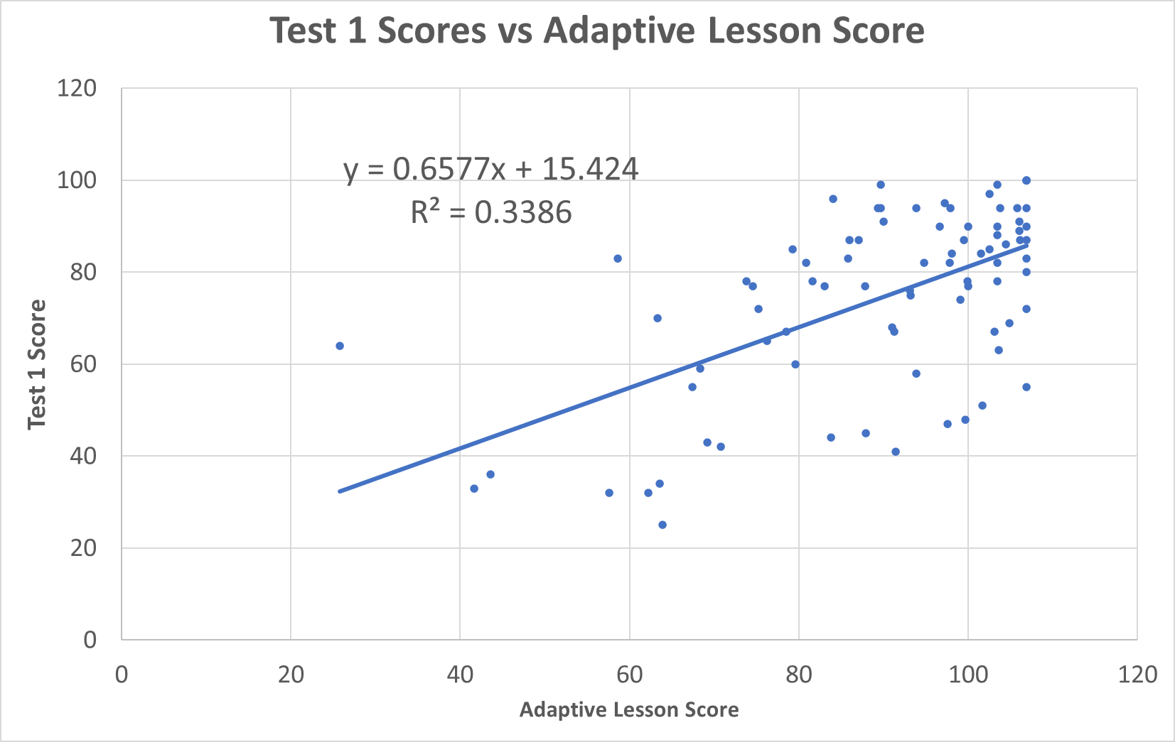
Test 1 vs Online HW Score Fall 2021

Slide 12
THE END

Slide 13
06.01
Pre-Requisite Knowledge

Slide 14
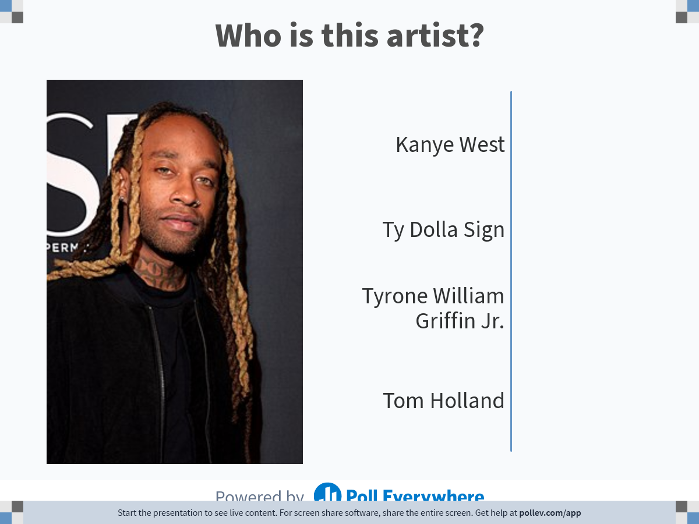
Notes:
Poll Title: Do not modify the notes in this section to avoid tampering with the Poll Everywhere activity.
More info at polleverywhere.com/support
Who is this artist?
https://www.polleverywhere.com/multiple_choice_polls/I3GkCUVgbGPog1Ih7CVjt?state=opened&flow=Default&onscreen=persist

Slide 15
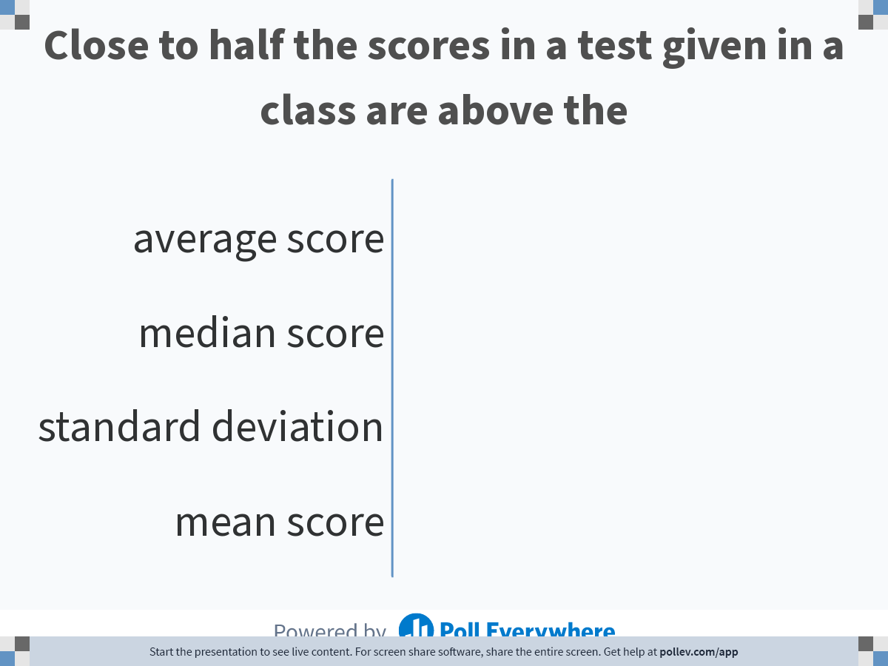
Notes:
Poll Title: Do not modify the notes in this section to avoid tampering with the Poll Everywhere activity.
More info at polleverywhere.com/support
Close to half the scores in a test given in a class are above the
https://www.polleverywhere.com/multiple_choice_polls/E5wAEP2cPLOUeEVprwuNY

Slide 16
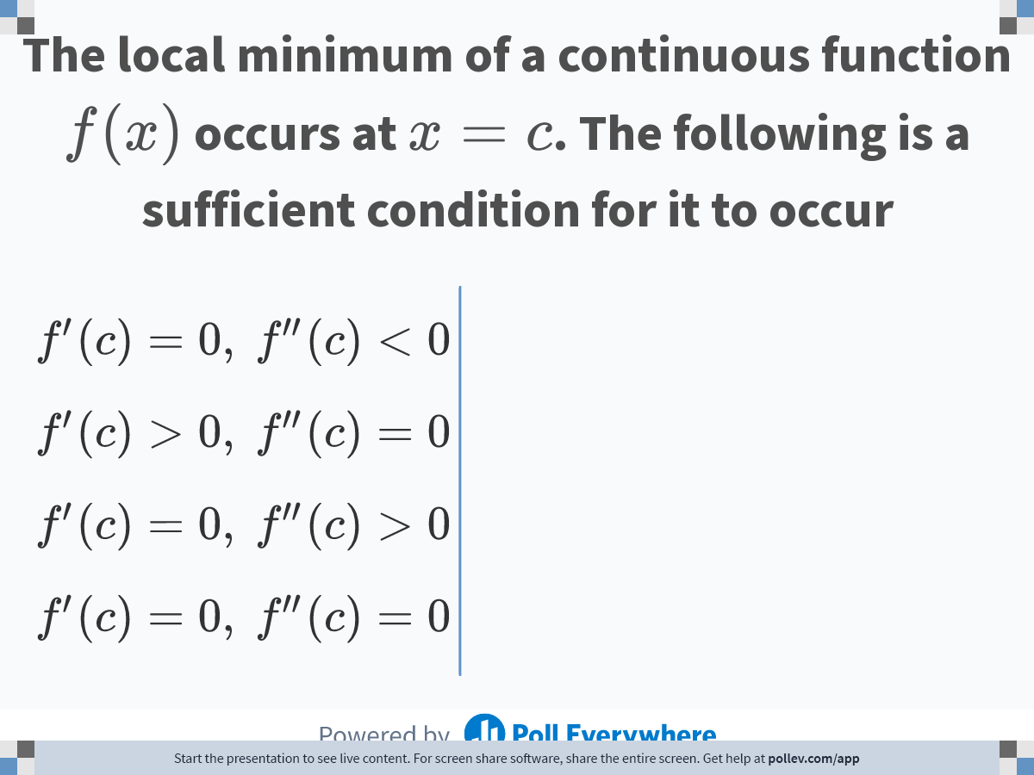
Notes:
Poll Title: Do not modify the notes in this section to avoid tampering with the Poll Everywhere activity.
More info at polleverywhere.com/support
The local minimum of a continuous function $$f(x)$$ occurs at $$x=c$$. The following is a sufficient condition for it to occur
https://www.polleverywhere.com/multiple_choice_polls/REdLwPx4DRxRDC5WbTfxs

Slide 17
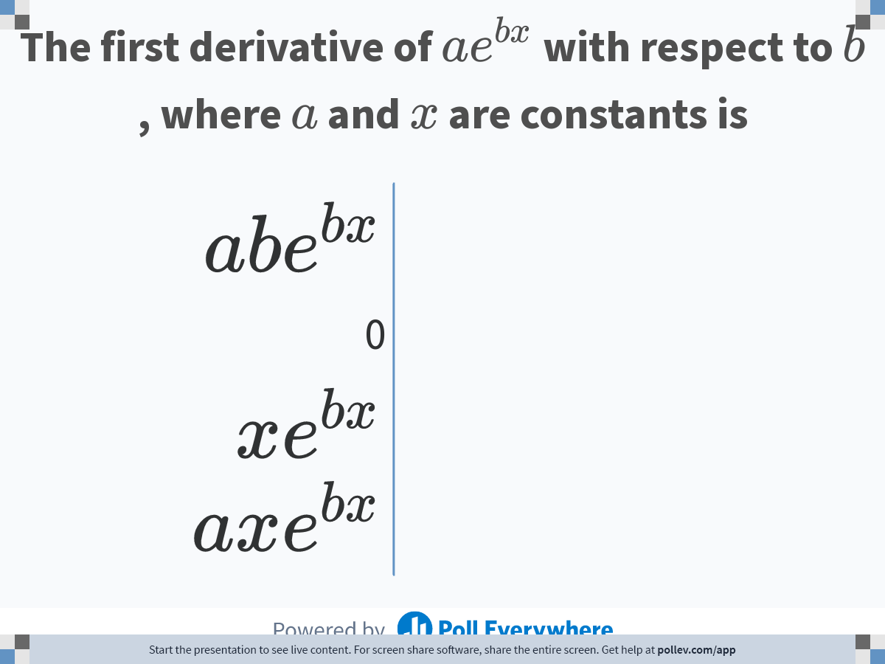
Notes:
Poll Title: Do not modify the notes in this section to avoid tampering with the Poll Everywhere activity.
More info at polleverywhere.com/support
The first derivative of $$ae^{bx}$$ with respect to $$b$$, where $$a$$ and $$x$$ are constants is
https://www.polleverywhere.com/multiple_choice_polls/DyL6XPfCW60anP76le8Zl

Slide 18
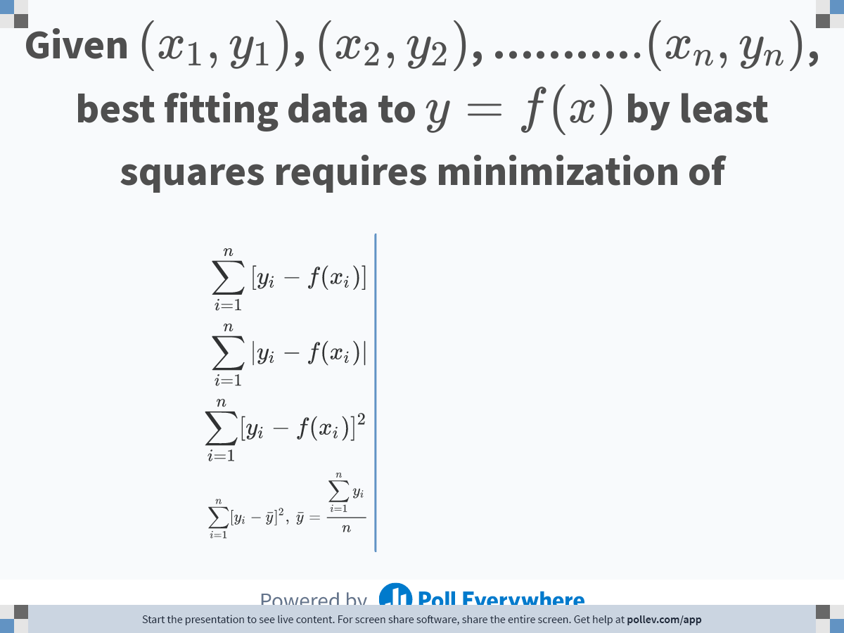
Notes:
Poll Title: Do not modify the notes in this section to avoid tampering with the Poll Everywhere activity.
More info at polleverywhere.com/support
Given $$(x_1,y_1)$$, $$(x_2,y_2)$$, ……….$$.(x_n,y_n)$$, best fitting data to $$y=f(x)$$ by least squares requires minimization of
https://www.polleverywhere.com/multiple_choice_polls/qB8rYv5puohiiPL1E0run

Slide 19
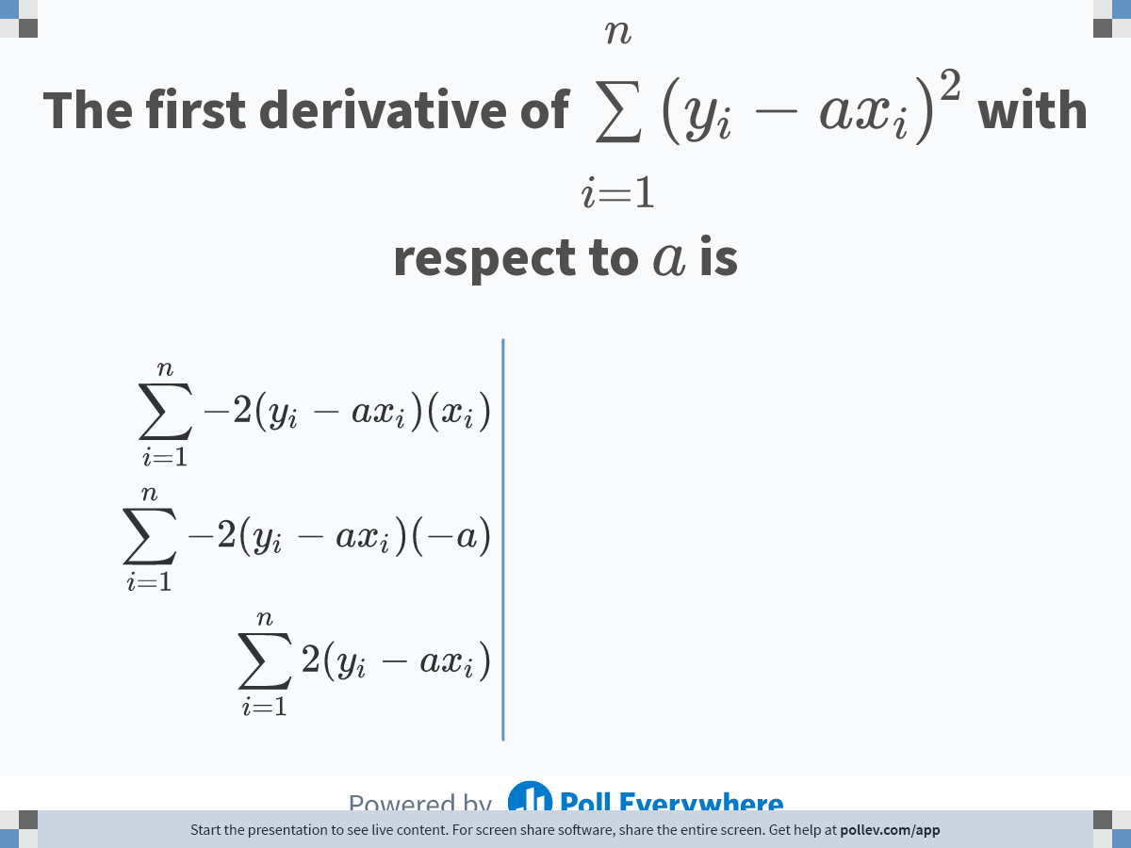
Notes:
Poll Title: Do not modify the notes in this section to avoid tampering with the Poll Everywhere activity.
More info at polleverywhere.com/support
The first derivative of $$\\displaystyle \\sum^n_{i=1}(y_i - ax_i)^2$$ with respect to $$a$$ is
https://www.polleverywhere.com/multiple_choice_polls/AFMzc5zSUddzOkN4SQEVf

Slide 20
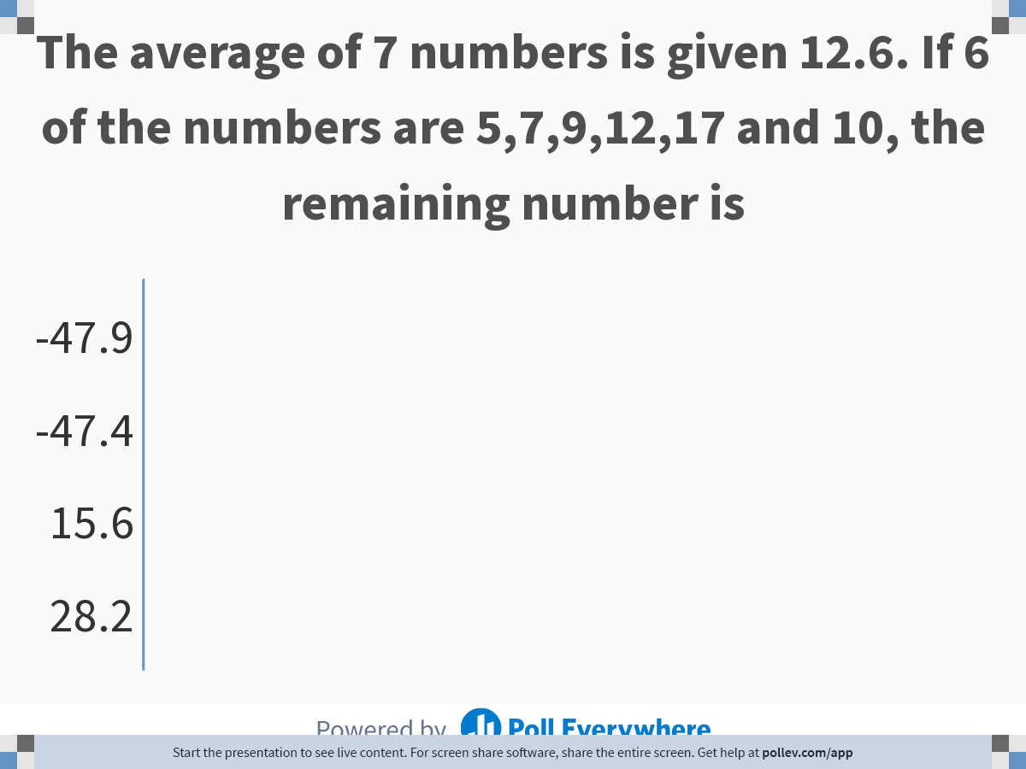
Notes:
Poll Title: Do not modify the notes in this section to avoid tampering with the Poll Everywhere activity.
More info at polleverywhere.com/support
The average of 7 numbers is given 12.6. If 6 of the numbers are 5,7,9,12,17 and 10, the remaining number is
https://www.polleverywhere.com/multiple_choice_polls/t46OhES5ssPANEB1wJDgR

Slide 21
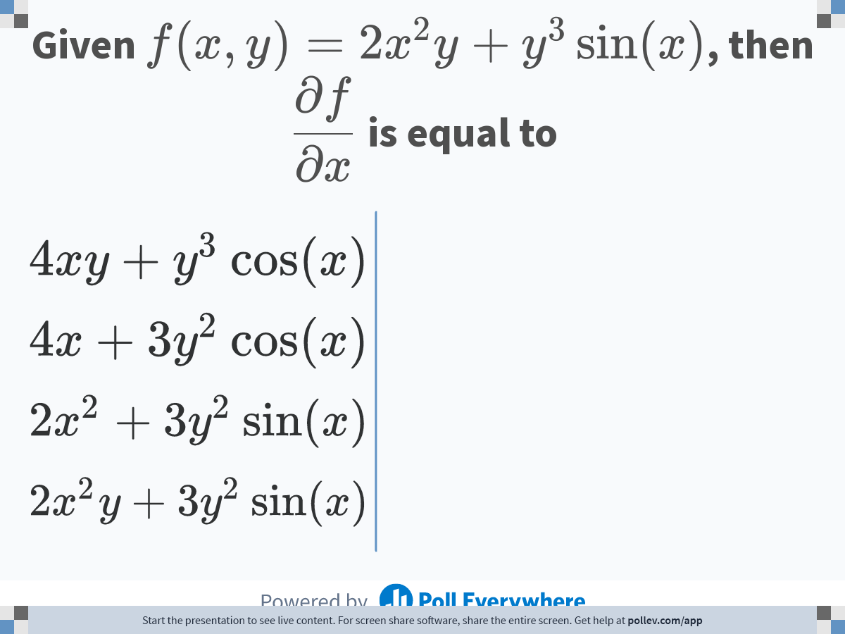
Notes:
Poll Title: Do not modify the notes in this section to avoid tampering with the Poll Everywhere activity.
More info at polleverywhere.com/support
Given $$f(x,y) = 2x^2y+y^3\\sin(x)$$, then $$\\displaystyle\\frac{\\partial f}{\\partial x}$$ is equal to
https://www.polleverywhere.com/multiple_choice_polls/IXzuE5fycJMjjJj01Zzao

Slide 22
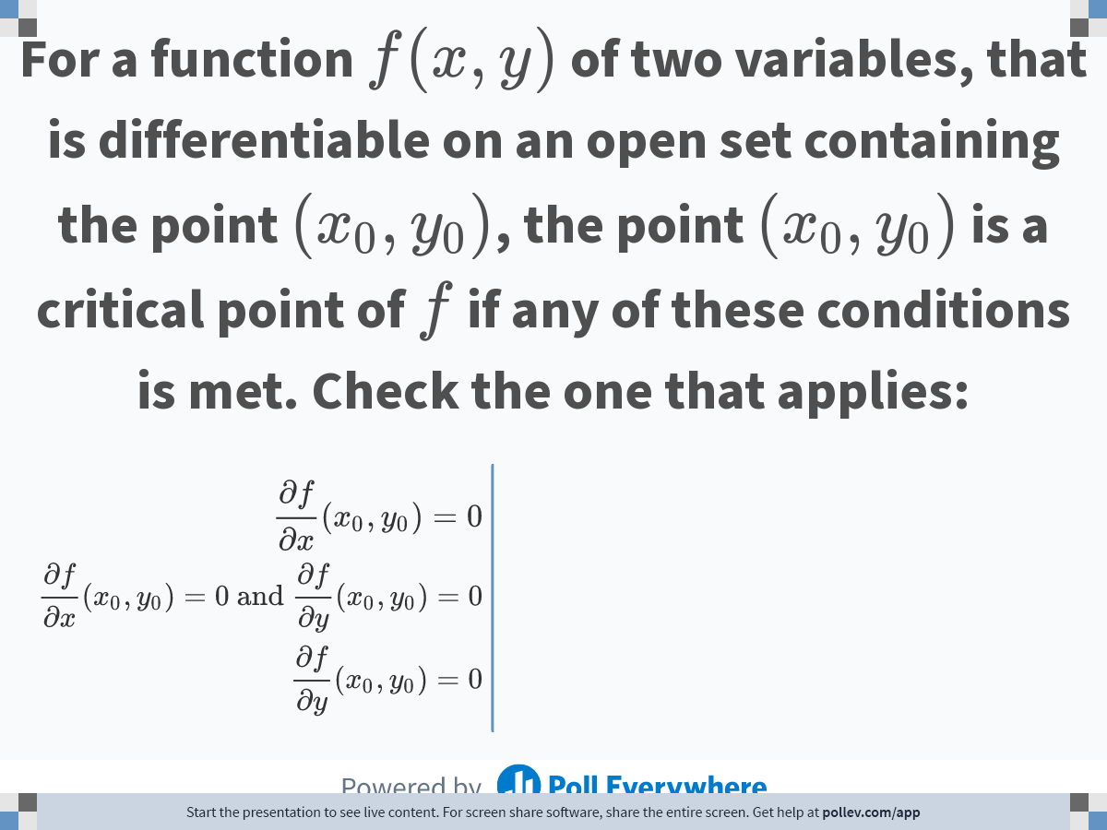
Notes:
Poll Title: Do not modify the notes in this section to avoid tampering with the Poll Everywhere activity.
More info at polleverywhere.com/support
For a function $$f(x,y)$$ of two variables, that is differentiable on an open set containing the point $$(x_0,y_0)$$, the point $$(x_0,y_0)$$ is a critical point of $$f$$ if any of these conditions is met. Check the one that applies:
https://www.polleverywhere.com/multiple_choice_polls/djb7RArgP5Gbebh19Zvx8

Slide 23
THE END

Slide 24
6.03
Linear Regression

Slide 25
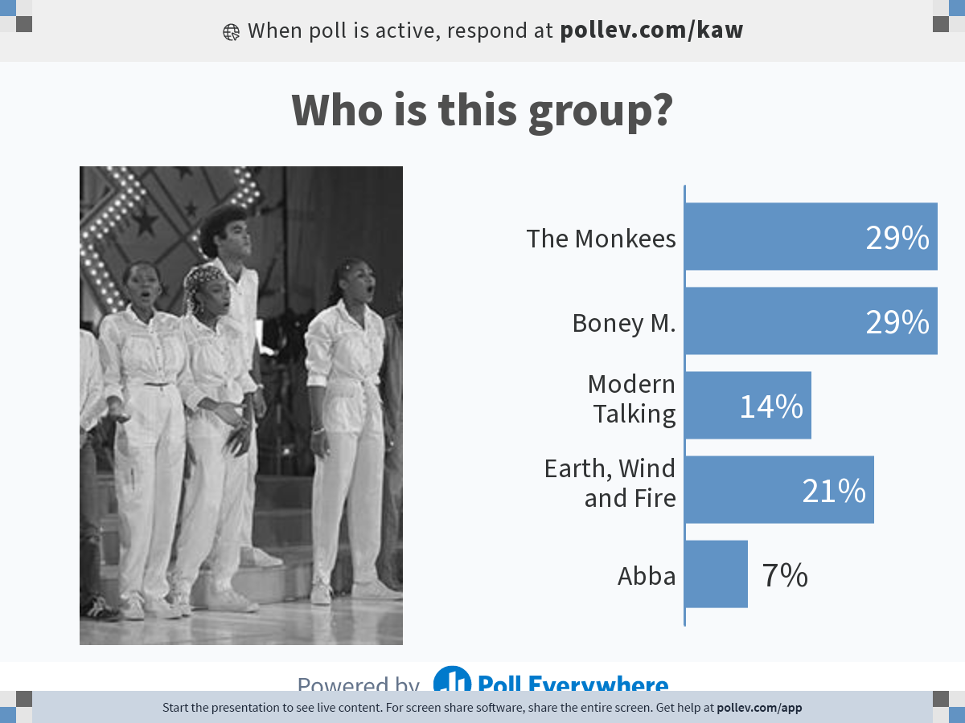
Notes:
Poll Title: Do not modify the notes in this section to avoid tampering with the Poll Everywhere activity.
More info at polleverywhere.com/support
Who is this group?
https://www.polleverywhere.com/multiple_choice_polls/4lfxhktVnwSv69i9t9sxc?state=opened&flow=Default&onscreen=persist

Slide 26
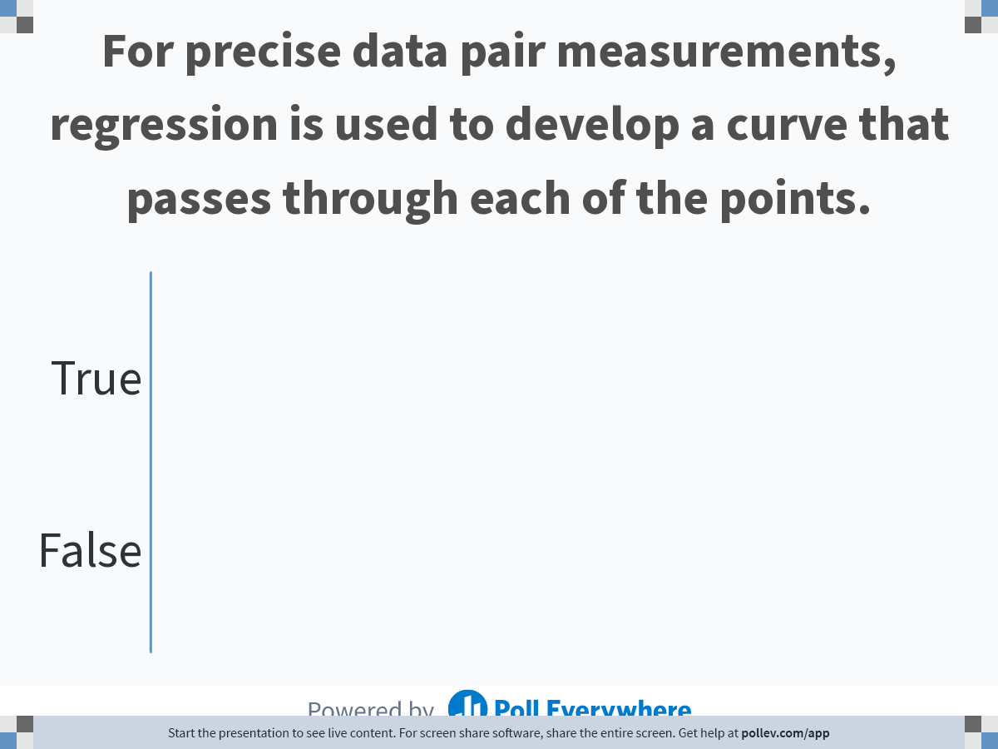
Notes:
Poll Title: Do not modify the notes in this section to avoid tampering with the Poll Everywhere activity.
More info at polleverywhere.com/support
For precise data pair measurements, regression is used to develop a curve that passes through each of the points.
https://www.polleverywhere.com/multiple_choice_polls/B8lQteBCcCDNF07so5FUD

Slide 27
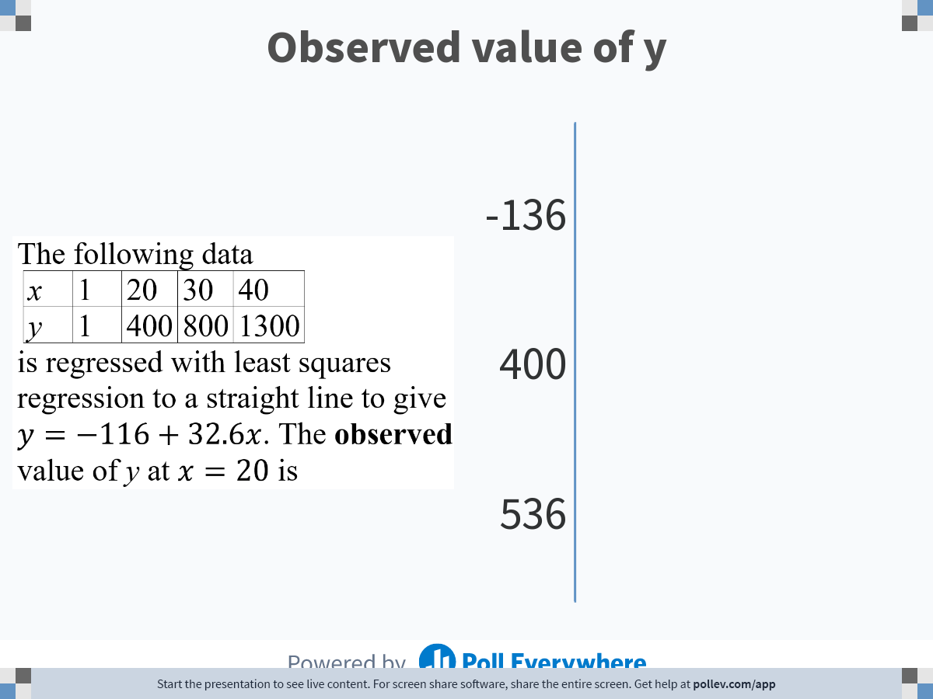
Notes:
Poll Title: Do not modify the notes in this section to avoid tampering with the Poll Everywhere activity.
More info at polleverywhere.com/support
Observed value of y
https://www.polleverywhere.com/multiple_choice_polls/2SG40gWUeDJrUeBYnTPVJ

Slide 28
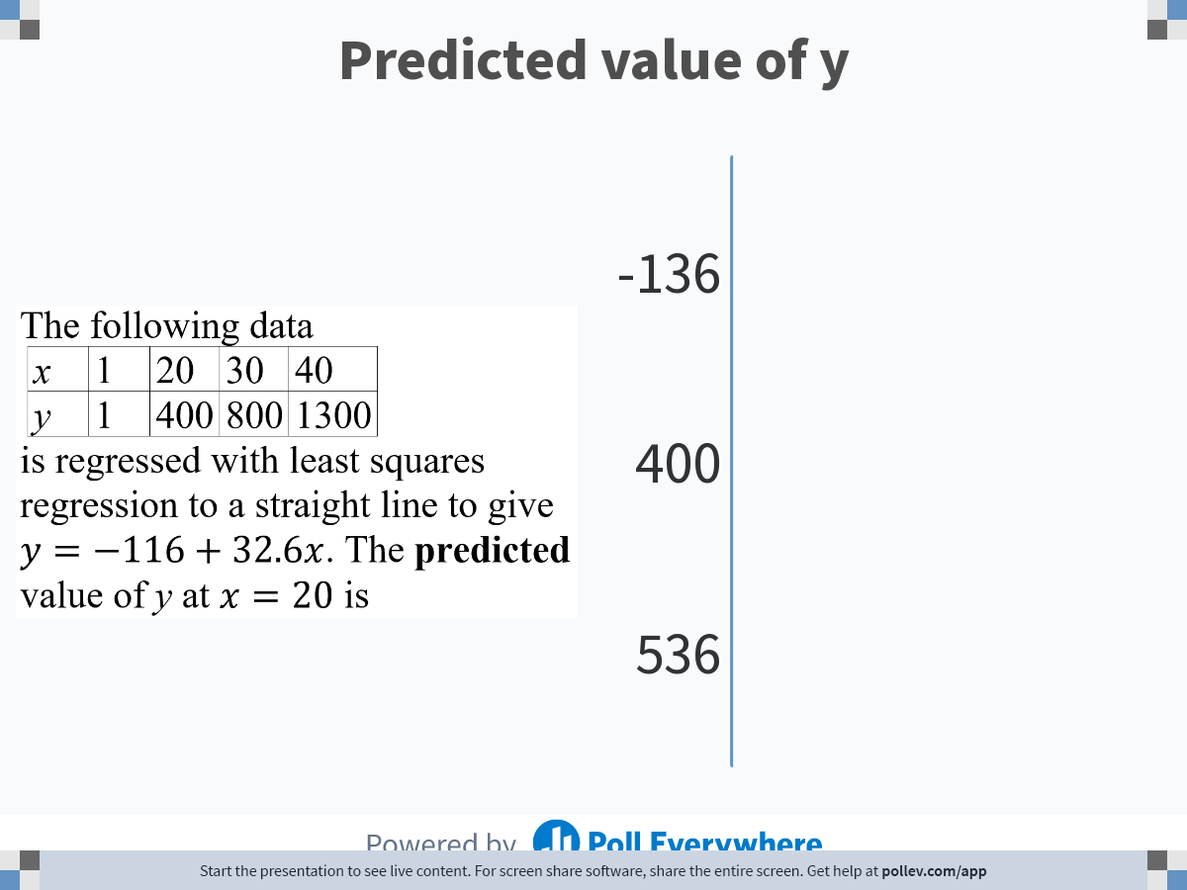
Notes:
Poll Title: Do not modify the notes in this section to avoid tampering with the Poll Everywhere activity.
More info at polleverywhere.com/support
Predicted value of y
https://www.polleverywhere.com/multiple_choice_polls/oVQuZxk7OHpWgJnZVfcIW

Slide 29
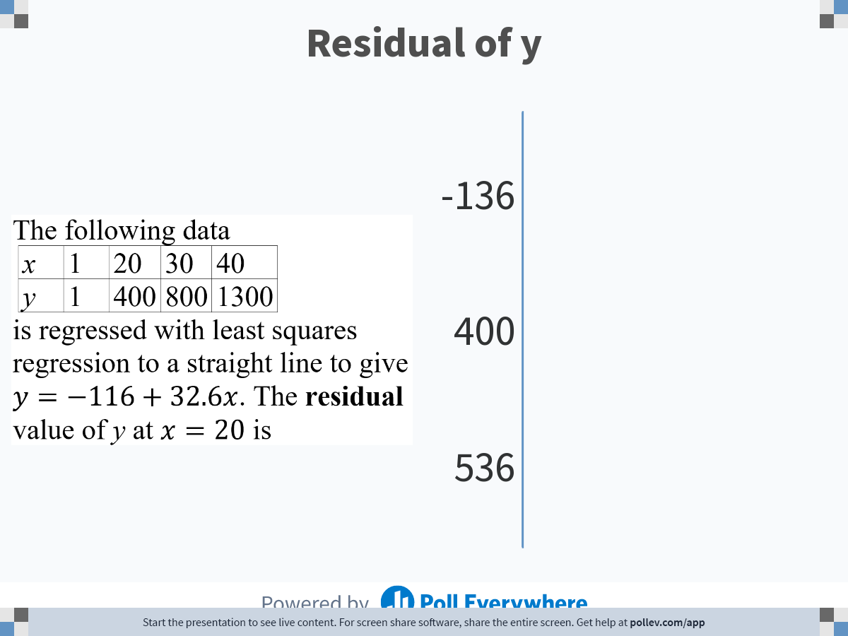
Notes:
Poll Title: Do not modify the notes in this section to avoid tampering with the Poll Everywhere activity.
More info at polleverywhere.com/support
Residual of y
https://www.polleverywhere.com/multiple_choice_polls/z4ZsU7LmjeBq6GO1XjH2W

Slide 30
THE END

