Slide 1
6.05
Adequacy of Linear Regression Models

Slide 2
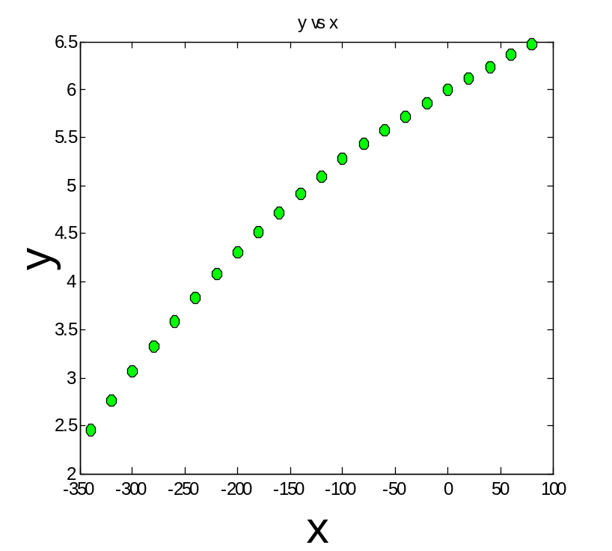
Data

Slide 3
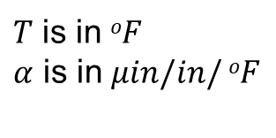
Therm exp coeff vs temperature
T | α
80 | 6.47
60 | 6.36
40 | 6.24
20 | 6.12
0 | 6.00
-20 | 5.86
-40 | 5.2
-60 | 5.58
-80 | 5.43
-100 | 5.28
-120 | 5.09
T | α
-140 | 4.91
-160 | 4.72
-180 | 4.52
-200 | 4.30
-220 | 4.08
-240 | 3.83
-260 | 3.58
-280 | 3.33
-300 | 3.07
-320 | 2.76
-340 | 2.45
$T$ is in $oF$
$α$ is in $μin/in/ oF$

Slide 4
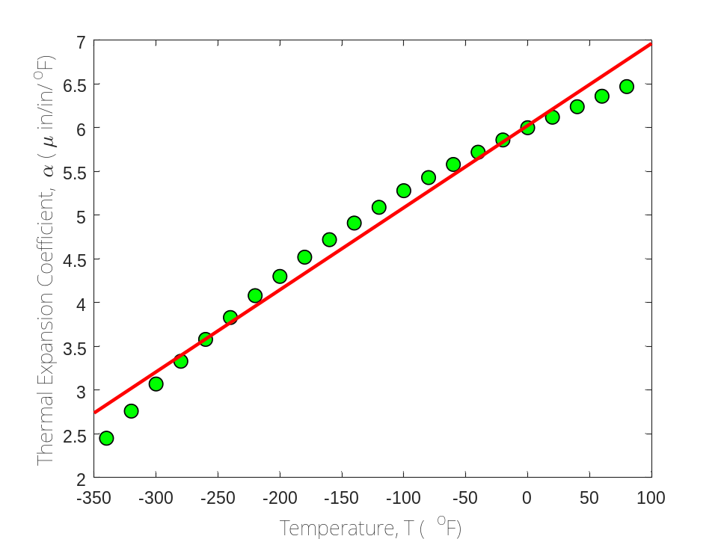
Is this adequate?
Straight Line Model

Slide 5
Quality of Fitted Data
Does the model describe the data adequately?
How well does the model predict the response variable predictably?

Slide 6
Linear Regression Models
Limit our discussion to adequacy of straight-line regression models

Slide 7
Four checks
Does the model look like it explains the data?
Do 95%of the residuals fall with ±2 standard error of estimate?
Is the coefficient of determination acceptable?
Does the model meet the assumption of random errors?

Slide 8
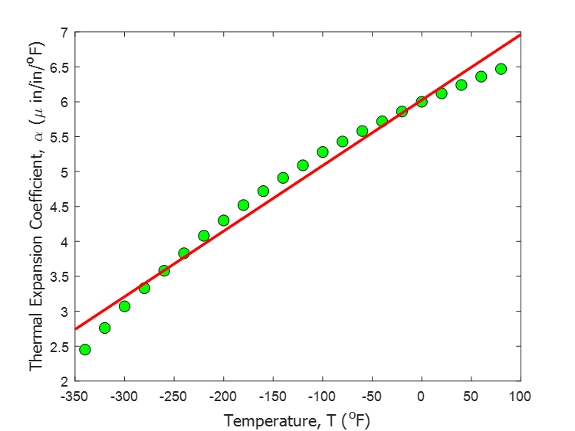
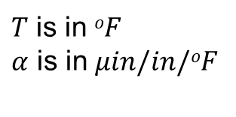
Therm exp coeff vs temperature (22 data points)
T | α
80 | 6.47
60 | 6.36
40 | 6.24
20 | 6.12
0 | 6.00
-20 | 5.86
-40 | 5.2
-60 | 5.58
-80 | 5.43
-100 | 5.28
-120 | 5.09
T | α
-140 | 4.91
-160 | 4.72
-180 | 4.52
-200 | 4.30
-220 | 4.08
-240 | 3.83
-260 | 3.58
-280 | 3.33
-300 | 3.07
-320 | 2.76
-340 | 2.45
$T$ is in $oF$
$α$ is in $μin/in/oF$

Slide 9
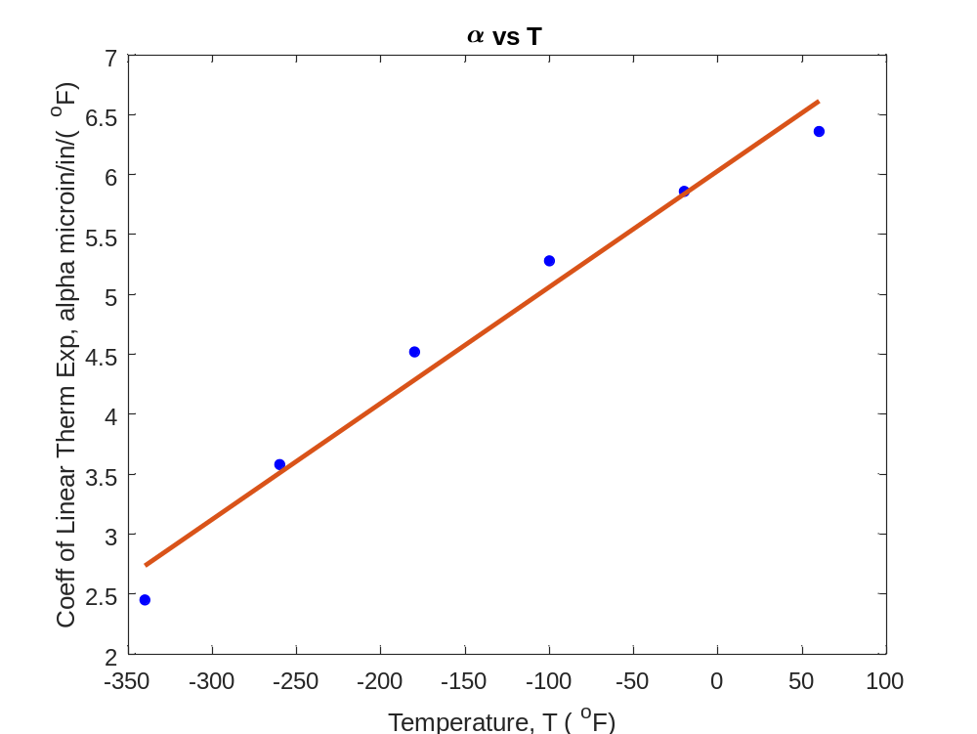
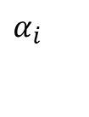


Therm exp coeff vs temperature (6 data points)
$$T_{i}$$
-340 -260 -180 -100 -20 60 | 2.45 3.58 4.52 5.28 5.86 6.36
$$α_{i}$$
$$α(T)=6.0325+0.0096964T$$

Slide 10
Four checks (with 6 data points)
Does the model look like it explains the data?
Do 95%of the residuals fall with ±2 standard error of estimate?
Is the coefficient of determination acceptable?
Does the model meet the assumption of random errors?

Slide 11
Check 1: Does the model look like it explains the data?

Slide 12
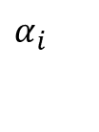

Data and Model
-340 -260 -180 -100 -20 60 | 2.45 3.58 4.52 5.28 5.86 6.36
$$T_{i}$$
$$α_{i}$$
$$α(T)=6.0325+0.0096964T$$

Slide 13
Check 2. Do 95%of the residuals fall within ±2 standard error of estimate?

Slide 14
Data and Model
$$α_{i}$$
$$T_{i}$$
-340 -260 -180 -100 -20 60 | 2.45 3.58 4.52 5.28 5.86 6.36
$$α(T)=6.0325+0.0096964T$$

Slide 15
Standard error of estimate
$$S_{r}=\sum_{i=1}^{n}{(α_{i}−a_{0}−a_{1}T_{i})^{2}}$$
$$s_{α/T}=\sqrt{\frac{S_{r}}{n−2}}$$

Slide 16
Standard Error of Estimate
$$α(T)=6.0325+0.0096964T$$
-340 -260 -180 -100 -20 60 | 2.45 3.58 4.52 5.28 5.86 6.36 | 2.7357 3.5114 4.2871 5.0629 5.8386 6.6143 | -0.28571 0.068571 0.23286 0.21714 0.021429 -0.25429
$$T_{i}$$
$$α_{i}$$
$$a_{0}+a_{1}T_{i}$$
$$α_{i}−a_{0}−a_{1}T_{i}$$

Slide 17
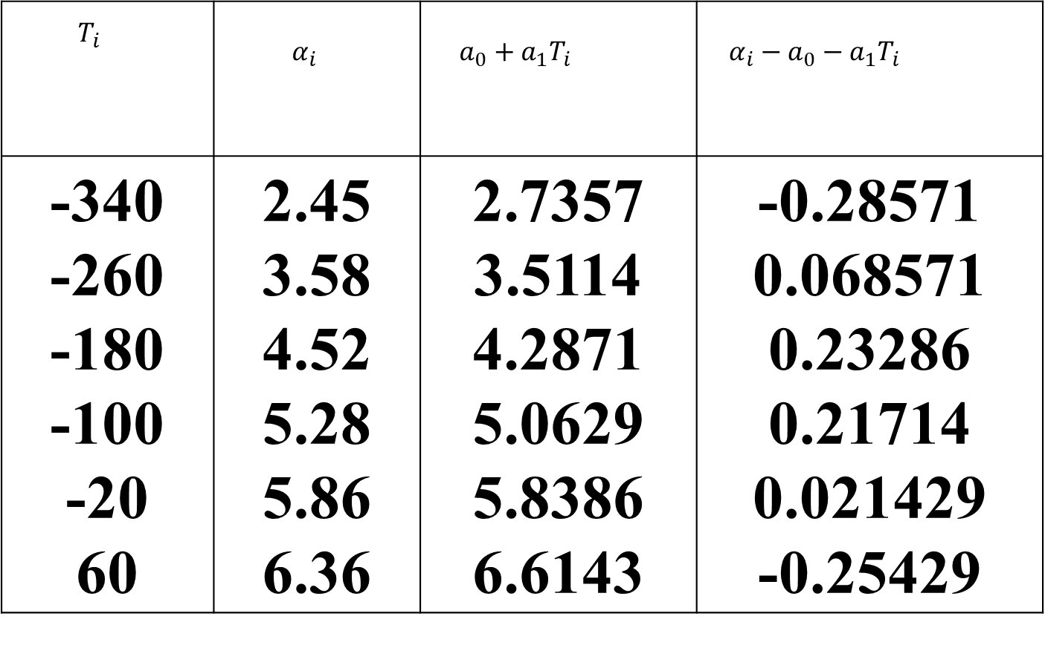
Standard Error of Estimate
$$S_{r}=0.25283$$
$$s_{α/T}=\sqrt{\frac{S_{r}}{n−2}}$$
$$=\sqrt{\frac{0.25283}{6−2}}$$
$$=0.25141$$

Slide 18
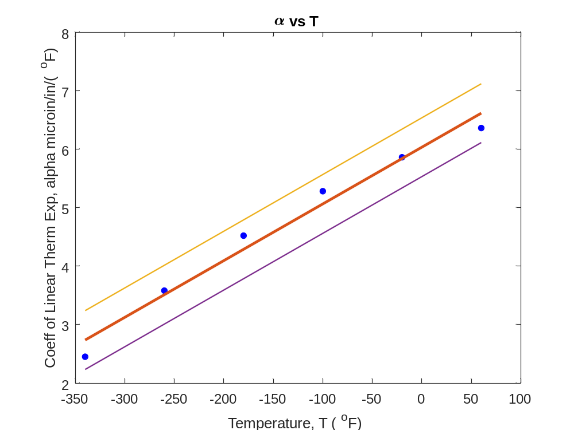

Standard Error of Estimate
$$α=(6.0325+2∗0.25141)+0.0096964T$$
$$α=6.0325+0.0096964T$$
$$α=(6.0325−2∗0.25141)+0.0096964T$$

Slide 19
Scaled Residuals
$$\text{Scaled} \text{Residual}=\frac{\text{Residual}}{\text{Standard} \text{Error} \text{of} \text{Estimate}}$$
$$\text{Scaled} \text{Residual}=\frac{α_{i}−a_{0}−a_{1}T_{i}}{s_{α/T}}$$
95% of the scaled residuals need to be in [-2,2]

Slide 20
Scaled Residuals
$$s_{α/T}=0.25141$$
T_{i} | α_{i} | Residual | Scaled Residual
-340 -260 -180 -100 -20 60 | 2.45 3.58 4.52 5.28 5.86 6.36 | -0.28571 0.068571 0.23286 0.21714 0.021429 -0.25429 | -1.1364 0.27275 0.92622 0.86369 0.085235 -1.0115

Slide 21
3. Is the coefficient of determination acceptable?

Slide 22

Notes:
Do not modify the notes in this section to avoid tampering with the Poll Everywhere activity.
More info at polleverywhere.com/support
LiveSlide
https://nm.mathforcollege.com/nmsims/06REG/06REG_adequacy_of_linear_regression/adequacy_en.html

Slide 23







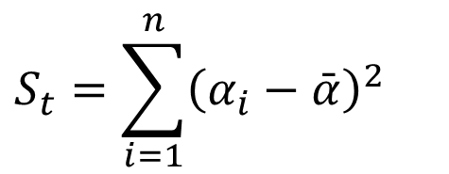

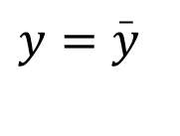
Sum of square of residuals between data and mean
$$S_{t}=\sum_{i=1}^{n}{{\left(α_{i}−\bar{α}\right)}^{2}}$$
$$(x_{n},y_{n})$$
y
$$\left(x_{i},y_{i}\right)$$
$$y−\overset{_}{y}$$
$$y=\overset{_}{y}$$
$$\left(x_{2},y_{2}\right)$$
$$\left(x_{3},y_{3}\right)$$
$$\left(x_{1},y_{1}\right)$$
x

Slide 24







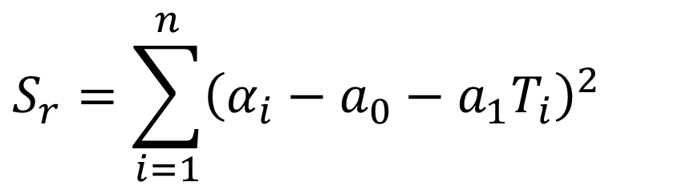

Sum of square of residuals between observed and predicted
$$S_{r}=\sum_{i=1}^{n}{{\left(α_{i}−a_{0}−a_{1}T_{i}\right)}^{2}}$$
$$(x_{n},y_{n})$$
y
$$\left(x_{i},y_{i}\right)$$
$$E_{i}=y_{i}−a_{0}−a_{1}x_{i}$$
$$\left(x_{2},y_{2}\right)$$
$$\left(x_{3},y_{3}\right)$$
$$\left(x_{1},y_{1}\right)$$
x

Slide 25
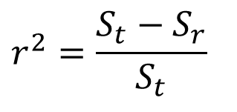
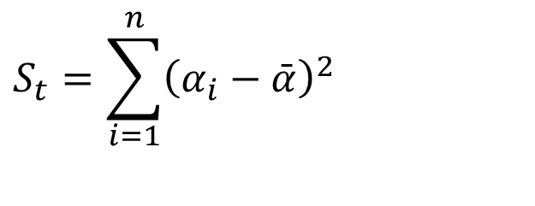
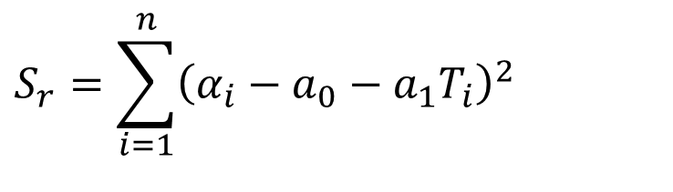
Coefficient of determination
$$S_{t}=\sum_{i=1}^{n}{{\left(α_{i}−\bar{α}\right)}^{2}}$$
$$S_{r}=\sum_{i=1}^{n}{{\left(α_{i}−a_{0}−a_{1}T_{i}\right)}^{2}}$$
$$r^{2}=\frac{S_{t}−S_{r}}{S_{t}}$$

Slide 26
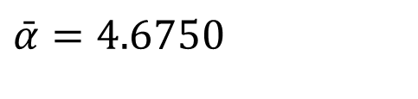
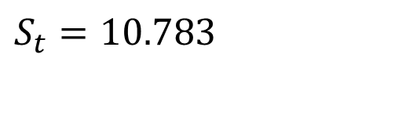
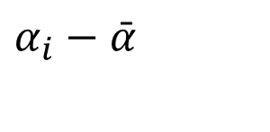
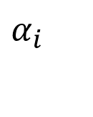

Calculation of S_{t}
-340 -260 -180 -100 -20 60 | 2.45 3.58 4.52 5.28 5.86 6.36 | -2.2250 -1.0950 -0.15500 0.60500 1.1850 1.6850
$$\bar{α}=4.6750$$
$$T_{i}$$
$$α_{i}$$
$$α_{i}−\bar{α}$$
$$S_{t}=10.783$$

Slide 27
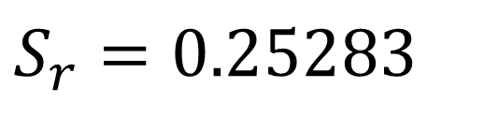
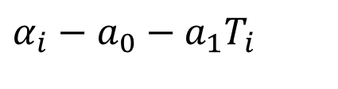
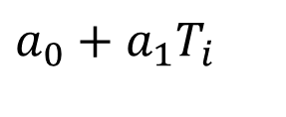
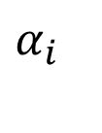


Calculation of S_{r}
$$α(T)=6.0325+0.0096964T$$
-340 -260 -180 -100 -20 60 | 2.45 3.58 4.52 5.28 5.86 6.36 | 2.7357 3.5114 4.2871 5.0629 5.8386 6.6143 | -0.28571 0.068571 0.23286 0.21714 0.021429 -0.25429
$$T_{i}$$
$$α_{i}$$
$$a_{0}+a_{1}T_{i}$$
$$α_{i}−a_{0}−a_{1}T_{i}$$
$$S_{r}=0.25283$$

Slide 28
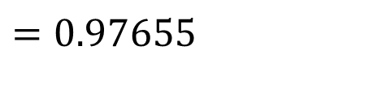
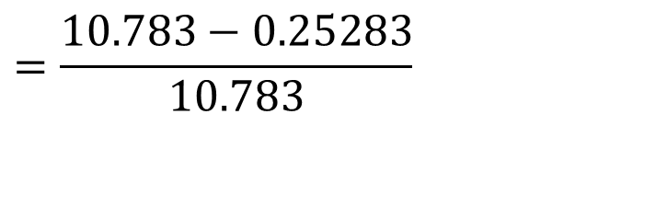
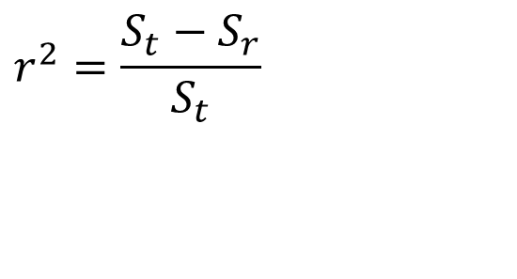
Coefficient of determination
$$r^{2}=\frac{S_{t}−S_{r}}{S_{t}}$$
$$=\frac{10.783−0.25283}{10.783}$$
$$=0.97655$$

Slide 29

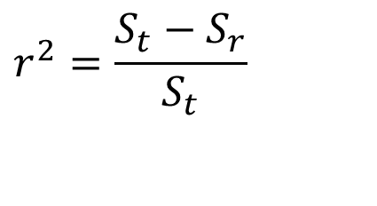
Limits of Coefficient of Determination
$$r^{2}=\frac{S_{t}−S_{r}}{S_{t}}$$
$$0≤r^{2}≤1$$

Slide 30
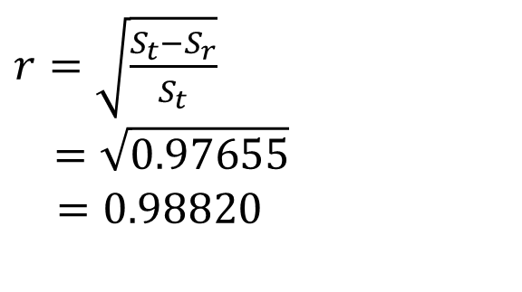
Correlation coefficient
$r=\sqrt{\frac{S_{t}−S_{r}}{S_{t}}}$
$$=\sqrt{0.97655}$$
$=0.98820$
How do you know if r is positive or negative ?

Slide 31
What does a particular value of |r| mean?
0.8 to 1.0 - Very strong relationship
0.6 to 0.8 - Strong relationship
0.4 to 0.6 - Moderate relationship
0.2 to 0.4 - Weak relationship
0.0 to 0.2 - Weak or no relationship

Slide 32
Four checks (with many data points)
Does the model look like it explains the data?
Do 95%of the residuals fall within ±2 of standard error of estimate?
Is the coefficient of determination acceptable?
Does the model meet the assumption of random errors?

Slide 33
Check 1: Does the model look like it explains the data?

Slide 34
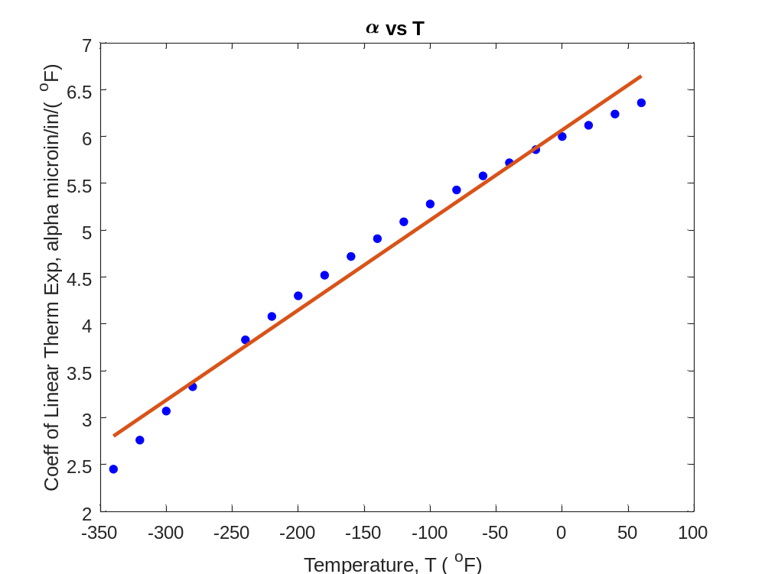

Check 1:Plot Model and Data
T | α
80 | 6.47
60 | 6.36
40 | 6.24
20 | 6.12
0 | 6.00
-20 | 5.86
-40 | 5.2
-60 | 5.58
-80 | 5.43
-100 | 5.28
-120 | 5.09
T | α
-140 | 4.91
-160 | 4.72
-180 | 4.52
-200 | 4.30
-220 | 4.08
-240 | 3.83
-260 | 3.58
-280 | 3.33
-300 | 3.07
-320 | 2.76
-340 | 2.45
$$α=6.0248+0.0093868T$$

Slide 35
Check 2. Do 95%of the residuals fall within ±2 standard error of estimate?

Slide 36
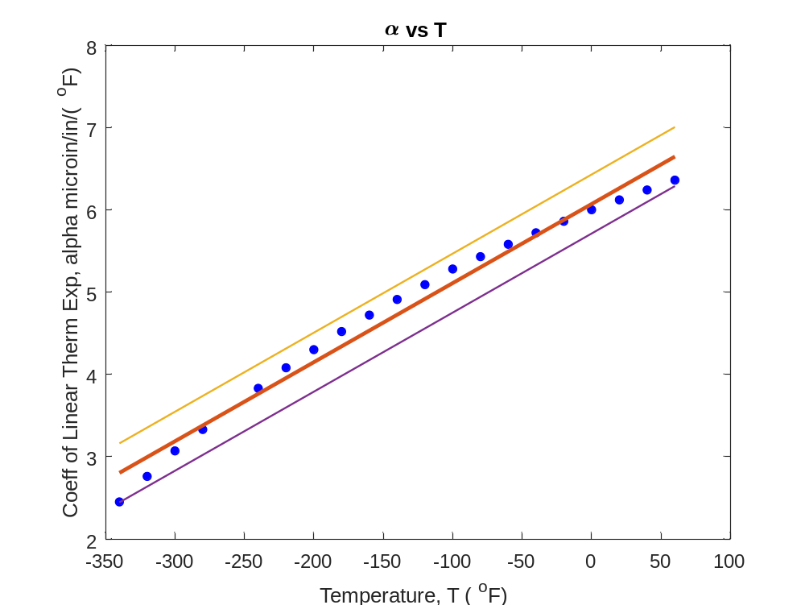

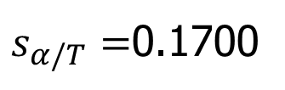
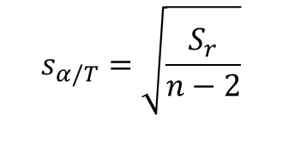
Check 2: Using Standard Error of Estimate
$$α=(6.0248+2∗0.1700)+0.0093868T$$
$$α=6.0248+0.0093868T$$
$$α=(6.0248−2∗0.1700)+0.0093868T$$
$$s_{α/T}=\sqrt{\frac{S_{r}}{n−2}}$$
$s_{α/T}=$0.1700

Slide 37
3. Is the coefficient of determination acceptable?

Slide 38
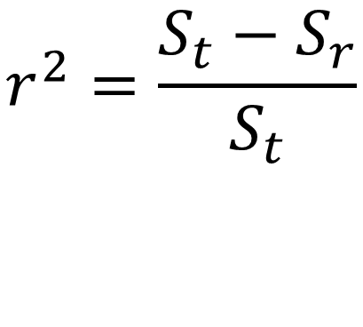
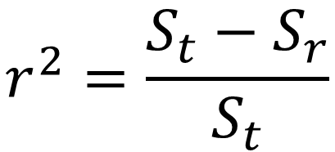
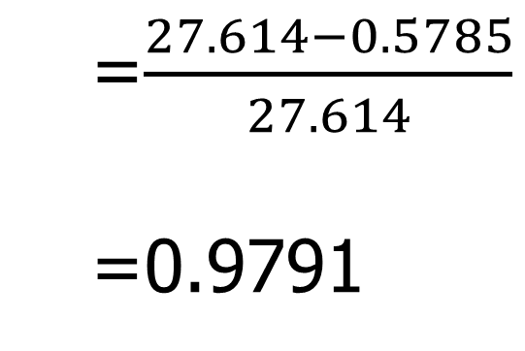
Check 3: Using Coefficient of Determination

Slide 39
Check 4. Does the model meet the assumption of random errors?

Slide 40
Therm exp coeff vs temperature
T | α
80 | 6.47
60 | 6.36
40 | 6.24
20 | 6.12
0 | 6.00
-20 | 5.86
-40 | 5.2
-60 | 5.58
-80 | 5.43
-100 | 5.28
-120 | 5.09
T | α
-140 | 4.91
-160 | 4.72
-180 | 4.52
-200 | 4.30
-220 | 4.08
-240 | 3.83
-260 | 3.58
-280 | 3.33
-300 | 3.07
-320 | 2.76
-340 | 2.45
$T$ is in $oF$
$α$ is in $μin/in/oF$

Slide 41
Model meets assumption of random errors
Residuals are negative as well as positive
Variation of residuals as a function of the independent variable is random
Residuals follow a normal distribution
There is no autocorrelation between the data points.

Slide 42
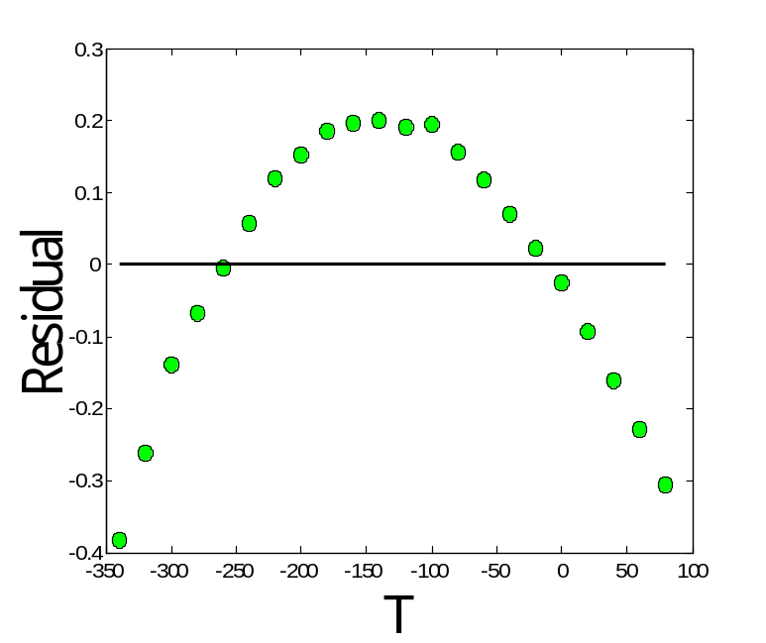
Are residuals negative and positive?

Slide 43
Is variation of residuals as a function of independent variable random?

Slide 44
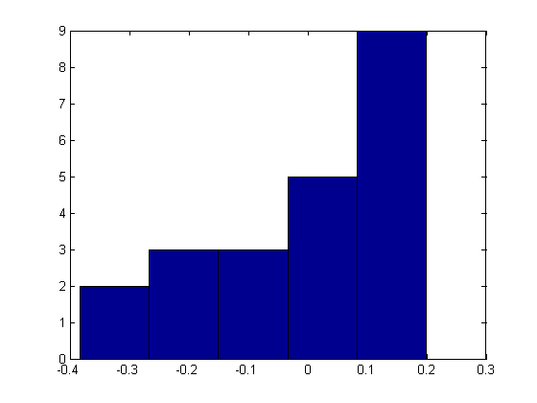
Do the residuals follow normal distribution?

Slide 45
06.XX
Parting Thoughts

Slide 46
Final Exam Grade

Slide 47

Final Exam Grade vs Pre-Req GPA

Slide 48
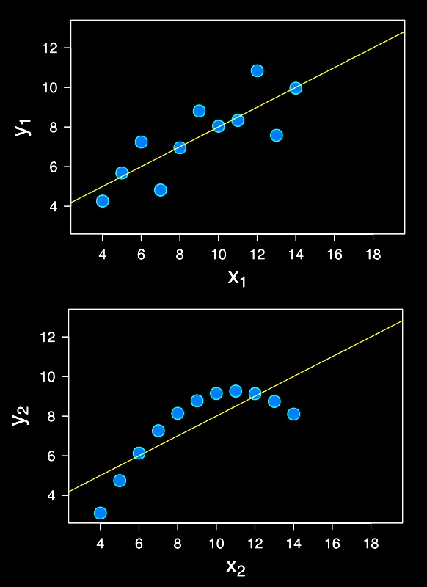
Same but different
The following are the same for both lines.
Mean of x
Sample variance of x
Mean of y
Sample variance of y
Correlation between x and y
Linear regression line
Coefficient of determination of the linear regression
Source: Cliff Pickover: https://twitter.com/pickover/status/1576630790309707776/photo/1

Slide 49
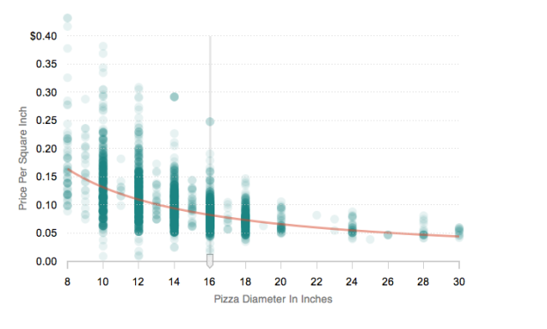
Pizza price vs Pizza Diameter
Sources: https://www.npr.org/sections/money/2014/02/26/282132576/74-476-reasons-you-should-always-get-the-bigger-pizza
https://www.themarysue.com/mpr-pizza-graph/

Slide 50
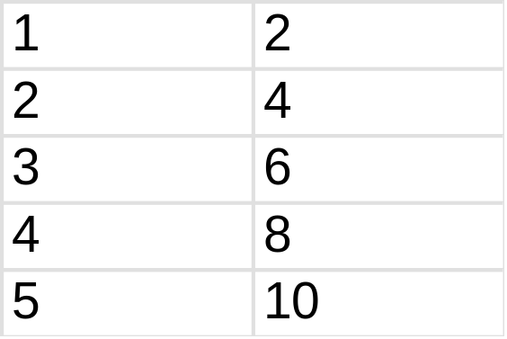
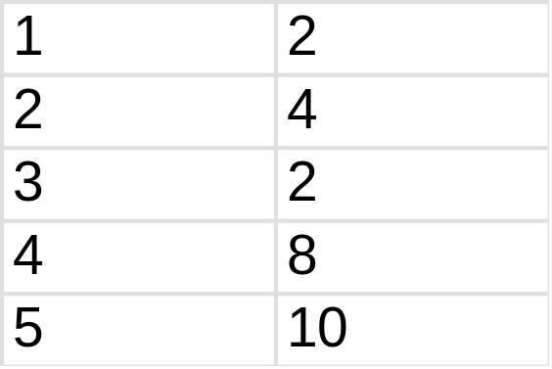
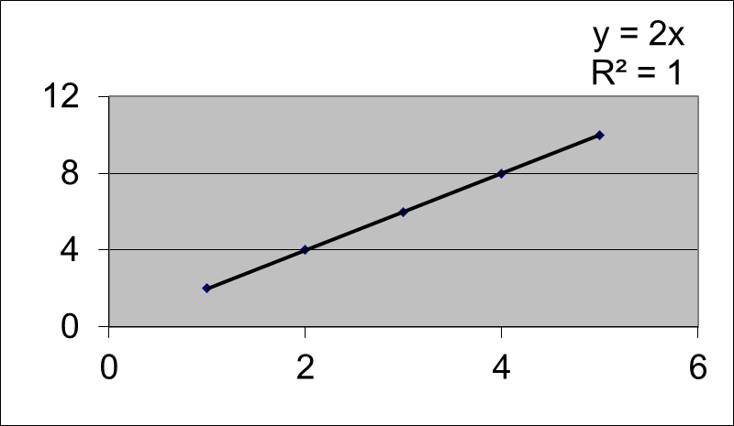
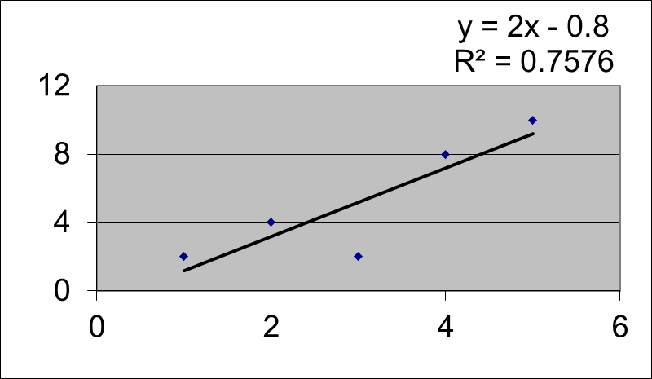
Effect of Outlier

Slide 51
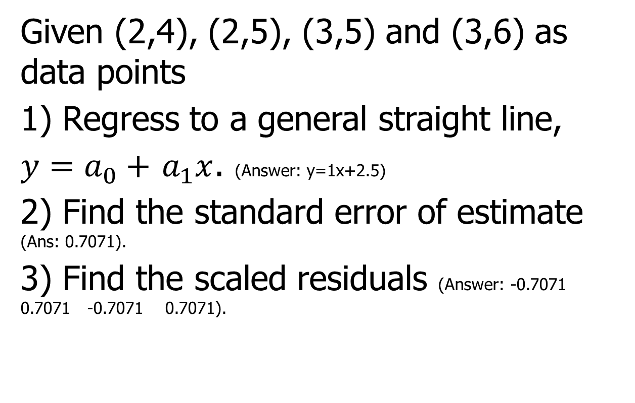
Problem Assigned
Given (2,4), (2,5), (3,5) and (3,6) as data points
1) Regress to a general straight line,
$y=a_{0}+$ $a_{1}x$. (Answer: y=1x+2.5)
2) Find the standard error of estimate (Ans: 0.7071).
3) Find the scaled residuals (Answer: -0.7071 0.7071 -0.7071 0.7071).

Slide 52
Problem Assigned
Given (2,4), (2,5), (3,5) and (3,6) as data points (extension of previous problem)
1) Find the sum of the square of the differences with the mean (Ans: 2).
2) Find the sum of the square of the residuals. (Ans: 1)
3) Find the coefficient of determination (Ans: 0.5).
4) Find the correlation coefficient (Ans: 0.7071).

Slide 53
END

