Slide 1
Regression
Reading While Skimming the Lines

Slide 2
Test 1 score vs attendance

Slide 3


Slide 4
6.04
Nonlinear Regression

Slide 5
Nonlinear Regression Without Transformation of Data (Untransformed Data)
5

Slide 6

Notes:
Poll Title: Do not modify the notes in this section to avoid tampering with the Poll Everywhere activity.
More info at polleverywhere.com/support
Who is this artist?
https://www.polleverywhere.com/multiple_choice_polls/cHcAgyXAhIaoYa09bH6Ky?state=opened&flow=Default&onscreen=persist

Slide 7
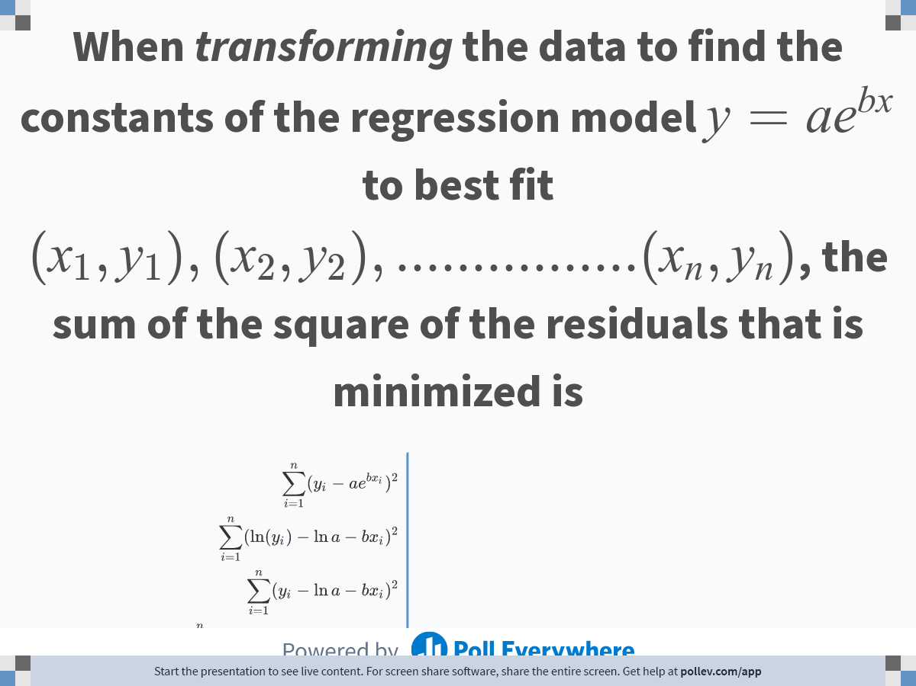
Notes:
Poll Title: Do not modify the notes in this section to avoid tampering with the Poll Everywhere activity.
More info at polleverywhere.com/support
When transforming the data to find the constants of the regression model $$y=ae^{bx}$$ to best fit $$(x_1,y_1),(x_2,y_2),................(x_n,y_n)$$, the sum of the square of the residuals that is minimized is
https://www.polleverywhere.com/multiple_choice_polls/WyT4ltd6kg29KTrQtJjC4

Slide 8
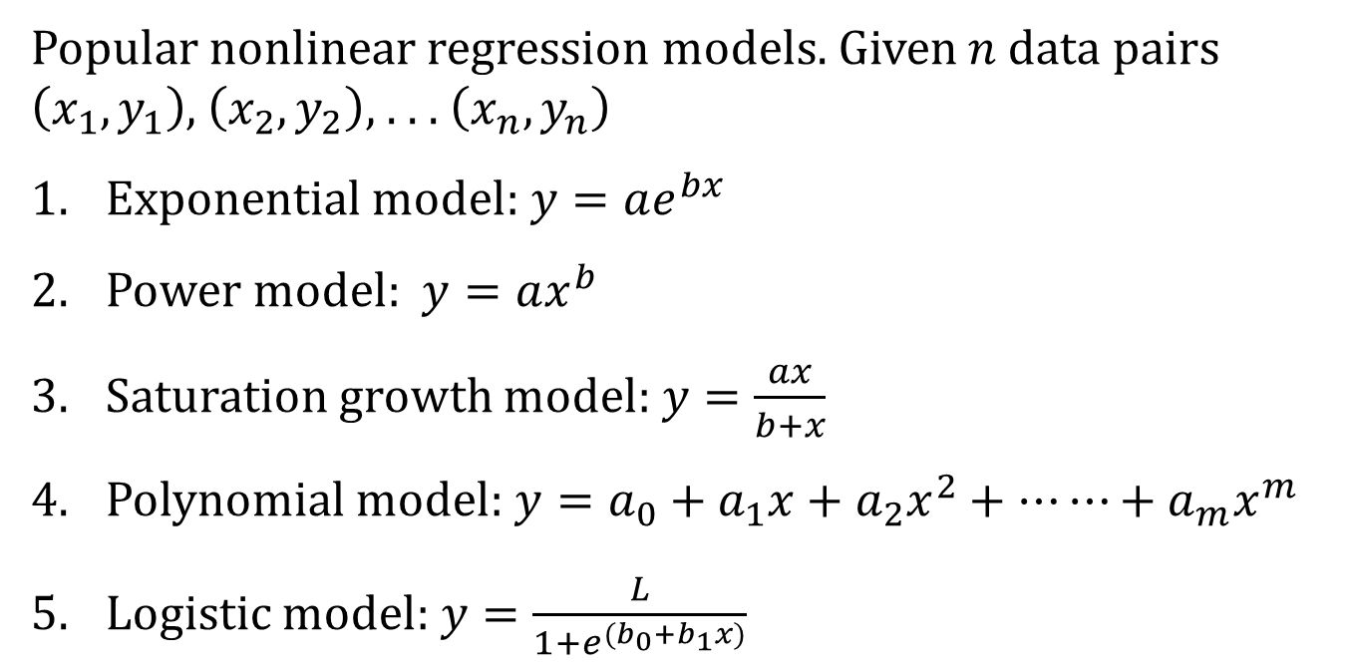
Nonlinear Regression
Popular nonlinear regression models. Given $n$data pairs $\left(x_{1},y_{1}\right)$, $\left(x_{2},y_{2}\right)$, . . . $\left(x_{n},y_{n}\right)$
Exponential model: $y=ae^{bx}$
Power model: $y=ax^{b}$
Saturation growth model: $y=\frac{ax}{b+x}$
Polynomial model:$y=a_{0}+a_{1}x+a_{2}x^{2}+⋯⋯+a_{m}x^{m}$
Logistic model:$y=\frac{L}{1+e^{(b_{0}+b_{1}x)}}$

Slide 9




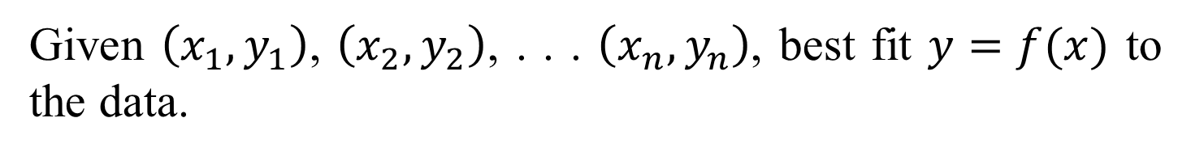


Nonlinear Regression
Given $\left(x_{1},y_{1}\right)$, $\left(x_{2},y_{2}\right)$, . . . $\left(x_{n},y_{n}\right)$, best fit $y=f(x)$ to the data.
$$(x_{n},y_{n})$$
$$(x_{2},y_{2})$$
$$y=f(x)$$
$$(x_{i},y_{i})$$
$$y_{i}−f(x_{i})$$
$$(x_{1},y_{1})$$
Figure. Nonlinear regression model for discrete y vs. x data

Slide 10




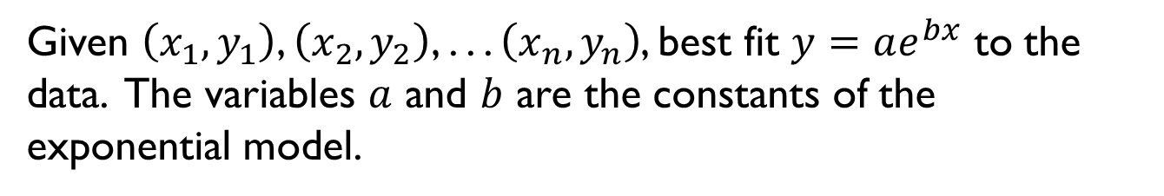

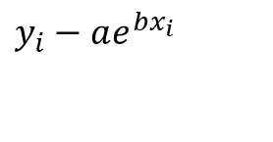
Exponential Model
Given $\left(x_{1},y_{1}\right)$, $\left(x_{2},y_{2}\right)$, . . . $\left(x_{n},y_{n}\right)$, best fit $y=ae^{bx}$ to the data. The variables $a$ and $b$ are the constants of the exponential model.
$$(x_{1},y_{1})$$
$$y=ae^{bx}$$
$$y_{i}−ae^{bx_{i}}$$
$$(x_{i},y_{i})$$
$$(x_{2},y_{2})$$
$$(x_{n},y_{n})$$
Figure. Exponential model of nonlinear regression for y vs. x data

Slide 11
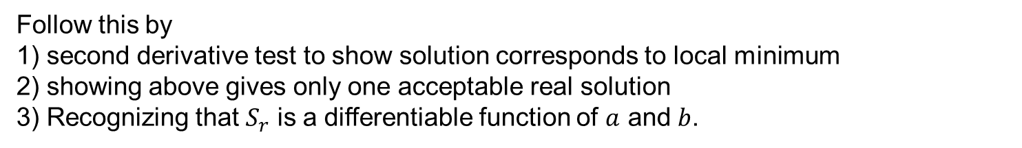
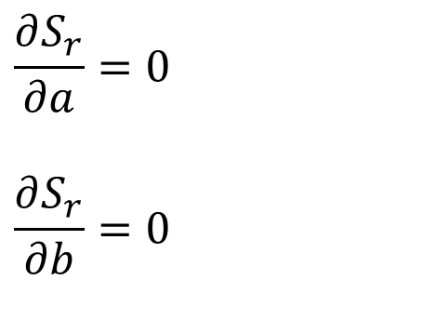
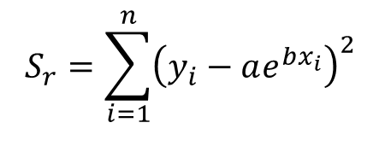
Finding Constants of Exponential Model
$$S_{r}=\sum_{i=1}^{n}{{\left(y_{i}−ae^{bx_{i}}\right)}^{2}}$$
$$\frac{∂S_{r}}{∂a}=0$$
$$\frac{∂S_{r}}{∂b}=0$$
Follow this by
1) second derivative test to show solution corresponds to local minimum
2) showing above gives only one acceptable real solution
3) Recognizing that $S_{r}$ is a differentiable function of $a$ and $b$.

Slide 12
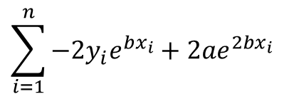
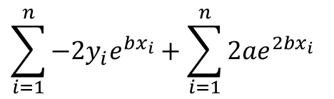
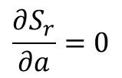
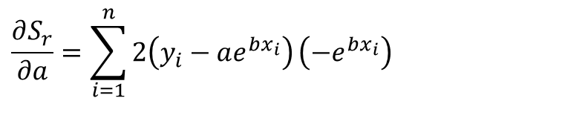
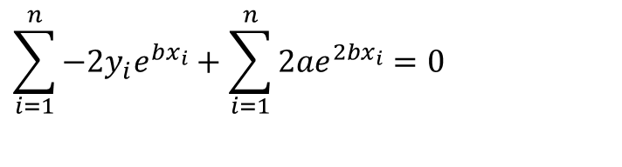

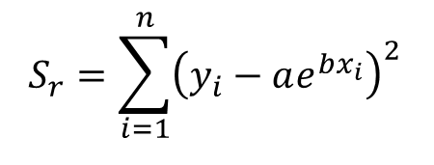

Finding Constants of Exponential Model
$$S_{r}=\sum_{i=1}^{n}{{\left(y_{i}−ae^{bx_{i}}\right)}^{2}}$$
Differentiate with respect to $a$
$$\frac{∂S_{r}}{∂a}=\sum_{i=1}^{n}{2\left(y_{i}−ae^{bx_{i}}\right)}\left(−e^{bx_{i}}\right)$$
$$\sum_{i=1}^{n}{−{2y}_{i}e^{bx_{i}}}+{2ae}^{2bx_{i}}$$
$$=$$
$$\sum_{i=1}^{n}{−{2y}_{i}e^{bx_{i}}}+\sum_{i=1}^{n}{{2ae}^{2bx_{i}}}$$
$$=$$
$$\frac{∂S_{r}}{∂a}=0$$
$$\sum_{i=1}^{n}{−{2y}_{i}e^{bx_{i}}}+\sum_{i=1}^{n}{{2ae}^{2bx_{i}}}=0$$
Equation 1

Slide 13

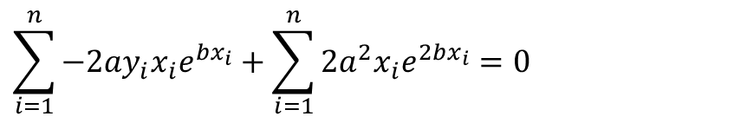
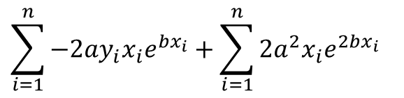
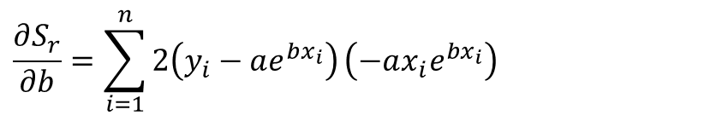
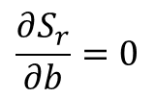

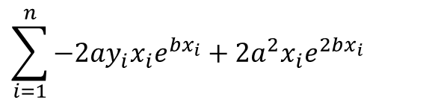
Finding Constants of Exponential Model
$$S_{r}=\sum_{i=1}^{n}{{\left(y_{i}−ae^{bx_{i}}\right)}^{2}}$$
Differentiate with respect to $b$
$$\frac{∂S_{r}}{∂b}=\sum_{i=1}^{n}{2\left(y_{i}−ae^{bx_{i}}\right)}\left(−ax_{i}e^{bx_{i}}\right)$$
$$\sum_{i=1}^{n}{{−2ay}_{i}x_{i}e^{bx_{i}}}+{2a^{2}x}_{i}e^{2bx_{i}}$$
$$=$$
$$\sum_{i=1}^{n}{{−2ay}_{i}x_{i}e^{bx_{i}}}+\sum_{i=1}^{n}{{2a^{2}x}_{i}e^{2bx_{i}}}$$
$$=$$
$$\frac{∂S_{r}}{∂b}=0$$
$$\sum_{i=1}^{n}{{−2ay}_{i}x_{i}e^{bx_{i}}}+\sum_{i=1}^{n}{{2a^{2}x}_{i}e^{2bx_{i}}}=0$$
Equation 2

Slide 14
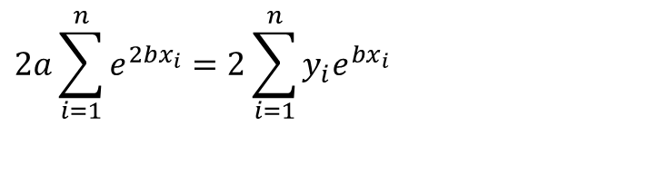
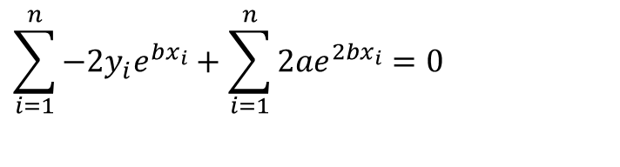
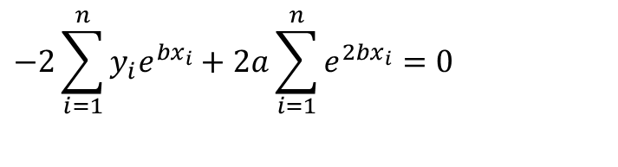
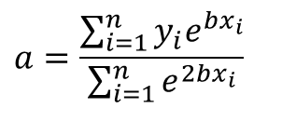
Finding Constants of Exponential Model
$$\sum_{i=1}^{n}{−{2y}_{i}e^{bx_{i}}}+\sum_{i=1}^{n}{{2ae}^{2bx_{i}}}=0$$
Equation 1
$$−2\sum_{i=1}^{n}{y_{i}e^{bx_{i}}}+2a\sum_{i=1}^{n}{e^{2bx_{i}}}=0$$
$$2a\sum_{i=1}^{n}{e^{2bx_{i}}}=2\sum_{i=1}^{n}{y_{i}e^{bx_{i}}}$$
$$a=\frac{\sum_{i=1}^{n}{y_{i}e^{bx_{i}}}}{\sum_{i=1}^{n}{e^{2bx_{i}}}}$$

Slide 15
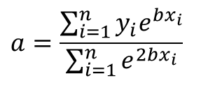
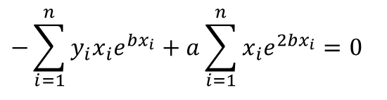
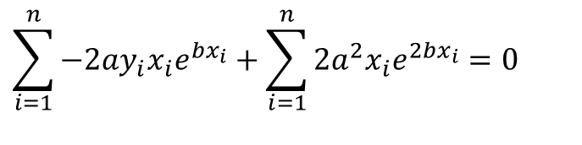
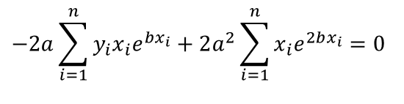
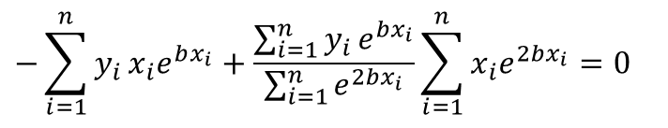
Finding Constants of Exponential Model
$$a=\frac{\sum_{i=1}^{n}{y_{i}e^{bx_{i}}}}{\sum_{i=1}^{n}{e^{2bx_{i}}}}$$
$$\sum_{i=1}^{n}{{−2ay}_{i}x_{i}e^{bx_{i}}}+\sum_{i=1}^{n}{{2a^{2}x}_{i}e^{2bx_{i}}}=0$$
Equation 2
$$−2a\sum_{i=1}^{n}{y_{i}x_{i}e^{bx_{i}}}+2a^{2}\sum_{i=1}^{n}{x_{i}e^{2bx_{i}}}=0$$
$$−\sum_{i=1}^{n}{y_{i}x_{i}e^{bx_{i}}}+a\sum_{i=1}^{n}{x_{i}e^{2bx_{i}}}=0$$
$$−\sum_{i=1}^{n}{y_{i}}x_{i}e^{bx_{i}}+\frac{\sum_{i=1}^{n}{y_{i}}e^{bx_{i}}}{\sum_{i=1}^{n}{e^{2bx_{i}}}}\sum_{i=1}^{n}{x_{i}e^{2bx_{i}}}=0$$

Slide 16
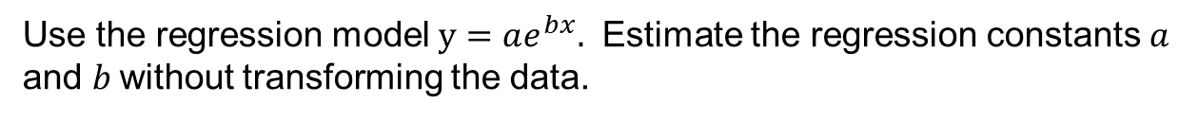
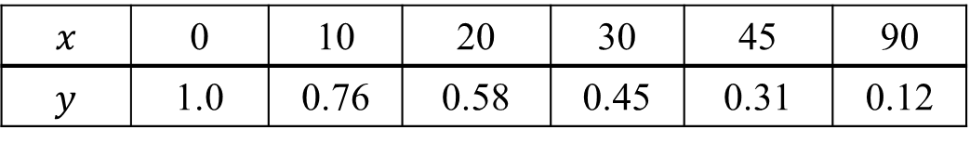
Example - Exponential Model
$$x$$ | 0 | 10 | 20 | 30 | 45 | 90
$$y$$ | 1.0 | 0.76 | 0.58 | 0.45 | 0.31 | 0.12
Use the regression model $y=ae^{bx}.$ Estimate the regression constants $a$ and $b$without transforming the data.

Slide 17
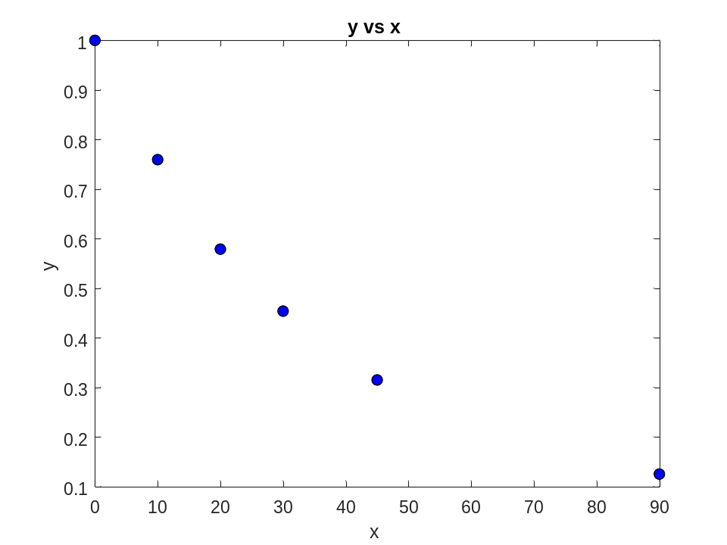
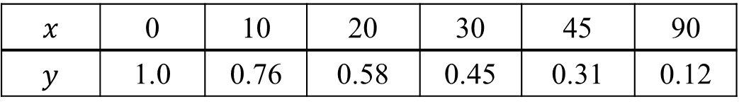
Plot of data
$$x$$ | 0 | 10 | 20 | 30 | 45 | 90
$$y$$ | 1.0 | 0.76 | 0.58 | 0.45 | 0.31 | 0.12

Slide 18

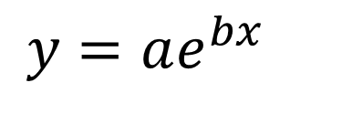
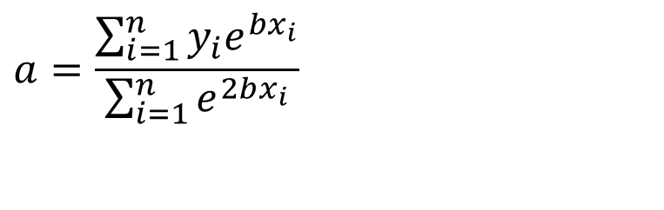
Constants of the Model
$$y=ae^{bx}$$
The value of $b$ is found by solving the nonlinear equation
$$f(b)=$$
$$a=\frac{\sum_{i=1}^{n}{y_{i}e^{bx_{i}}}}{\sum_{i=1}^{n}{e^{2bx_{i}}}}$$

Slide 19
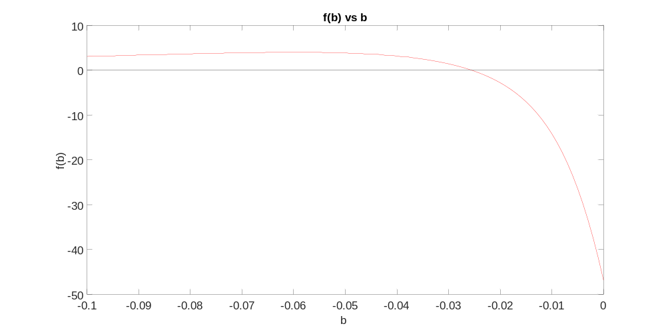
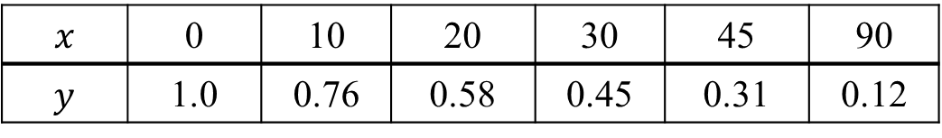

Setting up the Equation in MATLAB
$$f(b)=$$
$$x$$ | 0 | 10 | 20 | 30 | 45 | 90
$$y$$ | 1.0 | 0.76 | 0.58 | 0.45 | 0.31 | 0.12

Slide 20

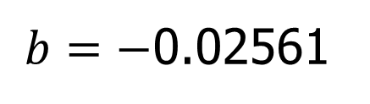
Setting up the Equation in MATLAB
$$f(b)=$$
x=[0 10 20 30 45 90]
y=[1.0 0.76 0.58 0.45 0.31 0.12]
syms b real
sum1=sum(y.*x.*exp(b*x));
sum2=sum(y.*exp(b*x));
sum3=sum(exp(2*b*x));
sum4=sum(x.*exp(2*b*x));
f=-sum1+sum2/sum3*sum4;
b_soln=vpasolve(f,b);
$b=−$0.02561

Slide 21
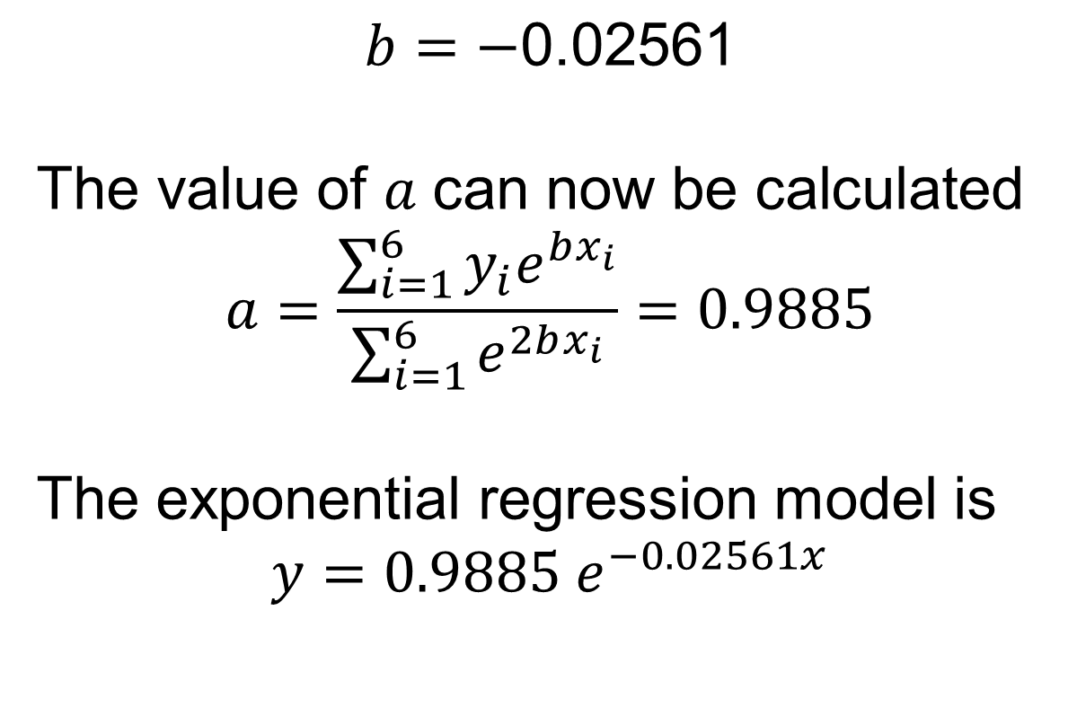
Calculating the Other Constant
$$b=−\text{0.02561}$$
$$\text{The} \text{value} \text{of} a \text{can} \text{now} \text{be} \text{calculated}$$
$$a=\frac{\sum_{i=1}^{6}{y_{i}e^{bx_{i}}}}{\sum_{i=1}^{6}{e^{2bx_{i}}}}=0.9885$$
The exponential regression model is
$$y=0.9885 e^{−0.02561x}$$

Slide 22
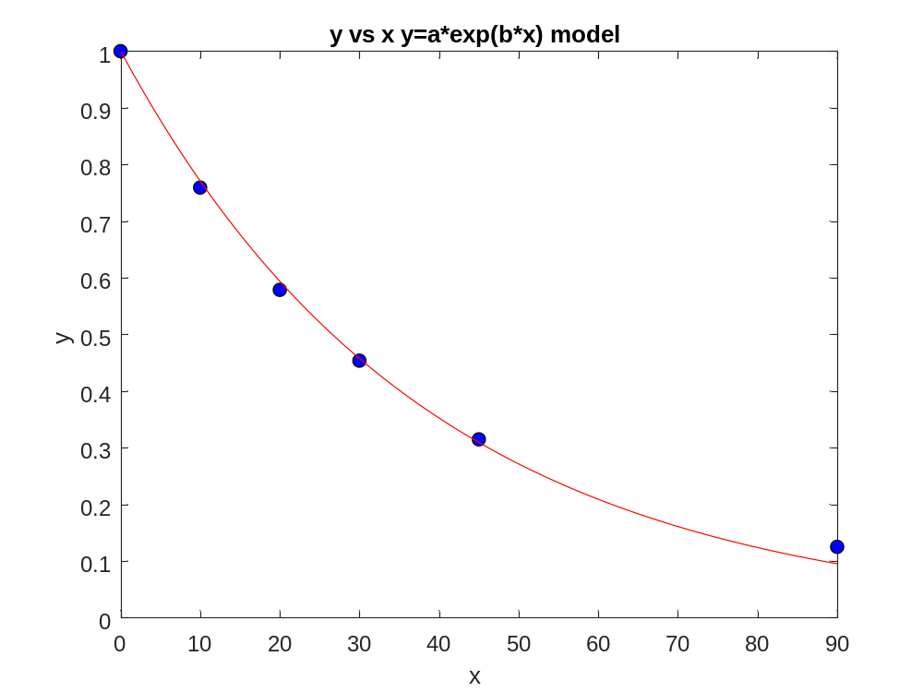
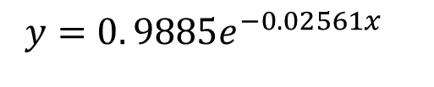
Plot of data and regression curve
$$y=0. 9885e^{−0.02561x}$$

Slide 23
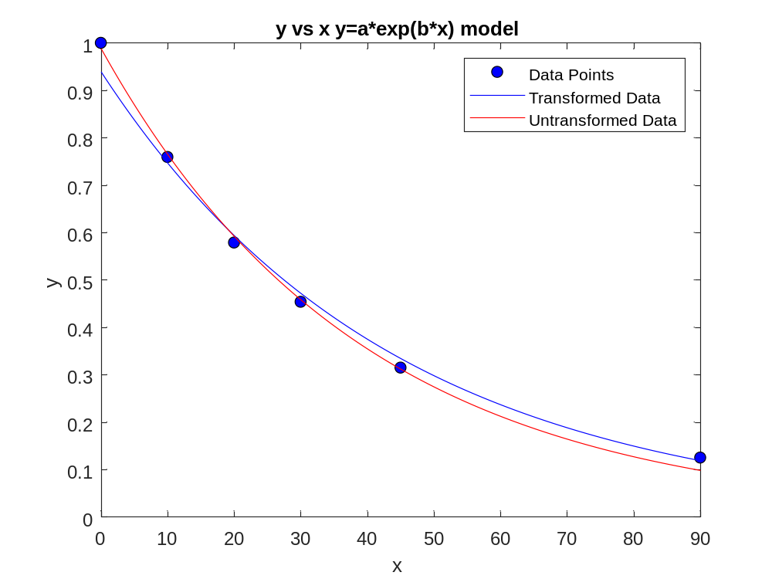
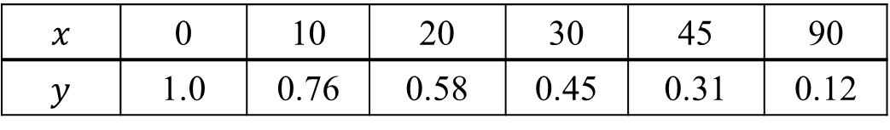
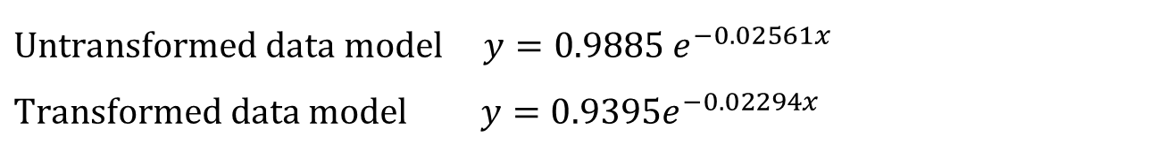
Transformed vs Untransformed Data
$$x$$ | 0 | 10 | 20 | 30 | 45 | 90
$$y$$ | 1.0 | 0.76 | 0.58 | 0.45 | 0.31 | 0.12
$$\text{Unt}\text{ransform}\text{ed} data model y=0.9885 e^{−0.02561x}$$
$$\text{Transform}\text{ed} data model y=0.9395e^{−0.02294x}$$

Slide 24
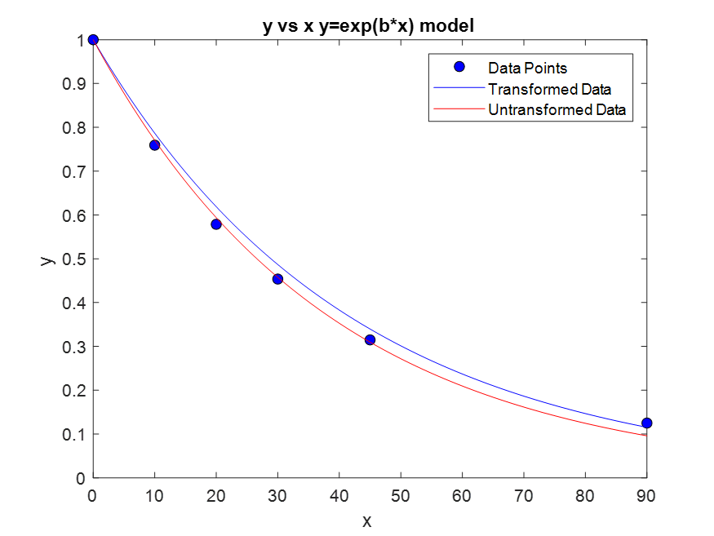
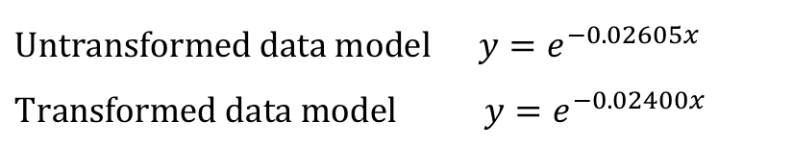
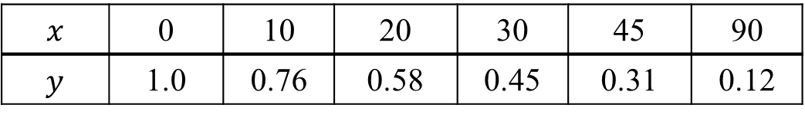
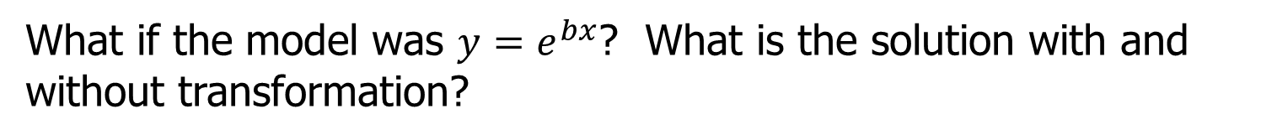
Classwork/Homework: Transformed vs Untransformed Data
$$x$$ | 0 | 10 | 20 | 30 | 45 | 90
$$y$$ | 1.0 | 0.76 | 0.58 | 0.45 | 0.31 | 0.12
What if the model was $y=e^{bx}$? What is the solution with and without transformation?
$$\text{Unt}\text{ransform}\text{ed} data model y=e^{−0.02605x}$$
$$\text{T}\text{ransform}\text{ed} \text{data} \text{model} y=e^{−0.02400x}$$

Slide 25
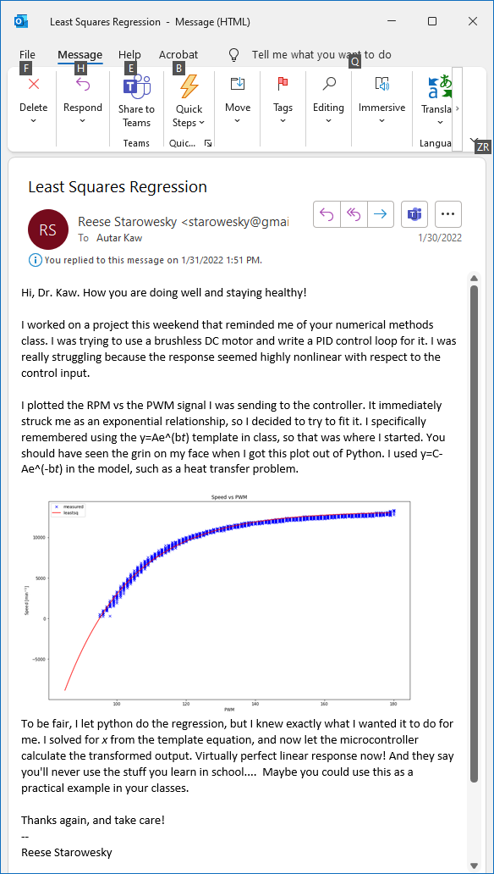
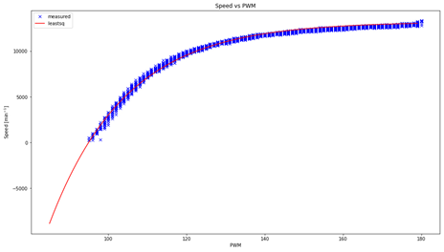

Slide 26
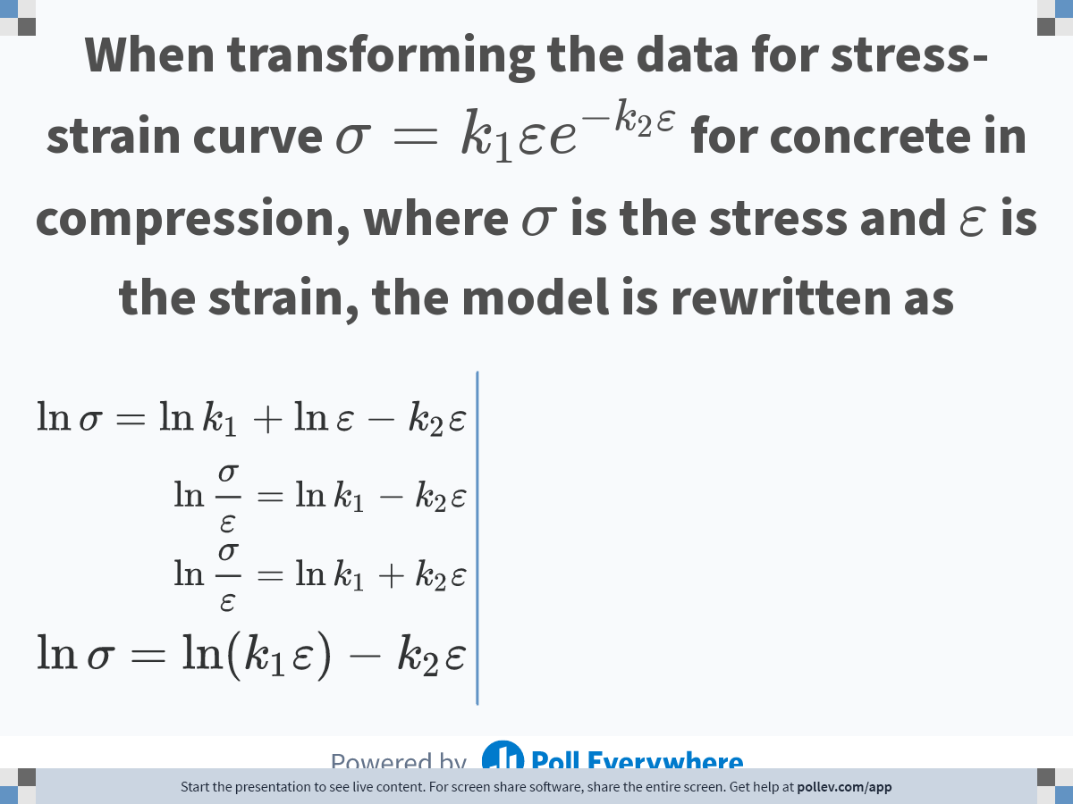
Notes:
Poll Title: Do not modify the notes in this section to avoid tampering with the Poll Everywhere activity.
More info at polleverywhere.com/support
When transforming the data for stress-strain curve $$\\sigma = k_1 \\varepsilon e^{-k_2 \\varepsilon}$$ for concrete in compression, where $$\\sigma$$ is the stress and $$\\varepsilon$$ is the strain, the model is rewritten as
https://www.polleverywhere.com/multiple_choice_polls/5fePUyebYZGd9JEqw7acP

Slide 27

Notes:
Poll Title: Do not modify the notes in this section to avoid tampering with the Poll Everywhere activity.
More info at polleverywhere.com/support
Without transforming the data to find the constants of the regression model $$y=ae^{bx}$$ to best fit $$(x_1,y_1),(x_2,y_2),................(x_n,y_n)$$, the sum of the square of the residuals that is minimized is
https://www.polleverywhere.com/multiple_choice_polls/ONkZoStGFTq97As5QDjF5

Slide 28
What polynomial model to choose if one needs to be chosen?

Slide 29



Which model to choose?
$$α=0.009387T+6.025$$
$$α=−0.000012{28T}^{2}+0.006196T+6.015$$

Slide 30


Optimum Polynomial: Wrong Criterion
Both graphs are same
Left one starts at m=1
Right one starts at m=2

Slide 31


Optimum Polynomial: Correct Criterion
Both graphs are same
Left one starts at m=1
Right one starts at m=2

Slide 32
6.05
Adequacy of Linear Regression Models

Slide 33

Data

Slide 34

Therm exp coeff vs temperature
T | α
80 | 6.47
60 | 6.36
40 | 6.24
20 | 6.12
0 | 6.00
-20 | 5.86
-40 | 5.2
-60 | 5.58
-80 | 5.43
-100 | 5.28
-120 | 5.09
T | α
-140 | 4.91
-160 | 4.72
-180 | 4.52
-200 | 4.30
-220 | 4.08
-240 | 3.83
-260 | 3.58
-280 | 3.33
-300 | 3.07
-320 | 2.76
-340 | 2.45
$T$ is in $oF$
$α$ is in $μin/in/ oF$

Slide 35
Is this adequate?
Straight Line Model

Slide 36
Quality of Fitted Data
Does the model describe the data adequately?
How well does the model predict the response variable predictably?

Slide 37
Linear Regression Models
Limit our discussion to adequacy of straight-line regression models

Slide 38
Four checks
Does the model look like it explains the data?
Do 95%of the residuals fall with ±2 standard error of estimate?
Is the coefficient of determination acceptable?
Does the model meet the assumption of random errors?

Slide 39


Check 1:Plot Model and Data
T | α
80 | 6.47
60 | 6.36
40 | 6.24
20 | 6.12
0 | 6.00
-20 | 5.86
-40 | 5.2
-60 | 5.58
-80 | 5.43
-100 | 5.28
-120 | 5.09
T | α
-140 | 4.91
-160 | 4.72
-180 | 4.52
-200 | 4.30
-220 | 4.08
-240 | 3.83
-260 | 3.58
-280 | 3.33
-300 | 3.07
-320 | 2.76
-340 | 2.45
$$α=6.0248+0.0093868T$$

Slide 40




Check 2: Using Standard Error of Estimate
$$α=(6.0248+2∗0.1700)+0.0093868T$$
$$α=6.0248+0.0093868T$$
$$α=(6.0248−2∗0.1700)+0.0093868T$$
$$s_{α/T}=\sqrt{\frac{S_{r}}{n−2}}$$
$s_{α/T}=$0.1700

Slide 41

Problem Assigned
Given (2,4), (2,5), (3,5) and (3,6) as data points
1) Regress to a general straight line,
$y=a_{0}+$ $a_{1}x$. (Answer: y=1x+2.5)
2) Find the standard error of estimate (Ans: 0.7071).
3) Find the scaled residuals (Answer: -0.7071 0.7071 -0.7071 0.7071).

Slide 42



Check 3: Using Coefficient of Determination

Slide 43
Problem Assigned
Given (2,4), (2,5), (3,5) and (3,6) as data points (extension of previous problem)
1) Find the sum of the square of the differences with the mean (Ans: 2).
2) Find the sum of the square of the residuals. (Ans: 1)
3) Find the coefficient of determination (Ans: 0.5).
4) Find the correlation coefficient (Ans: 0.7071).

Slide 44
Check 4. Does the model meet assumption of random errors?

Slide 45
Model meets assumption of random errors
Residuals are negative as well as positive
Variation of residuals as a function of the independent variable is random
Residuals follow a normal distribution
There is no autocorrelation between the data points.

Slide 46

Are residuals negative and positive?

Slide 47
Is variation of residuals as a function of independent variable random?

Slide 48

Do the residuals follow normal distribution?

Slide 49
06.XX
Parting Thoughts

Slide 50
Final Exam Grade

Slide 51

Final Exam Grade vs Pre-Req GPA

Slide 52

Same but different
The following are same for both lines.
Mean of x
Sample variance of x
Mean of y
Sample variance of y
Correlation between x and y
Linear regression line
Coefficient of determination of the linear regression
Source: Cliff Pickover: https://twitter.com/pickover/status/1576630790309707776/photo/1

Slide 53

Pizza price vs Pizza Diameter
Sources: https://www.npr.org/sections/money/2014/02/26/282132576/74-476-reasons-you-should-always-get-the-bigger-pizza
https://www.themarysue.com/mpr-pizza-graph/

Slide 54




Effect of Outlier

Slide 55
END

