Slide 1

Source: Kent Wetzel: https://twitter.com/KentWetzelFCPS/status/1510586212238737415/photo/1

Slide 2
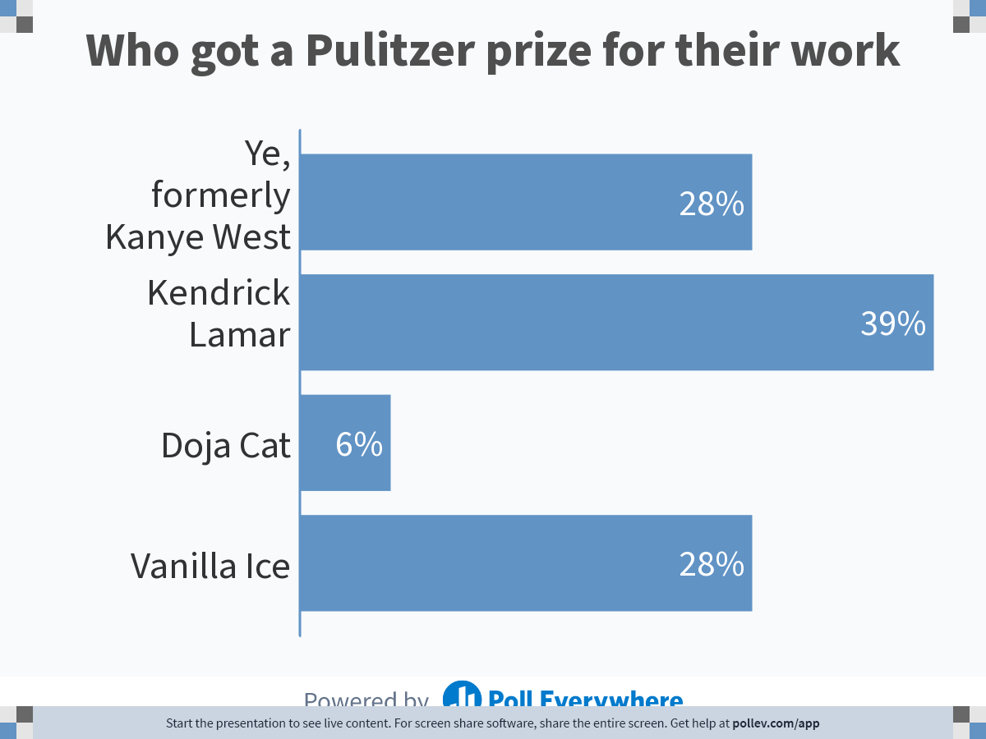
Notes:
Poll Title: Do not modify the notes in this section to avoid tampering with the Poll Everywhere activity.
More info at polleverywhere.com/support
Who got a Pulitzer for their work
https://www.polleverywhere.com/multiple_choice_polls/iCZCqVvjKUhoZCSiEcjiu?state=opened&flow=Default&onscreen=persist

Slide 3
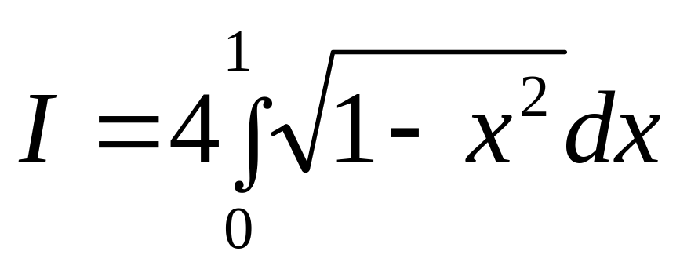
Integration
As difficult a problem as thou
finding quadrature of a circle

Slide 4
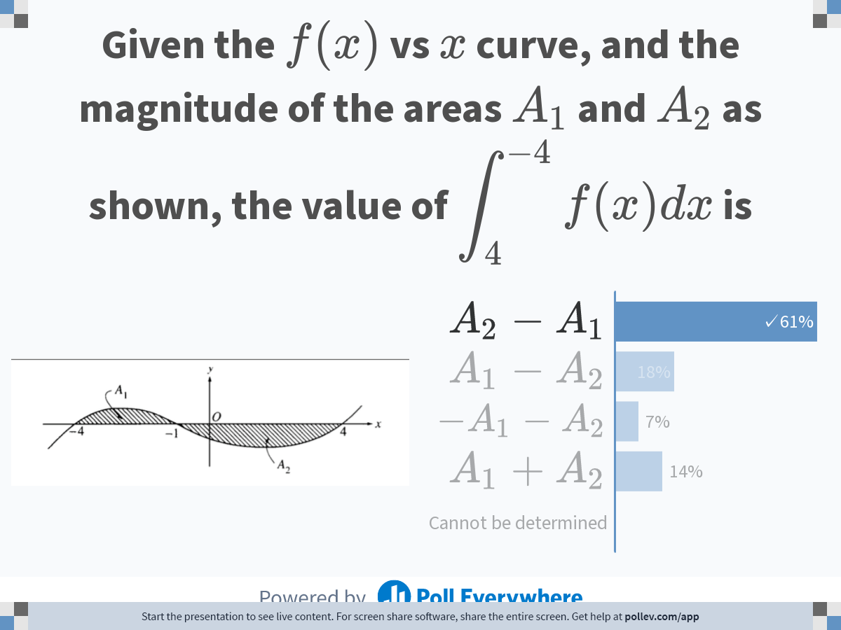
Notes:
Poll Title: Do not modify the notes in this section to avoid tampering with the Poll Everywhere activity.
More info at polleverywhere.com/support
Given the $$f(x)$$ vs $$x$$ curve, and the magnitude of the areas $$A_1$$ and $$A_2$$ as shown, the value of $$\\displaystyle \\int_{4}^{-4}{f(x)dx}$$ is
https://www.polleverywhere.com/multiple_choice_polls/riBEdZ3Tdw0RqZUMhT8Uy?state=opened&flow=Default&onscreen=persist

Slide 5
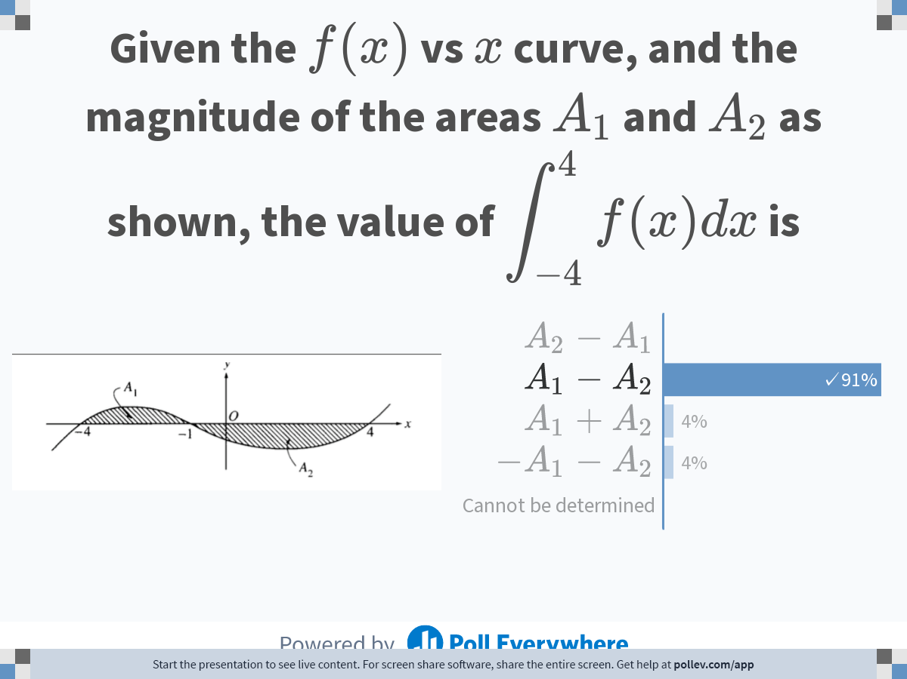
Notes:
Poll Title: Do not modify the notes in this section to avoid tampering with the Poll Everywhere activity.
More info at polleverywhere.com/support
Given the $$f(x)$$ vs $$x$$ curve, and the magnitude of the areas as shown, the value of $$\\displaystyle \\int_{-4}^{4}{f(x)dx}$$ is
https://www.polleverywhere.com/multiple_choice_polls/7Cdqwhcu6DNwSGPSCAjgu

Slide 6
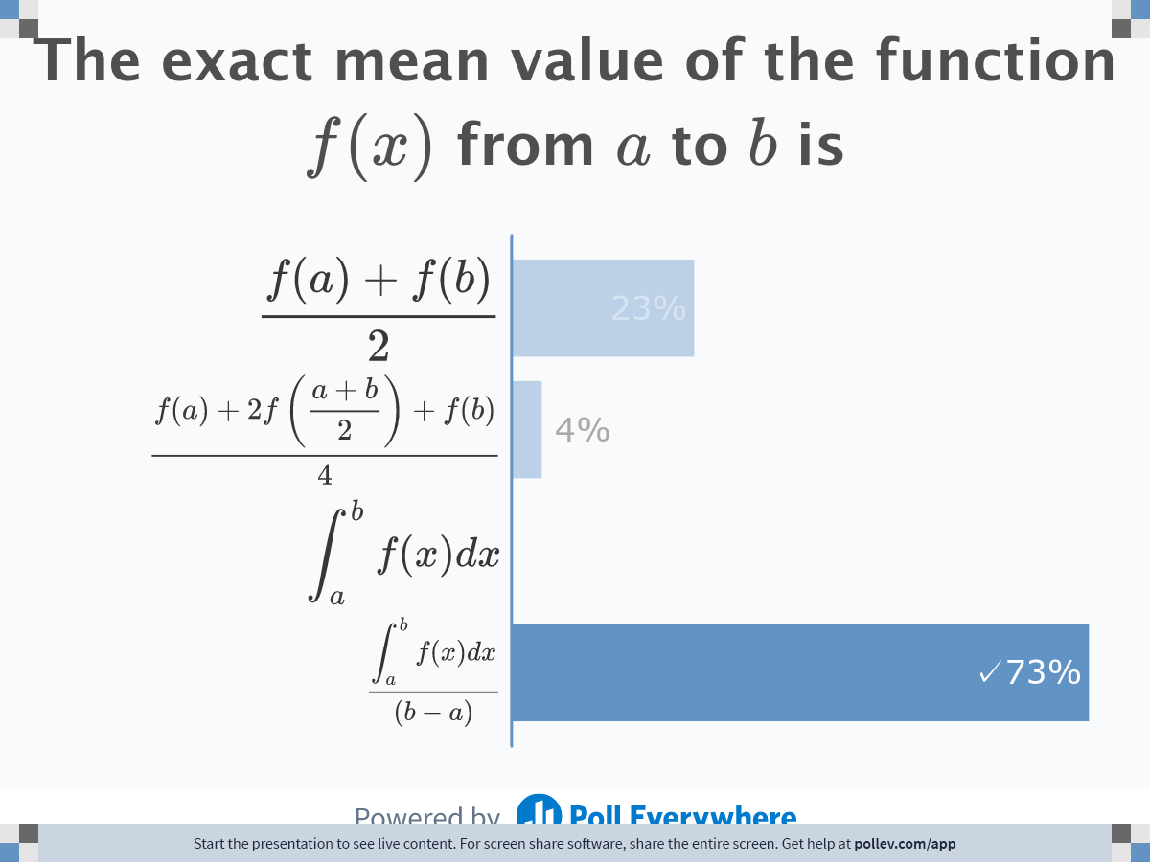
Notes:
Poll Title: Do not modify the notes in this section to avoid tampering with the Poll Everywhere activity.
More info at polleverywhere.com/support
The exact mean value of the function $$f(x)$$ from $$a$$ to $$b$$ is
https://www.polleverywhere.com/multiple_choice_polls/TKdZuBZNiQuzJFPvTLzaH

Slide 7
Physical examples

Slide 8
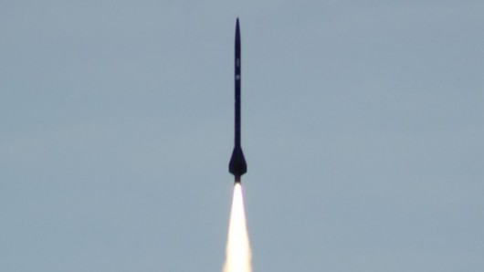
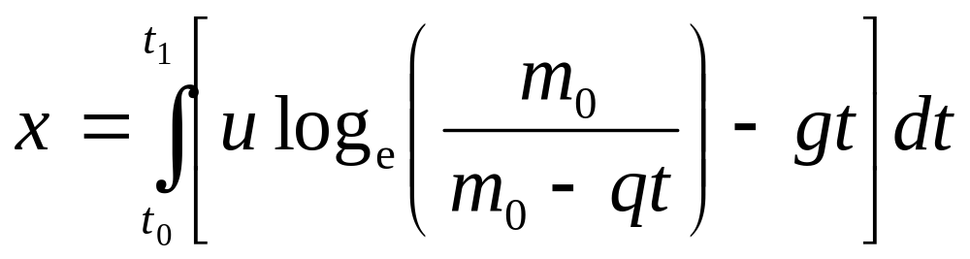
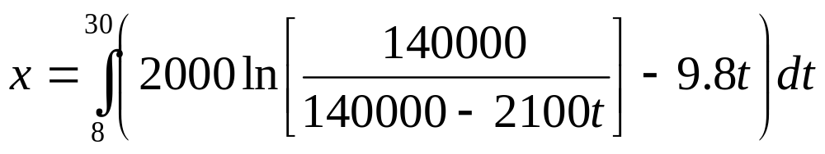
Distance Covered By Rocket

Slide 9
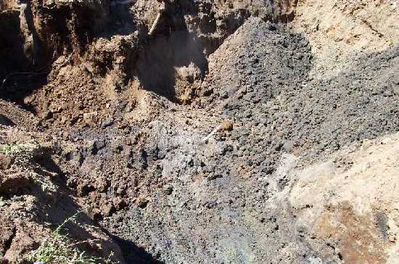
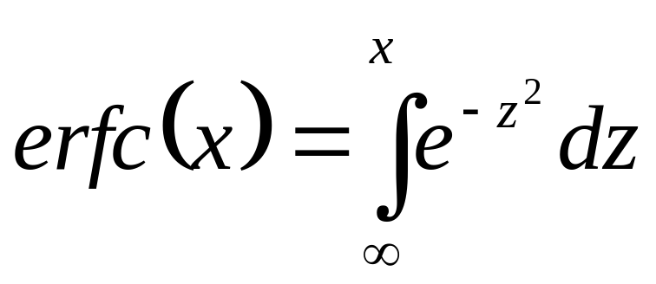
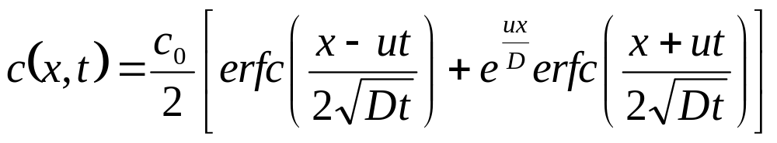
Concentration of Benzene
u= velocity of ground water flow in the x -direction (m/s)
D = dispersion coefficient (m²/s)
C₀= initial concentration (kg/m³)

Slide 10
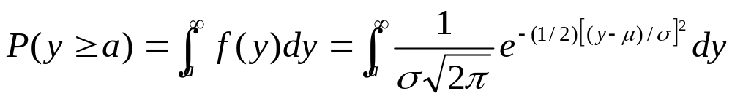

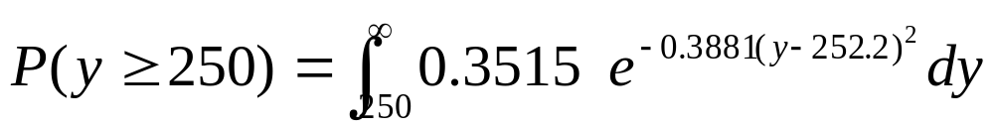
Is Wal*** “short shifting” you?
Roll | Number of sheets
1 | 253
2 | 250
3 | 251
4 | 252
5 | 253
6 | 253
7 | 252
8 | 254
9 | 252
10 | 252

Slide 11
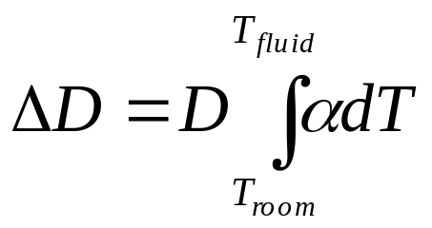

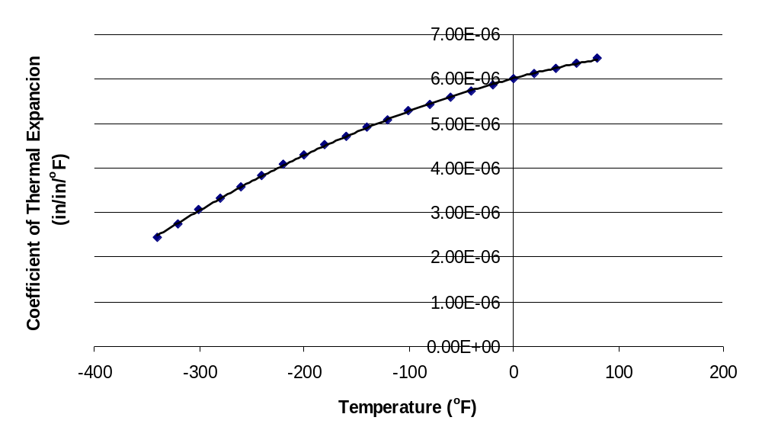
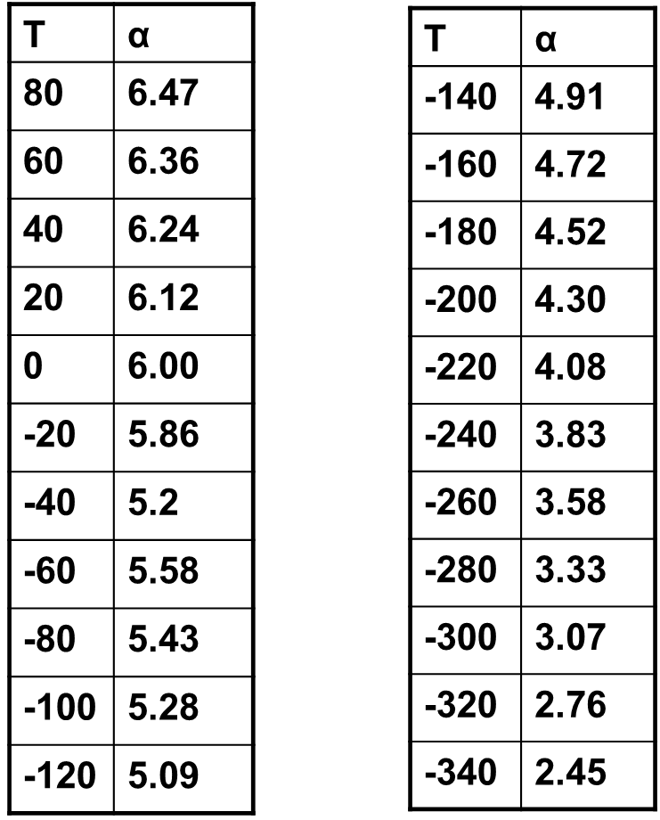
Calculating diameter contraction for trunnion-hub problem

Slide 12
Trapezoidal Rule

Slide 13
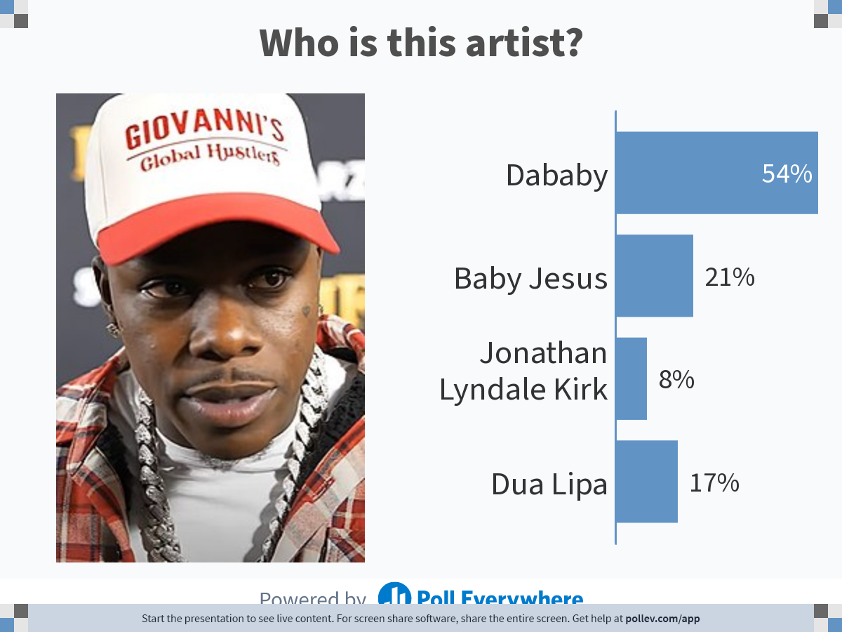
Notes:
Poll Title: Do not modify the notes in this section to avoid tampering with the Poll Everywhere activity.
More info at polleverywhere.com/support
Who is this artist?
https://www.polleverywhere.com/multiple_choice_polls/ExXXhx1qyHk4QpzVIWLfE?state=opened&flow=Default&onscreen=persist

Slide 14

Notes:
Do not modify the notes in this section to avoid tampering with the Poll Everywhere activity.
More info at polleverywhere.com/support
LiveSlide
http://nm.mathforcollege.com/nmsims/07INT/07INT_Reimann_Sum/reimann-sum_en.html

Slide 15

Notes:
Poll Title: Do not modify the notes in this section to avoid tampering with the Poll Everywhere activity.
More info at polleverywhere.com/support
Who is this artist?
https://www.polleverywhere.com/multiple_choice_polls/NpZEWqBeXq5PDSz55ciIH?state=opened&flow=Default&onscreen=persist

Slide 16



Slide 17
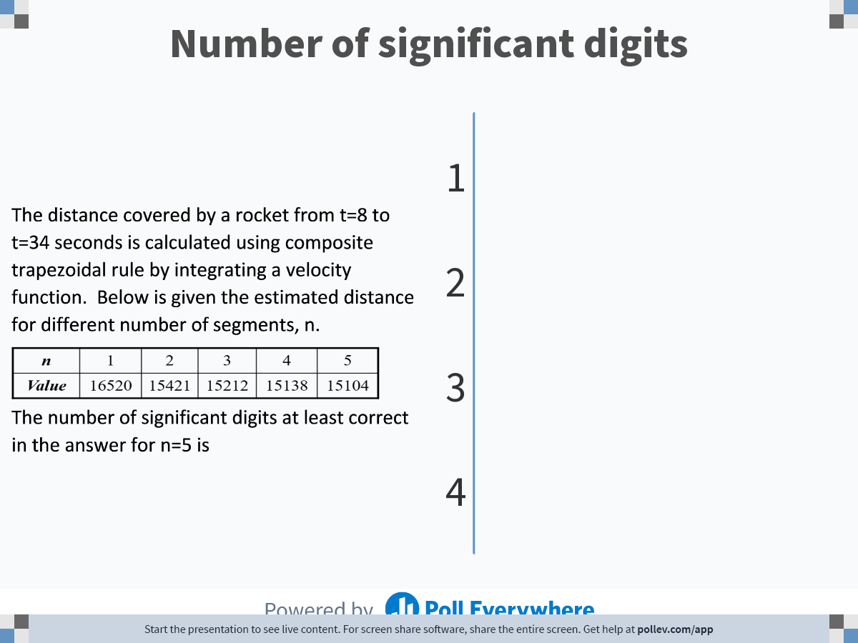
Notes:
Poll Title: Do not modify the notes in this section to avoid tampering with the Poll Everywhere activity.
More info at polleverywhere.com/support
Number of significant digits
https://www.polleverywhere.com/multiple_choice_polls/56dtscqK8kgnZQy0NLMLB

Slide 18
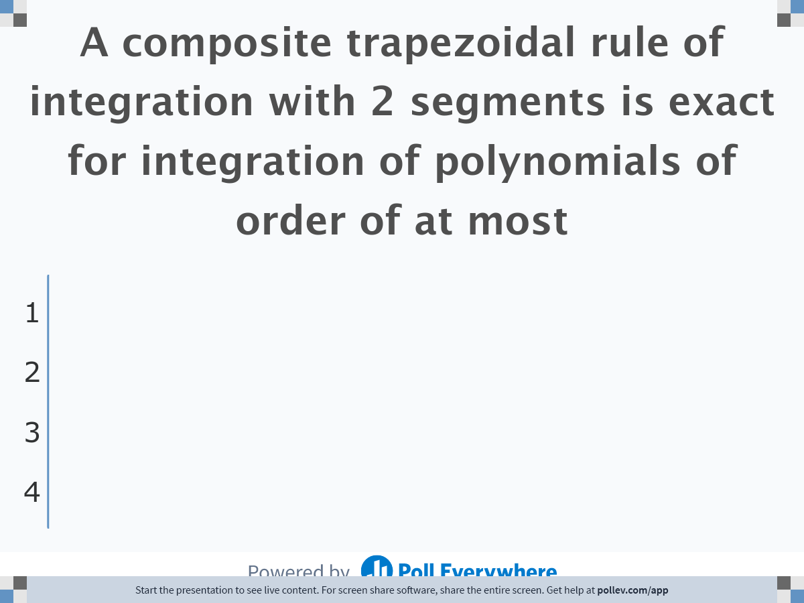
Notes:
Poll Title: Do not modify the notes in this section to avoid tampering with the Poll Everywhere activity.
More info at polleverywhere.com/support
A composite trapezoidal rule of integration with 2 segments is exact for integration of polynomials of order of at most
https://www.polleverywhere.com/multiple_choice_polls/KVPW6tD9k4mz7lQc2ttGb

Slide 19
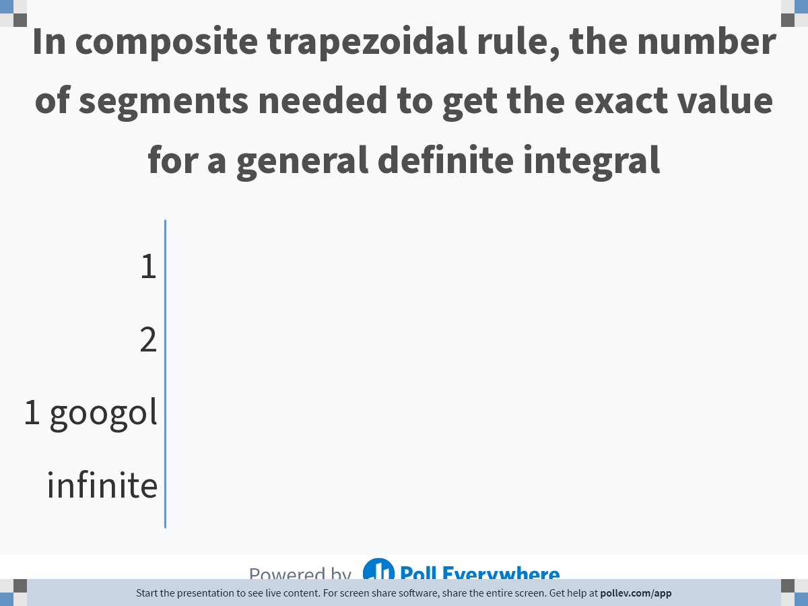
Notes:
Poll Title: Do not modify the notes in this section to avoid tampering with the Poll Everywhere activity.
More info at polleverywhere.com/support
In composite trapezoidal rule, the number of segments needed to get the exact value for a general definite integral
https://www.polleverywhere.com/multiple_choice_polls/DT8kzZMUds8z5Mqnwtt31

Slide 20
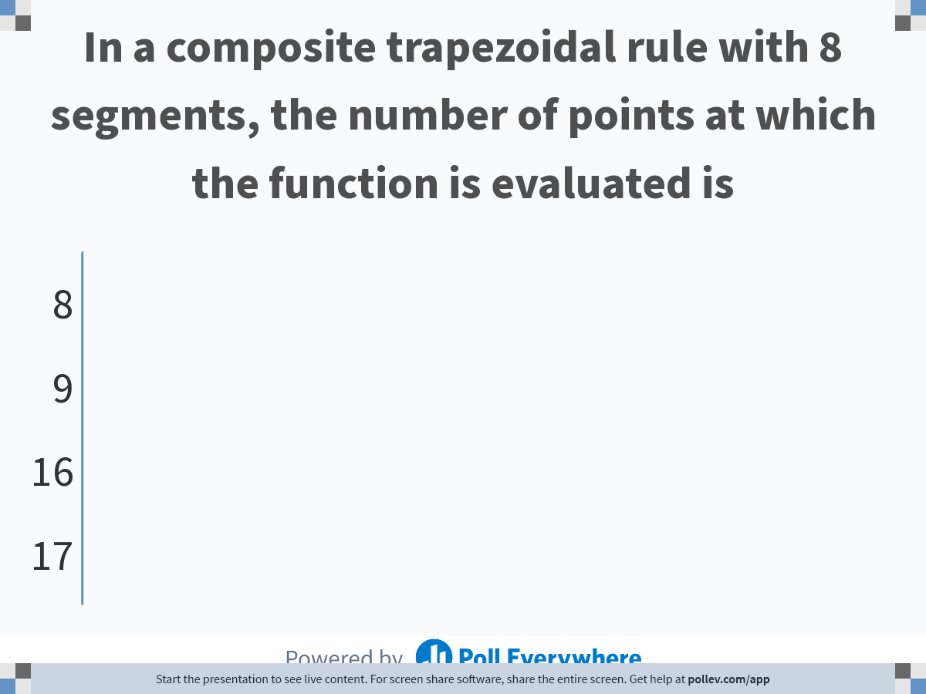
Notes:
Poll Title: Do not modify the notes in this section to avoid tampering with the Poll Everywhere activity.
More info at polleverywhere.com/support
In a composite trapezoidal rule with 8 segments, the number of points at which the function is evaluated is
https://www.polleverywhere.com/multiple_choice_polls/O2O7FaY6MFaS1AmnaRfcK

Slide 21
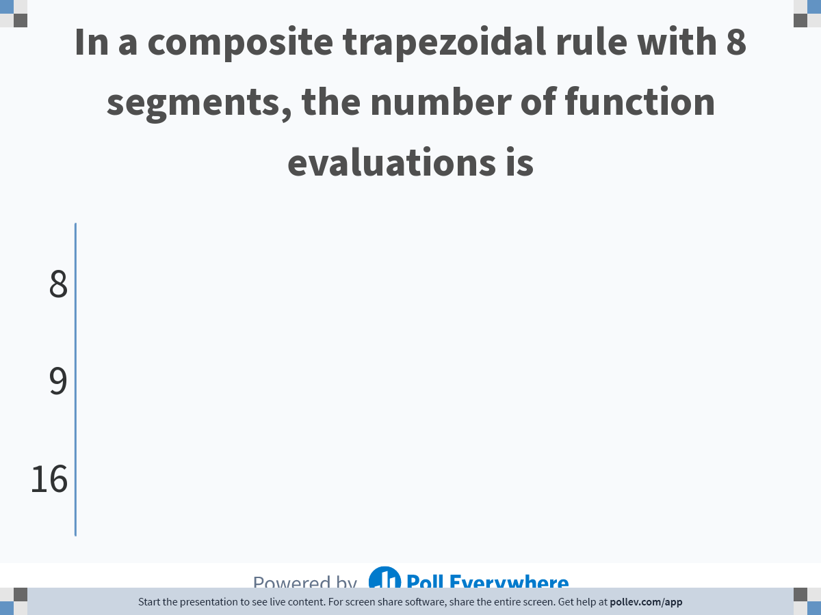
Notes:
Poll Title: Do not modify the notes in this section to avoid tampering with the Poll Everywhere activity.
More info at polleverywhere.com/support
In a composite trapezoidal rule with 8 segments, the number of function evaluations is
https://www.polleverywhere.com/multiple_choice_polls/StUbJZQjX6DLKyUal4NnH

Slide 22
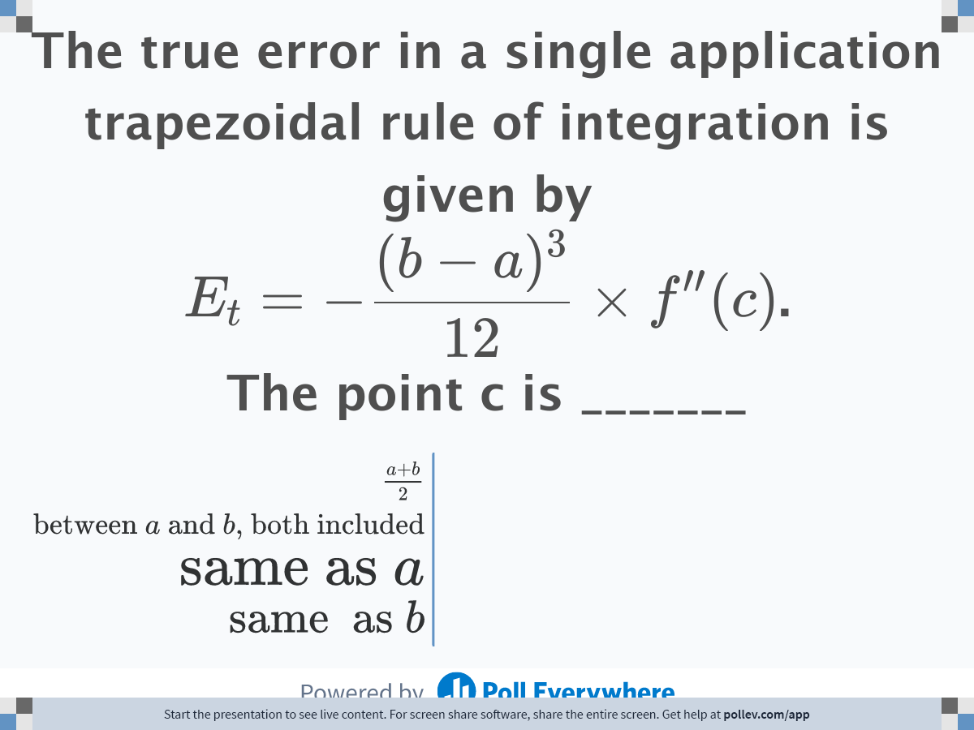
Notes:
Poll Title: Do not modify the notes in this section to avoid tampering with the Poll Everywhere activity.
More info at polleverywhere.com/support
The true error in a single application trapezoidal rule of integration is given by $$E_t = \\displaystyle -\\frac{(b-a)^3}{12}\\times f^{\\prime\\prime}(c)$$. The point c is _______
https://www.polleverywhere.com/multiple_choice_polls/M9sM5I4n6br07WY43y0EU

Slide 23
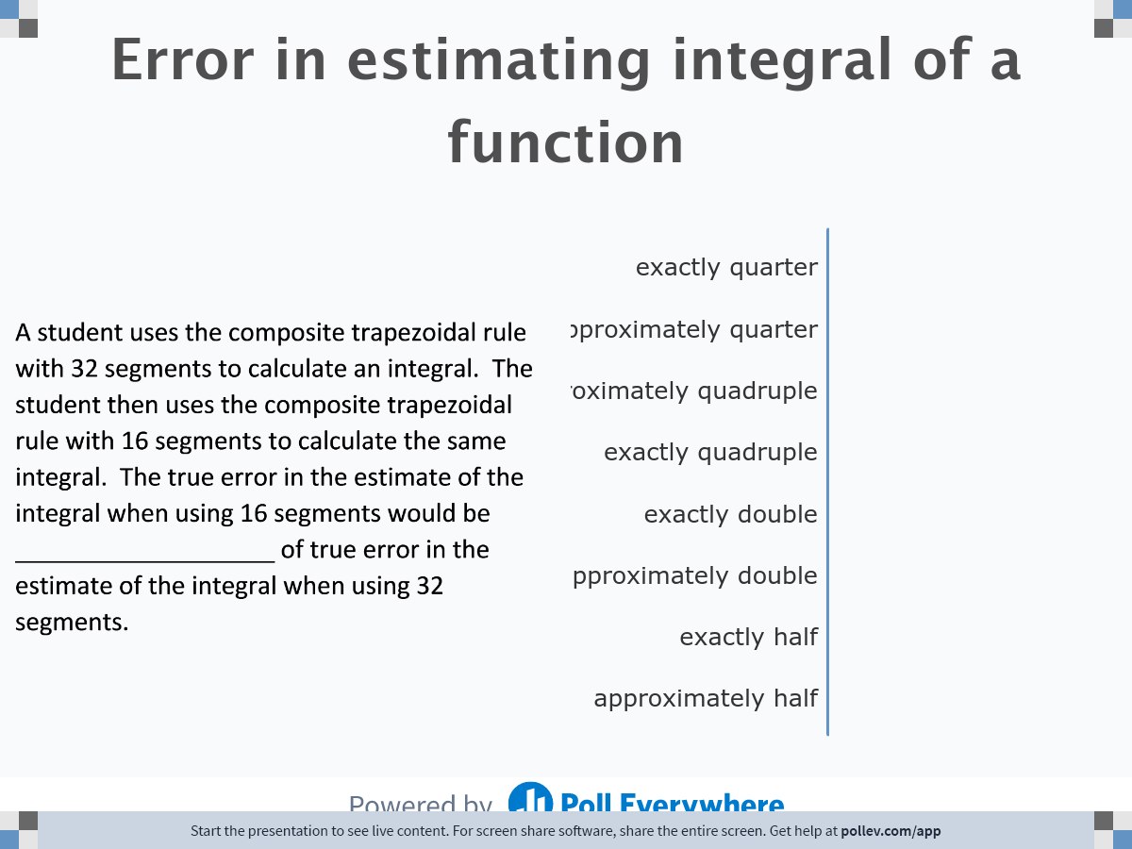
Notes:
Poll Title: Do not modify the notes in this section to avoid tampering with the Poll Everywhere activity.
More info at polleverywhere.com/support
Error in estimating integral of a function
https://www.polleverywhere.com/multiple_choice_polls/yMUs7rIKL7LI6GTSWzQEP

Slide 24
Notes:
Do not modify the notes in this section to avoid tampering with the Poll Everywhere activity.
More info at polleverywhere.com/support
LiveSlide
http://nm.mathforcollege.com/nmsims/07INT/07INT_Reimann_Sum/reimann-sum_en.html

Slide 25


