Slide 1
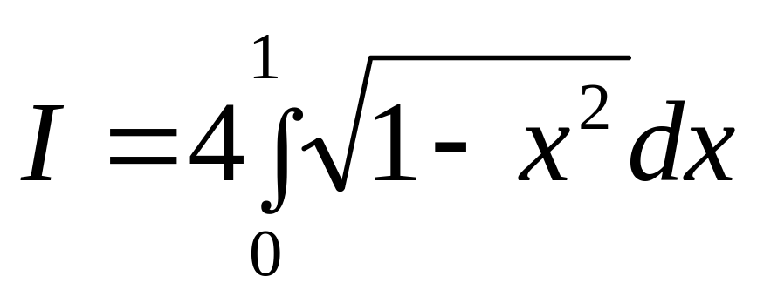
Integration
As difficult a problem as thou
finding quadrature of a circle

Slide 2

Notes:
Poll Title: Do not modify the notes in this section to avoid tampering with the Poll Everywhere activity.
More info at polleverywhere.com/support
Who is this artist?
https://www.polleverywhere.com/multiple_choice_polls/adq2vFGpmml9xCfiYgOEk?state=opened&flow=Default&onscreen=persist

Slide 3
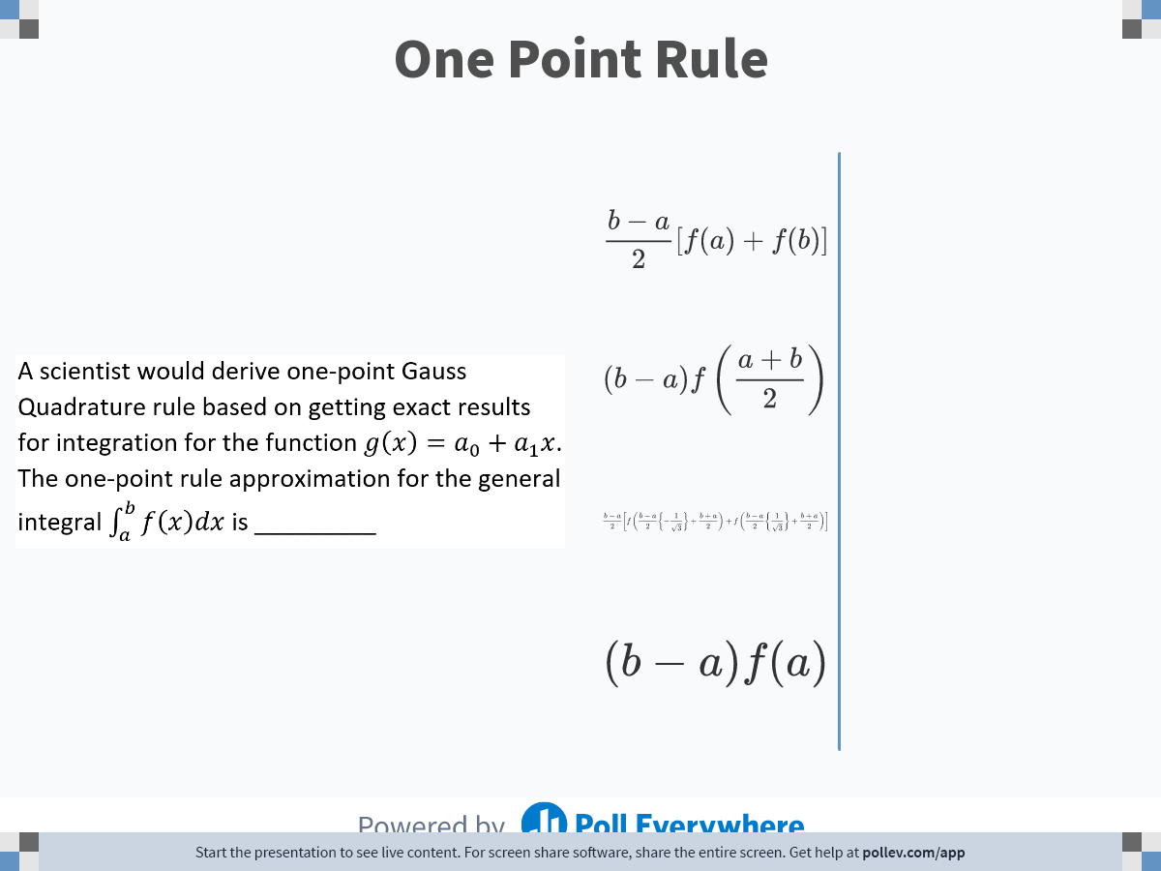
Notes:
Poll Title: Do not modify the notes in this section to avoid tampering with the Poll Everywhere activity.
More info at polleverywhere.com/support
One Point Rule
https://www.polleverywhere.com/multiple_choice_polls/zHolYXgRQbyqWCt92ZdIs

Slide 4
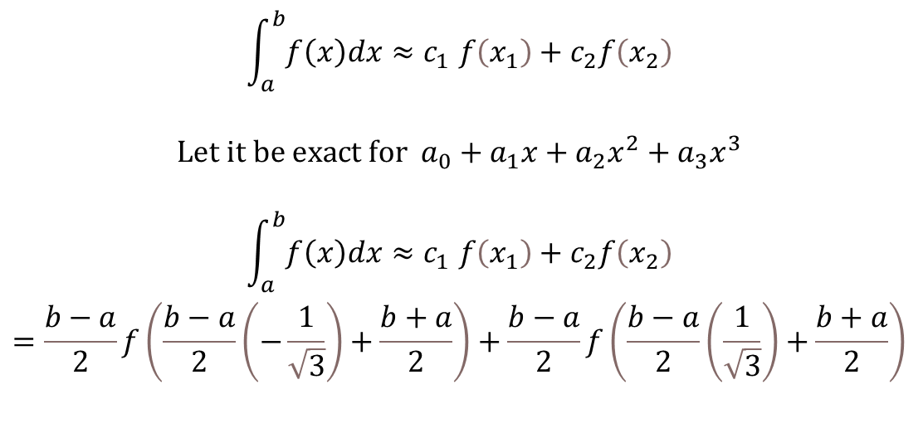
Two-Point Gauss Quadrature Rule
$$\begin{matrix}\begin{aligned}\int_{a}^{b}{f\left(x\right)dx}{≈c}_{1}f\left(x_{1}\right)+c_{2}f\left(x_{2}\right) \\ \\ Let it be exact for a_{0}+a_{1}x+a_{2}x^{2}+a_{3}x^{3} \\ \\ \int_{a}^{b}{f\left(x\right)dx}{≈c}_{1}f\left(x_{1}\right)+c_{2}f\left(x_{2}\right) \\ =\frac{b−a}{2}f\left(\frac{b−a}{2}\left(−\frac{1}{\sqrt{3}}\right)+\frac{b+a}{2}\right)+\frac{b−a}{2}f\left(\frac{b−a}{2}\left(\frac{1}{\sqrt{3}}\right)+\frac{b+a}{2}\right)\end{aligned} & \\ & \\ & \end{matrix}$$

Slide 5
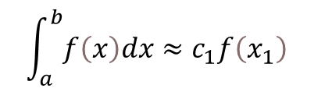
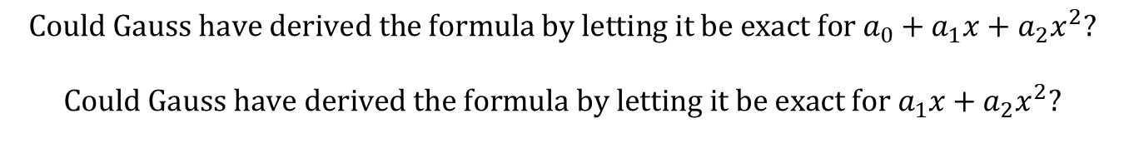
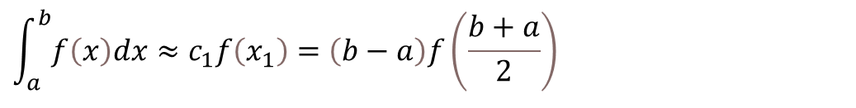
One-Point Gauss Quadrature Rule
$$\int_{a}^{b}{f\left(x\right)dx}≈c_{1}f\left(x_{1}\right)$$
$$Let the formula be exact for a_{0}+a_{1}x$$
$$\begin{matrix}\int_{a}^{b}{f\left(x\right)dx}≈c_{1}f\left(x_{1}\right)=\left(b−a\right)f\left(\frac{b+a}{2}\right) & \\ & \end{matrix}$$
$$Could Gauss have derived the formula by letting it be exact for a_{0}+a_{1}x+a_{2}x^{2}?$$
$$Could Gauss have derived the formula by letting it be exact for a_{1}x+a_{2}x^{2}?$$

Slide 6
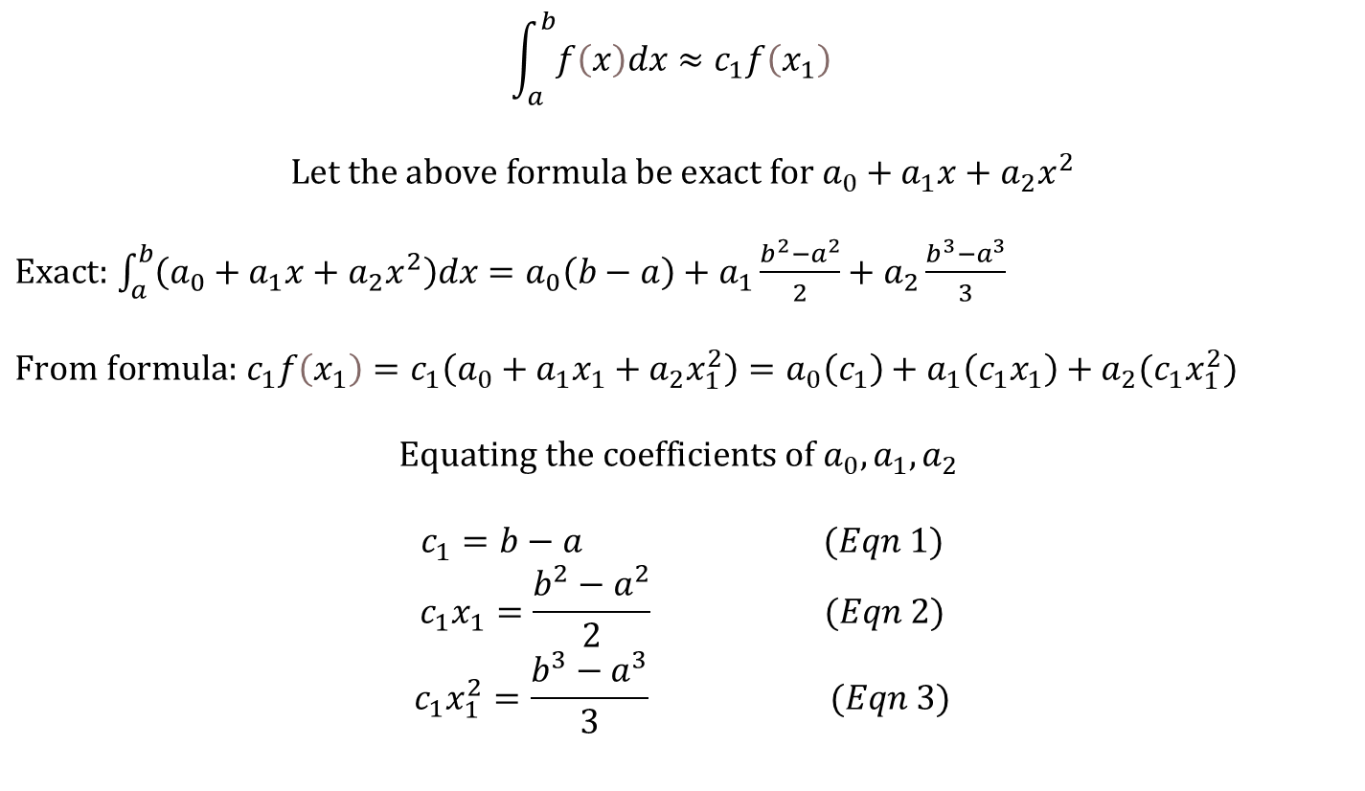

Would $f\left(x\right)=a_{0}+a_{1}x+a_{2}x^{2}$work for one-point rule
$$\int_{a}^{b}{f\left(x\right)dx}≈c_{1}f\left(x_{1}\right)$$
$$Let the above formula be exact for a_{0}+a_{1}x+a_{2}x^{2}$$
$Exact:$ $\int_{a}^{b}{\left(a_{0}+a_{1}x+a_{2}x^{2}\right)dx=a_{0}\left(b−a\right)+a_{1}\frac{b^{2}−a^{2}}{2}+a_{2}\frac{b^{3}−a^{3}}{3}}$
$From formula:$ $c_{1}f\left(x_{1}\right)=c_{1}\left(a_{0}+a_{1}x_{1}+a_{2}x_{1}^{2}\right)=a_{0}\left(c_{1}\right)+a_{1}\left(c_{1}x_{1}\right)+a_{2}(c_{1}x_{1}^{2})$
$$Equating the coefficients of a_{0}, a_{1}, a_{2}$$
$c_{1}=b−a$ $(Eqn 1)$
$$c_{1}x_{1}=\frac{b^{2}−a^{2}}{2} (Eqn 2)$$
$$c_{1}x_{1}^{2}=\frac{b^{3}−a^{3}}{3} (Eqn 3)$$

Slide 7
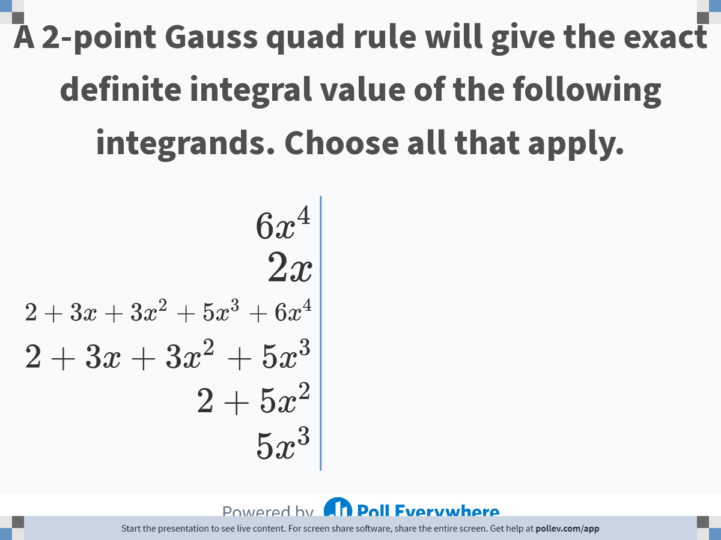
Notes:
Poll Title: Do not modify the notes in this section to avoid tampering with the Poll Everywhere activity.
More info at polleverywhere.com/support
A 2-point Gauss quad rule will give the exact definite integral value of the following integrands. Choose all that apply.
https://www.polleverywhere.com/multiple_choice_polls/tIHOauwcQf5nJ8ZqBtuYw

Slide 8
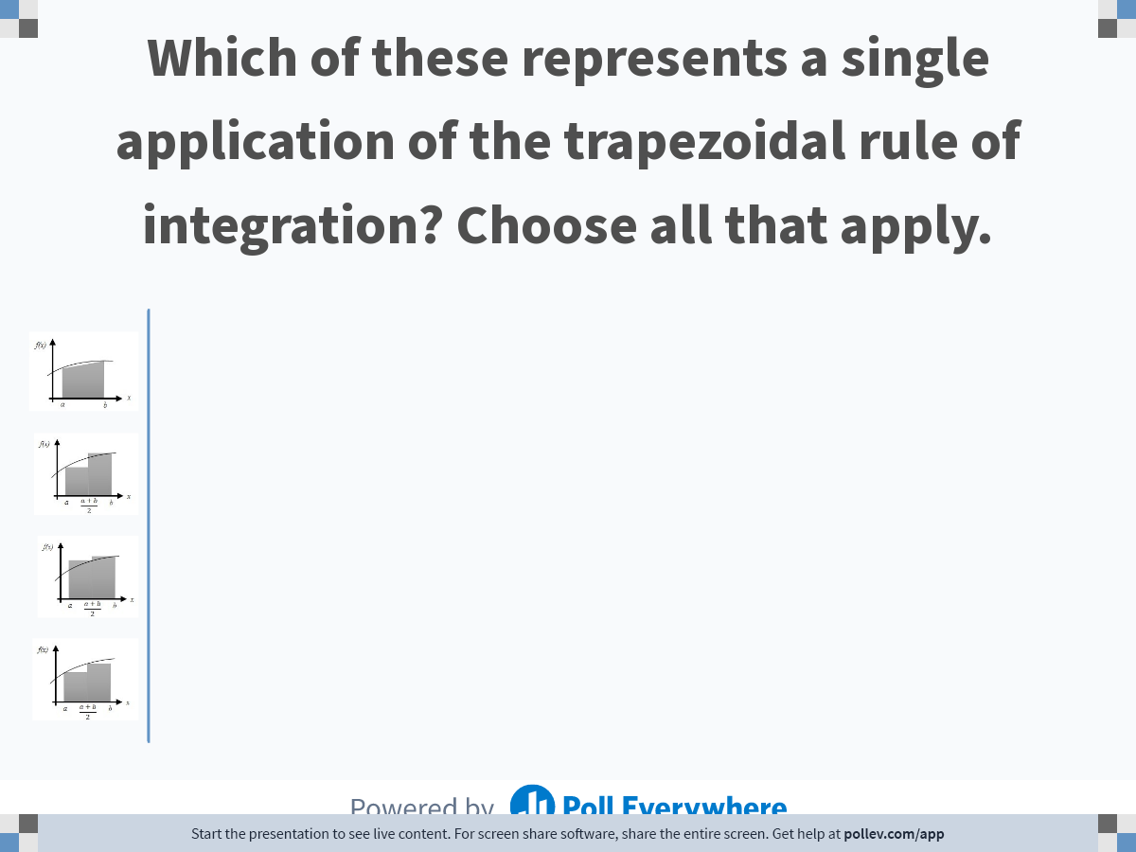
Notes:
Poll Title: Do not modify the notes in this section to avoid tampering with the Poll Everywhere activity.
More info at polleverywhere.com/support
Which one of these represents a single application of the trapezoidal rule of integration? Choose all that apply.
https://www.polleverywhere.com/multiple_choice_polls/iMCJUc5NVWsKKKP40SACP?state=opened&flow=Default&onscreen=persist

Slide 9
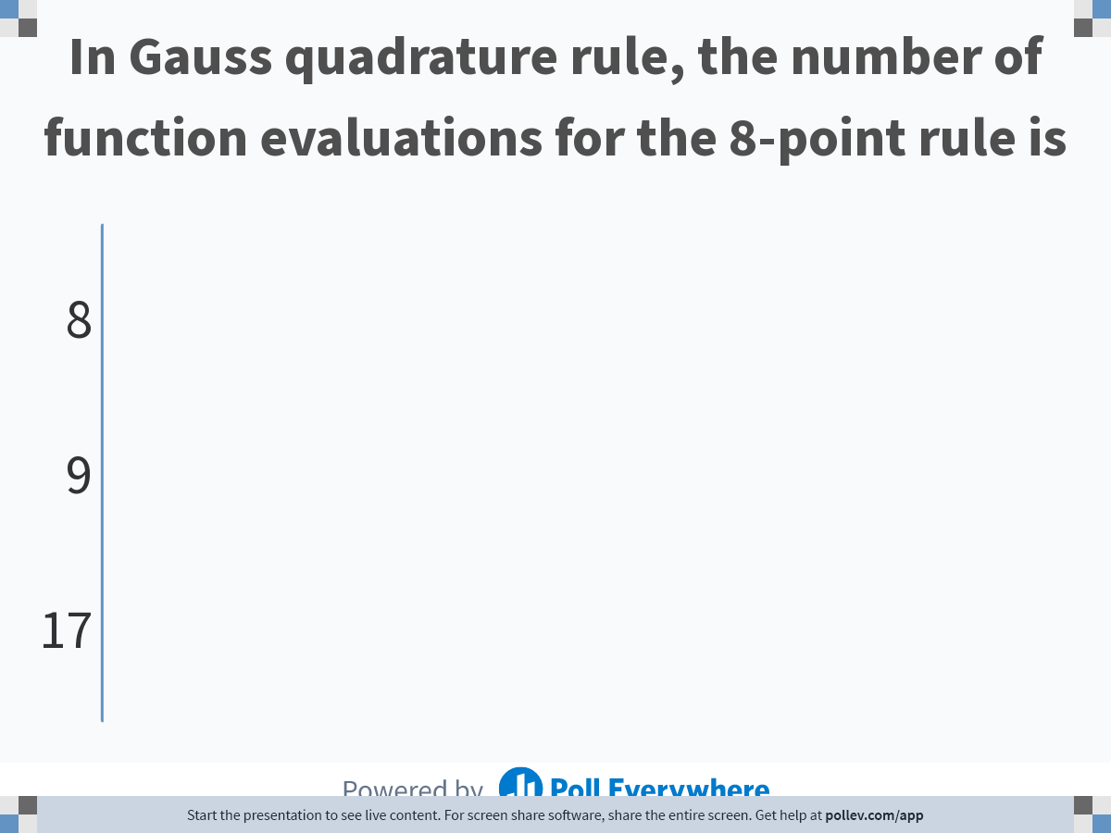
Notes:
Poll Title: Do not modify the notes in this section to avoid tampering with the Poll Everywhere activity.
More info at polleverywhere.com/support
In Gauss quadrature rule, the number of function evaluations for the 8-point rule is
https://www.polleverywhere.com/multiple_choice_polls/fOaqKtw0hW60KKvZYzlLE

Slide 10
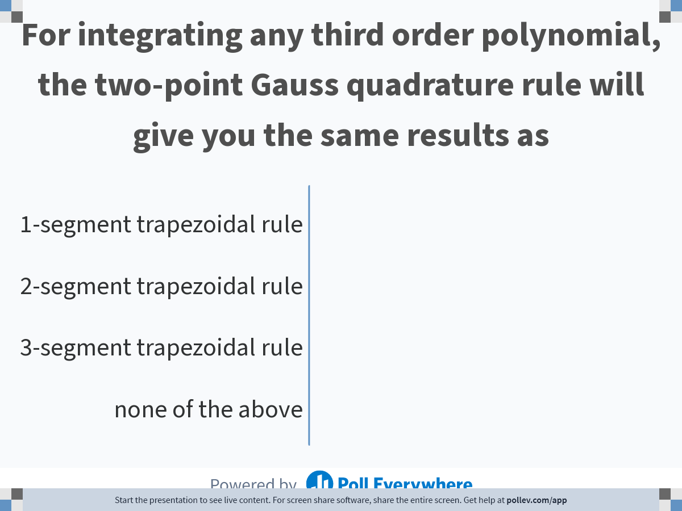
Notes:
Poll Title: Do not modify the notes in this section to avoid tampering with the Poll Everywhere activity.
More info at polleverywhere.com/support
For integrating any third order polynomial, the two-point Gauss quadrature rule will give you the same results as
https://www.polleverywhere.com/multiple_choice_polls/4NDHXqEZLddWK8ZUeBcK5

Slide 11
Notes:
Poll Title: Do not modify the notes in this section to avoid tampering with the Poll Everywhere activity.
More info at polleverywhere.com/support
In Gauss quadrature rule, the number of function evaluations for the 8-point rule is
https://www.polleverywhere.com/multiple_choice_polls/fOaqKtw0hW60KKvZYzlLE

Slide 12
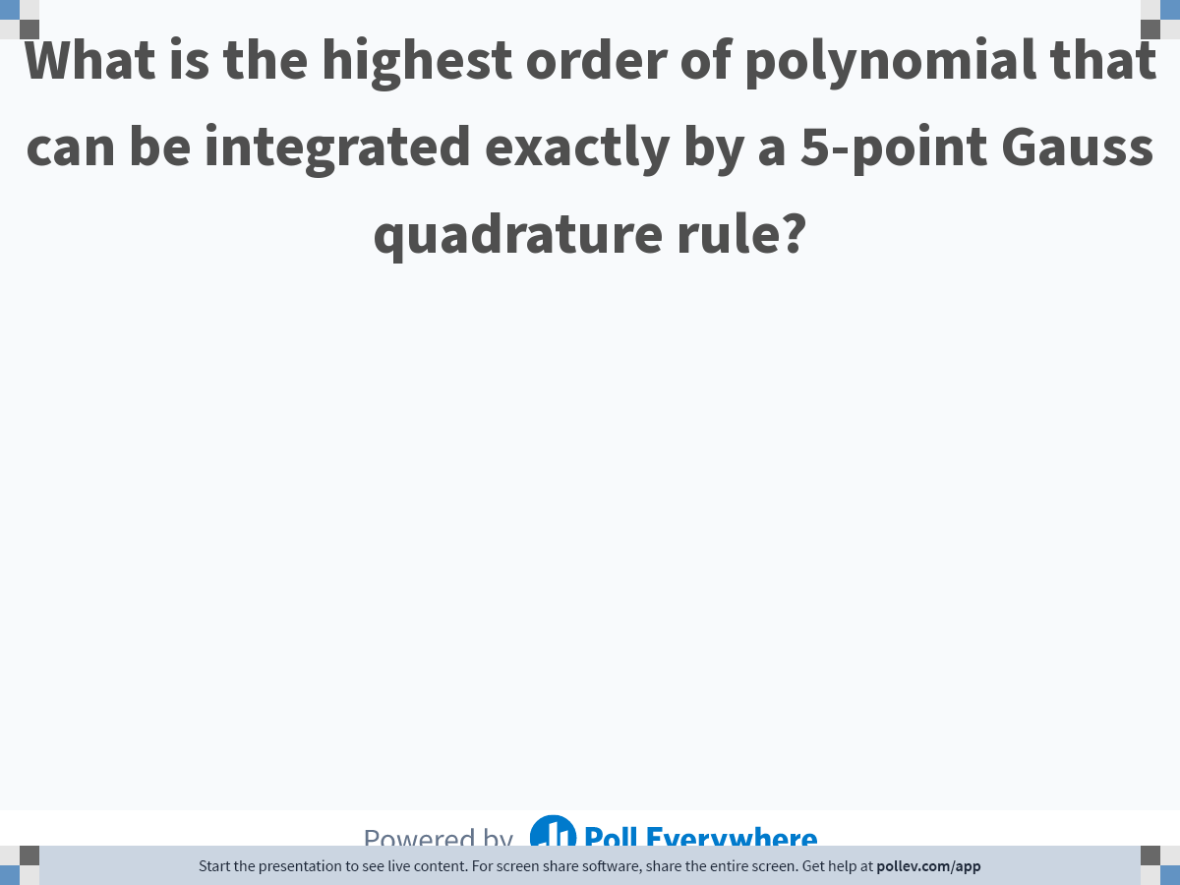
Notes:
Poll Title: Do not modify the notes in this section to avoid tampering with the Poll Everywhere activity.
More info at polleverywhere.com/support
What is the highest order of polynomial that can be integrated exactly by a 5-point Gauss quadrature rule?
https://www.polleverywhere.com/free_text_polls/fxeY5JNay3ffkxaqpwMY5

Slide 13
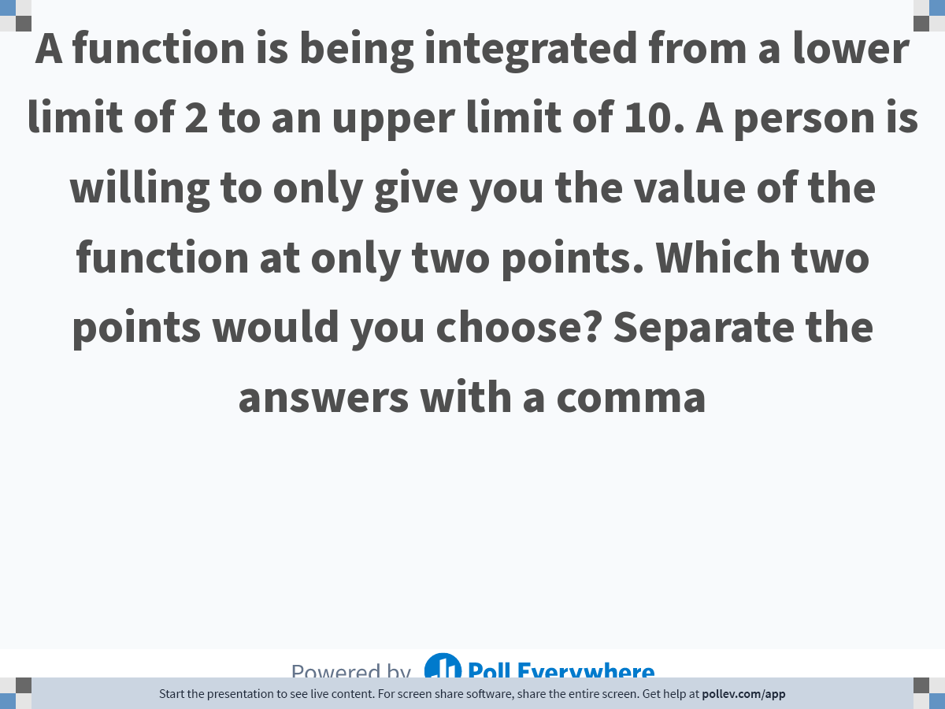
Notes:
Poll Title: Do not modify the notes in this section to avoid tampering with the Poll Everywhere activity.
More info at polleverywhere.com/support
A function is being integrated from a lower limit of 2 to an upper limit of 10. A person is willing to only give you the value of the function at only two points. Which two points would you choose? Separate the answers with a comma
https://www.polleverywhere.com/free_text_polls/UdBe0lsRcrvgS37uwU8r8

Slide 14
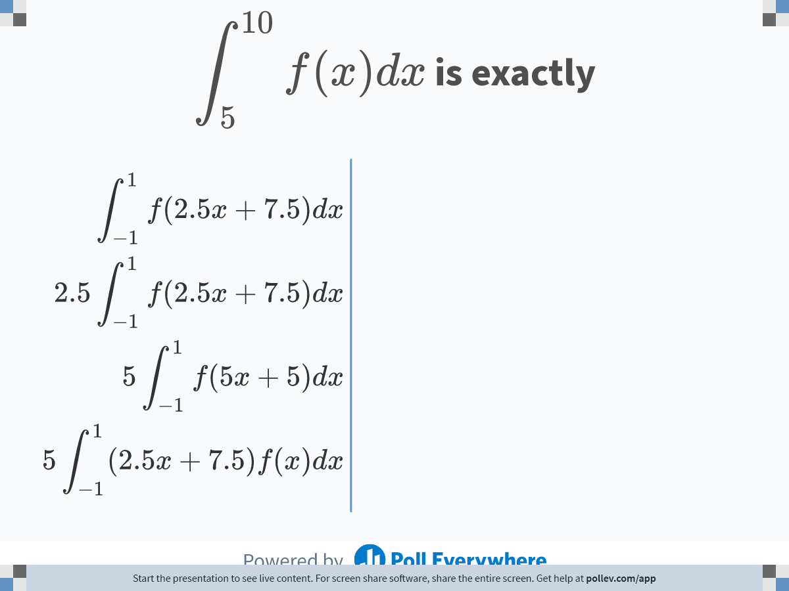
Notes:
Poll Title: Do not modify the notes in this section to avoid tampering with the Poll Everywhere activity.
More info at polleverywhere.com/support
$$\\displaystyle \\int^{10}_5f(x)dx$$ is exactly
https://www.polleverywhere.com/multiple_choice_polls/TQtPjk3UZ70RiAHd3qxIo

Slide 15


