Slide 1
Ordinary Differential Equations
Everything is ordinary about them

Slide 2
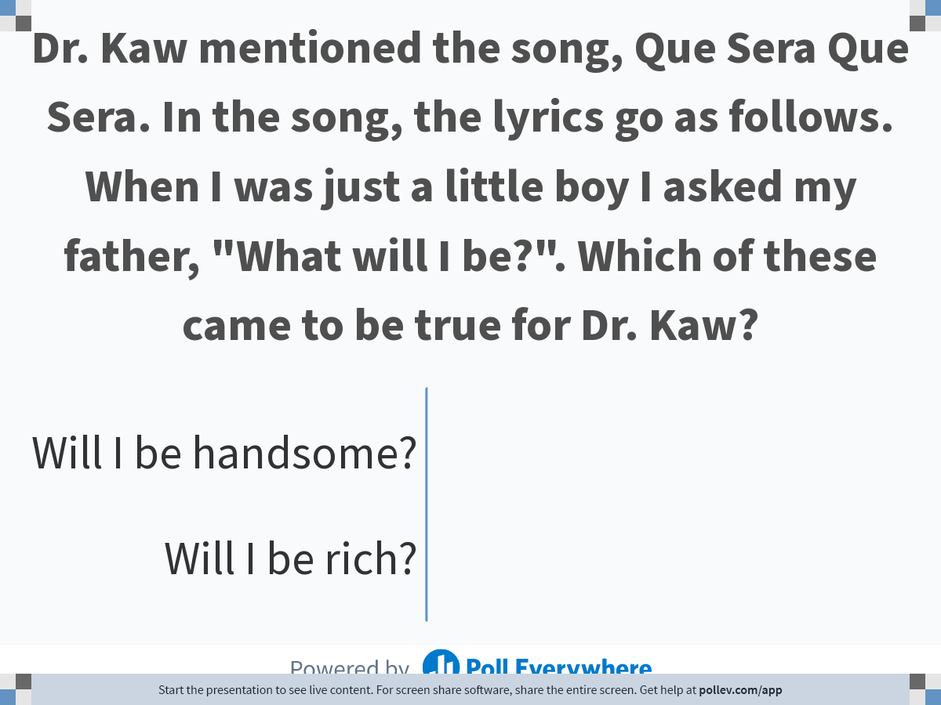
Notes:
Poll Title: Do not modify the notes in this section to avoid tampering with the Poll Everywhere activity.
More info at polleverywhere.com/support
Dr. Kaw mentioned the song, Que Sera Que Sera. In the song, ten lyrics go as follows. When I was just a little boy I asked my father, "What will I be?". Which of these came to be true for Dr. Kaw?
https://www.polleverywhere.com/multiple_choice_polls/ngDBbf4yjyDjvZbyp4jOl?state=opened&flow=Default&onscreen=persist

Slide 3
Physical Examples

Slide 4
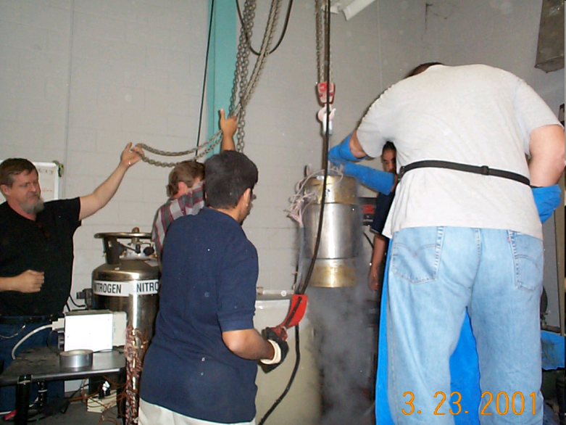

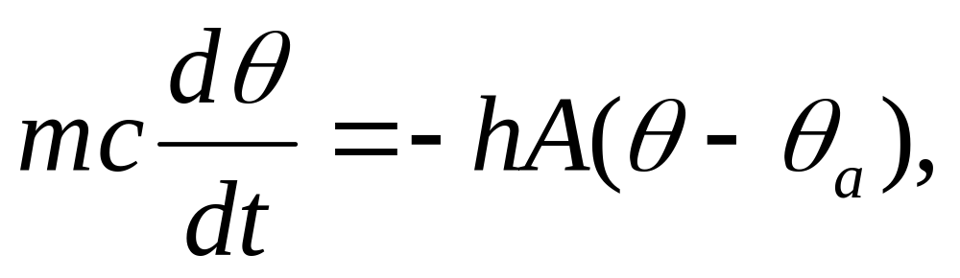
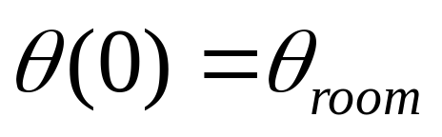
How long will it take to cool the trunnion?

Slide 5
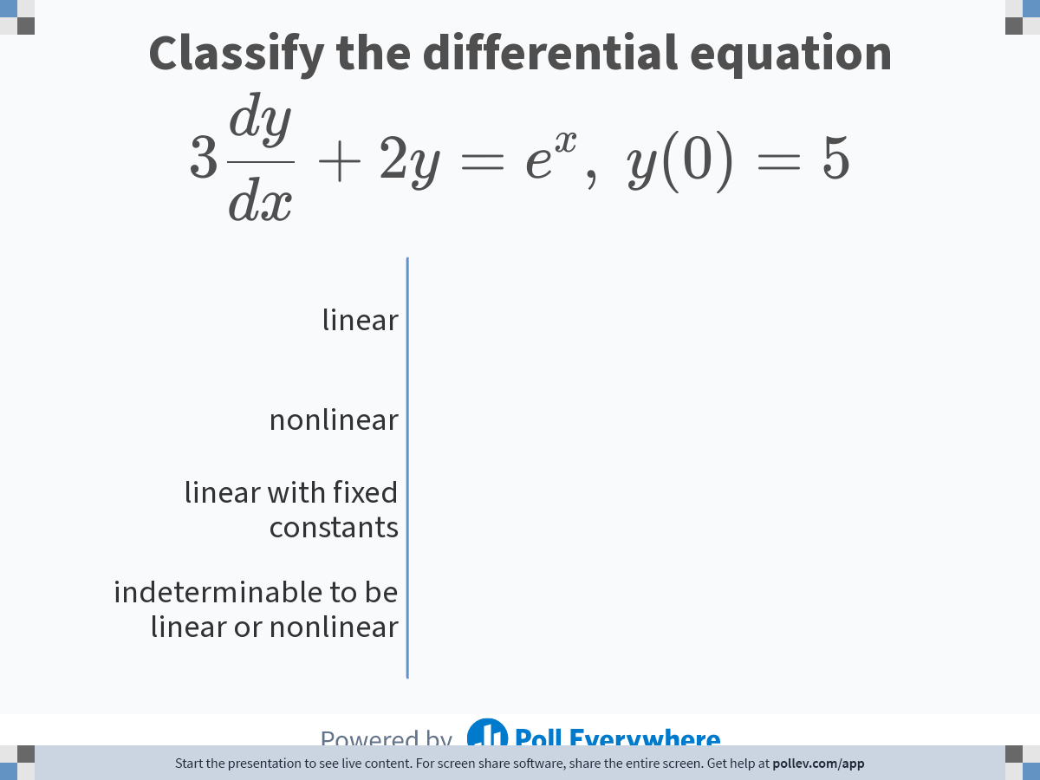
Notes:
Poll Title: Do not modify the notes in this section to avoid tampering with the Poll Everywhere activity.
More info at polleverywhere.com/support
Classify the differential equation $$\\displaystyle 3\\frac{dy}{dx} + 2y = e^x,\\ y(0)=5$$
https://www.polleverywhere.com/multiple_choice_polls/PXn8SZ76zlE49ODWOh8KH

Slide 6
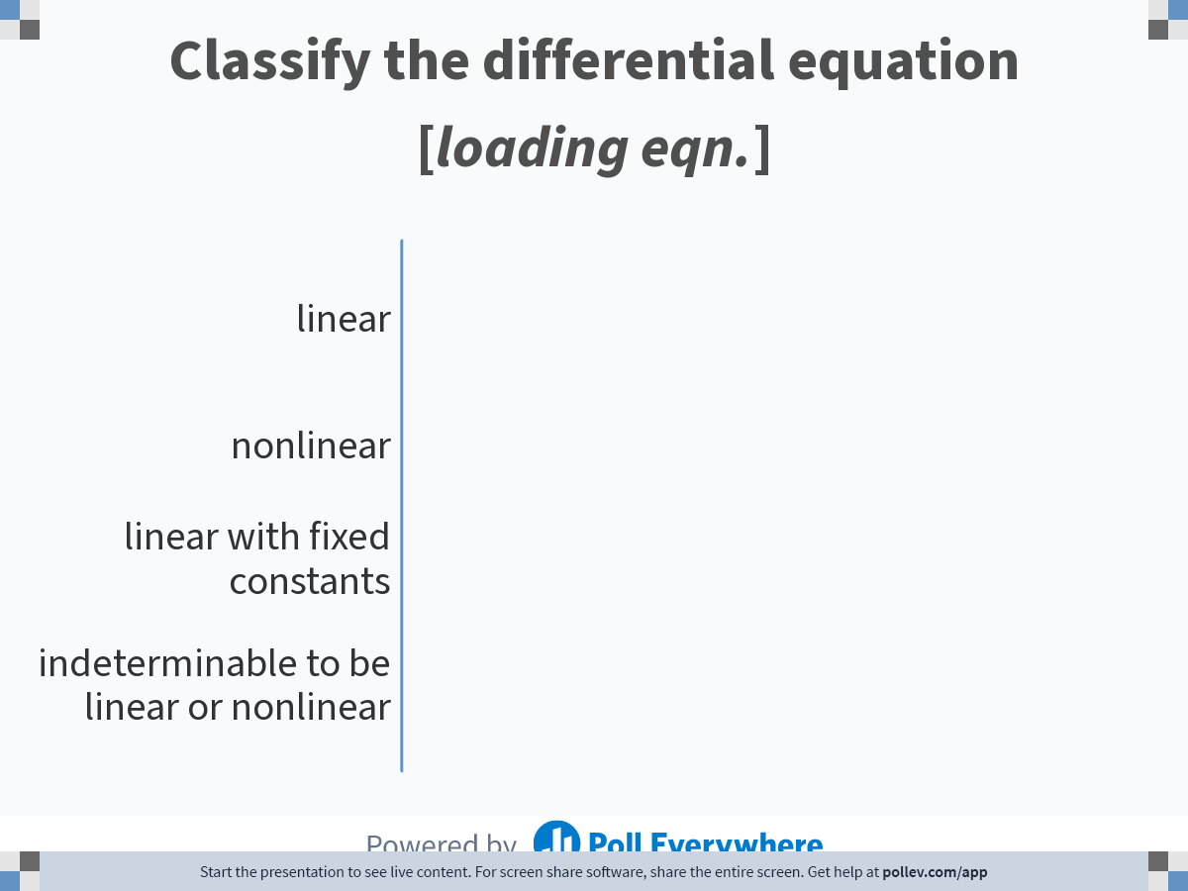
Notes:
Poll Title: Do not modify the notes in this section to avoid tampering with the Poll Everywhere activity.
More info at polleverywhere.com/support
Classify the differential equation $$\\displaystyle 3x^3\\frac{dy}{dx} + 2x^2y = e^x,\\ y(0)=5$$
https://www.polleverywhere.com/multiple_choice_polls/Ml5JrXdvCTc8q1pneBzEc

Slide 7
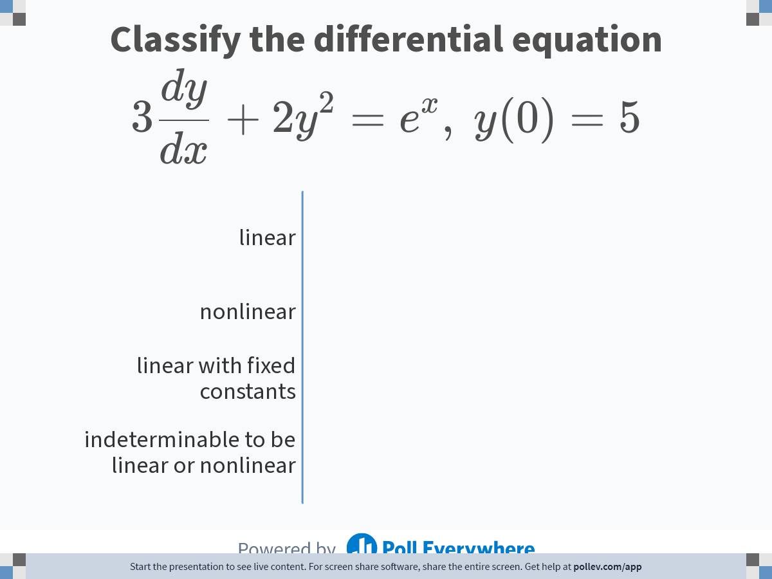
Notes:
Poll Title: Do not modify the notes in this section to avoid tampering with the Poll Everywhere activity.
More info at polleverywhere.com/support
Classify the differential equation $$\\displaystyle 3\\frac{dy}{dx} + 2y^2 = e^x,\\ y(0)=5$$
https://www.polleverywhere.com/multiple_choice_polls/PRl3ohV9hvOGPrlfdA0BW

Slide 8
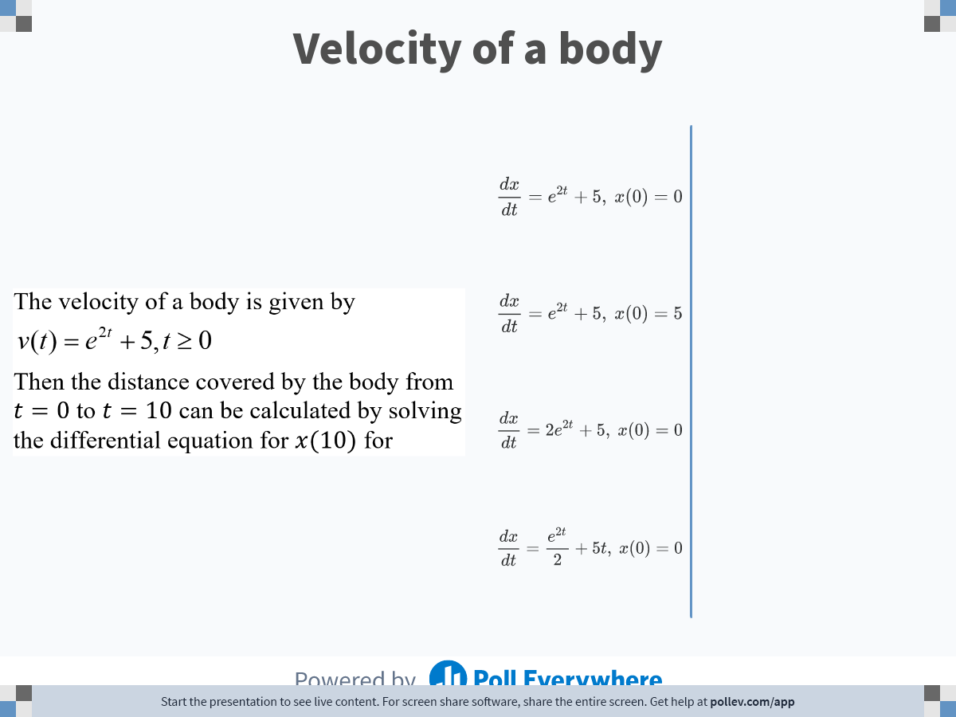
Notes:
Poll Title: Do not modify the notes in this section to avoid tampering with the Poll Everywhere activity.
More info at polleverywhere.com/support
Velocity of a body
https://www.polleverywhere.com/multiple_choice_polls/WNMY3b9YuFxi3sENhAB5N

Slide 9
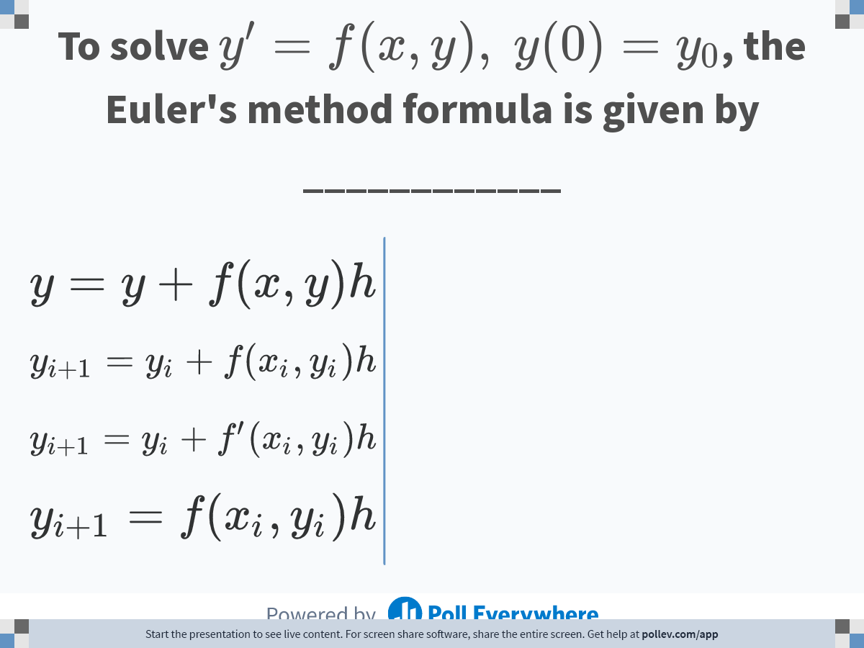
Notes:
Poll Title: Do not modify the notes in this section to avoid tampering with the Poll Everywhere activity.
More info at polleverywhere.com/support
To solve $$y^\\prime = f(x,y),\\ y(0)=y_0$$, the Euler's method formula is given by ____________
https://www.polleverywhere.com/multiple_choice_polls/vhh6HC7mUUNcueiGBvqIx

Slide 10
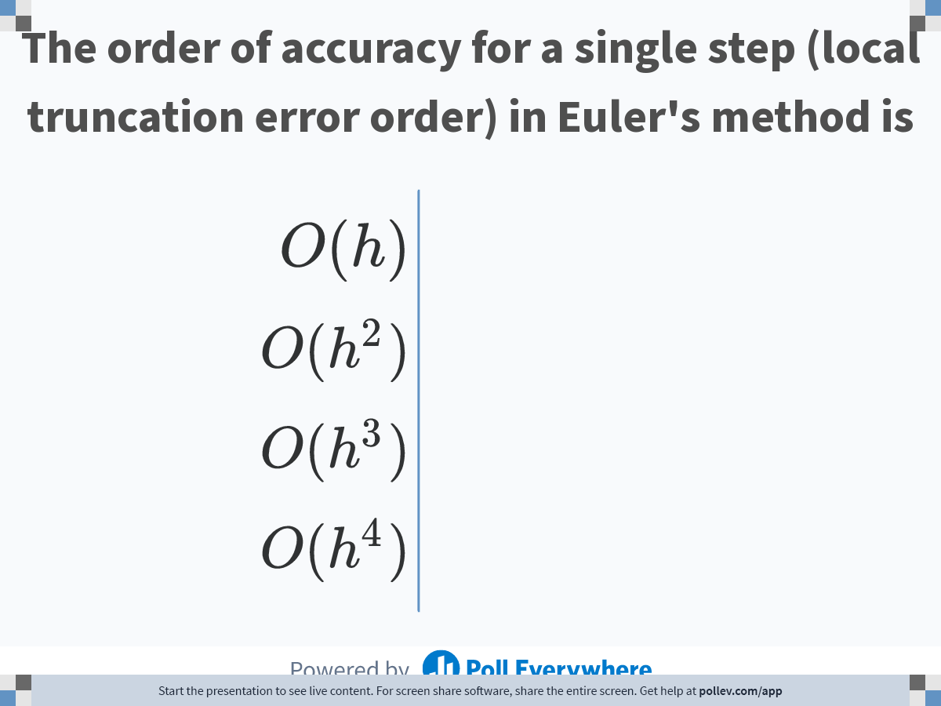
Notes:
Poll Title: Do not modify the notes in this section to avoid tampering with the Poll Everywhere activity.
More info at polleverywhere.com/support
The order of accuracy for a single step in Euler's method is
https://www.polleverywhere.com/multiple_choice_polls/gYAqzDvoXlANwfTmfp0Hw

Slide 11
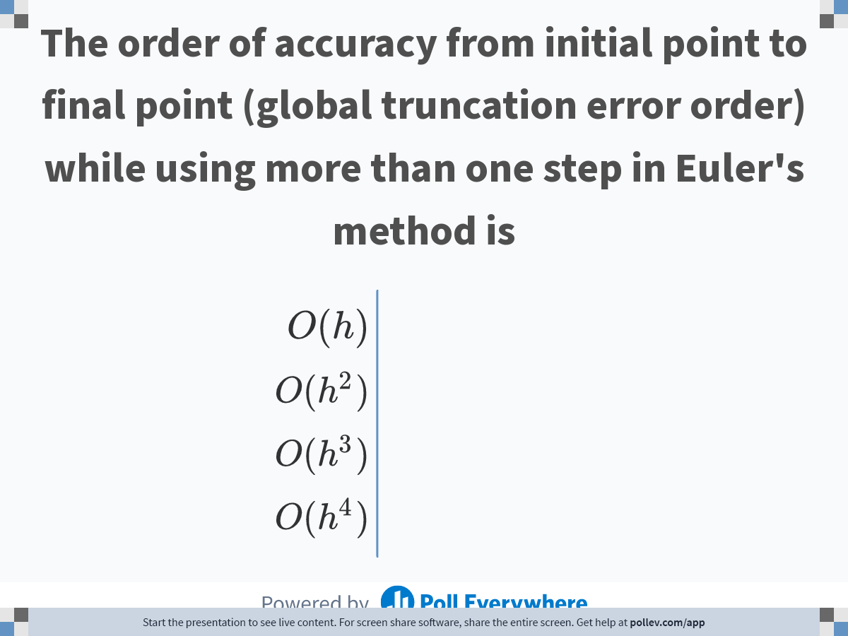
Notes:
Poll Title: Do not modify the notes in this section to avoid tampering with the Poll Everywhere activity.
More info at polleverywhere.com/support
The order of accuracy from initial point to final point while using more than one step in Euler's method is
https://www.polleverywhere.com/multiple_choice_polls/YTapBIIGrhar9SaIqFJax

Slide 12
END

Slide 13


