Slide 1

Bring Computational Methods Course Together
http://nm.MathForCollege.com
Transforming Numerical Methods Education for STEM Undergraduates
1

Slide 2
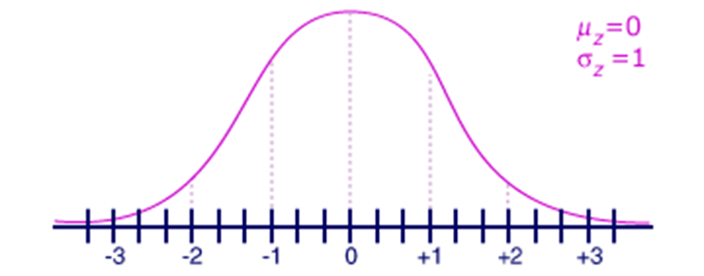
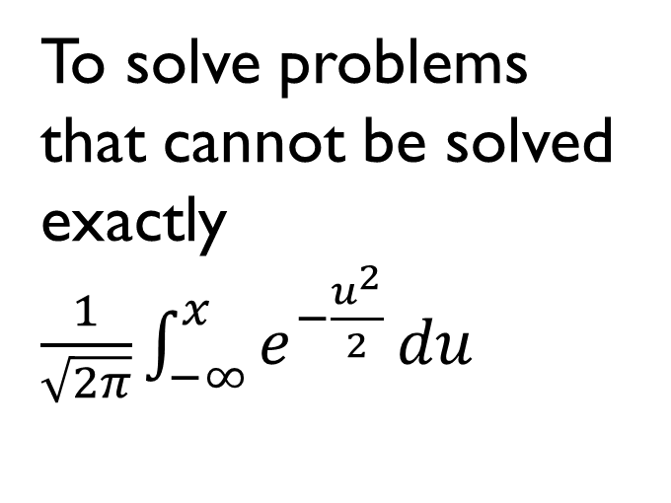
Why Use Numerical Methods?
To solve problems that cannot be solved exactly$\frac{1}{\sqrt{2π}}\int_{−∞}^{x}{e^{−\frac{u^{2}}{2}}}du$

Slide 3
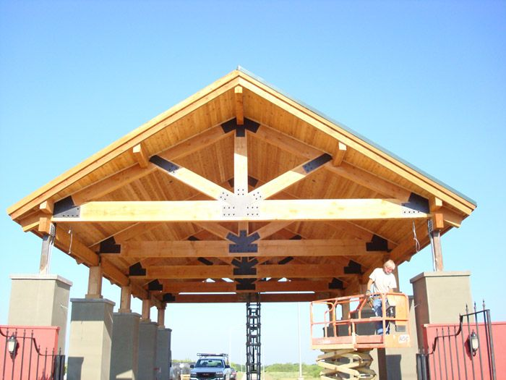
Why Use Numerical Methods?
To solve problems that are intractable to solve exactly!

Slide 4
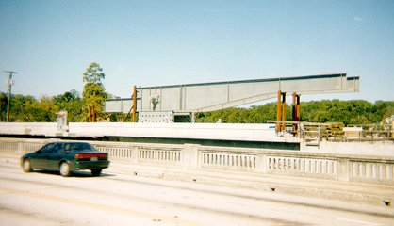
Bascule Bridge THG

Slide 5

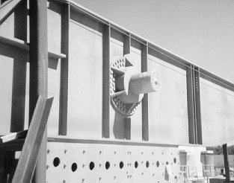
Bascule Bridge THG
Hub
Trunnion
Girder
Notes:
THG picture

Slide 6



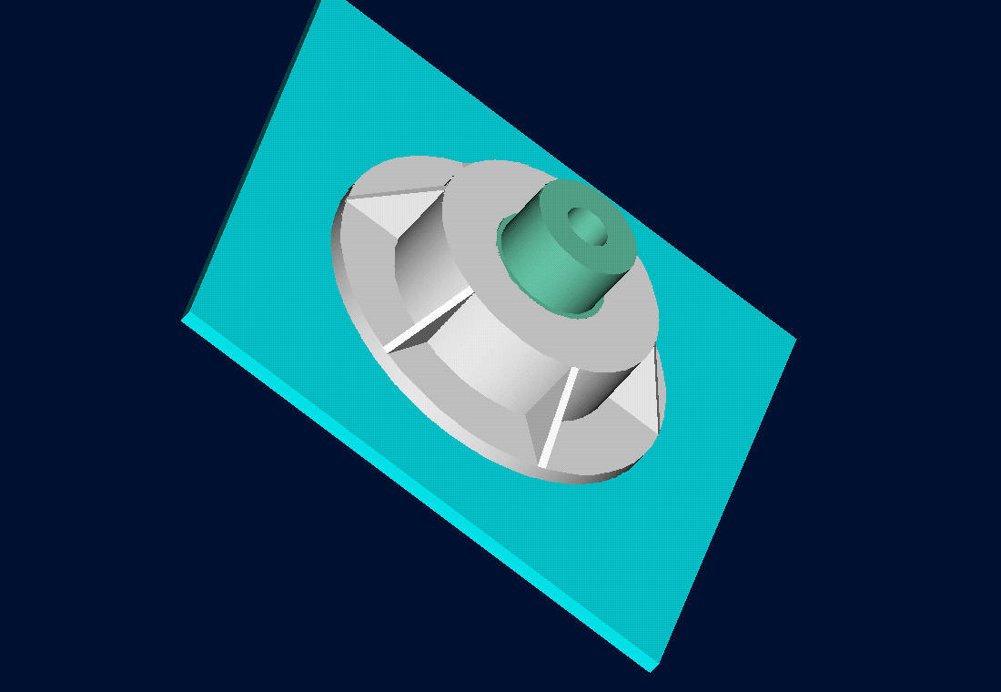
Trunnion-Hub-Girder Assembly Procedure
  Step1. Trunnion immersed in dry-ice/alcohol
  Step2. Trunnion warm-up in hub
  Step3. Trunnion-Hub immersed in dry-ice/alcohol
  Step4. Trunnion-Hub warm-up into girder

Slide 7
Problem
After Cooling, the Trunnion Got Stuck in Hub

Slide 8

Why did it get stuck?
Magnitude of contraction needed in the trunnion was $0.015′′$ or more. Did it contract enough?

Slide 9
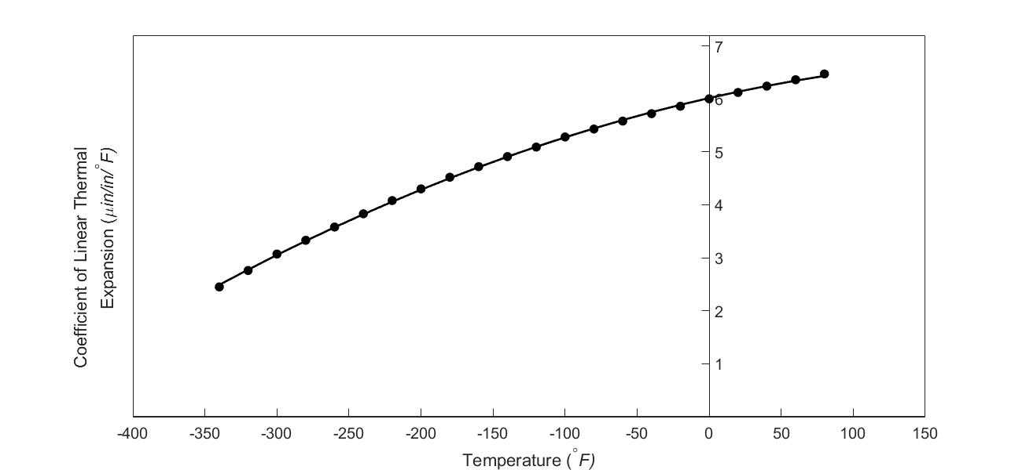

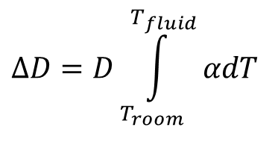
What model should I use to calculate contraction of trunnion?
$$ΔD=D\int_{T_{room}}^{T_{fluid}}{αdT}$$
$$ΔD=DαΔT$$

Slide 10
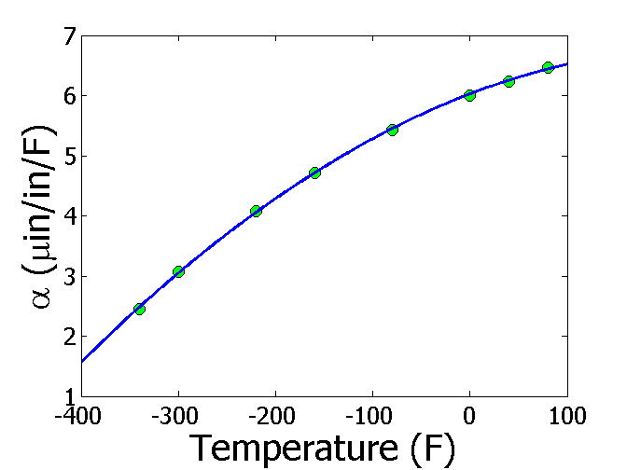
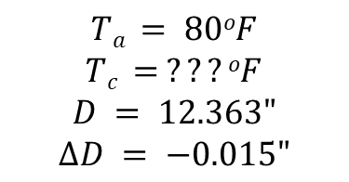
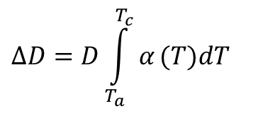
Finding the fluid temperature to get enough contraction
$$ΔD=D\int_{T_{a}}^{T_{c}}{α}(T)dT$$
$$Ta = 80oF$$
$$Tc = ???oF$$
$$D = 12.363"$$
$$∆D = −0.015"$$
$$α=−1.228×10^{−5}T^{2}+6.195×10^{−3}T+6.015$$
$$−0.015=12.363\int_{80}^{T_{c}}{(−1.228×10^{−5}T^{2}+6.195×10^{−3}T+6.015)}dT$$
$$−0.015=−5.059×10^{−9}{T_{c}}^{3}+3.829×10^{−6}{T_{c}}^{2}+7.435×10^{−5}T_{c}−6.166×10^{−3}$$
$$f(T_{c})=−5.059×10^{−9}{T_{c}}^{3}+3.829×10^{−6}{T_{c}}^{2}+7.435×10^{−5}T_{c}+8.834×10^{−3}=0$$

Slide 11
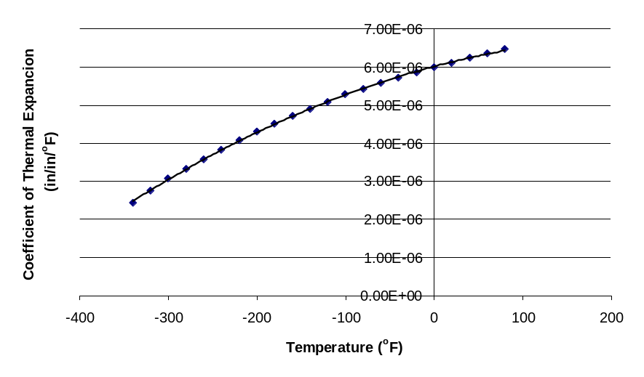
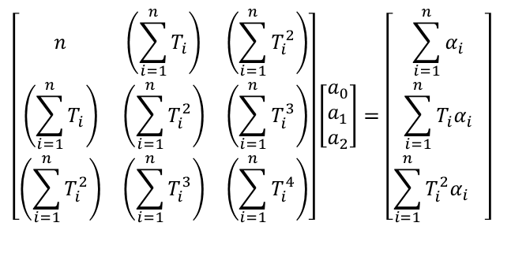

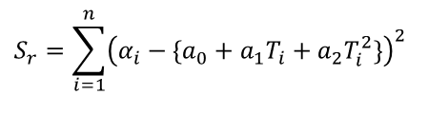
Finding the expression for thermal expansion coefficient
$$α=a_{0}+a_{1}T+a_{2}T^{2}$$
$$S_{r}=\sum_{i=1}^{n}{{\left(α_{i}−\{a_{0}+a_{1}T_{i}+a_{2}T_{i}^{2}\}\right)}^{2}}$$
$$\left[\begin{matrix}n & \left(\sum_{i=1}^{n}{T_{i}}\right) & \left(\sum_{i=1}^{n}{T_{i}^{2}}\right) \\ \left(\sum_{i=1}^{n}{T_{i}}\right) & \left(\sum_{i=1}^{n}{T_{i}^{2}}\right) & \left(\sum_{i=1}^{n}{T_{i}^{3}}\right) \\ \left(\sum_{i=1}^{n}{T_{i}^{2}}\right) & \left(\sum_{i=1}^{n}{T_{i}^{3}}\right) & \left(\sum_{i=1}^{n}{T_{i}^{4}}\right)\end{matrix}\right]\left[\begin{aligned}&a_{0} \\ &a_{1} \\ &a_{2}\end{aligned}\right]=\left[\begin{matrix}\sum_{i=1}^{n}{α_{i}} \\ \sum_{i=1}^{n}{T_{i}α_{i}} \\ \sum_{i=1}^{n}{T_{i}^{2}{α_{i}}^{}}\end{matrix}\right]$$
$$α=−1.2278×10^{−11}T^{2}+6.1946×10^{−9}T+6.0150×10^{−6}$$

Slide 12
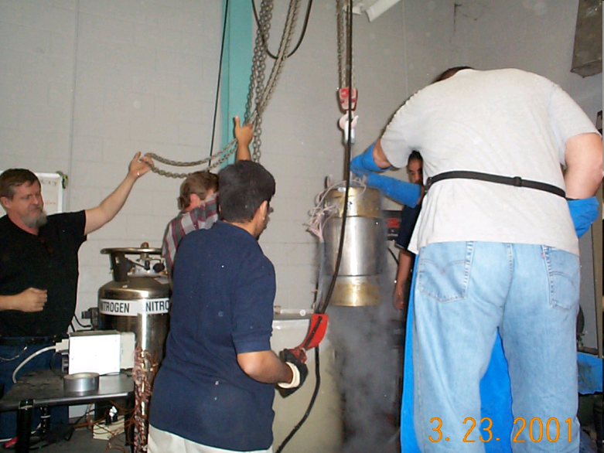


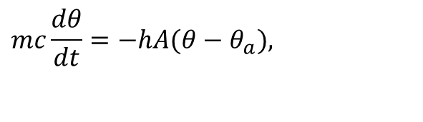
What is the temperature of the trunnion after half an hour?
$$mc\frac{dθ}{dt}=−hA(θ−θ_{a}),$$
$$θ(0)=θ_{room}$$

Slide 13

How long does it take a trunnion to cool down?
$$mc\frac{dθ}{dt}=−hA(θ−θ_{a}),$$
$$θ(0)=θ_{room}$$

Slide 14

What is the rate of change of heat stored in the cylinder?
$$mc\frac{dθ}{dt}=−hA(θ−θ_{a}),$$
$$θ(0)=θ_{room}$$

Slide 15
Can you identify?
We talked about 7 mathematical procedures in this course. Write them down.
Now connect the problem just discussed to these 7 mathematical procedures on each of the previous slides.
Write down the names of the various numerical methods under the 7 mathematical procedures

Slide 16
Chapter by Chapter Review by the Fire Hose

Slide 17
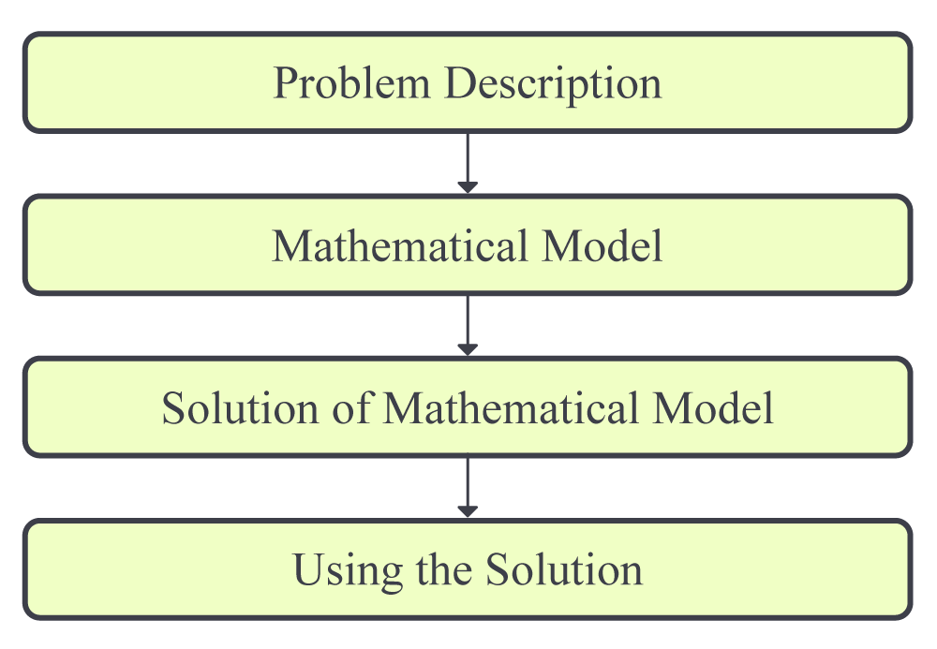
01.01 Introduction to Numerical Methods

Slide 18
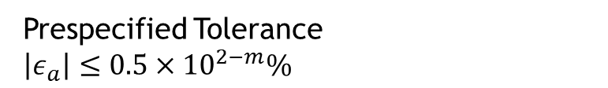
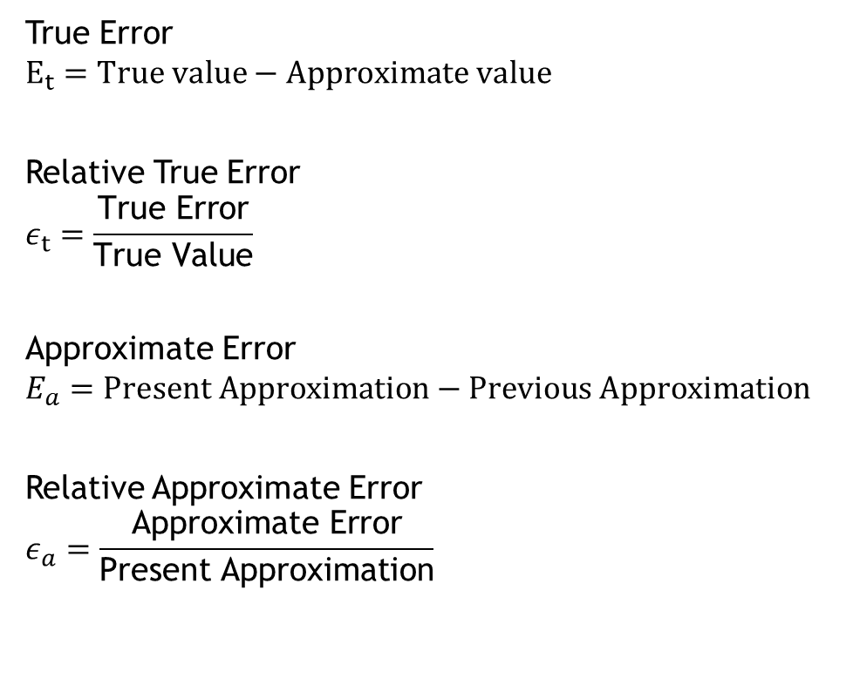
01.02 Measuring Errors
True Error
$$E_{t}=True value−Approximate value$$
Relative True Error
$$ε_{t}=\frac{\text{True} \text{Error}}{\text{True} \text{Value}}$$
Approximate Error
$$E_{a}=Present Approximation−Previous Approximation$$
Relative Approximate Error
$$ε_{a}=\frac{\text{Approximate} \text{Error}}{\text{Present} \text{Approximation}}$$
Prespecified Tolerance
$\left|ε_{a}\right|≤0.5×{10}^{2−m}\%$

Slide 19
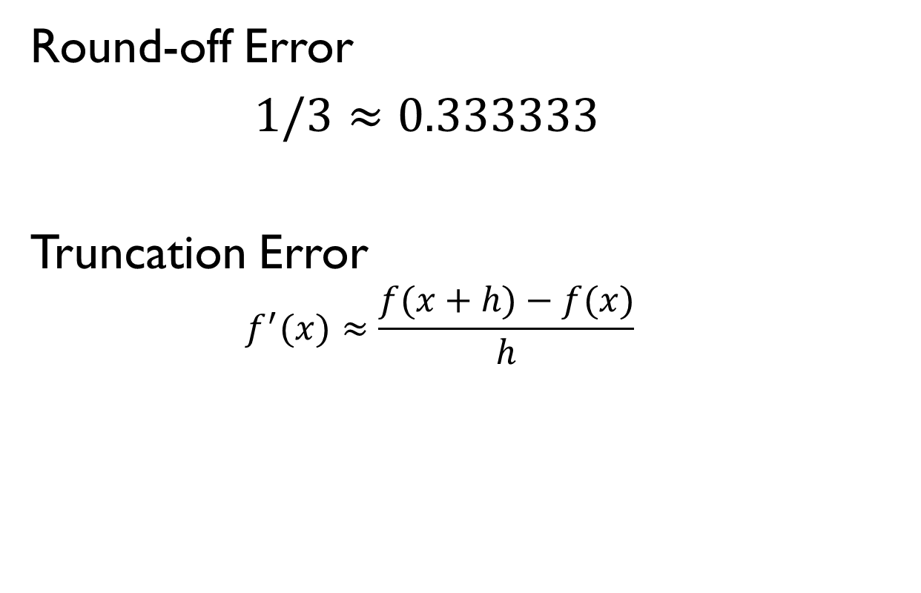
01.03 Sources of Error
Round-off Error
$1/3≈0.333333$
Truncation Error
  $$f^{′}(x)≈\frac{f(x+h)−f(x)}{h}$$

Slide 20
01.04 Fixed Binary Representation
$$(11.1875)_{10}=(1011.0011)_{2}$$
0 | 1 | 0 | 1 | 1
0 | 0 | 1 | 1 | 0 | 0

Slide 21
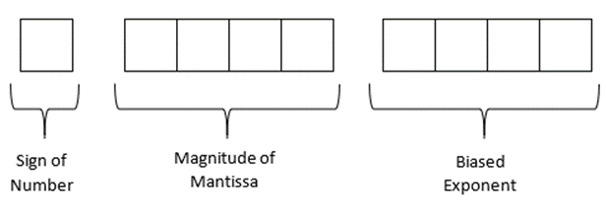
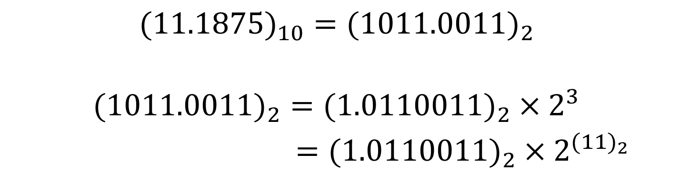
01.05 Floating Point Representation
$$(11.1875)_{10}=(1011.0011)_{2}$$
$$(1011.0011)_{2}=(1.0110011)_{2}×2^{3}$$
$=(1.0110011)_{2}×2^{{(11)}_{2}}$

Slide 22
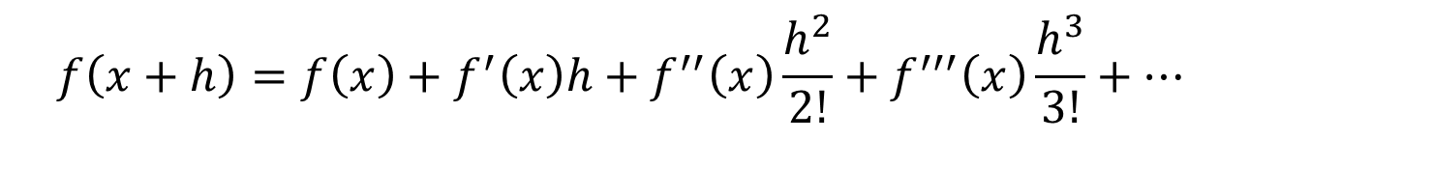
01.07 Taylor Series
$$f\left(x+h\right)=f\left(x\right)+f^{′}\left(x\right)h+f^{′′}\left(x\right)\frac{h^{2}}{2!}+f^{′′′}\left(x\right)\frac{h^{3}}{3!}+…$$

Slide 23
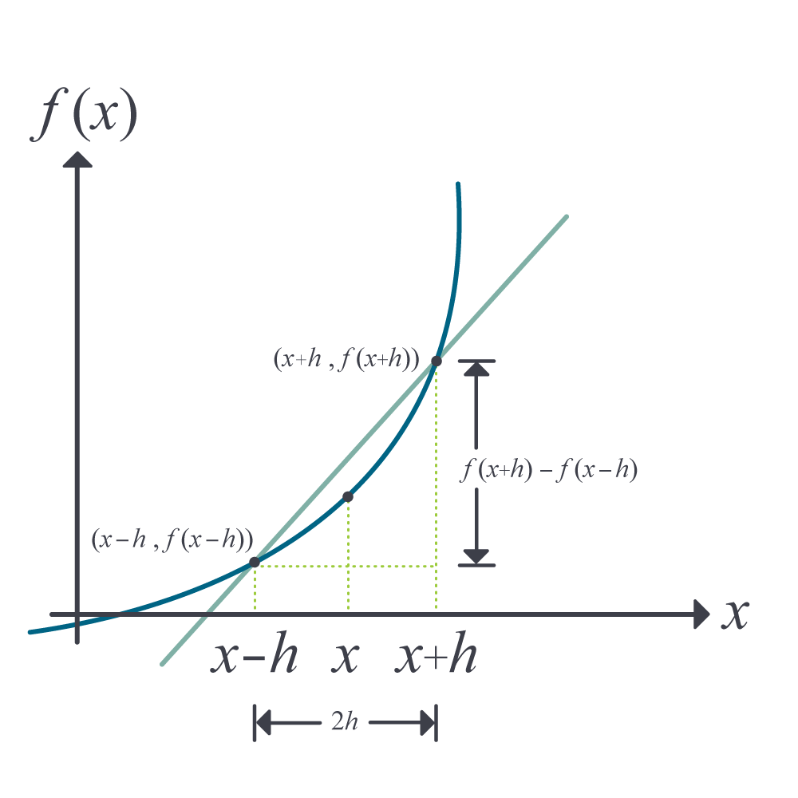
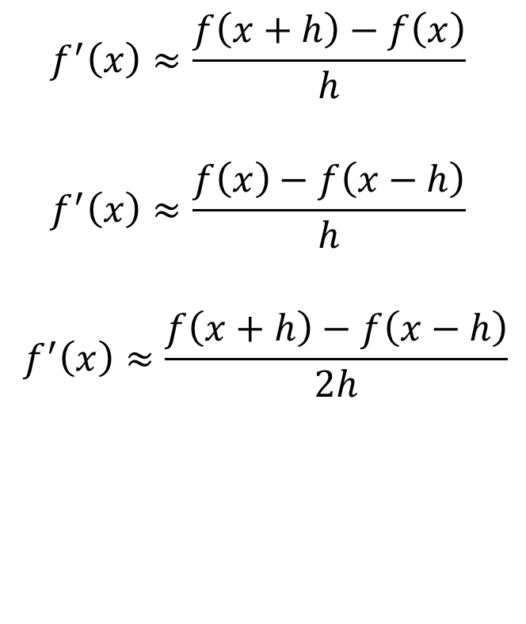
02.02 Differentiation of Continuous Functions
$$f^{′}\left(x\right)≈\frac{f\left(x+h\right)−f\left(x\right)}{h}$$
$$f^{′}\left(x\right)≈\frac{f\left(x\right)−f\left(x−h\right)}{h}$$
$$f^{′}\left(x\right)≈\frac{f\left(x+h\right)−f\left(x−h\right)}{2h}$$

Slide 24
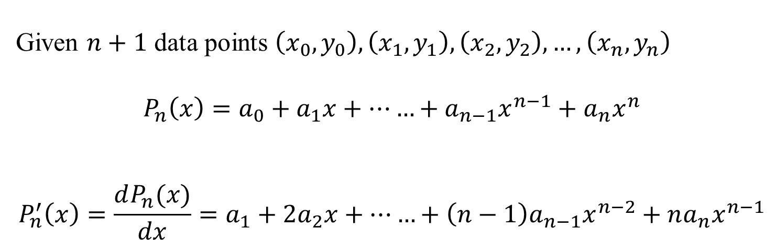
02.03 Differentiation of Function Given at Discrete Points
Given $n+1$ data points $\left(x_{0},y_{0}\right),\left(x_{1},y_{1}\right),\left(x_{2},y_{2}\right),…,\left(x_{n},y_{n}\right)$
$$P_{n}\left(x\right)=a_{0}+a_{1}x+……+a_{n−1}x^{n−1}+a_{n}x^{n}$$
$$P_{n}^{′}\left(x\right)=\frac{dP_{n}(x)}{dx}=a_{1}+2a_{2}x+……+\left(n−1\right)a_{n−1}x^{n−2}+na_{n}x^{n−1}$$

Slide 25
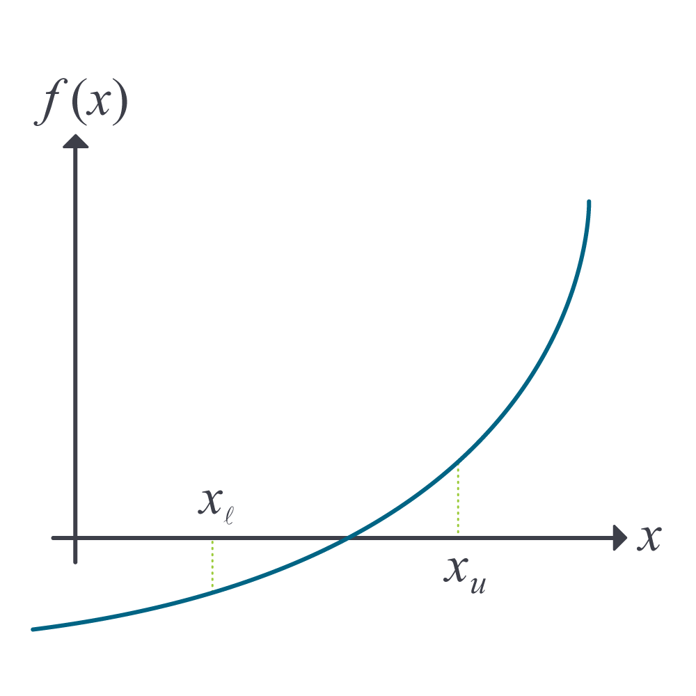

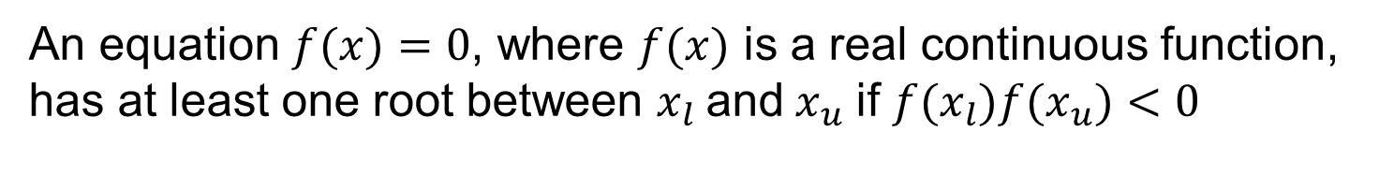
03.02 Bisection Method
An equation $f(x)=0$, where $f(x)$ is a real continuous function,
has at least one root between $x_{l}$and${ x}_{u}$ if $f(x_{l})f(x_{u})<0$
$$x_{m}=\frac{x_{l}+ x_{u}}{2}$$

Slide 26
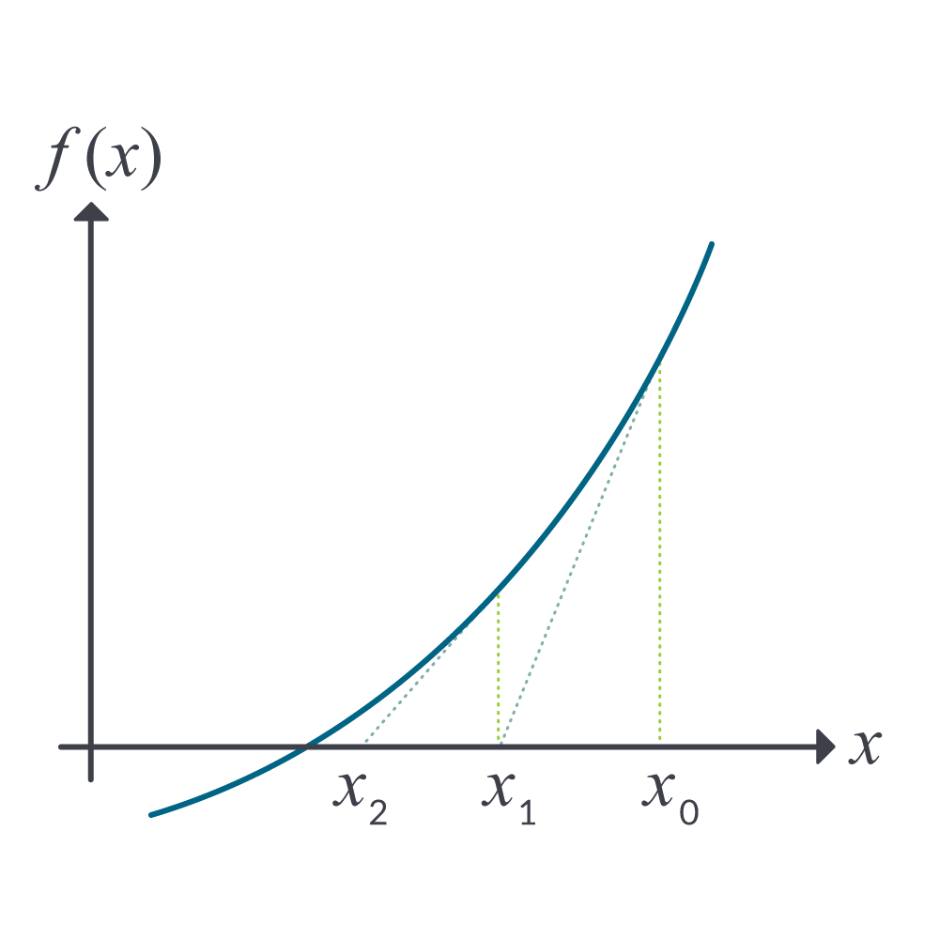

03.03 Newton Raphson Method
$$x_{i+1} = x_{i}−\frac{f\left(x_{i}\right)}{f^{′}\left(x_{i}\right)}$$

Slide 27
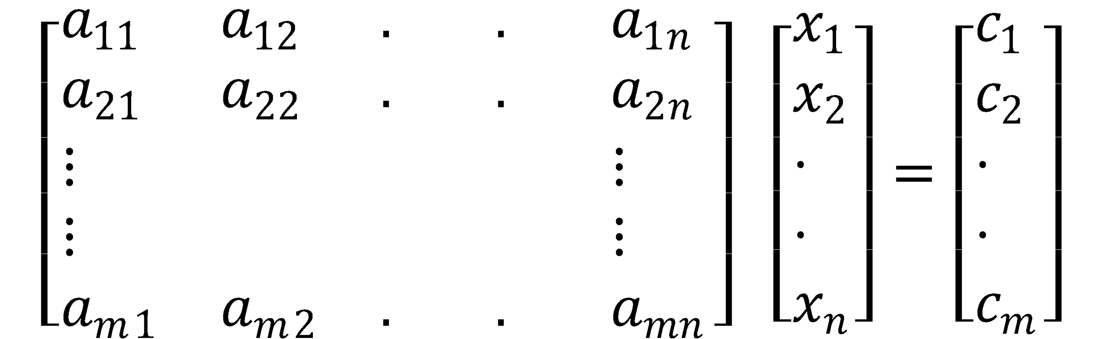
04.01 Prerequisites to Simultaneous Linear Equations
Binary matrix operations
Inverse of a matrix
Determinant of a matrix

Slide 28
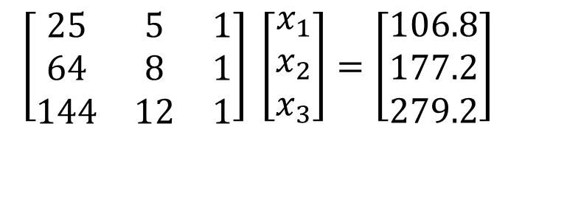
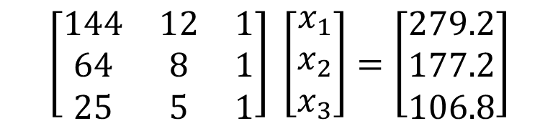
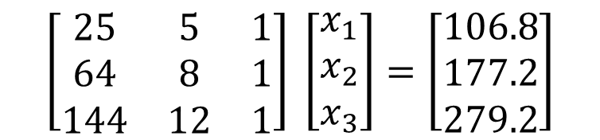
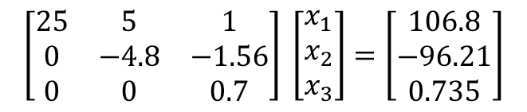
04.06 Gaussian Elimination
$$\left[\begin{matrix}25 & 5 & 1 \\ 64 & 8 & 1 \\ 144 & 12 & 1\end{matrix}\right] \left[\begin{matrix}x_{1} \\ x_{2} \\ x_{3}\end{matrix}\right]=\left[\begin{matrix}106.8 \\ 177.2 \\ 279.2\end{matrix}\right]$$
$$\left[\begin{matrix}25 & 5 & 1 \\ 0 & −4.8 & −1.56 \\ 0 & 0 & 0.7\end{matrix}\right] \left[\begin{matrix}x_{1} \\ x_{2} \\ x_{3}\end{matrix}\right]=\left[\begin{matrix}106.8 \\ −96.21 \\ 0.735\end{matrix}\right]$$
$$\left[\begin{matrix}25 & 5 & 1 \\ 64 & 8 & 1 \\ 144 & 12 & 1\end{matrix}\right] \left[\begin{matrix}x_{1} \\ x_{2} \\ x_{3}\end{matrix}\right]=\left[\begin{matrix}106.8 \\ 177.2 \\ 279.2\end{matrix}\right]$$
$$\left[\begin{matrix}144 & 12 & 1 \\ 64 & 8 & 1 \\ 25 & 5 & 1\end{matrix}\right] \left[\begin{matrix}x_{1} \\ x_{2} \\ x_{3}\end{matrix}\right]=\left[\begin{matrix}279.2 \\ 177.2 \\ 106.8\end{matrix}\right]$$

Slide 29
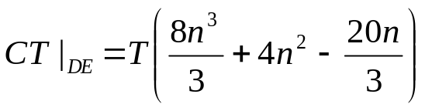


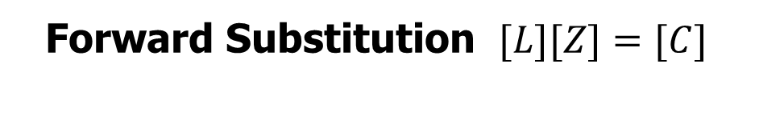


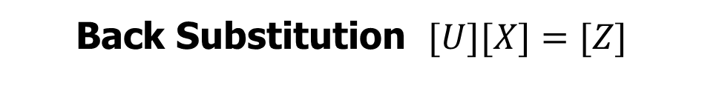
04.07 LU Decomposition
$$[A][X]=[C]$$
Decomposition of [A] to LU$[A]=[L][U]$
Forward Substitution $[L][Z]=[C]$
Back Substitution $[U][X]=[Z]$

Slide 30
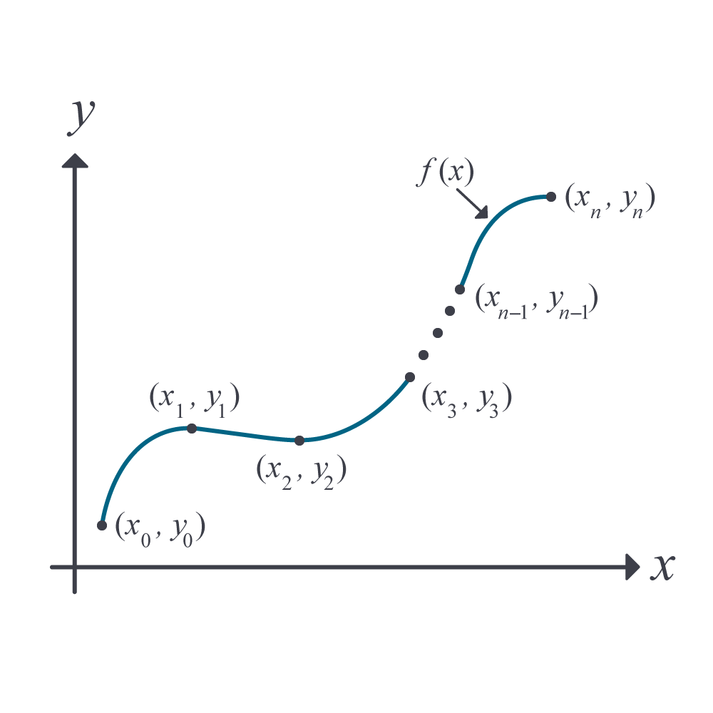
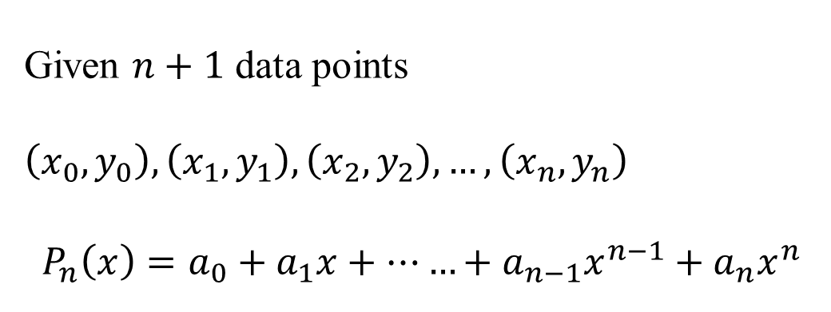
05.02 Direct Method of Interpolation
Given $n+1$ data points $\left(x_{0},y_{0}\right),\left(x_{1},y_{1}\right),\left(x_{2},y_{2}\right),…,\left(x_{n},y_{n}\right)$
$$P_{n}\left(x\right)=a_{0}+a_{1}x+……+a_{n−1}x^{n−1}+a_{n}x^{n}$$

Slide 31
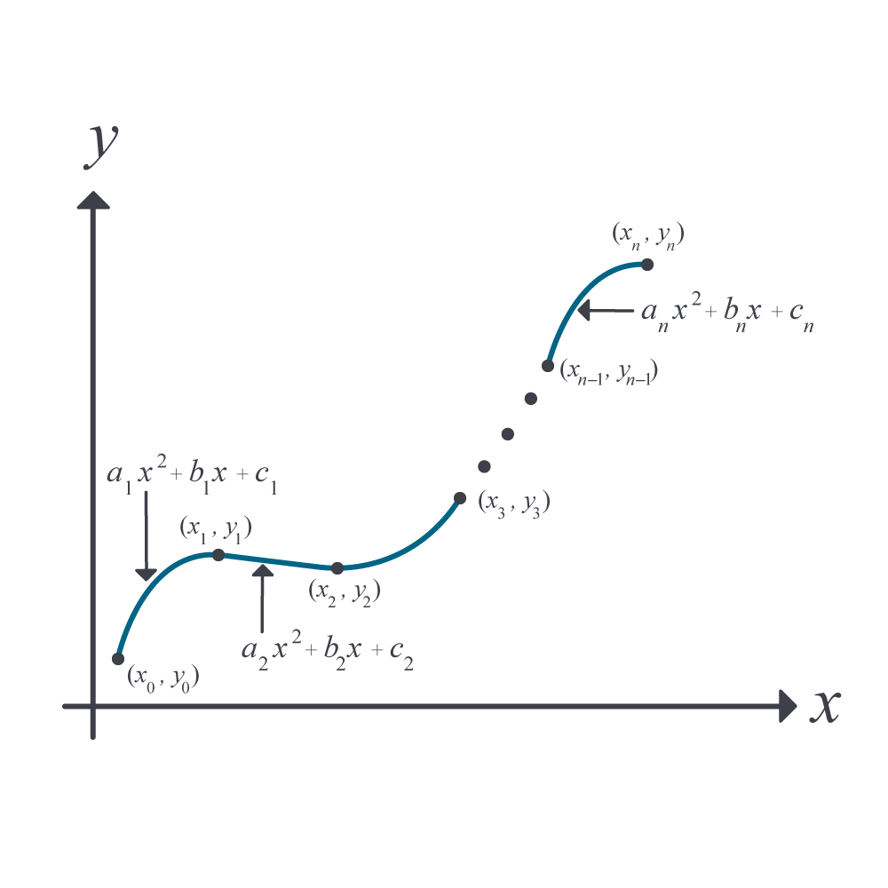
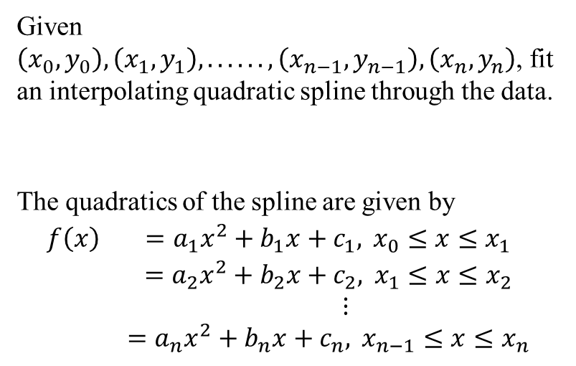
05.05 Spline Interpolation
Given $\left(x_{0},y_{0}\right),\left(x_{1},y_{1}\right),......,\left(x_{n−1},y_{n−1}\right),\left(x_{n},y_{n}\right)$, fit an interpolating quadratic spline through the data.
The quadratics of the spline are given by
$$\begin{matrix}f\left(x\right) & =a_{1}x^{2}+b_{1}x+c_{1}, x_{0}≤x≤x_{1} \\ & =a_{2}x^{2}+b_{2}x+c_{2}, x_{1}≤x≤x_{2} \\ & ⋮ \\ & =a_{n}x^{2}+b_{n}x+c_{n}, x_{n−1}≤x≤x_{n}\end{matrix}$$

Slide 32
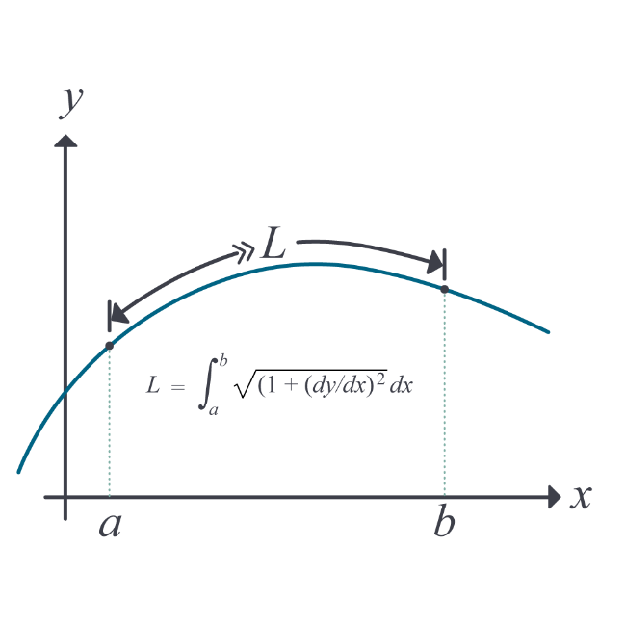
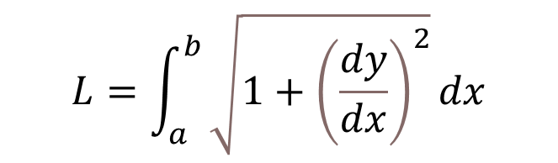
05.10 Length of a Curve
$$L=\int_{a}^{b}{\sqrt{1+{\left(\frac{dy}{dx}\right)}^{2}}dx}$$

Slide 33
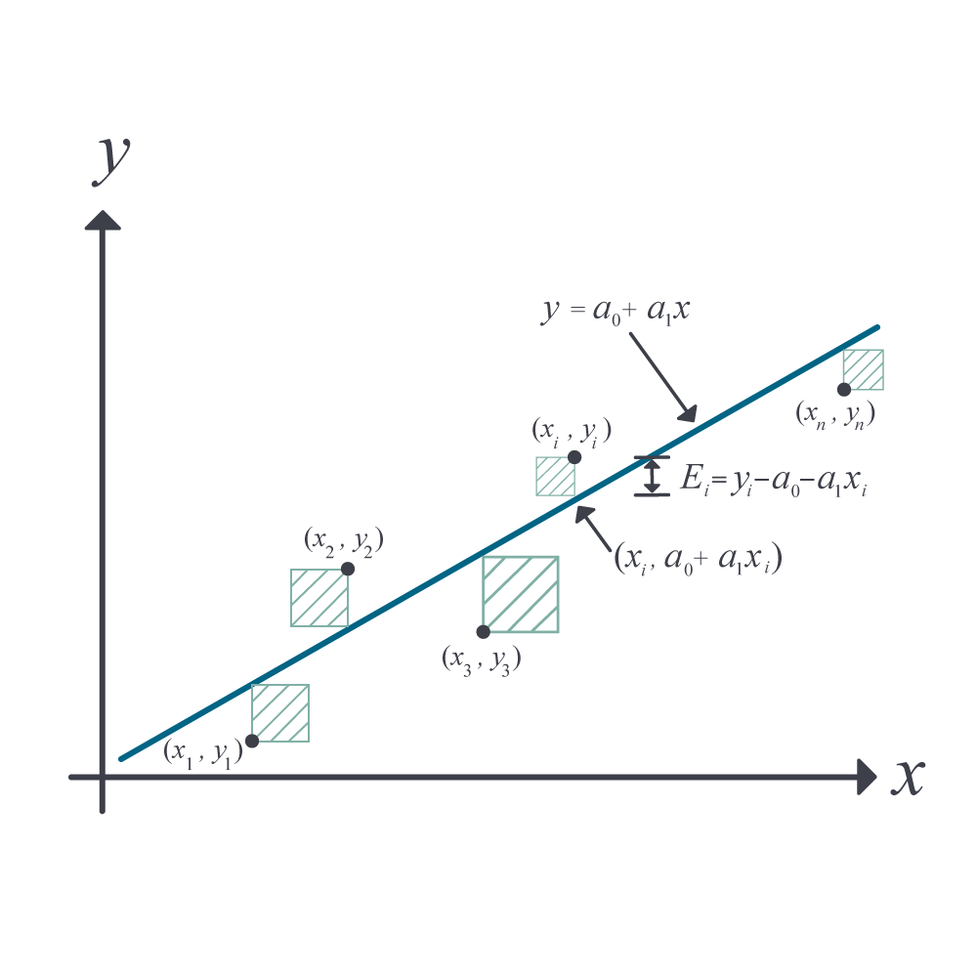
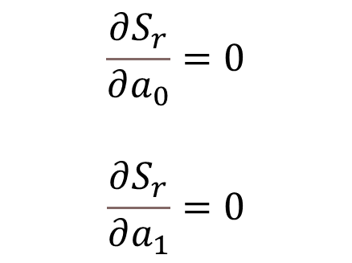
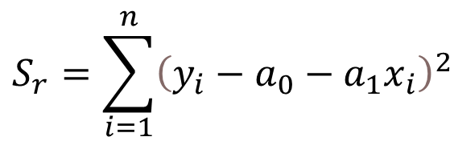
06.03 Linear Regression
$$\begin{matrix}S_{r}=\sum_{i=1}^{n}{{\left(y_{i}−a_{0}−a_{1}x_{i}\right)}^{2}} & \\ & \end{matrix}$$
$$\frac{∂S_{r}}{∂a_{0}}=0$$
$$\frac{∂S_{r}}{∂a_{1}}=0$$
Second derivative test

Slide 34
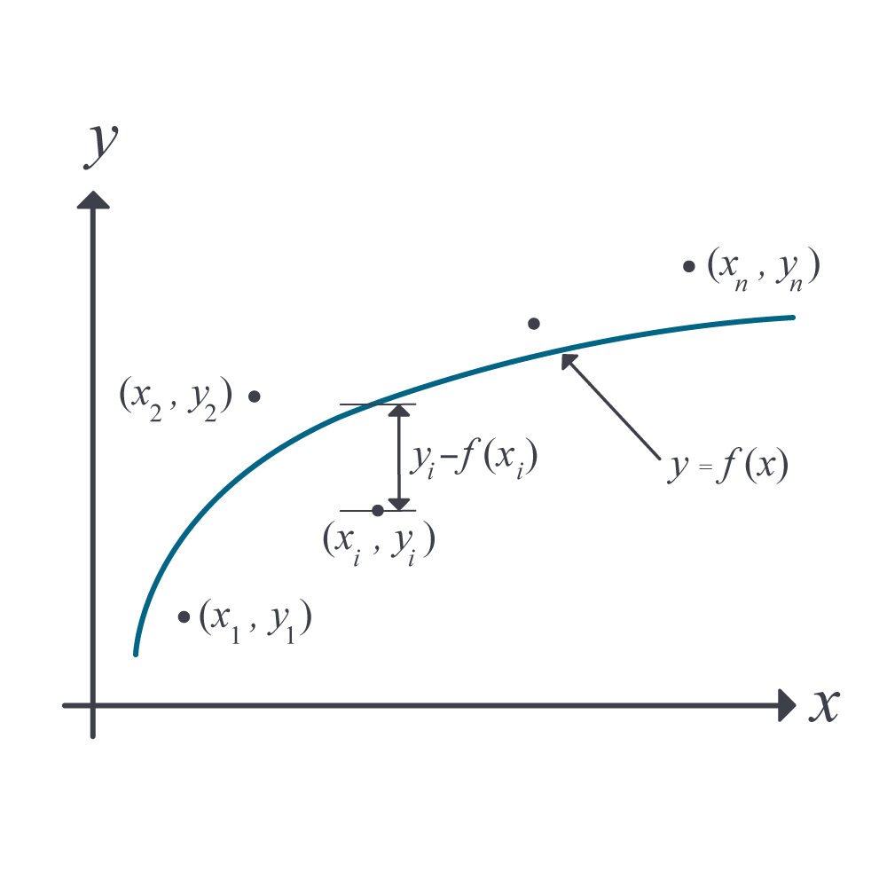
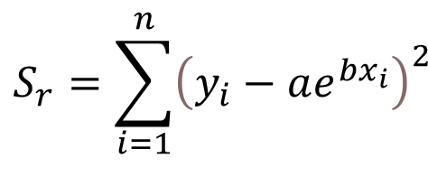
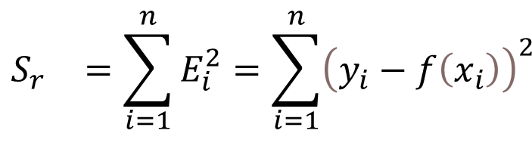
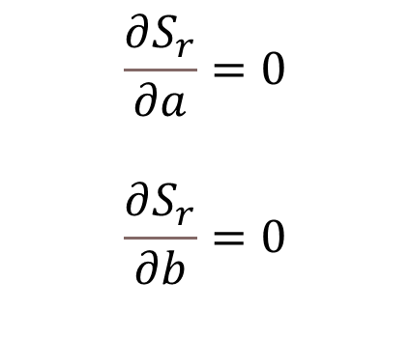
06.04 Nonlinear Regression
$$\begin{matrix}S_{r}=\sum_{i=1}^{n}{{\left(y_{i}−ae^{bx_{i}}\right)}^{2}} & \\ & \end{matrix}$$
$$\frac{∂S_{r}}{∂a}=0$$
$$\frac{∂S_{r}}{∂b}=0$$
$$\begin{matrix}S_{r} & =\sum_{i=1}^{n}{E_{i}^{2}=\sum_{i=1}^{n}{{\left(y_{i}−f\left(x_{i}\right)\right)}^{2}}} \\ & \end{matrix}$$

Slide 35

06.05 Adequacy of Regression Model
Checks
1) Plotting the data and the linear regression model.
2) Calculate a standard estimate of the error. Calculate scaled residuals. Calculate how many scaled residuals are in the [-2,2] bracket.
3) Calculate the coefficient of determination. Calculate how close the coefficient of determination is to 1.
4) Calculate if it meets the assumptions of random errors.

Slide 36



07.02 Trapezoidal Rule of Integration
$$\int_{a}^{b}{f\left(x\right)dx=}$$
$$=\frac{b−a}{2n}\left[f\left(a\right)+2\left\{\sum_{i=1}^{n−1}{f\left(a+ih\right)}\right\}+f\left(b\right)\right]$$
$$h=\frac{b−a}{n}$$
$$E_{t}≈−\frac{{\left(b−a\right)}^{3}}{12n^{2}}\overline{f^{′′}}$$

Slide 37


07.06 Integrating Functions Given at Discrete Points
$\int_{x_{1}}^{x_{n}}{f\left(x\right)}dx≈\sum_{i=1}^{n−1}{\left(x_{i+1}−x_{i}\right)\frac{f\left(x_{i}\right)+f\left(x_{i+1}\right)}{2}}$

Slide 38


07.05 Gauss Quadrature Rule of Integration
$$\begin{matrix}\int_{a}^{b}{f\left(x\right)dx}≈\frac{b−a}{2}f\left(\frac{b−a}{2}\left(−\frac{1}{\sqrt{3}}\right)+\frac{b+a}{2}\right)+\frac{b−a}{2}f\left(\frac{b−a}{2}\left(\frac{1}{\sqrt{3}}\right)+\frac{b+a}{2}\right) & \\ & \\ & \end{matrix}$$

Slide 39



08.02 Euler’s Method
$$\frac{dy}{dx}=f(x,y),y\left(a\right)=y_{a}$$
$$y_{i+1}=y_{i}+f\left(x_{i},y_{i}\right)h$$

Slide 40



08.03 Runge Kutta 2nd Order Method
$$\frac{dy}{dx}=f(x,y),y\left(a\right)=y_{a}$$
$$y_{i+1}=y_{i}+\left(\frac{1}{2}k_{1}+\frac{1}{2}k_{2}\right)h$$
$$k_{1}=f\left(x_{i},y_{i}\right)$$
$$k_{2}=f\left(x_{i}+h,y_{i}+k_{1}h\right)$$

Slide 41


08.05 Solving Higher-Order/Coupled Ordinary Differential Equations
$$10\frac{d^{2}x_{1}}{dt^{2}}−15\left(−2x_{1}+x_{2}\right)=\sin{t}$$
$$20\frac{d^{2}x_{2}}{dt^{2}}−15\left(x_{1}−2x_{2}\right)=0$$
$$\frac{dx_{1}}{dt}\left(0\right)=4, \frac{dx_{2}}{dt}\left(0\right)=5,$$
$$x_{1}\left(0\right)=2, x_{2}\left(0\right)=3$$
$\left[\begin{matrix}{\dot{x}}_{1} \\ {\dot{x}}_{2} \\ {\dot{x}}_{3} \\ {\dot{x}}_{4}\end{matrix}\right]=\left[\begin{matrix}0 & 0 & 1 & 0 \\ 0 & 0 & 0 & 1 \\ −3 & 1.5 & 0 & 0 \\ 0.75 & −1.5 & 0 & 0\end{matrix}\right]\left[\begin{matrix}x_{1} \\ x_{2} \\ x_{3} \\ x_{4}\end{matrix}\right]$+ $\left[\begin{matrix}0 \\ 0 \\ 0.1\sin{t} \\ 0\end{matrix}\right]$
$$\left[\begin{matrix}x_{1}\left(0\right) \\ x_{2}\left(0\right) \\ x_{3}\left(0\right) \\ x_{4}\left(0\right)\end{matrix}\right]=\left[\begin{matrix}2 \\ 3 \\ 4 \\ 5\end{matrix}\right]$$

Slide 42


