Slide 1

EML 4230 Introduction to Composite Materials
Chapter 3 Micromechanical Analysis of a Lamina
Ultimate Strengths of a Unidirectional Lamina
Part 1
Dr. Autar Kaw
Department of Mechanical Engineering
University of South Florida, Tampa, FL 33620
Courtesy of the Textbook
Mechanics of Composite Materials by Kaw

Slide 2
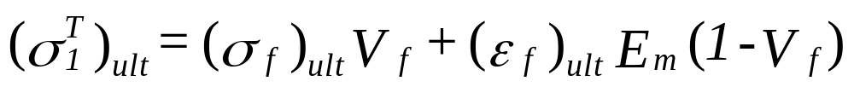
Longitudinal Tensile Strength of Unidirectional Lamina,

Slide 3
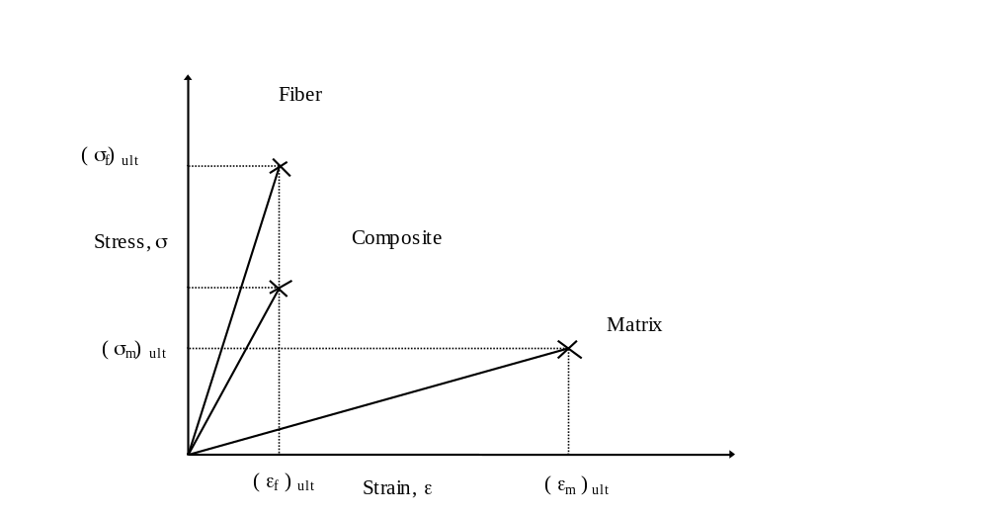
Longitudinal Tensile Strength
Stress–strain curve for a unidirectional composite under uniaxial tensile load along fibers.

Slide 4

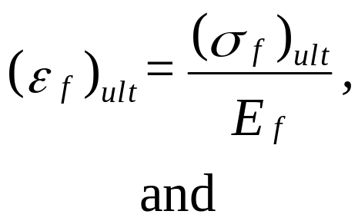
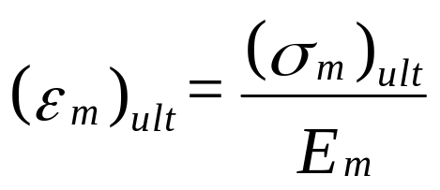

Longitudinal Tensile Strength

Slide 5
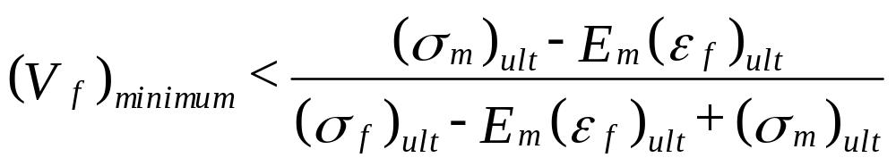
Minimum Fiber Volume Fraction

Slide 6
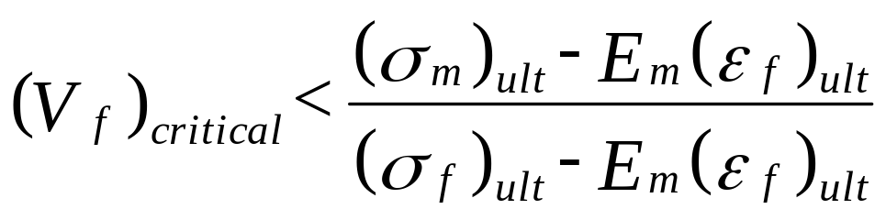
Critical Fiber Volume Fraction

Slide 7
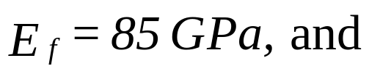



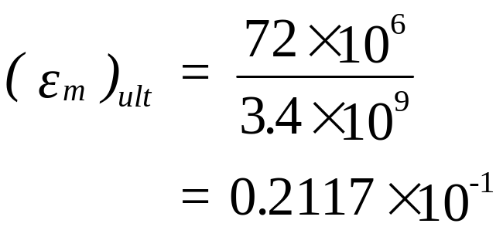
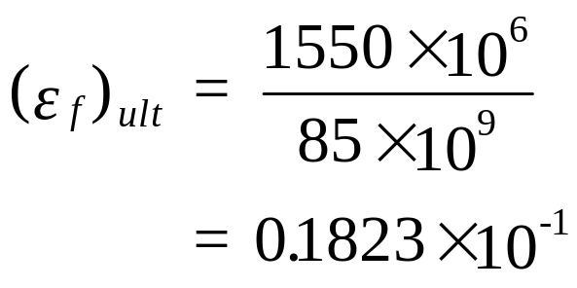
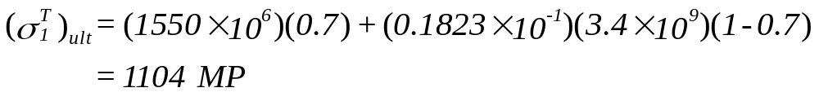


Example, Ultimate Longitudinal Tensile Strength
Find the ultimate longitudinal tensile strength for a Glass/Epoxy lamina with a 70% fiber volume fraction. Use the properties for glass and epoxy from Tables 3.1 and 3.2, respectively. Also, find the minimum and critical fiber volume fractions.
$$A=πr^{2}$$
$$=1104 MPa$$

Slide 8
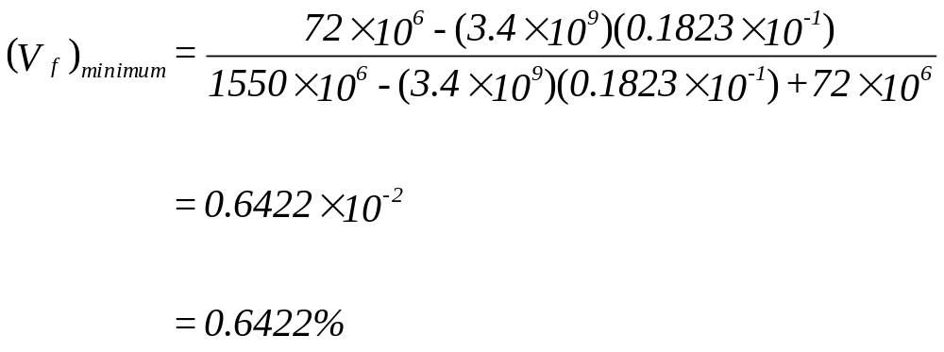
Example, Minimum Fiber Volume Fraction

Slide 9
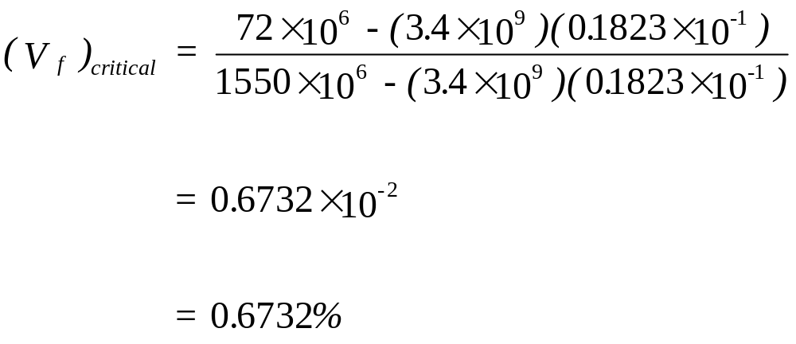
Example, Critical Fiber Volume Fraction

Slide 10
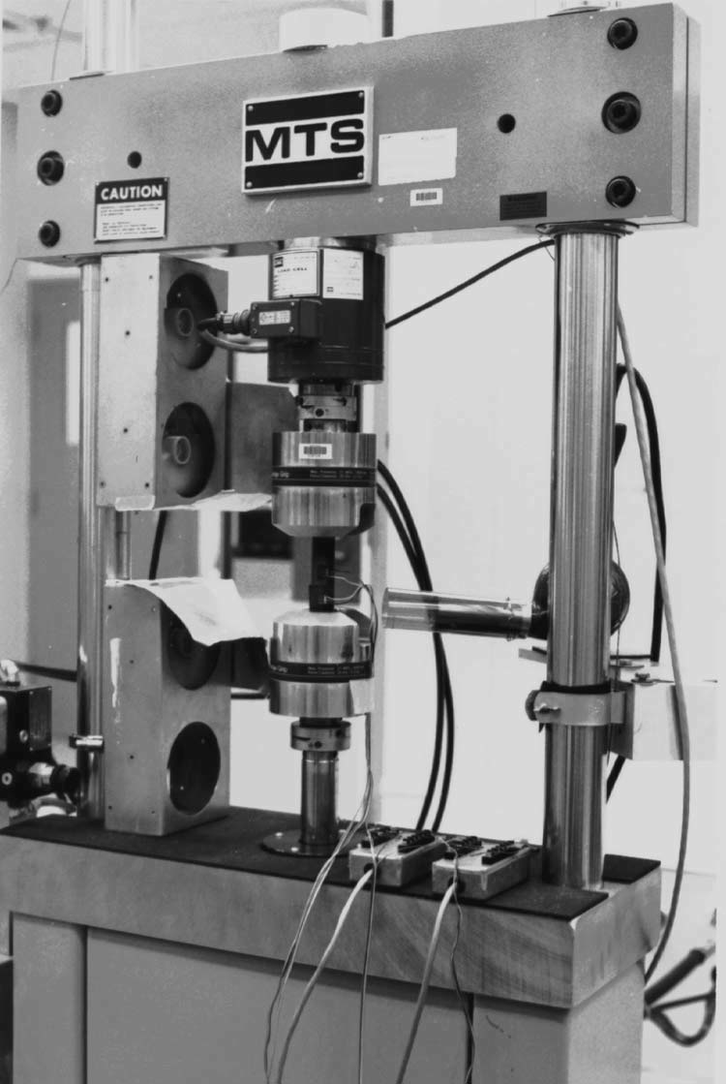
Experimental Longitudinal Tensile Strength Setup
Tensile coupon mounted in the test frame for finding the tensile strengths of a unidirectional lamina. (Photo courtesy of Dr. R.Y. Kim, University of Dayton Research Institute, Dayton, OH.)

Slide 11
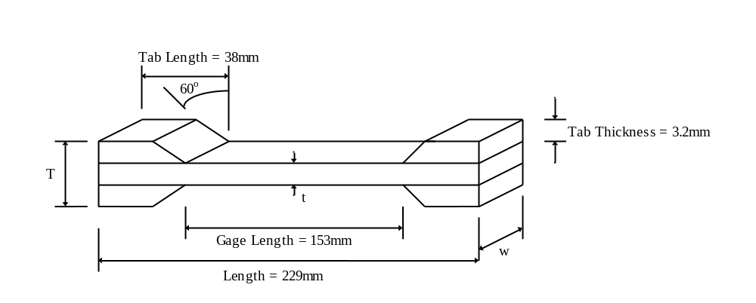
Coupon Used for Longitudinal Tensile Strength
FIGURE 3.26
Geometry of a longitudinal tensile strength specimen.

Slide 12
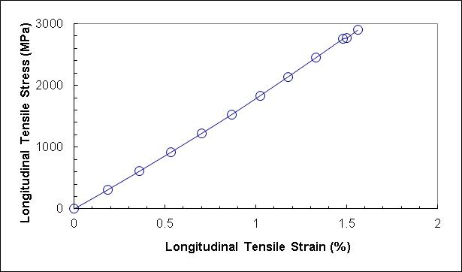

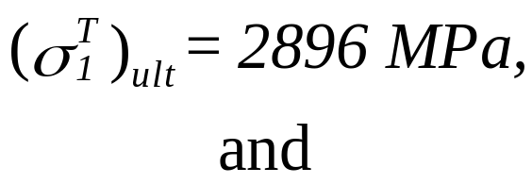
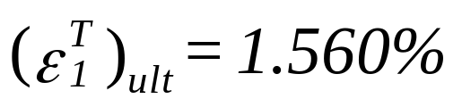
Experimental Results of Longitudinal Tensile Strength
Stress–strain curve for a [0]₈ laminate under a longitudinal tensile load. (Data courtesy of Dr. R.Y. Kim, University of Dayton Research Institute, Dayton, OH).

Slide 13
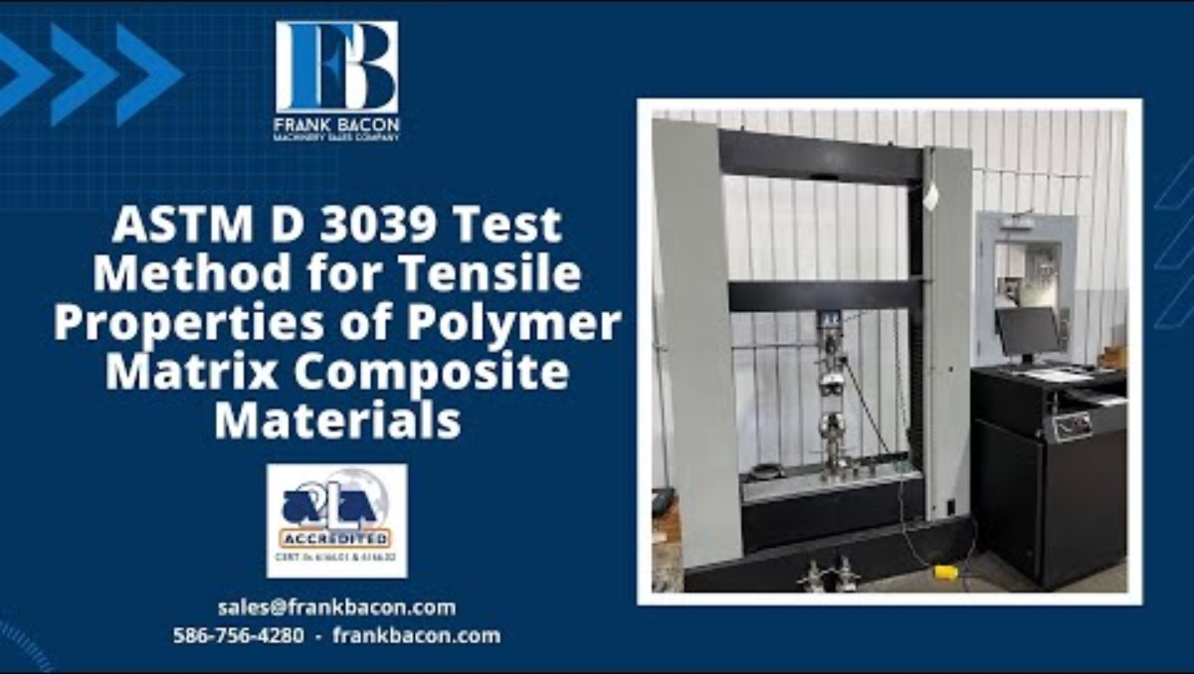
Video of ASTM D3039 Test

Slide 14
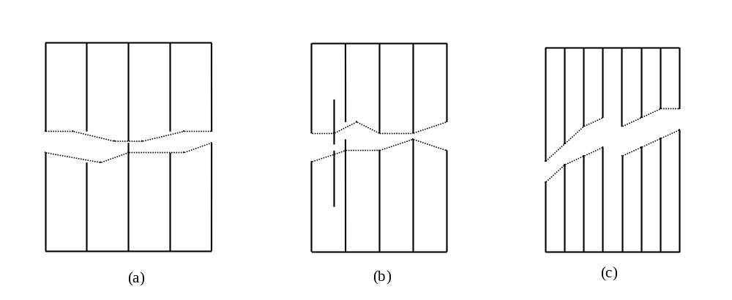
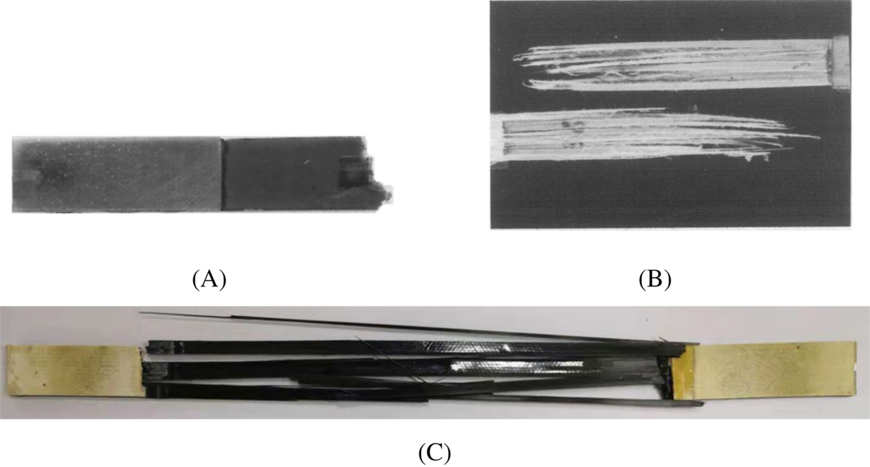
Modes of Failure under Longitudinal Tensile Stress
Modes of failure of unidirectional lamina under a longitudinal tensile load.

Slide 15

Longitudinal Compressive Strength of Unidirectional Lamina,

Slide 16
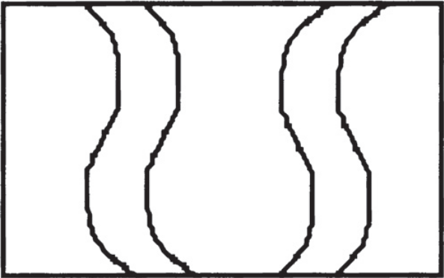
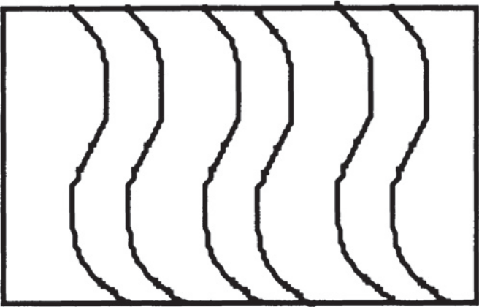
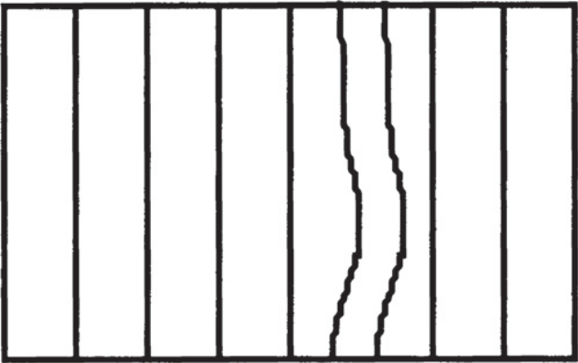
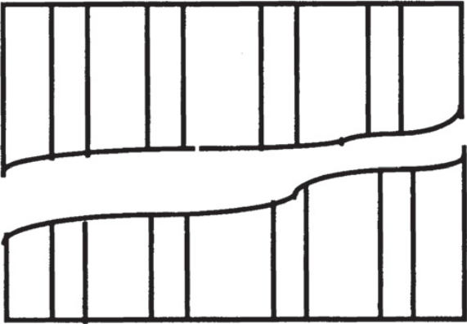
Longitudinal Compressive Strength
Fiber microbuckling extensional mode Fiber microbuckling shear mode
Transverse tensile failure of matrix mode Shear failure mode
Modes of failure of a unidirectional lamina under a longitudinal compressive load.

Slide 17
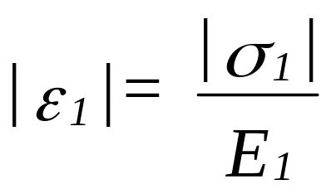
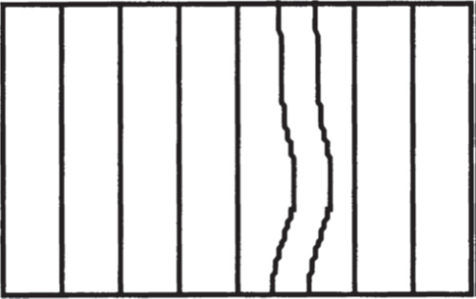
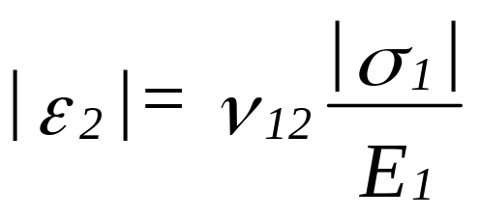
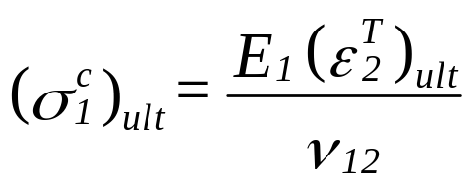
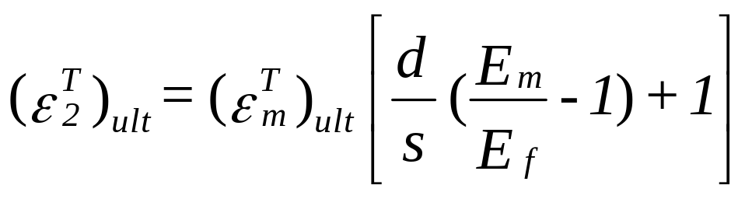
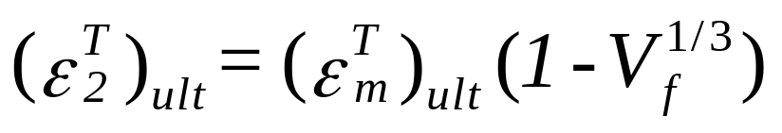
Longitudinal Compressive Strength
Transverse Matrix Failure Mode
(Maximum strain failure theory)
(Mechanics of materials formula)
(Empirical Formula)

Slide 18
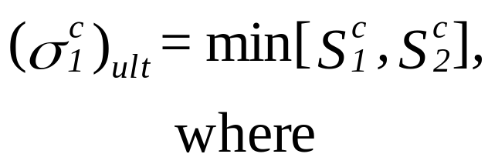
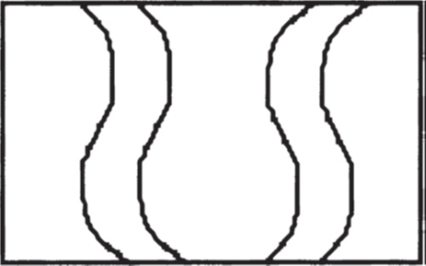
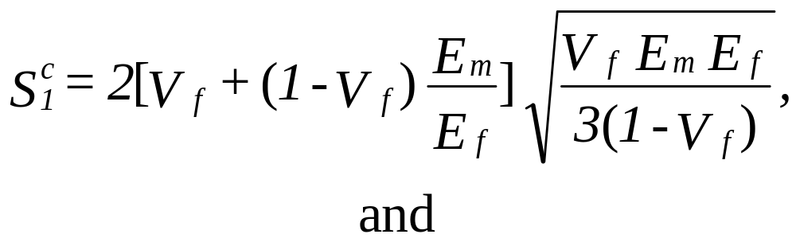
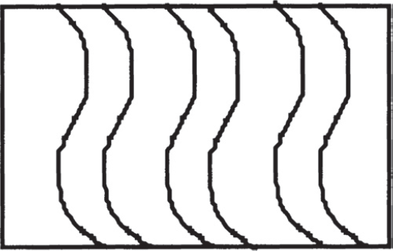
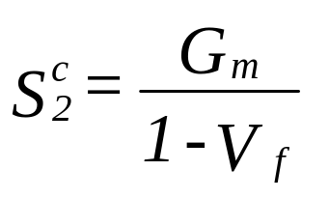
Longitudinal Compressive Strength
Shear/Extensional Fiber Microbuckling Load
Extensional
Shear

Slide 19
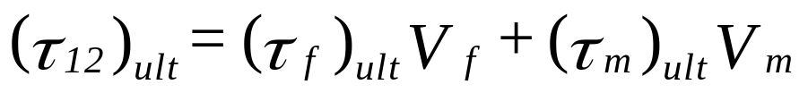
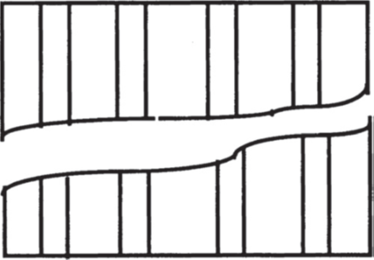
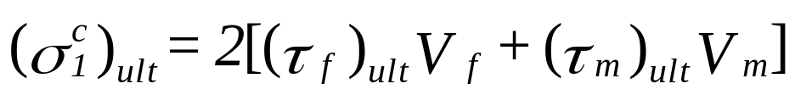
Longitudinal Compressive Strength
Shear Failure Mode

Slide 20
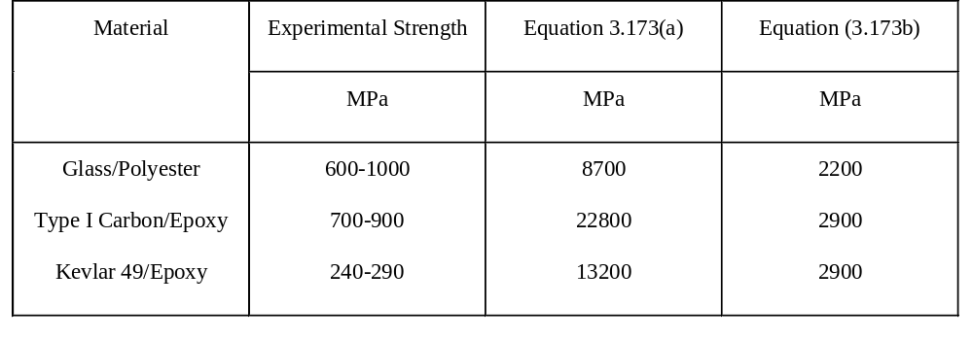
Longitudinal Compressive Strength, Experiment vs Theory
Comparison of experimental and predicted values of longitudinal compressive
strength of unidirectional laminae, V_{f} =0.50. (Source: Table 7.2 in Introduction to Composite Materials by D. Hull, 1981, 8 Cambridge University Press, 1981, Reprinted with the permission of Cambridge University Press)

Slide 21
Why experimental numbers do not match theoretical results
Irregular spacing of fibers causing premature failure in matrix-rich areas
Less than perfect bonding between the fibers and the matrix
Poor alignment of fibers
Not accounting for Poisson’s ratio mismatch between the fiber and the matrix
Not accounting for the transversely isotropic nature of fibers such as aramids and graphite

Slide 22
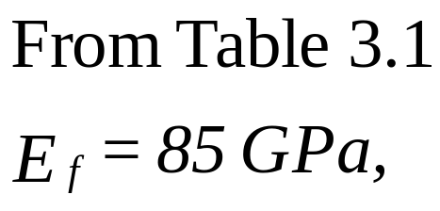
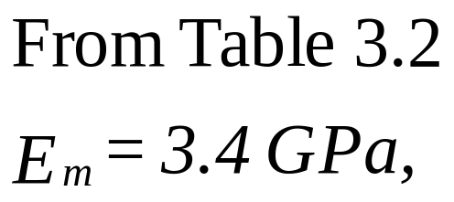
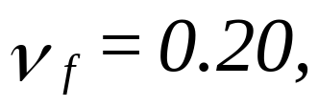
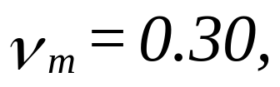
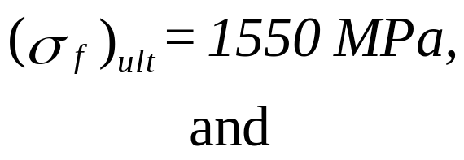
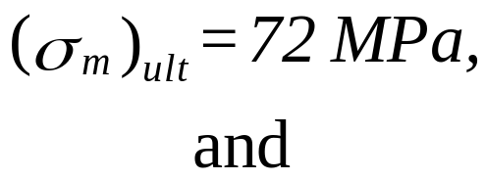
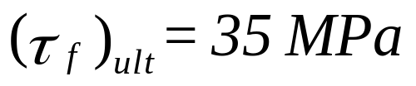
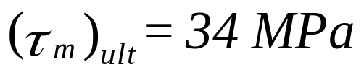
Example, Longitudinal Compressive Strength
Find the longitudinal compressive strength of a Glass/Epoxy lamina with a 70% fiber volume fraction. Use the properties of glass and epoxy from Tables 3.1 and 3.2, respectively. Assume fibers are circular and are in a square array.

Slide 23
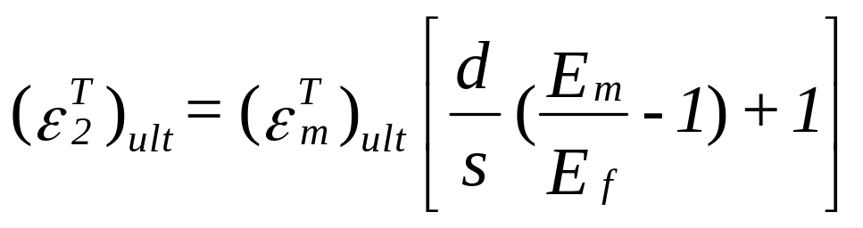

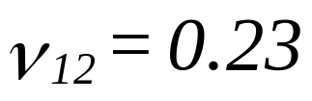
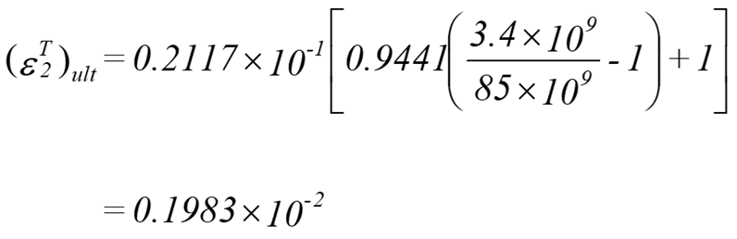




Using transverse matrix failure mode equations

Slide 24



Using transverse matrix failure mode equations

Slide 25

Using extensional microbuckling mode
Extensional

Slide 26


Using shear microbuckling mode
Example 3.14.
Shear

Slide 27


From Shear Mode Failure
=min(521.8, 4360, 69.4)=69.4 MPa

Slide 28

Experimental Setup Longitudinal Compressive Strength
Example 3.14.
IITRI fixture mounted in a test frame for finding the compressive strengths of a lamina. (Data reprinted with permission from Experimental Characterization of Advanced Composites, Carlsson, L.A. and Pipes, R.B., Technomic Publishing Co., Inc., 1987, p. 76. Copyright CRC Press, Boca
Raton, FL.)

Slide 29

Longitudinal Compressive Strength Specimen Specifications
Geometry of a longitudinal compressive strength specimen. (Data reprinted with permission from Experimental Characterization of Advanced Composites, Carlsson, L.A. and Pipes, R.B., Technomic Publishing Co., Inc., 1987, p. 76. Copyright CRC Press, Boca Raton, FL.)

Slide 30

IITRI Test for Longitudinal Compression Strength

Slide 31




Experimental Data for Longitudinal Compressive Strength
Stress–strain curve for a [0]24 graphite/epoxy laminate under a longitudinal compressive load. (Data courtesy of Dr. R.Y. Kim, University of Dayton Research Institute, Dayton, OH.)

Slide 32

Transverse Tensile Strength of Unidirectional Lamina,

Slide 33

Transverse Tensile Strength Model
Representative volume element to calculate transverse tensile strength of a unidirectional lamina.

Slide 34





Transverse Tensile Strength Model,

Slide 35







Transverse Tensile Strength Derivation
$$sε_{c}=dε_{f}+(d−s)ε_{m}$$

Slide 36


Example, Transverse Tensile Strength
Find the ultimate transverse tensile strength for a unidirectional Glass/Epoxy lamina with a 70% fiber volume fraction. Use properties of glass and epoxy from Table 3.1 and Table 3.2, respectively. Assume the fibers are circular and are arranged in a square array.

Slide 37




Experimental Results, Transverse Tensile Strength
Stress–strain curve for a [90]₁₆ graphite/epoxy laminate under a transverse tensile load. (Data courtesy of Dr. R.Y. Kim, University of Dayton Research Institute, Dayton, OH.)

Slide 38
END

