Slide 1

EML 4230 Introduction to Composite Materials
Chapter 3 Micromechanical Analysis of a Lamina
Ultimate Strengths of a Unidirectional Lamina
Part 2
Dr. Autar Kaw
Department of Mechanical Engineering
University of South Florida, Tampa, FL 33620
Courtesy of the Textbook
Mechanics of Composite Materials by Kaw

Slide 2

Transverse Compressive Strength of Unidirectional Lamina,

Slide 3
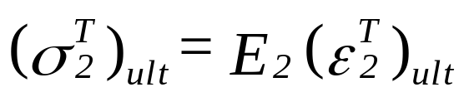
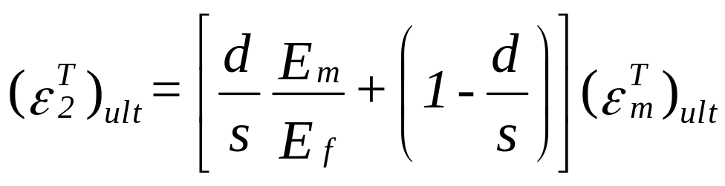
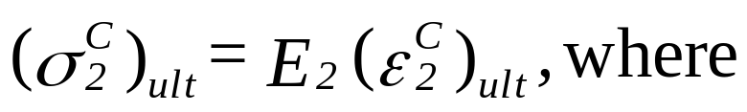
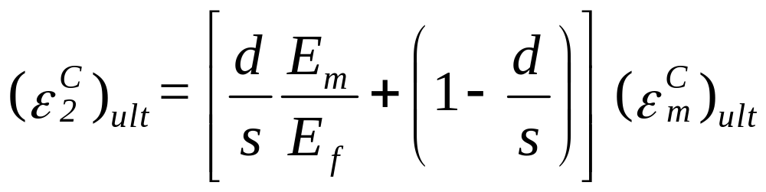
Derivation for Transverse Compressive Strength
Remember for the transverse tensile strength formula derivation
Following same logic

Slide 4
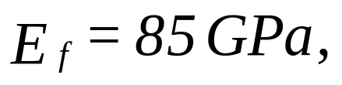
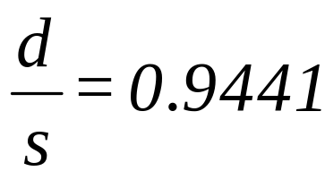
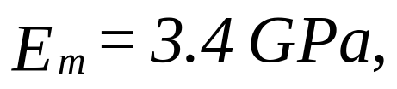
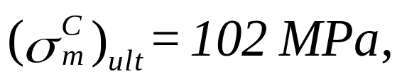
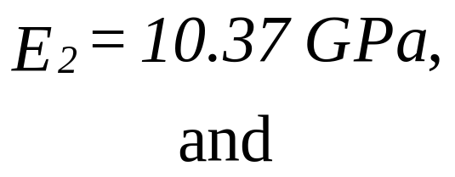
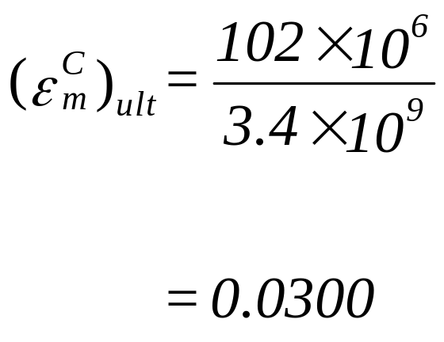
Example, Transverse Compressive Strength
Find the ultimate transverse compressive strength of a Glass/Epoxy lamina with 70% fiber volume fraction. Use the properties of glass and epoxy from Table 3.1 and Table 3.2, respectively. Assume the fibers are circular and are packed in a square array.

Slide 5

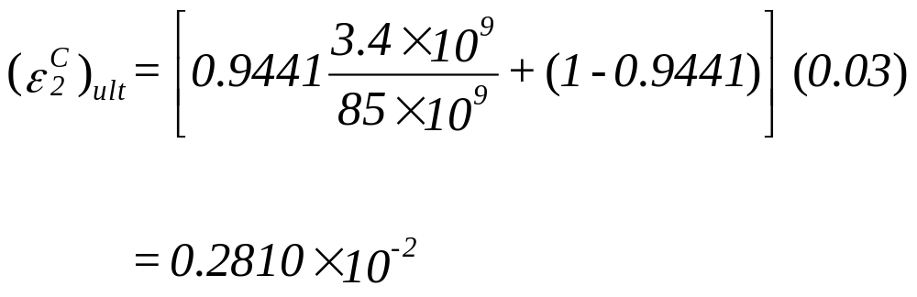
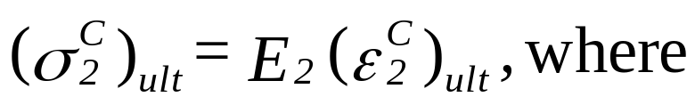
Example, Transverse Compressive Strength

Slide 6
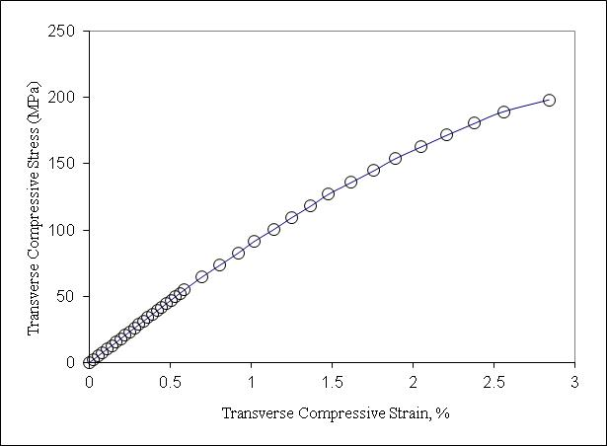
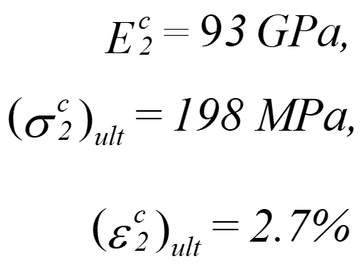
Experimental Results for Transverse Compressive Strength Test
FIGURE 3.35
Stress–strain curve for a [90]₄₀ graphite/epoxy laminate under a transverse compressive load perpendicular to the fibers.

Slide 7

In-Plane Shear Strength of Unidirectional Lamina,

Slide 8
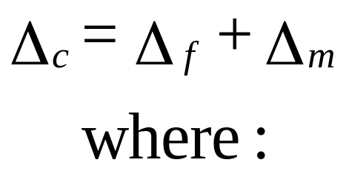
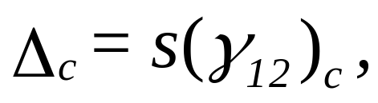
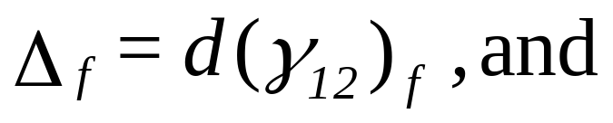
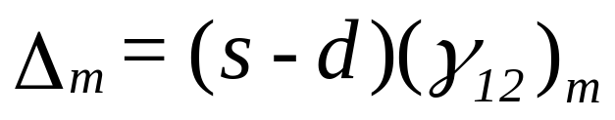
Derivation In-Plane Shear Strength

Slide 9
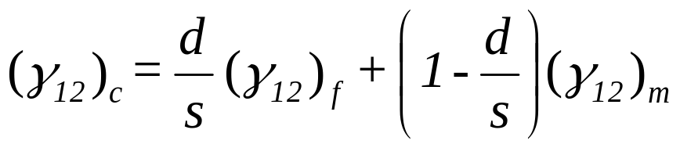
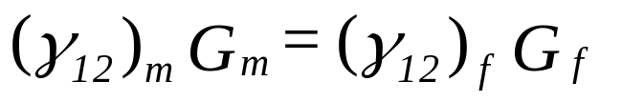
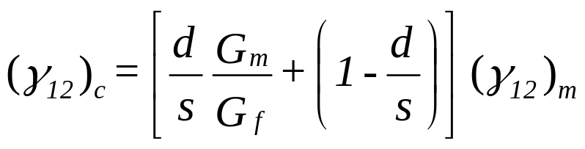
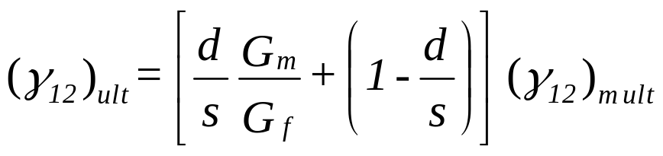
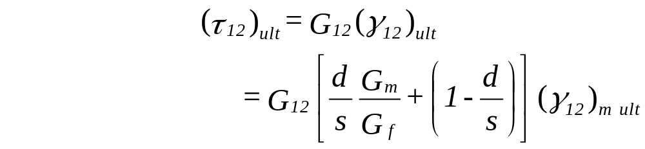
Derivation of In-Plane Shear Strength

Slide 10
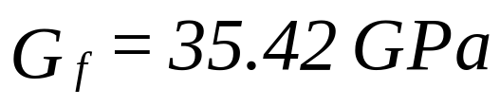
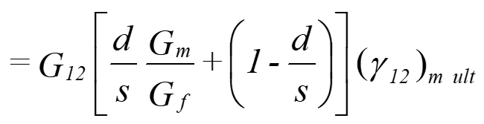

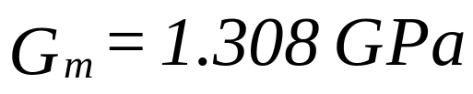

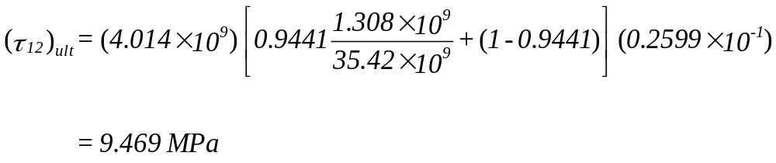

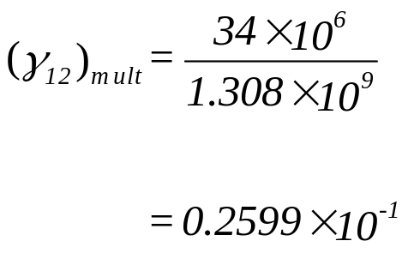
Example, In-Plane Shear Strength
Find the ultimate shear strength for a Glass/Epoxy lamina with 70% fiber volume fraction. Use properties for glass and epoxy from Tables 3.1 and 3.2, respectively. Assume the fibers are circular and are arranged in a square array.

Slide 11
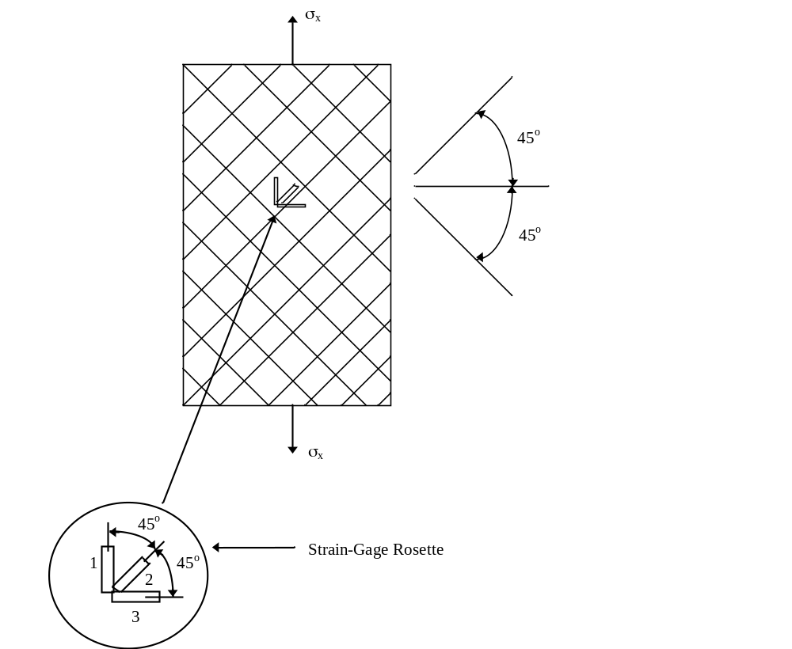
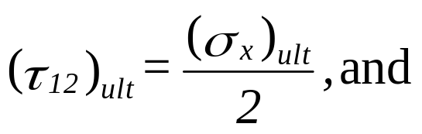

In-Plane Shear Strength Test
Schematic of a [±45]_{2S} laminate shear test.

Slide 12
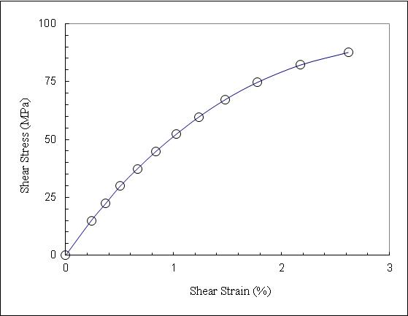
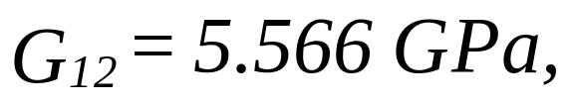
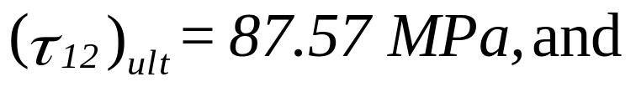
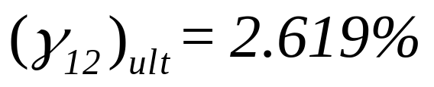
Experimental Results for In-Plane Shear Strength Test
Shear stress–shear strain curve obtained from a [±45]_{2S} graphite/epoxy laminate under a tensile load.

Slide 13
END

