Slide 1

EML 4230 Introduction to Composite Materials
Chapter 3 Micromechanical Analysis of a Lamina
Coefficients of Thermal Expansion
Dr. Autar Kaw
Department of Mechanical Engineering
University of South Florida, Tampa, FL 33620
Courtesy of the Textbook
Mechanics of Composite Materials by Kaw

Slide 2
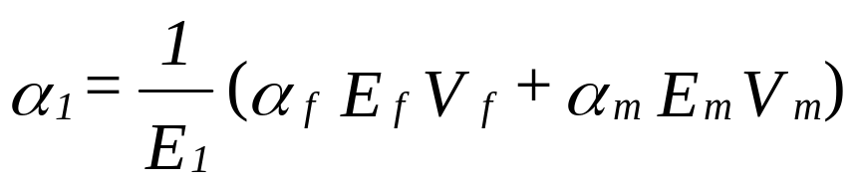
Coefficients of Thermal Expansion of Unidirectional Lamina

Slide 3


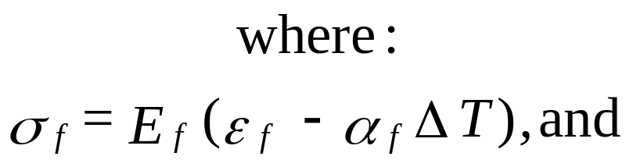

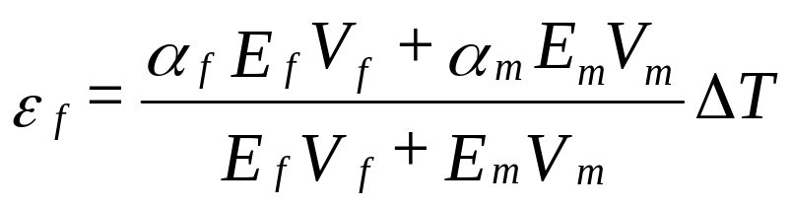
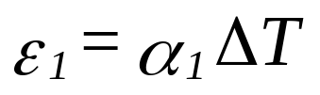
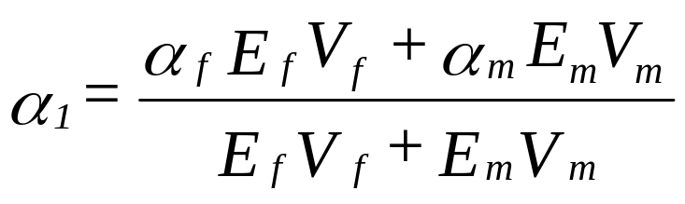
Derivation of Longitudinal Coefficient of Thermal Expansion, $α_{1}$

Slide 4

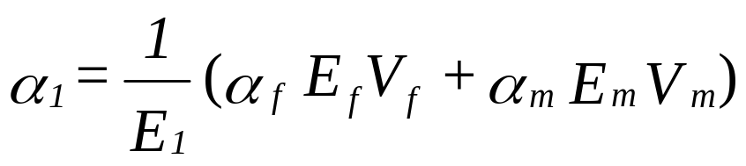
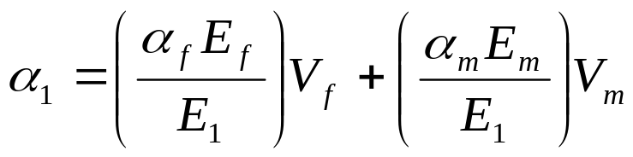
Rewriting Longitudinal Thermal Expansion Coefficient Formula

Slide 5
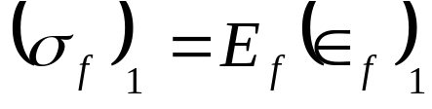
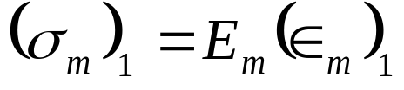
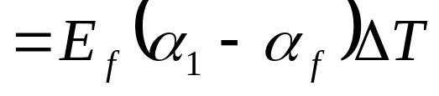
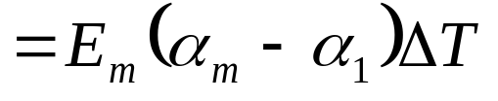
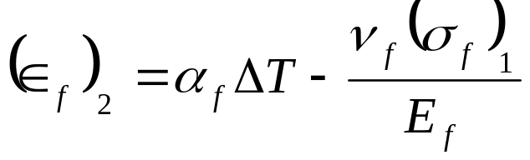
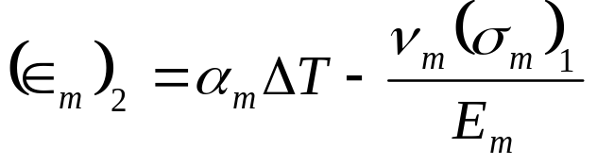
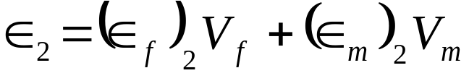
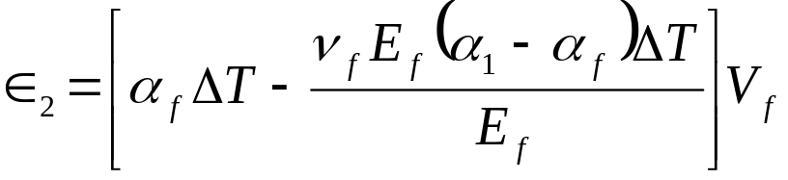
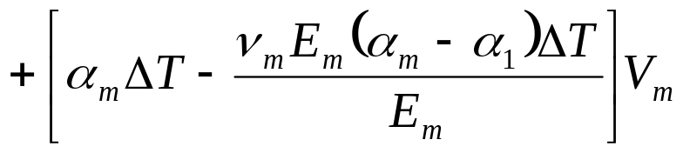


Derivation of Transverse Thermal Expansion Coefficient, $α_{2}$
$${\left(∈_{f}\right)}_{1}={\left(∈_{m}\right)}_{1}=∈_{1}$$

Slide 6
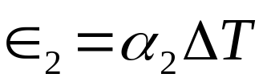
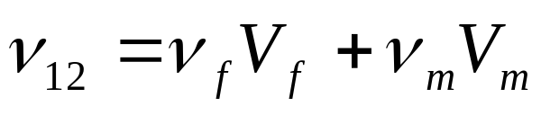
Transverse Thermal Expansion Coefficient

Slide 7




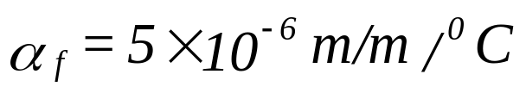



Example, Coefficients of Thermal Expansion
Find the coefficients of thermal expansion for a Glass/Epoxy lamina with 70% fiber volume fraction. Use the properties of glass and epoxy from Tables 3.1 and 3.2, respectively.

Slide 8
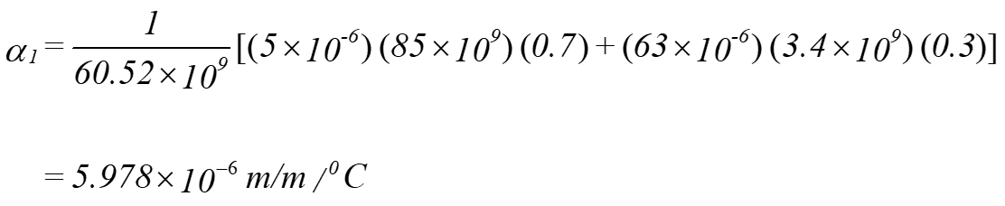
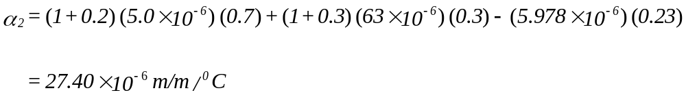
Example, Coefficients of Thermal Expansion

Slide 9
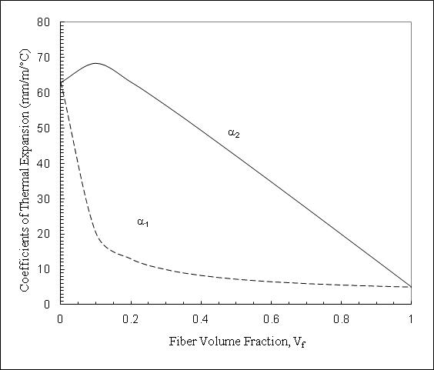
How Coefficients of Thermal Expansion Vary as a Function of Fiber Volume Fraction
Longitudinal and transverse coefficients of thermal expansion as a function of fiber volume fraction for a glass/epoxy unidirectional lamina.

Slide 10
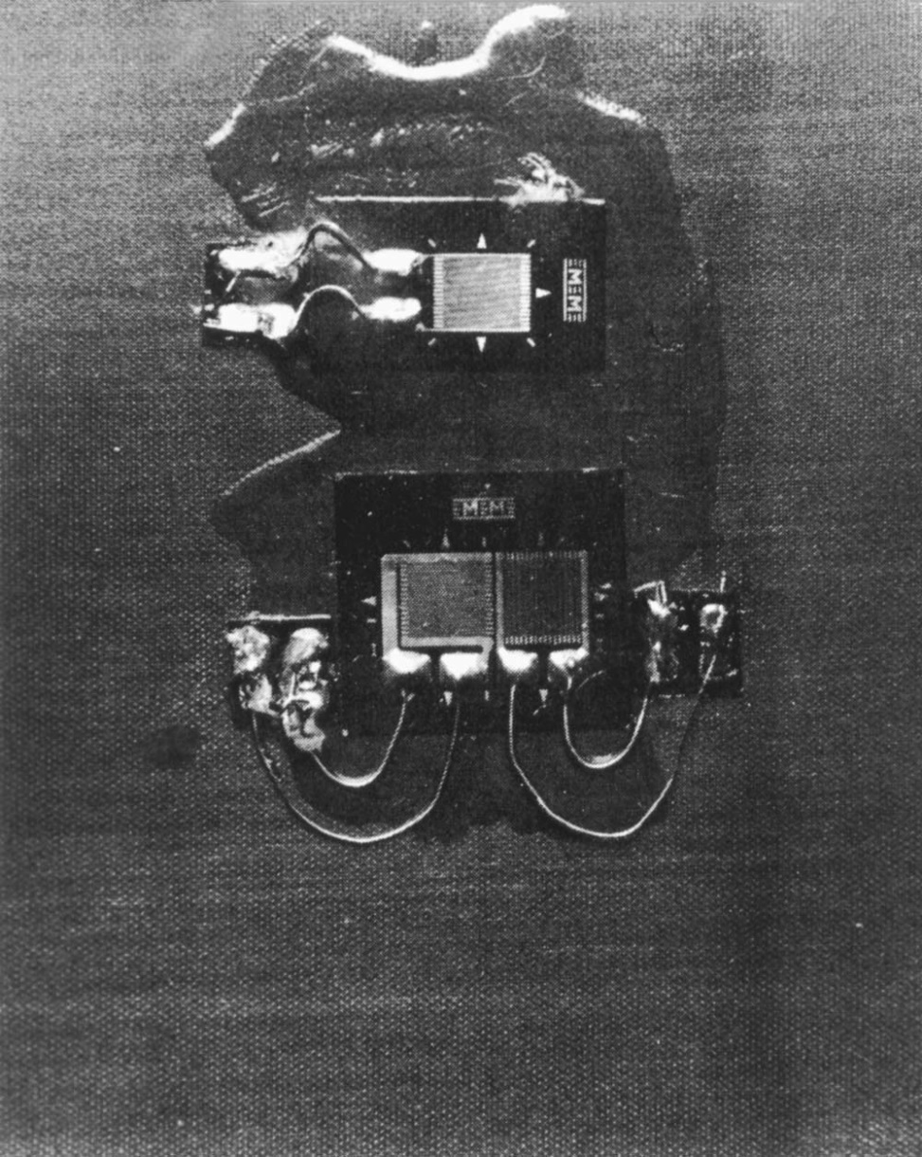
Experimental Setup to Find Thermal Expansion Coefficient
FIGURE 3.39
Unidirectional graphite/epoxy specimen with strain gages and temperature sensors for finding
coefficients of thermal expansion.

Slide 11
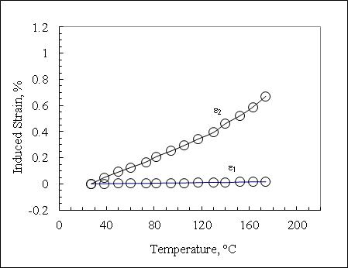


Experimental Results for Coefficient of Thermal Expansion
Induced strain as a function of temperature to find the coefficients of thermal expansion of a unidirectional graphite/epoxy laminate.

Slide 12
END

