Slide 1
FE Exam Tutorial
http://fe.eng.usf.edu

Slide 2
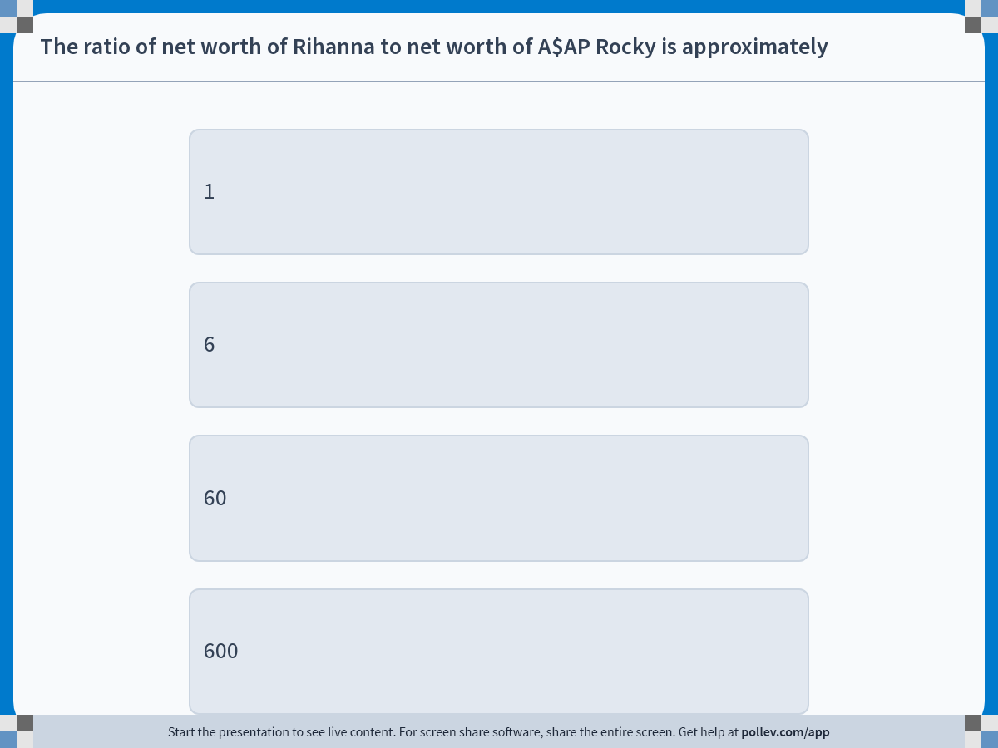
Notes:
Poll Title: Do not modify the notes in this section to avoid tampering with the Poll Everywhere activity.
More info at polleverywhere.com/support
The ratio of net worth of Rihanna to net worth of A$AP Rocky is approximately
https://www.polleverywhere.com/multiple_choice_polls/48Df31DfZuvoq15bzzTF7?display_state=instructions&activity_state=opened&state=opened&flow=Engagement&onscreen=persist

Slide 3
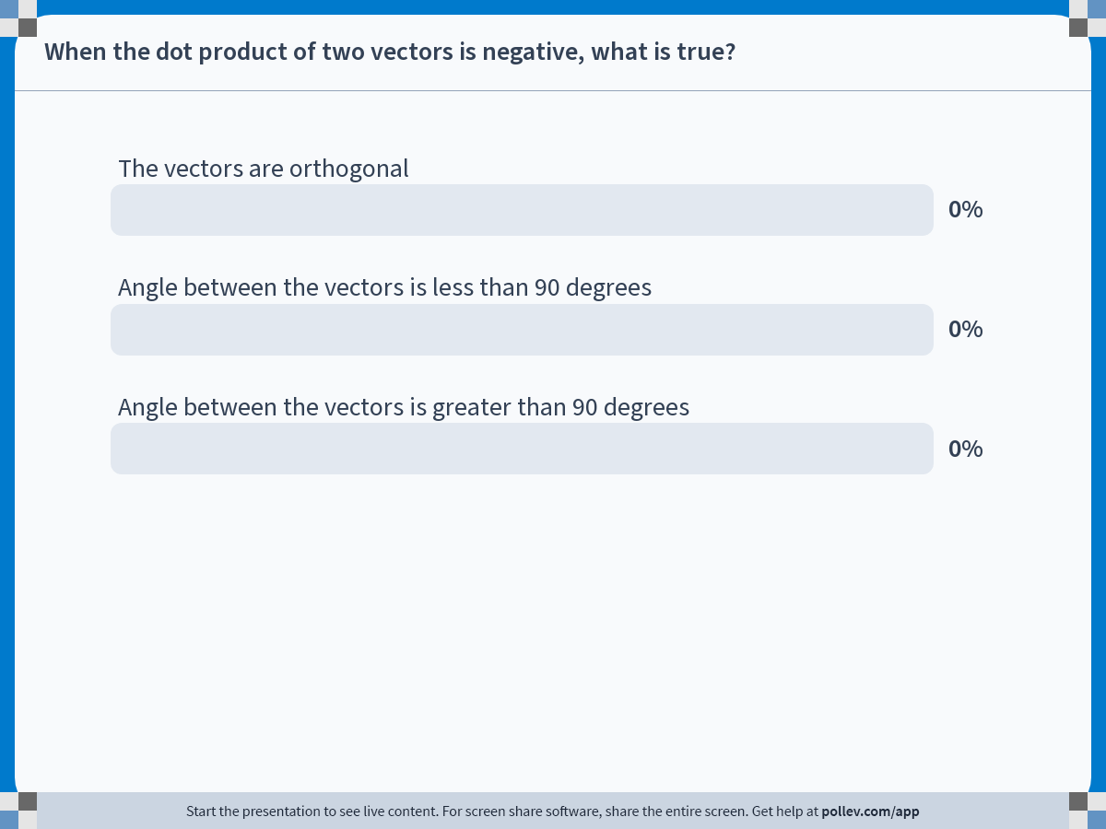
Notes:
Poll Title: Do not modify the notes in this section to avoid tampering with the Poll Everywhere activity.
More info at polleverywhere.com/support
When the dot product of two vectors is negative, what is true?
https://www.polleverywhere.com/multiple_choice_polls/oNPihTAWsLz8bDbr6hK6V

Slide 4
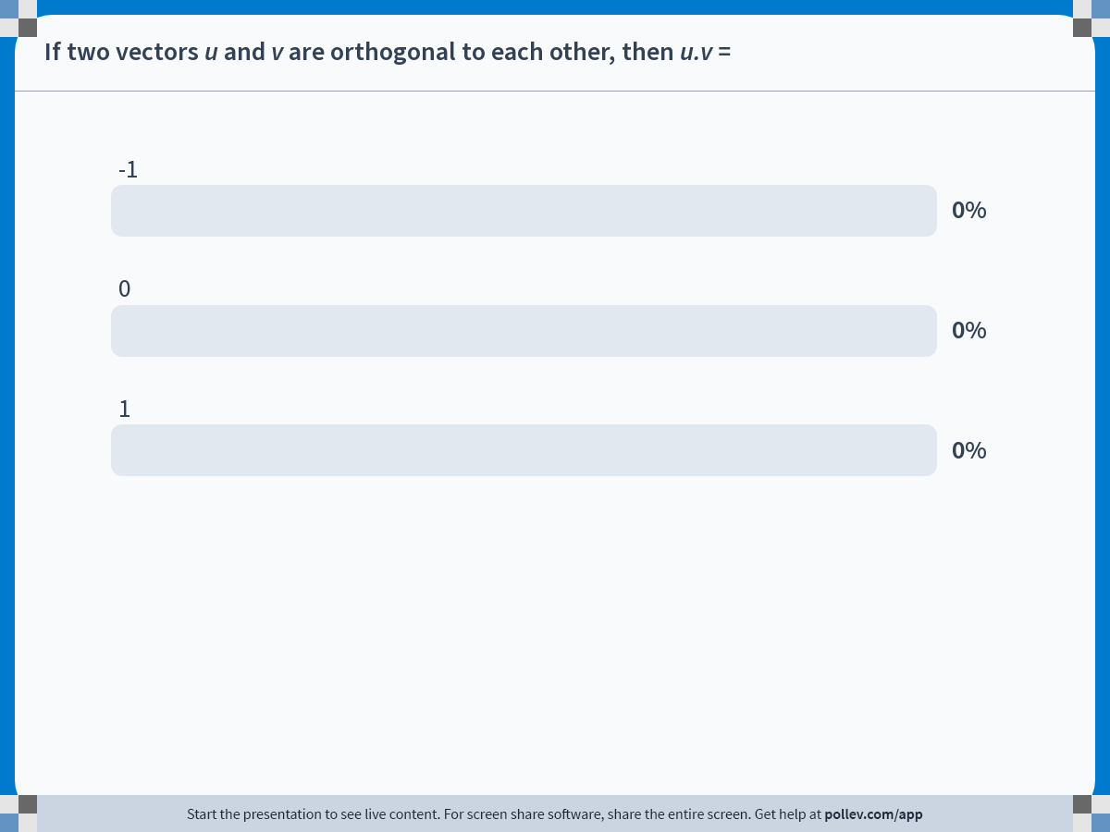
Notes:
Poll Title: Do not modify the notes in this section to avoid tampering with the Poll Everywhere activity.
More info at polleverywhere.com/support
If two vectors u and v are orthogonal to each other, then u.v =
https://www.polleverywhere.com/multiple_choice_polls/xRVO8swWWNz8Xp5frykSk

Slide 5
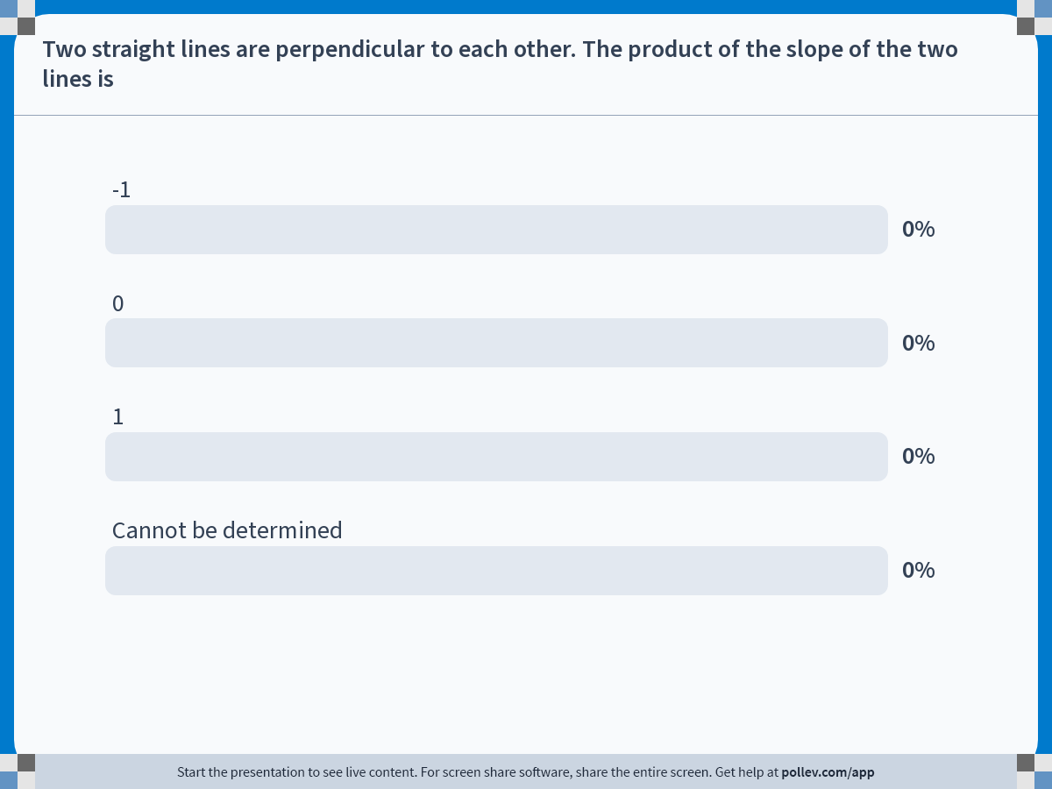
Notes:
Poll Title: Do not modify the notes in this section to avoid tampering with the Poll Everywhere activity.
More info at polleverywhere.com/support
Two straight lines are perpendicular to each other. The product of the slope of the two lines is
https://www.polleverywhere.com/multiple_choice_polls/DsTllmlKBkWURwm5X9SGG

Slide 6
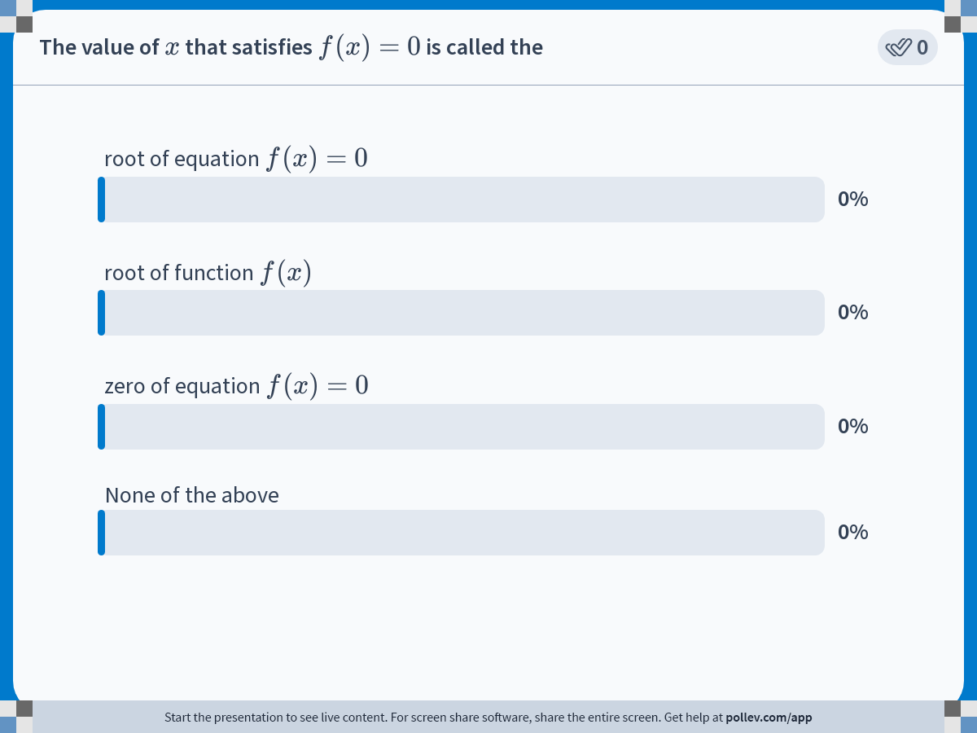
Notes:
Poll Title: Do not modify the notes in this section to avoid tampering with the Poll Everywhere activity.
More info at polleverywhere.com/support
The value of $$x$$ that satisfies $$f (x)=0$$ is called the
https://www.polleverywhere.com/multiple_choice_polls/HJKmZHMldMMrwP2RnKKy0

Slide 7
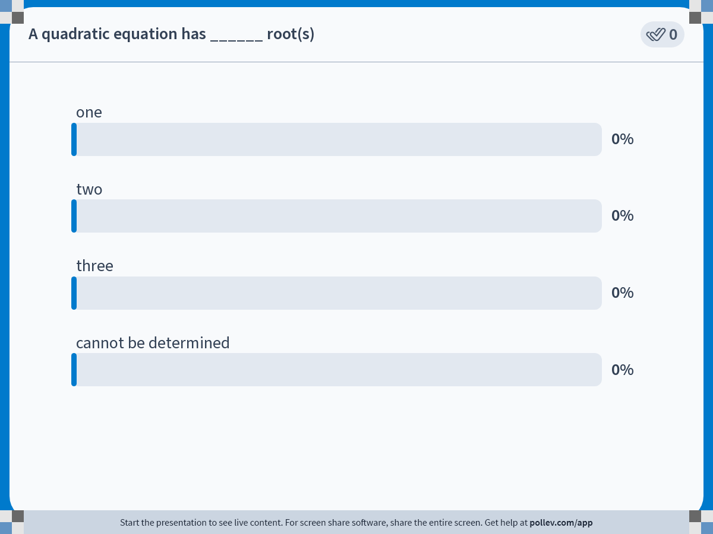
Notes:
Poll Title: Do not modify the notes in this section to avoid tampering with the Poll Everywhere activity.
More info at polleverywhere.com/support
A quadratic equation has ______ root(s)
https://www.polleverywhere.com/multiple_choice_polls/3bMTZegCfKriIynjL0OPy

Slide 8
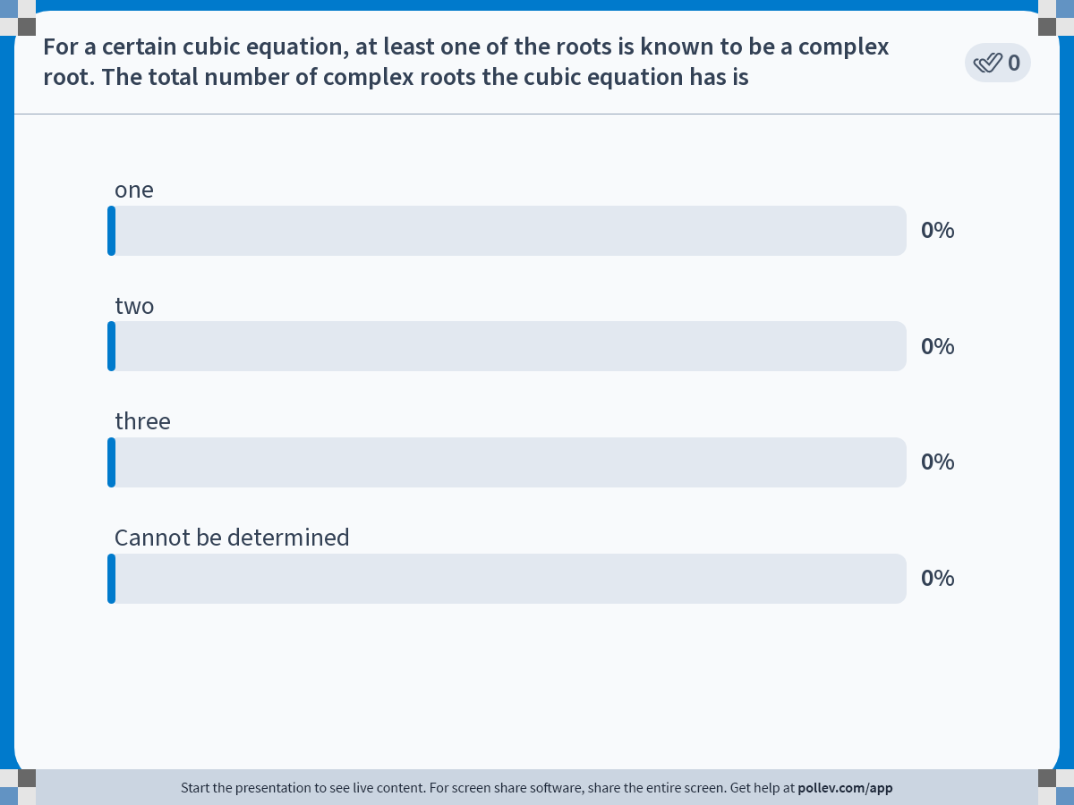
Notes:
Poll Title: Do not modify the notes in this section to avoid tampering with the Poll Everywhere activity.
More info at polleverywhere.com/support
For a certain cubic equation, at least one of the roots is known to be a complex root. The total number of complex roots the cubic equation has is
https://www.polleverywhere.com/multiple_choice_polls/iYIfRrGcXclf3aN5GZW6X

Slide 9
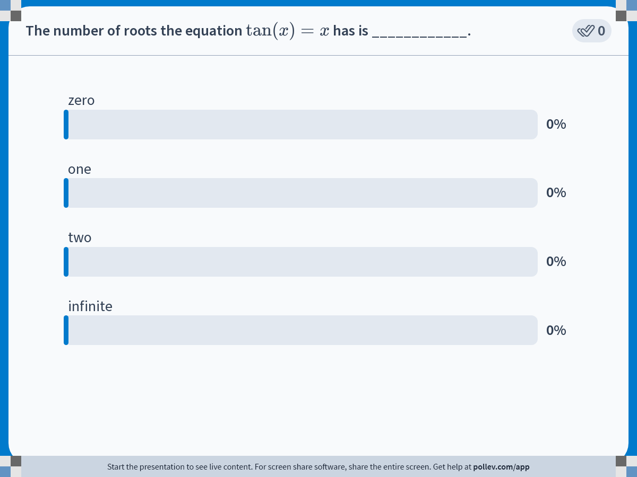
Notes:
Poll Title: Do not modify the notes in this section to avoid tampering with the Poll Everywhere activity.
More info at polleverywhere.com/support
The number of roots the equation $$\\tan (x)=x$$ has is ____________.
https://www.polleverywhere.com/multiple_choice_polls/t7zkio1uxZwj8PU7aItBS

Slide 10
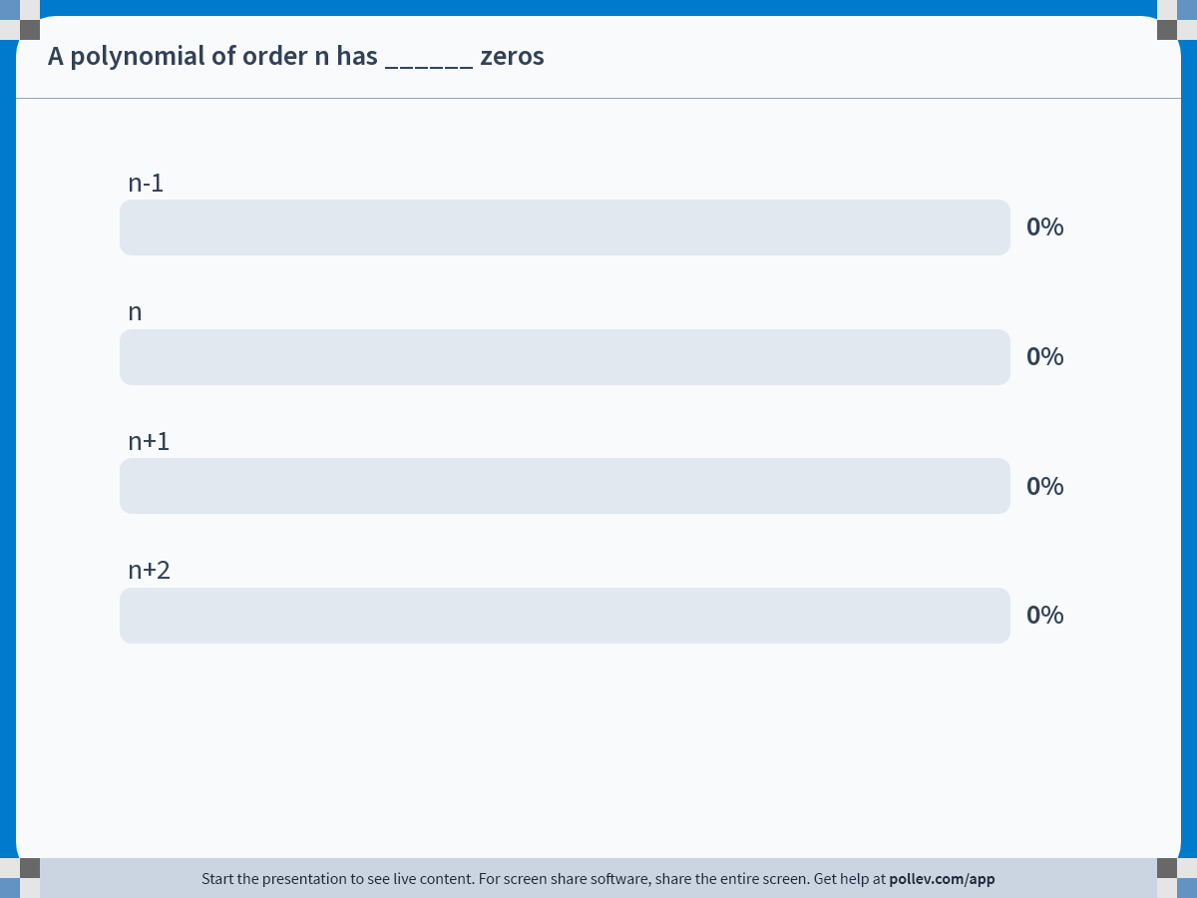
Notes:
Poll Title: Do not modify the notes in this section to avoid tampering with the Poll Everywhere activity.
More info at polleverywhere.com/support
A polynomial of order n has ______ zeros
https://www.polleverywhere.com/multiple_choice_polls/YJdg62SJYcubMxNSfVMM8

Slide 11
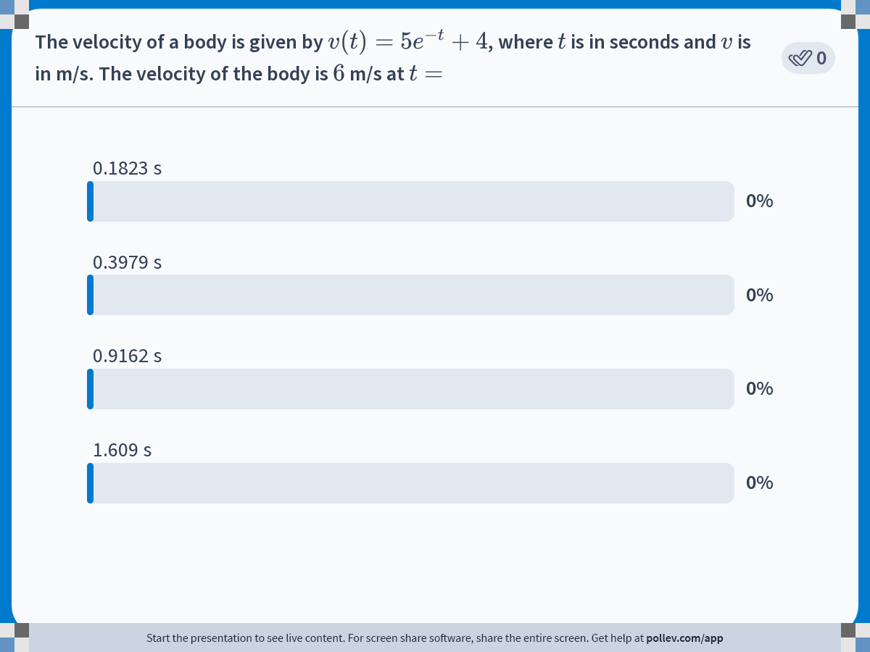
Notes:
Poll Title: Do not modify the notes in this section to avoid tampering with the Poll Everywhere activity.
More info at polleverywhere.com/support
The velocity of a body is given by $$v (t)=5e^{-t}+4$$, where $$t$$ is in seconds and $$v$$ is in m/s. The velocity of the body is $$6$$ m/s at $$t =$$
https://www.polleverywhere.com/multiple_choice_polls/iIgjYK4ZyrtKUVIcLwvIT

Slide 12
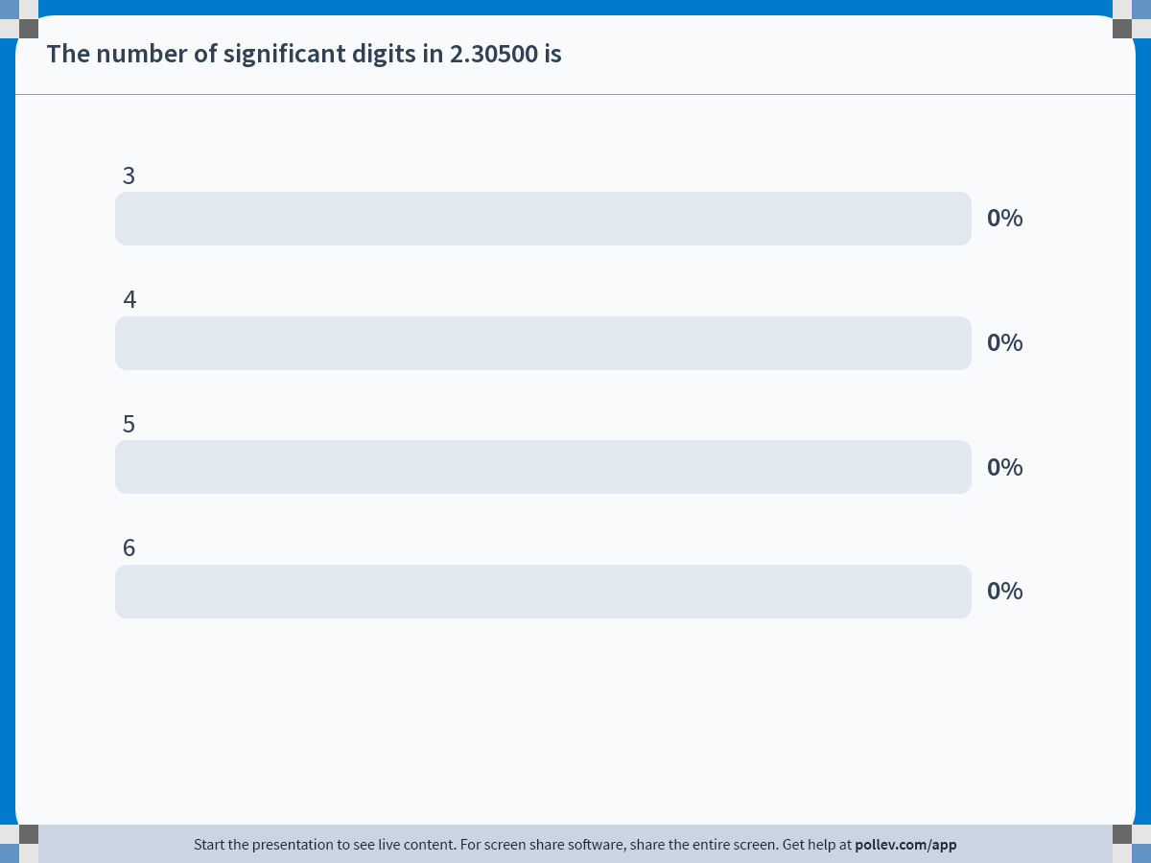
Notes:
Poll Title: Do not modify the notes in this section to avoid tampering with the Poll Everywhere activity.
More info at polleverywhere.com/support
The number of significant digits in 2.30500 is
https://www.polleverywhere.com/multiple_choice_polls/DHwO7AUCPw8flDxKlmHuO

Slide 13
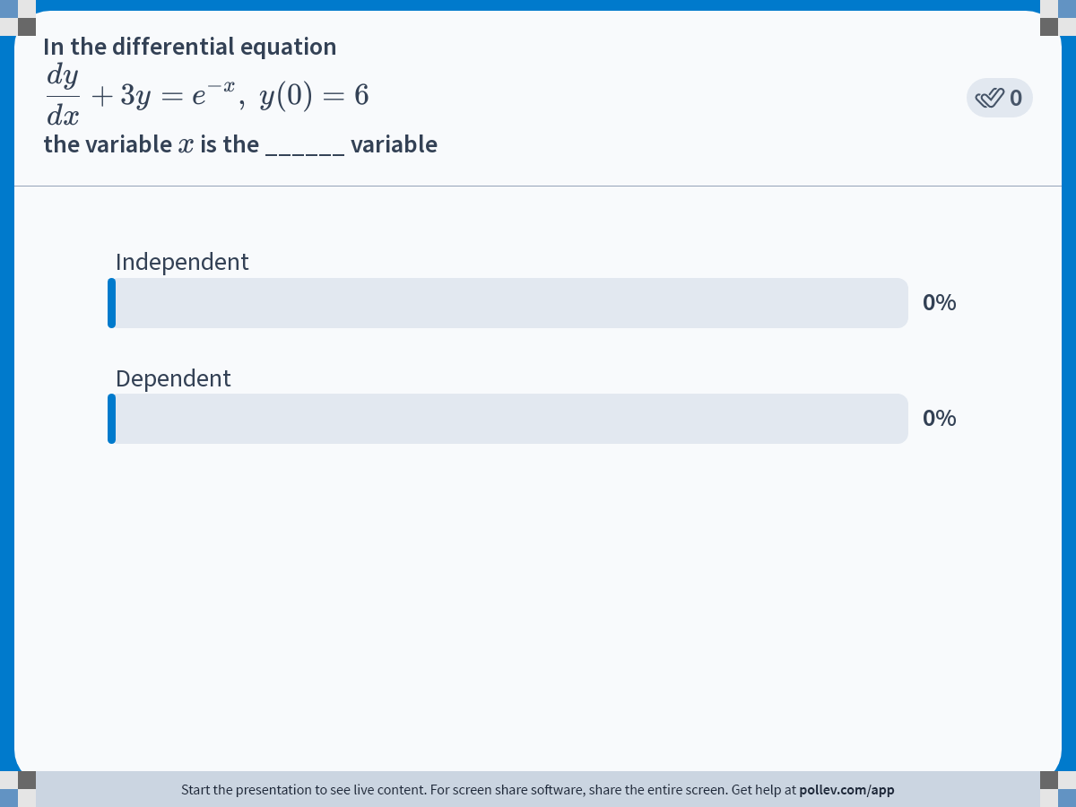
Notes:
Poll Title: Do not modify the notes in this section to avoid tampering with the Poll Everywhere activity.
More info at polleverywhere.com/support
In the differential equation $$\\displaystyle \\frac{dy}{dx} + 3y = e^{-x},\\ y(0)=6$$ the variable $$x$$ is the ______ variable
https://www.polleverywhere.com/multiple_choice_polls/EgLK2FiXDBpTcULh7vKAd

Slide 14
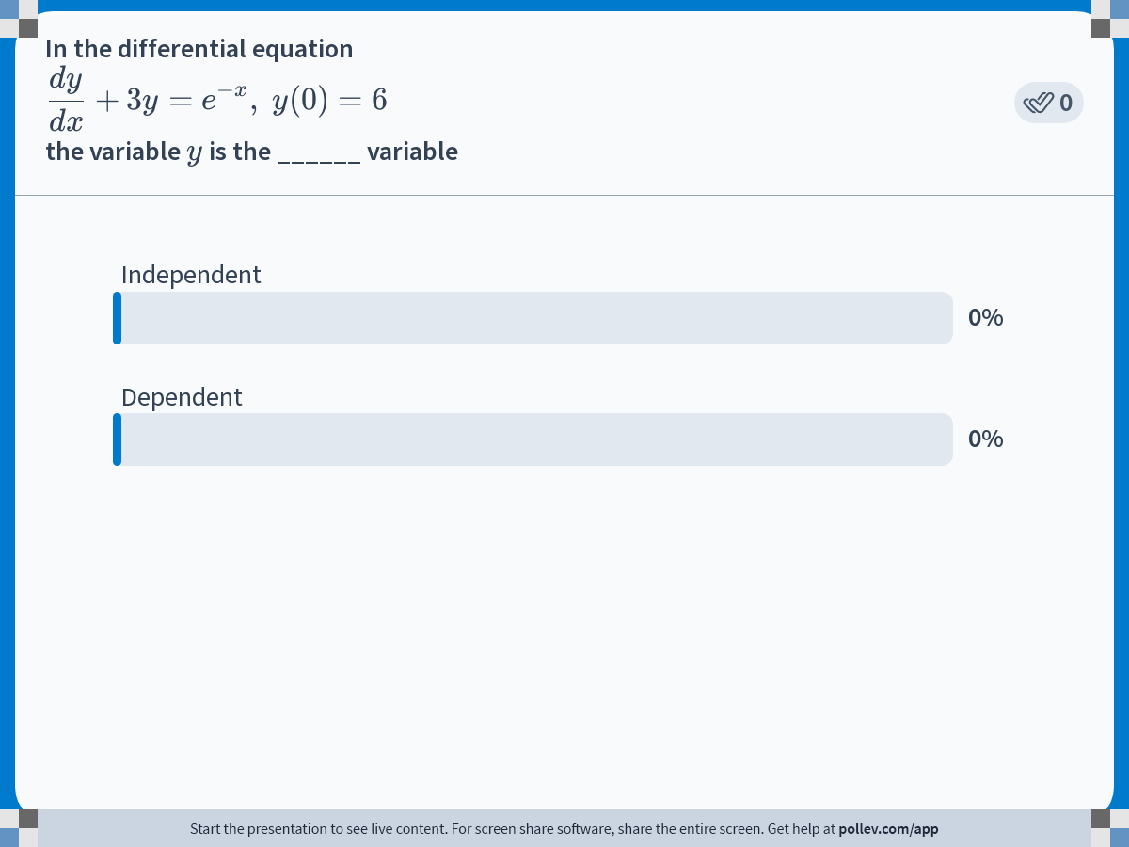
Notes:
Poll Title: Do not modify the notes in this section to avoid tampering with the Poll Everywhere activity.
More info at polleverywhere.com/support
In the differential equation $$\\displaystyle \\frac{dy}{dx} + 3y = e^{-x},\\ y(0)=6$$ the variable $$y$$ is the ______ variable
https://www.polleverywhere.com/multiple_choice_polls/ZSU6xUNfxqHIGafq4Yd6d

Slide 15
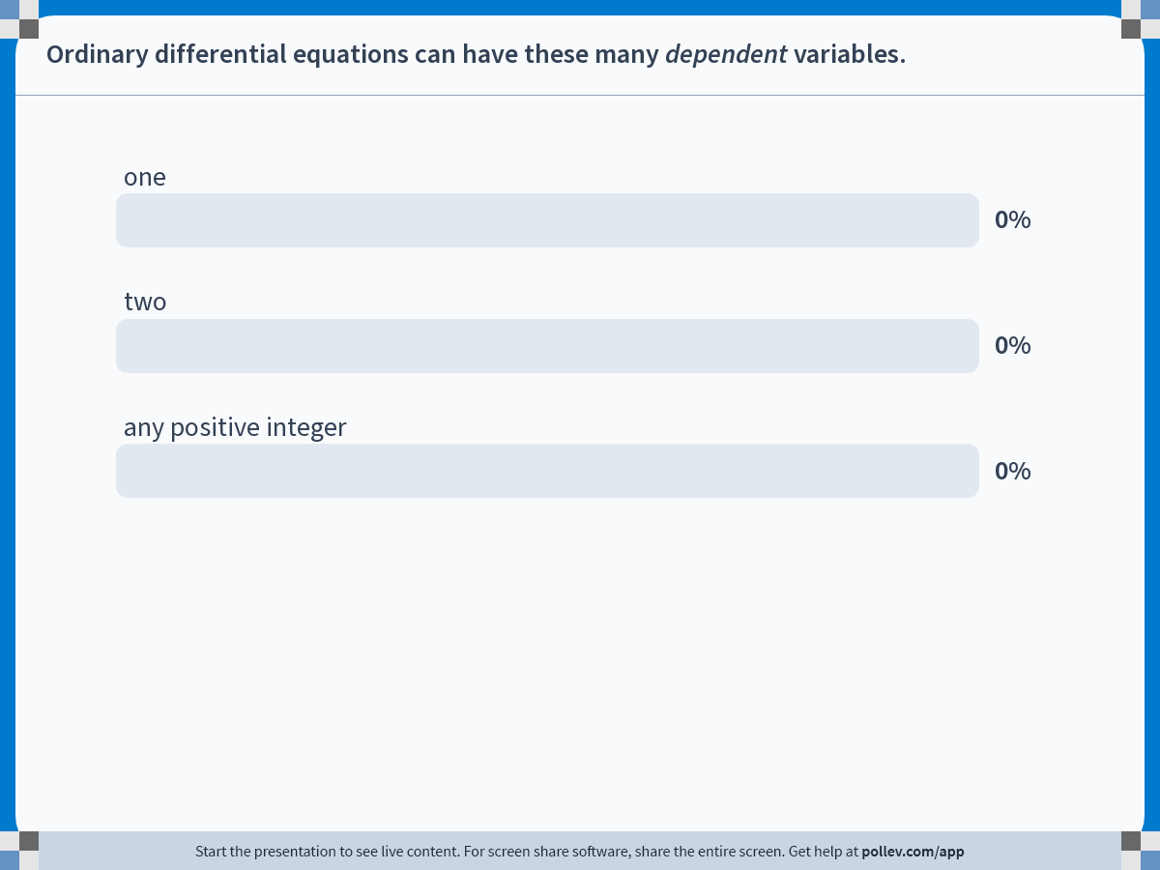
Notes:
Poll Title: Do not modify the notes in this section to avoid tampering with the Poll Everywhere activity.
More info at polleverywhere.com/support
Ordinary differential equations can have these many dependent variables.
https://www.polleverywhere.com/multiple_choice_polls/FIhRgsIXNI4qzT1hsnzFg

Slide 16
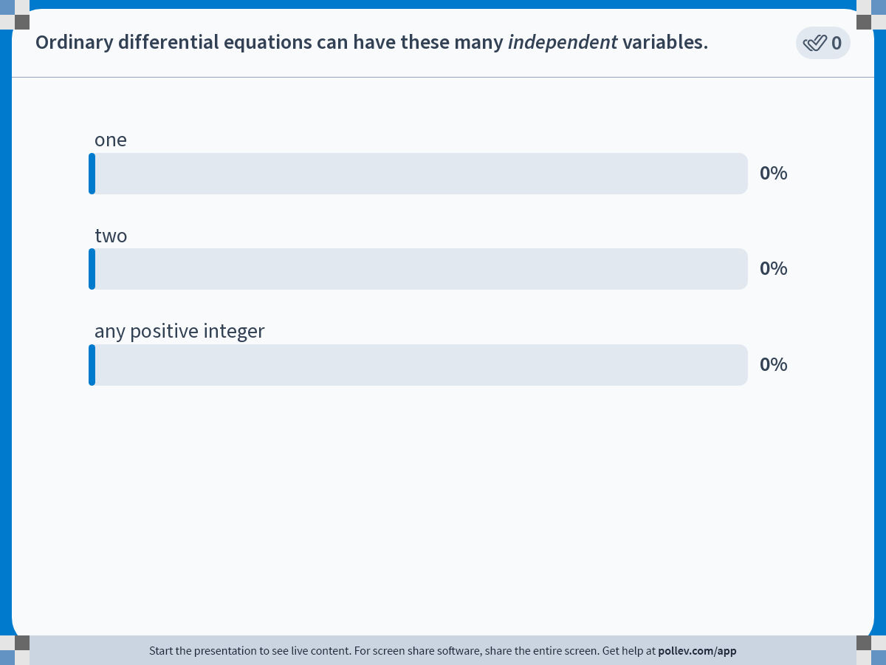
Notes:
Poll Title: Do not modify the notes in this section to avoid tampering with the Poll Everywhere activity.
More info at polleverywhere.com/support
Ordinary differential equations can have these many independent variables.
https://www.polleverywhere.com/multiple_choice_polls/rKAKRK8w3aceOVRXWFQLX

Slide 17
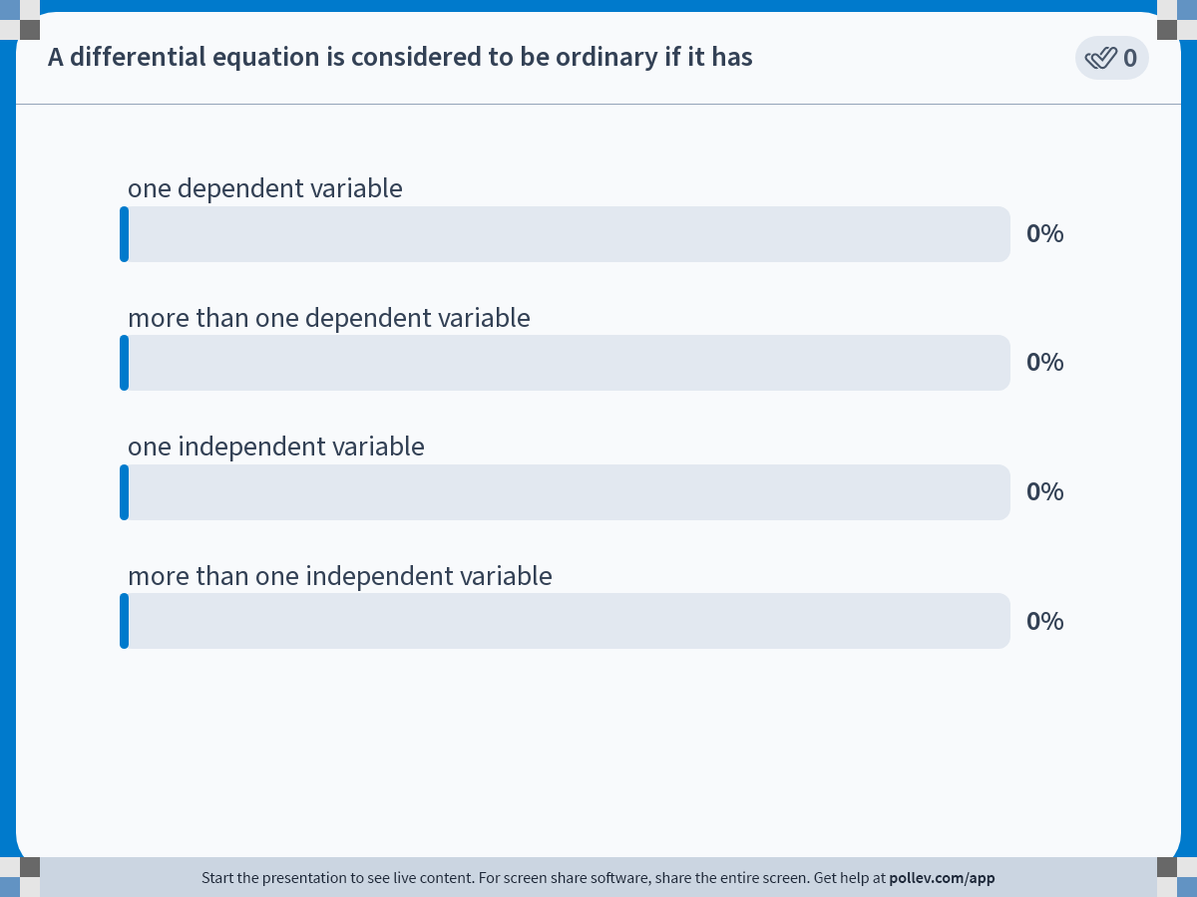
Notes:
Poll Title: Do not modify the notes in this section to avoid tampering with the Poll Everywhere activity.
More info at polleverywhere.com/support
A differential equation is considered to be ordinary if it has
https://www.polleverywhere.com/multiple_choice_polls/QgI7GCR2jS02DpumFmdqu

Slide 18
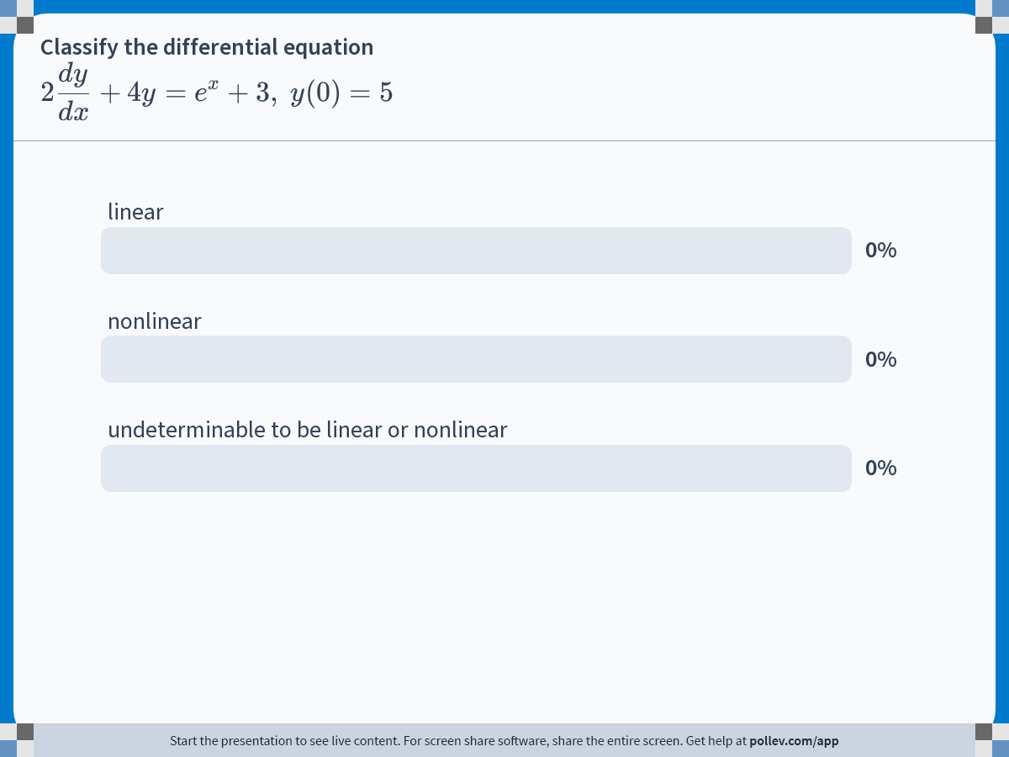
Notes:
Poll Title: Do not modify the notes in this section to avoid tampering with the Poll Everywhere activity.
More info at polleverywhere.com/support
Classify the differential equation $$\\displaystyle 2\\frac{dy}{dx} + 4y = e^x + 3,\\ y(0) = 5$$
https://www.polleverywhere.com/multiple_choice_polls/kgM1h9Sf4kA5pWcRPpqQm

Slide 19
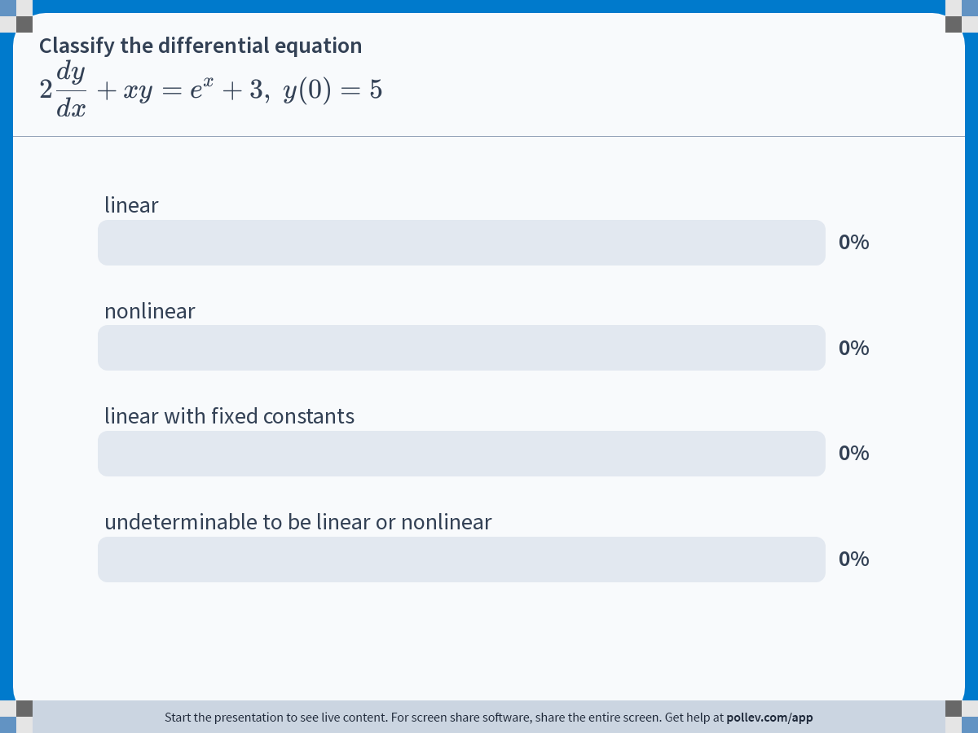
Notes:
Poll Title: Do not modify the notes in this section to avoid tampering with the Poll Everywhere activity.
More info at polleverywhere.com/support
Classify the differential equation $$\\displaystyle 2\\frac{dy}{dx} + xy = e^x + 3,\\ y(0) = 5$$
https://www.polleverywhere.com/multiple_choice_polls/foPaSfoYRlvSA22x2hVMv

Slide 20

Notes:
Poll Title: Do not modify the notes in this section to avoid tampering with the Poll Everywhere activity.
More info at polleverywhere.com/support
Classify the differential equation $$\\displaystyle 2\\frac{dy}{dx} + y^2 = e^x + 3,\\ y(0) = 5$$
https://www.polleverywhere.com/multiple_choice_polls/cFvrakBsbRYBUqzfOpDoq

Slide 21
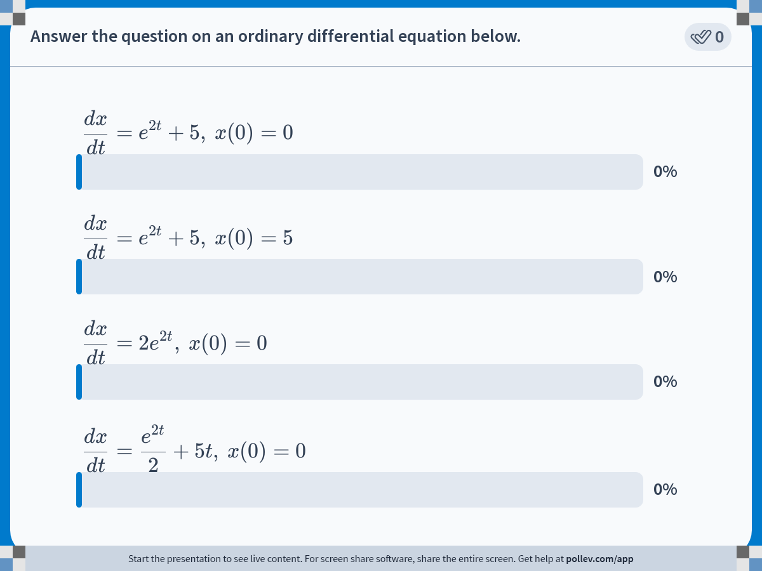
Notes:
Poll Title: Do not modify the notes in this section to avoid tampering with the Poll Everywhere activity.
More info at polleverywhere.com/support
Answer the question on an ordinary differential equation below.
https://www.polleverywhere.com/multiple_choice_polls/7obSggNdJyDxdiM5vNZVV

Slide 22
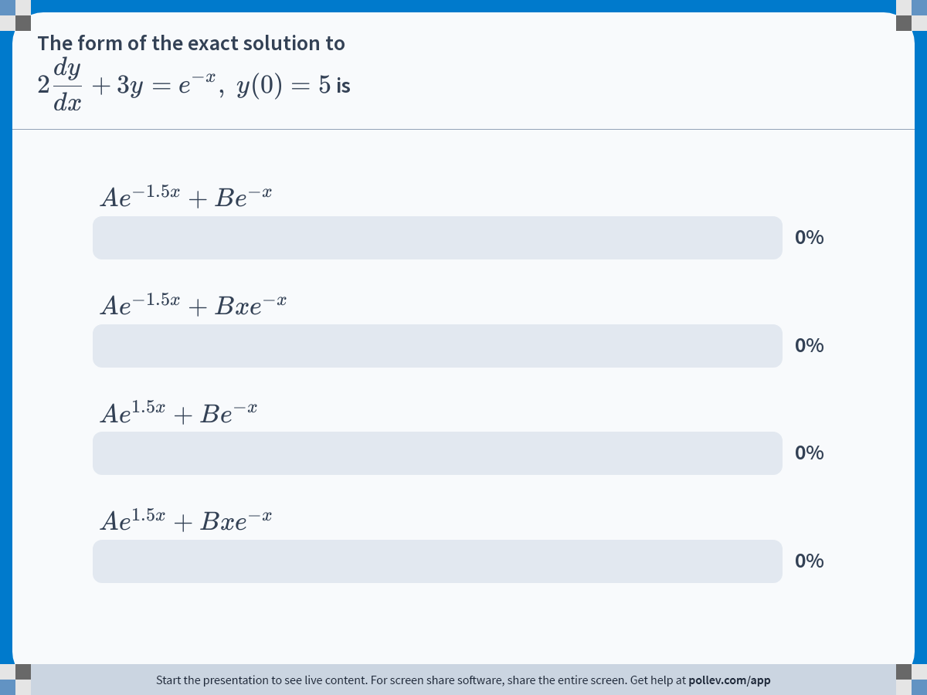
Notes:
Poll Title: Do not modify the notes in this section to avoid tampering with the Poll Everywhere activity.
More info at polleverywhere.com/support
The form of the exact solution to $$\\displaystyle 2\\frac{dy}{dx}+3y=e^{-x},\\ y(0)=5$$ is
https://www.polleverywhere.com/multiple_choice_polls/jMOPqh0v4150HNxdWQBH6

Slide 23
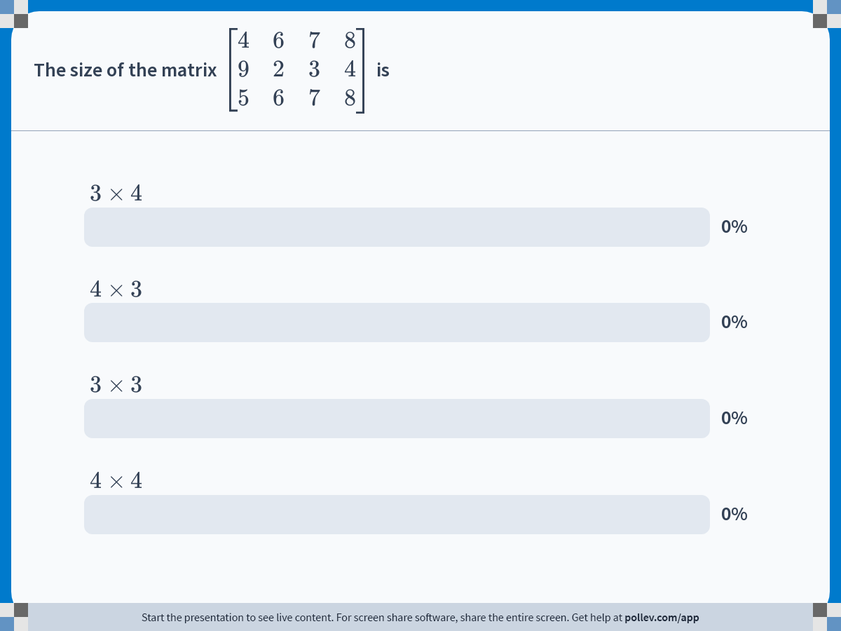
Notes:
Poll Title: Do not modify the notes in this section to avoid tampering with the Poll Everywhere activity.
More info at polleverywhere.com/support
The size of the matrix $$\\left[\\begin{matrix} 4 & 6 & 7 & 8 \\\\ 9 & 2 & 3 & 4 \\\\ 5 & 6 & 7 & 8 \\end{matrix}\\right]$$ is
https://www.polleverywhere.com/multiple_choice_polls/62PwJhQMJvboPdEUcRJfy

Slide 24
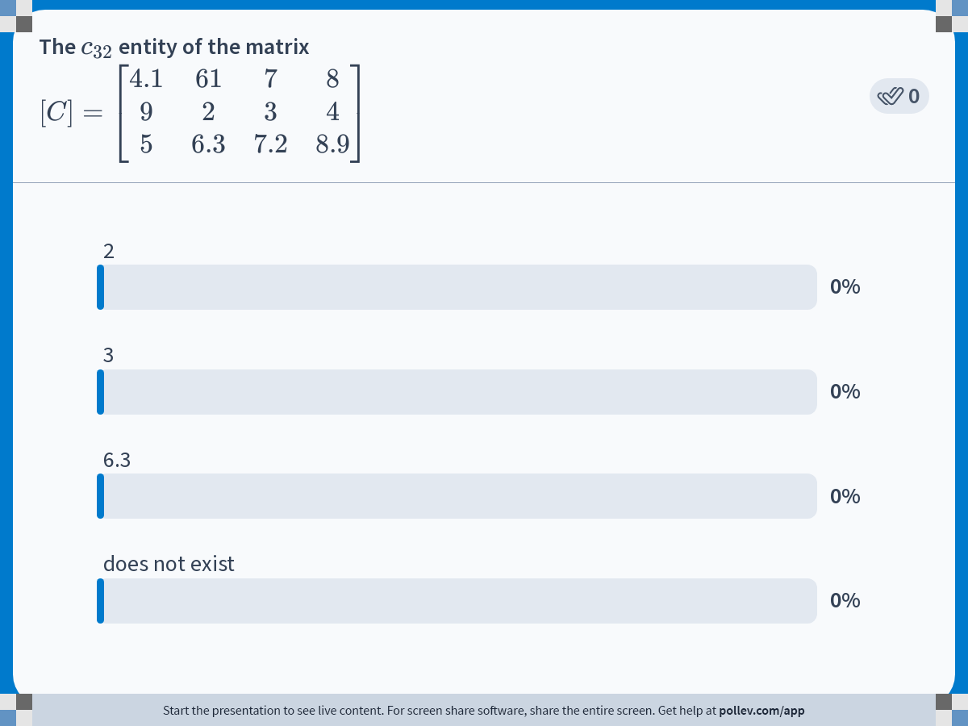
Notes:
Poll Title: Do not modify the notes in this section to avoid tampering with the Poll Everywhere activity.
More info at polleverywhere.com/support
The $$c_{32}$$ entity of the matrix $$[C] = \\left[\\begin{matrix} 4.1 &amp; 61 &amp; 7 &amp; 8 \\\\ 9 &amp; 2 &amp; 3 &amp; 4 \\\\ 5 &amp; 6.3 &amp; 7.2 &amp; 8.9 \\end{matrix} \\right]$$
https://www.polleverywhere.com/multiple_choice_polls/zJm3HGJDIFtp3jYMS10KP

Slide 25
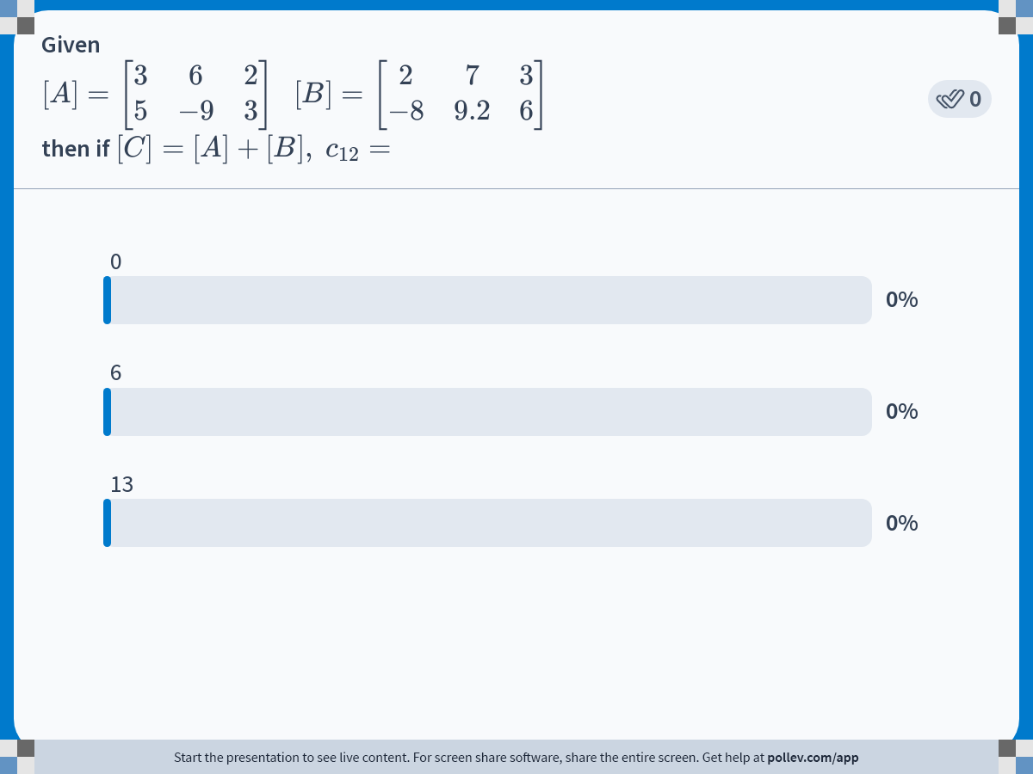
Notes:
Poll Title: Do not modify the notes in this section to avoid tampering with the Poll Everywhere activity.
More info at polleverywhere.com/support
Given $$[A] = \\left[\\begin{matrix} 3 &amp; 6 &amp; 2 \\\\ 5 &amp; -9 &amp; 3 \\end{matrix}\\right] \\ \\ [B] = \\left[\\begin{matrix} 2 &amp; 7 &amp; 3 \\\\ -8 &amp; 9.2 &amp; 6 \\end{matrix}\\right]$$ then if $$[C] = [A]+[B],\\ c_{12}=$$
https://www.polleverywhere.com/multiple_choice_polls/qeM6exaMUxYwSc8dyQyUV

Slide 26
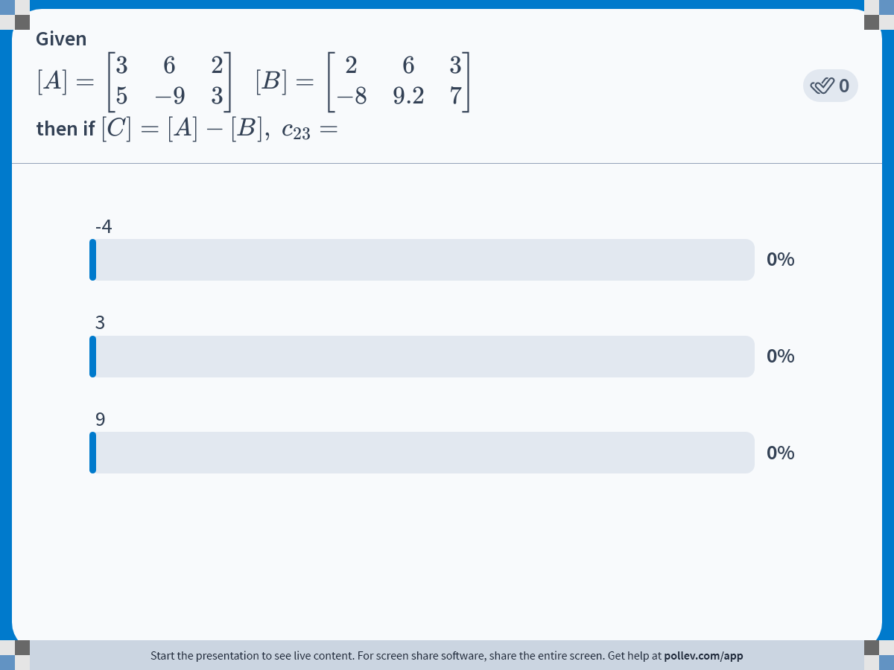
Notes:
Poll Title: Do not modify the notes in this section to avoid tampering with the Poll Everywhere activity.
More info at polleverywhere.com/support
Given $$[A] = \\left[\\begin{matrix} 3 &amp; 6 &amp; 2 \\\\ 5 &amp; -9 &amp; 3 \\end{matrix}\\right] \\ \\ [B] = \\left[\\begin{matrix} 2 &amp; 6 &amp; 3 \\\\ -8 &amp; 9.2 &amp; 7 \\end{matrix}\\right]$$ then if $$[C] = [A]-[B],\\ c_{23}=$$
https://www.polleverywhere.com/multiple_choice_polls/mMtciyPjyiildWUFKU1aT

Slide 27
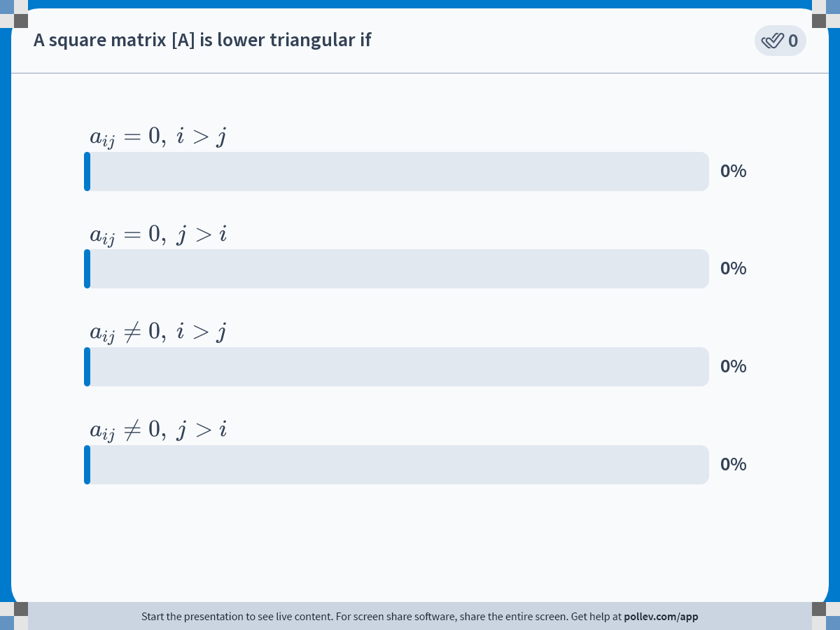
Notes:
Poll Title: Do not modify the notes in this section to avoid tampering with the Poll Everywhere activity.
More info at polleverywhere.com/support
A square matrix [A] is lower triangular if
https://www.polleverywhere.com/multiple_choice_polls/vVj1yObnL7MHDsQ5PfxRc

Slide 28
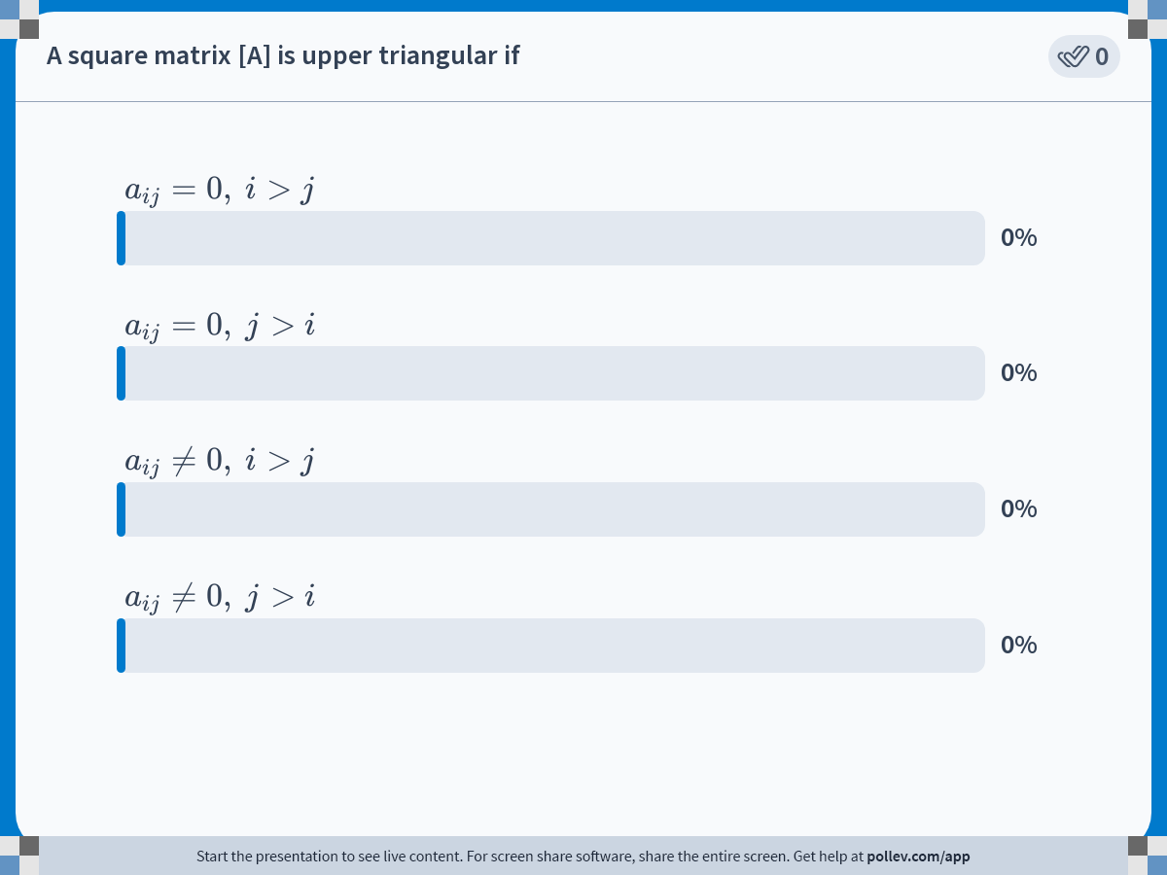
Notes:
Poll Title: Do not modify the notes in this section to avoid tampering with the Poll Everywhere activity.
More info at polleverywhere.com/support
A square matrix [A] is upper triangular if
https://www.polleverywhere.com/multiple_choice_polls/AdyEXzOqNLEQsdDjSbk9l

Slide 29
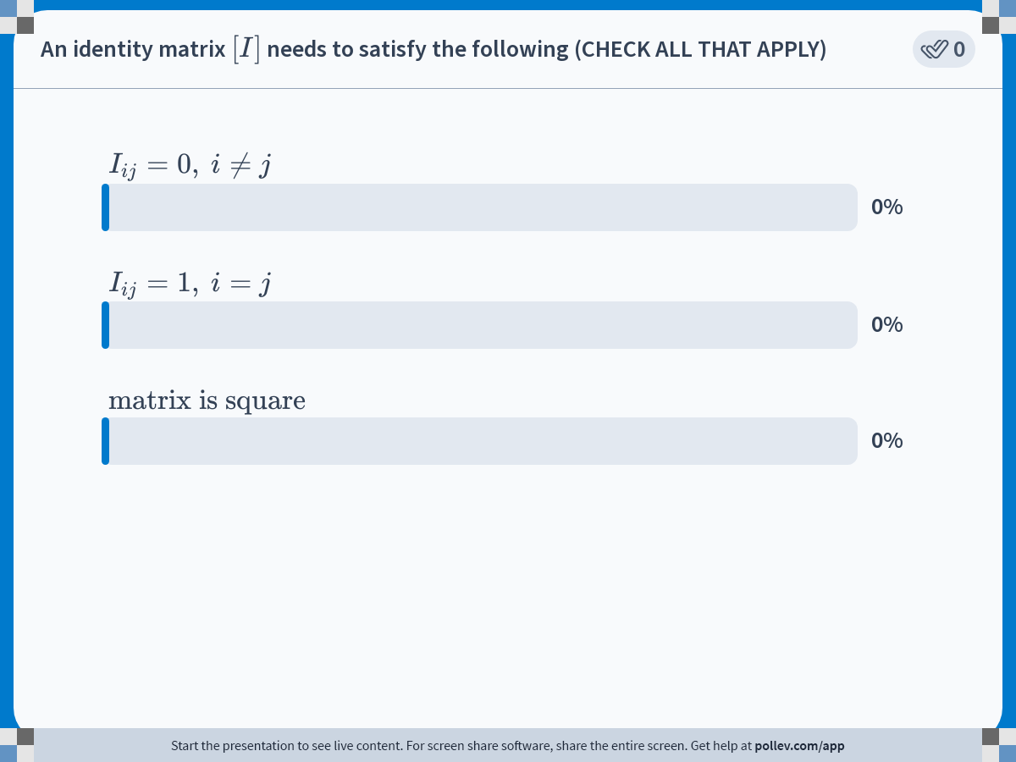
Notes:
Poll Title: Do not modify the notes in this section to avoid tampering with the Poll Everywhere activity.
More info at polleverywhere.com/support
An identity matrix $$[I]$$ needs to satisfy the following (CHECK ALL THAT APPLY)
https://www.polleverywhere.com/multiple_choice_polls/rsoMnZme7pmz4Bl3gA77Y

Slide 30
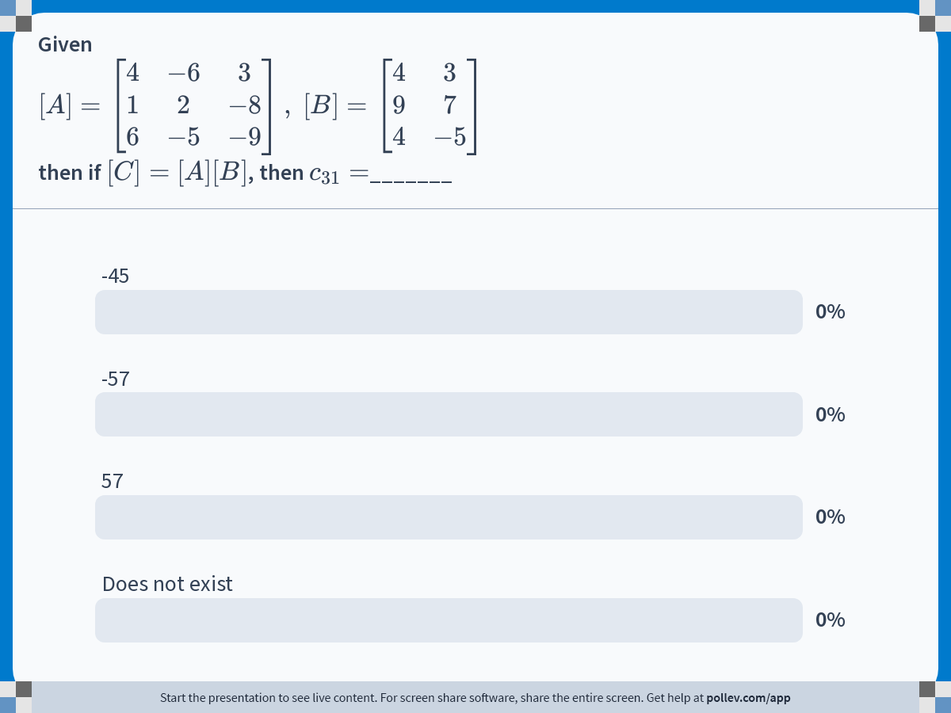
Notes:
Poll Title: Do not modify the notes in this section to avoid tampering with the Poll Everywhere activity.
More info at polleverywhere.com/support
Given $$[A] = \\left[\\begin{matrix}4 &amp; -6 &amp; 3 \\\\ 1 &amp; 2 &amp; -8 \\\\ 6 &amp; -5 &amp; -9 \\end{matrix}\\right],\\ [B] = \\left[\\begin{matrix} 4 &amp; 3 \\\\ 9 &amp; 7 \\\\ 4 &amp; -5 \\end{matrix}\\right]$$ then if $$[C] = [A][B]$$, then $$c_{31}=$$_______
https://www.polleverywhere.com/multiple_choice_polls/JrcxDlz0QFYBB8Pwu9dWe

Slide 31
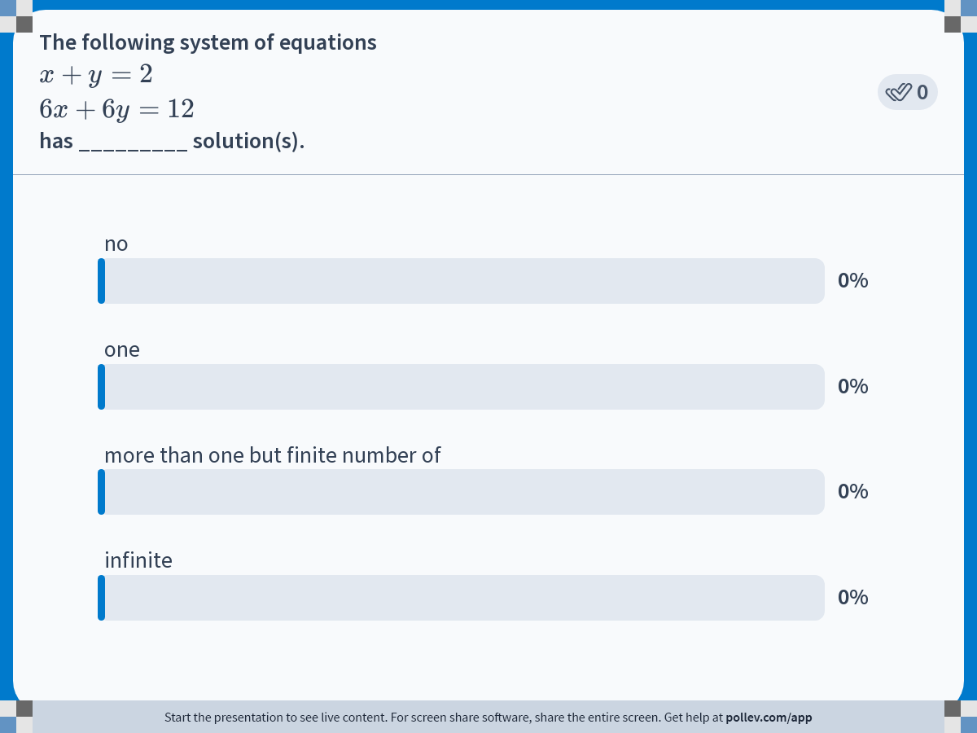
Notes:
Poll Title: Do not modify the notes in this section to avoid tampering with the Poll Everywhere activity.
More info at polleverywhere.com/support
The following system of equations $$x+y=2$$ $$6x+6y=12$$ has _________ solution(s).
https://www.polleverywhere.com/multiple_choice_polls/p3Zfp3EUAzAtbsscTV5mL

Slide 32
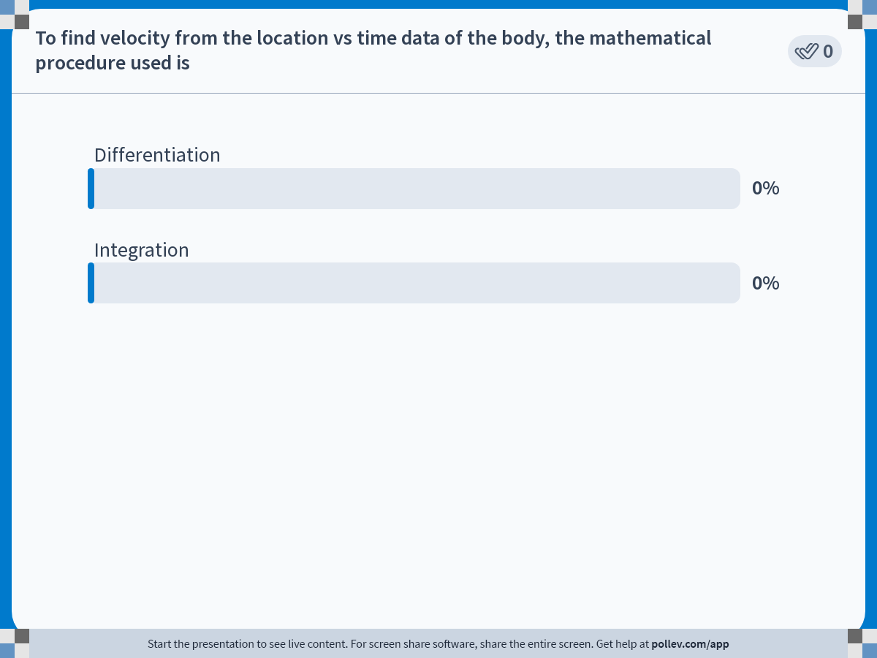
Notes:
Poll Title: Do not modify the notes in this section to avoid tampering with the Poll Everywhere activity.
More info at polleverywhere.com/support
To find velocity from the location vs time data of the body, the mathematical procedure used is
https://www.polleverywhere.com/multiple_choice_polls/OwWTiekifWL5nVdNcJb4k

Slide 33
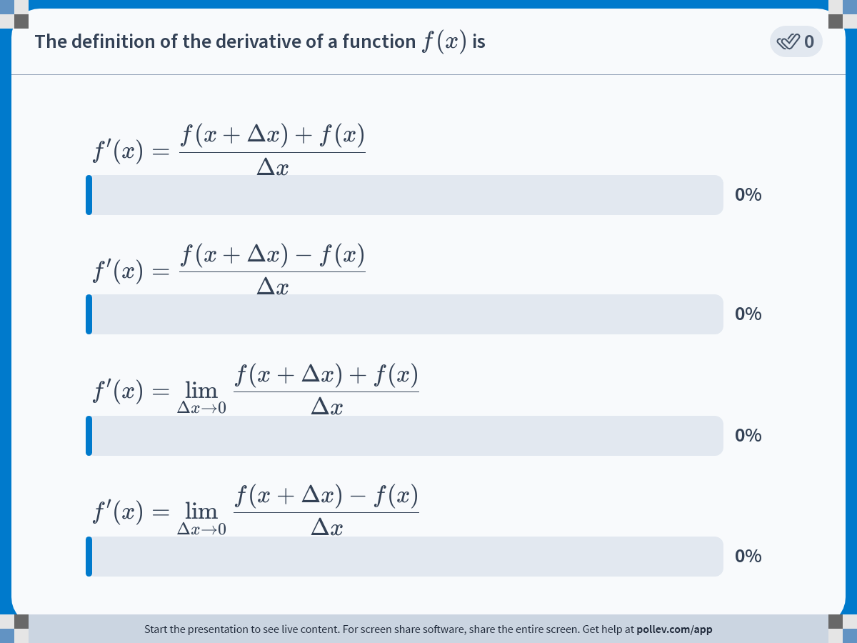
Notes:
Poll Title: Do not modify the notes in this section to avoid tampering with the Poll Everywhere activity.
More info at polleverywhere.com/support
The definition of the derivative of a function $$f(x)$$ is
https://www.polleverywhere.com/multiple_choice_polls/aA2dWjQRO4v4wtRXM8aIZ

Slide 34
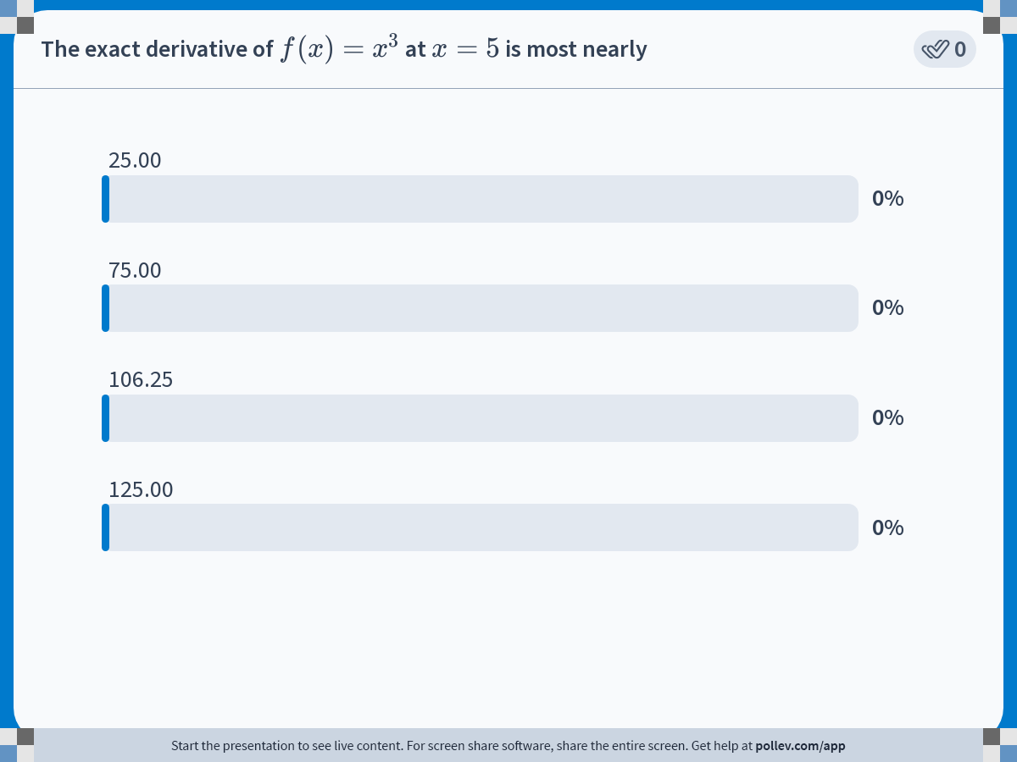
Notes:
Poll Title: Do not modify the notes in this section to avoid tampering with the Poll Everywhere activity.
More info at polleverywhere.com/support
The exact derivative of $$f(x) = x^3$$ at $$x=5$$ is most nearly
https://www.polleverywhere.com/multiple_choice_polls/kTinhvSdVEexmbIhV9kWF

Slide 35
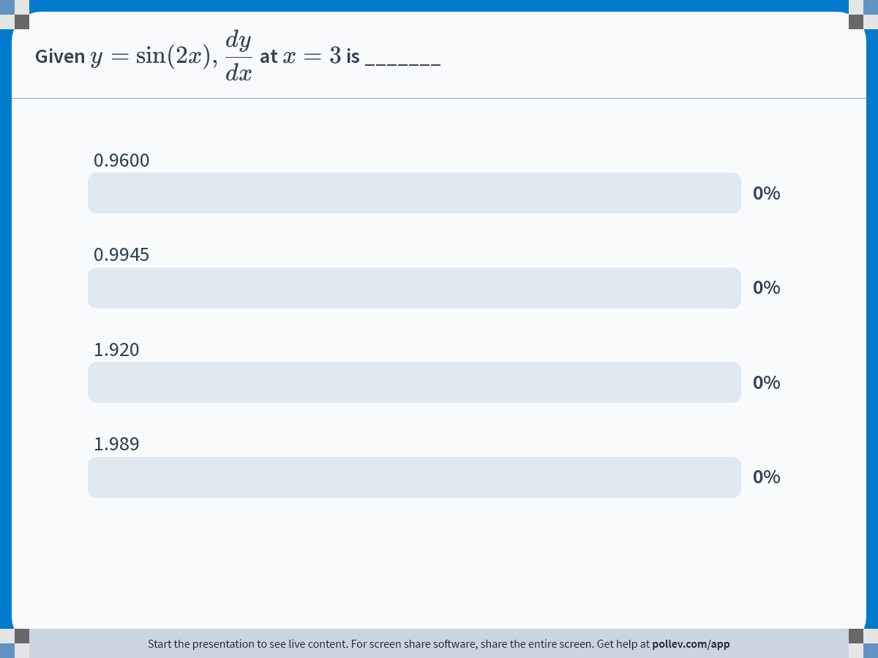
Notes:
Poll Title: Do not modify the notes in this section to avoid tampering with the Poll Everywhere activity.
More info at polleverywhere.com/support
Given $$ y = \\sin(2x), \\displaystyle \\frac{dy}{dx}$$ at $$x = 3$$ is _______
https://www.polleverywhere.com/multiple_choice_polls/zTRxjyFJtVTt6m22id3Xf

Slide 36
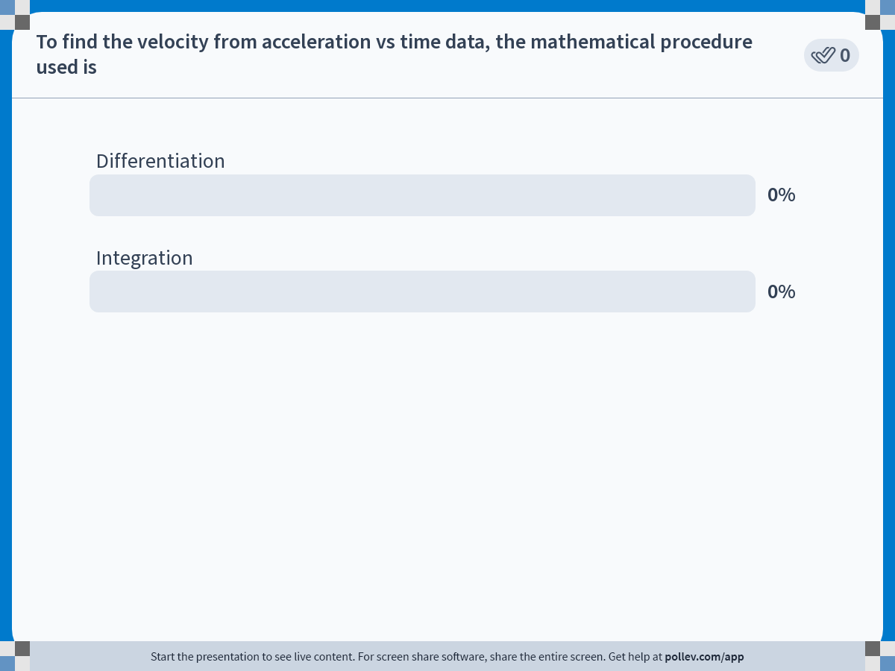
Notes:
Poll Title: Do not modify the notes in this section to avoid tampering with the Poll Everywhere activity.
More info at polleverywhere.com/support
To find the velocity from acceleration vs time data, the mathematical procedure used is
https://www.polleverywhere.com/multiple_choice_polls/WDIevIvBAO2MZoSrbEaNn

Slide 37
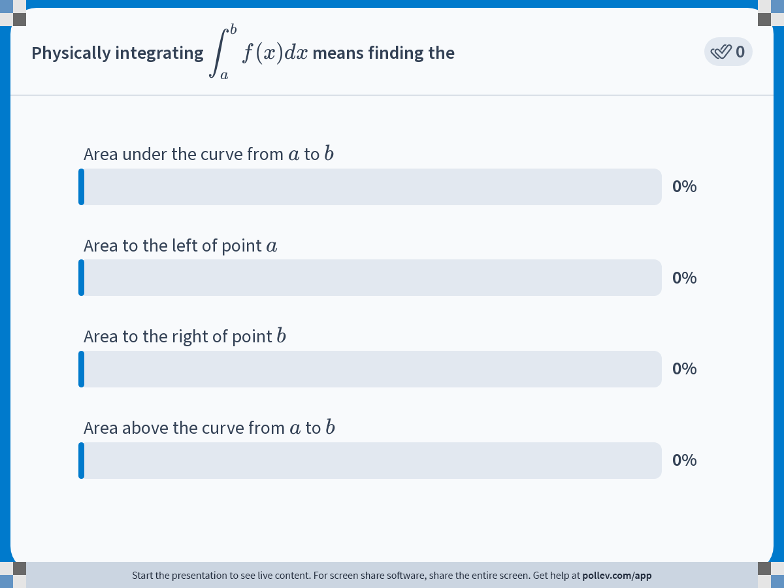
Notes:
Poll Title: Do not modify the notes in this section to avoid tampering with the Poll Everywhere activity.
More info at polleverywhere.com/support
Physically integrating $$\\displaystyle \\int_a^b f(x)dx$$ means finding the
https://www.polleverywhere.com/multiple_choice_polls/mVlM0DhbCg25SgyHasji4

Slide 38
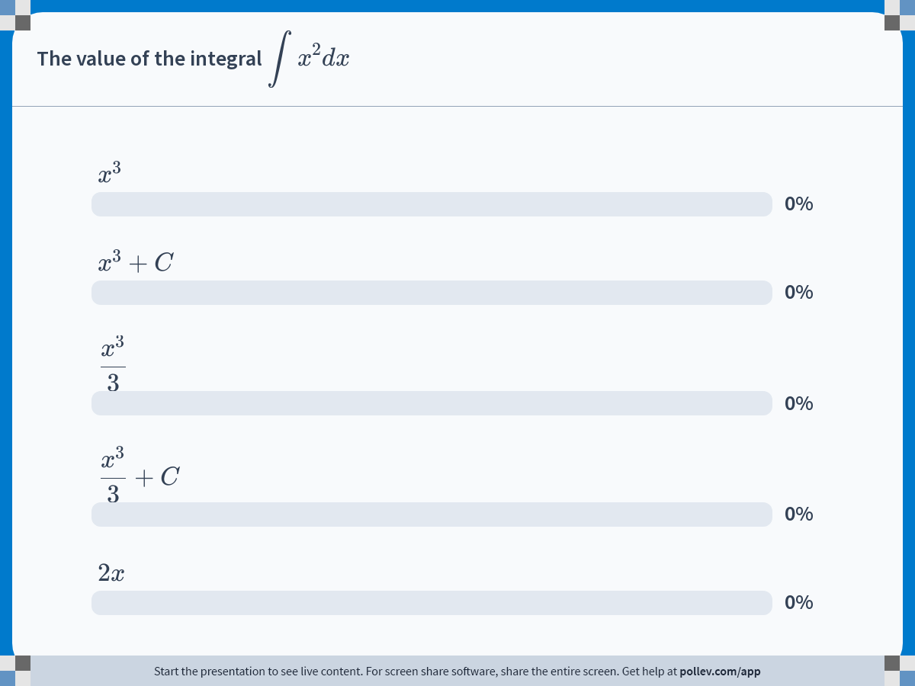
Notes:
Poll Title: Do not modify the notes in this section to avoid tampering with the Poll Everywhere activity.
More info at polleverywhere.com/support
The value of the integral $$\\displaystyle \\int x^2dx$$
https://www.polleverywhere.com/multiple_choice_polls/GOFr3ongZMtYX2hHZK2Sr

Slide 39
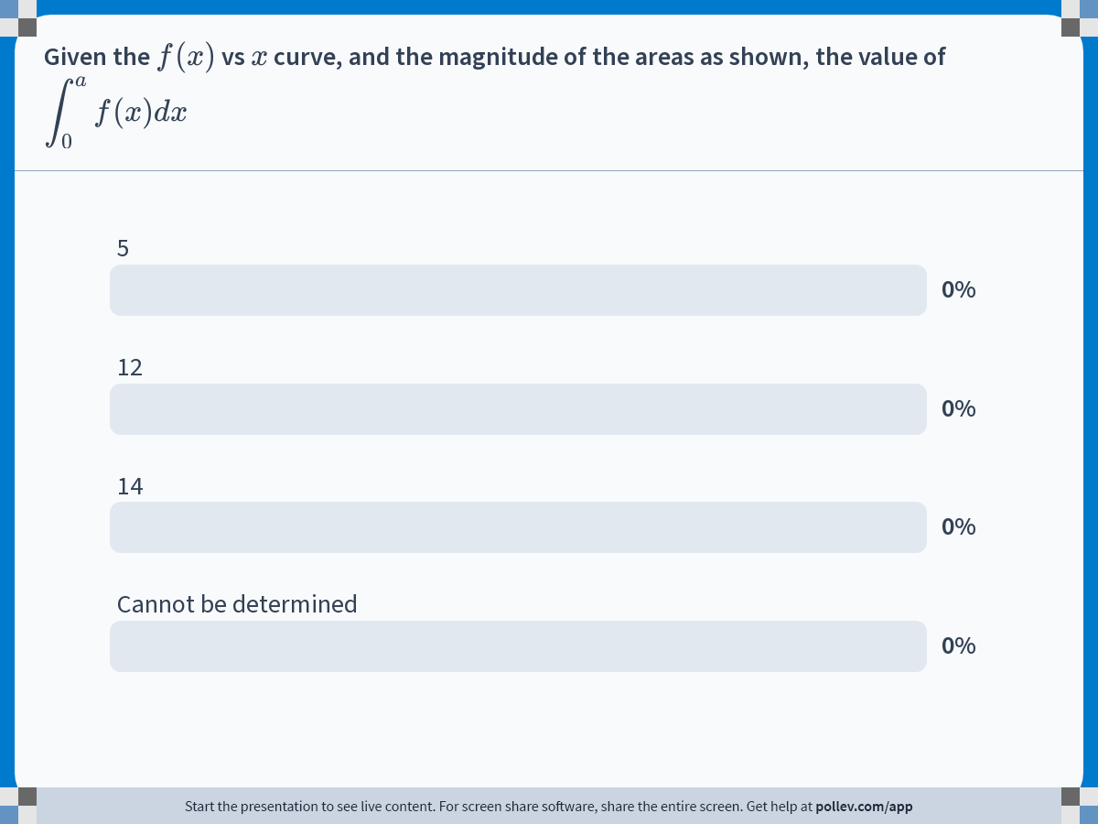
Notes:
Poll Title: Do not modify the notes in this section to avoid tampering with the Poll Everywhere activity.
More info at polleverywhere.com/support
Given the $$f(x)$$ vs $$x$$ curve, and the magnitude of the areas as shown, the value of $$\\displaystyle \\int ^a_0f(x)dx$$
https://www.polleverywhere.com/multiple_choice_polls/27dPbVXowIThkba2goYwV

Slide 40
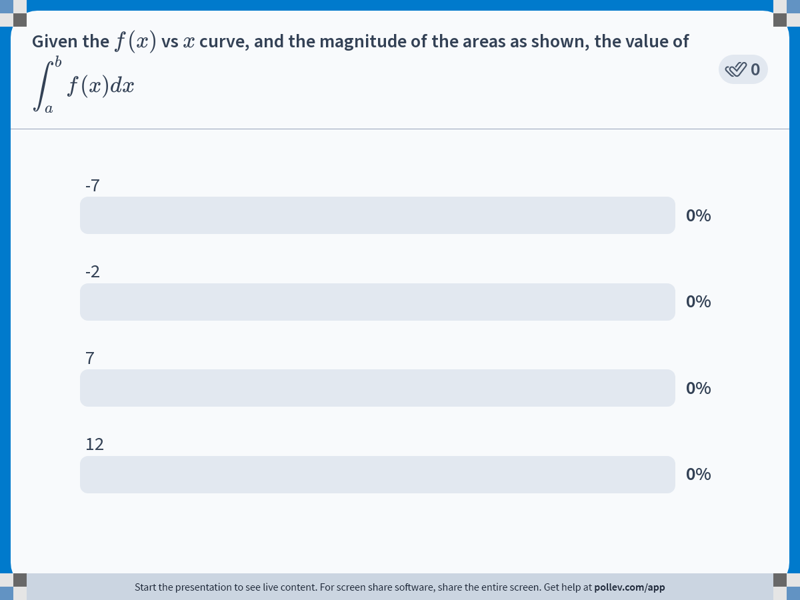
Notes:
Poll Title: Do not modify the notes in this section to avoid tampering with the Poll Everywhere activity.
More info at polleverywhere.com/support
Given the $$f(x)$$ vs $$x$$ curve, and the magnitude of the areas as shown, the value of $$\\displaystyle \\int ^b_af(x)dx$$
https://www.polleverywhere.com/multiple_choice_polls/FD2EaxC5QK84i4zDOVqaD

Slide 41
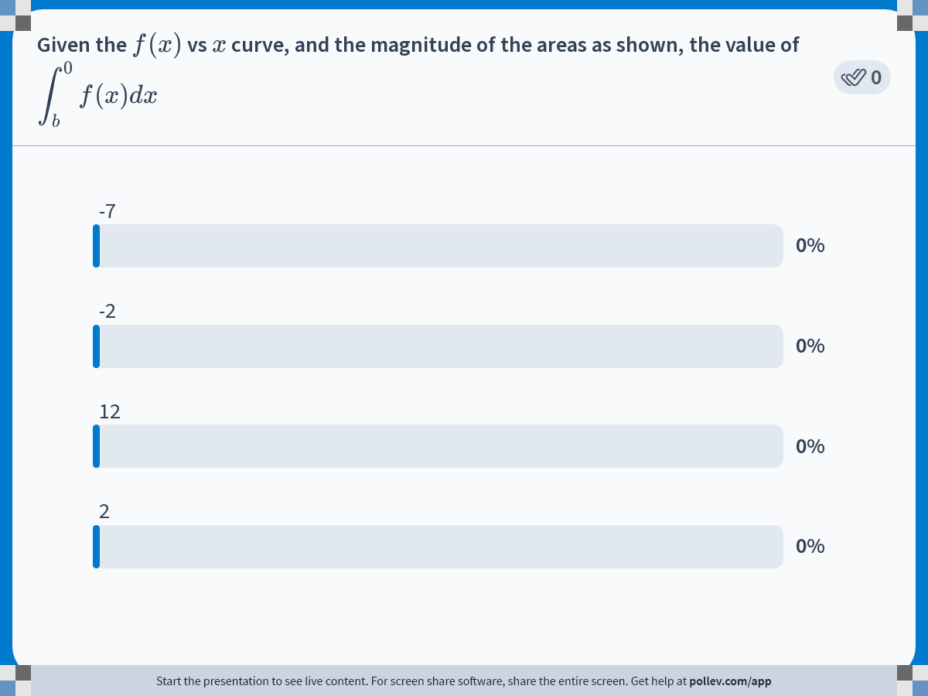
Notes:
Poll Title: Do not modify the notes in this section to avoid tampering with the Poll Everywhere activity.
More info at polleverywhere.com/support
Given the $$f(x)$$ vs $$x$$ curve, and the magnitude of the areas as shown, the value of $$\\displaystyle \\int ^0_bf(x)dx$$
https://www.polleverywhere.com/multiple_choice_polls/28t3L7fH57SdCCO5Lc52d

Slide 42
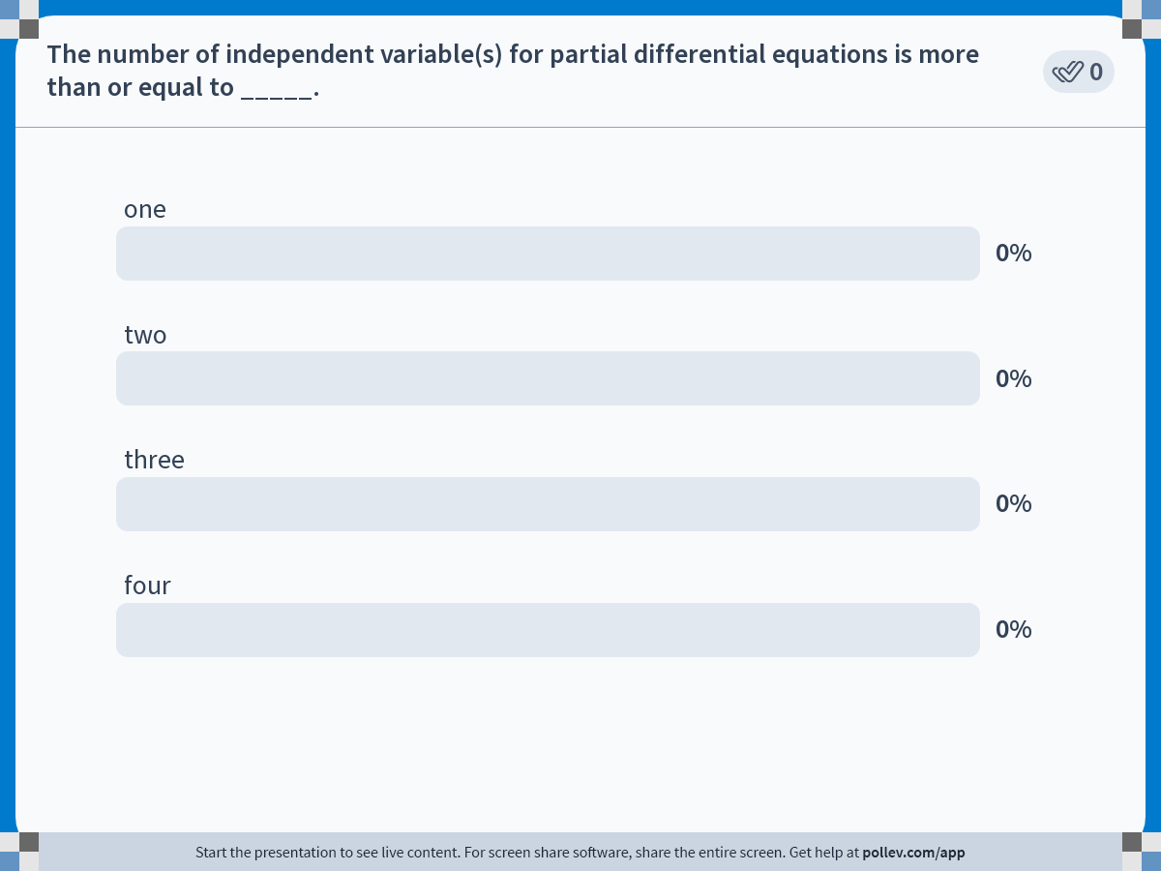
Notes:
Poll Title: Do not modify the notes in this section to avoid tampering with the Poll Everywhere activity.
More info at polleverywhere.com/support
The number of independent variable(s) for partial differential equations is more than or equal to _____.
https://www.polleverywhere.com/multiple_choice_polls/dpxoxg3r71EYkx8Gwv1lB

