Slide 1
Using Poll Everywhere
January 20, 2023
Autar Kaw
http://AutarKaw.com

Slide 2
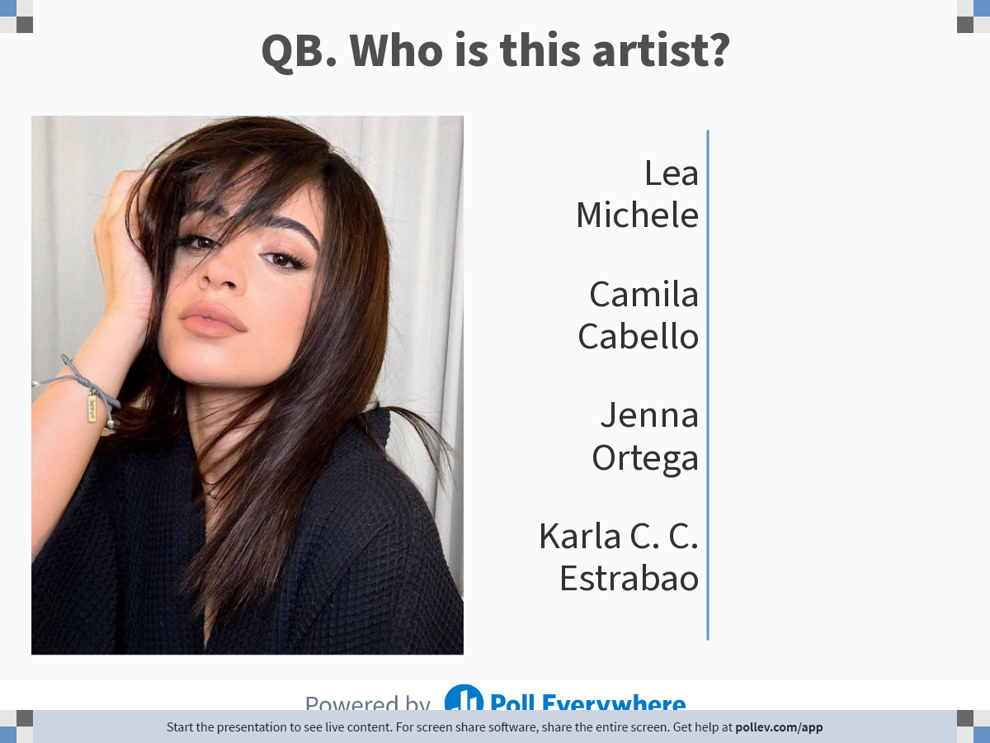
Notes:
Poll Title: Do not modify the notes in this section to avoid tampering with the Poll Everywhere activity.
More info at polleverywhere.com/support
QB. Who is this artist?
https://www.polleverywhere.com/multiple_choice_polls/9AGFOd5pzZyGp826yur8N?state=opened&flow=Default&onscreen=persist

Slide 3
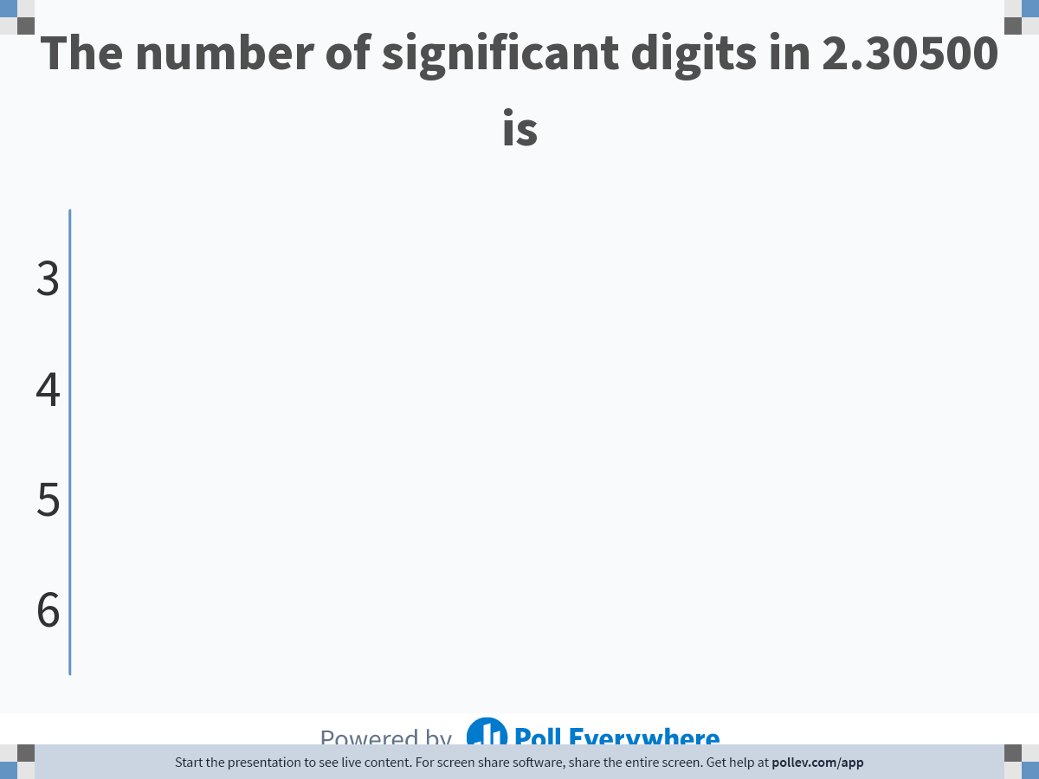
Notes:
Poll Title: Do not modify the notes in this section to avoid tampering with the Poll Everywhere activity.
More info at polleverywhere.com/support
The number of significant digits in 2.30500 is
https://www.polleverywhere.com/multiple_choice_polls/G2YQvAszin3SMMPKV6HaO?state=opened&flow=Default&onscreen=persist

Slide 4
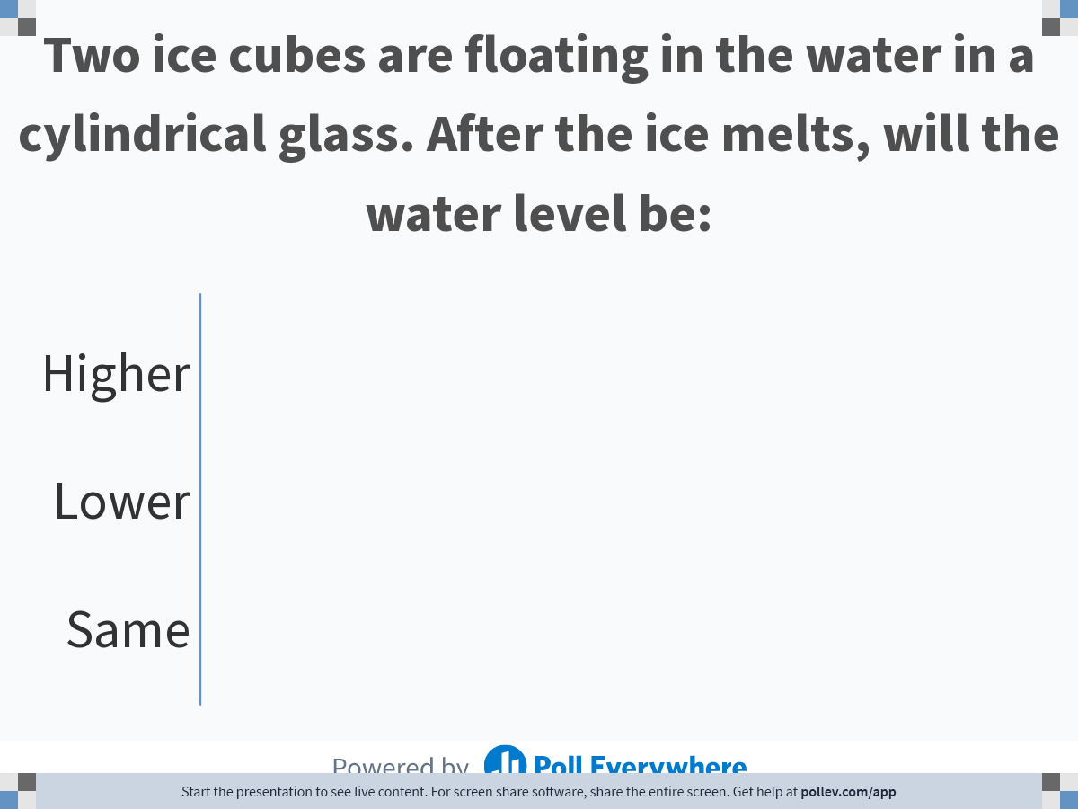
Notes:
Poll Title: Do not modify the notes in this section to avoid tampering with the Poll Everywhere activity.
More info at polleverywhere.com/support
Two ice cubes are floating in the water in a cylindrical glass. After the ice melts, will the water level be:
https://www.polleverywhere.com/multiple_choice_polls/x3l8gOdybmxofyWPHDCMz?state=opened&flow=Default&onscreen=persist

