Slide 1
A Sad Story
Bad things happen to good people, if you consider me to be good

Slide 2
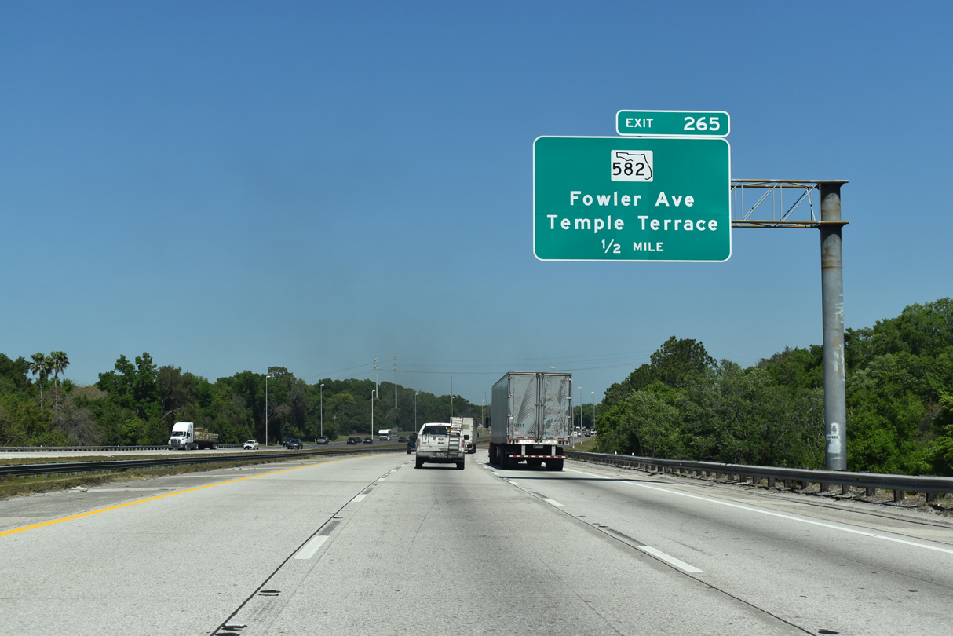
Dr. Kaw got a traffic ticket today
Today, I was going on I-75 and got pulled over by a cop who was hiding under the bridge.
The cop said, “Sir, you were driving recklessly. I saw you swerving back there.”
I said, “Sorry, I did not do so intentionally. There was a large box in the middle of the lane, and I had to avoid it.”

Slide 3
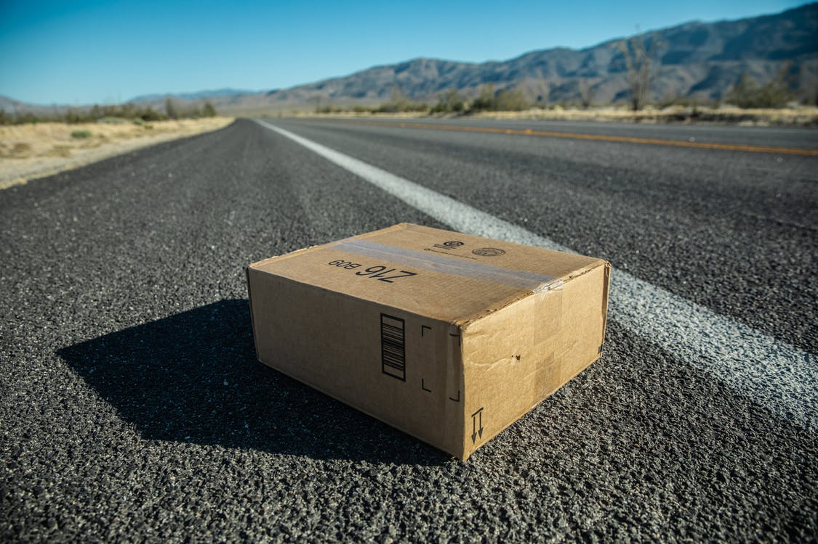
My bad morning continues
The cop said, “Wait here so I can see if you are telling me the truth.” He took my Drivers License and Car Registration and went back to investigate.
The cop came back and said, “I am glad that I stopped you. There really was a box in the middle of the lane. I removed it and guess what I found – thumb tacks. That could have been dangerous.”

Slide 4
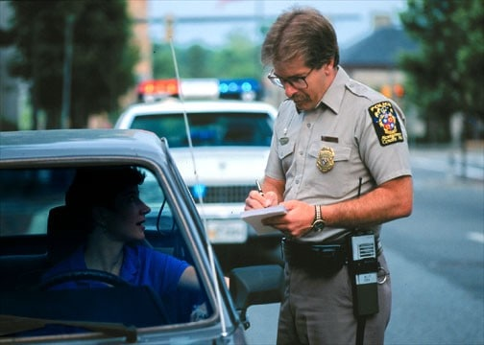
What a lucky break?
I felt relieved to say, “So can I go now.”
The cop said, “No, you cannot go. I still have to give you a ticket.”
I was getting ticked off. I could have killed myself avoiding the box of thumb tacks. I was already late to get to today’s class. So, I asked, “Why do you have to give me a ticket?”

Slide 5
And he said
I have to give you a ticket for
TACKS EVASION

Slide 6
Today’s Date
April 1

