Slide 1
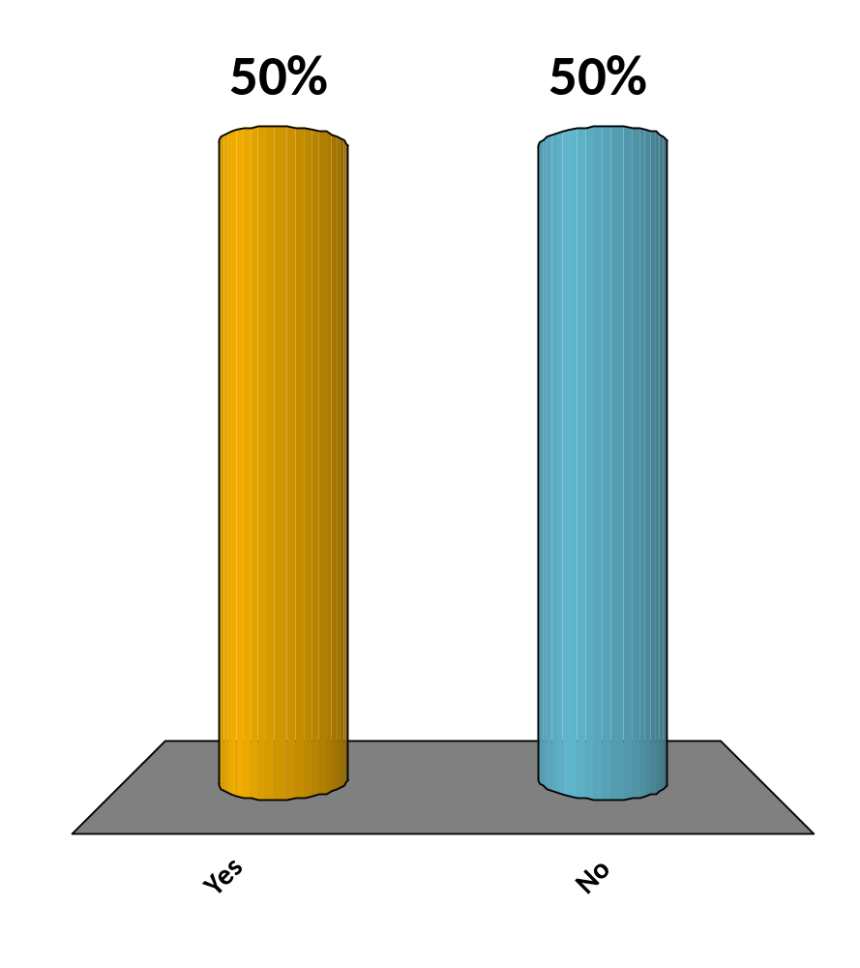
Do you know how Runge- Kutta 4th Order Method works?
Yes
No
Maybe
I take the 5th

Slide 2
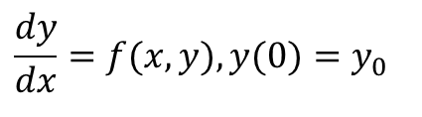
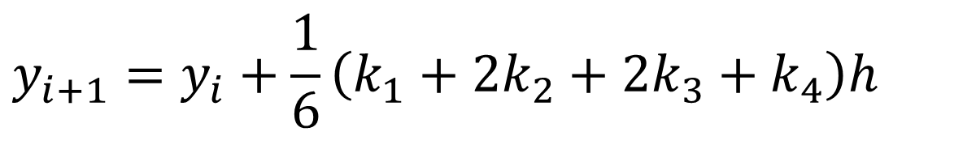

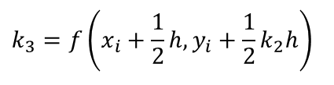
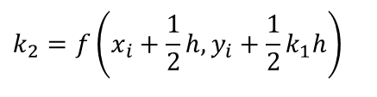

Runge-Kutta 4th Order Method
$$\frac{dy}{dx}=f(x,y),y(0)=y_{0}$$
$$y_{i+1}=y_{i}+\frac{1}{6}\left(k_{1}+2k_{2}+2k_{3}+k_{4}\right)h$$
$$k_{1}=f\left(x_{i},y_{i}\right)$$
$$k_{2}=f\left(x_{i}+\frac{1}{2}h,y_{i}+\frac{1}{2}k_{1}h\right)$$
$$k_{3}=f\left(x_{i}+\frac{1}{2}h,y_{i}+\frac{1}{2}k_{2}h\right)$$
$$k_{4}=f\left(x_{i}+h,y_{i}+k_{3}h\right)$$

Slide 3
Bus Suspension System
Autar Kaw
Humberto Isaza
http://nm.MathForCollege.com
Transforming Numerical Methods Education for STEM Undergraduates

Slide 4
Bus Suspension System
http://nm.MathForCollege.com

Slide 5
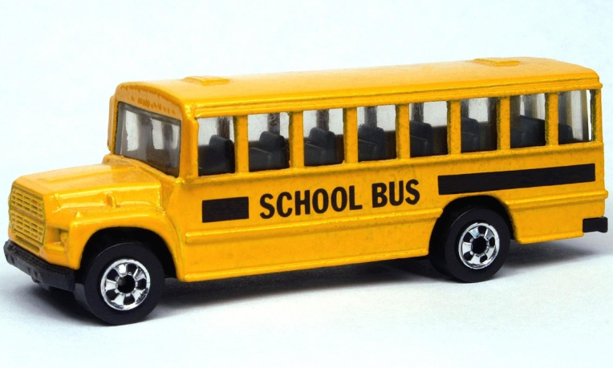
Bus Suspension System
An Example to Show How to Reduce Coupled Differential Equations to a Set of First Order Differential Equations
3
Figure 1: A school bus.

Slide 6
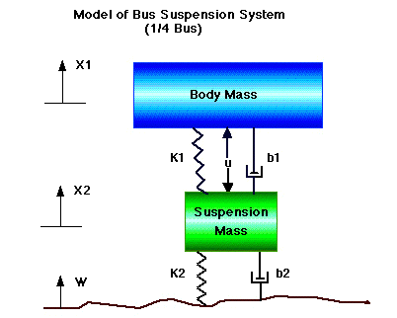
Bus Suspension System (cont.)
Figure 2: A model of 1/4th of suspension system of bus.

Slide 7


Bus Suspension System (cont.)
Problem Statement:
A suspension system of a bus can be modeled as above. Only 1/4th of the bus is modeled. The differential equations that govern the above system can be derived (this is something you will do in your vibrations course) as
(1)
(2)
$$M_{1}\frac{d^{2}x_{1}}{dt^{2}}+B_{1}\left(\frac{dx_{1}}{dt}−\frac{dx_{2}}{dt}\right)+K_{1}\left(x_{1}−x_{2}\right)=0$$
$$M_{2}\frac{d^{2}x_{2}}{dt^{2}}+B_{1}\left(\frac{dx_{2}}{dt}−\frac{dx_{1}}{dt}\right)+K_{1}\left(x_{2}−x_{1}\right)+B_{2}\left(\frac{dx_{2}}{dt}−\frac{dw}{dt}\right)+K_{2}\left(x_{2}−w\right)=0$$
$$x_{1}(0)=0,v_{1}(0)=0,x_{2}(0)=0,v_{2}(0)=0$$

Slide 8








Bus Suspension System (cont.)
Where
body
suspension mass
spring constant of suspension system
spring constant of wheel and tire
damping constant of suspension system
damping constant of wheel and tire
displacement of the body mass as a function of time
displacement of the suspension mass as a function of time
input profile of the road as a function of time
$$M_{1}=$$
$$M_{2}=$$
$$K_{1}=$$
$$K_{2}=$$
$$B_{1}=$$
$$B_{2}=$$
$$x_{1}=$$
$$x_{2}=$$
$$w=$$

Slide 9






Bus Suspension System (cont.)
The constants are given as
Reduce the simultaneous differential equations (1) and (2) to simultaneous first order differential equations and put them in the state variable form complete with corresponding initial conditions.
$$m_{1}=2500\text{kg}$$
$$m_{2}=320\text{kg}$$
$$K_{1}=80,000 \text{N}\text{/}\text{m}$$
$$K_{2}=500,000 \text{N}\text{/}\text{m}$$
$$B_{1}=350 \text{N}\text{−}\text{s}\text{/}\text{m}$$
$$B_{2}=15,020 \text{N}\text{−}\text{s}\text{/}\text{m}$$

Slide 10

Bus Suspension System (cont.)
Solution
Substituting the values of the constants in the two differential equations (1) and (2) gives the differential equations (3) and (4), respectively.
(3)
(4)
$$2500\frac{d^{2}x_{1}}{dt^{2}}+350\left(\frac{dx_{1}}{dt}−\frac{dx_{2}}{dt}\right)+80000\left(x_{1}−x_{2}\right)=0$$
$$320\frac{d^{2}x_{2}}{dt^{2}}+350\left(\frac{dx_{2}}{dt}−\frac{dx_{1}}{dt}\right)+80000\left(x_{2}−x_{1}\right)+15020\left(\frac{dx_{2}}{dt}−\frac{dw}{dt}\right)+500000(x_{2}−w)=0$$

Slide 11
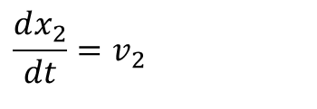
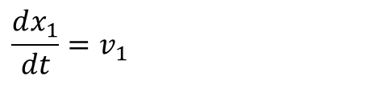
Bus Suspension System (cont.)
,
,
Since w is an input, we take it to the right hand side to show it as a forcing function and rewrite Equation (4) as
(5)
Now let us start the process of reducing the 2 simultaneous differential equations: Equations (3) and (5) to 4 simultaneous first order differential equations.
Choose
(6)
(7)
$$320\frac{d^{2}x_{2}}{dt^{2}}+350\left(\frac{dx_{2}}{dt}−\frac{dx_{1}}{dt}\right)+80000\left(x_{2}−x_{1}\right)+15020\left(\frac{dx_{2}}{dt}\right)+500000x_{2}=15020\frac{dw}{dt}+500000w$$
$$\frac{dx_{1}}{dt}=v_{1}$$
$$\frac{dx_{2}}{dt}=v_{2}$$

Slide 12
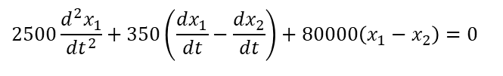



Bus Suspension System (cont.)
then Equation (3)
can be written as
(8)
$$2500\frac{d^{2}x_{1}}{dt^{2}}+350\left(\frac{dx_{1}}{dt}−\frac{dx_{2}}{dt}\right)+80000\left(x_{1}−x_{2}\right)=0$$
$$2500\frac{dv_{1}}{dt}+350\left(v_{1}−v_{2}\right)+80000\left(x_{1}−x_{2}\right)=0$$
$$2500\frac{dv_{1}}{dt}=−350(v_{1}−v_{2})−80000(x_{1}−x_{2})$$
$$\frac{dv_{1}}{dt}=−0.14\left(v_{1}−v_{2}\right)−32\left(x_{1}−x_{2}\right)$$

Slide 13
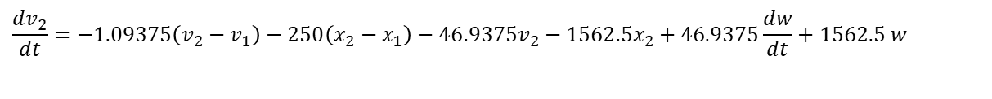
Bus Suspension System (cont.)
and Equation (5)
can be written as
(9)
$$320\frac{d^{2}x_{2}}{dt^{2}}+350\left(\frac{dx_{2}}{dt}−\frac{dx_{1}}{dt}\right)+80000\left(x_{2}−x_{1}\right)+15020\left(\frac{dx_{2}}{dt}\right)+500000x_{2}=15020\frac{dw}{dt}+500000w$$
$$320\frac{dv_{2}}{dt}+350\left(v_{2}−v_{1}\right)+80000\left(x_{2}−x_{1}\right)+15020v_{2}+500000x_{2}=15020\frac{dw}{dt}+500000w$$
$$320\frac{dv_{2}}{dt}=−350(v_{2}−v_{1})−80000(x_{2}−x_{1})−15020v_{2}−500000x_{2}+15020\frac{dw}{dt}+500000w$$
$$\frac{dv_{2}}{dt}=−1.09375\left(v_{2}−v_{1}\right)−250\left(x_{2}−x_{1}\right)−46.9375v_{2}−1562.5x_{2}+46.9375\frac{dw}{dt}+1562.5 w$$

Slide 14
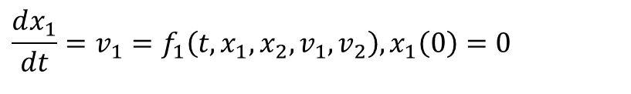
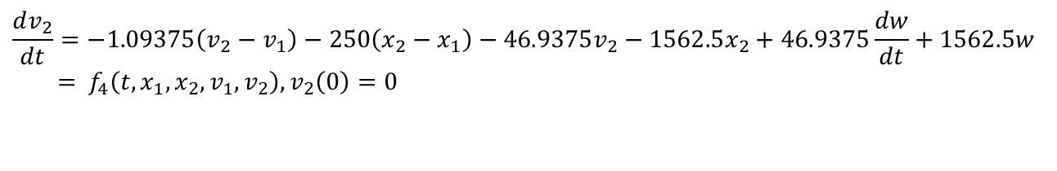

Bus Suspension System (cont.)
The 4 simultaneous first order differential equations given by Equations 6 thru 9 complete with the corresponding initial condition then are
(10)
(11)
(12)
(13)
$$\frac{dx_{1}}{dt}=v_{1}=f_{1}\left(t,x_{1},x_{2},v_{1},v_{2}\right),x_{1}\left(0\right)=0$$
$$\frac{dx_{2}}{dt}=v_{2}=f_{2}\left(t,x_{1},x_{2},v_{1},v_{2}\right),x_{2}\left(0\right)=0$$
$$\frac{dv_{1}}{dt}=−0.14\left(v_{1}−v_{2}\right)−32\left(x_{1}−x_{2}\right)=f_{3}\left(t,x_{1},x_{2},v_{1},v_{2}\right),v_{1}\left(0\right)=0$$
$$\frac{dv_{2}}{dt}=−1.09375\left(v_{2}−v_{1}\right)−250\left(x_{2}−x_{1}\right)−46.9375v_{2}−1562.5x_{2}+46.9375\frac{dw}{dt}+1562.5w \\ = f_{4}\left(t,x_{1},x_{2},v_{1},v_{2}\right),v_{2}\left(0\right)=0$$

Slide 15
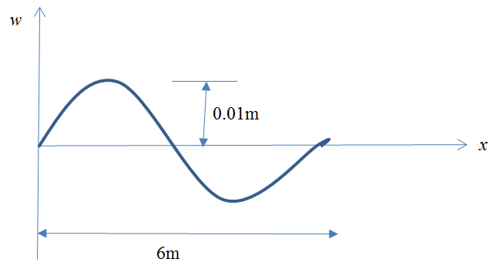

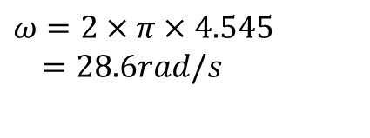
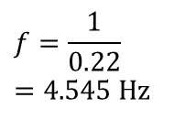
Bus Suspension System (cont.)
Assuming that the bus is going at 60 mph, that is, approximately 27 m/s, it takes
to go through one period. So, the frequency
The angular frequency then is
$$\frac{6m}{27m/s}=0.22s$$
$$f=\frac{1}{0.22} \\ =\text{4.545 }\text{Hz}$$
$$ω=2×π×4.545 \\ =28.6rad/s$$

Slide 16
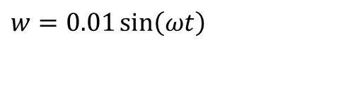
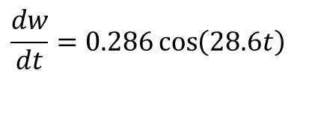
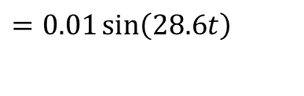
Bus Suspension System (cont.)
Giving
and
$$w=0.01\sin\left(ωt\right)$$
$$=0.01\sin\left(28.6t\right)$$
$$\frac{dw}{dt}=0.286\cos\left(28.6t\right)$$

Slide 17
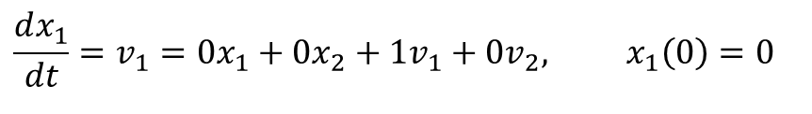
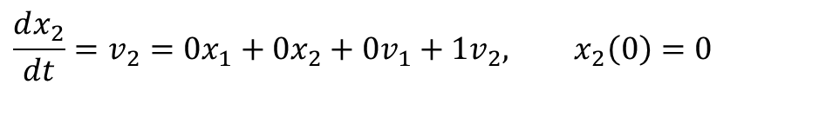
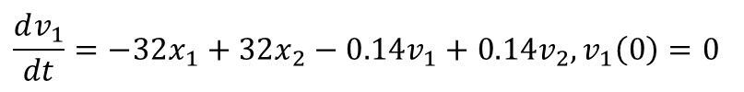
Bus Suspension System (cont.)
To put the differential equations given by Equations in matrix form, we rewrite them as
$$\frac{dx_{1}}{dt}=v_{1}=0x_{1}+0x_{2}+1v_{1}+0v_{2}, x_{1}\left(0\right)=0$$
$$\frac{dx_{2}}{dt}=v_{2}=0x_{1}+0x_{2}+0v_{1}+1v_{2}, x_{2}\left(0\right)=0$$
$$\frac{dv_{1}}{dt}=−32x_{1}+32x_{2}−0.14v_{1}+0.14v_{2},v_{1}\left(0\right)=0$$
$$\frac{dv_{2}}{dt}=250x_{1}−1812.5x_{2}+1.09375v_{1}−48.03125v_{2}+1562.5w+46.9375\frac{dw}{dt},v_{2}\left(0\right)=0$$

Slide 18

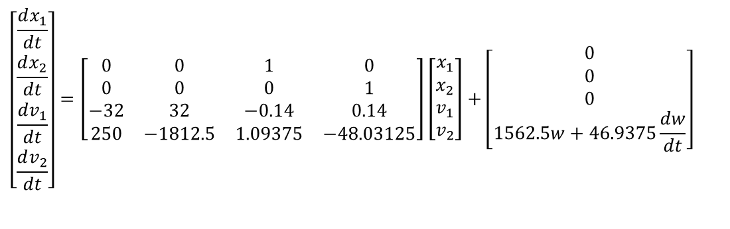
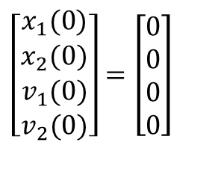
Bus Suspension System (cont.)
In state variable matrix form, the differential equations are given by
where
and the corresponding initial conditions are
$$\left[\begin{matrix}\frac{dx_{1}}{dt} \\ \frac{dx_{2}}{dt} \\ \frac{dv_{1}}{dt} \\ \frac{dv_{2}}{dt}\end{matrix}\right]=\left[\begin{matrix}0 & 0 & 1 & 0 \\ 0 & 0 & 0 & 1 \\ −32 & 32 & −0.14 & 0.14 \\ 250 & −1812.5 & 1.09375 & −48.03125\end{matrix}\right]\left[\begin{matrix}x_{1} \\ x_{2} \\ v_{1} \\ v_{2}\end{matrix}\right]+\left[\begin{matrix}0 \\ 0 \\ 0 \\ 1562.5w+46.9375\frac{dw}{dt}\end{matrix}\right]$$
$$w=0.01\sin{(}28.6t)$$
$$\left[\begin{matrix}x_{1}(0) \\ x_{2}(0) \\ v_{1}(0) \\ v_{2}(0)\end{matrix}\right]=\left[\begin{matrix}0 \\ 0 \\ 0 \\ 0\end{matrix}\right]$$

Slide 19
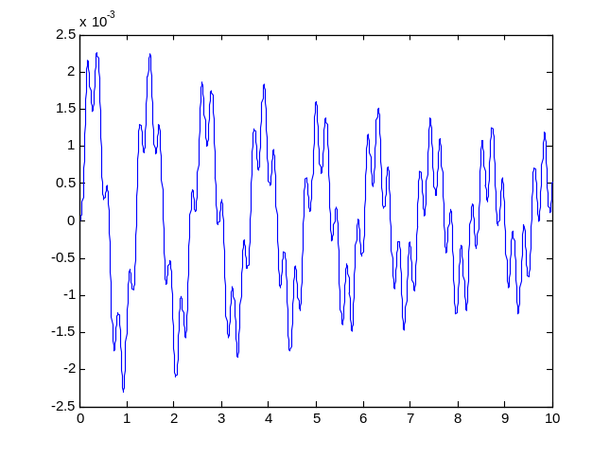
Using MATLAB to Solve
function diffx=sysofeqn(t,x)
A=[0 0 1 0; ...
0 0 0 1; ...
-32 32 -0.14 0.14; ...
250 -1812.5 1.09375 -48.03125];
w=0.01*sin(28.6*t);
dw=0.286*cos(28.6*t);
B=[0; 0; 0; 1652.5*w+46.9375*dw];
diffx=A*x+B;
end
tspan=[0 10];
initial_cond=[0;0;0;0];
[t,x]=ode45('sysofeqn',tspan,initial_cond);
figure (1)
plot(t,x(:,1))

Slide 20
How the output data looks like
t =
0
0.000003742346606
0.000007484693212
0.000011227039818
0.000014969386423
0.000033681119453
0.000052392852482
x =
0 0 0 0
0.000000000000000 0.000000000094002 0.000000000013164 0.000050236522812
0.000000000000000 0.000000000376002 0.000000000052670 0.000100470633045
0.000000000000000 0.000000000845991 0.000000000118540 0.000150702329280
0.000000000000001 0.000000001503960 0.000000000210794 0.000200931610101
0.000000000000012 0.000000007613185 0.000000001068580 0.000452041733437
0.000000000000045 0.000000018420550 0.000000002589166 0.000703091259071

Slide 21
End
See how MATLAB ode45 is used to solve such problems
http://www.math.purdue.edu/academic/files/courses/past//2004fall/MA266/ode45.pdf

