Slide 1
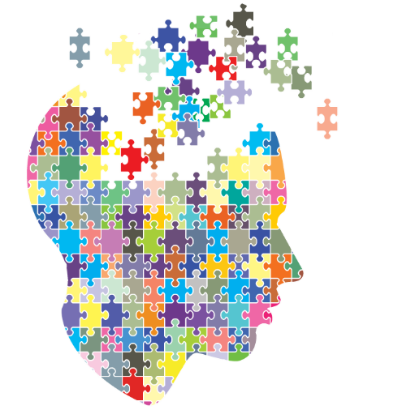
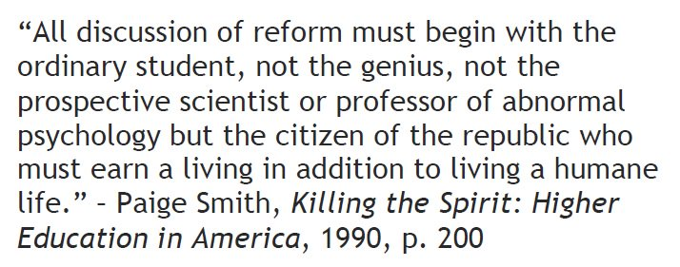
How Effective is the Flipped Classroom?
^{Autar Kaw}
^{http://AutarKaw.com}
^{University of South Florida}
^{Renee Clark}
^{University of Pittsburgh}
Course Hero Summit, July 2019

Slide 2
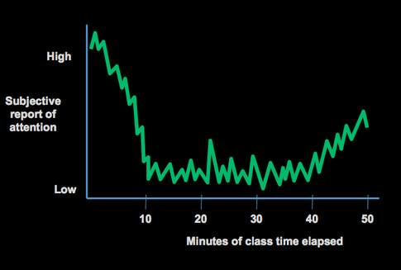
Attention vs. Time elapsed
Source: Brain Rules by John Medina http://brainrules.blogspot.com

Slide 3
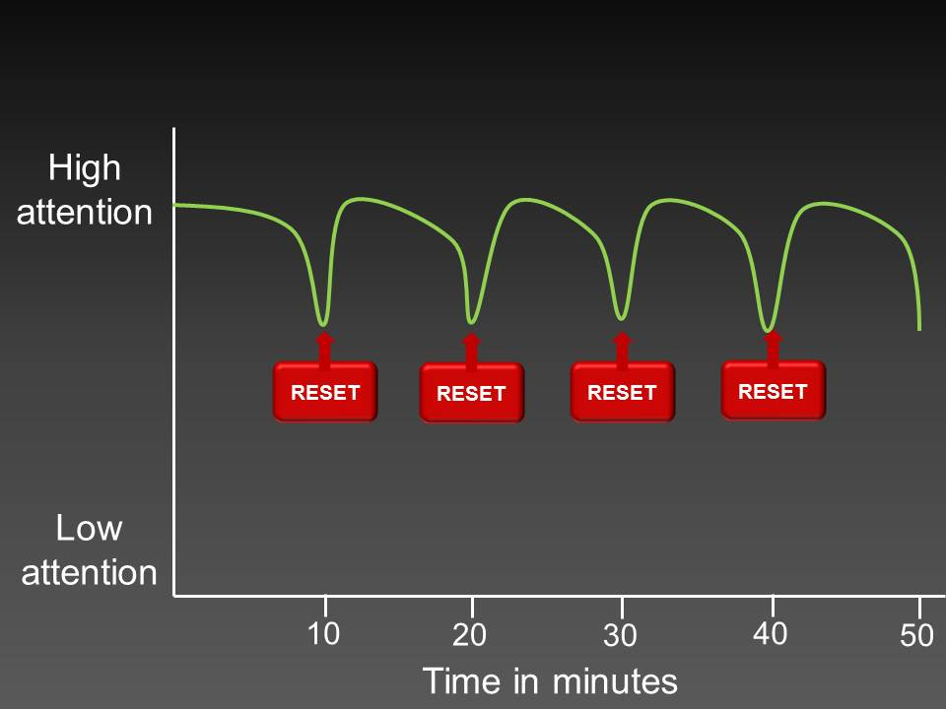
Resetting the Attention
Source: What to do when you’re losing your audience by Olivia Mitchell

Slide 4

Active Learning
Student performance on examinations and concept inventories under active learning, effect size≈0.5
$$Effect Size=\frac{Average of Experimental Gp−Average of Control Gp}{Standard Deviation}$$
Trivial ≈0 | Small =0.2 | Medium =0.5 | Large =0.8
Source: Active learning increases student performance in science, engineering, and mathematics by Freeman, et. al., 2014

Slide 5
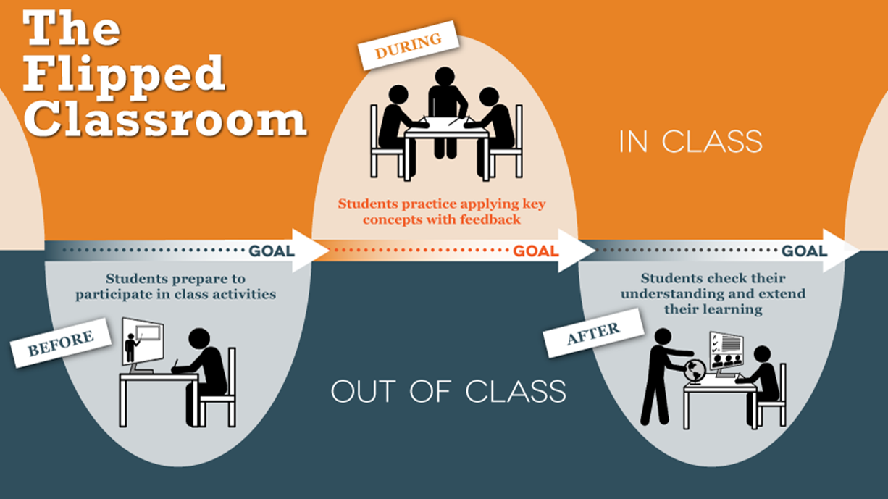
Flipped Learning
Source: University of Texas at Austin Flipped Classroom https://facultyinnovate.utexas.edu/flipped-classroom

Slide 6
Why teach the flipped class?
Interact with lecture videos and textbook on own. Schedule yourself and watch several times.
Class time can be used for higher level thinking skills.
Student engagement and motivation increase due to accountability and interactions.

Slide 7
Flipped vs Blended (effect size)
University | Sample Size (TOTAL) | Lower Order | Higher Order | Classroom Environment
USF | 206 | Trivial +ve | Trivial –ve | Medium –ve
ASU | 145 | Trivial +ve | Small +ve | Small +ve
AAMU | 36 | Large –ve | Small –ve | Large –ve
Overall | 387 | Trivial –ve | Trivial +ve | N/A
Source: Evaluating Blended and Flipped Instruction in Numerical Methods at Multiple Engineering Schools by Clark, Kaw, Lou, Scott, Besterfield-Sacre, International Journal for the Scholarship of Teaching and Learning: Vol. 12: No. 1, Article 11, 2018.

Slide 8

Why not compare to traditional classroom?

Slide 9
Expected Course Outcomes
Cognitive: “What will students completing this course know?”
Behavioral: “What will students completing this course be able to do?”
Affective: “What will students completing this course care about or think?”
Source: http://tillamookbaycc.edu/wp-content/uploads/2017/03/HowToWriteCourseLearningOutcomesforYourSyllabus.pdf

Slide 10
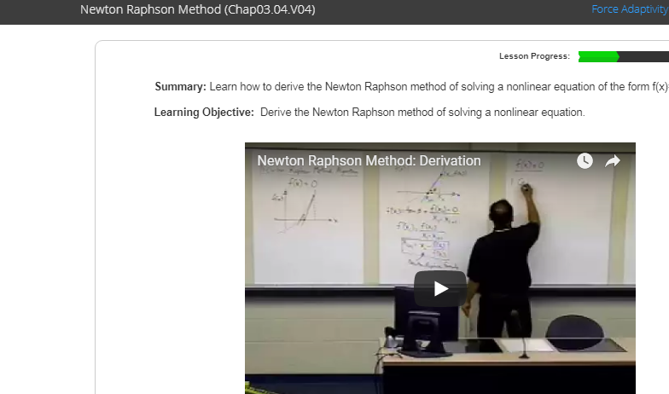
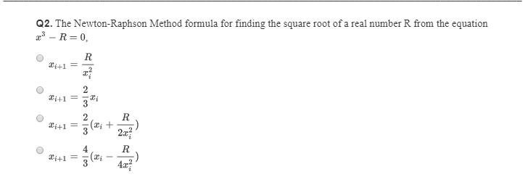
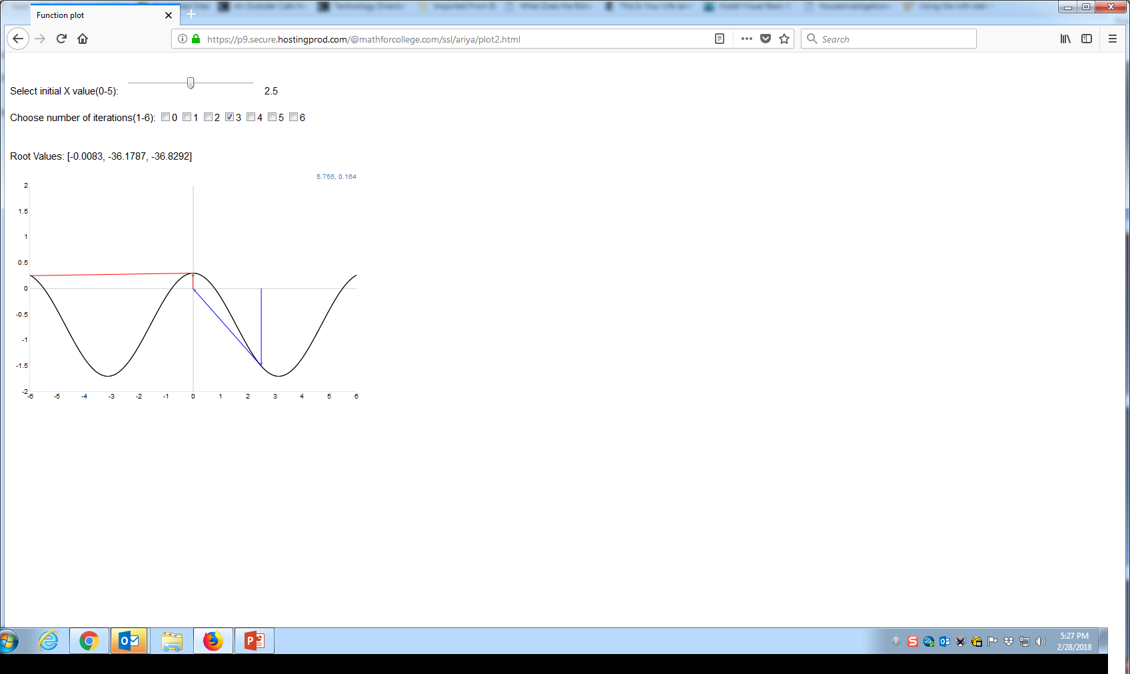
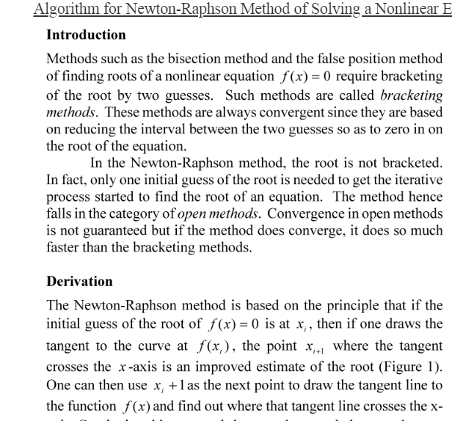
Using Adaptive Learning to Improve Flipped Classroom

Slide 11
Effect Size For Final Exam (Higher Order)
We are comparing three modalities
Blended class
Flipped class
Flipped class with adaptive pre-class learning
Comparative Modalities | Effect Size
Flipped Adaptive over Flipped Without Adaptive | 0.35
Flipped Adaptive over Flipped Without Adaptive for Pell Grant Students | 0.42
Flipped Adaptive over Blended | 0.22
Flipped Adaptive over Blended for Pell Grant Students | 0.12

Slide 12
Ten Common Learning Techniques
Elaborative interrogation
Self-explanation
Summarization
Highlighting/underlining
Keyword mnemonic
Imagery for text
Rereading
Practice testing
Distributed practice
Interleaved practice
Moderate
Moderate
Low
Low
Low
Low
Low
High
High
Moderate
Source: Improving Students’ Learning with Effective Learning Techniques, Psychological Science in the Public Interest, Vol. 14, 2013

Slide 13
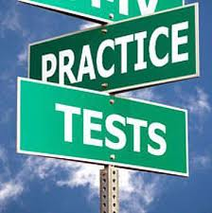
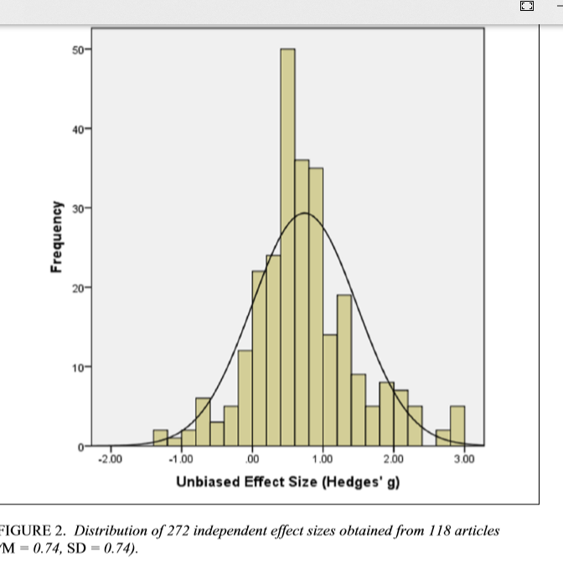
Practice Testing
Effect size =0.74

Slide 14
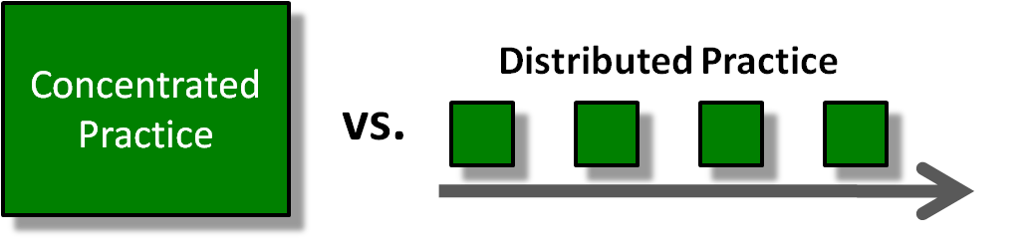
Distributed Practice
Effect size=0.46
Source: http://blog.learningelevated.com/archives/62

Slide 15
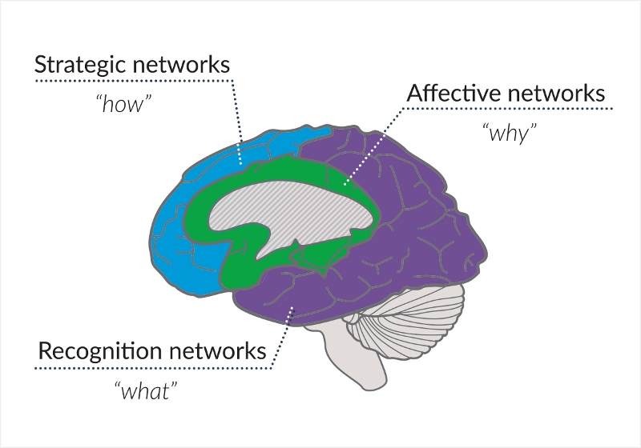
Universal Design for Learning (UDL)

Slide 16
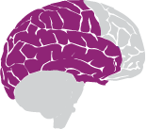
The Trinity of UDL
  1. Multiple means of representation
What – Recognition network
Source: National Center on Universal Design for Learning

Slide 17
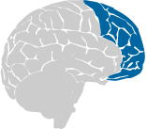
The Trinity of UDL
  2. Multiple means of action and expression
How – Strategic Network
Source: National Center on Universal Design for Learning

Slide 18

The Trinity of UDL
  3. Multiple means of engagement
Why – Affective Network
Source: National Center on Universal Design for Learning

Slide 19
QUESTIONS?
How Effective is the Flipped Classroom?
Autar Kaw
http://AutarKaw.com
@numericalguy
University of South Florida

