Slide 1

Patriot missile failure
http://nm.MathForCollege.com
Transforming Numerical Methods Education for STEM Undergraduates
1

Slide 2
For more details on this topic
Go to http://nm.MathForCollege.com
Click on Sources of Error

Slide 3
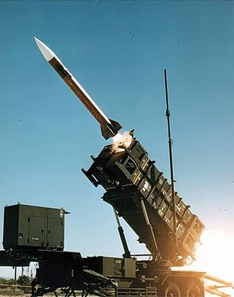
Problems created by round off error
28 Americans were killed on February 25, 1991 by an Iraqi Scud missile in Dhahran, Saudi Arabia.
The patriot defense system failed to track and intercept the Scud. Why?
Source: https://upload.wikimedia.org/wikipedia/commons/thumb/f/f8/Patriot_missile_launch_b.jpg/300px-Patriot_missile_launch_b.jpg

Slide 4
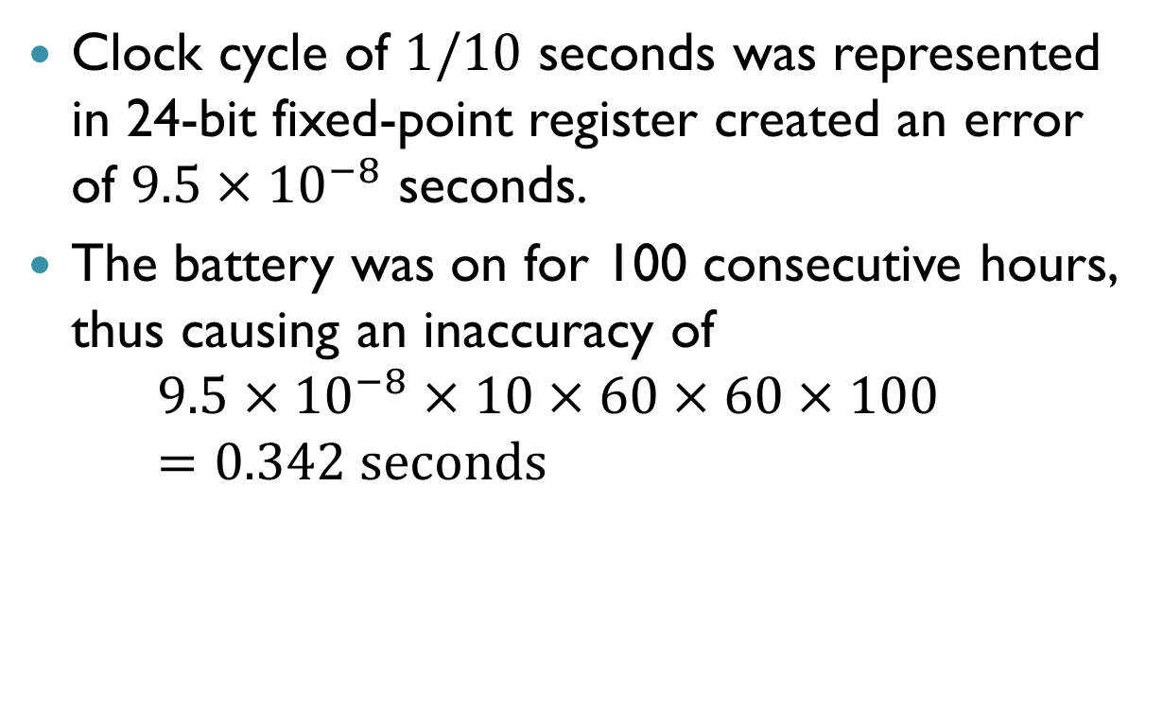
Problem with Patriot missile
Clock cycle of $1/10$ seconds was represented in 24-bit fixed-point register created an error of $9.5×{10}^{−8}$ seconds.
The battery was on for 100 consecutive hours, thus causing an inaccuracy of
  $$9.5×{10}^{−8}×10×60×60×100=0.342 seconds$$

Slide 5
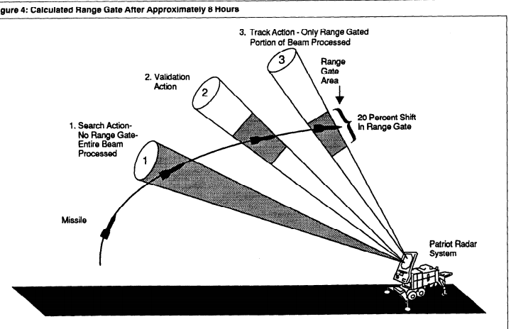
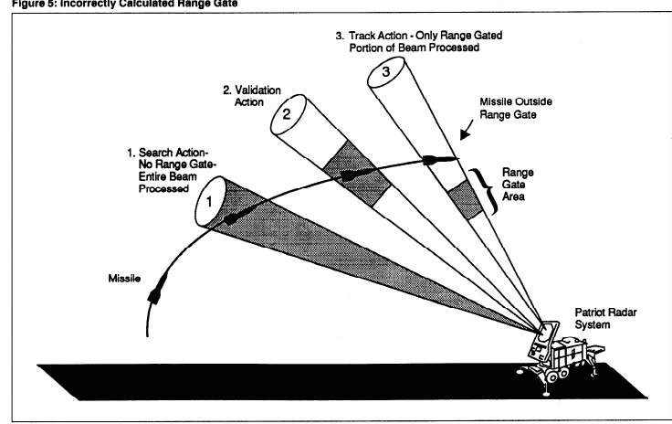
Calculated and Actual Range Data
The shift calculated in the ranging system of the missile was 687 m.
The target was considered to be out of range at a distance greater than 137 m.
Source: https://www.gao.gov/assets/220/215614.pdf

Slide 6


