Slide 1
How the Class Will be Taught
Autar Kaw

Slide 2
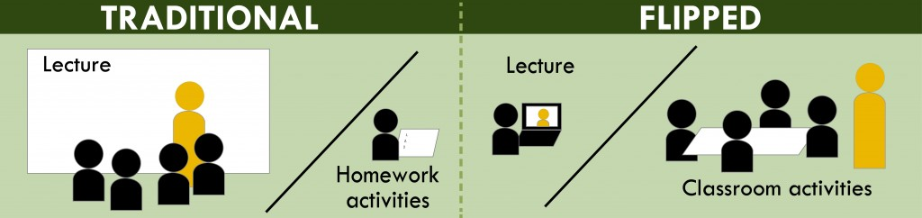
What is different?
Transmission in class and assimilation at home
Transmission at home and assimilation in class
Source: CTL, University of Washington

Slide 3
Before, In, and After
Before Class
In Class
After Class

Slide 4
What happens BEFORE class?

Slide 5
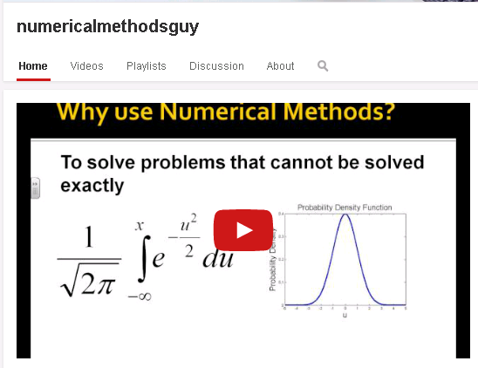
Assign video lectures before class.

Slide 6
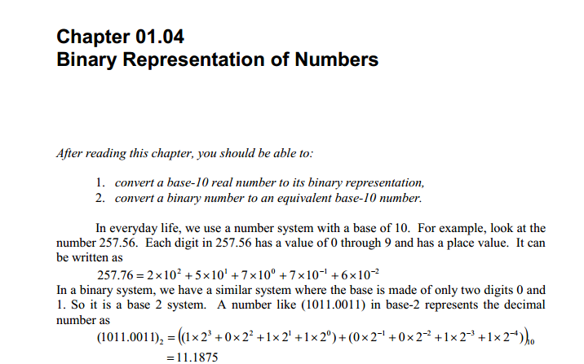
What is done before class at home?
Assign reading assignment.

Slide 7
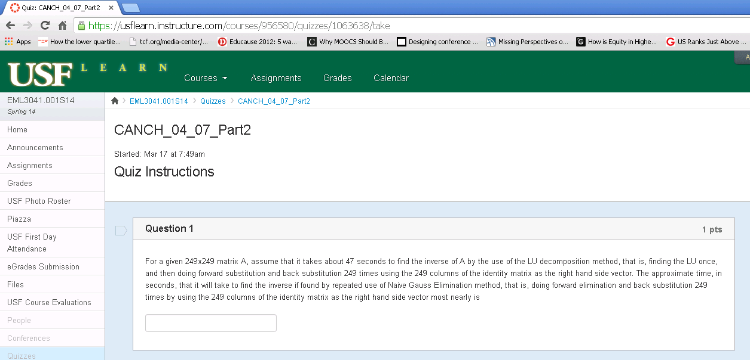
What graded assignments are given before class?
Automatically graded quizzes are assigned

Slide 8
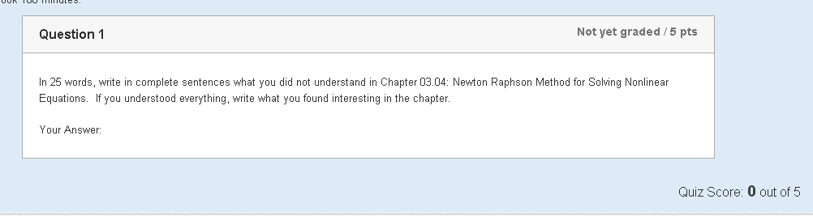
What graded assignments are given before class?
What did you not understand about the assigned chapter?

Slide 9
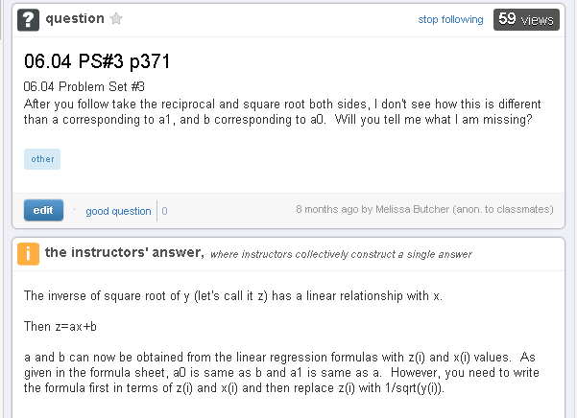
What other resources are available to students before class?
  PPTs
  MC questions and their full solutions
  Extra examples
  Real world applications
  Wolfram demos
  Piazza discussion board

Slide 10
What happens IN class?

Slide 11

Ask clicker questions
10-15 minutes:
Clickers are used for quizzes
  Answer
  Pair
  re-poll
  instructor discussion.

Slide 12
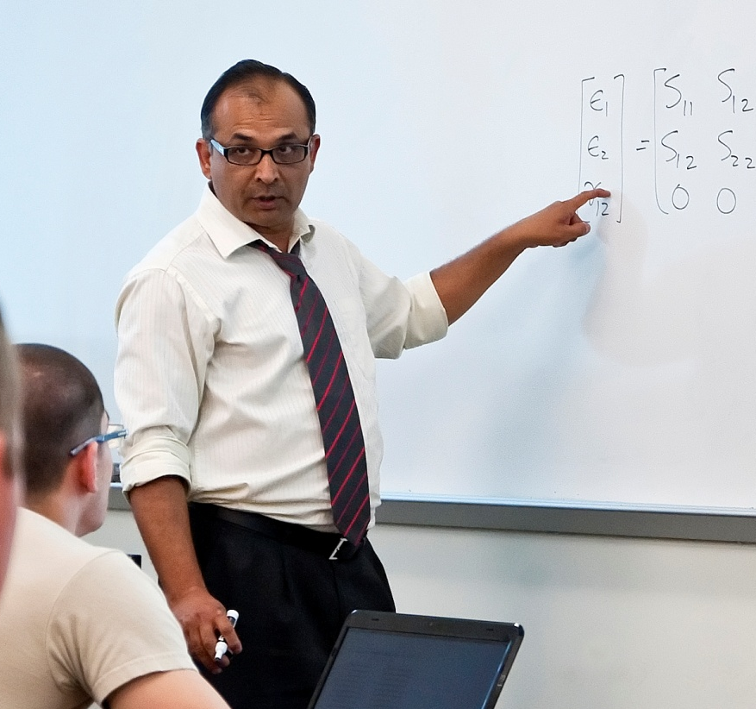
Give microlectures
10-15 minutes:
Micro-lectures are based on questions asked

Slide 13
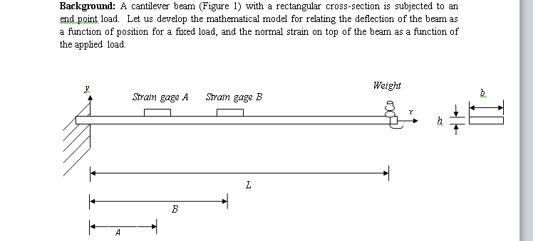
Outline in-class exercises
10-15 minutes: Advanced exercises on higher order thinking?

Slide 14
What happens AFTER class?

Slide 15
Assignments and help!
Take another automatically graded algorithmic quiz on the LMS
Complete and submit higher-order thinking exercise for grading.
Continue discussion on Piazza. Answers given via text, videos, links, Livescribe pen, and ShowMe App.

Slide 16
QUESTIONS?
How the Class will be Taught?
Autar Kaw
University of South Florida
kaw@usf.edu

