Slide 1
Effect of Letting Students Choose the Weight of Each Assessment Category for the Semester Grade
^{Autar Kaw}
^{kaw@usf.edu}
^{http://AutarKaw.com}
^{University of South Florida}
ASEE-SE Conference
March 9, 2020

Slide 2
What is variable grading?
Let students pick the weights of the grading categories within reason.
Category Weightage
Test#1 12% to 14%
Test#2 12% to 14%
Test#3 12% to 14%
Computer Projects 8% to 10%
CANVAS Quizzes 5% to 9%
CANVAS Online Adaptive Lessons 6% to 10%
Special Assignments 6% to 8%
Concept Test 4% to 6%
Final Exam 25% to 25%
Source: https://www.chronicle.com/article/How-Much-Do-You-Want-Your/242802?cid=rclink

Slide 3

Why use variable grading?
Let students take ownership of their education
Meets the 3rd Universal Design for Learning (UDL) Principle of “Ways of Expression”
Source: https://udlcenter.org

Slide 4
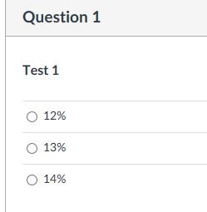
How do students choose variable grades?

Slide 5
When do students choose the weights?
By end of the 7th week, they make a choice via a Canvas Quiz.

Slide 6
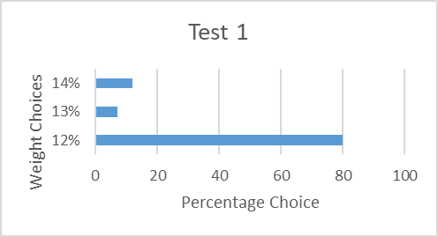
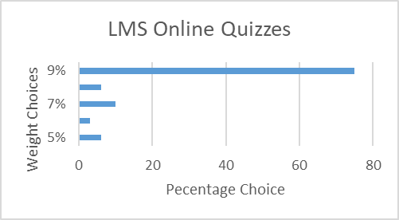
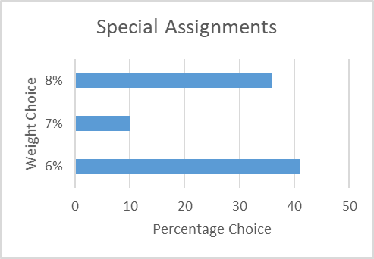
What did they choose for weights?
96% of the students made a choice
4% of the students chose the default weights

Slide 7
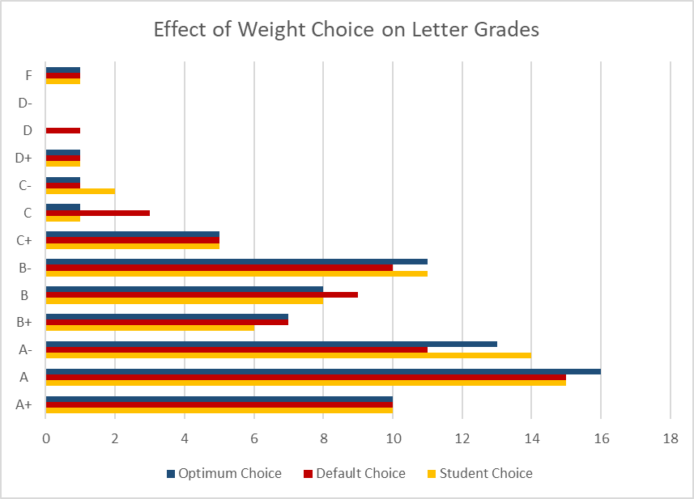
Effect of Weight Choice on Letter Grades
Grades | Student Choice | Default Choice | Optimum Choice
A+ | 10 | 10 | 10
A | 15 | 15 | 15
A- | 14 | 11 | 12
B+ | 6 | 7 | 7
B | 8 | 9 | 8
B- | 11 | 10 | 12
C+ | 5 | 5 | 3
C | 1 | 3 | 3
C- | 2 | 1 | 2
D+ | 1 | 1 | 0
D | 0 | 1 | 1
D- | 0 | 0 | 0
F | 1 | 1 | 1
A+ 10 10 10
A 15 15 16
A- 14 11 13
B+ 6 7 7
B 8 9 8
B- 11 10 11
C+ 5 5 5
C 1 3 1
C- 2 1 1
D+ 1 1 1
D 0 1 0
D- 0 0 0
F 1 1 1

Slide 8
How Many Students Can Get Affected?
Option for Variable Grade | Students Affected
Current Student Choice | 16%
Optimum Choice | 24%
Optimum Choice with Final Exam Variation (23%-27%) | 32%
5% Variation Allowed | 22%
10% Variation Allowed | 35%
15% Variation Allowed | 41%
20% Variation Allowed | 51%

Slide 9
QUESTIONS?
Effect of Letting Students Choose the Weight of Each Assessment Category for the Semester Grade
Autar Kaw
kaw@usf.edu
University of South Florida

