Slide 1
FE Exam Tutorial
http://fe.eng.usf.edu

Slide 2
1. Vectors

Slide 3
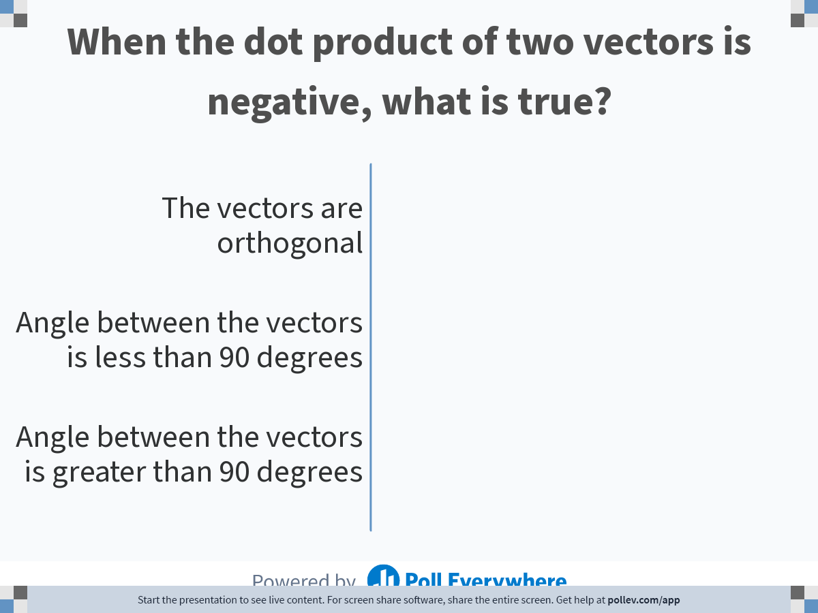
Notes:
Poll Title: Do not modify the notes in this section to avoid tampering with the Poll Everywhere activity.
More info at polleverywhere.com/support
When the dot product of two vectors is negative, what is true?
https://www.polleverywhere.com/multiple_choice_polls/oNPihTAWsLz8bDbr6hK6V

Slide 4
2. Analytic Geometry

Slide 5
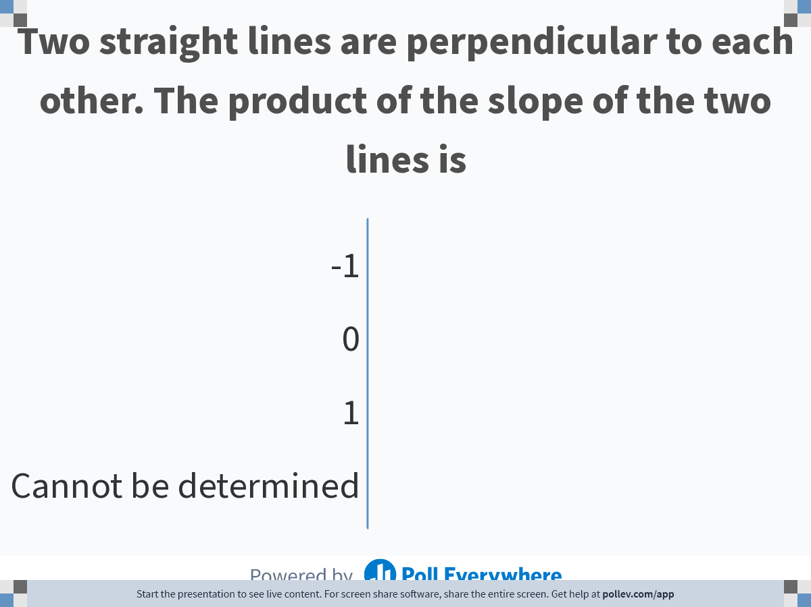
Notes:
Poll Title: Do not modify the notes in this section to avoid tampering with the Poll Everywhere activity.
More info at polleverywhere.com/support
Two straight lines are perpendicular to each other. The product of the slope of the two lines is
https://www.polleverywhere.com/multiple_choice_polls/DsTllmlKBkWURwm5X9SGG

Slide 6
3. Roots of Equations

Slide 7
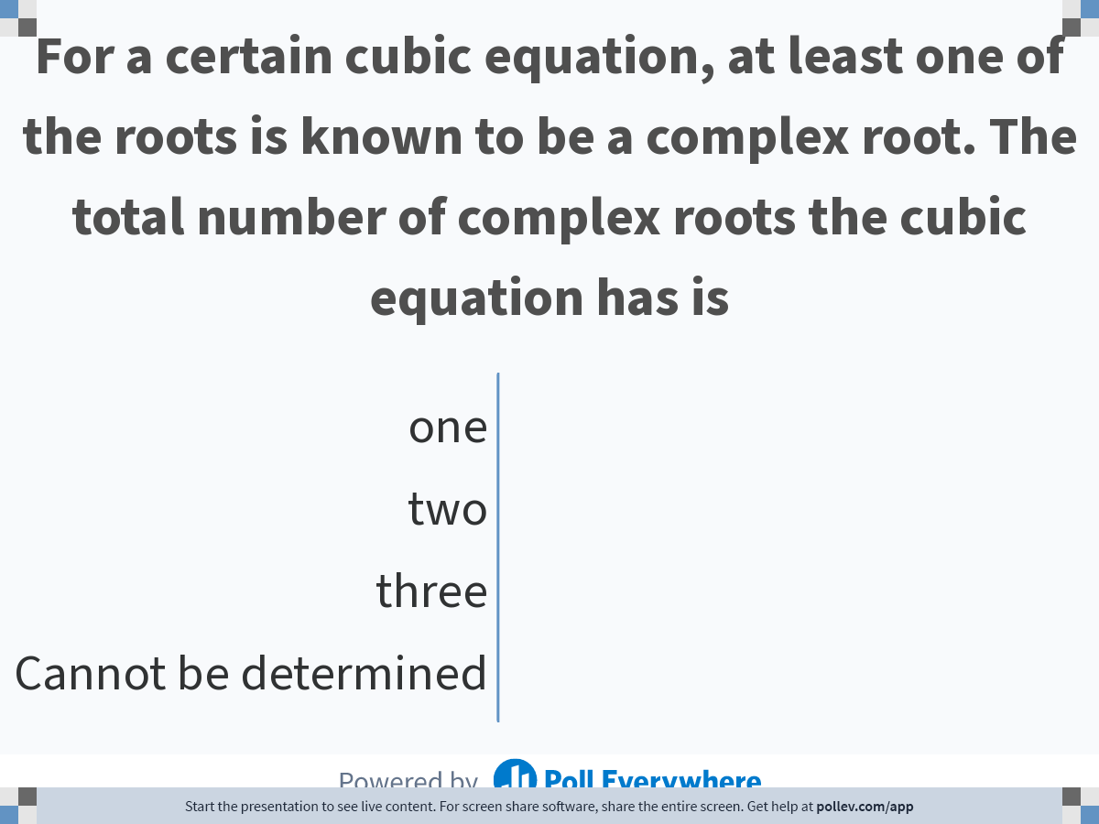
Notes:
Poll Title: Do not modify the notes in this section to avoid tampering with the Poll Everywhere activity.
More info at polleverywhere.com/support
For a certain cubic equation, at least one of the roots is known to be a complex root. The total number of complex roots the cubic equation has is
https://www.polleverywhere.com/multiple_choice_polls/iYIfRrGcXclf3aN5GZW6X

Slide 8
4. Numerical Methods

Slide 9
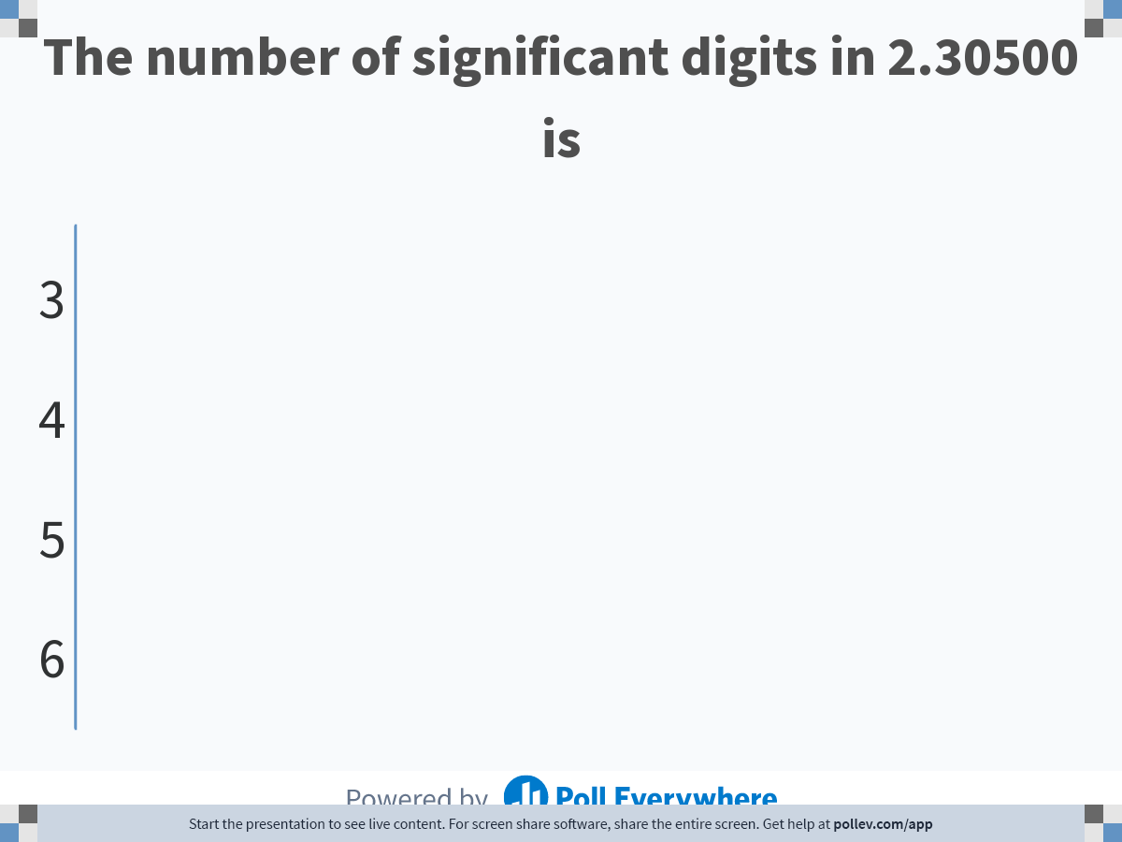
Notes:
Poll Title: Do not modify the notes in this section to avoid tampering with the Poll Everywhere activity.
More info at polleverywhere.com/support
The number of significant digits in 2.30500 is
https://www.polleverywhere.com/multiple_choice_polls/DHwO7AUCPw8flDxKlmHuO

Slide 10
5. Ordinary Differential Equations

Slide 11
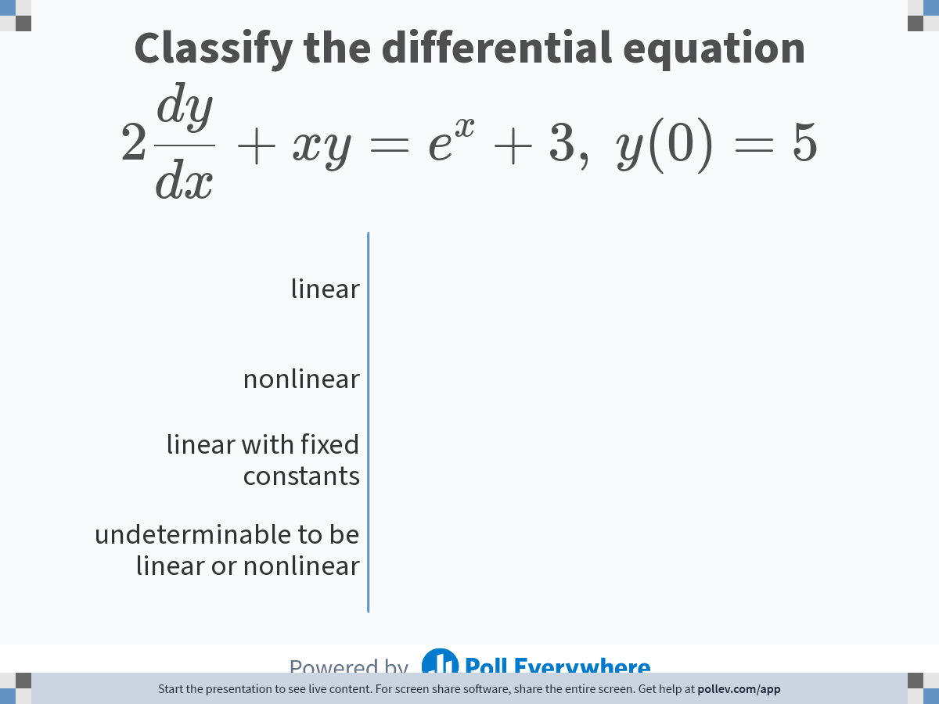
Notes:
Poll Title: Do not modify the notes in this section to avoid tampering with the Poll Everywhere activity.
More info at polleverywhere.com/support
Classify the differential equation $$\\displaystyle 2\\frac{dy}{dx} + xy = e^x + 3,\\ y(0) = 5$$
https://www.polleverywhere.com/multiple_choice_polls/foPaSfoYRlvSA22x2hVMv

Slide 12
6. Matrices

Slide 13
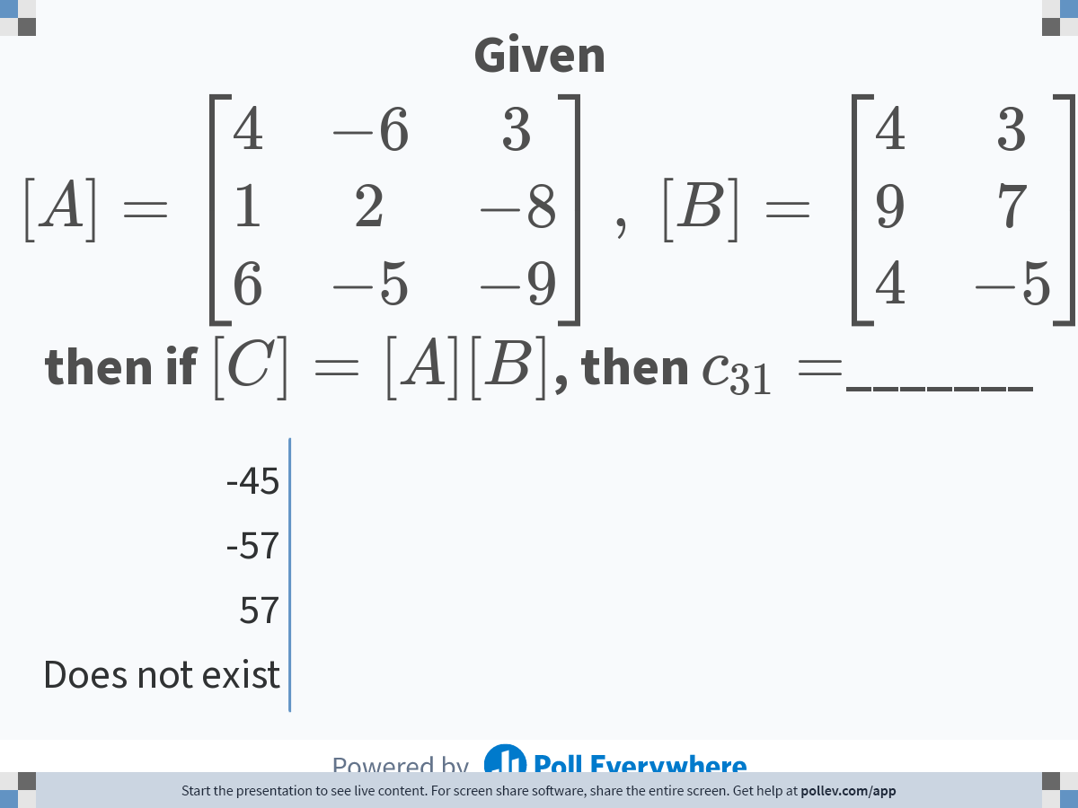
Notes:
Poll Title: Do not modify the notes in this section to avoid tampering with the Poll Everywhere activity.
More info at polleverywhere.com/support
Given $$[A] = \\left[\\begin{matrix}4 &amp; -6 &amp; 3 \\\\ 1 &amp; 2 &amp; -8 \\\\ 6 &amp; -5 &amp; -9 \\end{matrix}\\right],\\ [B] = \\left[\\begin{matrix} 4 &amp; 3 \\\\ 9 &amp; 7 \\\\ 4 &amp; -5 \\end{matrix}\\right]$$ then if $$[C] = [A][B]$$, then $$c_{31}=$$_______
https://www.polleverywhere.com/multiple_choice_polls/JrcxDlz0QFYBB8Pwu9dWe

Slide 14
7. Differential Calculus

Slide 15
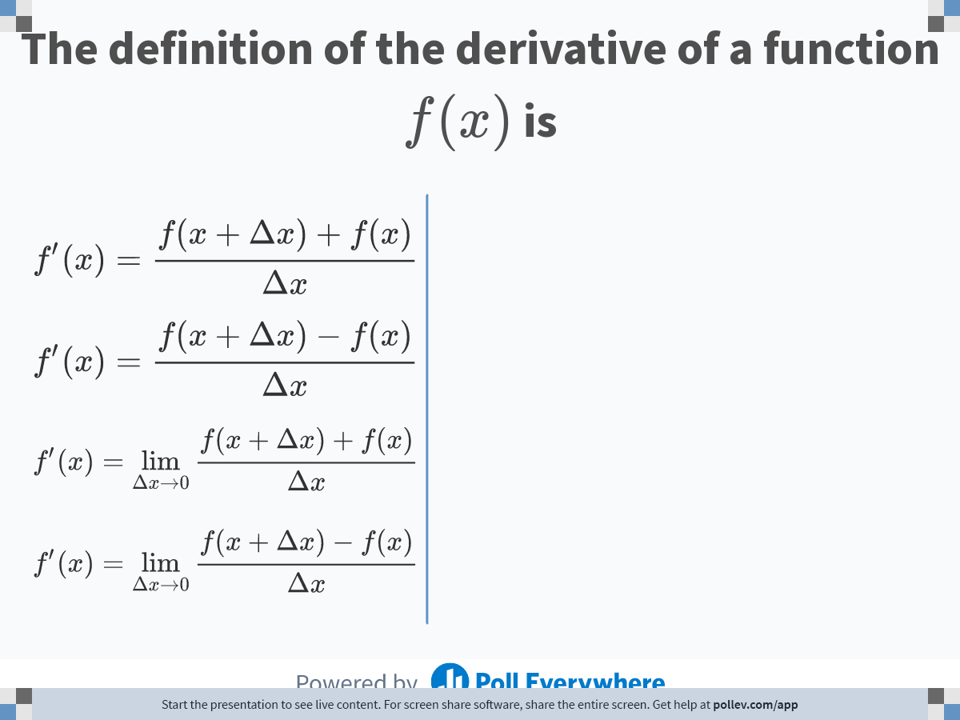
Notes:
Poll Title: Do not modify the notes in this section to avoid tampering with the Poll Everywhere activity.
More info at polleverywhere.com/support
The definition of the derivative of a function $$f(x)$$ is
https://www.polleverywhere.com/multiple_choice_polls/aA2dWjQRO4v4wtRXM8aIZ

Slide 16
8. Integral Calculus

Slide 17
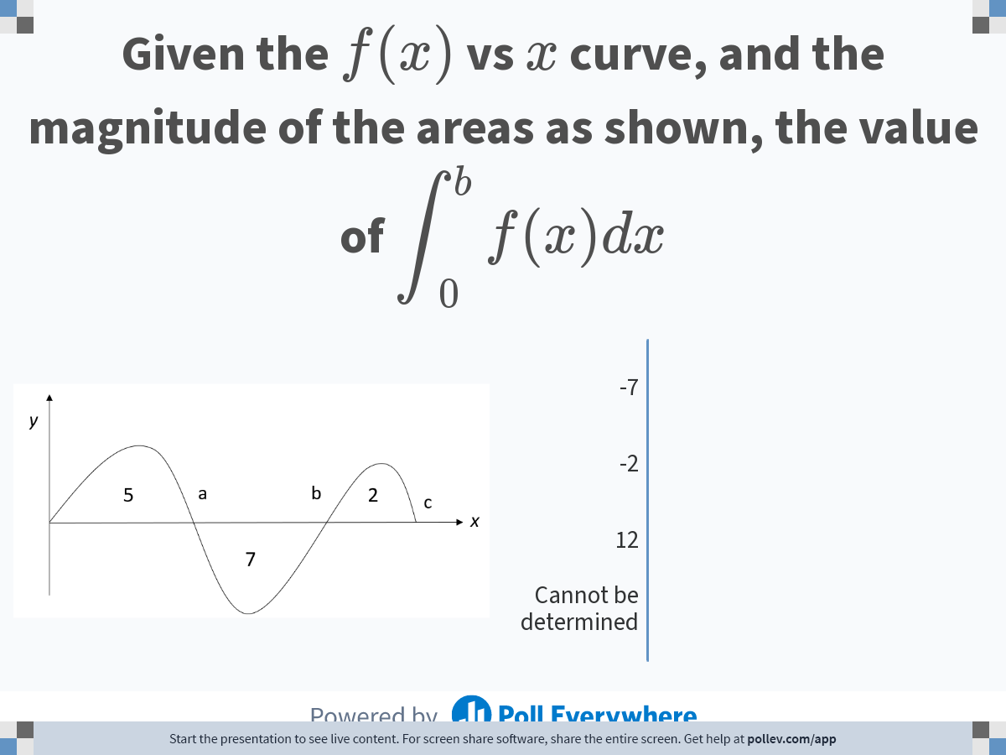
Notes:
Poll Title: Do not modify the notes in this section to avoid tampering with the Poll Everywhere activity.
More info at polleverywhere.com/support
Given the $$f(x)$$ vs $$x$$ curve, and the magnitude of the areas as shown, the value of $$\\displaystyle \\int ^b_0f(x)dx$$
https://www.polleverywhere.com/multiple_choice_polls/28t3L7fH57SdCCO5Lc52d

Slide 18
9. Partial Differential Equations

Slide 19
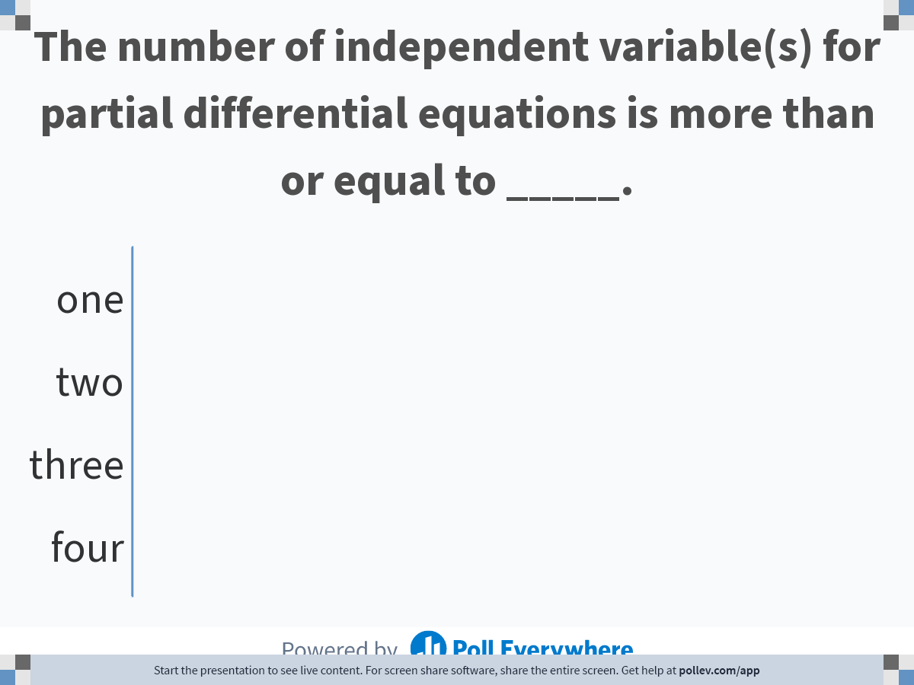
Notes:
Poll Title: Do not modify the notes in this section to avoid tampering with the Poll Everywhere activity.
More info at polleverywhere.com/support
The number of independent variable(s) for partial differential equations is more than or equal to _____.
https://www.polleverywhere.com/multiple_choice_polls/dpxoxg3r71EYkx8Gwv1lB

Slide 20
END

