Slide 1

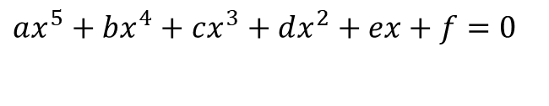
Nonlinear Equations
Your nonlinearity confuses me
$$ax^{5}+bx^{4}+cx^{3}+dx^{2}+ex+f=0$$
$$\tanh{(}x)=x$$

Slide 2
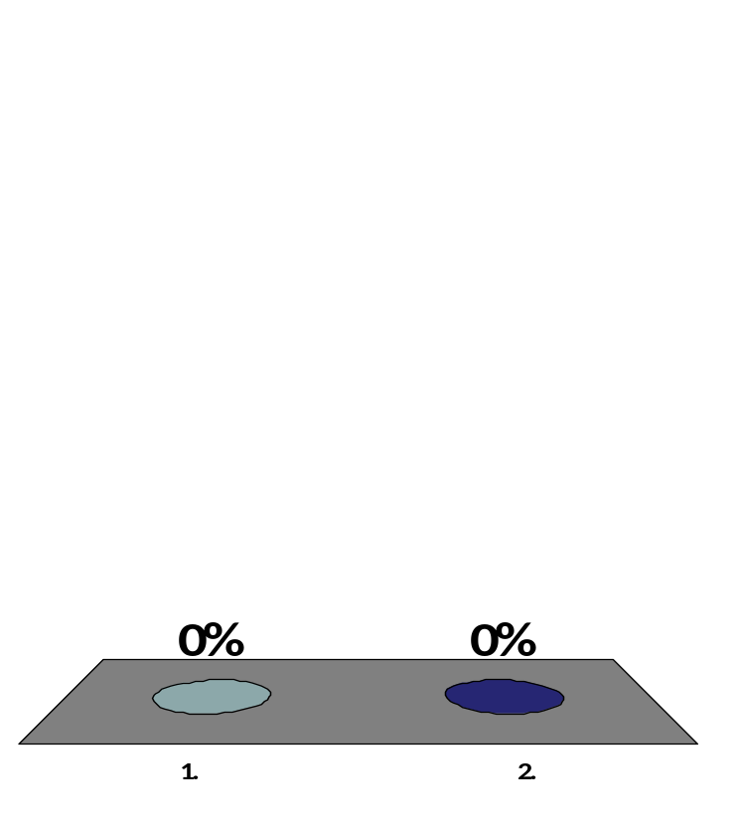
For the trunnion-hub problem discussed on first day of class where we were seeking contraction of 0.015″, did the trunnion shrink enough when dipped in dry-ice/alcohol mixture?
Yes
No

Slide 3

Example – Mechanical Engineering
Since the answer was a resounding NO, a logical question to ask would be:
If the temperature of
-108ºF is not enough for the contraction, what is?

Slide 4
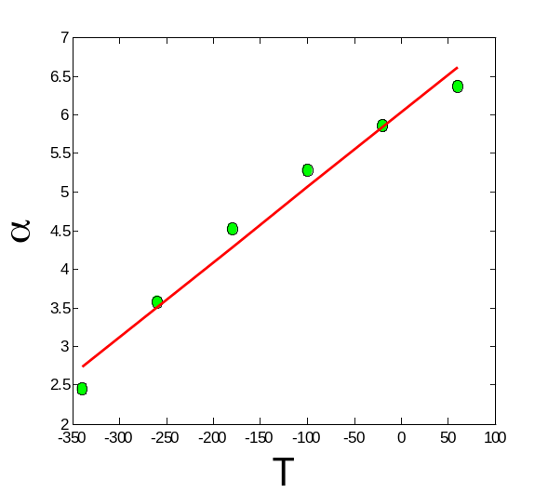

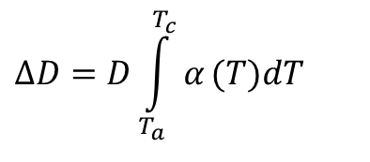
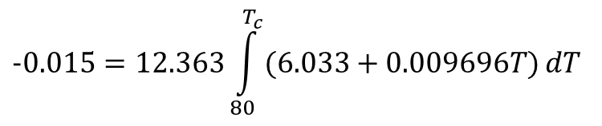
Finding The Temperature of the Fluid
$$ΔD=D\int_{T_{a}}^{T_{c}}{α}(T)dT$$
T_{a} = 80ºF
T_{c} = ???ºF
D = 12.363"
∆D = -0.015"
$$α\left(T\right)=6.033+0.009696T$$
$$−0.015=12.363\int_{80}^{T_{c}}{(6.033+0.009696T)}dT$$
$$−0.015=5.992×10^{−8}{T_{c}}^{2}+7.457×10^{−5}T_{c}−6.349×10^{−3}$$
$$f(T_{c})=5.992×10^{−8}{T_{c}}^{2}+7.457×10^{−5}T_{c}+8.651×10^{−3}=0$$

Slide 5
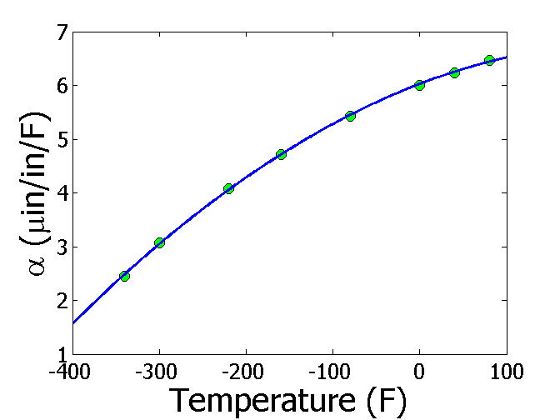
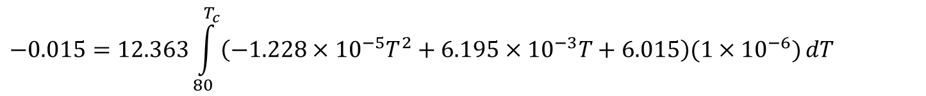
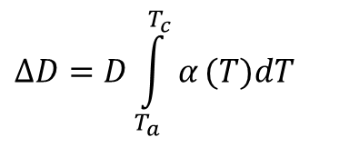
Finding The Temperature of the Fluid
$$ΔD=D\int_{T_{a}}^{T_{c}}{α}(T)dT$$
T_{a} = 80ºF
T_{c} = ???ºF
D = 12.363"
∆D = -0.015"
$$α=−1.228×10^{−5}T^{2}+6.195×10^{−3}T+6.015$$
$$−0.015=12.363\int_{80}^{T_{c}}{\left(−1.228×10^{−5}T^{2}+6.195×10^{−3}T+6.015\right)(1×{10}^{−6})}dT$$
$$−0.015=−5.059×10^{−11}{T_{c}}^{3}+3.829×10^{−8}{T_{c}}^{2}+7.435×10^{−5}T_{c}−6.166×10^{−3}$$
$$f(T_{c})=−5.059×10^{−11}{T_{c}}^{3}+3.829×10^{−8}{T_{c}}^{2}+7.435×10^{−5}T_{c}+8.834×10^{−3}=0$$

Slide 6
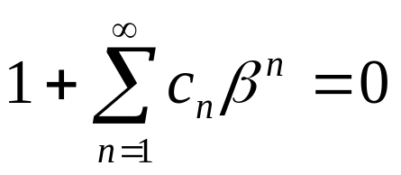

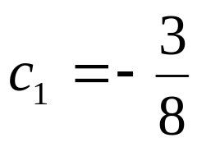
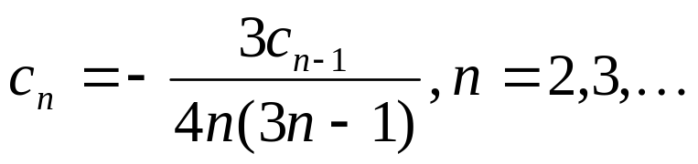
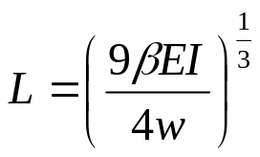
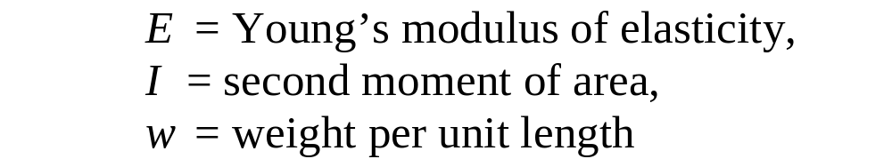
How tall can a vertical mast be
Thanks to Markus Gjengaar for sharing their work on Unsplash.

Slide 7
Nonlinear Equations
(Background)

Slide 8
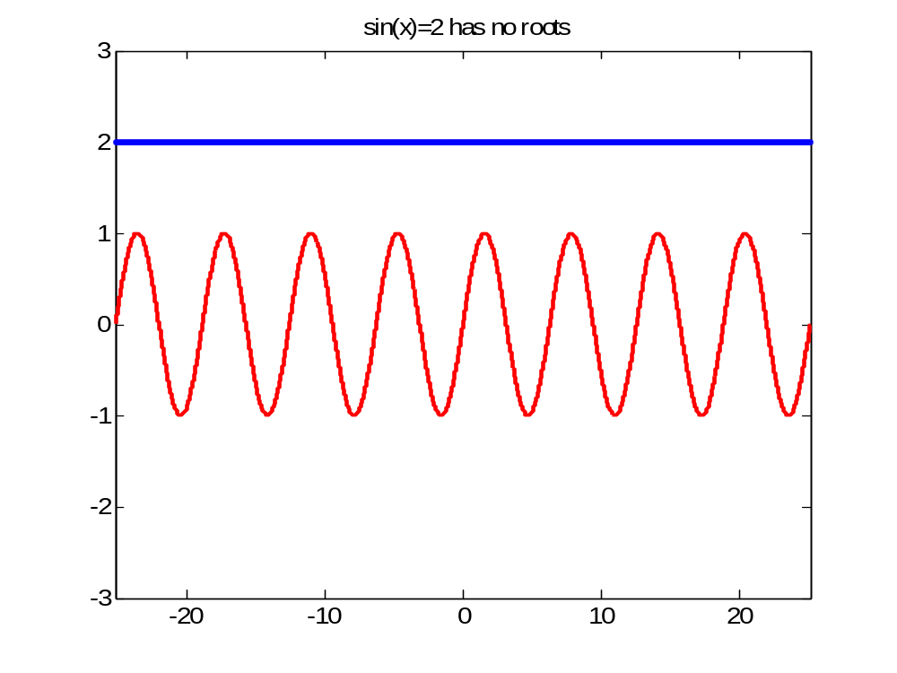
How many real roots can a nonlinear equation have?

Slide 9
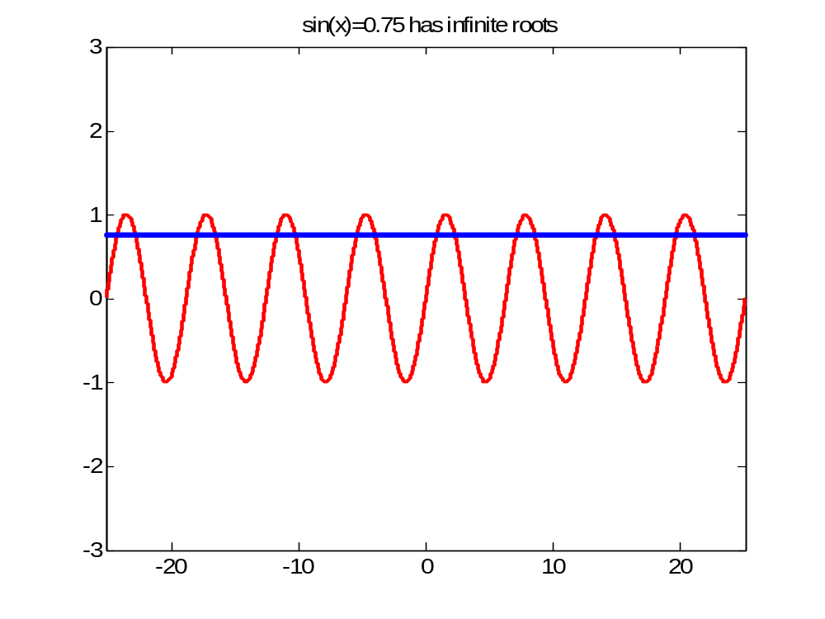
How many real roots can a nonlinear equation have?

Slide 10
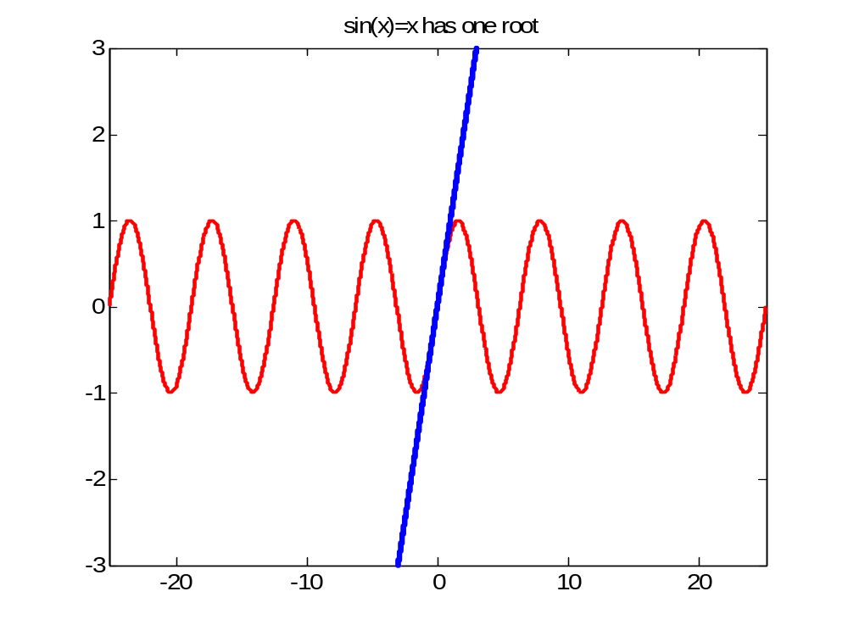
How many real roots can a nonlinear equation have?

Slide 11
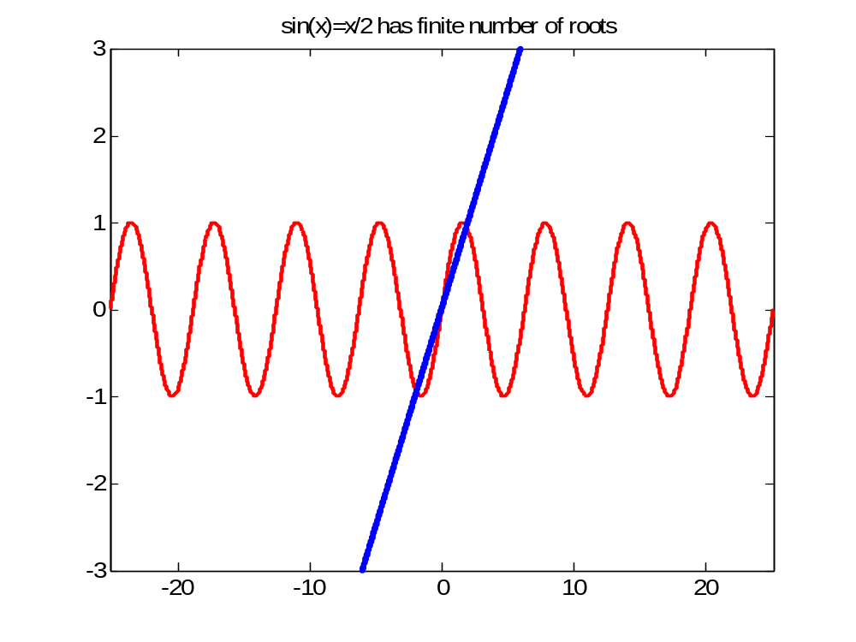
How many real roots can a nonlinear equation have?

Slide 12
“The problem of not knowing what we missed is that we believe we haven't missed anything” – Stephen Chew on Multitasking

Slide 13
END http://nm.MathForCollege.com
Numerical Methods for the STEM undergraduate

Slide 14
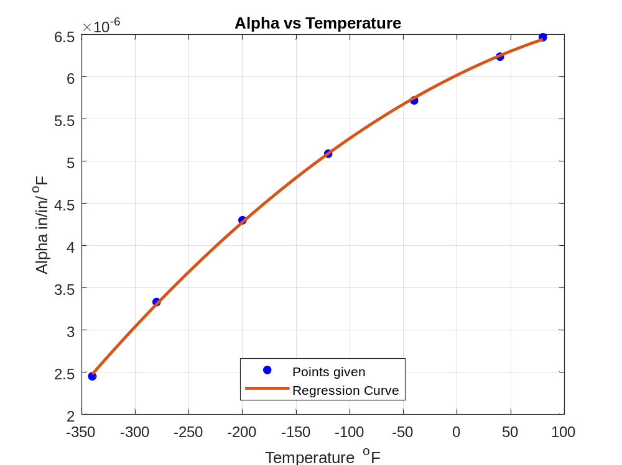

Slide 15
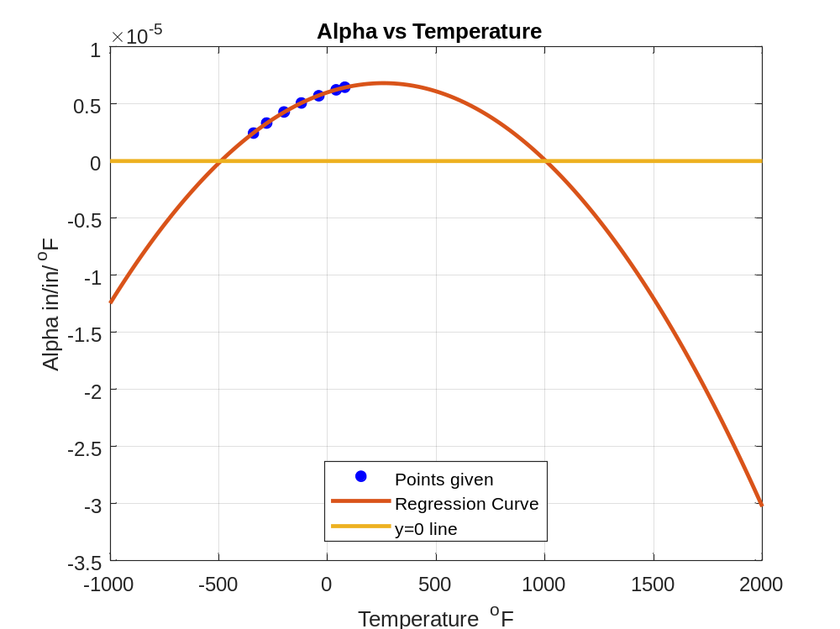
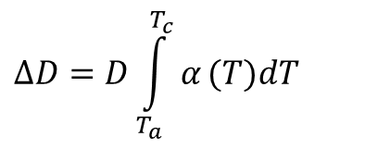
$$ΔD=D\int_{T_{a}}^{T_{c}}{α}(T)dT$$
$$f(T_{c})=−5.059×10^{−9}{T_{c}}^{3}+3.829×10^{−6}{T_{c}}^{2}+7.435×10^{−5}T_{c}+8.834×10^{−3}=0$$

Slide 16
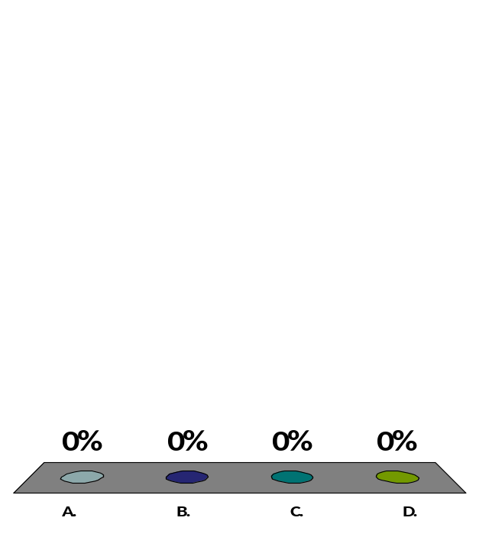
This is what you have been saying about your TI-30Xa
I don't care what people say
The rush is worth the price
I pay I get so high when you're with me
But crash and crave you when you are away
Give me back now my TI89
Before I start to drink and whine
TI30Xa calculators you make me cry
Incarnation of Jason will you ever die
TI30Xa – you make me forget the high maintenance TI89.
I never thought I will fall in love again!

Slide 17
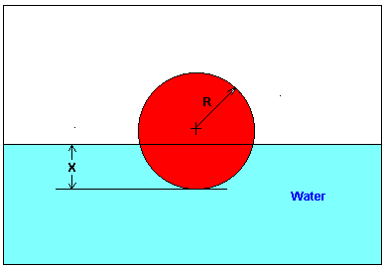
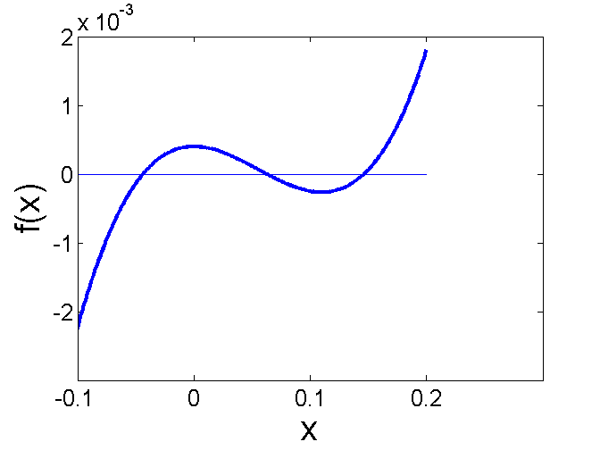

Example – General Engineering
You are working for ‘DOWN THE TOILET COMPANY’ that makes floats for ABC commodes. The floating ball has a specific gravity of 0.6 and has a radius of 5.5 cm. You are asked to find the depth to which the ball is submerged when floating in water.
$$x^{3}−0.165x^{2}+3.993×10^{−4}=0$$
Figure: Diagram of the floating ball

Slide 18

The value of x that satisfies f (x)=0 is called the
root of equation f (x)=0
root of function f (x)
zero of equation f (x)=0
none of the above

Slide 19
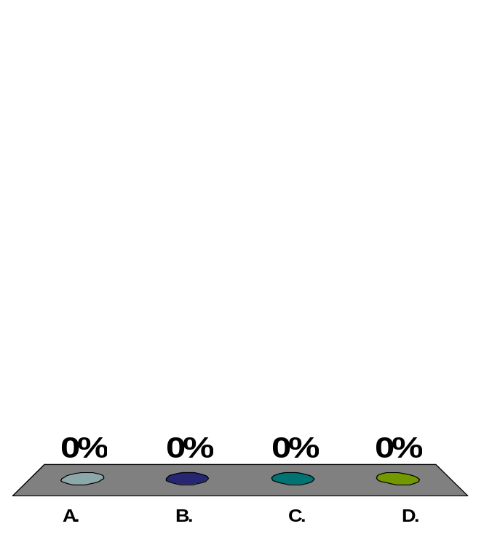
For a certain cubic equation, at least one of the roots is known to be a complex root. The total number of complex roots the cubic equation has is
one
two
three
cannot be determined

Slide 20

A polynomial of order n has zeros
n -1
n
n +1
n +2

Slide 21

The velocity of a body is given by v (t)=5e^{-t}+4, where t is in seconds and v is in m/s. The velocity of the body is 6 m/s at t =___.
0.1823 s
0.3979 s
0.9162 s
1.609 s

Slide 22
END

Slide 23
Bisection Method

Slide 24

Bisection method of finding roots of nonlinear equations falls under the category of a (an) method.
open
bracketing
random
graphical

Slide 25

If for a real continuous function f(x), f (a) f (b)<0, then in the range [a,b] for f(x)=0, there is (are)
one root
undeterminable number of roots
no root
at least one root

Slide 26
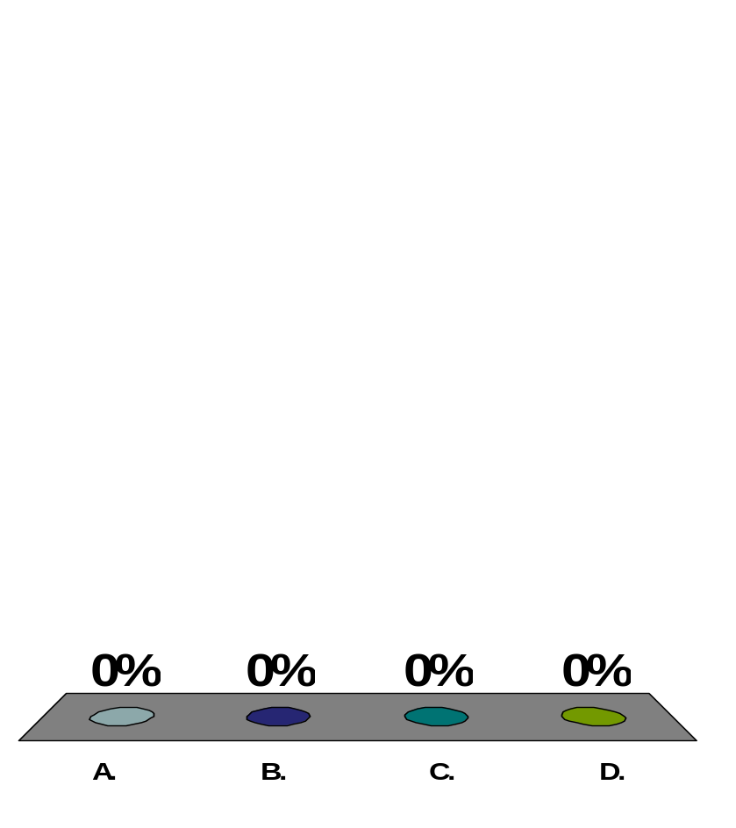
The velocity of a body is given by v (t)=5e^{-t}+4, where t is in seconds and v is in m/s. We want to find the time when the velocity of the body is 6 m/s. The equation form needed for bisection and Newton-Raphson methods is
f (t)= 5e^{-t}+4=0
f (t)= 5e^{-t}+4=6
f (t)= 5e^{-t}=2
f (t)= 5e^{-t}-2=0

Slide 27

To find the root of an equation f (x)=0, a student started using the bisection method with a valid bracket of [20,40]. The smallest range for the absolute true error at the end of the 2nd iteration is
0 ≤ |E_{t}|≤2.5
0 ≤ |E_{t}| ≤ 5
0 ≤ |E_{t}| ≤ 10
0 ≤ |E_{t}| ≤ 20

Slide 28
For an equation like x²=0, a root exists at x=0. The bisection method cannot be adopted to solve this equation in spite of the root existing at x=0 because the function f(x)=x ²
is a polynomial
has repeated zeros at x=0
is always non-negative
slope is zero at x=0

Slide 29
END

Slide 30
Newton Raphson Method

Slide 31

Newton-Raphson method of finding roots of nonlinear equations falls under the category of __________ method.
bracketing
open
random
graphical

Slide 32
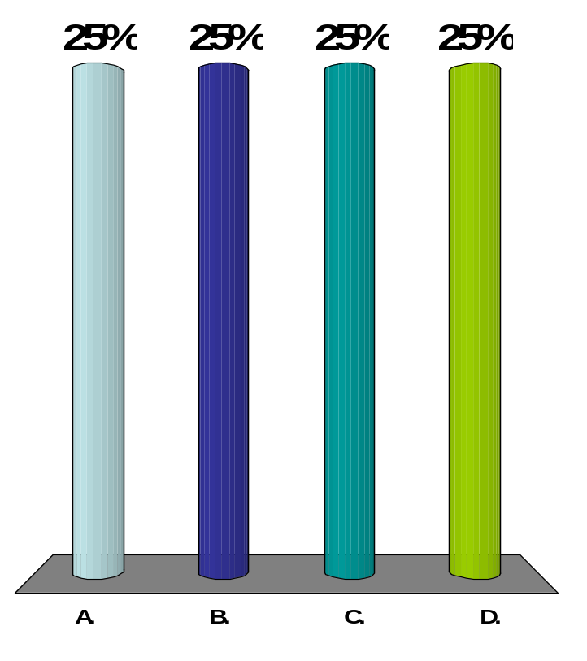
The root of equation f (x)=0 is found by using Newton-Raphson method.
The initial estimate of the root is x_{o}=3, f (3)=5.
The angle the tangent to the function f (x) at x=3 makes with the x-axis is 57º.
The next estimate of the root, x₁ most nearly is
-3.2470
-0.2470
3.2470
6.2470

Slide 33
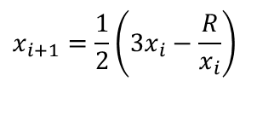
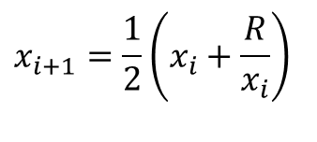
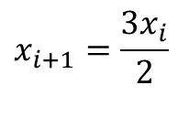
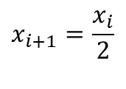
The Newton-Raphson method formula for finding the square root of a real number R from the equation x²-R=0 is,
$$x_{i+1}=\frac{x_{i}}{2}$$
$$x_{i+1}=\frac{3x_{i}}{2}$$
$$x_{i+1}=\frac{1}{2}\left(x_{i}+\frac{R}{x_{i}}\right)$$
$$x_{i+1}=\frac{1}{2}\left(3x_{i}−\frac{R}{x_{i}}\right)$$

Slide 34
END http://numericalmethods.eng.usf.edu
Numerical Methods for the STEM undergraduate

