Slide 1
Simultaneous Linear Equations

Slide 2
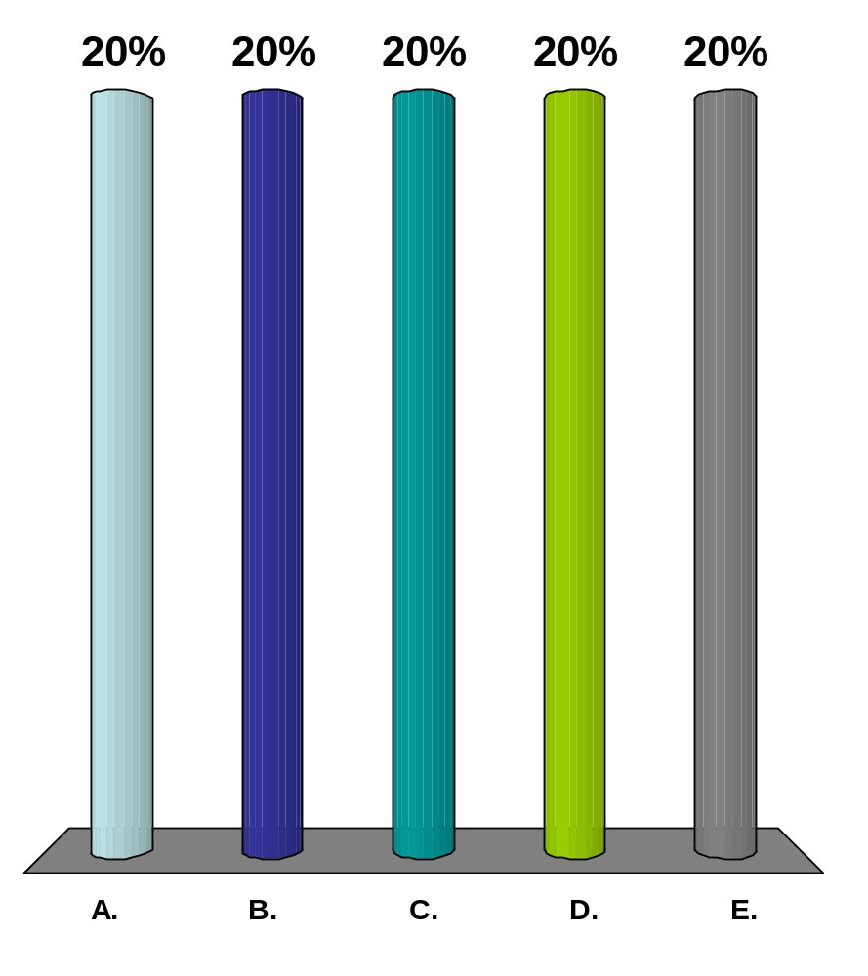

The name of the person in the picture is
A$AP Rocky
Kid Cudi
MC Hammer
Scooter
Vanilla Ice

Slide 3
PHYSICAL PROBLEMS

Slide 4
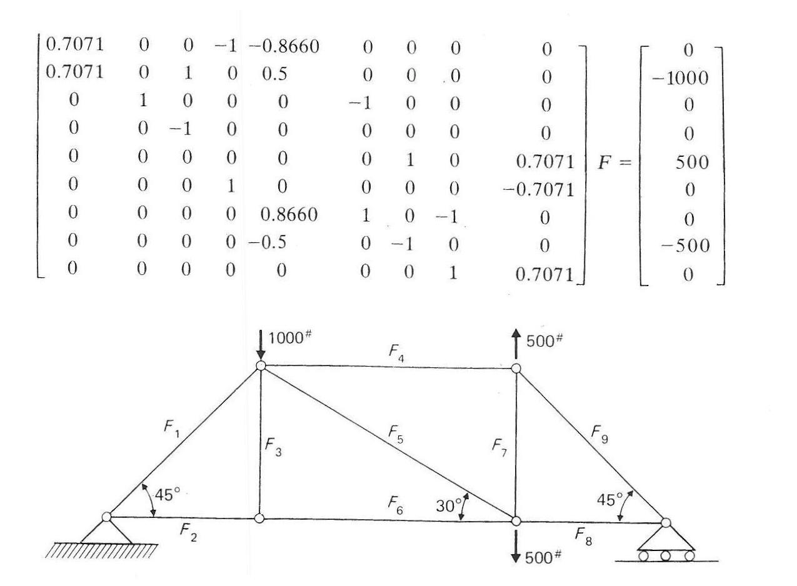
Truss Problem

Slide 5
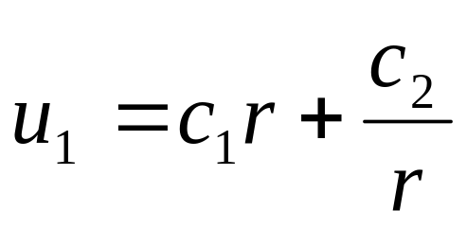
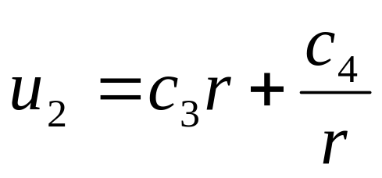
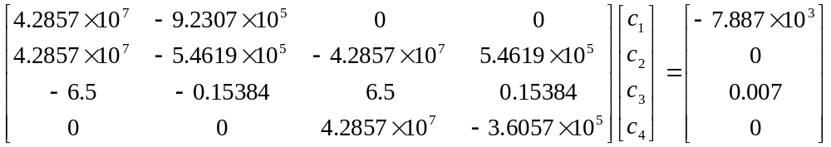
Pressure vessel problem
a
c
b
a
b

Slide 6
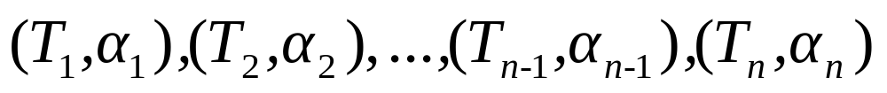
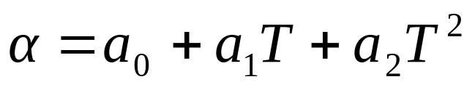
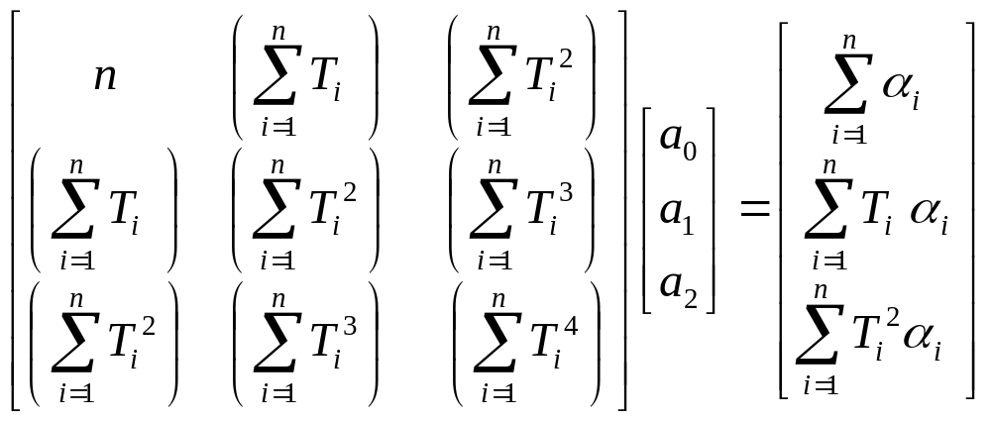
Polynomial Regression
We are to fit the data to the polynomial regression model

Slide 7
END

