Slide 1
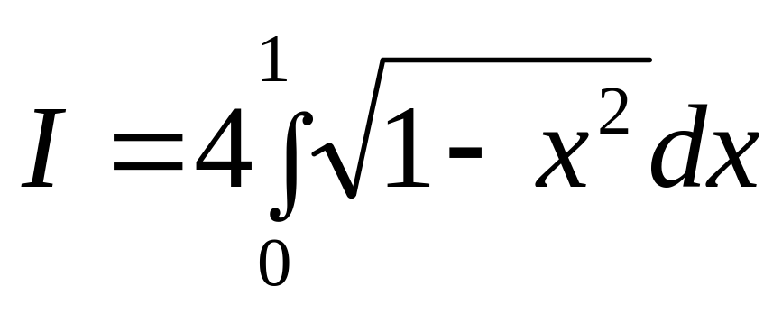
Integration
As thy a difficult a problem as
finding quadrature of a circle

Slide 2
Physical examples

Slide 3
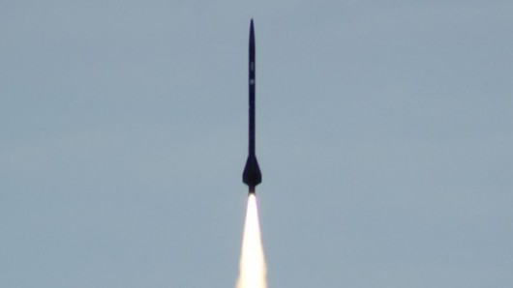
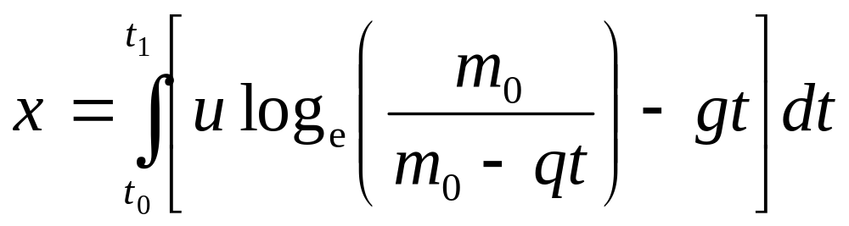
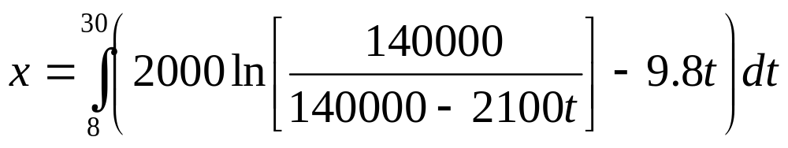
Distance Covered By Rocket

Slide 4
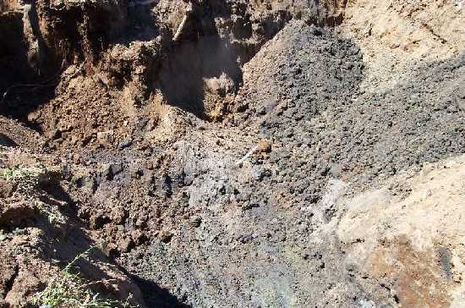
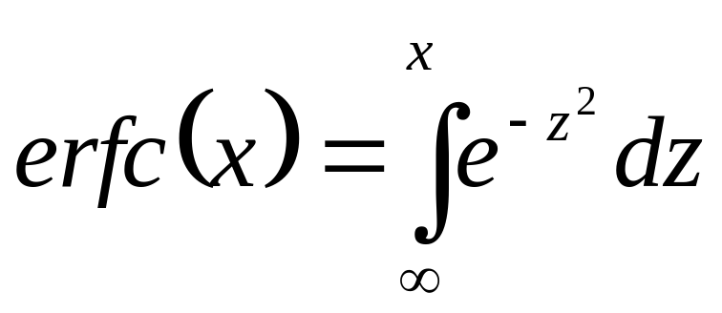
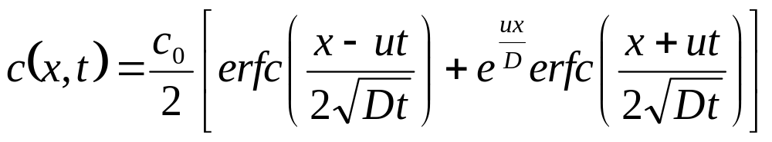
Concentration of Benzene
u= velocity of ground water flow in the x -direction (m/s)
D = dispersion coefficient (m²/s)
C₀= initial concentration (kg/m³)

Slide 5
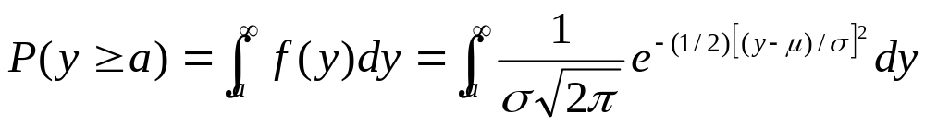

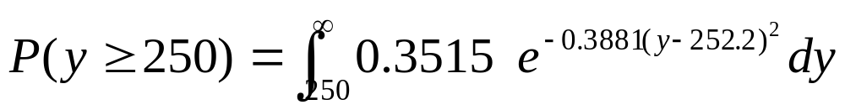
Is Wal*** “short shifting” you?
Roll | Number of sheets
1 | 253
2 | 250
3 | 251
4 | 252
5 | 253
6 | 253
7 | 252
8 | 254
9 | 252
10 | 252

Slide 6
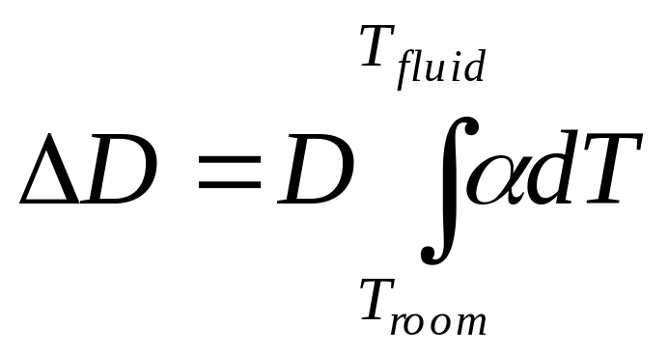
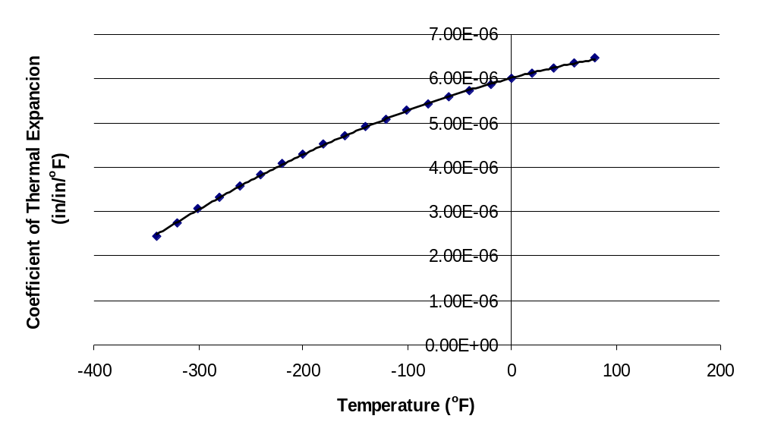

Calculating diameter contraction for trunnion-hub problem

Slide 7
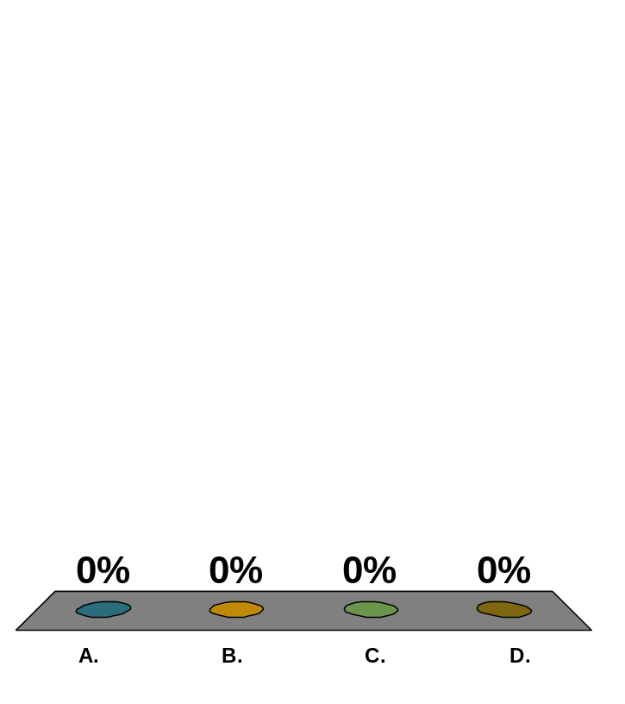
The distance covered by a rocket from t=8 to t=34 seconds is calculated using multiple segment trapezoidal rule by integrating a velocity function. Below is given the estimated distance for different number of segments, n.
n | 1 | 2 | 3 | 4 | 5
Value | 16520 | 15421 | 15212 | 15138 | 15104
The number of significant digits at least correct in the answer for n=5 is
1
2
3
4

Slide 8


