Slide 1
Bring it together

Slide 2
Why do we use numerical methods?

Slide 3
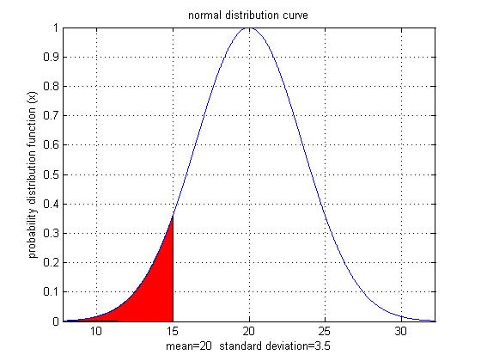
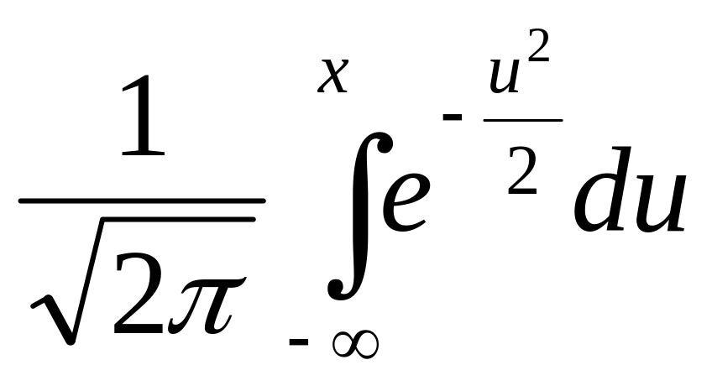
Why use Numerical Methods?
To solve problems that cannot be solved exactly

Slide 4
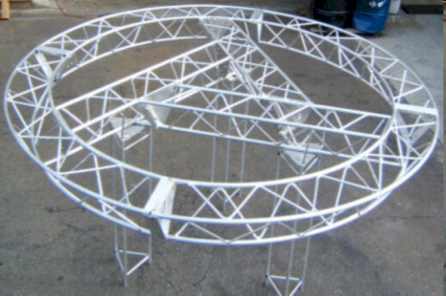
Why use Numerical Methods?
To solve problems that have exact solutions but are otherwise intractable!

Slide 5


Assembling a fulcrum for a bascule bridge
Girder
Trunnion
Hub

Slide 6
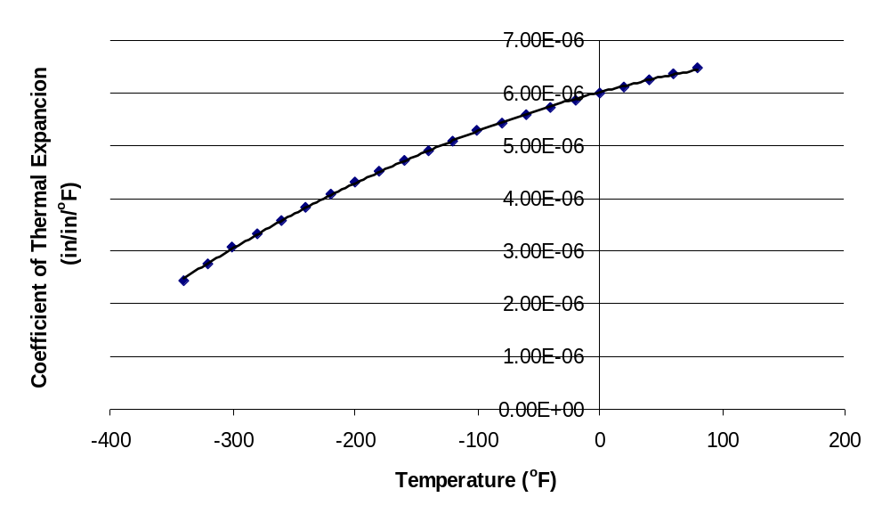
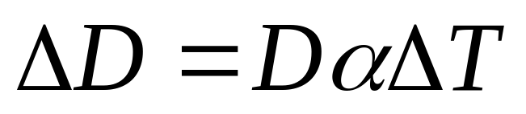
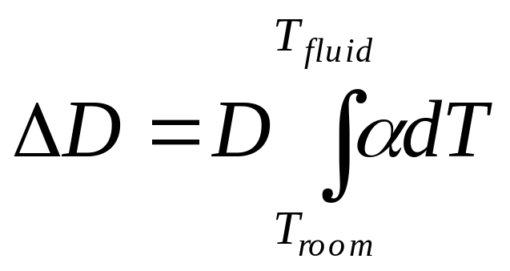
What model should I use?

Slide 7
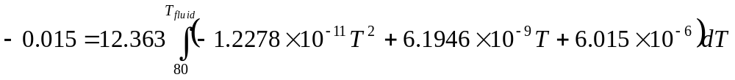
Finding the fluid temperature to get enough contraction

Slide 8

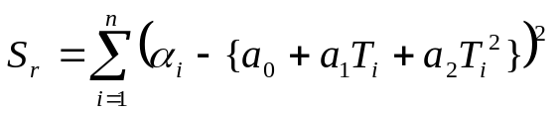
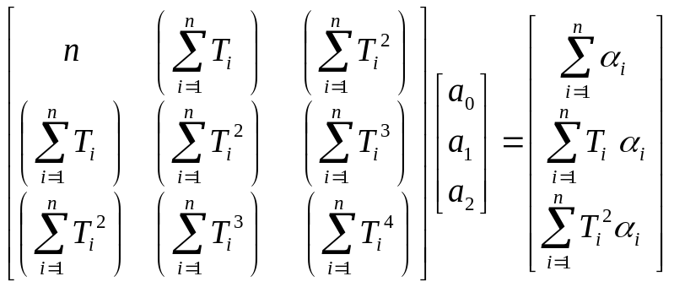
Finding the expression for thermal expansion coefficient

Slide 9
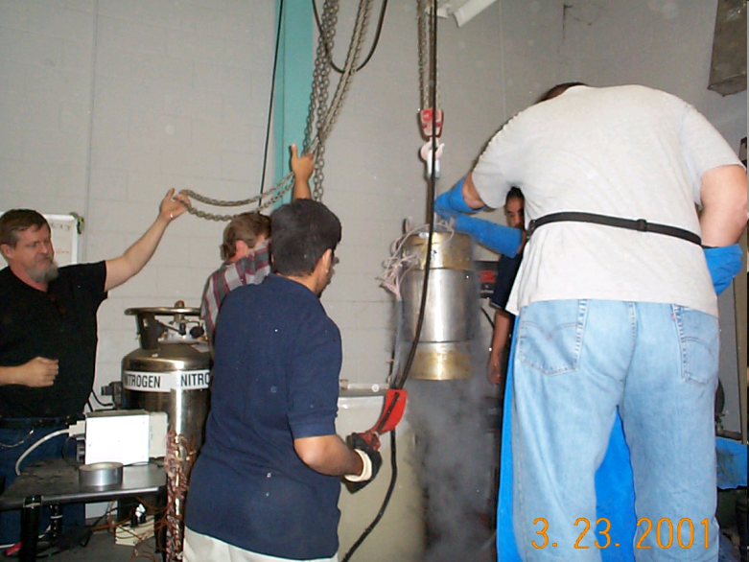

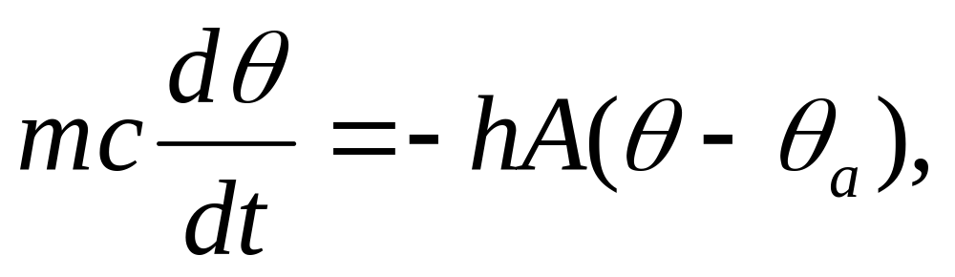
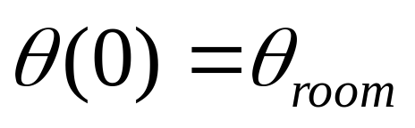
How long does it take a trunnion to cool down?

Slide 10
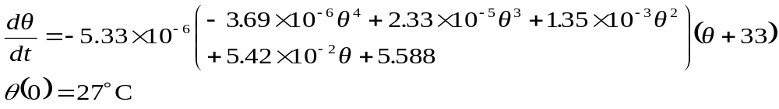
Example
A solid steel shaft at room temperature of 27°C is needed to be contracted so that it can be shrunk-fit into a hollow hub. It is placed in a refrigerated chamber that is maintained at −33°C. The rate of change of temperature of the solid shaft θ is given by
Using Euler’s method, find the temperature of the steel shaft after 86400 seconds. Take a step size of h = 43200 seconds.

Slide 11
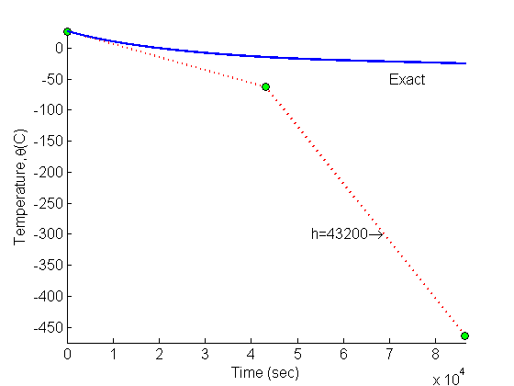
Comparison of Exact and Numerical Solutions
Figure 3. Comparing exact and Euler’s method

