Slide 1

Bring Numerical Methods together
http://nm.MathForCollege.com
Transforming Numerical Methods Education for STEM Undergraduates
1

Slide 2
Why Use Numerical Methods?

Slide 3
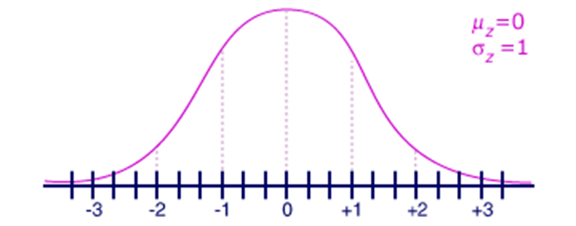
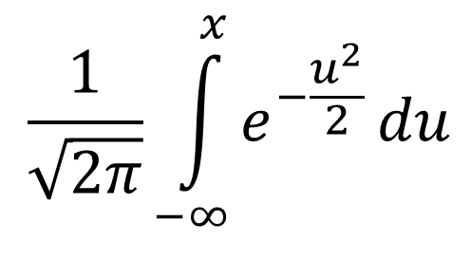
Why Use Numerical Methods?
To solve problems that cannot be solved exactly
$$\frac{1}{\sqrt{2π}}\int_{−∞}^{x}{e^{−\frac{u^{2}}{2}}}du$$

Slide 4
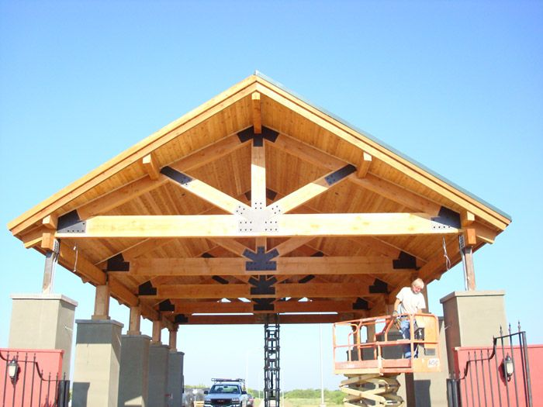
Why Use Numerical Methods?
To solve problems that are intractable to solve exactly!

Slide 5
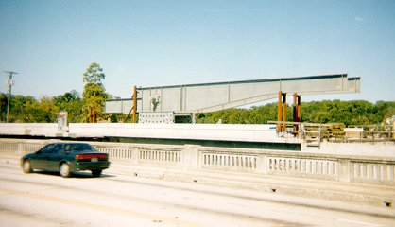
Bascule Bridge THG

Slide 6

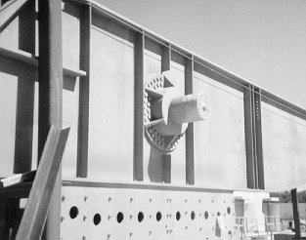
Bascule Bridge THG
Hub
Trunnion
Girder
Notes:
THG picture

Slide 7



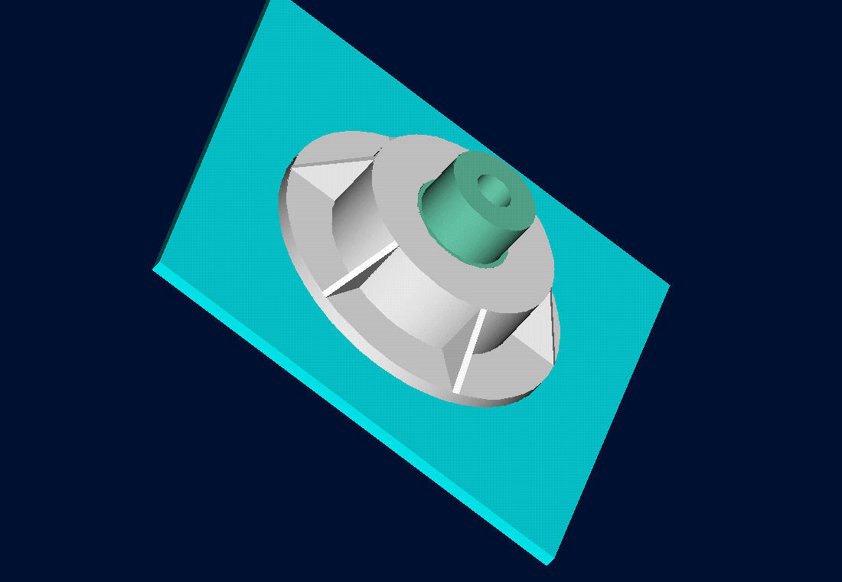
Trunnion-Hub-Girder Assembly Procedure
  Step1. Trunnion immersed in dry-ice/alcohol
  Step2. Trunnion warm-up in hub
  Step3. Trunnion-Hub immersed in dry-ice/alcohol
  Step4. Trunnion-Hub warm-up into girder

Slide 8
Problem
After Cooling, the Trunnion Got Stuck in Hub

Slide 9
Why did it get stuck?
Magnitude of contraction needed in the trunnion was 0.015˝ or more. Did it contract enough?

Slide 10
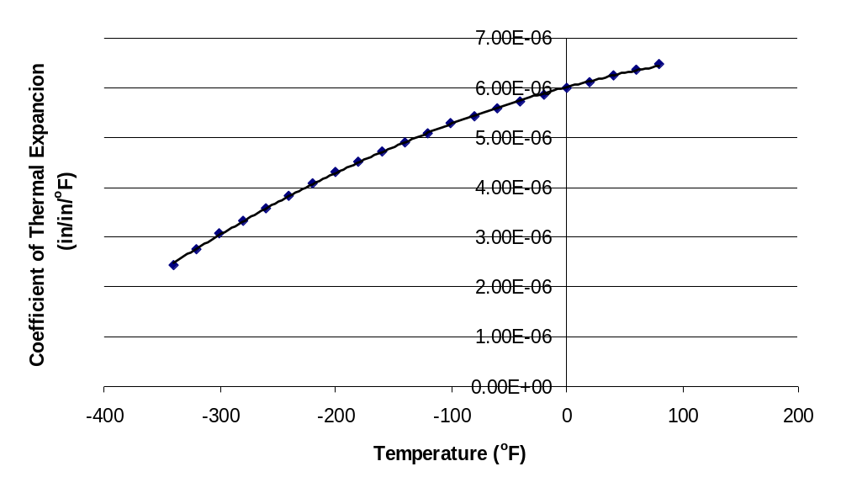
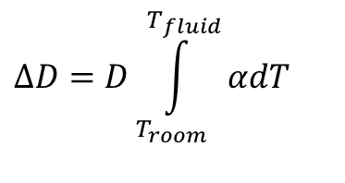

What model should I use to calculate contraction of trunnion?
$$ΔD=DαΔT$$
$$ΔD=D\int_{T_{room}}^{T_{fluid}}{αdT}$$

Slide 11
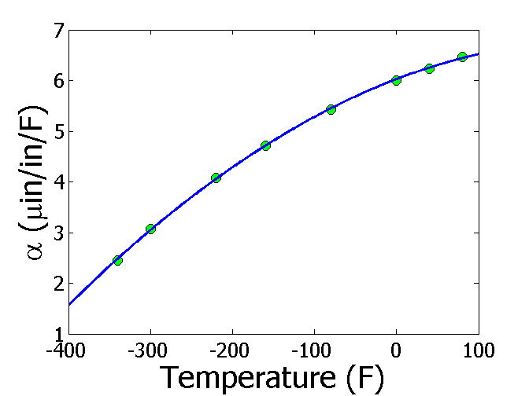
Finding the fluid temperature to get enough contraction
$$ΔD=D\int_{T_{a}}^{T_{c}}{α}(T)dT$$
T_{a} = 80ºF
T_{c} = ???ºF
D = 12.363"
∆D = -0.015"
$$α=−1.228×10^{−5}T^{2}+6.195×10^{−3}T+6.015$$
$$−0.015=12.363\int_{80}^{T_{c}}{(−1.228×10^{−5}T^{2}+6.195×10^{−3}T+6.015)}dT$$
$$−0.015=−5.059×10^{−9}{T_{c}}^{3}+3.829×10^{−6}{T_{c}}^{2}+7.435×10^{−5}T_{c}−6.166×10^{−3}$$
$$f(T_{c})=−5.059×10^{−9}{T_{c}}^{3}+3.829×10^{−6}{T_{c}}^{2}+7.435×10^{−5}T_{c}+8.834×10^{−3}=0$$

Slide 12
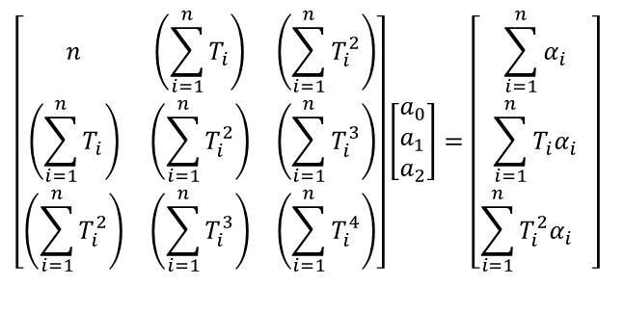

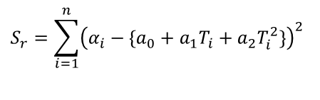
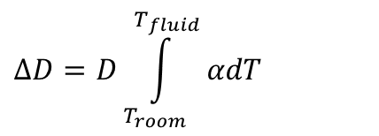
Finding the expression for thermal expansion coefficient
$$ΔD=D\int_{T_{room}}^{T_{fluid}}{αdT}$$
$$α=a_{0}+a_{1}T+a_{2}T^{2}$$
$$S_{r}=\sum_{i=1}^{n}{{\left(α_{i}−\{a_{0}+a_{1}T_{i}+a_{2}T_{i}^{2}\}\right)}^{2}}$$
$$\left[\begin{matrix}n & \left(\sum_{i=1}^{n}{T_{i}}\right) & \left(\sum_{i=1}^{n}{T_{i}^{2}}\right) \\ \left(\sum_{i=1}^{n}{T_{i}}\right) & \left(\sum_{i=1}^{n}{T_{i}^{2}}\right) & \left(\sum_{i=1}^{n}{T_{i}^{3}}\right) \\ \left(\sum_{i=1}^{n}{T_{i}^{2}}\right) & \left(\sum_{i=1}^{n}{T_{i}^{3}}\right) & \left(\sum_{i=1}^{n}{T_{i}^{4}}\right)\end{matrix}\right]\left[\begin{aligned}&a_{0} \\ &a_{1} \\ &a_{2}\end{aligned}\right]=\left[\begin{matrix}\sum_{i=1}^{n}{α_{i}} \\ \sum_{i=1}^{n}{T_{i}α_{i}} \\ \sum_{i=1}^{n}{T_{i}^{2}{α_{i}}^{}}\end{matrix}\right]$$
$$α=−1.2278×10^{−11}T^{2}+6.1946×10^{−9}T+6.0150×10^{−6}$$

Slide 13
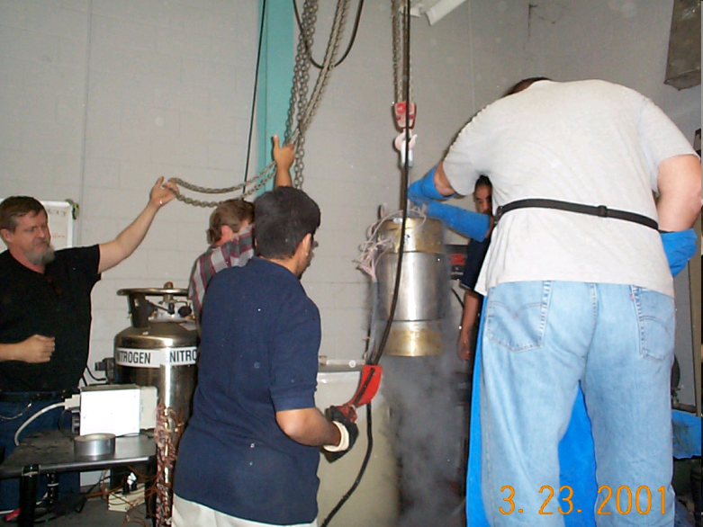
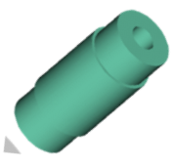

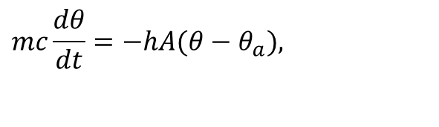
What is the temperature of the trunnion after half an hour?
$$mc\frac{dθ}{dt}=−hA(θ−θ_{a}),$$
$$θ(0)=θ_{room}$$

Slide 14

How long does it take a trunnion to cool down?
$$mc\frac{dθ}{dt}=−hA(θ−θ_{a}),$$
$$θ(0)=θ_{room}$$

Slide 15

What is the rate of change of heat stored in the cylinder?
$$mc\frac{dθ}{dt}=−hA(θ−θ_{a}),$$
$$θ(0)=θ_{room}$$

Slide 16
Can you identify?
We talked about 7 mathematical procedures in this course. Write them down.
Now connect the problem just discussed to these 7 mathematical procedures on each of the previous slides.

Slide 17
THE END

