Slide 1
Computational Methods
http://nm.MathForCollege.com
Transforming Numerical Methods Education for STEM Undergraduates

Slide 2

Welcome to EML3041: Computational Methods.
My name is Dr. Kaw.
Have you gotten your textbooks and TI30Xa calculator!
Introduce yourself to the person on your left and right. Say one thing (nothing personal) about yourself to them.
At home, go thru all the CANVAS modules.
All is well that ends well; well-begun is half-done.
Cell phones, laptops or other distractions are discouraged other than for allowed use.
Daydreamers and sleepers will not be disturbed.

Slide 3

Why use Numerical Methods?

Slide 4
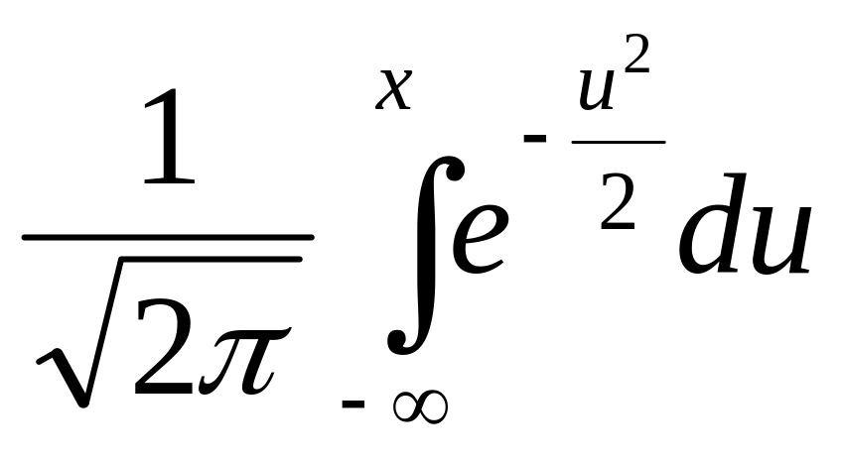
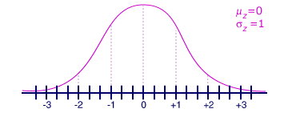
Why use Numerical Methods?
To solve problems that cannot be solved exactly

Slide 5
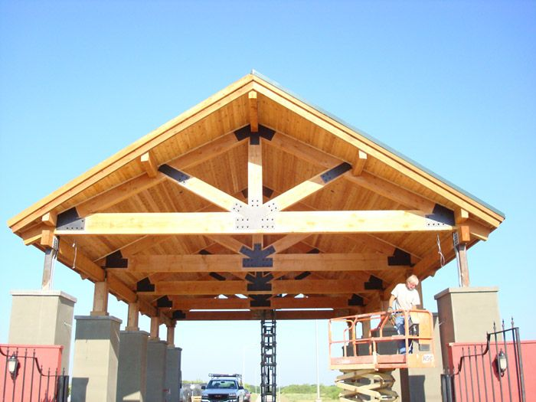
Why use Numerical Methods?
To solve problems that are intractable to solve exactly!

Slide 6
Steps in Solving an
Engineering Problem http://nm.MathForCollege.com

Slide 7
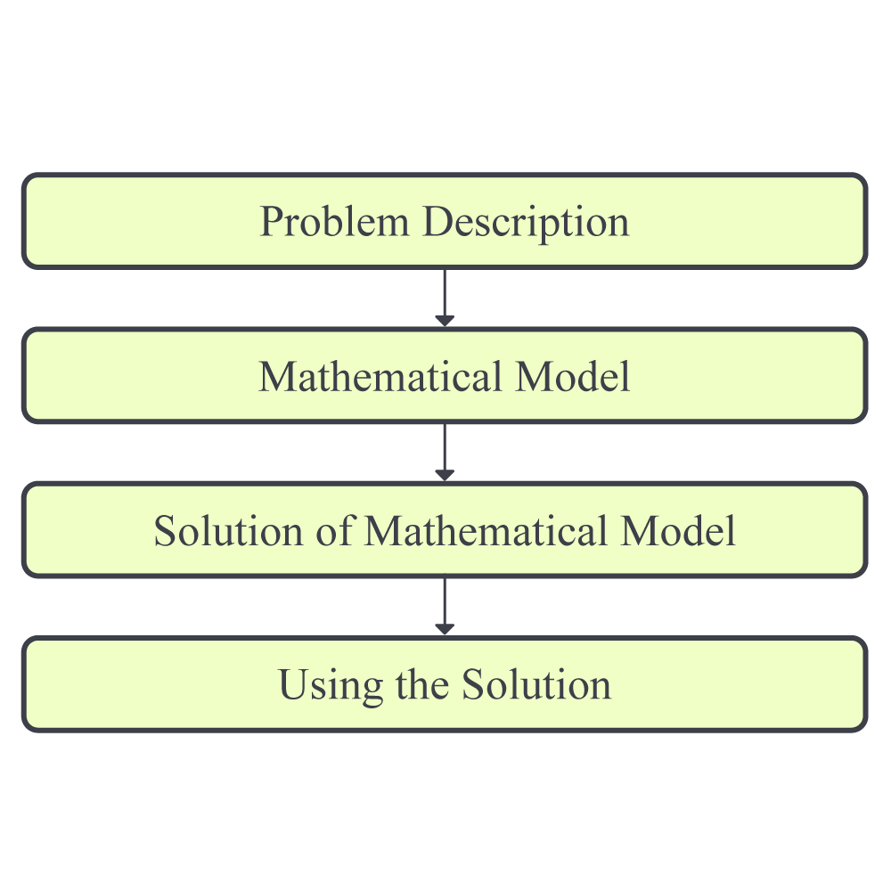
How do we solve an engineering problem?

Slide 8
PROBLEM DESCRIPTION

Slide 9
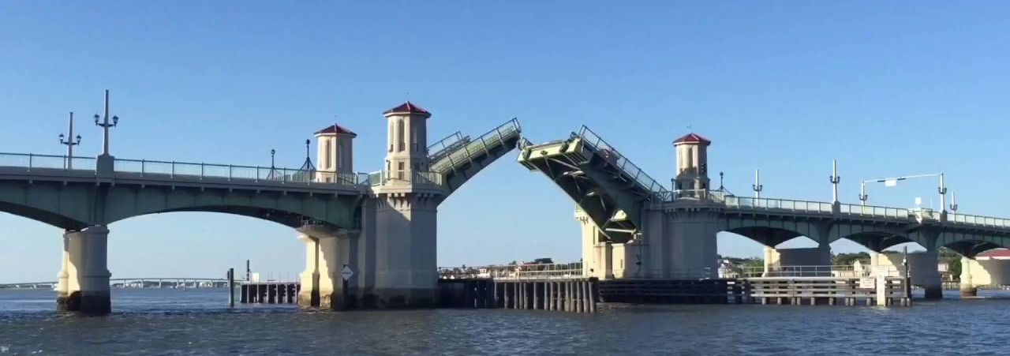
Example of Solving an Engineering Problem
Notes:
Oldest city’s oldest bascule bridge – the Bridge of Lions in St. Augustine, Florida

Slide 10
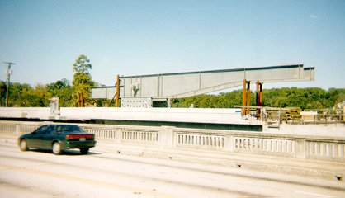
Bascule Bridge THG

Slide 11

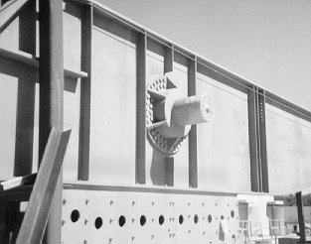
Bascule Bridge THG
Hub
Trunnion
Girder
Notes:
THG picture

Slide 12



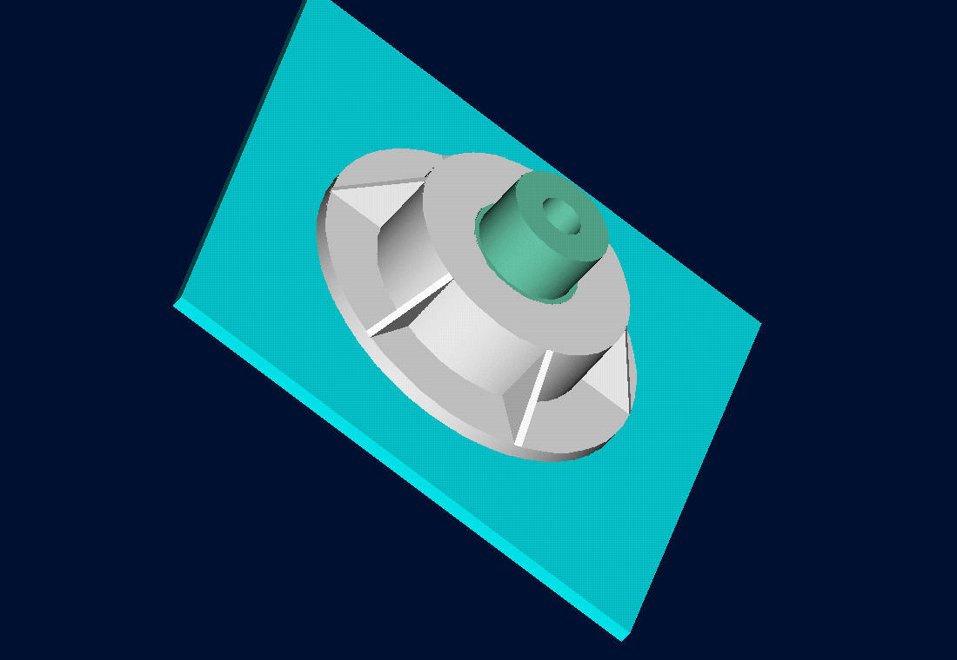
Trunnion-Hub-Girder Assembly Procedure
  Step1. Trunnion immersed in dry-ice/alcohol
  Step2. Trunnion shrink fit and warm up
  Step3. Trunnion-hub immersed in dry-ice/alcohol
  Step4. Trunnion-hub shrink fit and warm-up

Slide 13
Problem
After cooling the trunnion, the trunnion got stuck in hub

Slide 14
Why did it get stuck?
Magnitude of contraction needed in the trunnion was 0.015" or more. Did it contract enough?

Slide 15
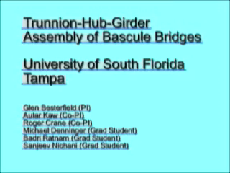
Video of Assembly Process

Slide 16
MATHEMATICAL MODELING

Slide 17
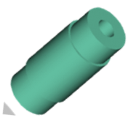
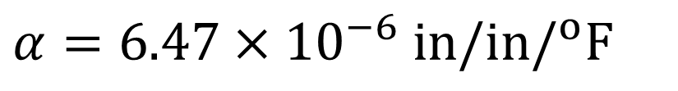
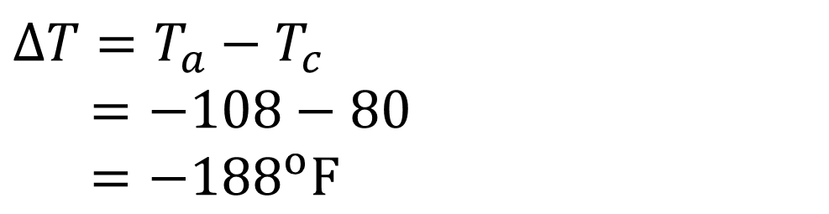
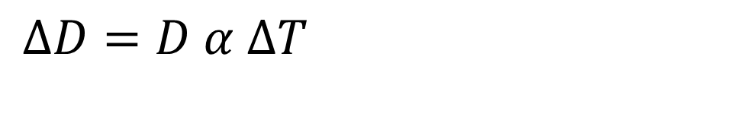

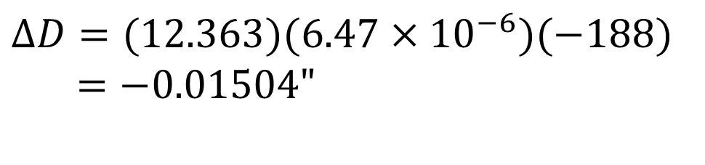
Consultant Calculations
$$ΔD=D α ΔT$$
$$D=12.363"$$
$$α=6.47×10^{−6} in/in/^{o}F$$
$$ΔT=T_{a}−T_{c}$$
$=−108−80$
$=−188^{o}F$
$$ΔD=(12.363)(6.47×10^{−6})(−188) \\ =−\text{0.01504"}$$

Slide 18
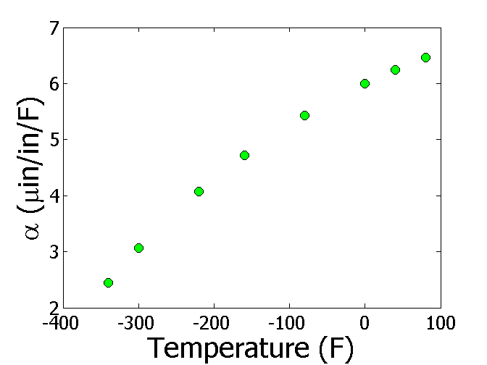
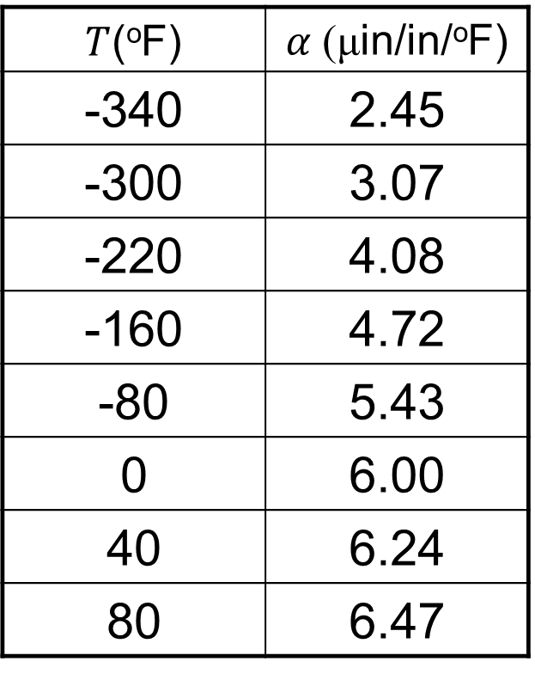
Is the Δ𝐷=𝐷𝛼Δ𝑇 formula correct?
$T$(ºF) | $α$ (μin/in/ºF)
-340 | 2.45
-300 | 3.07
-220 | 4.08
-160 | 4.72
-80 | 5.43
0 | 6.00
40 | 6.24
80 | 6.47

Slide 19
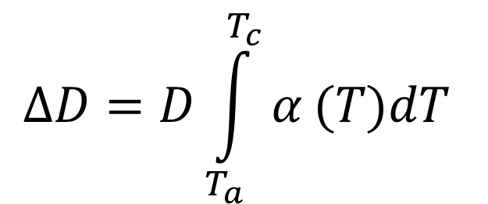
The correct model would account for varying thermal expansion coefficient
$$ΔD=D\int_{T_{a}}^{T_{c}}{α}(T)dT$$

Slide 20
SOLUTION OF MATHEMATICAL MODEL

Slide 21
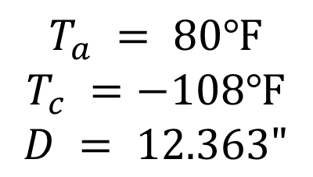
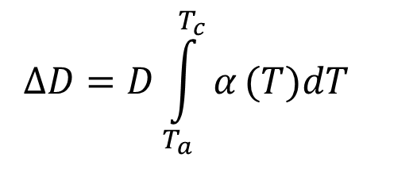
Can you roughly estimate the contraction?
$$ΔD=D\int_{T_{a}}^{T_{c}}{α}(T)dT$$
$$T_{a} = 80℉$$
$$T_{c} =−108℉$$
$$D = 12.363"$$

Slide 22
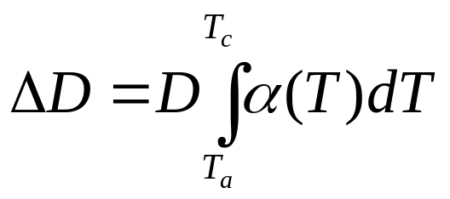
Can You Find a Better Estimate for the Contraction?
T_{a} = 80ºF
T_{c} = -108ºF
D = 12.363"

Slide 23
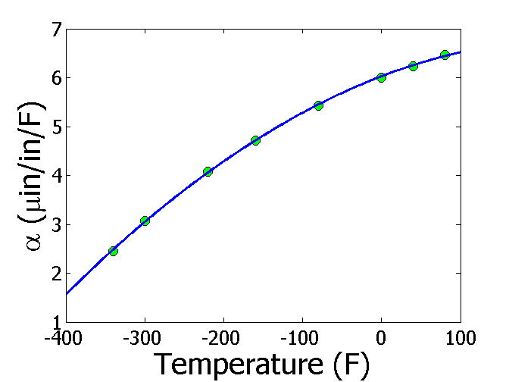
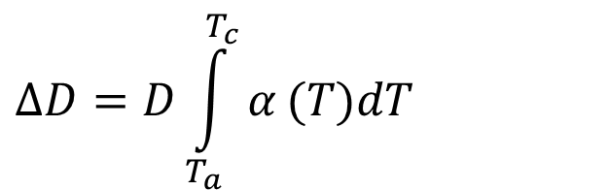
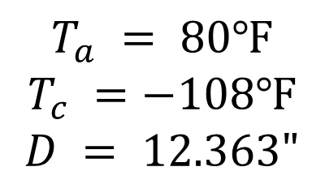

Can you estimate the contraction more accurately?
$$α=−1.2278×10^{−5}T^{2}+6.1946×10^{−3}T+6.0150$$
$$ΔD=D\int_{T_{a}}^{T_{c}}{α}(T)dT$$
$$T_{a} = 80℉$$
$$T_{c} =−108℉$$
$$D = 12.363"$$
$$ΔD=−0.0137"$$

Slide 24
USING THE SOLUTION

Slide 25
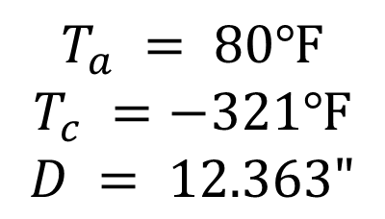

So, what is the solution to the problem?
$$α=−1.2278×10^{−5}T^{2}+6.1946×10^{−3}T+6.0150$$
$$ΔD=D\int_{T_{a}}^{T_{c}}{α}(T)dT$$
$$T_{a} = 80℉$$
$$T_{c} =−321℉$$
$$D = 12.363"$$
$$ΔD=−0.0244"$$

Slide 26
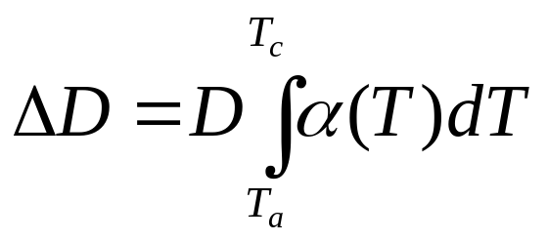
Revisiting steps to solve a problem
1) Problem Statement: Trunnion got stuck in the hub.
2) Modeling: Developed a new model
3) Solution: 1) Used trapezoidal rule OR b) Used regression and integration.
4) Implementation: Cool the trunnion in liquid nitrogen.

Slide 27
To Do List
Get your textbook and calculator
Go through first day of class module
Download MATLAB today for free
Cell phones or laptops are discouraged in class other than for allowed use
Please refrain from excessive talking
Turn on your notifications in CANVAS

Slide 28
THE END
http://nm.MathForCollege.com

Slide 29
Introduction to Numerical Methods
Mathematical Procedures
http://nm.MathForCollege.com

Slide 30

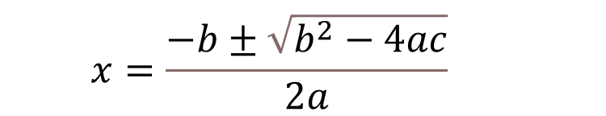
Nonlinear Equations
$$ax^{2}+bx+c=0$$
$$x=\frac{−b±\sqrt{b^{2}−4ac}}{2a}$$

Slide 31
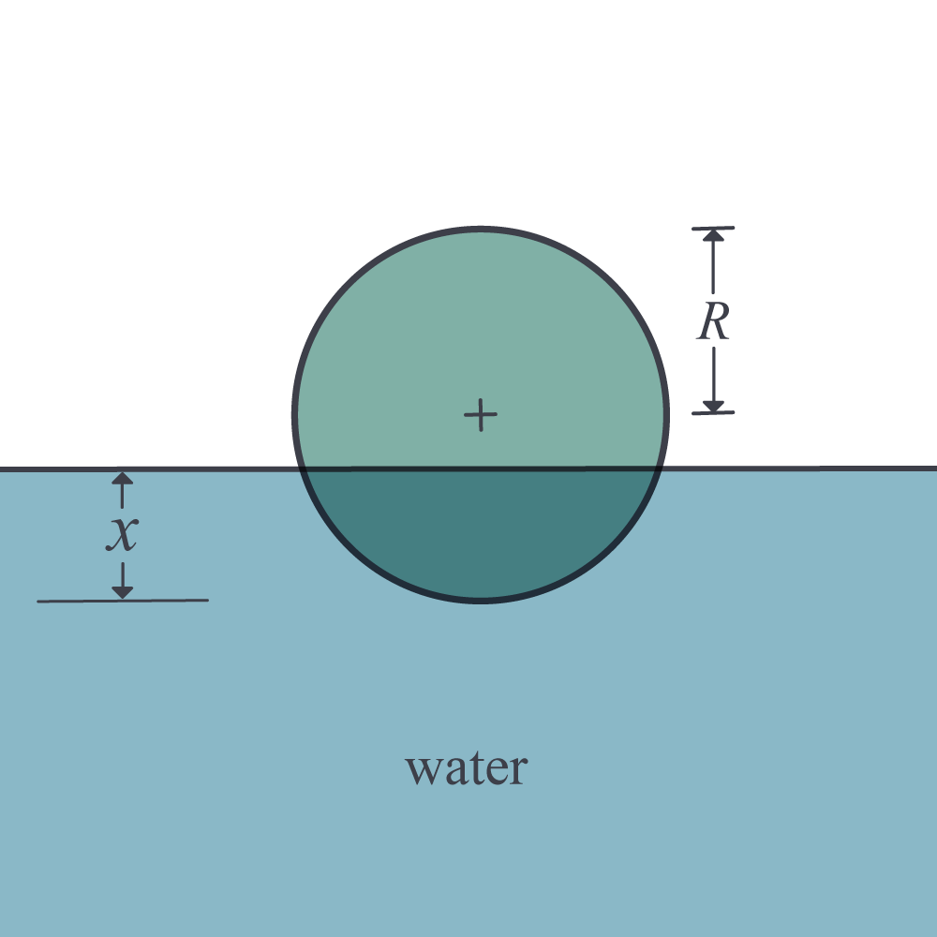
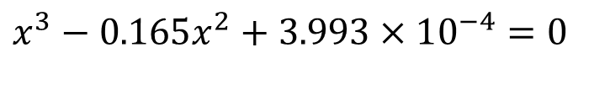
Nonlinear Equations
How much of the floating ball is under water?
Radius=0.055 m
Specific Gravity=0.6
$$x^{3}−0.165x^{2}+3.993×10^{−4}=0$$

Slide 33

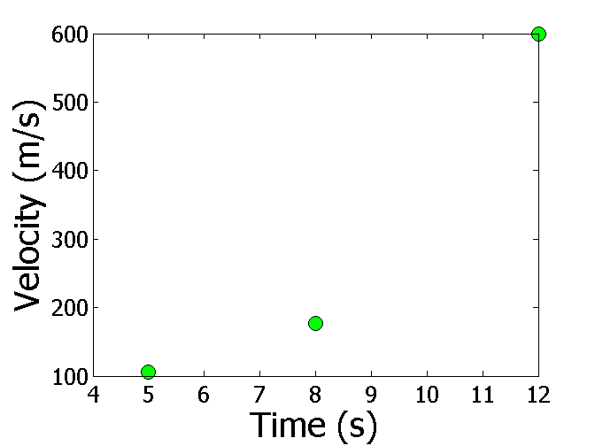
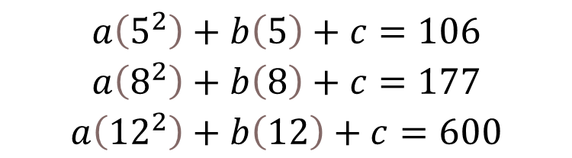
Simultaneous Linear Equations
Find the velocity profile, given
Time (s) | 5 | 8 | 12
Vel (m/s) | 106 | 177 | 600
$v(t)=at^{2}+bt+c,$ $5≤t≤12$
Three simultaneous linear equations
$$\begin{matrix}a\left(5^{2}\right)+b\left(5\right)+c=106 \\ a\left(8^{2}\right)+b\left(8\right)+c=177 \\ a\left({12}^{2}\right)+b\left(12\right)+c=600\end{matrix}$$
Source: Photo by NASA

Slide 35
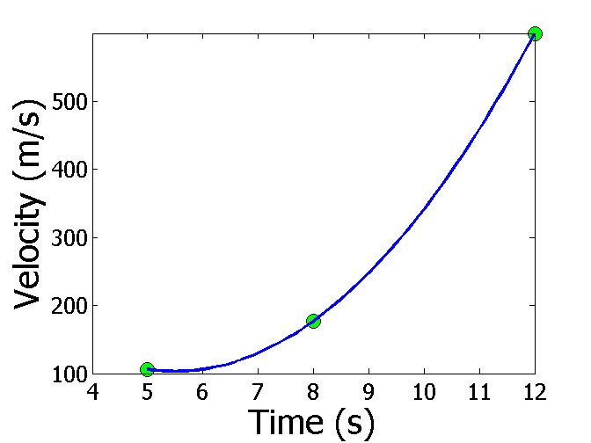
Interpolation
What is the velocity of the rocket at t=7 seconds?
Time (s) | 5 | 8 | 12
Vel (m/s) | 106 | 177 | 600
Source: Photo by NASA

Slide 36
Mathematical Procedures
Nonlinear Equations
Differentiation
Simultaneous Linear Equations
Curve Fitting
  Interpolation
  Regression
Integration
Ordinary Differential Equations
Other Advanced Mathematical Procedures:
  Partial Differential Equations
  Optimization
  Fast Fourier Transforms

Slide 37
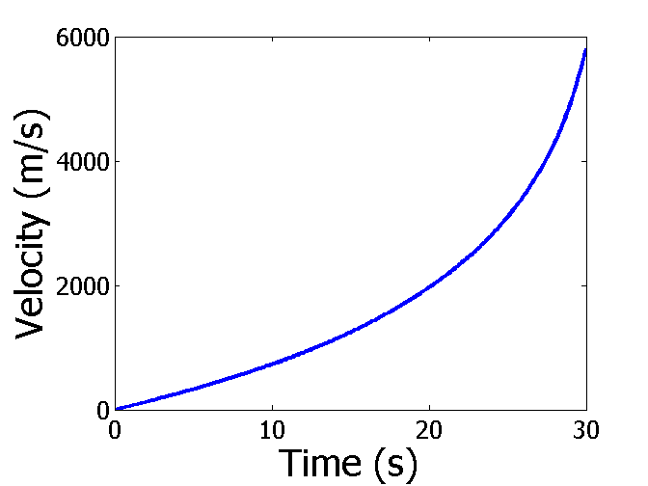
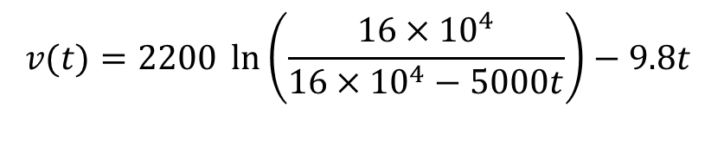
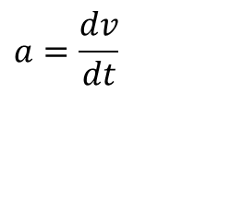
Differentiation
What is the acceleration at t=7 seconds?
$$v(t)=2200 \ln\left(\frac{16×10^{4}}{16×10^{4}−5000t}\right)−9.8t$$
$$a=\frac{dv}{dt}$$
Source: Photo by NASA

Slide 38
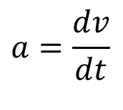
Differentiation
What is the acceleration at t=7 seconds?
Time (s) | 5 | 8 | 12
Vel (m/s) | 106 | 177 | 600
$$a=\frac{dv}{dt}$$

Slide 39
Regression
Thermal expansion coefficient data for cast steel

Slide 40
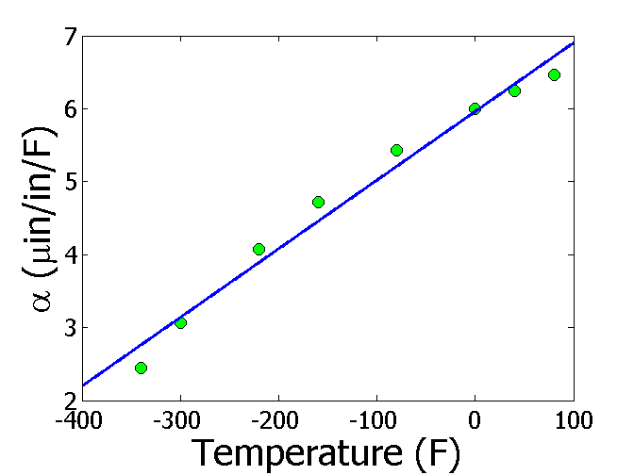
Regression – Linear

Slide 41
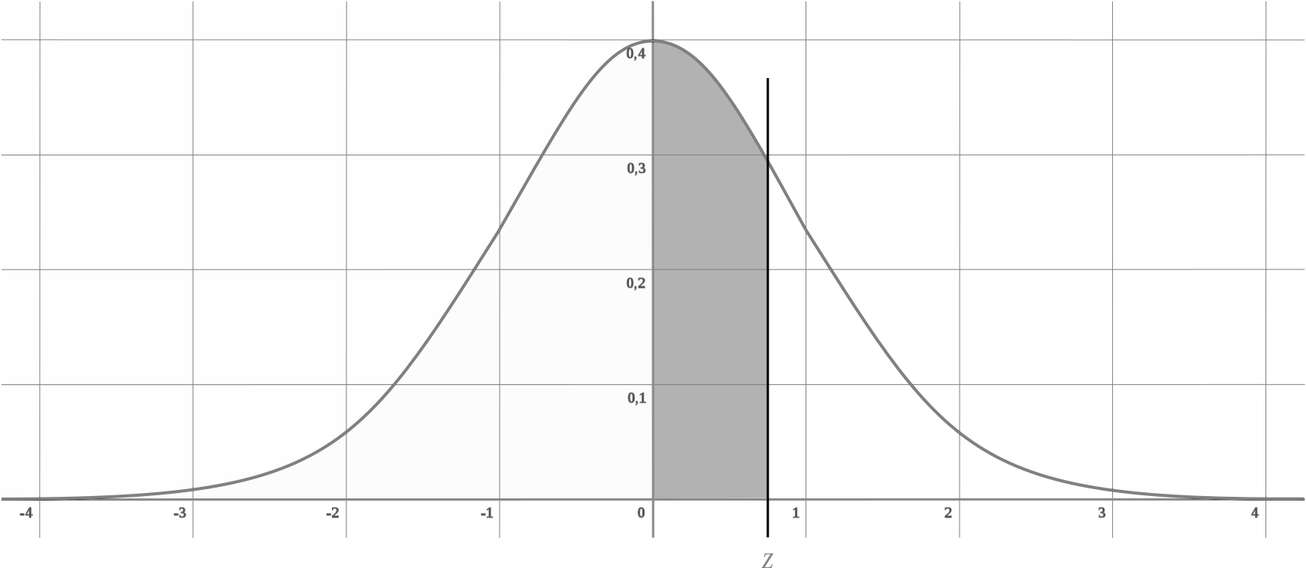
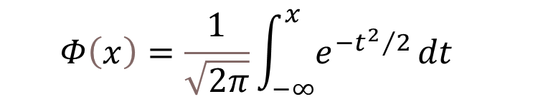
Integration
$$Φ\left(x\right)=\frac{1}{\sqrt{2π}}\int_{−∞}^{x}{e^{−{t^{2}}/2}}dt$$
Source: Wikipedia.org https://upload.wikimedia.org/wikipedia/commons/thumb/f/f9/Z_cumulative_from_mean.svg/1704px-Z_cumulative_from_mean.svg.png

Slide 42
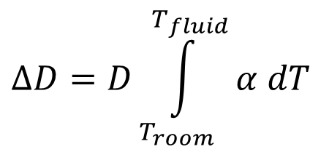
Integration
Finding the diametric contraction in a steel shaft when dipped in liquid nitrogen.
$$ΔD=D\int_{T_{room}}^{T_{fluid}}{α dT}$$

Slide 43
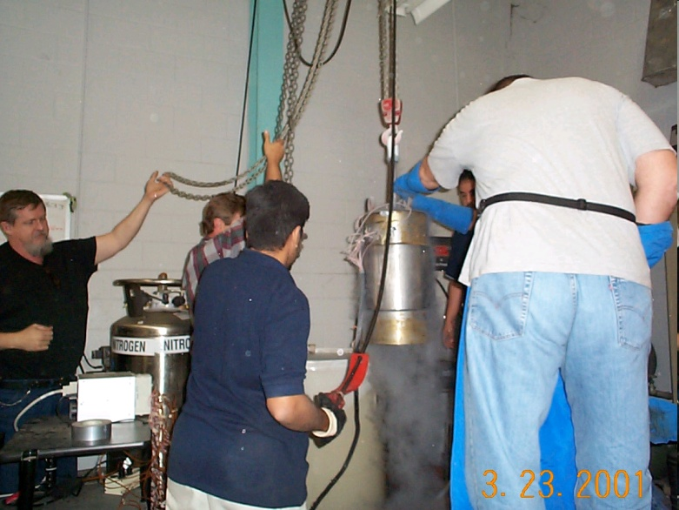
Ordinary Differential Equations
How long does it take a trunnion to cool down?
$$mc\frac{dθ}{dt}=−hA\left(θ−θ_{a}\right),θ(0)=θ_{room}$$

Slide 44
THE END
http://nm.MathForCollege.com

