Slide 1
Computational Methods
http://nm.MathForCollege.com
Transforming Numerical Methods Education for STEM Undergraduates

Slide 2

Welcome to EML3041: Computational Methods.
My name is Dr. Kaw.
Have you gotten your textbooks and TI30Xa calculator!
Introduce yourself to the person on your left and right. Say one thing (nothing personal) about yourself to them.
At home, go thru all the CANVAS modules.
All is well that ends well; well-begun is half-done.
No cell phones, laptops or other distractions. Daydreamers and sleepers will not be disturbed.

Slide 3
Why use Numerical Methods?

Slide 4
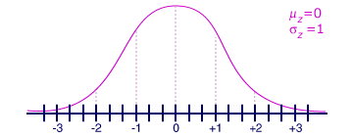
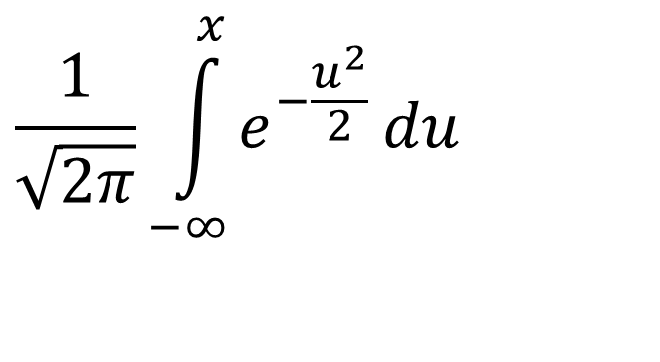
Why use Numerical Methods?
To solve problems that cannot be solved exactly
$$\frac{1}{\sqrt{2π}}\int_{−∞}^{x}{e^{−\frac{u^{2}}{2}}}du$$

Slide 5
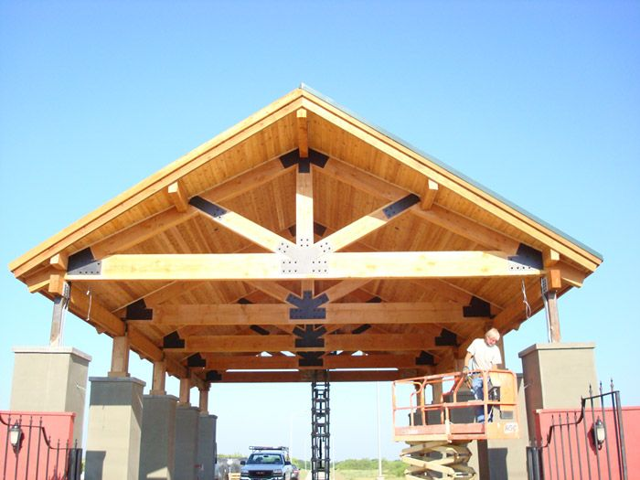
Why use Numerical Methods?
To solve problems that are intractable to solve exactly!

Slide 6
Steps in Solving an
Engineering Problem http://nm.MathForCollege.com

Slide 7
How do we solve an engineering problem?
Problem Description
Mathematical Model
Solution of Mathematical Model
Using the Solution

Slide 8
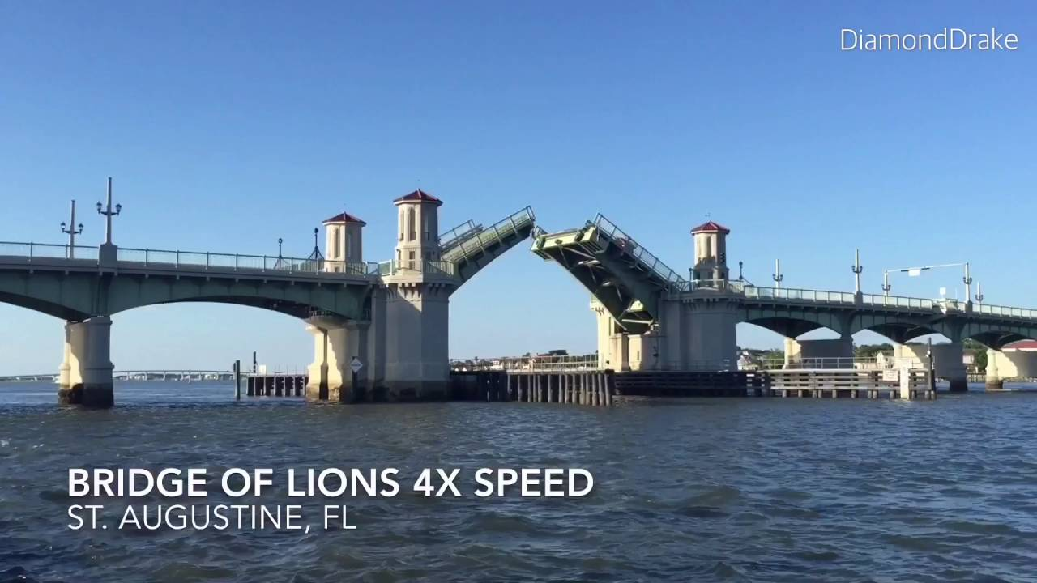
Example of Solving an Engineering Problem
Notes:
Oldest city’s oldest bascule bridge – the Bridge of Lions in St. Augustine, Florida

Slide 9
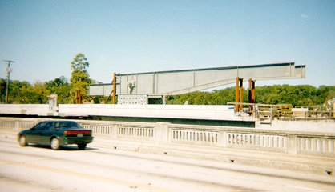
Bascule Bridge THG

Slide 10

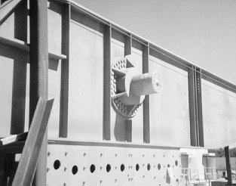
Bascule Bridge THG
Hub
Trunnion
Girder
Notes:
THG picture

Slide 11



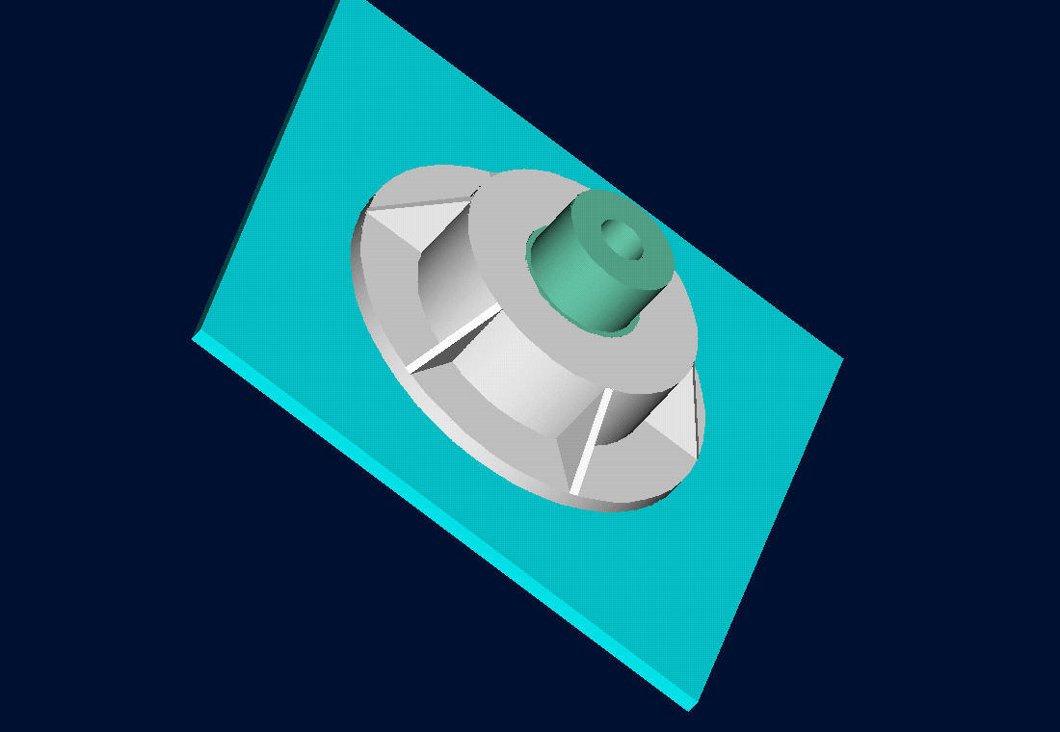
Trunnion-Hub-Girder Assembly Procedure
  Step1. Trunnion immersed in dry-ice/alcohol
  Step2. Trunnion warm-up in hub
  Step3. Trunnion-Hub immersed in
  dry-ice/alcohol
  Step4. Trunnion-Hub warm-up into girder
Simulation

Slide 12
Problem
After Cooling, the Trunnion Got Stuck in Hub

Slide 13
Why did it get stuck?
Magnitude of contraction needed in the trunnion was 0.015” or more. Did it contract enough?

Slide 14
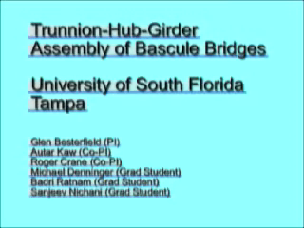
Video of Assembly Process

Slide 15
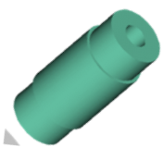

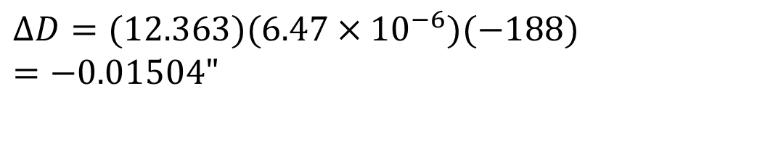
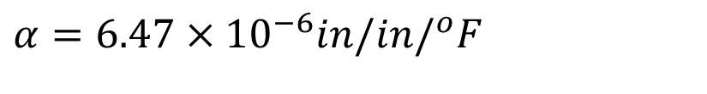
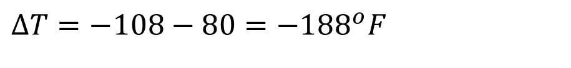
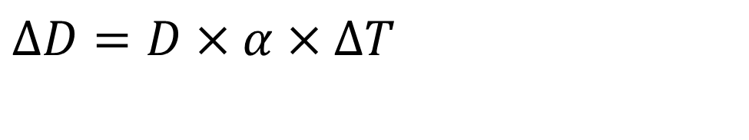
Consultant calculations
$$ΔD=D×α×ΔT$$
$$D=12.363"$$
$$α=6.47×10^{−6}in/in/^{o}F$$
$$ΔT=−108−80=−188^{o}F$$
$$ΔD=(12.363)(6.47×10^{−6})(−188) \\ =−\text{0.01504"}$$

Slide 16
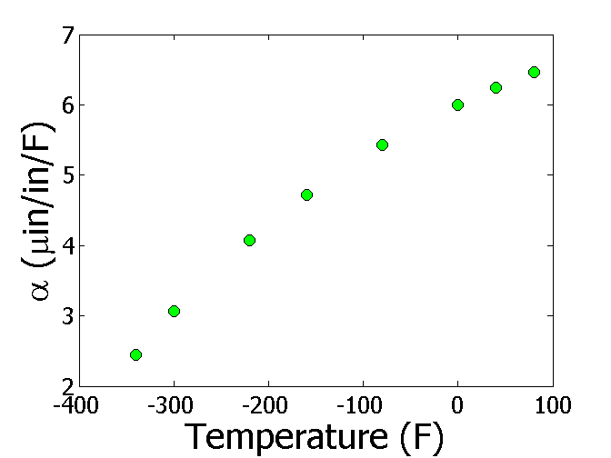


Is the formula used correct?
$$ΔD=D×α×ΔT$$
T(ºF) | α (μin/in/ºF)
-340 | 2.45
-300 | 3.07
-220 | 4.08
-160 | 4.72
-80 | 5.43
0 | 6.00
40 | 6.24
80 | 6.47
$$ΔD=DαΔT$$

Slide 17
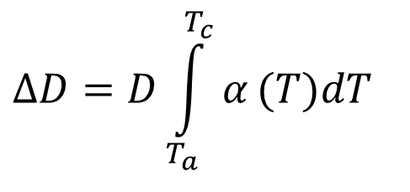
The Correct Model Would Account for Varying Thermal Expansion Coefficient
$$ΔD=D\int_{T_{a}}^{T_{c}}{α}(T)dT$$

Slide 18
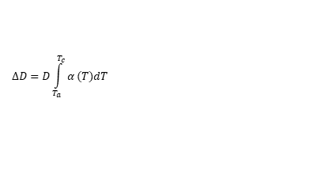
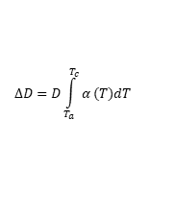
Can You Roughly Estimate the Contraction?
$$ΔD=D\int_{T_{a}}^{T_{c}}{α}(T)dT$$
T_{a}=80ºF; T_{c}=-108ºF; D=12.363”
$$ΔD=D\int_{T_{a}}^{T_{c}}{α}(T)dT$$

Slide 19
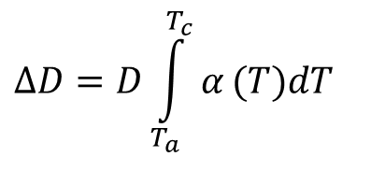
Can You Find a Better Estimate for the Contraction?
$$ΔD=D\int_{T_{a}}^{T_{c}}{α}(T)dT$$
T_{a} = 80ºF
T_{c} = -108ºF
D = 12.363"

Slide 20
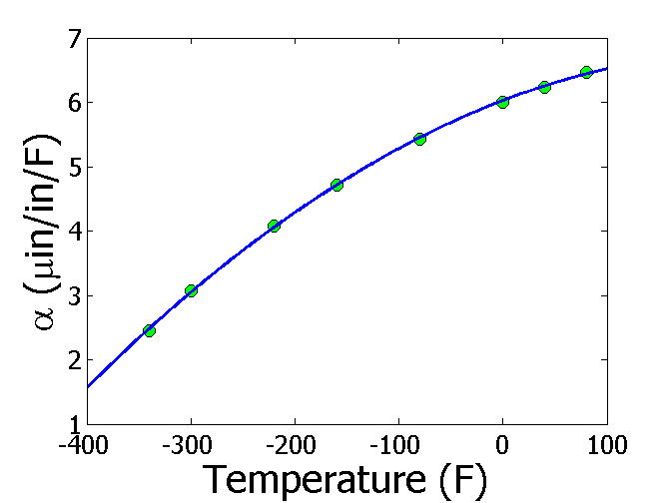

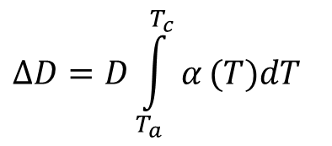
Estimating Contraction Accurately
Change in diameter (ΔD) by cooling it in dry ice/alcohol is given by
$$ΔD=D\int_{T_{a}}^{T_{c}}{α}(T)dT$$
T_{a} = 80ºF
T_{c} = -108ºF
D = 12.363"
$$α=−1.2278×10^{−5}T^{2}+6.1946×10^{−3}T+6.0150$$
$$ΔD=−0.0137"$$

Slide 21
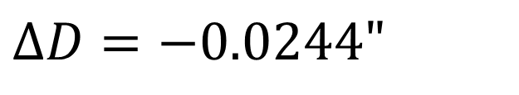
So what is the solution to the problem?
One solution is to immerse the trunnion in liquid nitrogen which has a boiling point of -321ºF as opposed to the dry-ice/alcohol temperature of -108ºF.
$$ΔD=−0.0244"$$

Slide 22
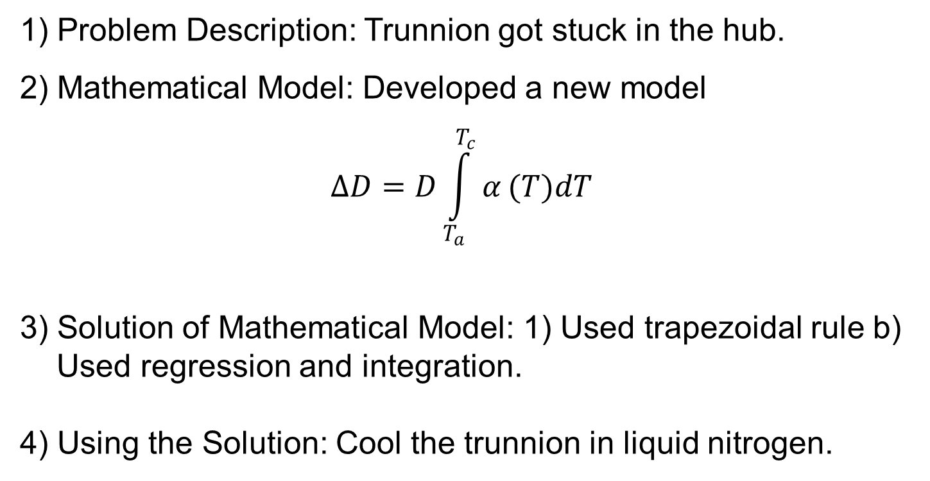
Revisiting steps to solve a problem
1) Problem Description: Trunnion got stuck in the hub.
2) Mathematical Model: Developed a new model
$$ΔD=D\int_{T_{a}}^{T_{c}}{α}(T)dT$$
3) Solution of Mathematical Model: 1) Used trapezoidal rule b) Used regression and integration.
4) Using the Solution: Cool the trunnion in liquid nitrogen.

Slide 23
THE END
http://nm.MathForCollege.com

Slide 24
Introduction to Numerical Methods
Mathematical Procedures
http://nm.MathForCollege.com

Slide 25
To Do List
Get your textbook and calculator
Go through first day of class module
Download MATLAB today for free
All tests are cumulative
No cell phones or laptops in class
Please refrain from excessive talking
Turn on your notifications in CANVAS

Slide 26
Mathematical Procedures
Nonlinear Equations
Differentiation
Simultaneous Linear Equations
Curve Fitting
  Interpolation
  Regression
Integration
Ordinary Differential Equations
Other Advanced Mathematical Procedures:
  Partial Differential Equations
  Optimization
  Fast Fourier Transforms

Slide 27
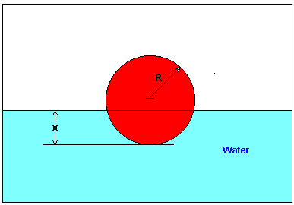
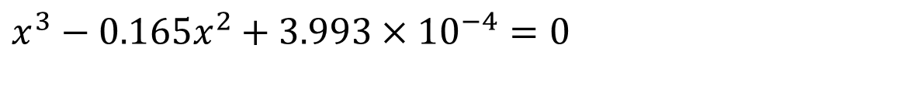
Nonlinear Equations
How much of the floating ball is under water?
Diameter=0.11m
Specific Gravity=0.6
$$x^{3}−0.165x^{2}+3.993×10^{−4}=0$$

Slide 28
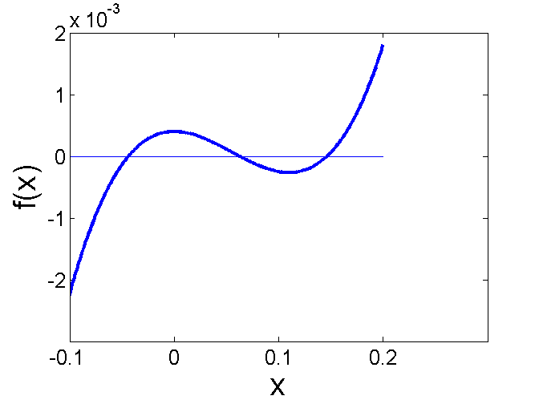
Nonlinear Equations
How much of the floating ball is under the water?
$$f(x)=x^{3}−0.165x^{2}+3.993×10^{−4}=0$$

Slide 29
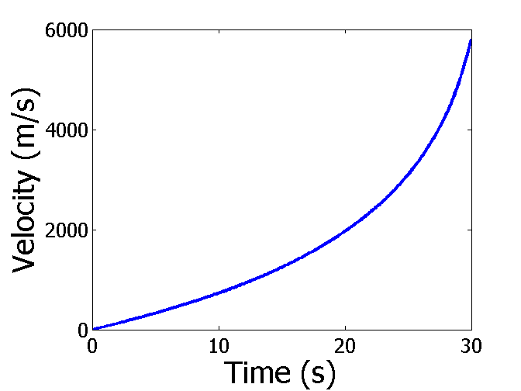

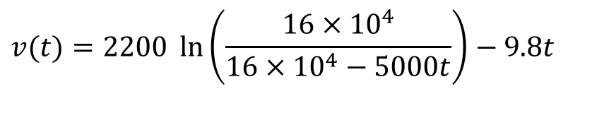
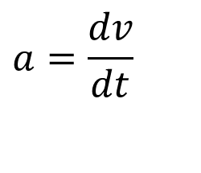
Differentiation
What is the acceleration at t=7 seconds?
$$a=\frac{dv}{dt}$$
$$v(t)=2200 \ln\left(\frac{16×10^{4}}{16×10^{4}−5000t}\right)−9.8t$$

Slide 30
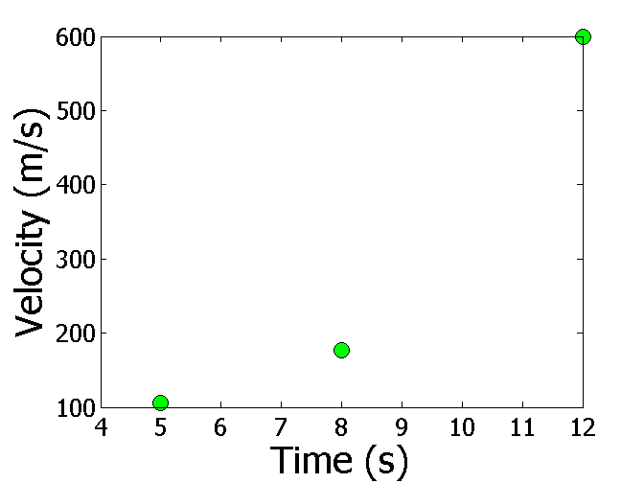
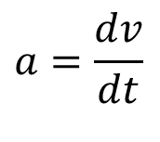
Differentiation
What is the acceleration at t=7 seconds?
Time (s) | 5 | 8 | 12
Vel (m/s) | 106 | 177 | 600
$$a=\frac{dv}{dt}$$

Slide 31





Simultaneous Linear Equations
Find the velocity profile, given
Time (s) | 5 | 8 | 12
Vel (m/s) | 106 | 177 | 600
$$v(t)=at^{2}+bt+c,$$
$$5≤t≤12$$
Three simultaneous linear equations
$$25a+5b+c=106$$
$$64a+8b+c=177$$
$$144a+12b+c=600$$

Slide 32
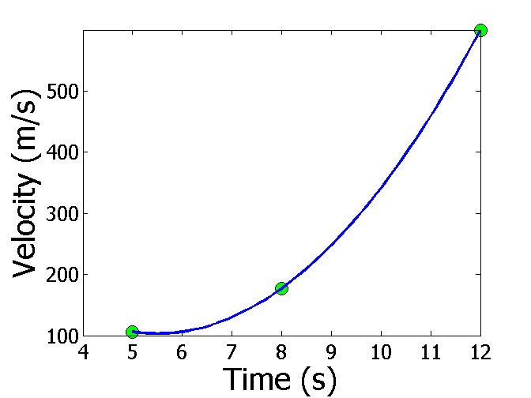
Interpolation
What is the velocity of the rocket at t=7 seconds?
Time (s) | 5 | 8 | 12
Vel (m/s) | 106 | 177 | 600

Slide 33
Regression
Thermal expansion coefficient data for cast steel

Slide 34
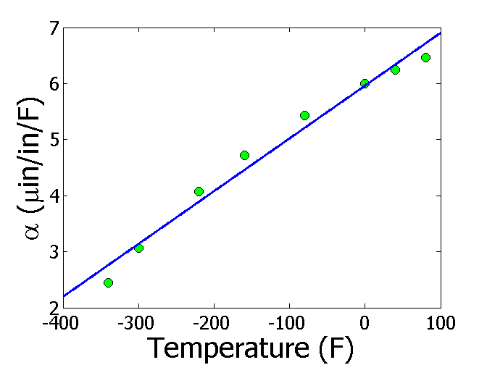
Regression (cont)

Slide 35
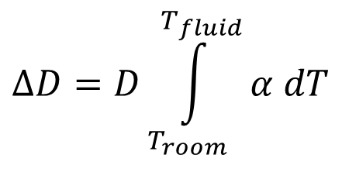
Integration
Finding the diametric contraction in a steel shaft when dipped in liquid nitrogen.
$$ΔD=D\int_{T_{room}}^{T_{fluid}}{α dT}$$

Slide 36
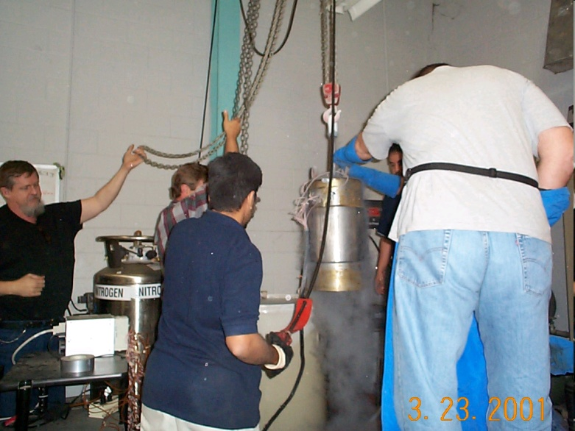
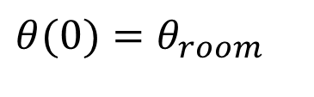
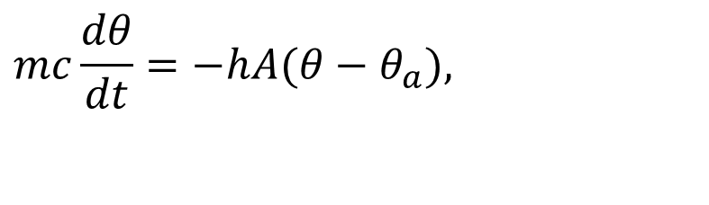
Ordinary Differential Equations
How long does it take a trunnion to cool down?
$$mc\frac{dθ}{dt}=−hA(θ−θ_{a}),$$
$$θ(0)=θ_{room}$$

Slide 37
THE END
http://nm.MathForCollege.com

