Slide 1
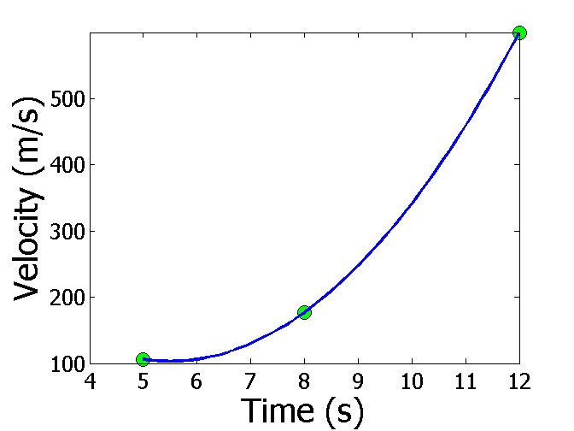
Interpolation
Reading Between the Lines

Slide 2
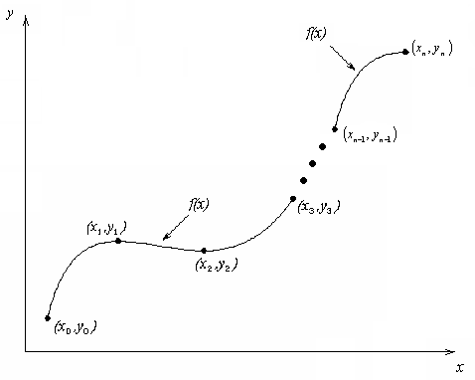
What is Interpolation ?
Given (x₀,y₀), (x₁,y₁), …… (x_{n},y_{n}), find the value of ‘y’ at a value of ‘x’ that is not given.
Figure Interpolation of discrete data.

Slide 3
APPLIED PROBLEMS

Slide 4

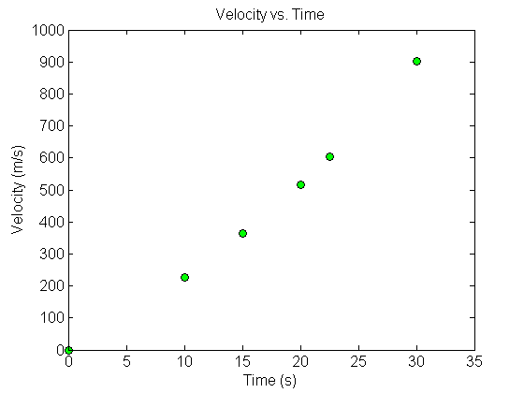


Fly Rocket Fly, Fly Rocket Fly
The upward velocity of a rocket is given as a function of time in table below. Find the velocity and acceleration at t=16 seconds.
Table Velocity as a function of time.
0 | 0
10 | 227.04
15 | 362.78
20 | 517.35
22.5 | 602.97
30 | 901.67
$$t, \left(s\right)$$
$$v\left(t\right)\text{, }\left(\text{m}\text{/}\text{s}\right)$$
Velocity vs. time data for the rocket example

Slide 5
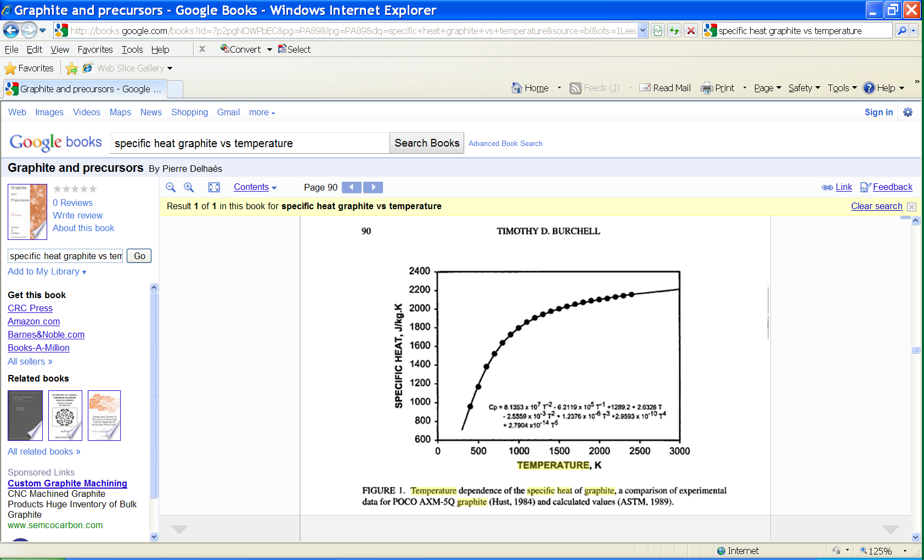
Specific Heat of Carbon
A carbon block is heated up from room temperature of 300K to 1800K. How much heat is required to do so?
Temperature (K) | Specific Heat (J/kg-K)
200 | 420
400 | 1070
600 | 1370
1000 | 1820
1500 | 2000
2000 | 2120

Slide 6

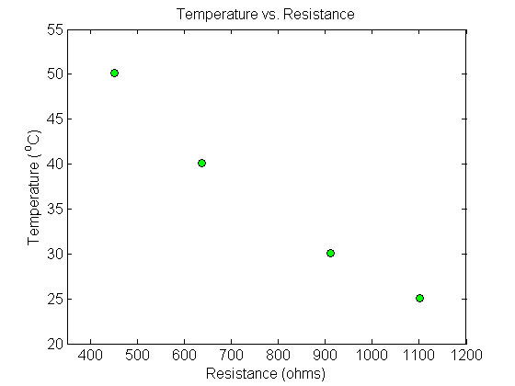
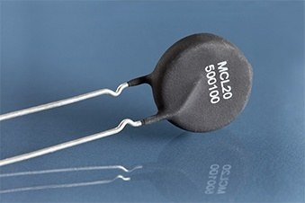
Thermistor Calibration
Thermistors are based on change in resistance of a material with temperature. A manufacturer of thermistors makes the following observations on a thermistor. Determine the calibration curve for thermistor.
R (Ω) | T(°C)
1101.0 911.3 636.0 451.1 | 25.113 30.131 40.120 50.128

Slide 7
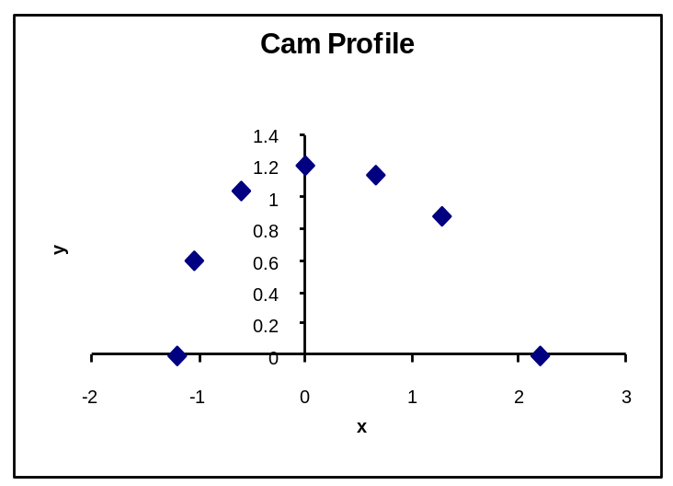
Follow the Cam
A curve needs to be fit through the given points to fabricate the cam.
4
3
5
2
6
Point | x (in.) | y (in.)
1 | 2.20 | 0.00
2 | 1.28 | 0.88
3 | 0.66 | 1.14
4 | 0.00 | 1.20
5 | –0.60 | 1.04
6 | –1.04 | 0.60
7 | –1.20 | 0.00
Y
1
7
X

Slide 8
Spline Interpolation Method
Major: All Engineering Majors
Authors: Autar Kaw, Jai Paul
http://numericalmethods.eng.usf.edu
Transforming Numerical Methods Education for STEM Undergraduates

Slide 9
Spline Method of Interpolation http://nm.MathForCollege.com

Slide 10
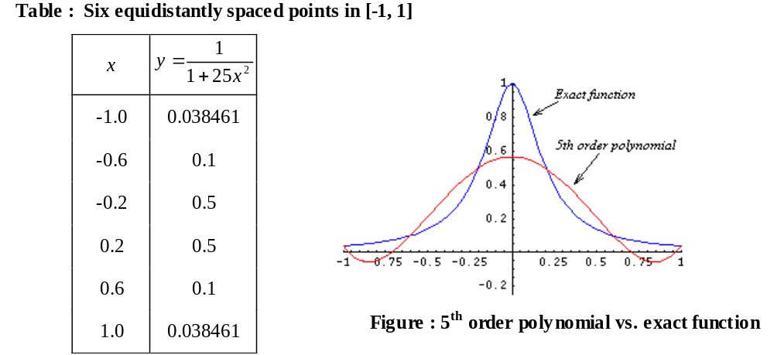
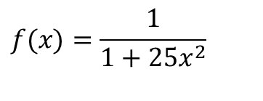
Why Splines ?
$$f(x)=\frac{1}{1+25x^{2}}$$

Slide 11
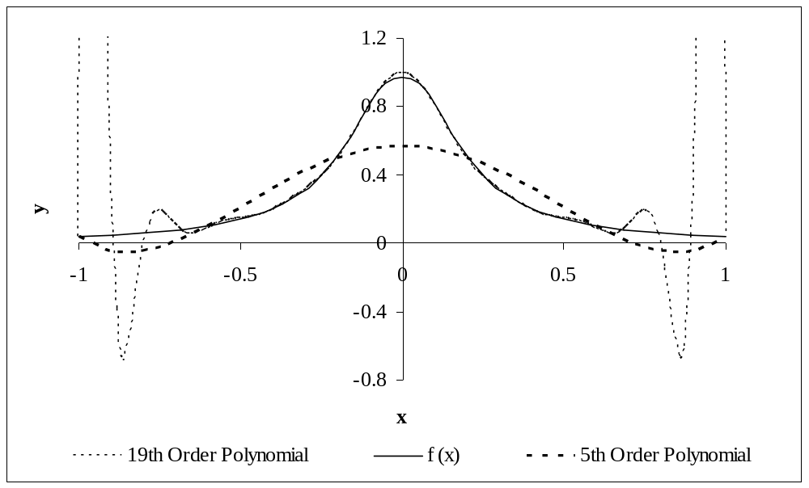
Why Splines ?
Figure : Higher order polynomial interpolation is a bad idea

Slide 12
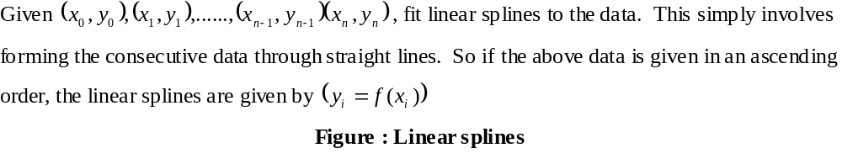
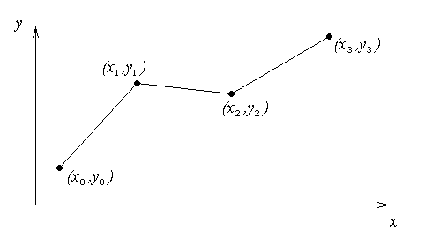
Linear Spline Interpolation

Slide 13
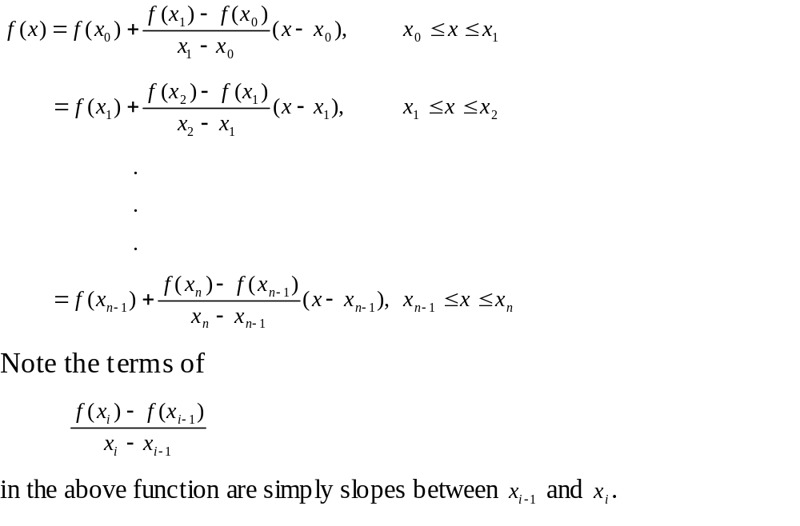
Linear Spline Interpolation (contd)

Slide 14

Example
The upward velocity of a rocket is given as a function of time in Table 1. Find the velocity at t=16 seconds using linear splines.
Table Velocity as a
function of time
(s) | (m/s)
0 | 0
10 | 227.04
15 | 362.78
20 | 517.35
22.5 | 602.97
30 | 901.67
$$t$$
$$v(t)$$
Figure. Velocity vs. time data
for the rocket example

Slide 15
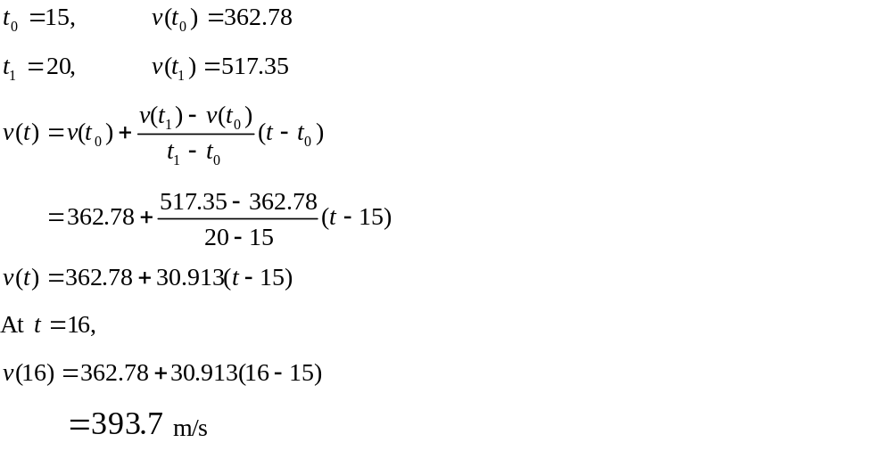
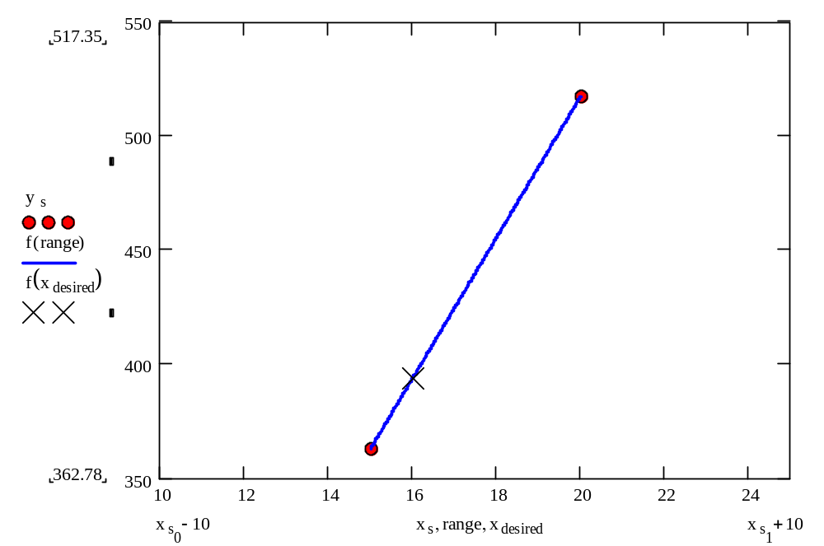
Linear Spline Interpolation

Slide 16
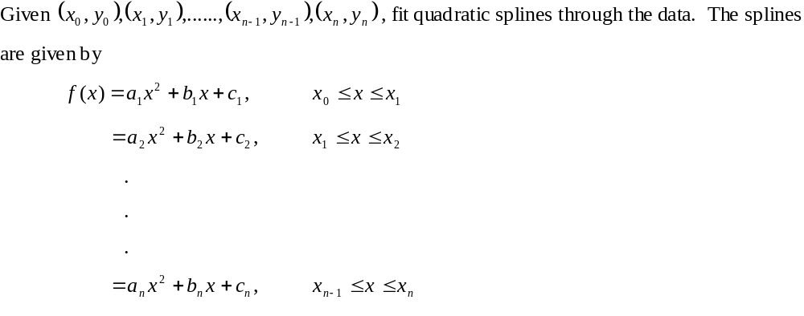
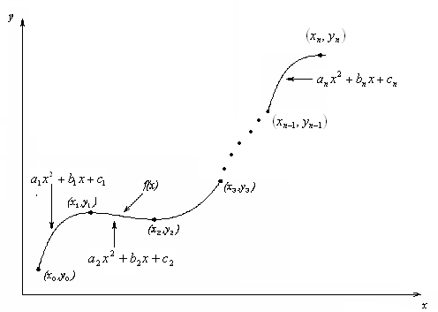
Quadratic Spline Interpolation

Slide 17
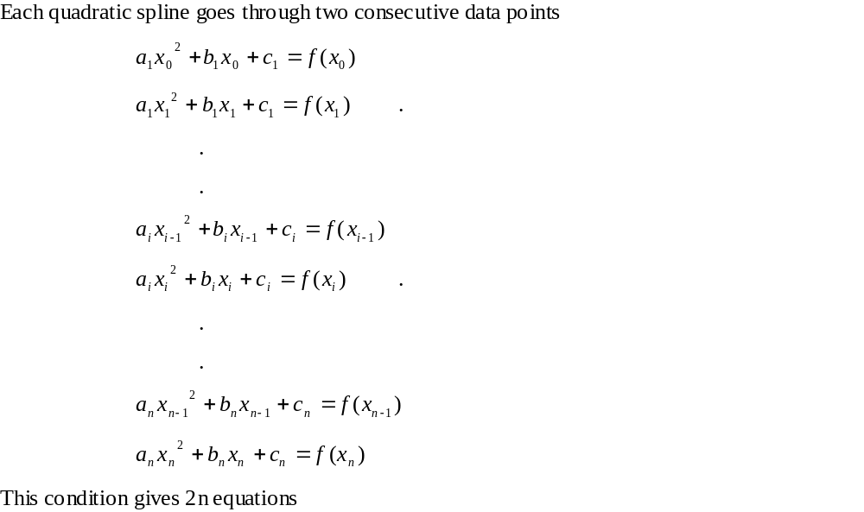
Quadratic Spline Interpolation (contd)

Slide 18
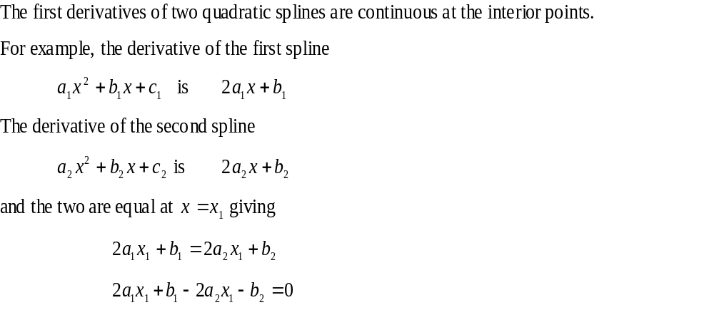
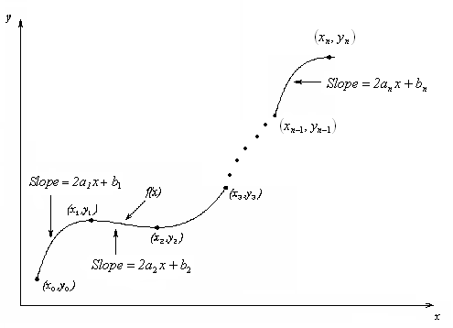
Quadratic Spline Interpolation (contd)

Slide 19
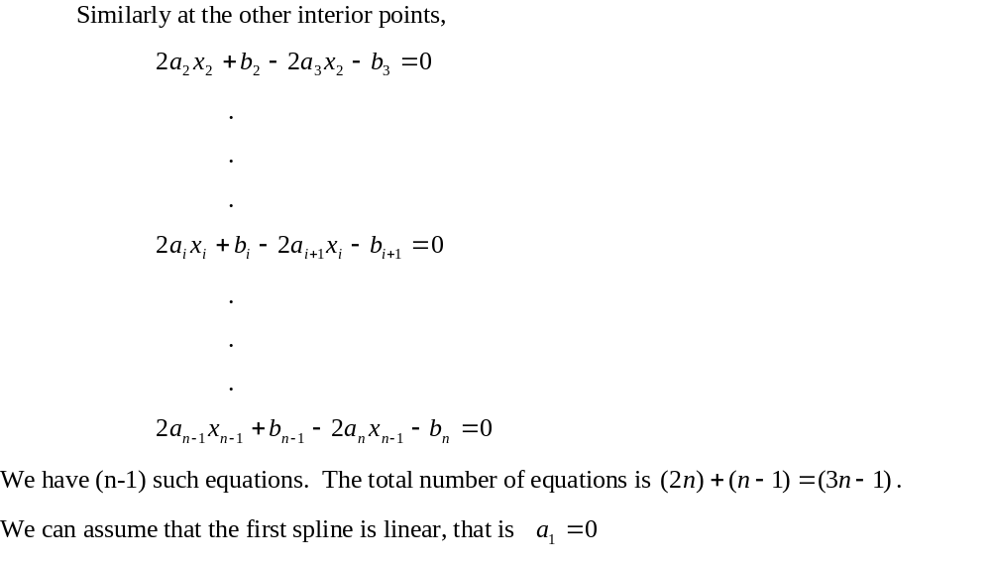
Quadratic Spline Interpolation (contd)

Slide 20
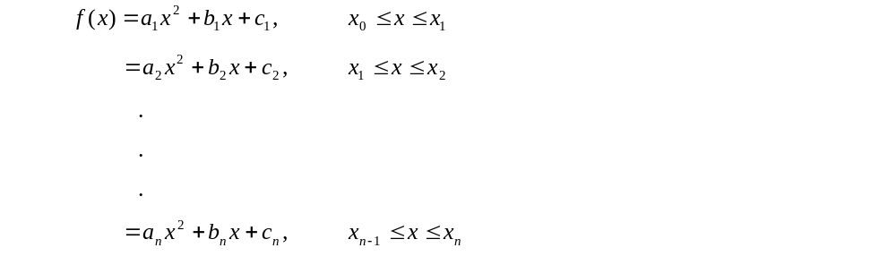
Quadratic Spline Interpolation (contd)

Slide 21
Quadratic Spline Example
The upward velocity of a rocket is given as a function of time. Using quadratic splines
Find the velocity at t=16 seconds
Find the acceleration at t=16 seconds
Find the distance covered between t=11 and t=16 seconds
t | v(t)
s | m/s
0 | 0
10 | 227.04
15 | 362.78
20 | 517.35
22.5 | 602.97
30 | 901.67

Slide 22
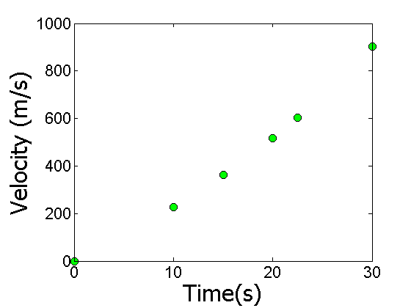
Data and Plot
t | v(t)
s | m/s
0 | 0
10 | 227.04
15 | 362.78
20 | 517.35
22.5 | 602.97
30 | 901.67
Notes:
22

Slide 23
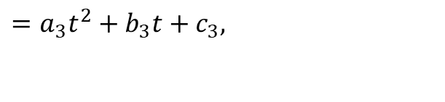


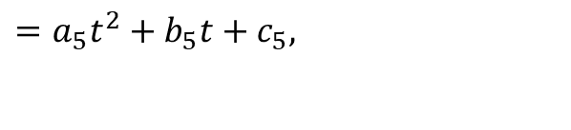
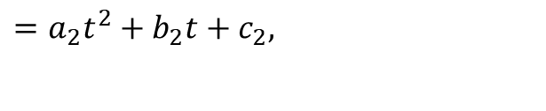


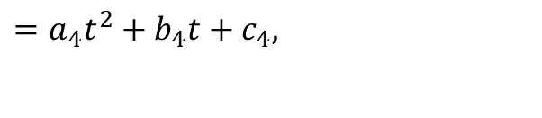
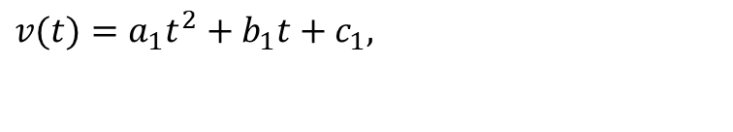

Solution
$$0≤t≤10$$
$$v(t)=a_{1}t^{2}+b_{1}t+c_{1},$$
$$=a_{2}t^{2}+b_{2}t+c_{2},$$
$$10≤t≤15$$
$$15≤t≤20$$
$$=a_{3}t^{2}+b_{3}t+c_{3},$$
$$20≤t≤22.5$$
$$=a_{4}t^{2}+b_{4}t+c_{4},$$
$$=a_{5}t^{2}+b_{5}t+c_{5},$$
$$22.5≤t≤30$$
Let us set up the equations

Slide 24
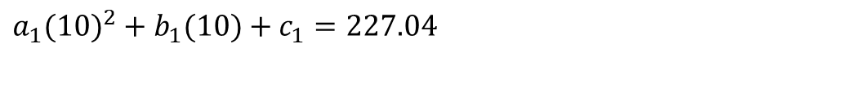
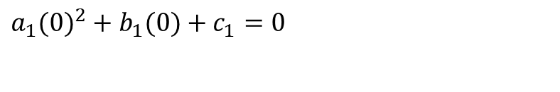

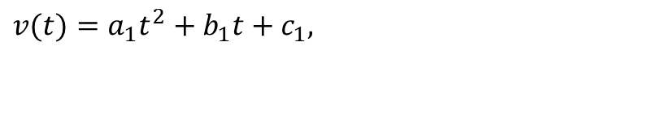
Each Spline Goes Through Two Consecutive Data Points
$$0≤t≤10$$
$$v(t)=a_{1}t^{2}+b_{1}t+c_{1},$$
$$a_{1}(0)^{2}+b_{1}(0)+c_{1}=0$$
$$a_{1}(10)^{2}+b_{1}(10)+c_{1}=227.04$$

Slide 25
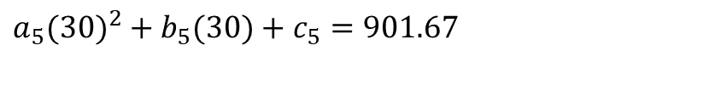
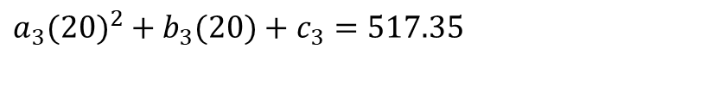
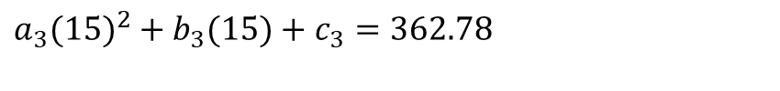
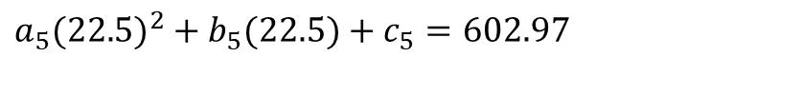
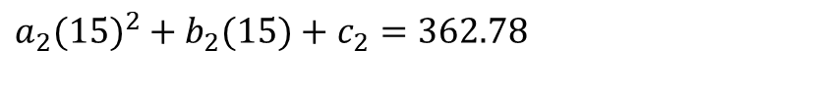

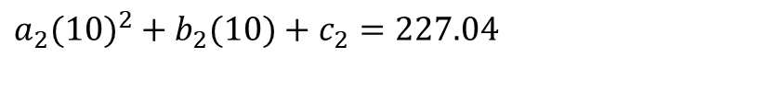

Each Spline Goes Through Two Consecutive Data Points
t | v(t)
s | m/s
0 | 0
10 | 227.04
15 | 362.78
20 | 517.35
22.5 | 602.97
30 | 901.67
$$a_{2}(10)^{2}+b_{2}(10)+c_{2}=227.04$$
$$a_{2}(15)^{2}+b_{2}(15)+c_{2}=362.78$$
$$a_{3}(15)^{2}+b_{3}(15)+c_{3}=362.78$$
$$a_{3}(20)^{2}+b_{3}(20)+c_{3}=517.35$$
$$a_{4}(20)^{2}+b_{4}(20)+c_{4}=517.35$$
$$a_{4}(22.5)^{2}+b_{4}(22.5)+c_{4}=602.97$$
$$a_{5}(22.5)^{2}+b_{5}(22.5)+c_{5}=602.97$$
$$a_{5}(30)^{2}+b_{5}(30)+c_{5}=901.67$$

Slide 26
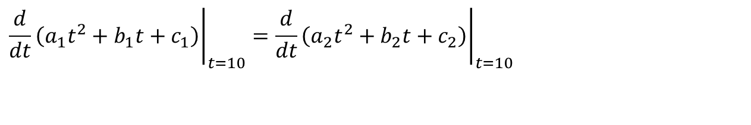

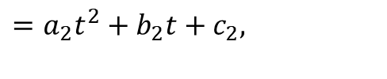
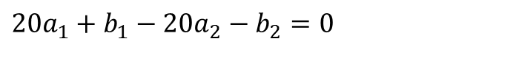

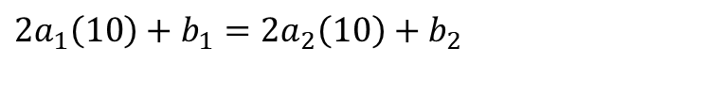
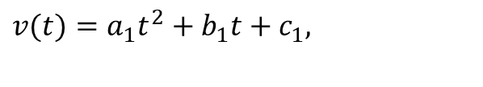
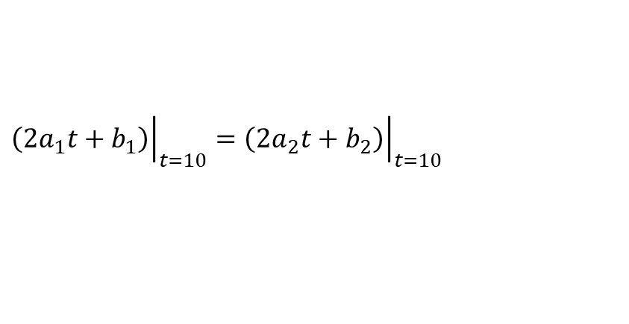
Derivatives are Continuous at Interior Data Points
$$v(t)=a_{1}t^{2}+b_{1}t+c_{1},$$
$$0≤t≤10$$
$$10≤t≤15$$
$$=a_{2}t^{2}+b_{2}t+c_{2},$$
$${\left.\frac{d}{dt}\left(a_{1}t^{2}+b_{1}t+c_{1}\right)\right|}_{t=10}={\left.\frac{d}{dt}\left(a_{2}t^{2}+b_{2}t+c_{2}\right)\right|}_{t=10}$$
$${\left.\left(2a_{1}t+b_{1}\right)\right|}_{t=10}={\left.\left(2a_{2}t+b_{2}\right)\right|}_{t=10}$$
$$2a_{1}\left(10\right)+b_{1}=2a_{2}\left(10\right)+b_{2}$$
$$20a_{1}+b_{1}−20a_{2}−b_{2}=0$$

Slide 27
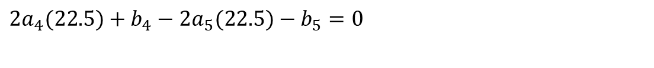
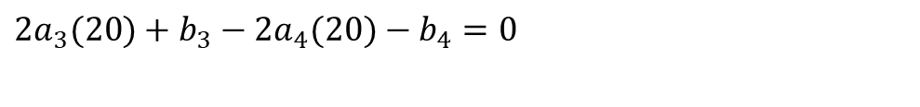
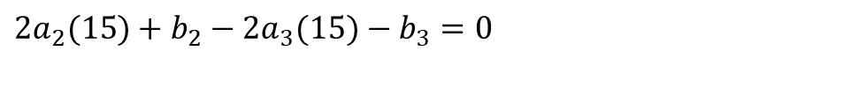
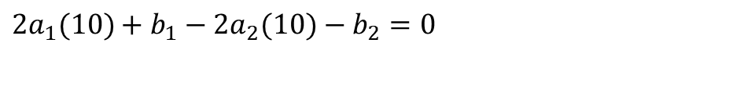
Derivatives are continuous at Interior Data Points
At t=10
$$2a_{1}(10)+b_{1}−2a_{2}(10)−b_{2}=0$$
At t=15
$$2a_{2}(15)+b_{2}−2a_{3}(15)−b_{3}=0$$
At t=20
$$2a_{3}(20)+b_{3}−2a_{4}(20)−b_{4}=0$$
At t=22.5
$$2a_{4}(22.5)+b_{4}−2a_{5}(22.5)−b_{5}=0$$

Slide 28
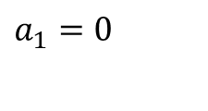
Last Equation
$$a_{1}=0$$

Slide 29
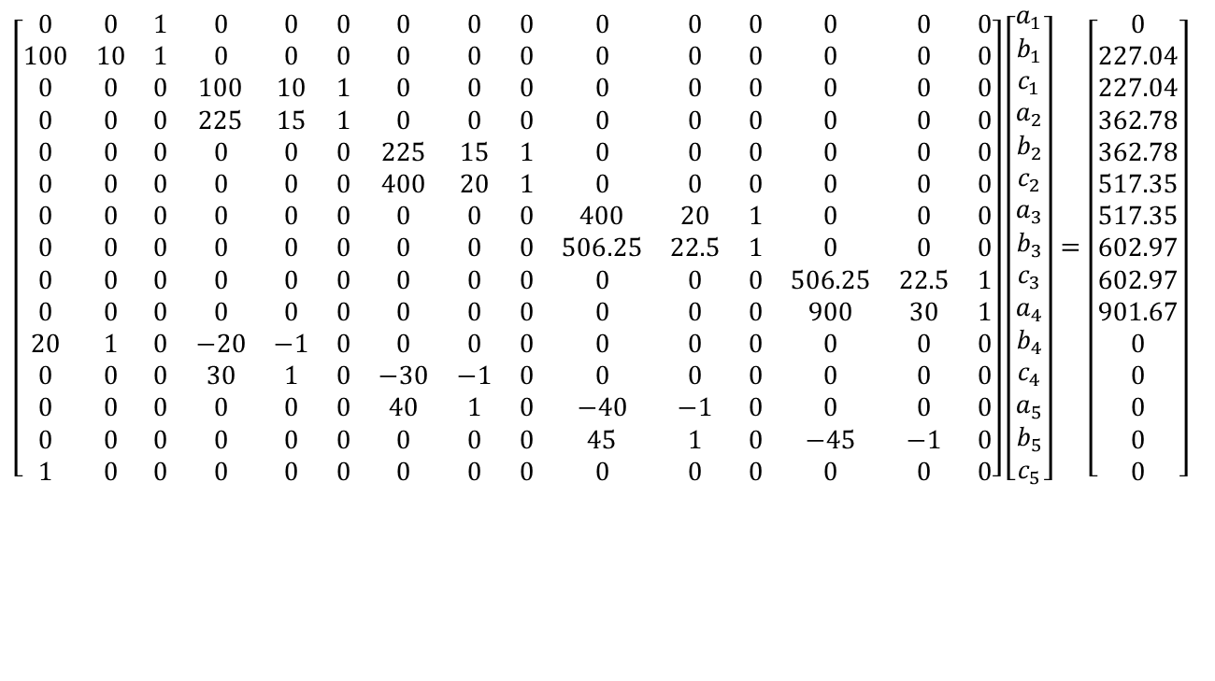
Final Set of Equations
$$\left[\begin{matrix}0 & 0 & 1 & 0 & 0 & 0 & 0 & 0 & 0 & 0 & 0 & 0 & 0 & 0 & 0 \\ 100 & 10 & 1 & 0 & 0 & 0 & 0 & 0 & 0 & 0 & 0 & 0 & 0 & 0 & 0 \\ 0 & 0 & 0 & 100 & 10 & 1 & 0 & 0 & 0 & 0 & 0 & 0 & 0 & 0 & 0 \\ 0 & 0 & 0 & 225 & 15 & 1 & 0 & 0 & 0 & 0 & 0 & 0 & 0 & 0 & 0 \\ 0 & 0 & 0 & 0 & 0 & 0 & 225 & 15 & 1 & 0 & 0 & 0 & 0 & 0 & 0 \\ 0 & 0 & 0 & 0 & 0 & 0 & 400 & 20 & 1 & 0 & 0 & 0 & 0 & 0 & 0 \\ 0 & 0 & 0 & 0 & 0 & 0 & 0 & 0 & 0 & 400 & 20 & 1 & 0 & 0 & 0 \\ 0 & 0 & 0 & 0 & 0 & 0 & 0 & 0 & 0 & 506.25 & 22.5 & 1 & 0 & 0 & 0 \\ 0 & 0 & 0 & 0 & 0 & 0 & 0 & 0 & 0 & 0 & 0 & 0 & 506.25 & 22.5 & 1 \\ 0 & 0 & 0 & 0 & 0 & 0 & 0 & 0 & 0 & 0 & 0 & 0 & 900 & 30 & 1 \\ 20 & 1 & 0 & −20 & −1 & 0 & 0 & 0 & 0 & 0 & 0 & 0 & 0 & 0 & 0 \\ 0 & 0 & 0 & 30 & 1 & 0 & −30 & −1 & 0 & 0 & 0 & 0 & 0 & 0 & 0 \\ 0 & 0 & 0 & 0 & 0 & 0 & 40 & 1 & 0 & −40 & −1 & 0 & 0 & 0 & 0 \\ 0 & 0 & 0 & 0 & 0 & 0 & 0 & 0 & 0 & 45 & 1 & 0 & −45 & −1 & 0 \\ 1 & 0 & 0 & 0 & 0 & 0 & 0 & 0 & 0 & 0 & 0 & 0 & 0 & 0 & 0\end{matrix}\right]\left[\begin{matrix}a_{1} \\ b_{1} \\ c_{1} \\ a_{2} \\ b_{2} \\ c_{2} \\ a_{3} \\ b_{3} \\ c_{3} \\ a_{4} \\ b_{4} \\ c_{4} \\ a_{5} \\ b_{5} \\ c_{5}\end{matrix}\right]=\left[\begin{matrix}0 \\ 227.04 \\ 227.04 \\ 362.78 \\ 362.78 \\ 517.35 \\ 517.35 \\ 602.97 \\ 602.97 \\ 901.67 \\ 0 \\ 0 \\ 0 \\ 0 \\ 0\end{matrix}\right]$$

Slide 30

Coefficients of Spline
$$a_{i}$$
$$b_{i}$$
$$c_{i}$$
i | a_{i} | b_{i} | c_{i}
1 | 0 | 22.704 | 0
2 | 0.8888 | 4.928 | 88.88
3 | -0.1356 | 35.66 | -141.61
4 | 1.6048 | -33.956 | 554.55
5 | 0.20889 | 28.86 | -152.13

Slide 31
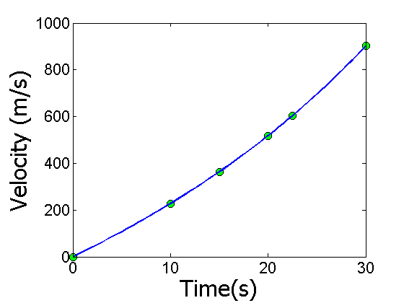










Final Solution
$$v(t)=22.704t,$$
$$0≤t≤10$$
$$10≤t≤15$$
$$=0.8888t^{2}+4.928t+88.88,$$
$$15≤t≤20$$
$$=−0.1356t^{2}+35.66t−141.61,$$
$$=1.6048t^{2}−33.956t+554.55,$$
$$20≤t≤22.5$$
$$=0.20889t^{2}+28.86t−152.13,$$
$$22.5≤t≤30$$

Slide 32











Velocity at a Particular Point
a) Velocity at t=16
$$v(t)=22.704t,$$
$$0≤t≤10$$
$$10≤t≤15$$
$$=0.8888t^{2}+4.928t+88.88,$$
$$15≤t≤20$$
$$=−0.1356t^{2}+35.66t−141.61,$$
$$=1.6048t^{2}−33.956t+554.55,$$
$$20≤t≤22.5$$
$$=0.20889t^{2}+28.86t−152.13,$$
$$22.5≤t≤30$$
$$v\left(16\right)=−0.1356{\left(16\right)}^{2}+35.66\left(16\right)−141.61 \\ =394.24\text{m}\text{/}\text{s}$$

Slide 33







Acceleration from Velocity Profile
b) Acceleration at t=16
$$v(t)=22.704t,$$
$$0≤t≤10$$
$$=0.8888t^{2}+4.928t+88.88,$$
$$10≤t≤15$$
$$=−0.1356t^{2}+35.66t−141.61,$$
$$15≤t≤20$$
$$=1.6048t^{2}−33.956t+554.55,$$
$$20≤t≤22.5$$
$$=0.20889t^{2}+28.86t−152.13,$$
$$22.5≤t≤30$$
$$a(16)=\frac{d}{dt}{\left.v(t)\right|}_{t=16}$$

Slide 34






Acceleration from Velocity Profile
The quadratic spline valid at t=16 is given by
,
$$15≤t≤20$$
$$v\left(t\right)=−0.1356t^{2}+35.66t−141.61,$$
$$a(t)=\frac{d}{dt}(−0.1356t^{2}+35.66t−141.61)$$
$$=−0.2712t+35.66,$$
$$15≤t≤20$$
$$a(16)=−0.2712(16)+35.66$$
$$=31.321\text{m}\text{/}{\text{s}}^{2}$$

Slide 35







Distance from Velocity Profile
c) Find the distance covered by the rocket from t=11s to t=16s.
$$v(t)=22.704t,$$
$$0≤t≤10$$
$$=0.8888t^{2}+4.928t+88.88,$$
$$10≤t≤15$$
$$15≤t≤20$$
$$=−0.1356t^{2}+35.66t−141.61,$$
$$=1.6048t^{2}−33.956t+554.55,$$
$$20≤t≤22.5$$
$$=0.20889t^{2}+28.86t−152.13,$$
$$22.5≤t≤30$$
$$S\left(16\right)−S\left(11\right)=\int_{11}^{16}{v(t)dt}$$
Notes:
35

Slide 36







Distance from Velocity Profile
$$10≤t≤15$$
$$v\left(t\right)=0.8888t^{2}+4.928t+88.88,$$
$$15≤t≤20$$
$$=−0.1356t^{2}+35.66t−141.61,$$
$$S\left(16\right)−S\left(11\right)=\int_{11}^{16}{v(t)dt=\int_{11}^{15}{v(t)dt+\int_{15}^{16}{v(t)dt}}}$$
$$=\int_{11}^{15}{(0.8888t^{2}+4.928t+88.88)dt} \\ +\int_{15}^{16}{(−0.1356t^{2}+35.66t−141.61)dt}$$
$$=1595.9m$$

Slide 37
END
http://numericalmethods.eng.usf.edu

Slide 38
Find a Smooth Shortest Path for a Robot
http://numericalmethods.eng.usf.edu

Slide 39

Points for Robot Path
x | y
2.00 | 7.2
4.5 | 7.1
5.25 | 6.0
7.81 | 5.0
9.20 | 3.5
10.60 | 5.0
$$x$$
$$y$$
Find the shortest but smooth path through consecutive data points

Slide 40

Polynomial Interpolant Path

Slide 41

Spline Interpolant Path

Slide 42

Compare Spline & Polynomial Interpolant Path
Length of path
Polynomial Interpolant=14.9
Spline Interpolant =12.9

