Slide 1
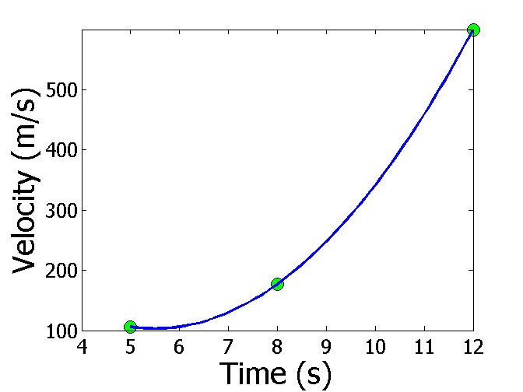
Interpolation - Introduction
Reading Between the Lines

Slide 2
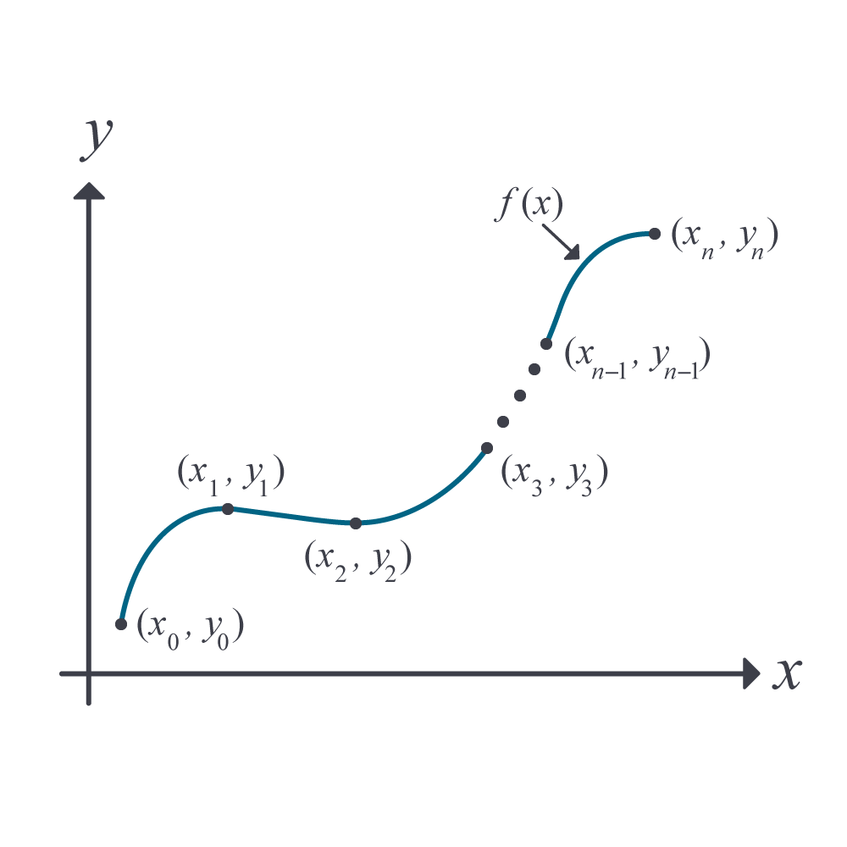
What is Interpolation ?
Given (x₀,y₀), (x₁,y₁), …… (x_{n},y_{n}), find the value of ‘y’ at a value of ‘x’ that is not given.
Figure Interpolation of discrete data.

Slide 3
APPLIED PROBLEMS

Slide 4

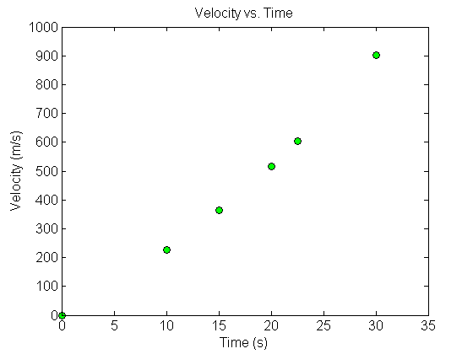
Fly Rocket Fly, Fly Rocket Fly
The upward velocity of a rocket is given as a function of time in table below. Find the velocity and acceleration at t=16 seconds.
Table Velocity as a function of time.
0 | 0
10 | 227.04
15 | 362.78
20 | 517.35
22.5 | 602.97
30 | 901.67
$$t, \left(s\right)$$
$$v\left(t\right)\text{, }\left(\text{m}\text{/}\text{s}\right)$$
Velocity vs. time data for the rocket example

Slide 5
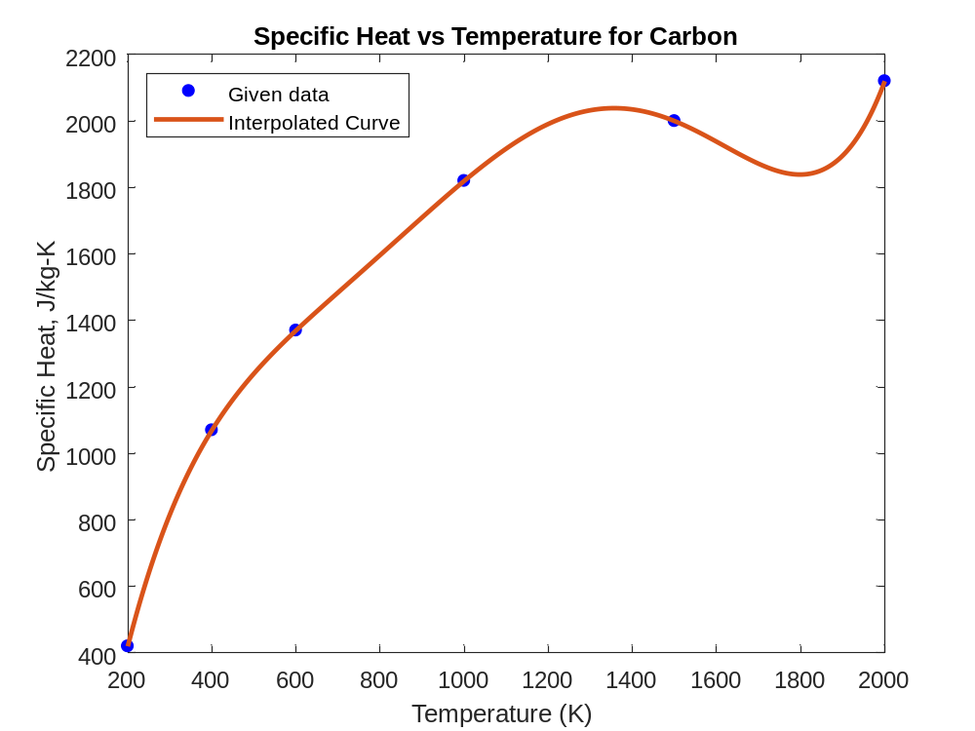
Specific Heat of Carbon
A carbon block of mass 2kg is heated up from room temperature of 400K to 1500K. How much heat is required to do so?
Temperature (K) | Specific Heat (J/kg-K)
200 | 420
400 | 1070
600 | 1370
1000 | 1820
1500 | 2000
2000 | 2120

Slide 6

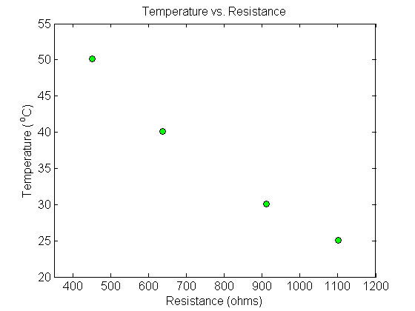
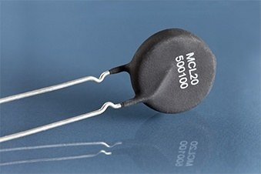
Thermistor Calibration
Thermistors are based on change in resistance of a material with temperature. A manufacturer of thermistors makes the following observations on a thermistor. Determine the calibration curve for thermistor.
R (Ω) | T(°C)
1101.0 911.3 636.0 451.1 | 25.113 30.131 40.120 50.128

Slide 7
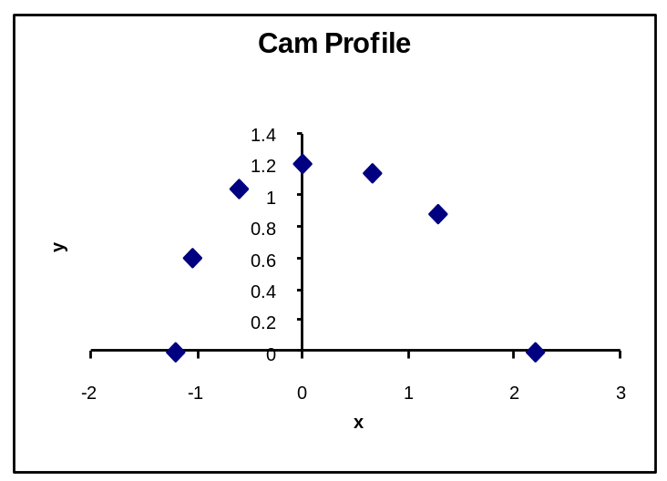
Follow the Cam
A curve needs to be fit through the given points to fabricate the cam.
4
3
5
2
6
Point | x (in.) | y (in.)
1 | 2.20 | 0.00
2 | 1.28 | 0.88
3 | 0.66 | 1.14
4 | 0.00 | 1.20
5 | –0.60 | 1.04
6 | –1.04 | 0.60
7 | –1.20 | 0.00
Y
1
7
X

Slide 8
END

Slide 9
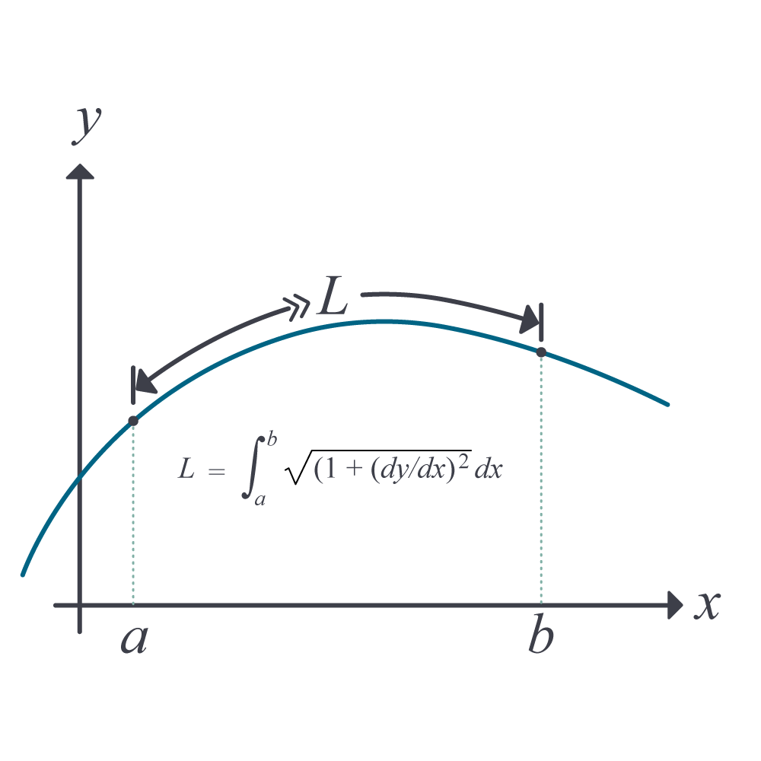
Length of a Path

Slide 11
END

Slide 12
Spline Method of Interpolation http://nm.MathForCollege.com

Slide 13
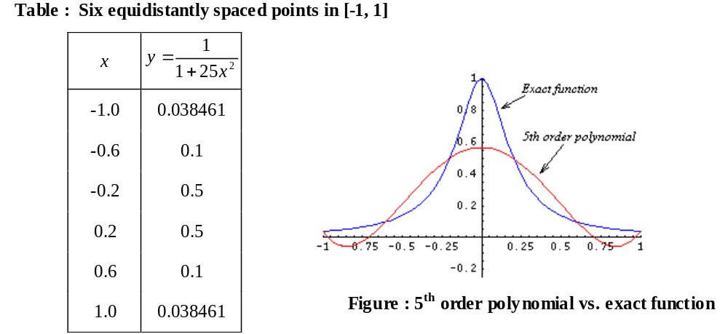
Why Splines ?
$$f(x)=\frac{1}{1+25x^{2}}$$

Slide 14
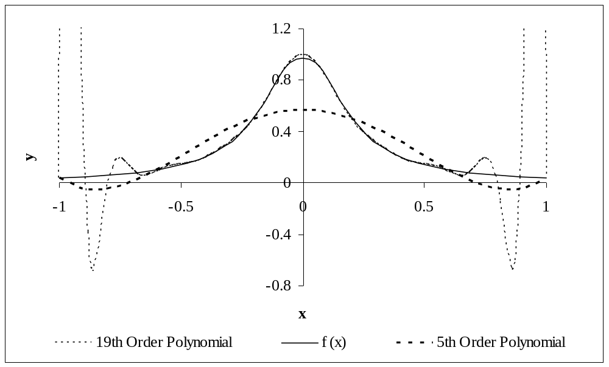
Why Splines ?
Figure : Higher order polynomial interpolation is a bad idea

Slide 15
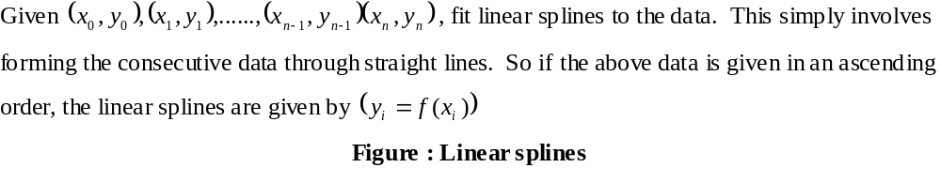
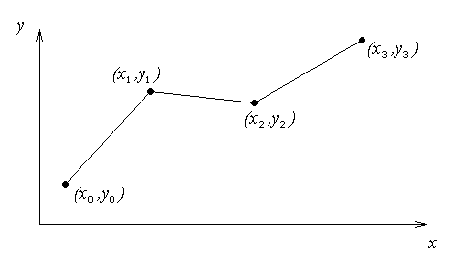
Linear Spline Interpolation

Slide 16
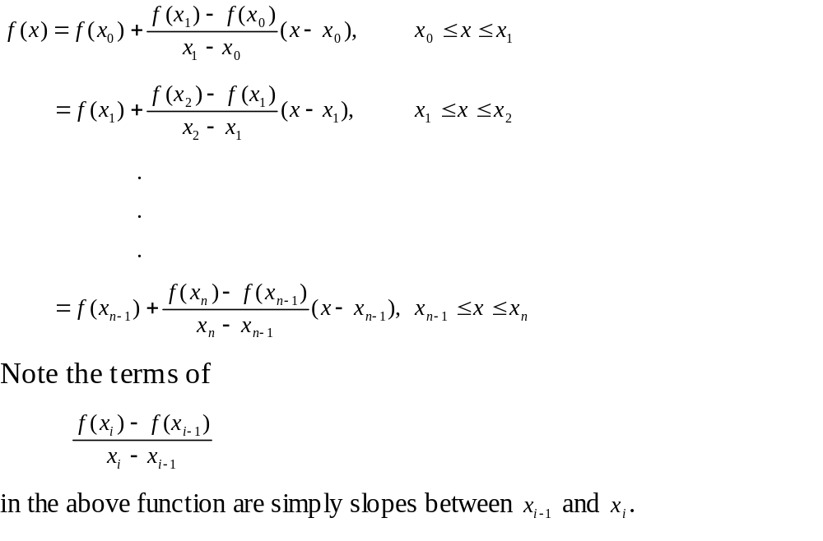
Linear Spline Interpolation (contd)

Slide 17
Example
The upward velocity of a rocket is given as a function of time in Table 1. Find the velocity at t=16 seconds using linear splines.
Table Velocity as a
function of time
(s) | (m/s)
0 | 0
10 | 227.04
15 | 362.78
20 | 517.35
22.5 | 602.97
30 | 901.67
$$t$$
$$v(t)$$
Figure. Velocity vs. time data
for the rocket example

Slide 18
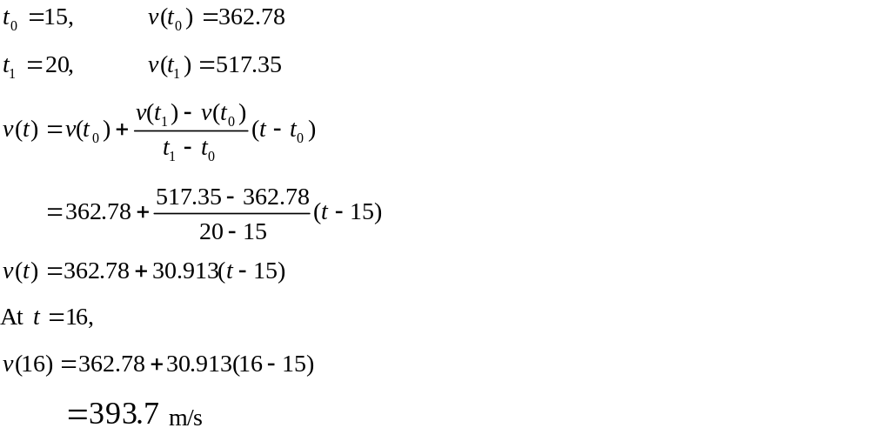
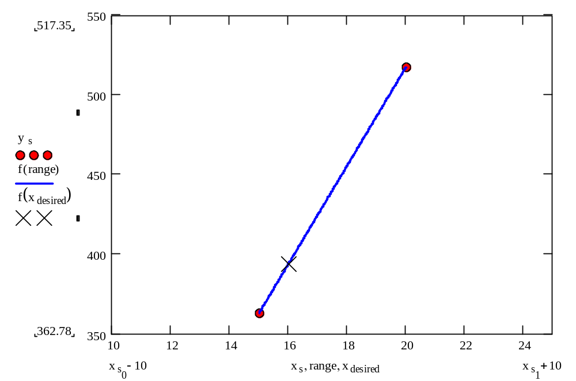
Linear Spline Interpolation

Slide 19
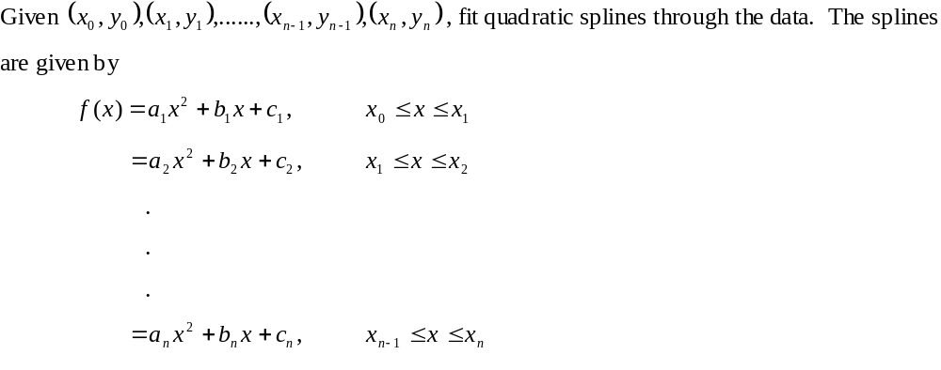
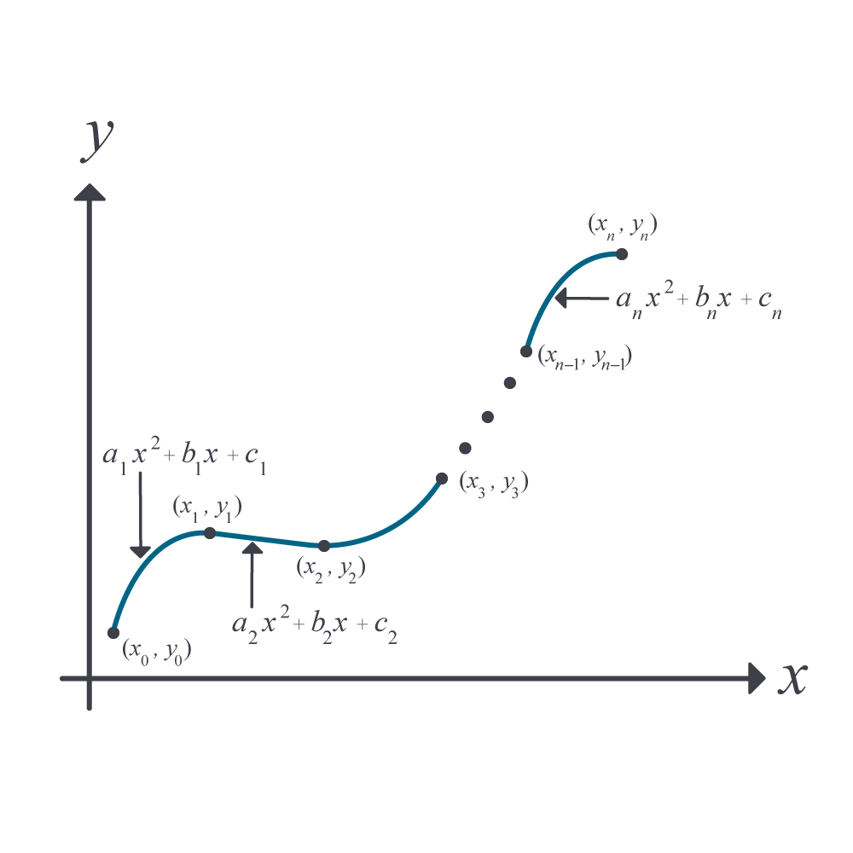
Quadratic Spline Interpolation

Slide 20
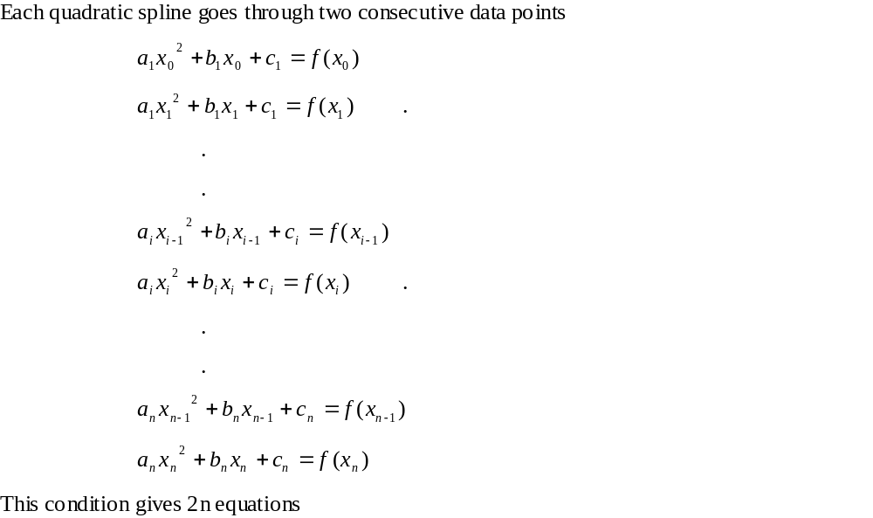
Quadratic Spline Interpolation (contd)

Slide 21
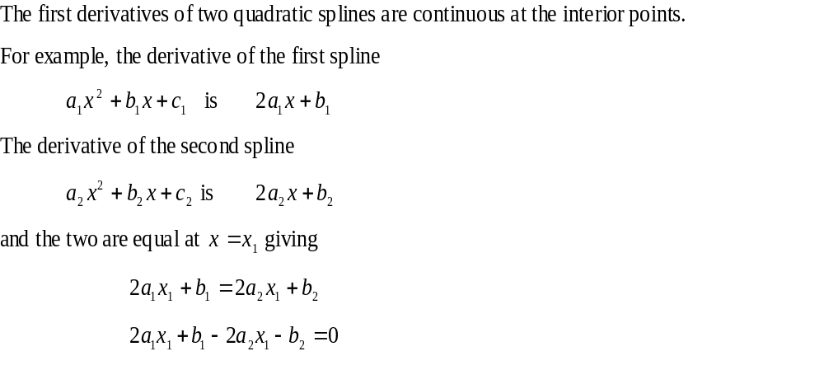
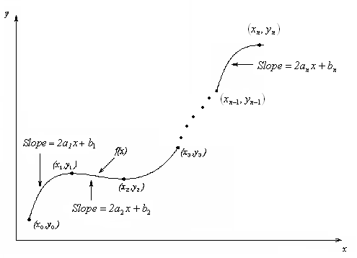
Quadratic Spline Interpolation (contd)

Slide 22
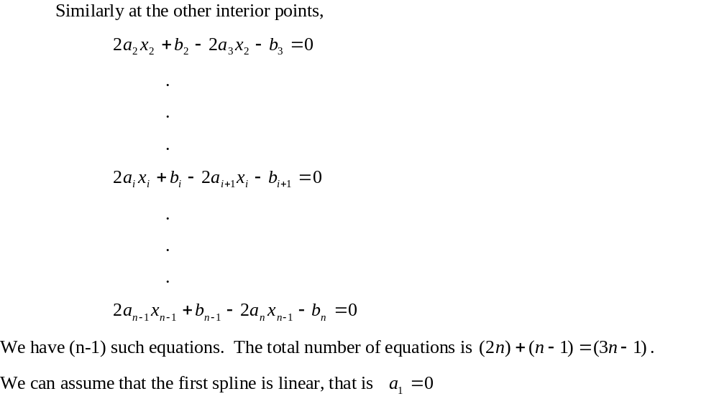
Quadratic Spline Interpolation (contd)

Slide 23
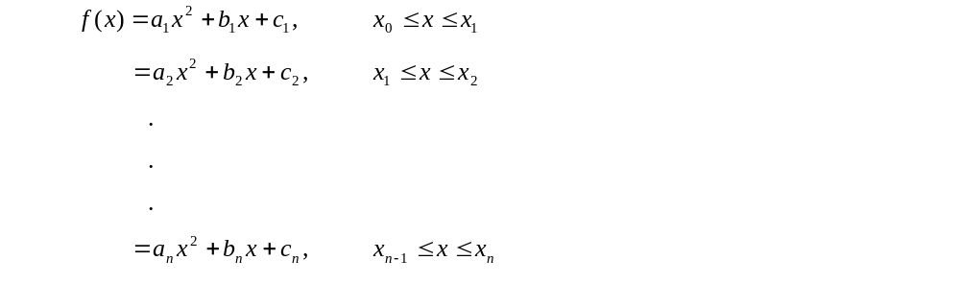
Quadratic Spline Interpolation (contd)

Slide 24
Quadratic Spline Example
The upward velocity of a rocket is given as a function of time. Using quadratic splines
Find the velocity at t=16 seconds
Find the acceleration at t=16 seconds
Find the distance covered between t=11 and t=16 seconds
t | v(t)
s | m/s
0 | 0
10 | 227.04
15 | 362.78
20 | 517.35
22.5 | 602.97
30 | 901.67

Slide 25
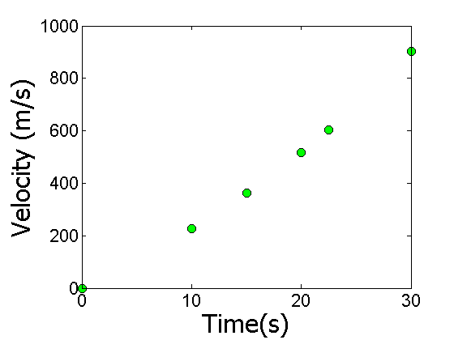
Data and Plot
t | v(t)
s | m/s
0 | 0
10 | 227.04
15 | 362.78
20 | 517.35
22.5 | 602.97
30 | 901.67
Notes:
25

Slide 26
Solution
$$0≤t≤10$$
$$v(t)=a_{1}t^{2}+b_{1}t+c_{1},$$
$$=a_{2}t^{2}+b_{2}t+c_{2},$$
$$10≤t≤15$$
$$15≤t≤20$$
$$=a_{3}t^{2}+b_{3}t+c_{3},$$
$$20≤t≤22.5$$
$$=a_{4}t^{2}+b_{4}t+c_{4},$$
$$=a_{5}t^{2}+b_{5}t+c_{5},$$
$$22.5≤t≤30$$
Let us set up the equations

Slide 27
Each Spline Goes Through Two Consecutive Data Points
$$0≤t≤10$$
$$v(t)=a_{1}t^{2}+b_{1}t+c_{1},$$
$$a_{1}(0)^{2}+b_{1}(0)+c_{1}=0$$
$$a_{1}(10)^{2}+b_{1}(10)+c_{1}=227.04$$

Slide 28
Each Spline Goes Through Two Consecutive Data Points
t | v(t)
s | m/s
0 | 0
10 | 227.04
15 | 362.78
20 | 517.35
22.5 | 602.97
30 | 901.67
$$a_{2}(10)^{2}+b_{2}(10)+c_{2}=227.04$$
$$a_{2}(15)^{2}+b_{2}(15)+c_{2}=362.78$$
$$a_{3}(15)^{2}+b_{3}(15)+c_{3}=362.78$$
$$a_{3}(20)^{2}+b_{3}(20)+c_{3}=517.35$$
$$a_{4}(20)^{2}+b_{4}(20)+c_{4}=517.35$$
$$a_{4}(22.5)^{2}+b_{4}(22.5)+c_{4}=602.97$$
$$a_{5}(22.5)^{2}+b_{5}(22.5)+c_{5}=602.97$$
$$a_{5}(30)^{2}+b_{5}(30)+c_{5}=901.67$$

Slide 29
Derivatives are Continuous at Interior Data Points
$$v(t)=a_{1}t^{2}+b_{1}t+c_{1},$$
$$0≤t≤10$$
$$10≤t≤15$$
$$=a_{2}t^{2}+b_{2}t+c_{2},$$
$${\left.\frac{d}{dt}\left(a_{1}t^{2}+b_{1}t+c_{1}\right)\right|}_{t=10}={\left.\frac{d}{dt}\left(a_{2}t^{2}+b_{2}t+c_{2}\right)\right|}_{t=10}$$
$${\left.\left(2a_{1}t+b_{1}\right)\right|}_{t=10}={\left.\left(2a_{2}t+b_{2}\right)\right|}_{t=10}$$
$$2a_{1}\left(10\right)+b_{1}=2a_{2}\left(10\right)+b_{2}$$
$$20a_{1}+b_{1}−20a_{2}−b_{2}=0$$

Slide 30
Derivatives are continuous at Interior Data Points
At t=10
$$2a_{1}(10)+b_{1}−2a_{2}(10)−b_{2}=0$$
At t=15
$$2a_{2}(15)+b_{2}−2a_{3}(15)−b_{3}=0$$
At t=20
$$2a_{3}(20)+b_{3}−2a_{4}(20)−b_{4}=0$$
At t=22.5
$$2a_{4}(22.5)+b_{4}−2a_{5}(22.5)−b_{5}=0$$

Slide 31
Last Equation
$$a_{1}=0$$

Slide 32
Final Set of Equations
$$\left[\begin{matrix}0 & 0 & 1 & 0 & 0 & 0 & 0 & 0 & 0 & 0 & 0 & 0 & 0 & 0 & 0 \\ 100 & 10 & 1 & 0 & 0 & 0 & 0 & 0 & 0 & 0 & 0 & 0 & 0 & 0 & 0 \\ 0 & 0 & 0 & 100 & 10 & 1 & 0 & 0 & 0 & 0 & 0 & 0 & 0 & 0 & 0 \\ 0 & 0 & 0 & 225 & 15 & 1 & 0 & 0 & 0 & 0 & 0 & 0 & 0 & 0 & 0 \\ 0 & 0 & 0 & 0 & 0 & 0 & 225 & 15 & 1 & 0 & 0 & 0 & 0 & 0 & 0 \\ 0 & 0 & 0 & 0 & 0 & 0 & 400 & 20 & 1 & 0 & 0 & 0 & 0 & 0 & 0 \\ 0 & 0 & 0 & 0 & 0 & 0 & 0 & 0 & 0 & 400 & 20 & 1 & 0 & 0 & 0 \\ 0 & 0 & 0 & 0 & 0 & 0 & 0 & 0 & 0 & 506.25 & 22.5 & 1 & 0 & 0 & 0 \\ 0 & 0 & 0 & 0 & 0 & 0 & 0 & 0 & 0 & 0 & 0 & 0 & 506.25 & 22.5 & 1 \\ 0 & 0 & 0 & 0 & 0 & 0 & 0 & 0 & 0 & 0 & 0 & 0 & 900 & 30 & 1 \\ 20 & 1 & 0 & −20 & −1 & 0 & 0 & 0 & 0 & 0 & 0 & 0 & 0 & 0 & 0 \\ 0 & 0 & 0 & 30 & 1 & 0 & −30 & −1 & 0 & 0 & 0 & 0 & 0 & 0 & 0 \\ 0 & 0 & 0 & 0 & 0 & 0 & 40 & 1 & 0 & −40 & −1 & 0 & 0 & 0 & 0 \\ 0 & 0 & 0 & 0 & 0 & 0 & 0 & 0 & 0 & 45 & 1 & 0 & −45 & −1 & 0 \\ 1 & 0 & 0 & 0 & 0 & 0 & 0 & 0 & 0 & 0 & 0 & 0 & 0 & 0 & 0\end{matrix}\right]\left[\begin{matrix}a_{1} \\ b_{1} \\ c_{1} \\ a_{2} \\ b_{2} \\ c_{2} \\ a_{3} \\ b_{3} \\ c_{3} \\ a_{4} \\ b_{4} \\ c_{4} \\ a_{5} \\ b_{5} \\ c_{5}\end{matrix}\right]=\left[\begin{matrix}0 \\ 227.04 \\ 227.04 \\ 362.78 \\ 362.78 \\ 517.35 \\ 517.35 \\ 602.97 \\ 602.97 \\ 901.67 \\ 0 \\ 0 \\ 0 \\ 0 \\ 0\end{matrix}\right]$$

Slide 33
Coefficients of Spline
$$a_{i}$$
$$b_{i}$$
$$c_{i}$$
i | a_{i} | b_{i} | c_{i}
1 | 0 | 22.704 | 0
2 | 0.8888 | 4.928 | 88.88
3 | -0.1356 | 35.66 | -141.61
4 | 1.6048 | -33.956 | 554.55
5 | 0.20889 | 28.86 | -152.13

Slide 34
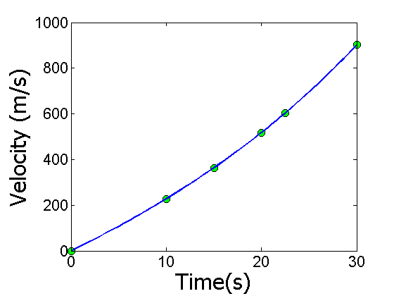
Final Solution
$$v(t)=22.704t,$$
$$0≤t≤10$$
$$10≤t≤15$$
$$=0.8888t^{2}+4.928t+88.88,$$
$$15≤t≤20$$
$$=−0.1356t^{2}+35.66t−141.61,$$
$$=1.6048t^{2}−33.956t+554.55,$$
$$20≤t≤22.5$$
$$=0.20889t^{2}+28.86t−152.13,$$
$$22.5≤t≤30$$

Slide 35
Velocity at a Particular Point
a) Velocity at t=16
$$v(t)=22.704t,$$
$$0≤t≤10$$
$$10≤t≤15$$
$$=0.8888t^{2}+4.928t+88.88,$$
$$15≤t≤20$$
$$=−0.1356t^{2}+35.66t−141.61,$$
$$=1.6048t^{2}−33.956t+554.55,$$
$$20≤t≤22.5$$
$$=0.20889t^{2}+28.86t−152.13,$$
$$22.5≤t≤30$$
$$v\left(16\right)=−0.1356{\left(16\right)}^{2}+35.66\left(16\right)−141.61 \\ =394.24\text{m}\text{/}\text{s}$$

Slide 36
Acceleration from Velocity Profile
b) Acceleration at t=16
$$v(t)=22.704t,$$
$$0≤t≤10$$
$$=0.8888t^{2}+4.928t+88.88,$$
$$10≤t≤15$$
$$=−0.1356t^{2}+35.66t−141.61,$$
$$15≤t≤20$$
$$=1.6048t^{2}−33.956t+554.55,$$
$$20≤t≤22.5$$
$$=0.20889t^{2}+28.86t−152.13,$$
$$22.5≤t≤30$$
$$a(16)=\frac{d}{dt}{\left.v(t)\right|}_{t=16}$$

Slide 37
Acceleration from Velocity Profile
The quadratic spline valid at t=16 is given by
,
$$15≤t≤20$$
$$v\left(t\right)=−0.1356t^{2}+35.66t−141.61,$$
$$a(t)=\frac{d}{dt}(−0.1356t^{2}+35.66t−141.61)$$
$$=−0.2712t+35.66,$$
$$15≤t≤20$$
$$a(16)=−0.2712(16)+35.66$$
$$=31.321\text{m}\text{/}{\text{s}}^{2}$$

Slide 38
Distance from Velocity Profile
c) Find the distance covered by the rocket from t=11s to t=16s.
$$v(t)=22.704t,$$
$$0≤t≤10$$
$$=0.8888t^{2}+4.928t+88.88,$$
$$10≤t≤15$$
$$15≤t≤20$$
$$=−0.1356t^{2}+35.66t−141.61,$$
$$=1.6048t^{2}−33.956t+554.55,$$
$$20≤t≤22.5$$
$$=0.20889t^{2}+28.86t−152.13,$$
$$22.5≤t≤30$$
$$S\left(16\right)−S\left(11\right)=\int_{11}^{16}{v(t)dt}$$
Notes:
38

Slide 39

Distance from Velocity Profile
$$10≤t≤15$$
$$v\left(t\right)=0.8888t^{2}+4.928t+88.88,$$
$$15≤t≤20$$
$$=−0.1356t^{2}+35.66t−141.61,$$
$$S\left(16\right)−S\left(11\right)=\int_{11}^{16}{v(t)dt=\int_{11}^{15}{v(t)dt+\int_{15}^{16}{v(t)dt}}}$$
$$=\int_{11}^{15}{(0.8888t^{2}+4.928t+88.88)dt} \\ +\int_{15}^{16}{(−0.1356t^{2}+35.66t−141.61)dt}$$
$$=1595.9m$$

Slide 40
END
http://nm.MathForCollege.com

Slide 41
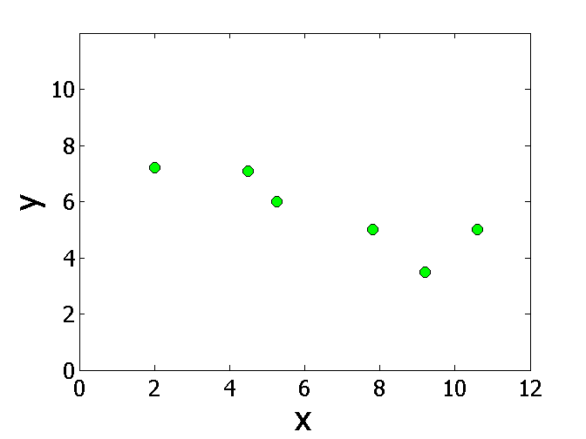
Points for Robot Path
x | y
2.00 | 7.2
4.5 | 7.1
5.25 | 6.0
7.81 | 5.0
9.20 | 3.5
10.60 | 5.0
$$x$$
$$y$$
Find the shortest but smooth path through consecutive data points

Slide 42
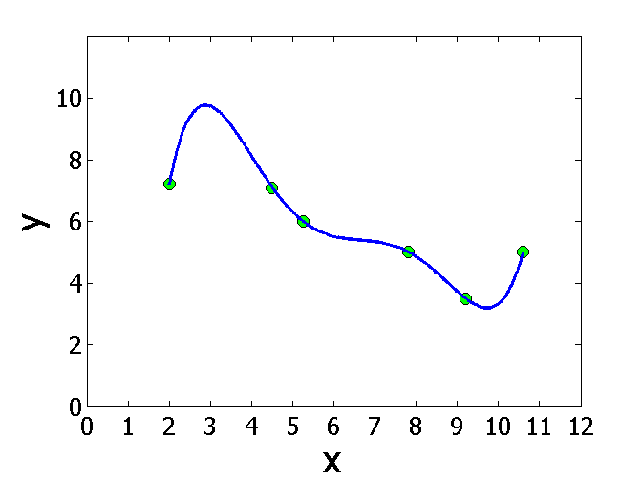
Polynomial Interpolant Path

Slide 43
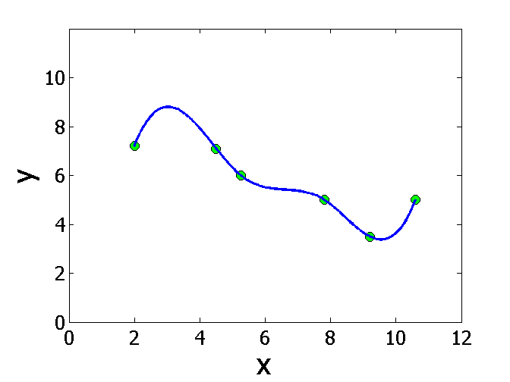
Spline Interpolant Path

Slide 44
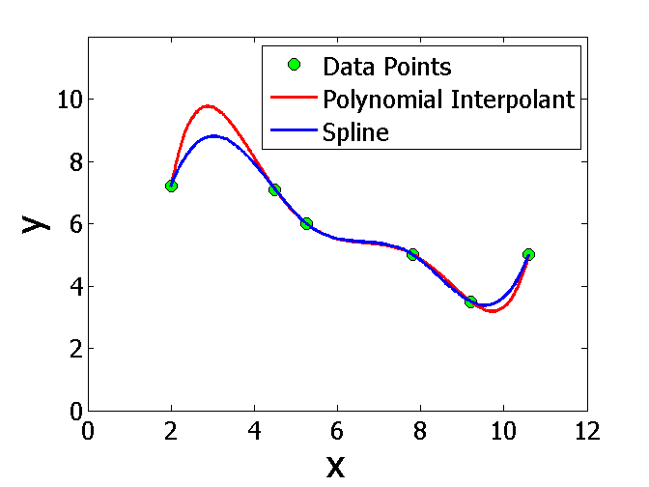
Compare Spline & Polynomial Interpolant Path
Length of path
Polynomial Interpolant=14.9
Spline Interpolant =12.9

Slide 45


