Slide 1
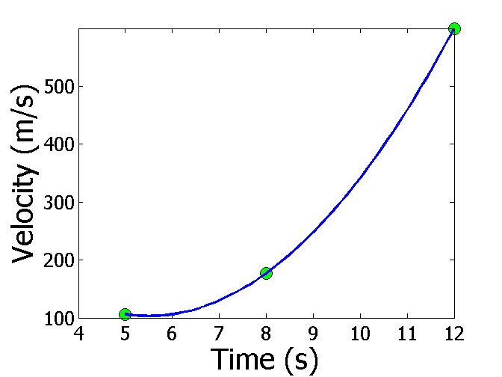
Interpolation
Reading Between the Lines

Slide 2
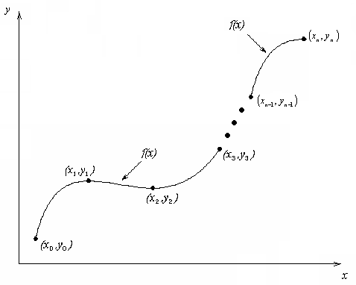
What is Interpolation ?
Given (x₀,y₀), (x₁,y₁), …… (x_{n},y_{n}), find the value of ‘y’ at a value of ‘x’ that is not given.
Figure Interpolation of discrete data.

Slide 3
APPLIED PROBLEMS

Slide 4

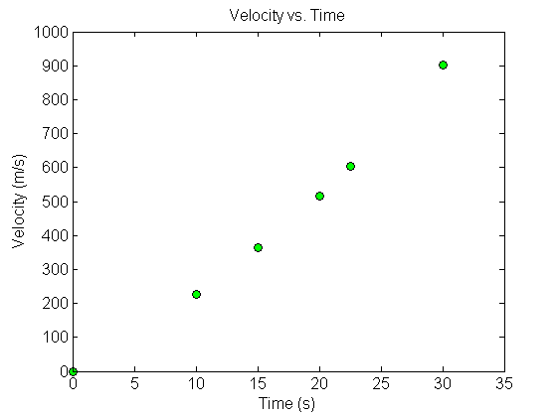


Fly Rocket Fly, Fly Rocket Fly
The upward velocity of a rocket is given as a function of time in table below. Find the velocity and acceleration at t=16 seconds.
Table Velocity as a function of time.
0 | 0
10 | 227.04
15 | 362.78
20 | 517.35
22.5 | 602.97
30 | 901.67
$$t, \left(s\right)$$
$$v\left(t\right)\text{, }\left(\text{m}\text{/}\text{s}\right)$$
Velocity vs. time data for the rocket example

Slide 5

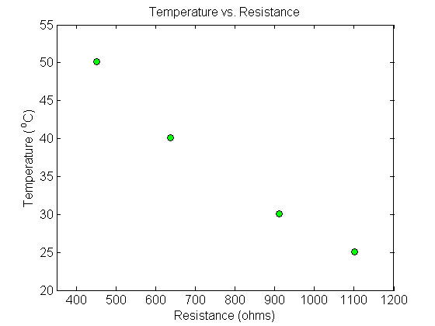
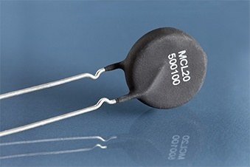
Thermistor Calibration
Thermistors are based on change in resistance of a material with temperature. A manufacturer of thermistors makes the following observations on a thermistor. Determine the calibration curve for thermistor.
R (Ω) | T(°C)
1101.0 911.3 636.0 451.1 | 25.113 30.131 40.120 50.128

Slide 6
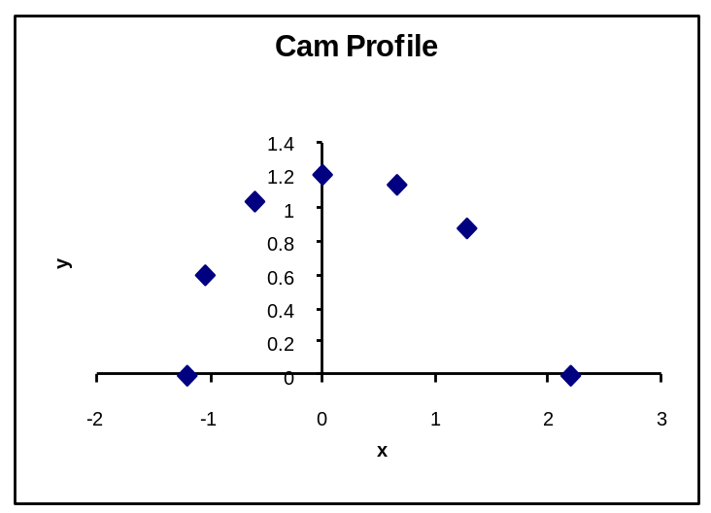
Follow the Cam
A curve needs to be fit through the given points to fabricate the cam.
4
3
5
2
6
Point | x (in.) | y (in.)
1 | 2.20 | 0.00
2 | 1.28 | 0.88
3 | 0.66 | 1.14
4 | 0.00 | 1.20
5 | –0.60 | 1.04
6 | –1.04 | 0.60
7 | –1.20 | 0.00
Y
1
7
X

Slide 7
Spline Method of Interpolation http://nm.MathForCollege.com

Slide 8
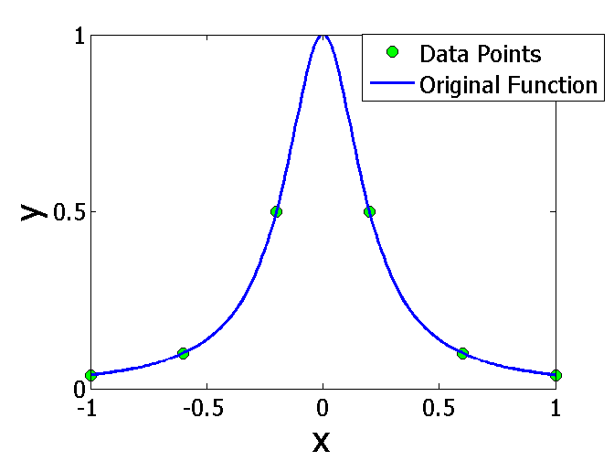
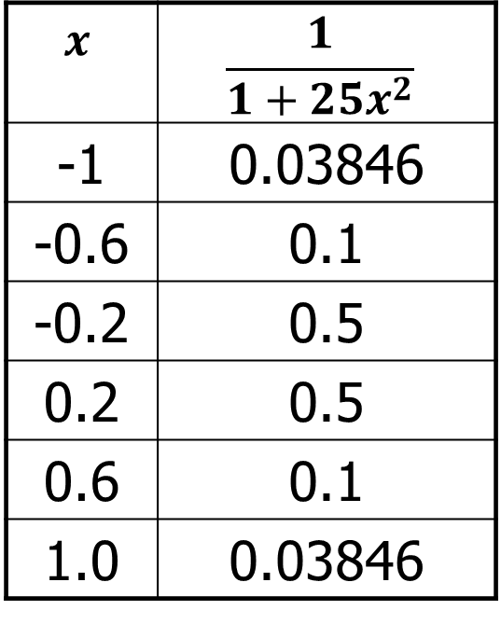
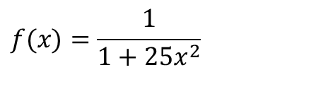
Why Spline Interpolation?
Runge’s Function
$$x$$ | $$\frac{1}{1+25x^{2}}$$
-1 | 0.03846
-0.6 | 0.1
-0.2 | 0.5
0.2 | 0.5
0.6 | 0.1
1.0 | 0.03846
$$f(x)=\frac{1}{1+25x^{2}}$$

Slide 9
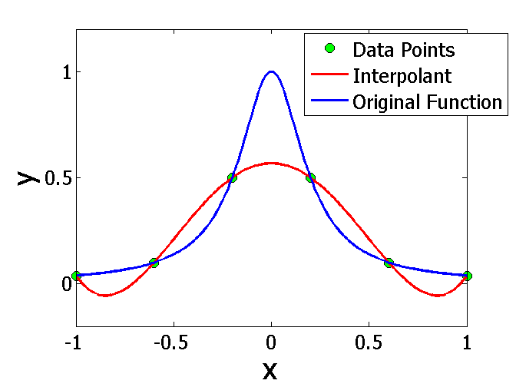
Comparing Function & Interpolant

Slide 10
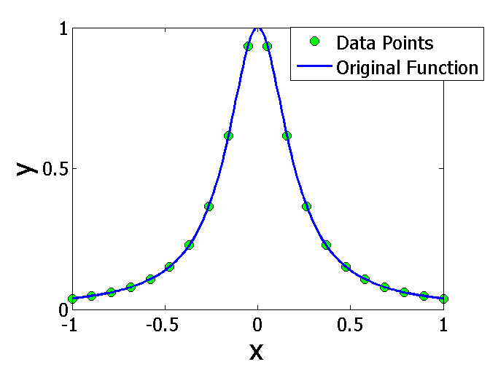
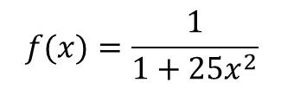
More is Better
$$f(x)=\frac{1}{1+25x^{2}}$$

Slide 11
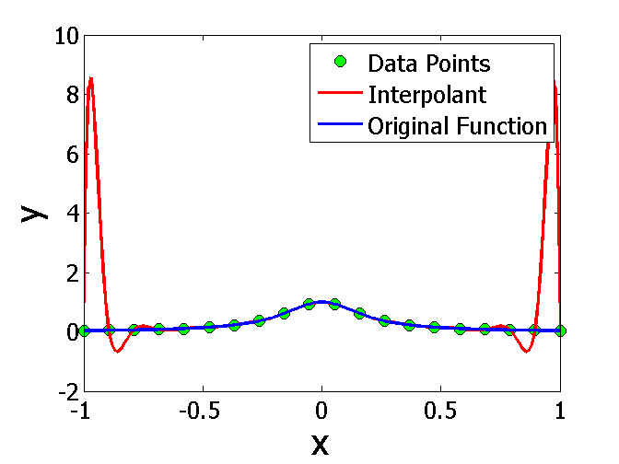
Comparing Function & Interpolant

Slide 12
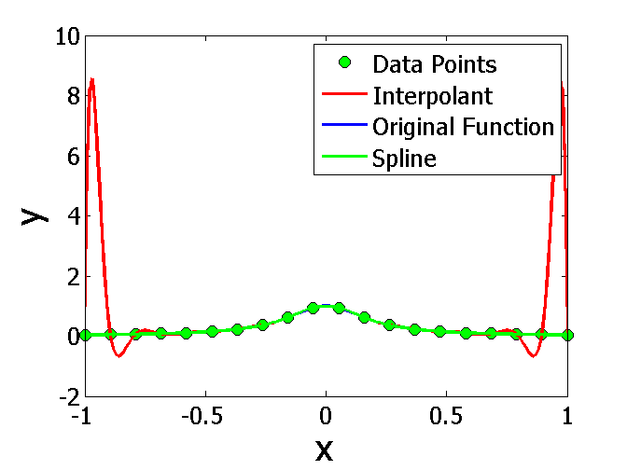
Answer to the Problem is Spline Interpolation

Slide 13
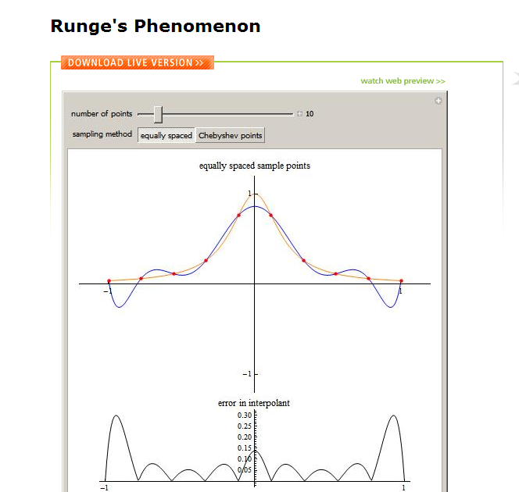
Wolfram Demonstration
A Wolfram Demonstration: http://demonstrations.wolfram.com/RungesPhenomenon/
Author: Chris Maes
With Permission from Wolfram Research

Slide 14
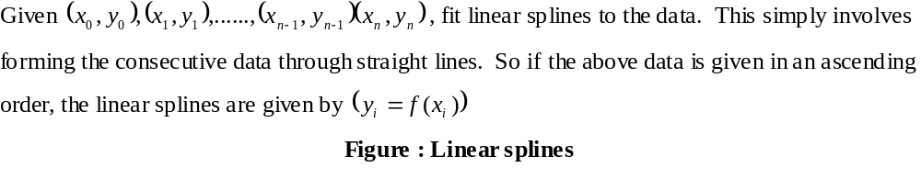
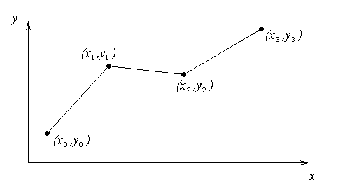
Linear Spline Interpolation

Slide 15
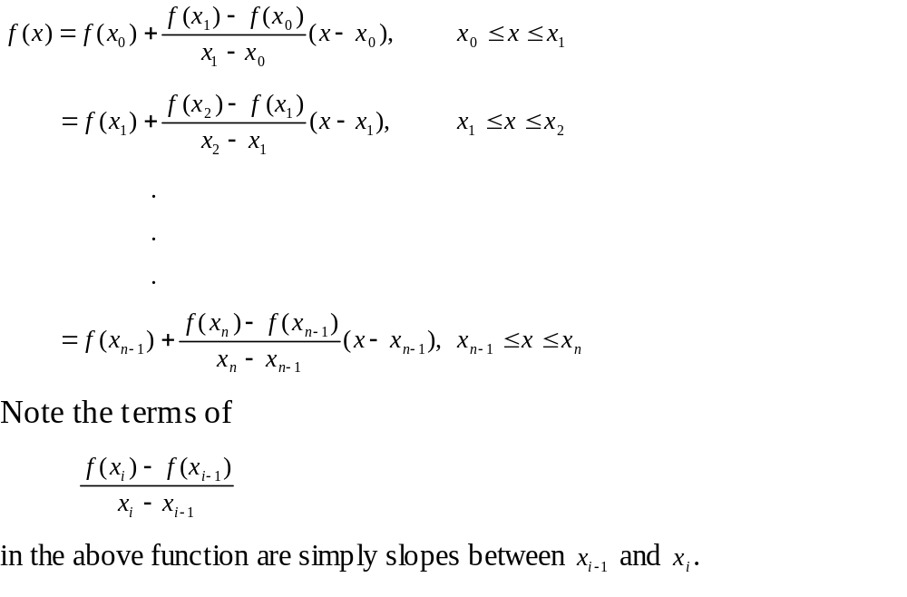

Linear Spline Interpolation (contd)

Slide 16

Example
The upward velocity of a rocket is given as a function of time in Table 1. Find the velocity at t=16 seconds using linear splines.
Table Velocity as a
function of time
(s) | (m/s)
0 | 0
10 | 227.04
15 | 362.78
20 | 517.35
22.5 | 602.97
30 | 901.67
$$t$$
$$v(t)$$
Figure. Velocity vs. time data
for the rocket example

Slide 17
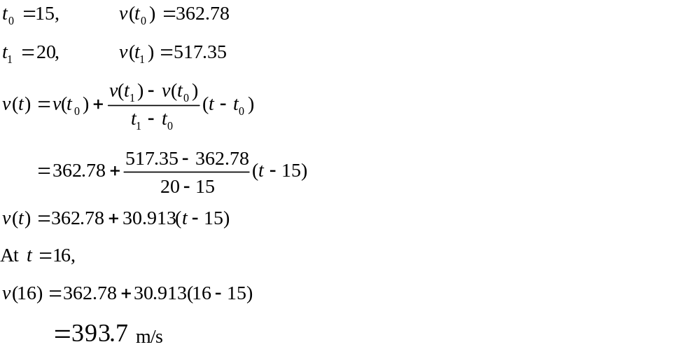
Linear Spline Interpolation

Slide 18
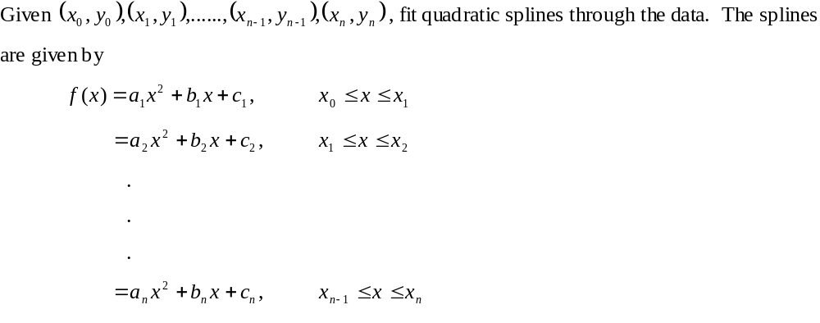
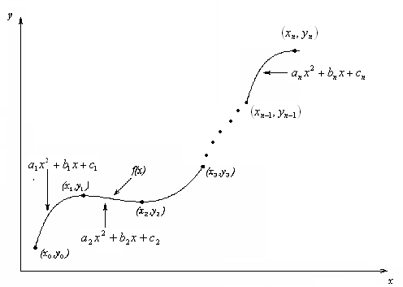
Quadratic Spline Interpolation

Slide 19
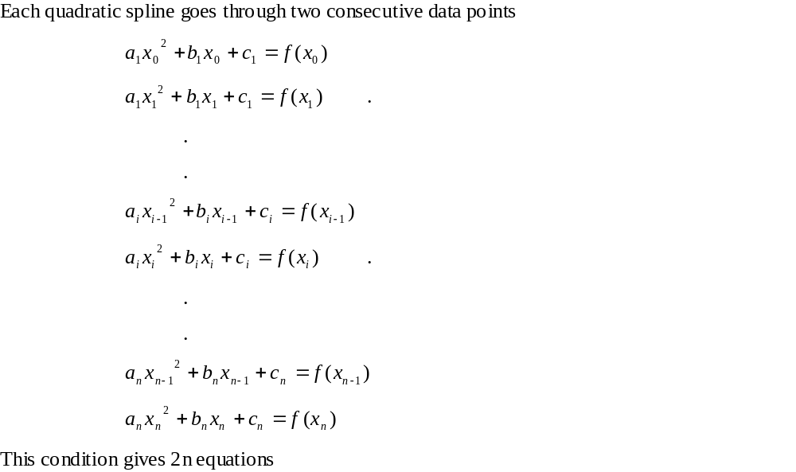
Quadratic Spline Interpolation (contd)

Slide 20
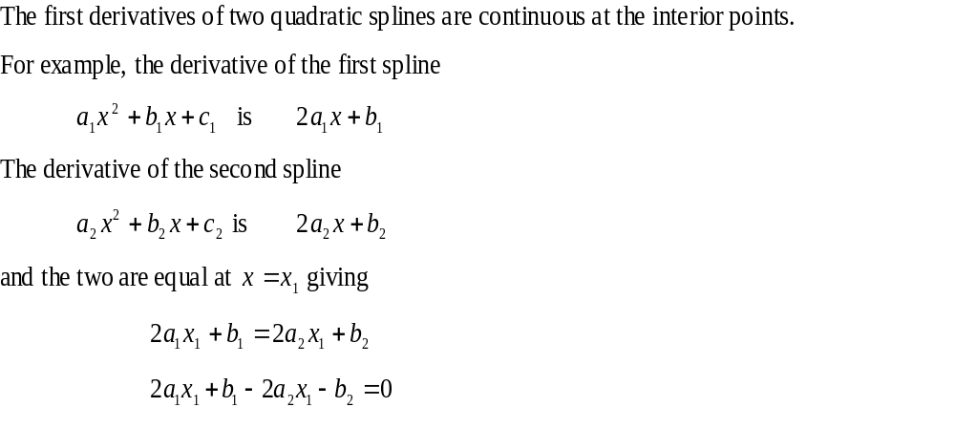
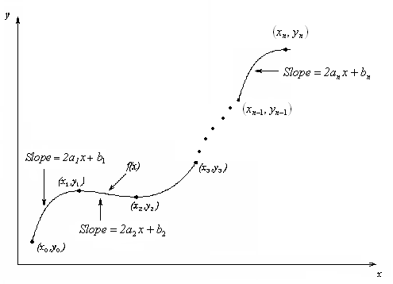
Quadratic Spline Interpolation (contd)

Slide 21
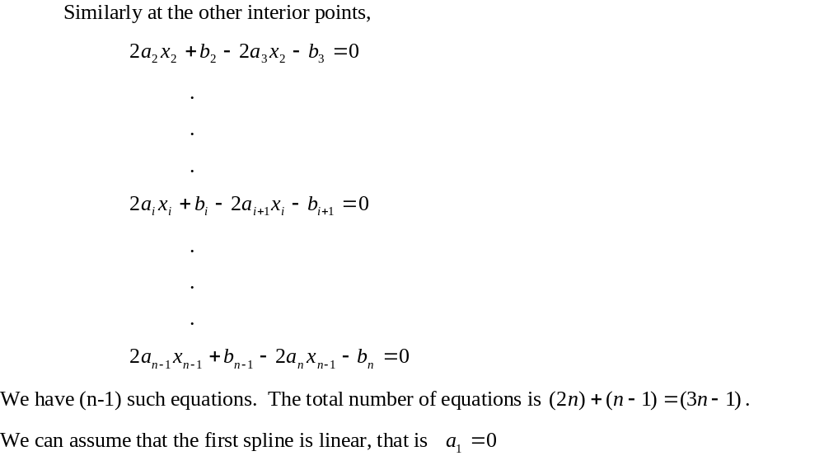
Quadratic Spline Interpolation (contd)

Slide 22
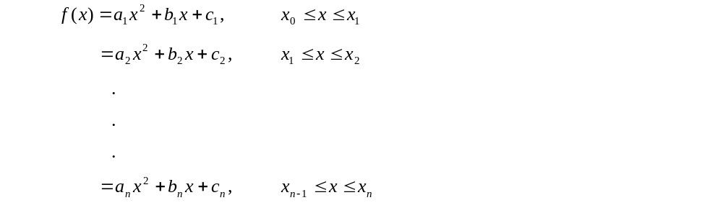
Quadratic Spline Interpolation (contd)

Slide 23
Quadratic Spline Example
The upward velocity of a rocket is given as a function of time. Using quadratic splines
Find the velocity at t=16 seconds
Find the acceleration at t=16 seconds
Find the distance covered between t=11 and t=16 seconds
t | v(t)
s | m/s
0 | 0
10 | 227.04
15 | 362.78
20 | 517.35
22.5 | 602.97
30 | 901.67

Slide 24
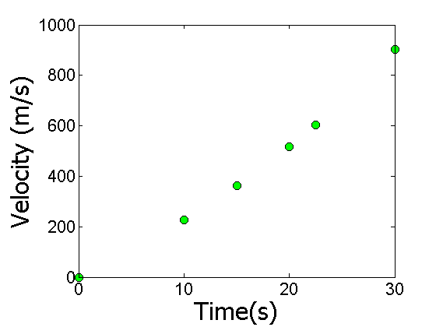
Data and Plot
t | v(t)
s | m/s
0 | 0
10 | 227.04
15 | 362.78
20 | 517.35
22.5 | 602.97
30 | 901.67
Notes:
24

Slide 25
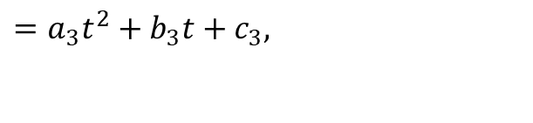


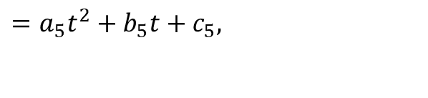
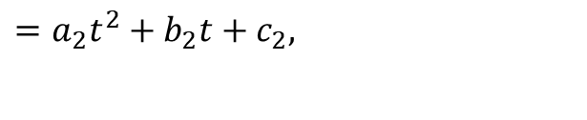


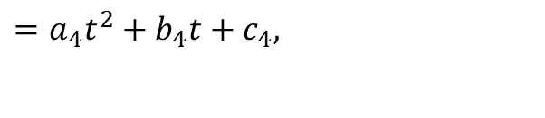
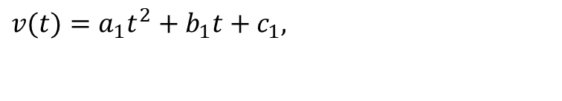

Solution
$$0≤t≤10$$
$$v(t)=a_{1}t^{2}+b_{1}t+c_{1},$$
$$=a_{2}t^{2}+b_{2}t+c_{2},$$
$$10≤t≤15$$
$$15≤t≤20$$
$$=a_{3}t^{2}+b_{3}t+c_{3},$$
$$20≤t≤22.5$$
$$=a_{4}t^{2}+b_{4}t+c_{4},$$
$$=a_{5}t^{2}+b_{5}t+c_{5},$$
$$22.5≤t≤30$$
Let us set up the equations

Slide 26
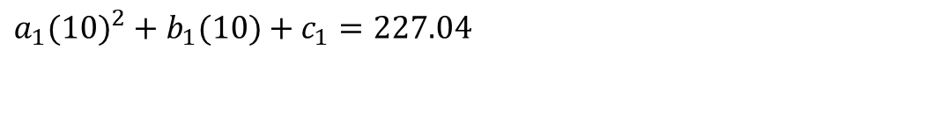
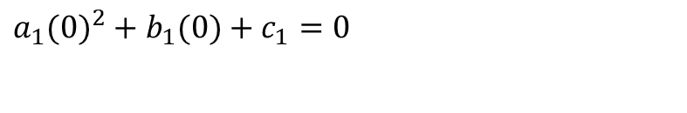

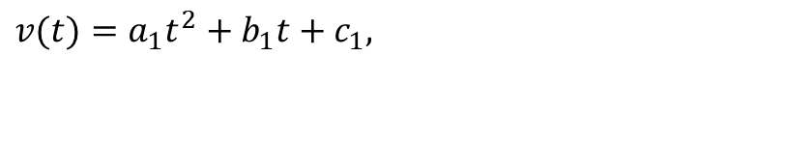
Each Spline Goes Through Two Consecutive Data Points
$$0≤t≤10$$
$$v(t)=a_{1}t^{2}+b_{1}t+c_{1},$$
$$a_{1}(0)^{2}+b_{1}(0)+c_{1}=0$$
$$a_{1}(10)^{2}+b_{1}(10)+c_{1}=227.04$$

Slide 27
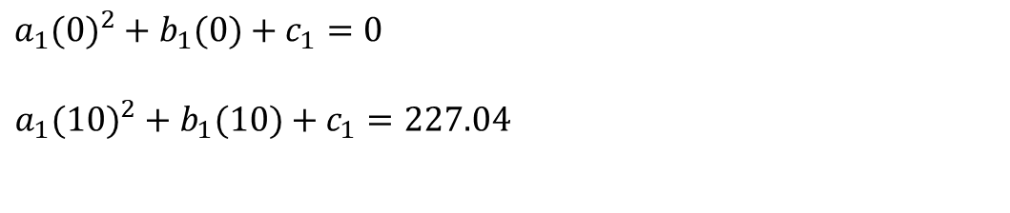
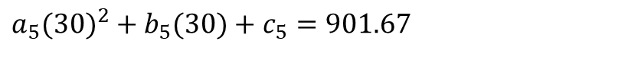
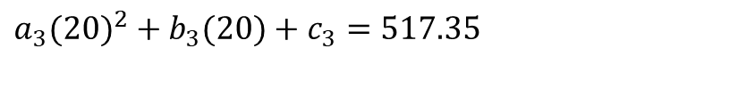
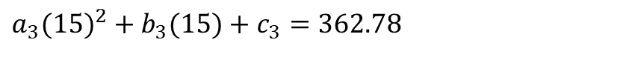
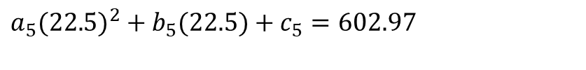
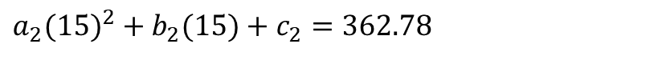

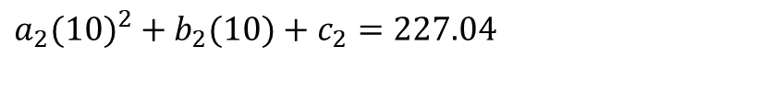

Each Spline Goes Through Two Consecutive Data Points
t | v(t)
s | m/s
0 | 0
10 | 227.04
15 | 362.78
20 | 517.35
22.5 | 602.97
30 | 901.67
$$a_{2}(10)^{2}+b_{2}(10)+c_{2}=227.04$$
$$a_{2}(15)^{2}+b_{2}(15)+c_{2}=362.78$$
$$a_{3}(15)^{2}+b_{3}(15)+c_{3}=362.78$$
$$a_{3}(20)^{2}+b_{3}(20)+c_{3}=517.35$$
$$a_{4}(20)^{2}+b_{4}(20)+c_{4}=517.35$$
$$a_{4}(22.5)^{2}+b_{4}(22.5)+c_{4}=602.97$$
$$a_{5}(22.5)^{2}+b_{5}(22.5)+c_{5}=602.97$$
$$a_{5}(30)^{2}+b_{5}(30)+c_{5}=901.67$$

Slide 28
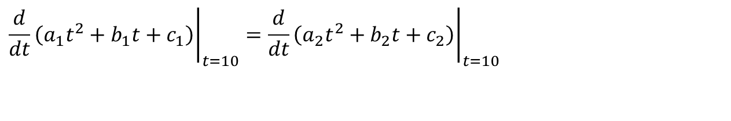

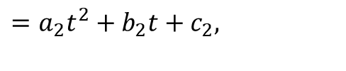
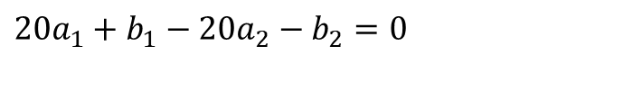

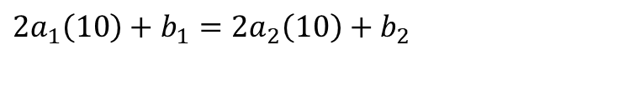
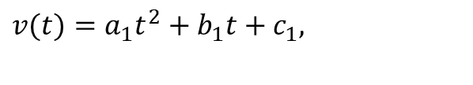
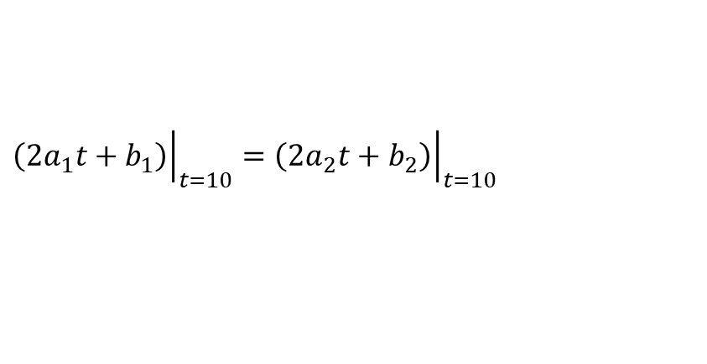
Derivatives are Continuous at Interior Data Points
$$v(t)=a_{1}t^{2}+b_{1}t+c_{1},$$
$$0≤t≤10$$
$$10≤t≤15$$
$$=a_{2}t^{2}+b_{2}t+c_{2},$$
$${\left.\frac{d}{dt}\left(a_{1}t^{2}+b_{1}t+c_{1}\right)\right|}_{t=10}={\left.\frac{d}{dt}\left(a_{2}t^{2}+b_{2}t+c_{2}\right)\right|}_{t=10}$$
$${\left.\left(2a_{1}t+b_{1}\right)\right|}_{t=10}={\left.\left(2a_{2}t+b_{2}\right)\right|}_{t=10}$$
$$2a_{1}\left(10\right)+b_{1}=2a_{2}\left(10\right)+b_{2}$$
$$20a_{1}+b_{1}−20a_{2}−b_{2}=0$$

Slide 29
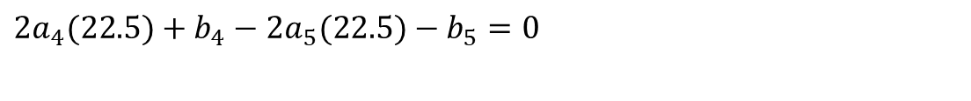
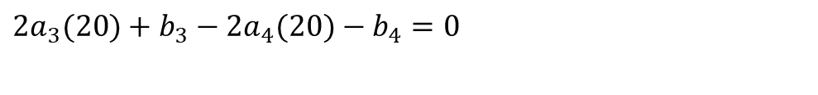


Derivatives are continuous at Interior Data Points
At t=10
$$2a_{1}(10)+b_{1}−2a_{2}(10)−b_{2}=0$$
At t=15
$$2a_{2}(15)+b_{2}−2a_{3}(15)−b_{3}=0$$
At t=20
$$2a_{3}(20)+b_{3}−2a_{4}(20)−b_{4}=0$$
At t=22.5
$$2a_{4}(22.5)+b_{4}−2a_{5}(22.5)−b_{5}=0$$

Slide 30

Last Equation
$$a_{1}=0$$

Slide 31

Final Set of Equations
$$\left[\begin{matrix}0 & 0 & 1 & 0 & 0 & 0 & 0 & 0 & 0 & 0 & 0 & 0 & 0 & 0 & 0 \\ 100 & 10 & 1 & 0 & 0 & 0 & 0 & 0 & 0 & 0 & 0 & 0 & 0 & 0 & 0 \\ 0 & 0 & 0 & 100 & 10 & 1 & 0 & 0 & 0 & 0 & 0 & 0 & 0 & 0 & 0 \\ 0 & 0 & 0 & 225 & 15 & 1 & 0 & 0 & 0 & 0 & 0 & 0 & 0 & 0 & 0 \\ 0 & 0 & 0 & 0 & 0 & 0 & 225 & 15 & 1 & 0 & 0 & 0 & 0 & 0 & 0 \\ 0 & 0 & 0 & 0 & 0 & 0 & 400 & 20 & 1 & 0 & 0 & 0 & 0 & 0 & 0 \\ 0 & 0 & 0 & 0 & 0 & 0 & 0 & 0 & 0 & 400 & 20 & 1 & 0 & 0 & 0 \\ 0 & 0 & 0 & 0 & 0 & 0 & 0 & 0 & 0 & 506.25 & 22.5 & 1 & 0 & 0 & 0 \\ 0 & 0 & 0 & 0 & 0 & 0 & 0 & 0 & 0 & 0 & 0 & 0 & 506.25 & 22.5 & 1 \\ 0 & 0 & 0 & 0 & 0 & 0 & 0 & 0 & 0 & 0 & 0 & 0 & 900 & 30 & 1 \\ 20 & 1 & 0 & −20 & −1 & 0 & 0 & 0 & 0 & 0 & 0 & 0 & 0 & 0 & 0 \\ 0 & 0 & 0 & 30 & 1 & 0 & −30 & −1 & 0 & 0 & 0 & 0 & 0 & 0 & 0 \\ 0 & 0 & 0 & 0 & 0 & 0 & 40 & 1 & 0 & −40 & −1 & 0 & 0 & 0 & 0 \\ 0 & 0 & 0 & 0 & 0 & 0 & 0 & 0 & 0 & 45 & 1 & 0 & −45 & −1 & 0 \\ 1 & 0 & 0 & 0 & 0 & 0 & 0 & 0 & 0 & 0 & 0 & 0 & 0 & 0 & 0\end{matrix}\right]\left[\begin{matrix}a_{1} \\ b_{1} \\ c_{1} \\ a_{2} \\ b_{2} \\ c_{2} \\ a_{3} \\ b_{3} \\ c_{3} \\ a_{4} \\ b_{4} \\ c_{4} \\ a_{5} \\ b_{5} \\ c_{5}\end{matrix}\right]=\left[\begin{matrix}0 \\ 227.04 \\ 227.04 \\ 362.78 \\ 362.78 \\ 517.35 \\ 517.35 \\ 602.97 \\ 602.97 \\ 901.67 \\ 0 \\ 0 \\ 0 \\ 0 \\ 0\end{matrix}\right]$$

Slide 32

Coefficients of Spline
$$a_{i}$$
$$b_{i}$$
$$c_{i}$$
i | a_{i} | b_{i} | c_{i}
1 | 0 | 22.704 | 0
2 | 0.8888 | 4.928 | 88.88
3 | -0.1356 | 35.66 | -141.61
4 | 1.6048 | -33.956 | 554.55
5 | 0.20889 | 28.86 | -152.13

Slide 33











Final Solution
$$v(t)=22.704t,$$
$$0≤t≤10$$
$$10≤t≤15$$
$$=0.8888t^{2}+4.928t+88.88,$$
$$15≤t≤20$$
$$=−0.1356t^{2}+35.66t−141.61,$$
$$=1.6048t^{2}−33.956t+554.55,$$
$$20≤t≤22.5$$
$$=0.20889t^{2}+28.86t−152.13,$$
$$22.5≤t≤30$$

Slide 34











Velocity at a Particular Point
a) Velocity at t=16
$$v(t)=22.704t,$$
$$0≤t≤10$$
$$10≤t≤15$$
$$=0.8888t^{2}+4.928t+88.88,$$
$$15≤t≤20$$
$$=−0.1356t^{2}+35.66t−141.61,$$
$$=1.6048t^{2}−33.956t+554.55,$$
$$20≤t≤22.5$$
$$=0.20889t^{2}+28.86t−152.13,$$
$$22.5≤t≤30$$
$$v\left(16\right)=−0.1356{\left(16\right)}^{2}+35.66\left(16\right)−141.61 \\ =394.24\text{m}\text{/}\text{s}$$

Slide 35







Acceleration from Velocity Profile
b) Acceleration at t=16
$$v(t)=22.704t,$$
$$0≤t≤10$$
$$=0.8888t^{2}+4.928t+88.88,$$
$$10≤t≤15$$
$$=−0.1356t^{2}+35.66t−141.61,$$
$$15≤t≤20$$
$$=1.6048t^{2}−33.956t+554.55,$$
$$20≤t≤22.5$$
$$=0.20889t^{2}+28.86t−152.13,$$
$$22.5≤t≤30$$
$$a(16)=\frac{d}{dt}{\left.v(t)\right|}_{t=16}$$

Slide 36






Acceleration from Velocity Profile
The quadratic spline valid at t=16 is given by
,
$$15≤t≤20$$
$$v\left(t\right)=−0.1356t^{2}+35.66t−141.61,$$
$$a(t)=\frac{d}{dt}(−0.1356t^{2}+35.66t−141.61)$$
$$=−0.2712t+35.66,$$
$$15≤t≤20$$
$$a(16)=−0.2712(16)+35.66$$
$$=31.321\text{m}\text{/}{\text{s}}^{2}$$

Slide 37







Distance from Velocity Profile
c) Find the distance covered by the rocket from t=11s to t=16s.
$$v(t)=22.704t,$$
$$0≤t≤10$$
$$=0.8888t^{2}+4.928t+88.88,$$
$$10≤t≤15$$
$$15≤t≤20$$
$$=−0.1356t^{2}+35.66t−141.61,$$
$$=1.6048t^{2}−33.956t+554.55,$$
$$20≤t≤22.5$$
$$=0.20889t^{2}+28.86t−152.13,$$
$$22.5≤t≤30$$
$$S\left(16\right)−S\left(11\right)=\int_{11}^{16}{v(t)dt}$$
Notes:
37

Slide 38







Distance from Velocity Profile
$$10≤t≤15$$
$$v\left(t\right)=0.8888t^{2}+4.928t+88.88,$$
$$15≤t≤20$$
$$=−0.1356t^{2}+35.66t−141.61,$$
$$S\left(16\right)−S\left(11\right)=\int_{11}^{16}{v(t)dt=\int_{11}^{15}{v(t)dt+\int_{15}^{16}{v(t)dt}}}$$
$$=\int_{11}^{15}{(0.8888t^{2}+4.928t+88.88)dt} \\ +\int_{15}^{16}{(−0.1356t^{2}+35.66t−141.61)dt}$$
$$=1595.9m$$

Slide 39
END
http://numericalmethods.eng.usf.edu

Slide 40
Find a Smooth Shortest Path for a Robot
http://numericalmethods.eng.usf.edu

Slide 41

Points for Robot Path
x | y
2.00 | 7.2
4.5 | 7.1
5.25 | 6.0
7.81 | 5.0
9.20 | 3.5
10.60 | 5.0
$$x$$
$$y$$
Find the shortest but smooth path through consecutive data points

Slide 42

Polynomial Interpolant Path

Slide 43

Spline Interpolant Path

Slide 44

Compare Spline & Polynomial Interpolant Path
Length of path
Polynomial Interpolant=14.9
Spline Interpolant =12.9

