Slide 1
Two-Point Gaussian Quadrature Rule
1

Slide 2
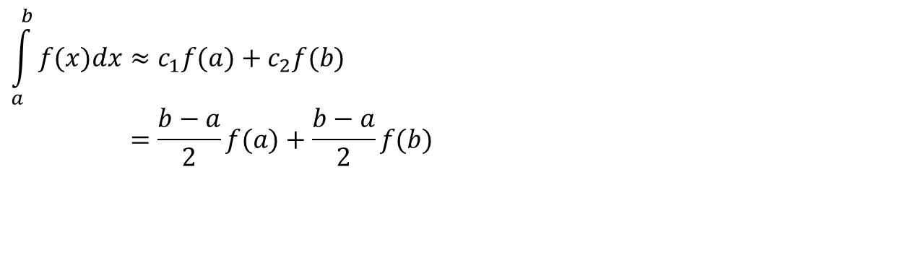
Background
Trapezoidal Rule by undetermined coefficients
$$\int_{a}^{b}{f(x)dx}≈c_{1}f(a)+c_{2}f(b) \\ =\frac{b−a}{2}f(a)+\frac{b−a}{2}f(b)$$

Slide 3
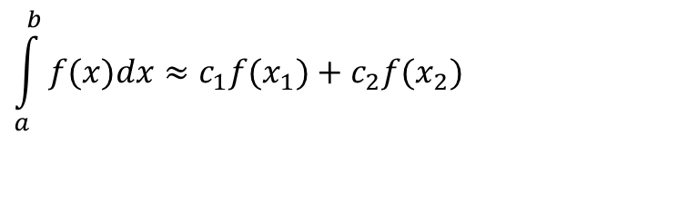
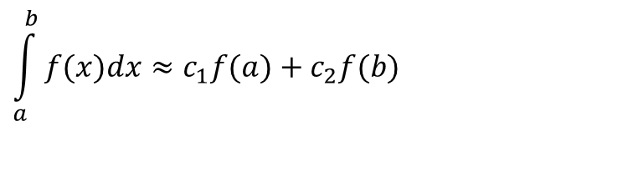
Basis of the Two-Point Gaussian Quadrature Rule
$$\int_{a}^{b}{f(x)dx}≈c_{1}f(a)+c_{2}f(b)$$
$$\int_{a}^{b}{f(x)dx}≈c_{1}f(x_{1})+c_{2}f(x_{2})$$

Slide 4

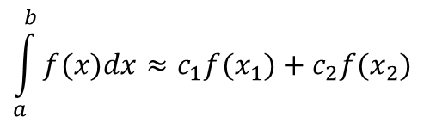
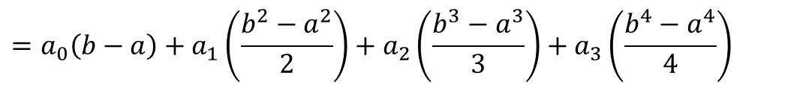
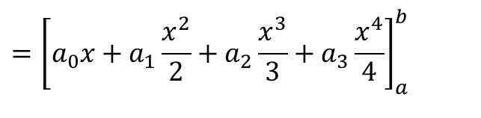
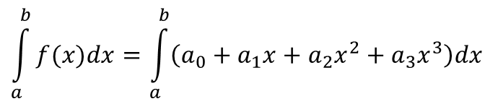
How do I find the 4 unknowns?
The four unknowns x₁, x₂, c₁ and c₂ are found by assuming that the formula
$$\int_{a}^{b}{f(x)dx}≈c_{1}f(x_{1})+c_{2}f(x_{2})$$
gives exact results for integrating a general third order polynomial
$$f(x)=a_{0}+a_{1}x+a_{2}x^{2}+a_{3}x^{3}.$$
Exact integral is
$$\int_{a}^{b}{f(x)dx}=\int_{a}^{b}{\left(a_{0}+a_{1}x+a_{2}x^{2}+a_{3}x^{3}\right)dx}$$
$$={\left[a_{0}x+a_{1}\frac{x^{2}}{2}+a_{2}\frac{x^{3}}{3}+a_{3}\frac{x^{4}}{4}\right]}_{a}^{b}$$
$$=a_{0}\left(b−a\right)+a_{1}\left(\frac{b^{2}−a^{2}}{2}\right)+a_{2}\left(\frac{b^{3}−a^{3}}{3}\right)+a_{3}\left(\frac{b^{4}−a^{4}}{4}\right)$$

Slide 5
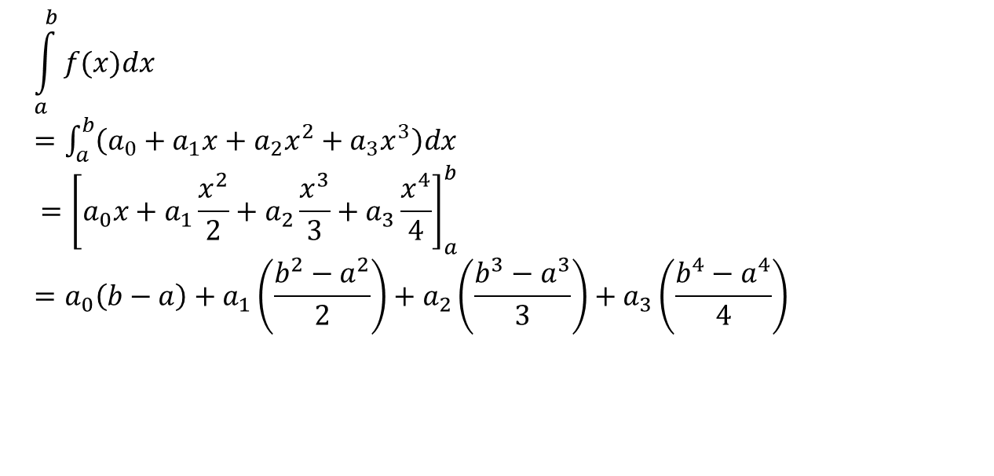
This is what I get from the exact integration
Exact integral is
$$\int_{a}^{b}{f(x)dx}$$
$=\int_{a}^{b}{\left(a_{0}+a_{1}x+a_{2}x^{2}+a_{3}x^{3}\right)dx}$
$$={\left[a_{0}x+a_{1}\frac{x^{2}}{2}+a_{2}\frac{x^{3}}{3}+a_{3}\frac{x^{4}}{4}\right]}_{a}^{b}=a_{0}\left(b−a\right)+a_{1}\left(\frac{b^{2}−a^{2}}{2}\right)+a_{2}\left(\frac{b^{3}−a^{3}}{3}\right)+a_{3}\left(\frac{b^{4}−a^{4}}{4}\right)$$

Slide 6
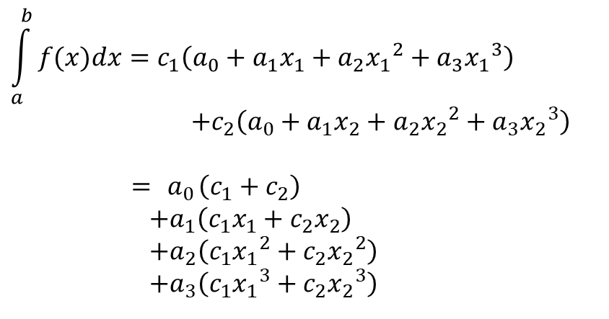

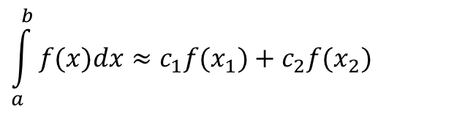
This is what I get from the RHS!
$$f(x)=a_{0}+a_{1}x+a_{2}x^{2}+a_{3}x^{3}.$$
$$\int_{a}^{b}{f(x)dx}≈c_{1}f(x_{1})+c_{2}f(x_{2})$$
$$\int_{a}^{b}{f(x)dx}=c_{1}\left(a_{0}+a_{1}x_{1}+a_{2}{x_{1}}^{2}+a_{3}{x_{1}}^{3}\right) \\ +c_{2}\left(a_{0}+a_{1}x_{2}+a_{2}{x_{2}}^{2}+a_{3}{x_{2}}^{3}\right)$$
$$={ a}_{0}\left(c_{1}+c_{2}\right)$$
$+a_{1}\left(c_{1}x_{1}+c_{2}x_{2}\right)$
$+a_{2}\left(c_{1}{x_{1}}^{2}+c_{2}{x_{2}}^{2}\right)$
$+a_{3}\left(c_{1}{x_{1}}^{3}+c_{2}{x_{2}}^{3}\right)$

Slide 7
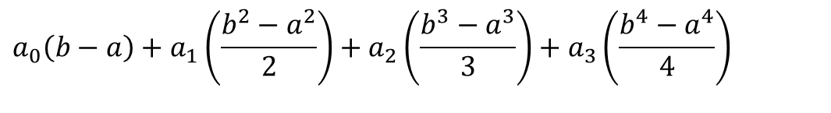
Equating exact value with formula
Equating equations
$$a_{0}\left(b−a\right)+a_{1}\left(\frac{b^{2}−a^{2}}{2}\right)+a_{2}\left(\frac{b^{3}−a^{3}}{3}\right)+a_{3}\left(\frac{b^{4}−a^{4}}{4}\right)$$
$$=a_{0}\left(c_{1}+c_{2}\right)+a_{1}\left(c_{1}x_{1}+c_{2}x_{2}\right)+a_{2}\left(c_{1}{x_{1}}^{2}+c_{2}{x_{2}}^{2}\right)+a_{3}\left(c_{1}{x_{1}}^{3}+c_{2}{x_{2}}^{3}\right)$$

Slide 8

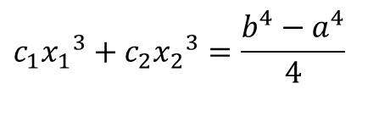
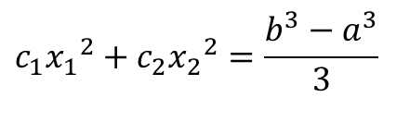
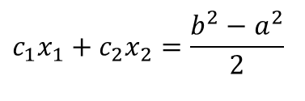
So we get 4 simultaneous NLEs
Since the constants a₀, a₁, a₂, a₃ are arbitrary
$$c_{1}+c_{2}=b−a$$
$$c_{1}x_{1}+c_{2}x_{2}=\frac{b^{2}−a^{2}}{2}$$
$$c_{1}{x_{1}}^{2}+c_{2}{x_{2}}^{2}=\frac{b^{3}−a^{3}}{3}$$
$$c_{1}{x_{1}}^{3}+c_{2}{x_{2}}^{3}=\frac{b^{4}−a^{4}}{4}$$

Slide 9
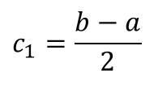
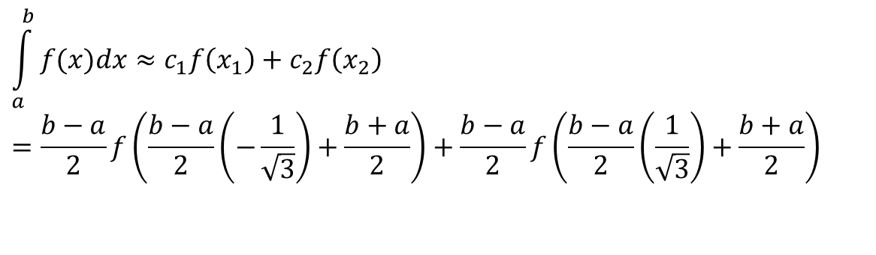
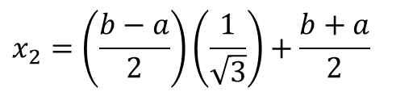
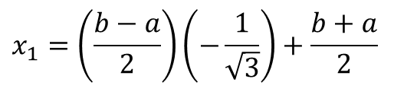
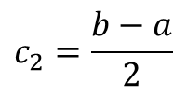
Solution of 4 simultaneous NLEs
$$x_{1}=\left(\frac{b−a}{2}\right)\left(−\frac{1}{\sqrt{3}}\right)+\frac{b+a}{2}$$
$$x_{2}=\left(\frac{b−a}{2}\right)\left(\frac{1}{\sqrt{3}}\right)+\frac{b+a}{2}$$
$$c_{1}=\frac{b−a}{2}$$
$$c_{2}=\frac{b−a}{2}$$
$$\int_{a}^{b}{f(x)dx}≈c_{1}f\left(x_{1}\right)+c_{2}f\left(x_{2}\right) \\ =\frac{b−a}{2}f\left(\frac{b−a}{2}\left(−\frac{1}{\sqrt{3}}\right)+\frac{b+a}{2}\right)+\frac{b−a}{2}f\left(\frac{b−a}{2}\left(\frac{1}{\sqrt{3}}\right)+\frac{b+a}{2}\right)$$

Slide 10


