Slide 1
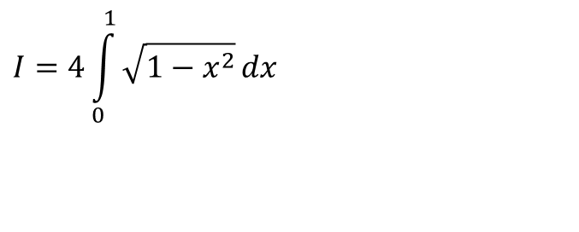
Introduction to Numerical Integration
$$I=4\int_{0}^{1}{\sqrt{1−x^{2}}}dx$$
As thy a difficult a problem as finding quadrature of a circle
1

Slide 2
Physical examples

Slide 3
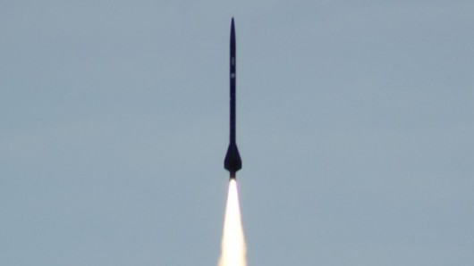
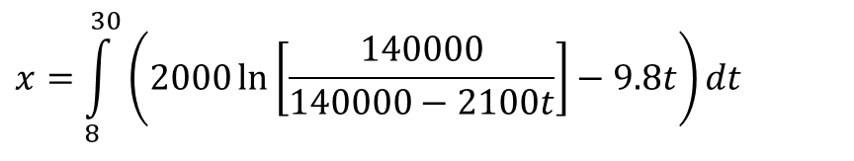
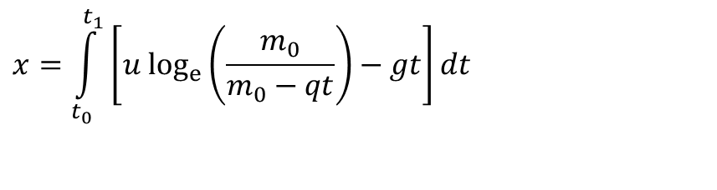
Distance Covered By Rocket
$$x=\int_{t_{0}}^{t_{1}}{\left[u \text{lo}{\text{g}}_{e}\left(\frac{m_{0}}{m_{0}−qt}\right)−gt\right]dt}$$
$$x=\int_{8}^{30}{\left(2000\ln\left[\frac{140000}{140000−2100t}\right]−9.8t\right)dt}$$

Slide 4
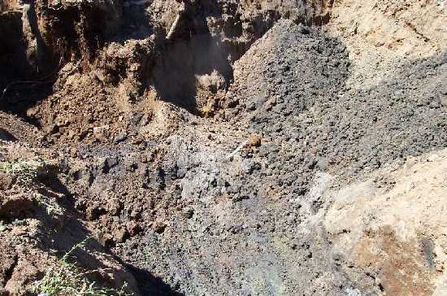
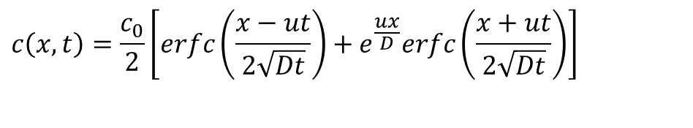
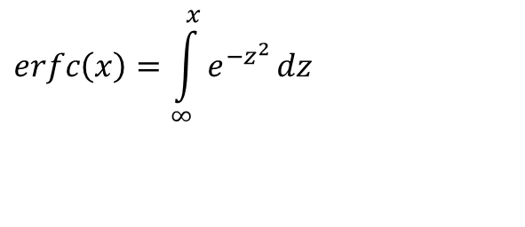
Concentration of Benzene
$$erfc\left(x\right)=\int_{∞}^{x}{e^{−z^{2}}}dz$$
$$c\left(x,t\right)=\frac{c_{0}}{2}\left[erfc\left(\frac{x−ut}{2\sqrt{Dt}}\right)+e^{\frac{ux}{D}}erfc\left(\frac{x+ut}{2\sqrt{Dt}}\right)\right]$$
u= velocity of ground water flow in the x -direction (m/s)
D = dispersion coefficient (m²/s)
C₀= initial concentration (kg/m³)

Slide 5

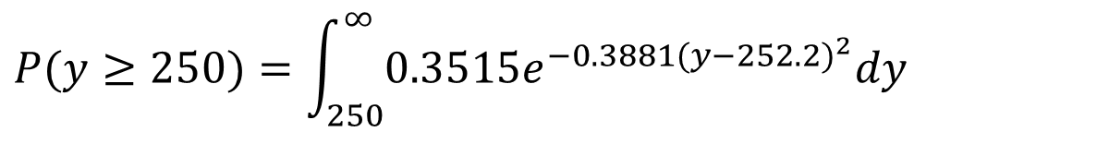
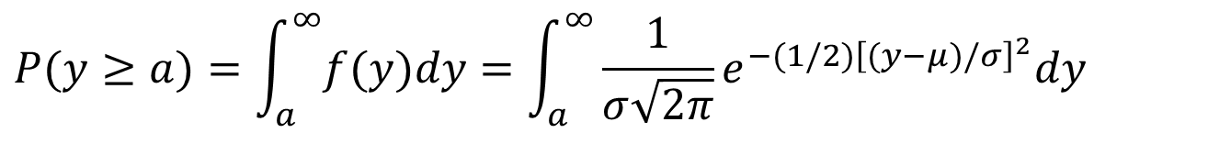
Is Wal*** “short shifting” you?
$$P(y≥a)=\int_{a}^{∞}{f(y)dy}=\int_{a}^{∞}{\frac{1}{σ\sqrt{2π}}e^{−(1/2){\left[(y−μ)/σ\right]}^{2}}dy}$$
Roll | Number of sheets
1 | 253
2 | 250
3 | 251
4 | 252
5 | 253
6 | 253
7 | 252
8 | 254
9 | 252
10 | 252
$$P(y≥250)=\int_{250}^{∞}{0.3515e^{−0.3881(y−252.2)^{2}}dy}$$

Slide 6
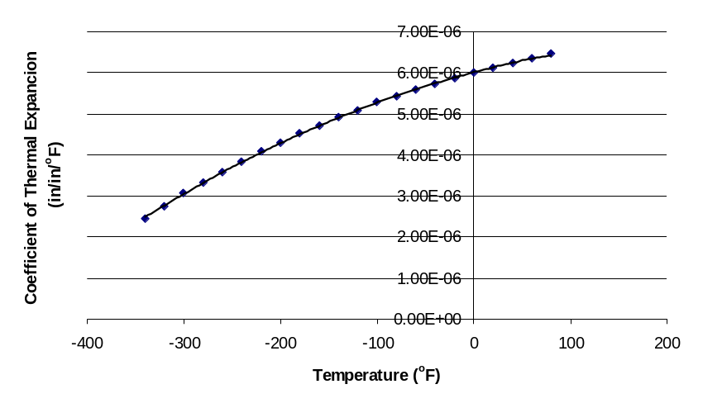

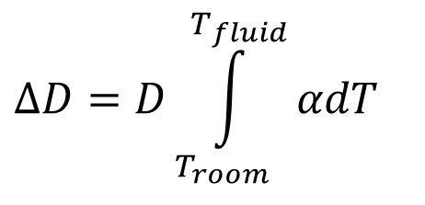
Calculating diameter contraction for trunnion-hub problem
$$ΔD=D\int_{T_{room}}^{T_{fluid}}{αdT}$$

Slide 7
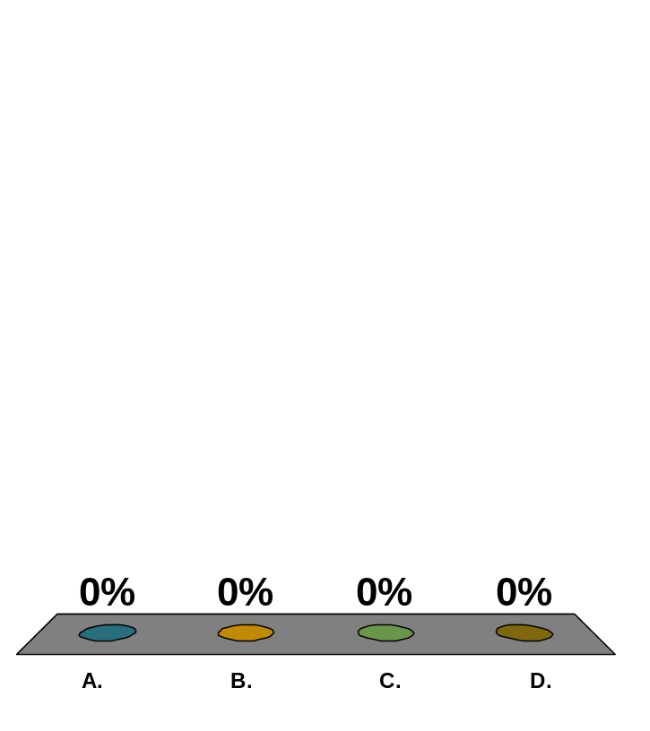
The distance covered by a rocket from t=8 to t=34 seconds is calculated using multiple segment trapezoidal rule by integrating a velocity function. Below is given the estimated distance for different number of segments, n.
n | 1 | 2 | 3 | 4 | 5
Value | 16520 | 15421 | 15212 | 15138 | 15104
The number of significant digits at least correct in the answer for n=5 is
1
2
3
4

Slide 8


