Slide 1


Nonlinear Regression: Untransformed Data
http://nm.MathForCollege.com
Transforming Numerical Methods Education for STEM Undergraduates
1

Slide 2

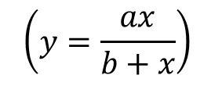


Nonlinear Regression
Some popular nonlinear regression models:
1. Exponential model:
$$(y=ae^{bx})$$
2. Power model:
$$(y=ax^{b})$$
3. Saturation growth model:
$$\left(y=\frac{ax}{b+x}\right)$$
4. Polynomial model:
$$(y=a0+a1x+...+amx^{m})$$

Slide 3








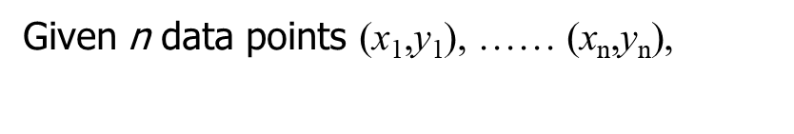

Nonlinear Regression
best fit
$$y=f(x)$$
Given n data points $\text{(}\text{x}\text{1}\text{,}\text{y}\text{1}\text{), …… (}\text{x}\text{n}\text{,}\text{y}\text{n}\text{),}$
to the data, where
$$f(x)$$
is a nonlinear function of
$$x$$
$$(x_{n},y_{n})$$
$$(x_{2},y_{2})$$
$$y=f(x)$$
$$(x_{i},y_{i})$$
$$y_{i}−f(x_{i})$$
$$(x_{1},y_{1})$$
Figure. Nonlinear regression model for discrete y vs. x data

Slide 4








Exponential Model
Given
$$(x_{1},y_{1}), (x_{2},y_{2}),\text{ ... , }(x_{n},y_{n})$$
best fit
$$y=ae^{bx}$$
to the data.
$$(x_{1},y_{1})$$
$$y=ae^{bx}$$
$$(x_{i},y_{i})$$
$$y_{i}−ae^{bx_{i}}$$
$$(x_{2},y_{2})$$
$$(x_{n},y_{n})$$
Figure. Exponential model of nonlinear regression for y vs. x data

Slide 5
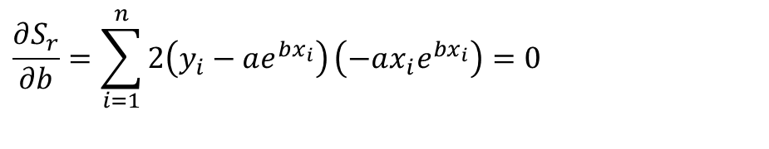
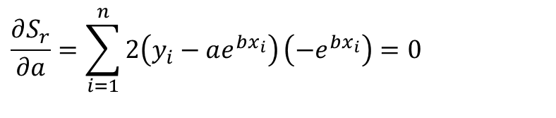
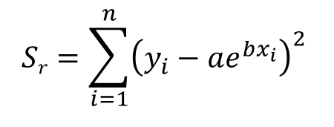
Finding Constants of Exponential Model
The sum of the square of the residuals is defined as
$$Sr=\sum_{i=1}^{n}{{\left(y_{i}−ae^{bx_{i}}\right)}^{2}}$$
Differentiate with respect to a and b
$$\frac{∂S_{r}}{∂a}=\sum_{i=1}^{n}{2\left(y_{i}−ae^{bx_{i}}\right)}\left(−e^{bx_{i}}\right)=0$$
$$\frac{∂S_{r}}{∂b}=\sum_{i=1}^{n}{2\left(y_{i}−ae^{bx_{i}}\right)}\left(−ax_{i}e^{bx_{i}}\right)=0$$

Slide 6
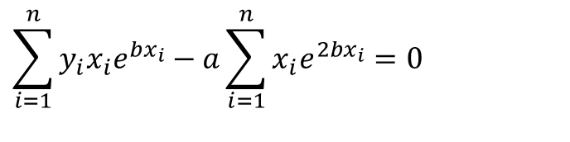
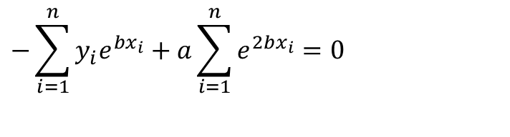
Finding Constants of Exponential Model
Rewriting the equations, we obtain
$$−\sum_{i=1}^{n}{y_{i}e^{bx_{i}}}+a\sum_{i=1}^{n}{e^{2bx_{i}}}=0$$
$$\sum_{i=1}^{n}{y_{i}x_{i}e^{bx_{i}}}−a\sum_{i=1}^{n}{x_{i}e^{2bx_{i}}}=0$$

Slide 7
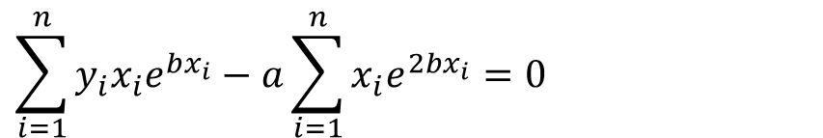
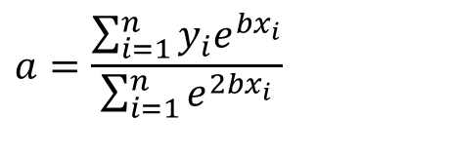
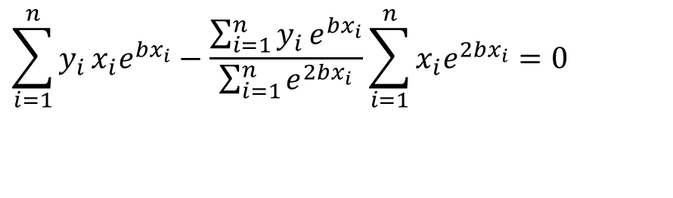
Finding constants of Exponential Model
Solving the first equation for a yields
$$a=\frac{\sum_{i=1}^{n}{y_{i}e^{bx_{i}}}}{\sum_{i=1}^{n}{e^{2bx_{i}}}}$$
$$\sum_{i=1}^{n}{y_{i}x_{i}e^{bx_{i}}}−a\sum_{i=1}^{n}{x_{i}e^{2bx_{i}}}=0$$
$$\sum_{i=1}^{n}{y_{i}}x_{i}e^{bx_{i}}−\frac{\sum_{i=1}^{n}{y_{i}}e^{bx_{i}}}{\sum_{i=1}^{n}{e^{2bx_{i}}}}\sum_{i=1}^{n}{x_{i}e^{2bx_{i}}}=0$$

Slide 8
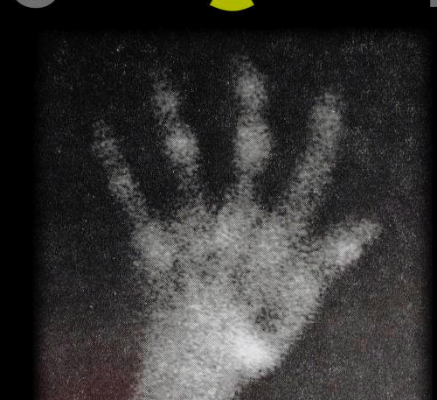

Example 1-Exponential Model
Many patients get concerned when a test involves injection of a radioactive material. For example for scanning a gallbladder, a few drops of Technetium-99m isotope is used. Half of the Technetium-99m would be gone in about 6 hours. It, however, takes about 24 hours for the radiation levels to reach what we are exposed to in day-to-day activities. Below is given the relative intensity of radiation as a function of time.
Table. Relative intensity of radiation as a function of time.
t(hrs) | 0 | 1 | 3 | 5 | 7 | 9
 | 1.000 | 0.891 | 0.708 | 0.562 | 0.447 | 0.355
$$γ$$

Slide 9



Example 1-Exponential Model cont.
The relative intensity is related to time by the equation
$$γ=Ae^{λt}$$
Find:
$$A$$
a) The value of the regression constants
and
$$λ$$
b) The half-life of Technetium-99m
c) Radiation intensity after 24 hours

Slide 10
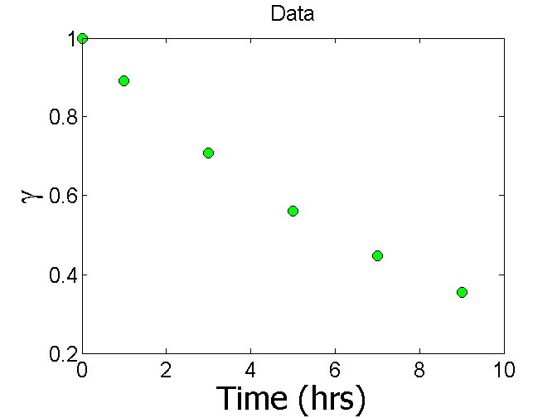
Plot of data

Slide 11

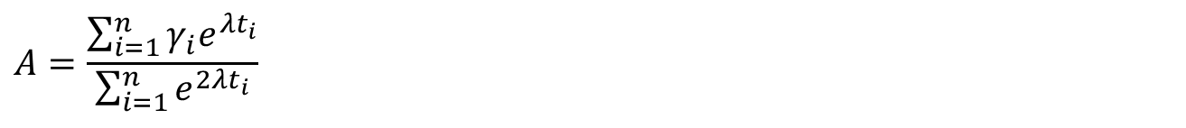
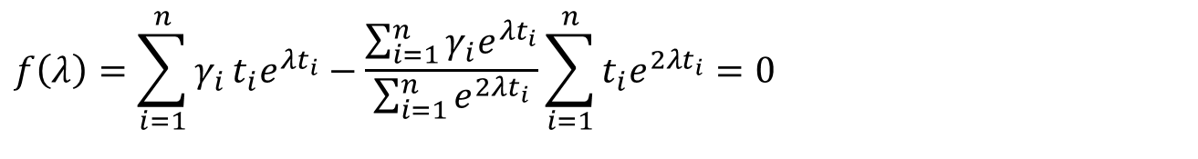
Constants of the Model
$$γ=Ae^{λt}$$
The value of λ is found by solving the nonlinear equation
$$f\left(λ\right)=\sum_{i=1}^{n}{γ_{i}}t_{i}e^{λt_{i}}−\frac{\sum_{i=1}^{n}{γ_{i}e^{λt_{i}}}}{\sum_{i=1}^{n}{e^{2λt_{i}}}}\sum_{i=1}^{n}{t_{i}e^{2λt_{i}}}=0$$
$$A=\frac{\sum_{i=1}^{n}{γ_{i}e^{λt_{i}}}}{\sum_{i=1}^{n}{e^{2λt_{i}}}}$$

Slide 12
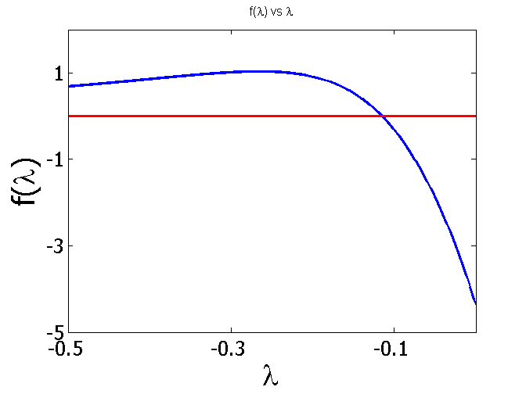
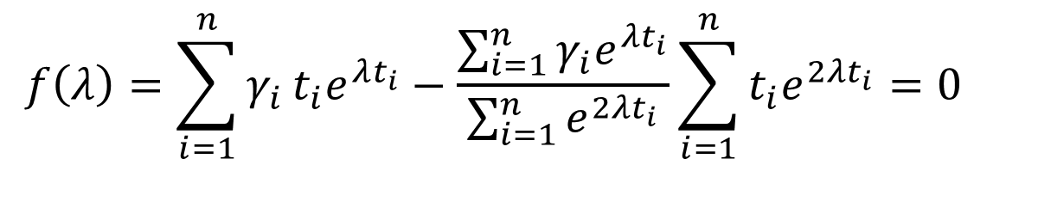
Plotting the Equation in MATLAB
$$f\left(λ\right)=\sum_{i=1}^{n}{γ_{i}}t_{i}e^{λt_{i}}−\frac{\sum_{i=1}^{n}{γ_{i}e^{λt_{i}}}}{\sum_{i=1}^{n}{e^{2λt_{i}}}}\sum_{i=1}^{n}{t_{i}e^{2λt_{i}}}=0$$
t (hrs) | 0 | 1 | 3 | 5 | 7 | 9
γ | 1.000 | 0.891 | 0.708 | 0.562 | 0.447 | 0.355

Slide 13

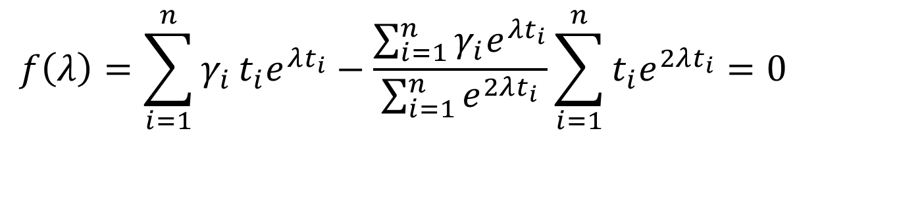
Setting up the Equation in MATLAB
$$f\left(λ\right)=\sum_{i=1}^{n}{γ_{i}}t_{i}e^{λt_{i}}−\frac{\sum_{i=1}^{n}{γ_{i}e^{λt_{i}}}}{\sum_{i=1}^{n}{e^{2λt_{i}}}}\sum_{i=1}^{n}{t_{i}e^{2λt_{i}}}=0$$
$$λ=−0.1151$$
t=[0 1 3 5 7 9]
gamma=[1 0.891 0.708 0.562 0.447 0.355]
syms lamda
sum1=sum(gamma.*t.*exp(lamda*t));
sum2=sum(gamma.*exp(lamda*t));
sum3=sum(exp(2*lamda*t));
sum4=sum(t.*exp(2*lamda*t));
f=sum1-sum2/sum3*sum4;

Slide 14
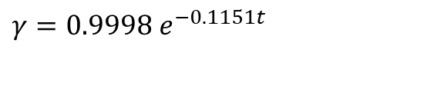

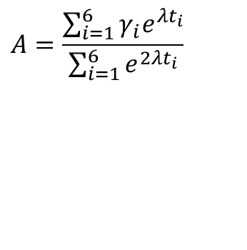
Calculating the Other Constant
The value of A can now be calculated
$$A=\frac{\sum_{i=1}^{6}{γ_{i}e^{λt_{i}}}}{\sum_{i=1}^{6}{e^{2λt_{i}}}}$$
$$=0.9998$$
The exponential regression model then is
$$γ=0.9998 e^{−0.1151t}$$

Slide 15
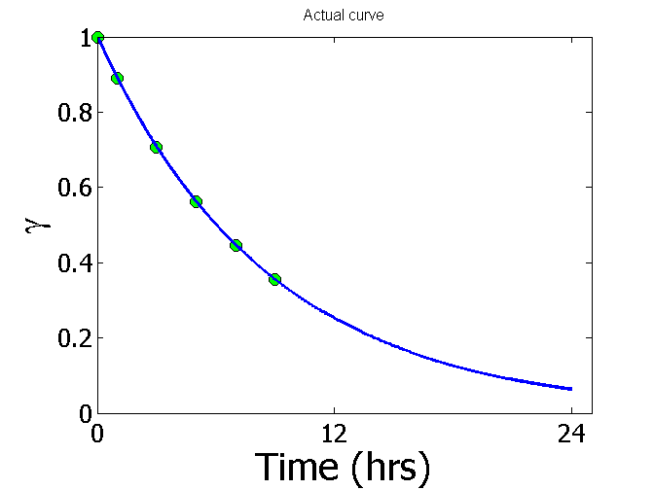
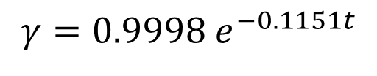
Plot of data and regression curve
$$γ=0.9998 e^{−0.1151t}$$

Slide 16
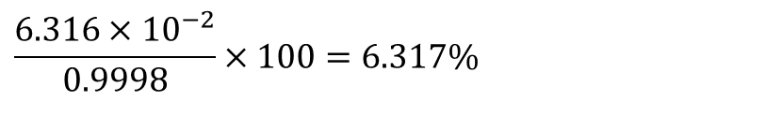
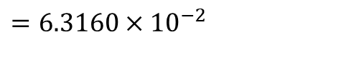
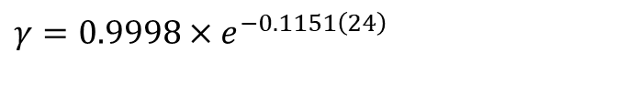
Relative Intensity After 24 hrs
The relative intensity of radiation after 24 hours
$$γ=0.9998×e^{−0.1151\left(24\right)}$$
$$=6.3160×10^{−2}$$
This result implies that only
$$\frac{6.316×10^{−2}}{0.9998}×100=6.317\%$$
radioactive intensity is left after 24 hours.

Slide 17

Homework
What is the half-life of Technetium-99m isotope?
Write a program in the language of your choice to find the constants of the model.
Compare the constants of this regression model with the one where the data is transformed.
What if the model was
$$γ=e^{λt}$$

