Slide 1
Adequacy of Linear Regression Models
1

Slide 2
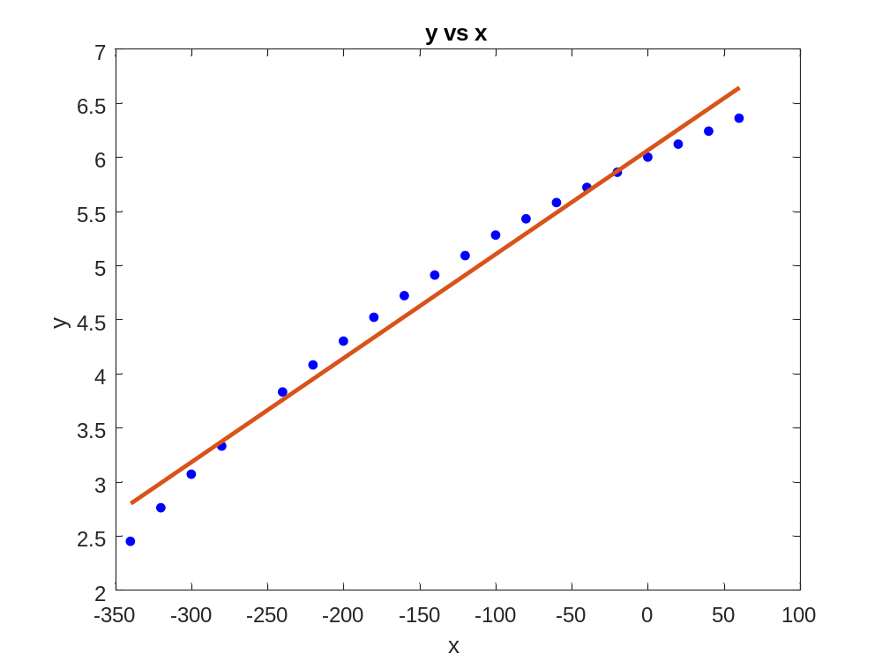
Data

Slide 3
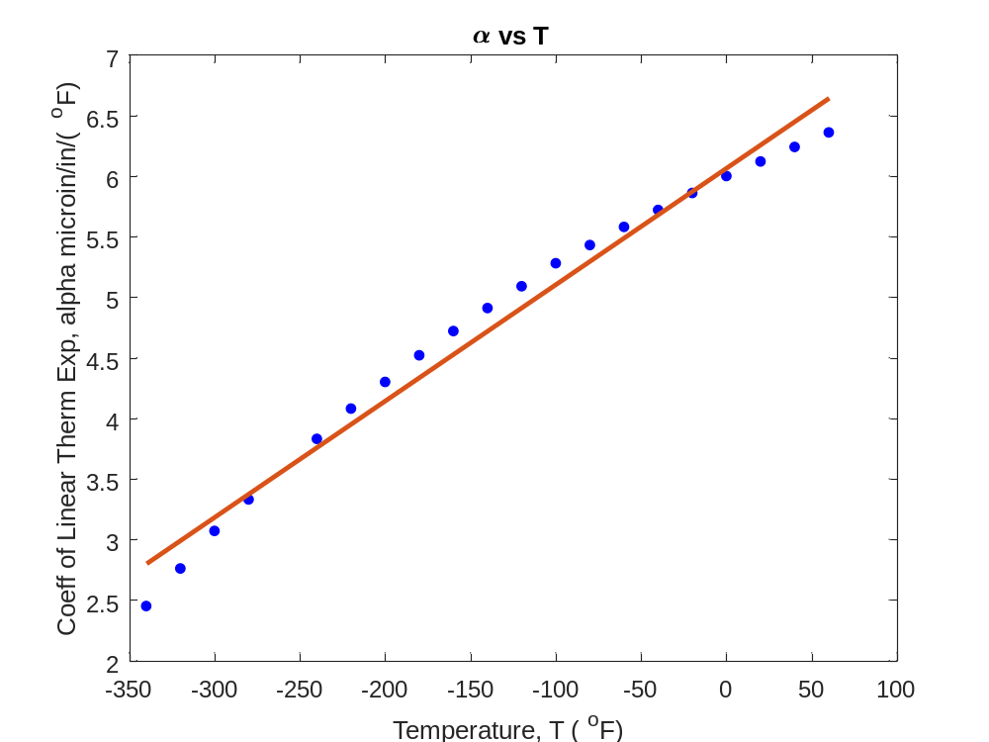
Therm exp coeff vs temperature
T | α
80 | 6.47
60 | 6.36
40 | 6.24
20 | 6.12
0 | 6.00
-20 | 5.86
-40 | 5.2
-60 | 5.58
-80 | 5.43
-100 | 5.28
-120 | 5.09
T | α
-140 | 4.91
-160 | 4.72
-180 | 4.52
-200 | 4.30
-220 | 4.08
-240 | 3.83
-260 | 3.58
-280 | 3.33
-300 | 3.07
-320 | 2.76
-340 | 2.45
T is in ºF; α is in μin/in/ºF
Is this adequate?

Slide 4
Quality of Fitted Data
Does the model describe the data adequately?
How well does the model predict the response variable predictably?

Slide 5
Linear Regression Models
Limit our discussion to adequacy of straight-line regression models

Slide 6
Four checks
Does the model look like it explains the data?
Do 95% of the residuals fall with ±2 standard error of estimate?
Is the coefficient of determination acceptable?
Does the model meet the assumption of random errors?

Slide 7
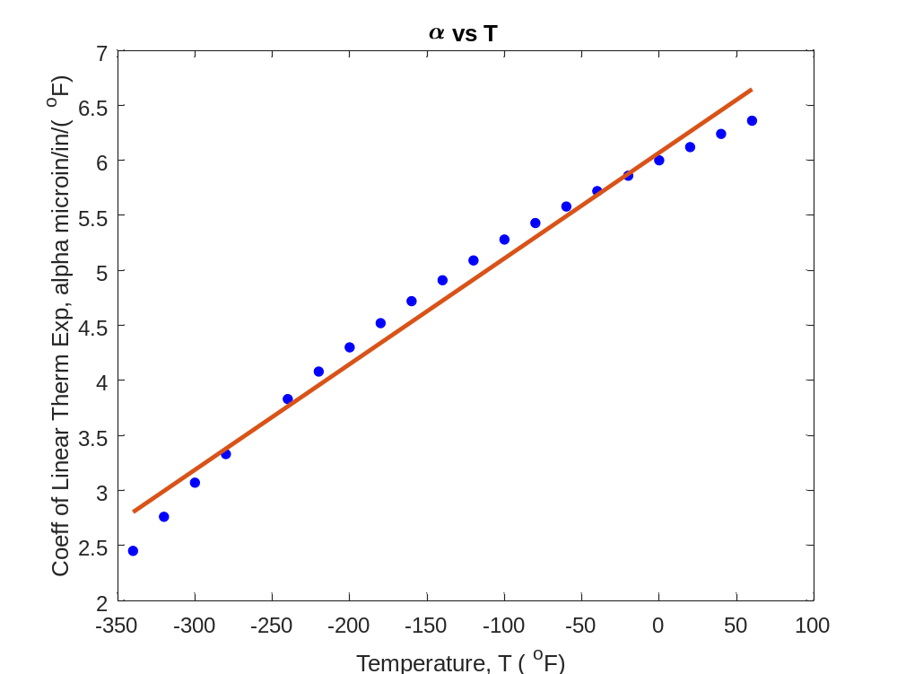

Check 1:Plot Model and Data
T | α
80 | 6.47
60 | 6.36
40 | 6.24
20 | 6.12
0 | 6.00
-20 | 5.86
-40 | 5.2
-60 | 5.58
-80 | 5.43
-100 | 5.28
-120 | 5.09
T | α
-140 | 4.91
-160 | 4.72
-180 | 4.52
-200 | 4.30
-220 | 4.08
-240 | 3.83
-260 | 3.58
-280 | 3.33
-300 | 3.07
-320 | 2.76
-340 | 2.45
$$α=6.0248+0.0093868T$$

Slide 8
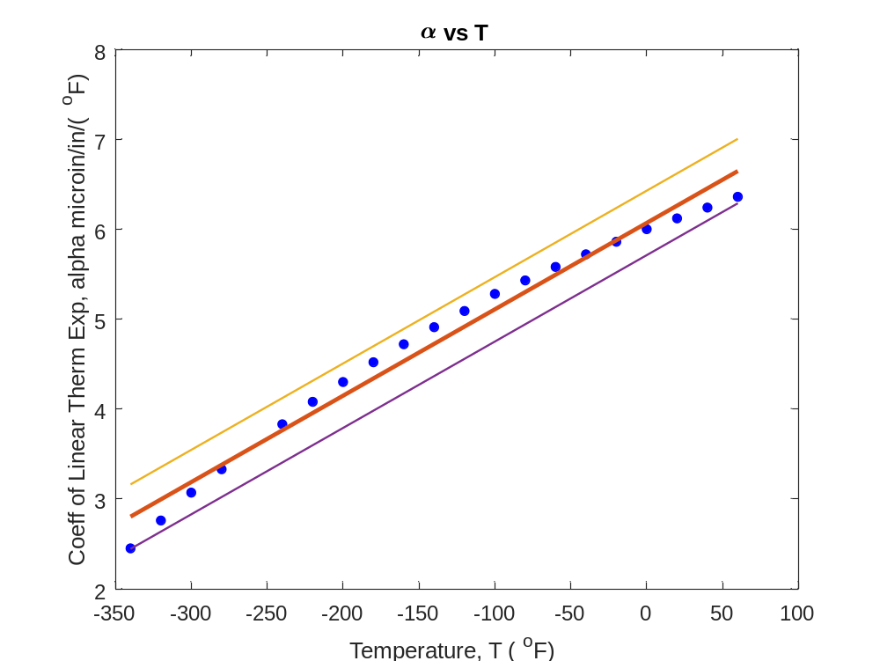



Check 2: Using Standard Error of Estimate
$$α=6.0248+0.0093868T$$
$$α=(6.0248+2∗0.1700)+0.0093868T$$
$$α=(6.0248−2∗0.1700)+0.0093868T$$
$s_{α/T}=$0.1700

Slide 9
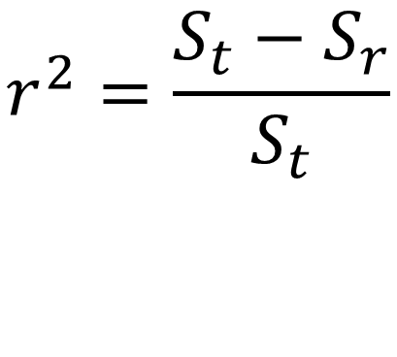
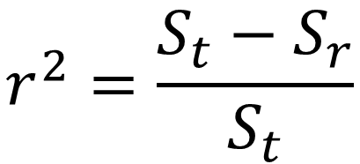
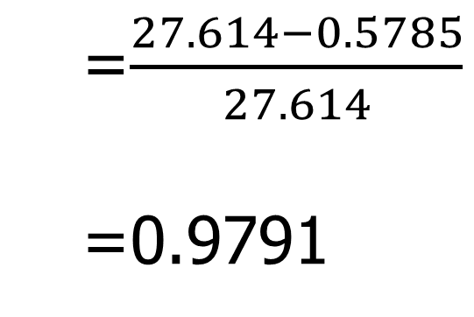
Check 3: Using Coefficient of Determination

Slide 10
Check 4. Does the model meet assumption of random errors?
Residuals are negative as well as positive
Variation of residuals as a function of the independent variable is random
Residuals follow a normal distribution
There is no autocorrelation between the data points.

Slide 11
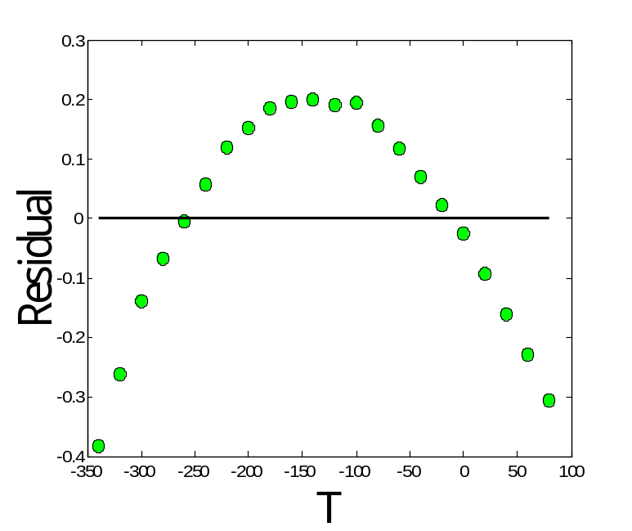
a) Are residuals negative and positive?

Slide 12
b) Is variation of residuals as a function of independent variable random?

Slide 13
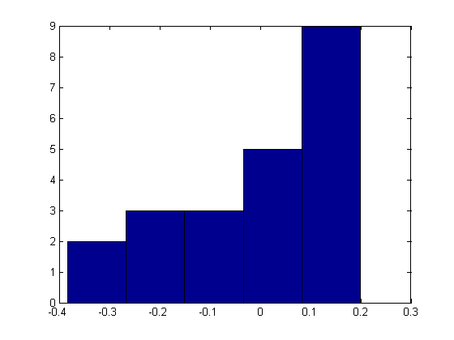
c) Do the residuals follow normal distribution?

Slide 14
END

Slide 15
What polynomial model to choose if one needs to be chosen?

Slide 16
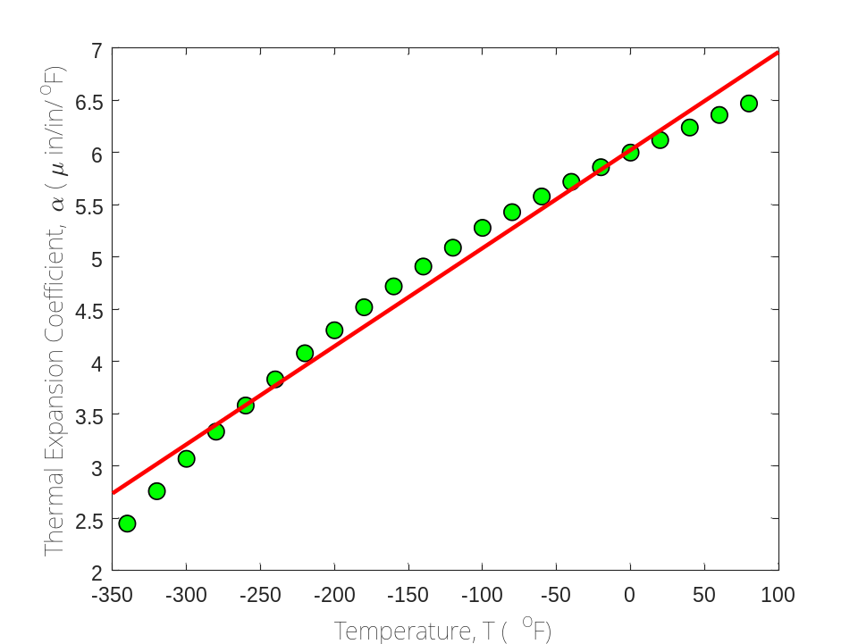
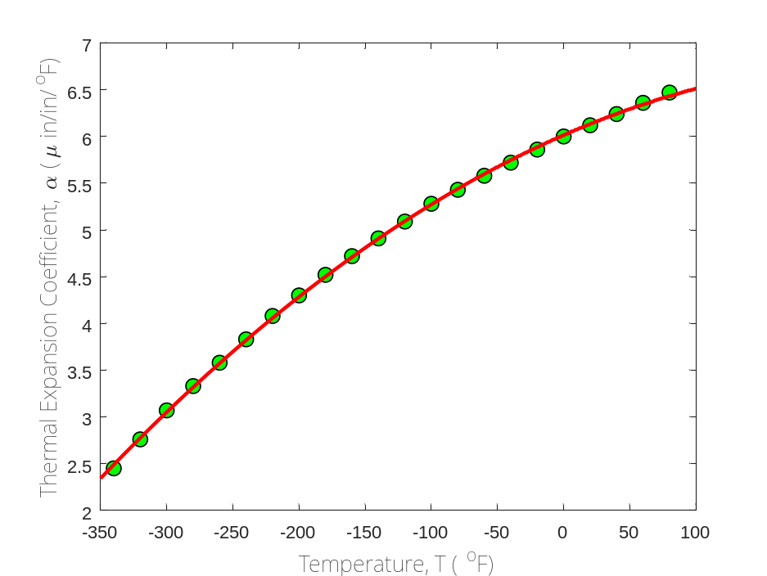

Which model to choose?
$$α=0.009387T+6.025$$
$$α=−0.000012{28T}^{2}+0.006196T+6.015$$

Slide 17
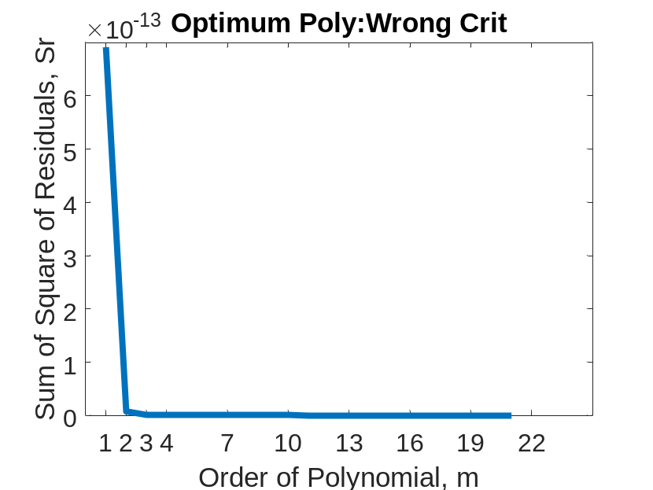
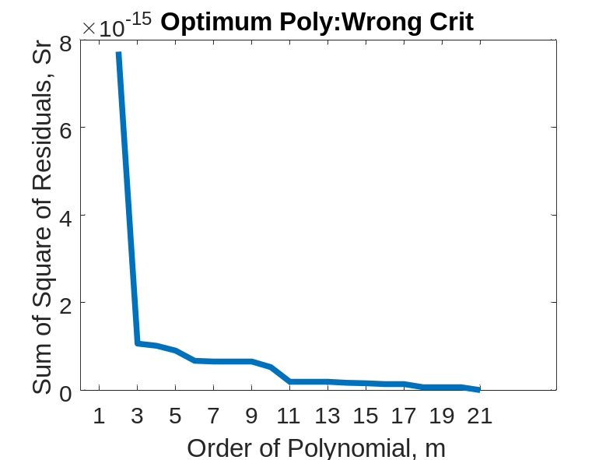
Optimum Polynomial: Wrong Criterion
Both graphs above are same
Left one starts at m=1
Right one starts at m=2

Slide 18
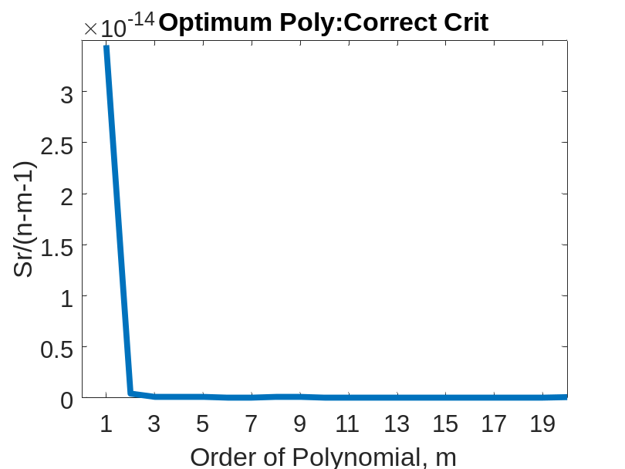
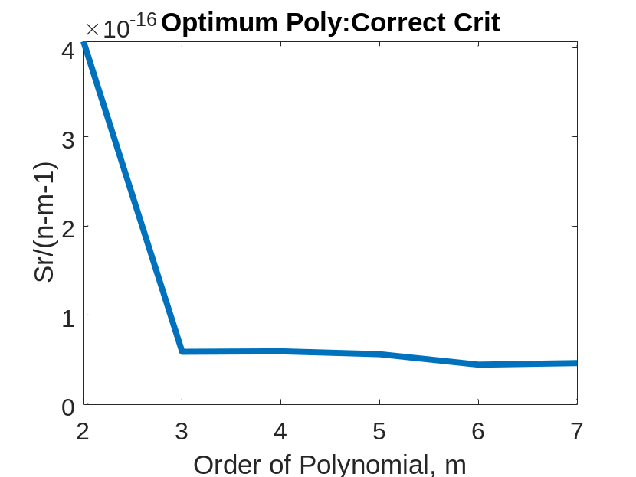
Optimum Polynomial: Correct Criterion
Both graphs are same
Left one starts at m=1
Right one starts at m=2

Slide 19
END

Slide 20
Effect of an Outlier

Slide 21
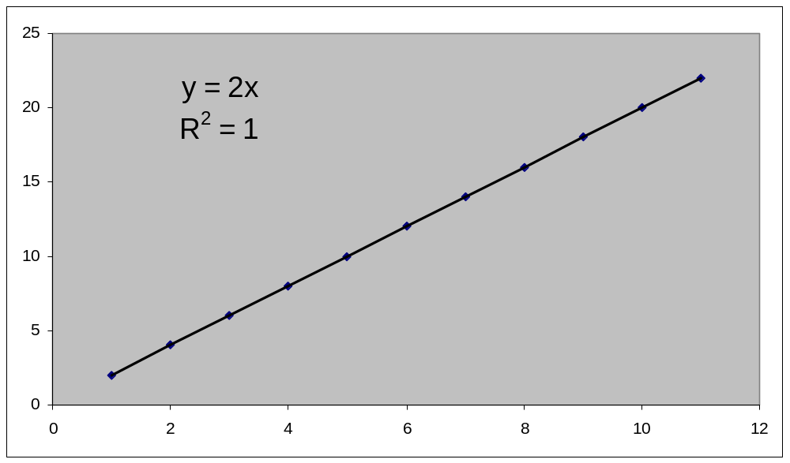
Effect of Outlier

Slide 22
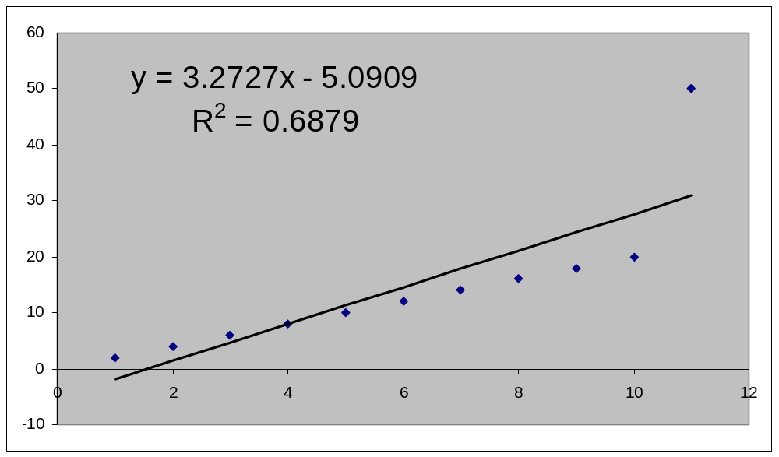
Effect of Outlier

Slide 23
END

Slide 24
Final Exam Grade

Slide 25

Final Exam Grade vs Pre-Req GPA

Slide 26


