Slide 1
Nonlinear Regression Without Transformation of Data
1

Slide 2
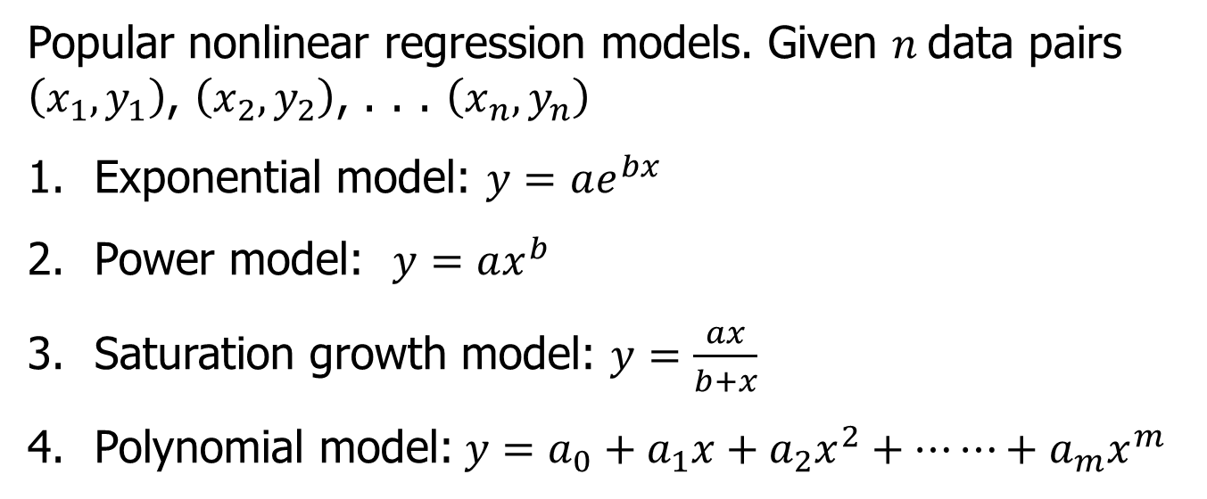
Nonlinear Regression
Popular nonlinear regression models. Given $n$data pairs $\left(x_{1},y_{1}\right)$, $\left(x_{2},y_{2}\right)$, . . . $\left(x_{n},y_{n}\right)$
Exponential model: $y=ae^{bx}$
Power model: $y=ax^{b}$
Saturation growth model: $y=\frac{ax}{b+x}$
Polynomial model:$y=a_{0}+a_{1}x+a_{2}x^{2}+⋯⋯+a_{m}x^{m}$

Slide 3




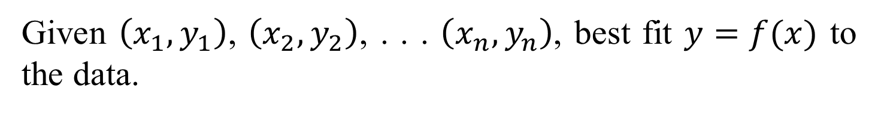


Nonlinear Regression
Given $\left(x_{1},y_{1}\right)$, $\left(x_{2},y_{2}\right)$, . . . $\left(x_{n},y_{n}\right)$, best fit $y=f(x)$ to the data.
$$(x_{n},y_{n})$$
$$(x_{2},y_{2})$$
$$y=f(x)$$
$$(x_{i},y_{i})$$
$$y_{i}−f(x_{i})$$
$$(x_{1},y_{1})$$
Figure. Nonlinear regression model for discrete y vs. x data

Slide 4




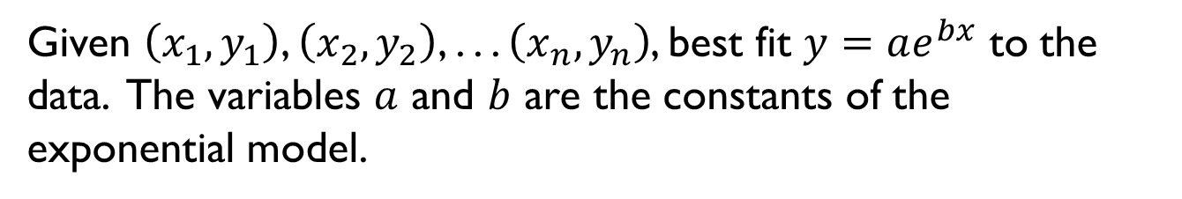

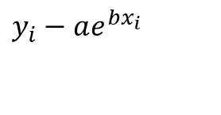
Exponential Model
Given $\left(x_{1},y_{1}\right)$, $\left(x_{2},y_{2}\right)$, . . . $\left(x_{n},y_{n}\right)$, best fit $y=ae^{bx}$ to the data. The variables $a$ and $b$ are the constants of the exponential model.
$$(x_{1},y_{1})$$
$$y=ae^{bx}$$
$$y_{i}−ae^{bx_{i}}$$
$$(x_{i},y_{i})$$
$$(x_{2},y_{2})$$
$$(x_{n},y_{n})$$
Figure. Exponential model of nonlinear regression for y vs. x data

Slide 5
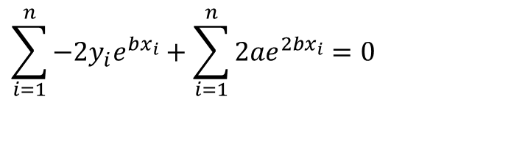
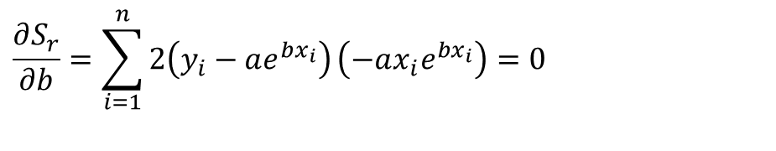
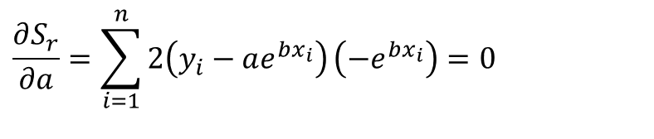
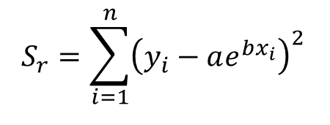
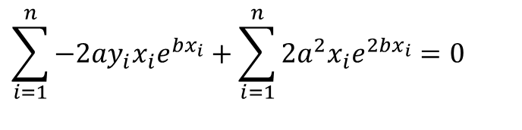
Finding Constants of Exponential Model
The sum of the square of the residuals is defined as
$$S_{r}=\sum_{i=1}^{n}{{\left(y_{i}−ae^{bx_{i}}\right)}^{2}}$$
Differentiate with respect to $a$ and $b,$and put it equal to zero
$$\frac{∂S_{r}}{∂a}=\sum_{i=1}^{n}{2\left(y_{i}−ae^{bx_{i}}\right)}\left(−e^{bx_{i}}\right)=0$$
$$\sum_{i=1}^{n}{−{2y}_{i}e^{bx_{i}}}+\sum_{i=1}^{n}{{2ae}^{2bx_{i}}}=0$$
$$\frac{∂S_{r}}{∂b}=\sum_{i=1}^{n}{2\left(y_{i}−ae^{bx_{i}}\right)}\left(−ax_{i}e^{bx_{i}}\right)=0$$
$$\sum_{i=1}^{n}{{−2ay}_{i}x_{i}e^{bx_{i}}}+\sum_{i=1}^{n}{{2a^{2}x}_{i}e^{2bx_{i}}}=0$$

Slide 6
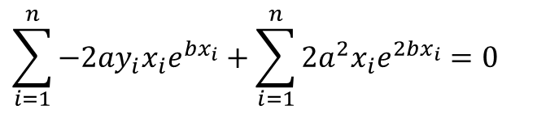
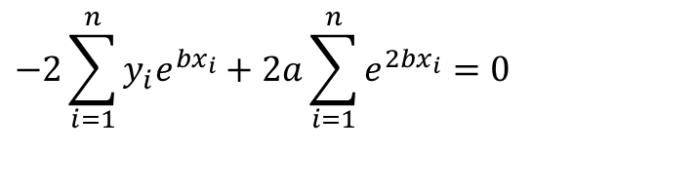
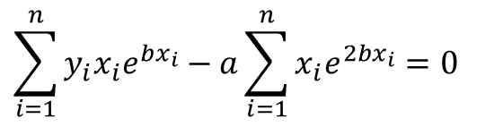
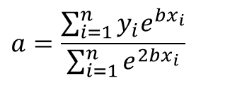
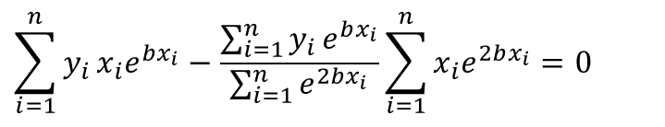
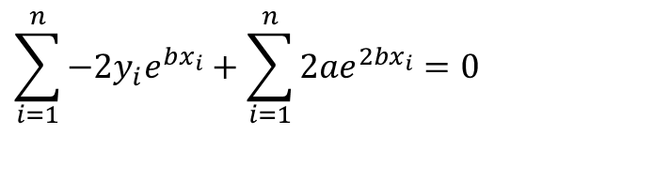
Finding Constants of Exponential Model
Solving the first equation for a yields
$$\sum_{i=1}^{n}{−{2y}_{i}e^{bx_{i}}}+\sum_{i=1}^{n}{{2ae}^{2bx_{i}}}=0$$
$$−2\sum_{i=1}^{n}{y_{i}e^{bx_{i}}}+2a\sum_{i=1}^{n}{e^{2bx_{i}}}=0$$
$$a=\frac{\sum_{i=1}^{n}{y_{i}e^{bx_{i}}}}{\sum_{i=1}^{n}{e^{2bx_{i}}}}$$
$$\sum_{i=1}^{n}{{−2ay}_{i}x_{i}e^{bx_{i}}}+\sum_{i=1}^{n}{{2a^{2}x}_{i}e^{2bx_{i}}}=0$$
$$\sum_{i=1}^{n}{y_{i}x_{i}e^{bx_{i}}}−a\sum_{i=1}^{n}{x_{i}e^{2bx_{i}}}=0$$
$$\sum_{i=1}^{n}{y_{i}}x_{i}e^{bx_{i}}−\frac{\sum_{i=1}^{n}{y_{i}}e^{bx_{i}}}{\sum_{i=1}^{n}{e^{2bx_{i}}}}\sum_{i=1}^{n}{x_{i}e^{2bx_{i}}}=0$$

Slide 7
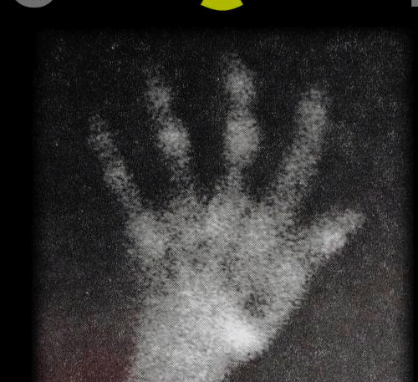

Example - Exponential Model
Many patients get concerned when a test involves injection of a radioactive material. For example for scanning a gallbladder, a few drops of Technetium-99m isotope is used. Half of the Technetium-99m would be gone in about 6 hours. It, however, takes about 24 hours for the radiation levels to reach what we are exposed to in day-to-day activities. Below is given the relative intensity of radiation as a function of time.
Table. Relative intensity of radiation as a function of time.
t(hrs) | 0 | 1 | 3 | 5 | 7 | 9
 | 1.000 | 0.891 | 0.708 | 0.562 | 0.447 | 0.355
$$γ$$

Slide 8
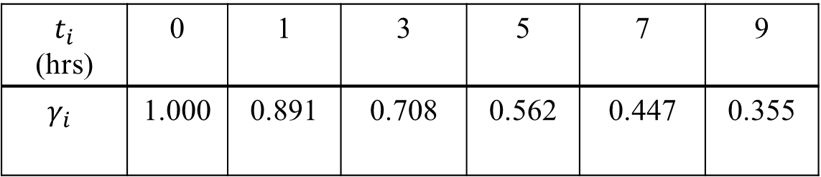
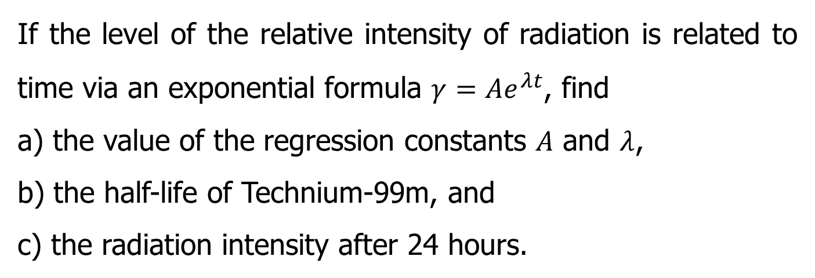
Example - Exponential Model (contd)
If the level of the relative intensity of radiation is related to time via an exponential formula $γ=Ae^{λt}$, find
a) the value of the regression constants $A$ and $λ$,
b) the half-life of Technium-99m, and
c) the radiation intensity after 24 hours.
Table. Relative intensity of radiation as a function of time.
$t_{i}$ (hrs) | 0 | 1 | 3 | 5 | 7 | 9
$$γ_{i}$$ | 1.000 | 0.891 | 0.708 | 0.562 | 0.447 | 0.355

Slide 9
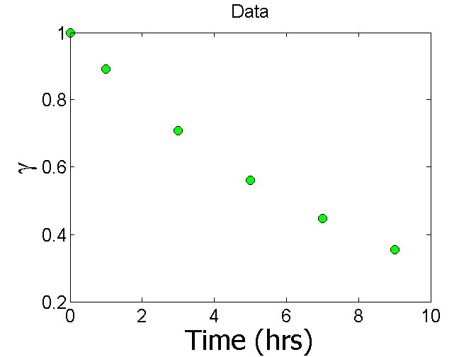
Plot of data

Slide 10
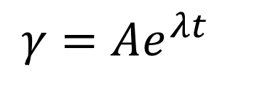
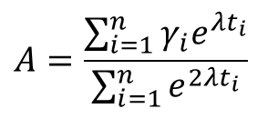
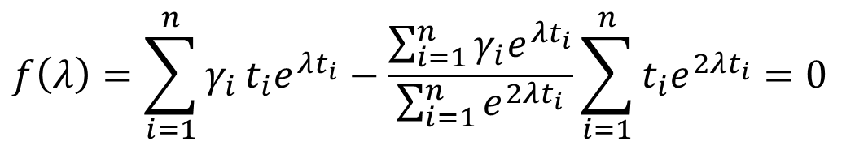
Constants of the Model
$$γ=Ae^{λt}$$
The value of λ is found by solving the nonlinear equation
$$f\left(λ\right)=\sum_{i=1}^{n}{γ_{i}}t_{i}e^{λt_{i}}−\frac{\sum_{i=1}^{n}{γ_{i}e^{λt_{i}}}}{\sum_{i=1}^{n}{e^{2λt_{i}}}}\sum_{i=1}^{n}{t_{i}e^{2λt_{i}}}=0$$
$$A=\frac{\sum_{i=1}^{n}{γ_{i}e^{λt_{i}}}}{\sum_{i=1}^{n}{e^{2λt_{i}}}}$$

Slide 11
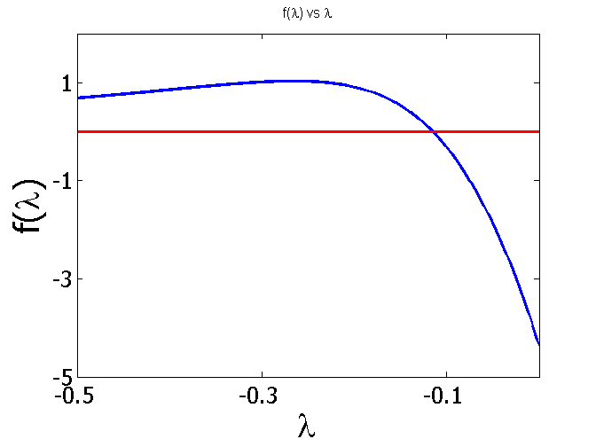
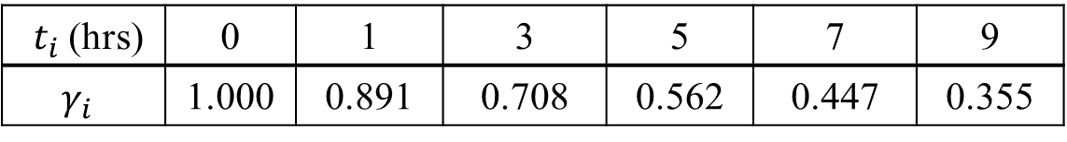
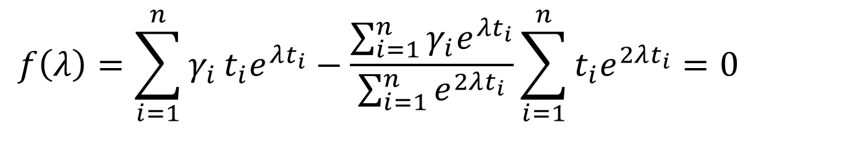
Setting up the Equation in MATLAB
$$f\left(λ\right)=\sum_{i=1}^{n}{γ_{i}}t_{i}e^{λt_{i}}−\frac{\sum_{i=1}^{n}{γ_{i}e^{λt_{i}}}}{\sum_{i=1}^{n}{e^{2λt_{i}}}}\sum_{i=1}^{n}{t_{i}e^{2λt_{i}}}=0$$
$t_{i}$(hrs) | 0 | 1 | 3 | 5 | 7 | 9
$$γ_{i}$$ | 1.000 | 0.891 | 0.708 | 0.562 | 0.447 | 0.355

Slide 12

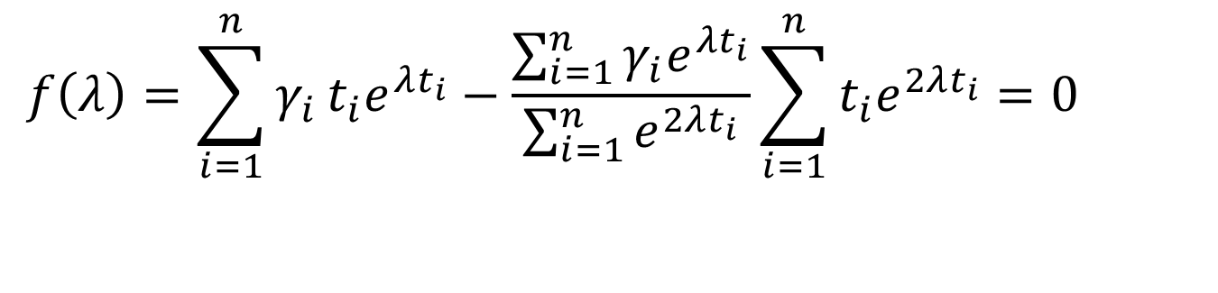
Setting up the Equation in MATLAB
$$f\left(λ\right)=\sum_{i=1}^{n}{γ_{i}}t_{i}e^{λt_{i}}−\frac{\sum_{i=1}^{n}{γ_{i}e^{λt_{i}}}}{\sum_{i=1}^{n}{e^{2λt_{i}}}}\sum_{i=1}^{n}{t_{i}e^{2λt_{i}}}=0$$
$$λ=−0.1151$$
t=[0 1 3 5 7 9]
gamma=[1.000 0.891 0.708 0.562 0.447 0.355]
syms lamda
sum1=sum(gamma.*t.*exp(lamda*t));
sum2=sum(gamma.*exp(lamda*t));
sum3=sum(exp(2*lamda*t));
sum4=sum(t.*exp(2*lamda*t));
f=sum1-sum2/sum3*sum4;

Slide 13
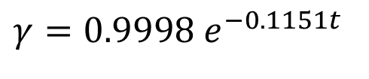
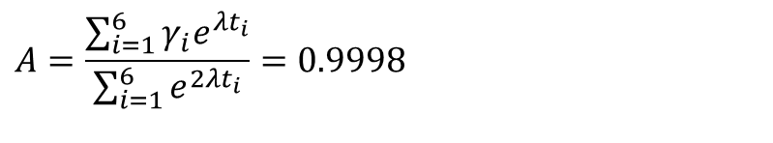
Calculating the Other Constant
The value of 𝐴 can now be calculated
$$A=\frac{\sum_{i=1}^{6}{γ_{i}e^{λt_{i}}}}{\sum_{i=1}^{6}{e^{2λt_{i}}}}=0.9998$$
The exponential regression model then is
$$γ=0.9998 e^{−0.1151t}$$

Slide 14
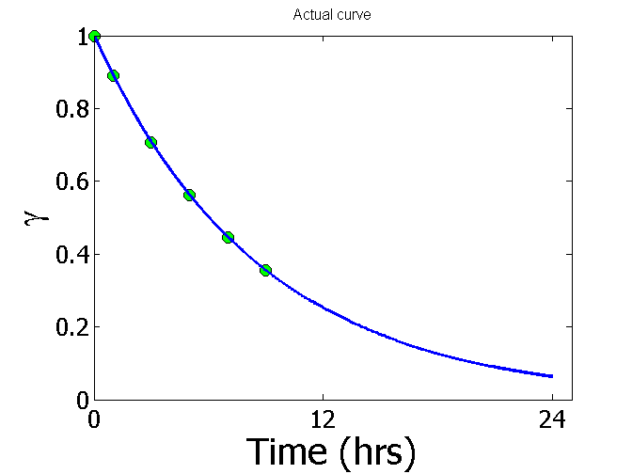
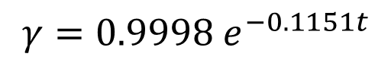
Plot of data and regression curve
$$γ=0.9998 e^{−0.1151t}$$

Slide 15
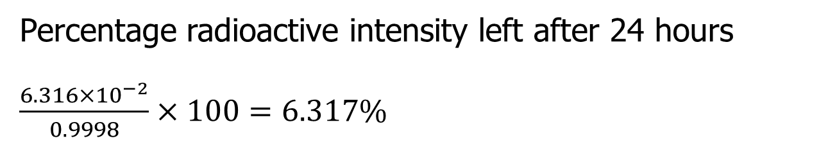
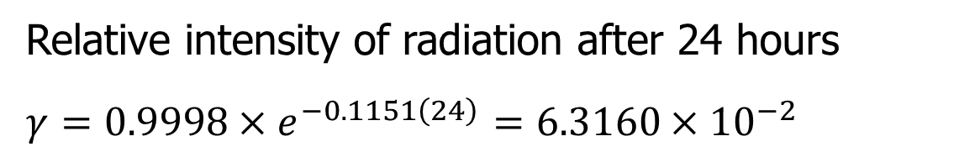
Relative Intensity After 24 hrs
Relative intensity of radiation after 24 hours
$γ=0.9998×e^{−0.1151\left(24\right)}$ $=6.3160×10^{−2}$
Percentage radioactive intensity left after 24 hours
$\frac{6.316×10^{−2}}{0.9998}×100=6.317\%$

Slide 16
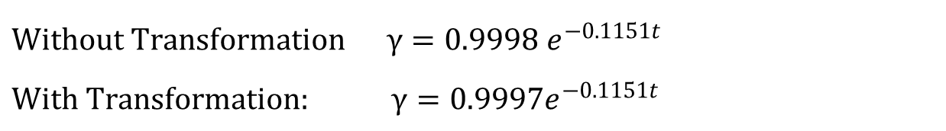
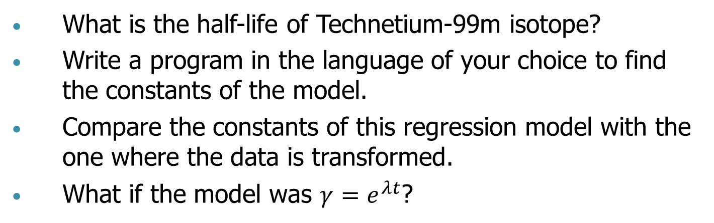
Homework
What is the half-life of Technetium-99m isotope?
Write a program in the language of your choice to find the constants of the model.
Compare the constants of this regression model with the one where the data is transformed.
What if the model was $γ=e^{λt}$?
$$\text{With}\text{out} \text{Transformation} γ=0.9998 e^{−0.1151t}$$
$$\text{W}\text{ith} \text{Transformation}\text{:} γ=0.9997e^{−0.1151t}$$

Slide 17
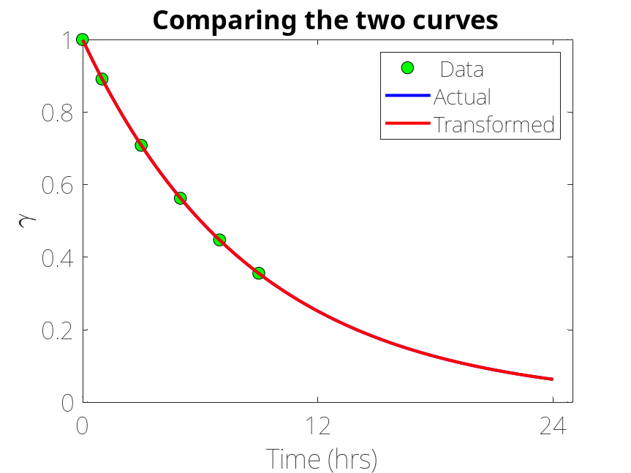
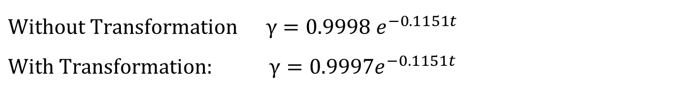
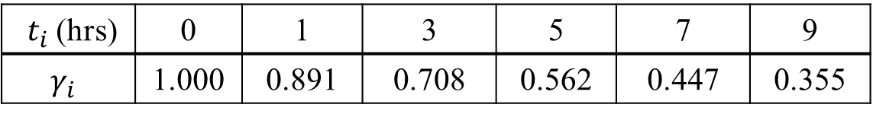
Transformed vs Untransformed Data
$t_{i}$(hrs) | 0 | 1 | 3 | 5 | 7 | 9
$$γ_{i}$$ | 1.000 | 0.891 | 0.708 | 0.562 | 0.447 | 0.355
$$\text{With}\text{out} \text{Transformation} γ=0.9998 e^{−0.1151t}$$
$$\text{W}\text{ith} \text{Transformation}\text{:} γ=0.9997e^{−0.1151t}$$

Slide 18
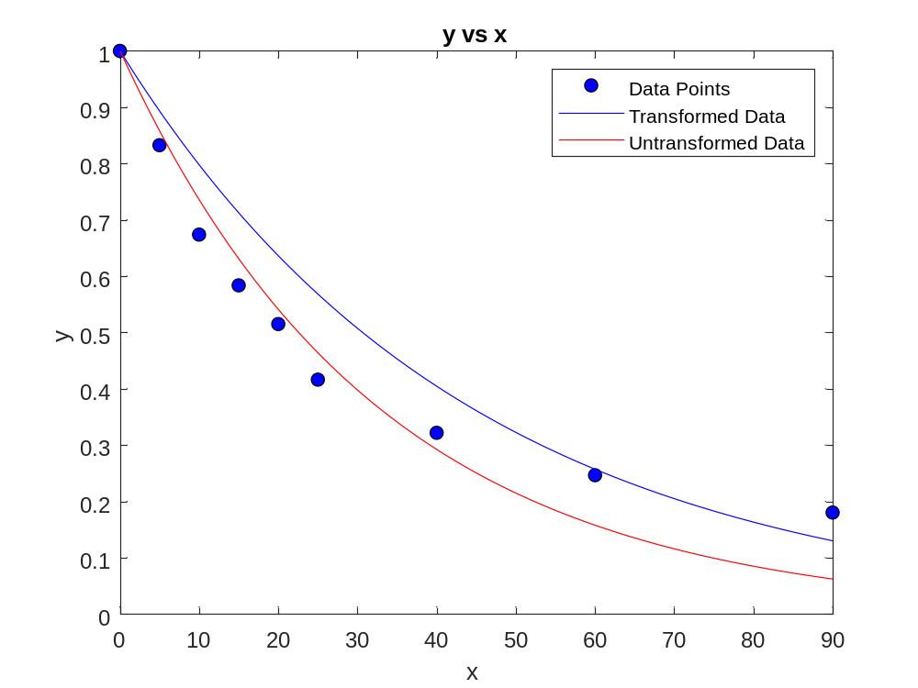
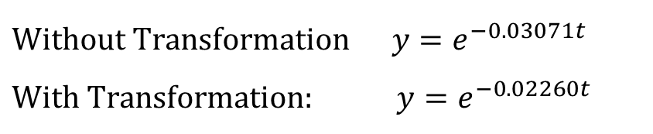


Transformed vs Untransformed Data
$$y=e^{bx}$$
x | y
0 | 1.0000
5 | 0.8326
10 | 0.6738
15 | 0.5837
20 | 0.5150
25 | 0.4163
40 | 0.3219
60 | 0.2466
90 | 0.1803
$$y=e^{−0.02260x}$$
$$y=e^{−0.03071x}$$
$$\text{With}\text{out} \text{Transformation} y=e^{−0.03071t}$$
$$\text{W}\text{ith} \text{Transformation}\text{:} y=e^{−0.02260t}$$

Slide 19


