Slide 1
Adequacy of Linear Regression Models
http://numericalmethods.eng.usf.edu
Transforming Numerical Methods Education for STEM Undergraduates
10/19/2020
http://numericalmethods.eng.usf.edu
1

Slide 2
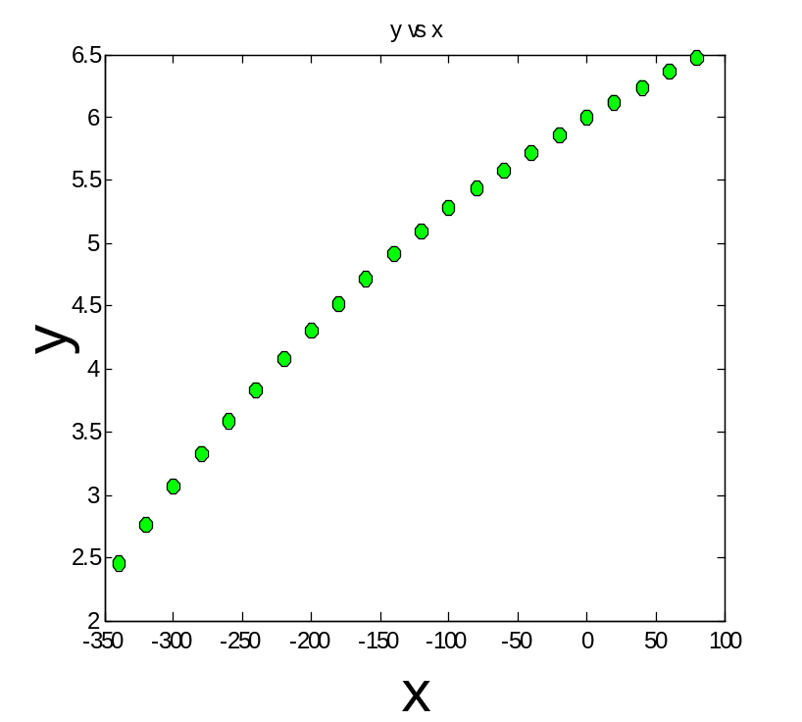
Data

Slide 3
Therm exp coeff vs temperature
T | α
80 | 6.47
60 | 6.36
40 | 6.24
20 | 6.12
0 | 6.00
-20 | 5.86
-40 | 5.2
-60 | 5.58
-80 | 5.43
-100 | 5.28
-120 | 5.09
T | α
-140 | 4.91
-160 | 4.72
-180 | 4.52
-200 | 4.30
-220 | 4.08
-240 | 3.83
-260 | 3.58
-280 | 3.33
-300 | 3.07
-320 | 2.76
-340 | 2.45
T is in ºF
α is in μin/in/ ºF

Slide 4
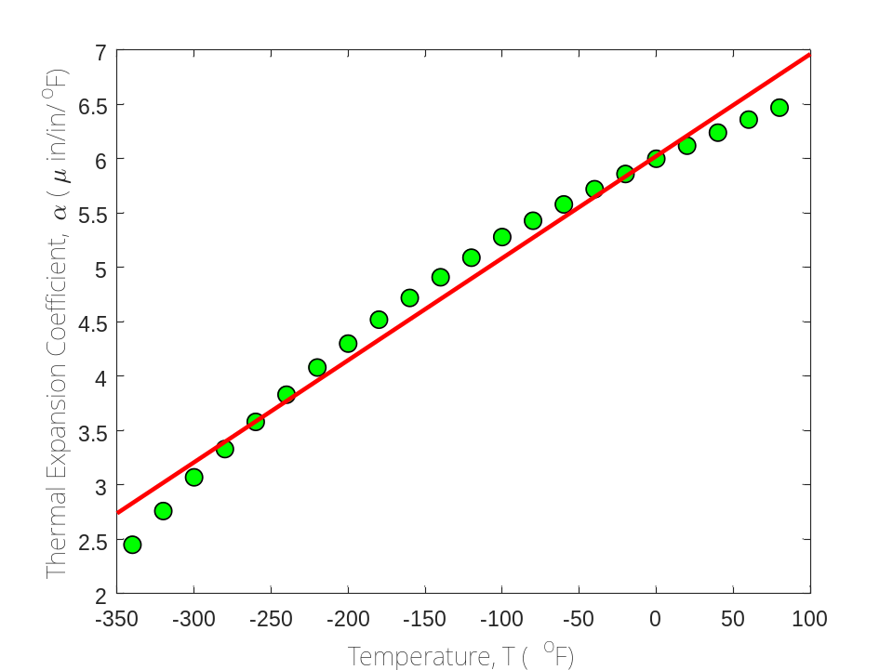
Is this adequate?
Straight Line Model

Slide 5
Quality of Fitted Data
Does the model describe the data adequately?
How well does the model predict the response variable predictably?

Slide 6
Linear Regression Models
Limit our discussion to adequacy of straight-line regression models

Slide 7
Four checks
Does the model look like it explains the data?
Do 95%of the residuals fall with ±2 standard error of estimate?
Is the coefficient of determination acceptable?
Does the model meet the assumption of random errors?

Slide 8
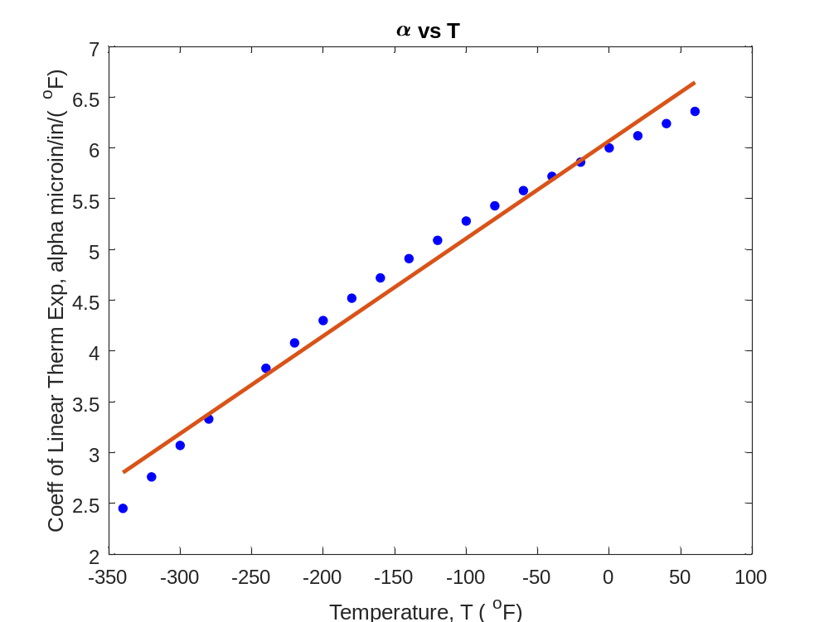

Check 1:Plot Model and Data
T | α
80 | 6.47
60 | 6.36
40 | 6.24
20 | 6.12
0 | 6.00
-20 | 5.86
-40 | 5.2
-60 | 5.58
-80 | 5.43
-100 | 5.28
-120 | 5.09
T | α
-140 | 4.91
-160 | 4.72
-180 | 4.52
-200 | 4.30
-220 | 4.08
-240 | 3.83
-260 | 3.58
-280 | 3.33
-300 | 3.07
-320 | 2.76
-340 | 2.45
$$α=6.0248+0.0093868T$$

Slide 9
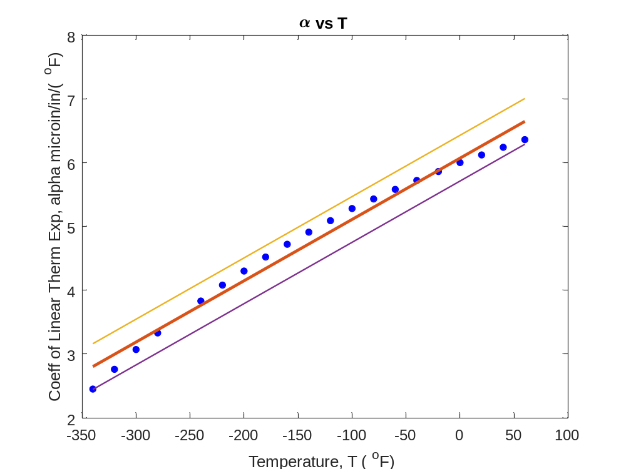



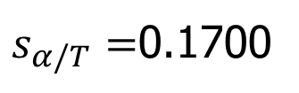
Check 2: Using Standard Error of Estimate
$$α=6.0248+0.0093868T$$
$$α=(6.0248+2∗0.1700)+0.0093868T$$
$$α=(6.0248−2∗0.1700)+0.0093868T$$
$s_{α/T}=$0.1700

Slide 10
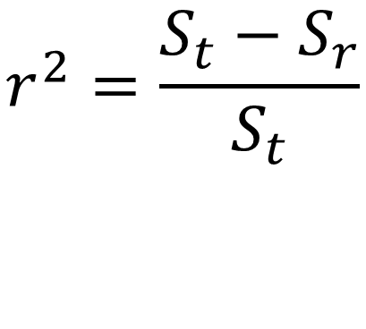
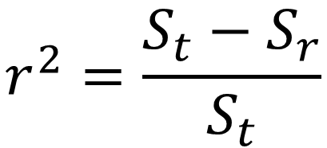
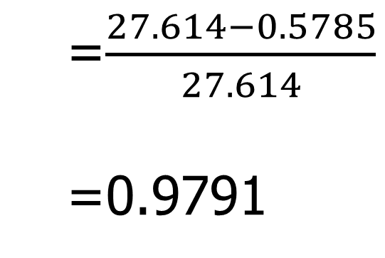
Check 3: Using Coefficient of Determination

Slide 11
Check 4. Does the model meet assumption of random errors?

Slide 12
Model meets assumption of random errors
Residuals are negative as well as positive
Variation of residuals as a function of the independent variable is random
Residuals follow a normal distribution
There is no autocorrelation between the data points.

Slide 13
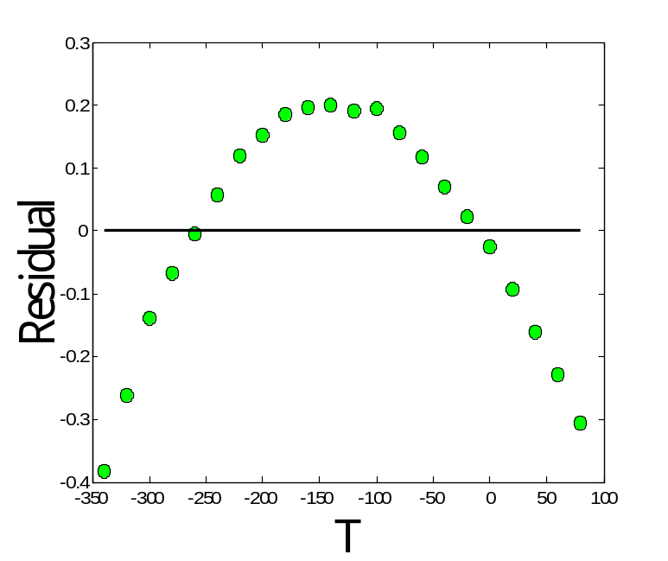
Are residuals negative and positive?

Slide 14
Is variation of residuals as a function of independent variable random?

Slide 15
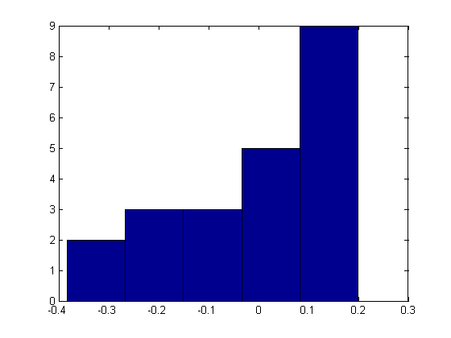
Do the residuals follow normal distribution?

Slide 16
END

Slide 17
What polynomial model to choose if one needs to be chosen?

Slide 18
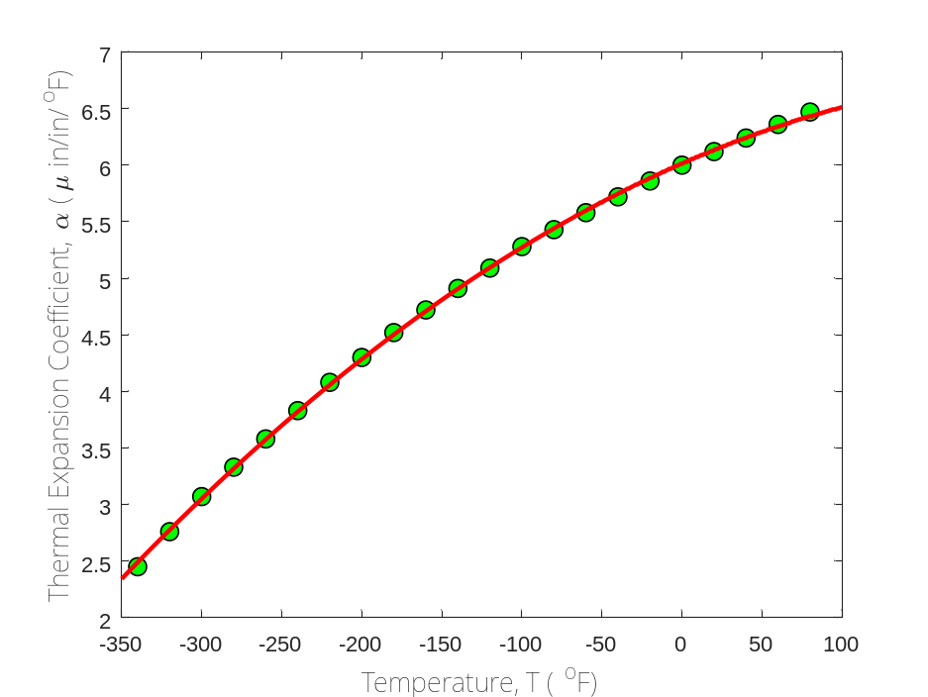

Which model to choose?
$$α=0.009387T+6.025$$
$$α=−0.000012{28T}^{2}+0.006196T+6.015$$

Slide 19
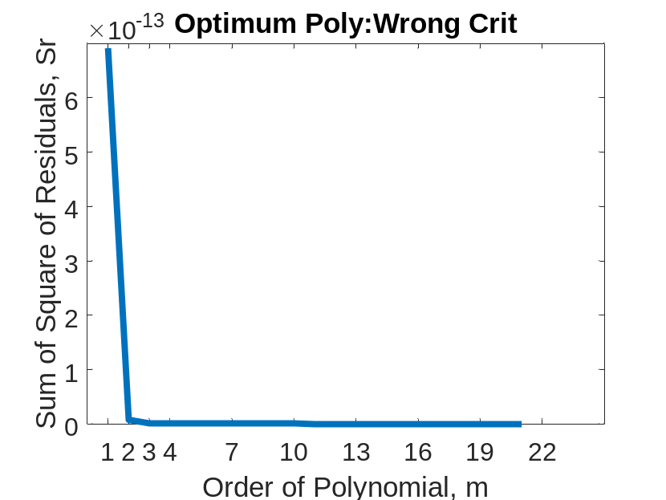
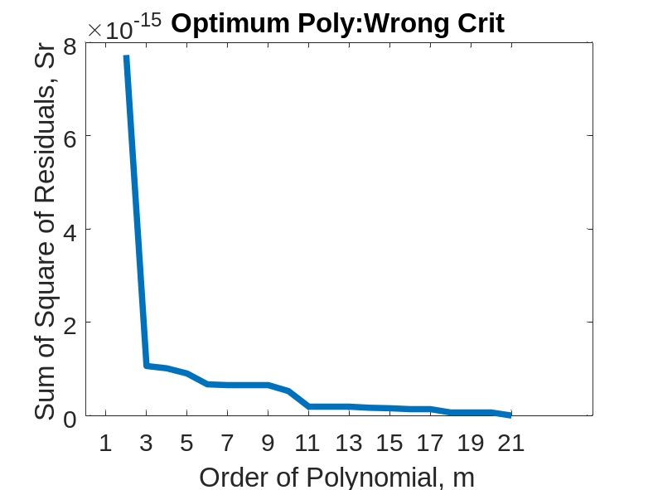
Optimum Polynomial: Wrong Criterion
Both graphs are same
Left one starts at m=1
Right one starts at m=2

Slide 20
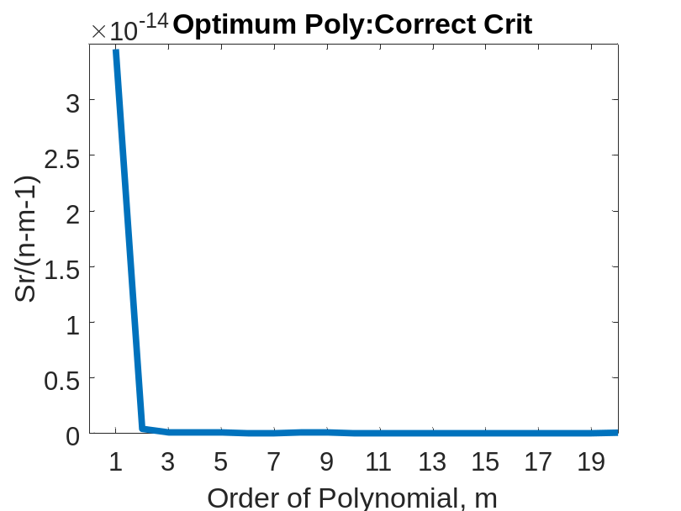
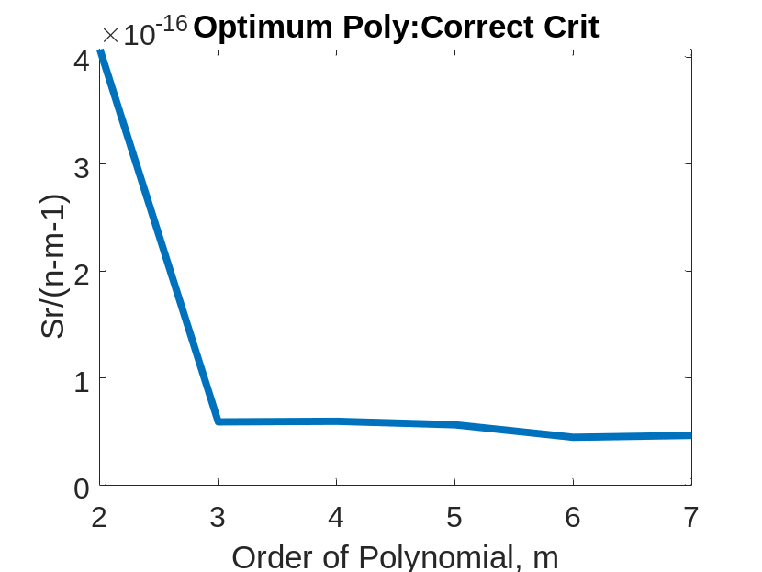
Optimum Polynomial: Correct Criterion
Both graphs are same
Left one starts at m=1
Right one starts at m=2

Slide 21
END

Slide 22
Effect of an Outlier

Slide 23
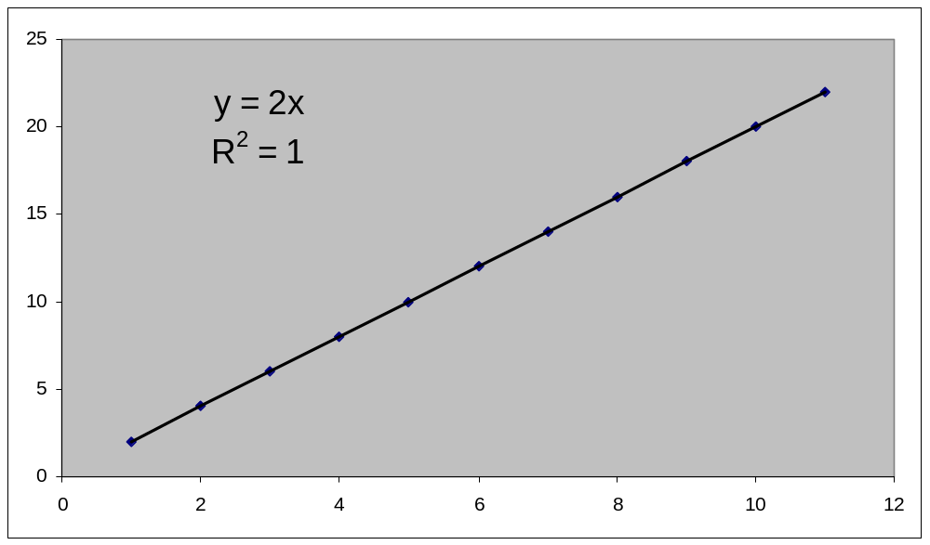
Effect of Outlier

Slide 24
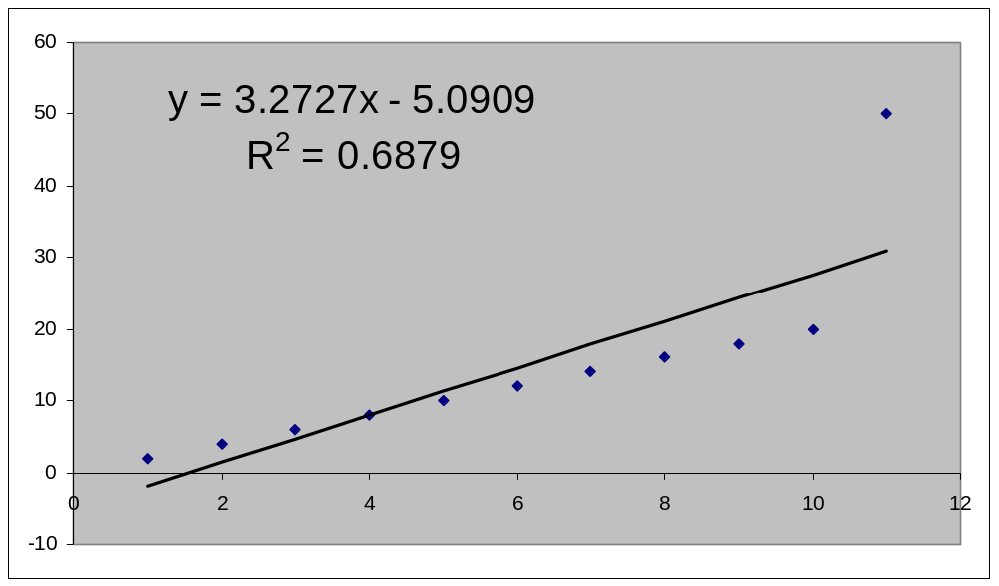
Effect of Outlier

Slide 25
END

Slide 26
Final Exam Grade

Slide 27

Final Exam Grade vs Pre-Req GPA

