Slide 1
Adequacy of Solutions
Autar Kaw
Humberto Isaza
“the magnitude of the determinant is an indication of neither the condition of the matrix nor the accuracy of the solution" - Henry Thacher
http://nm.MathForCollege.com
Transforming Numerical Methods Education for STEM Undergraduates

Slide 2
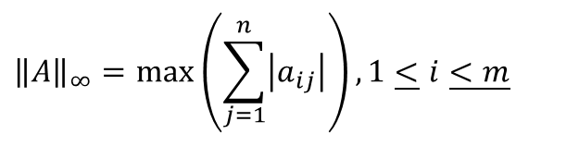
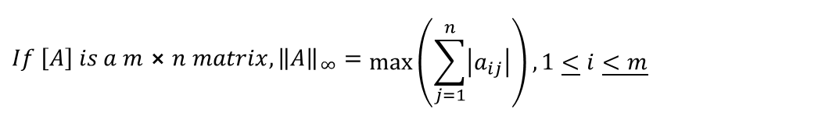
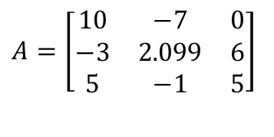


Norm of a matrix
$${If \left[A\right] is a m⨯n matrix, \left\|A\right\|}_{∞}=\begin{matrix} \\ \max\left(\sum_{j=1}^{n}{\left|a_{ij}\right|}\right),1\underline{<}i\underline{<m}\end{matrix}$$
$$A=\left[\begin{matrix}10 & −7 & 0 \\ −3 & 2.099 & 6 \\ 5 & −1 & 5\end{matrix}\right]$$
Find the row sum norm of the following matrix
$${\left\|A\right\|}_{∞}=\max\left(\sum_{j=1}^{n}{\left|a_{ij}\right|}\right),1\underline{<}i\underline{<m}$$
$$=\text{max}\left[\left(\left|10\right|+\left|−7\right|+\left|0\right|\right),\left(\left|−3\right|+\left|2.099\right|+\left|6\right|\right),\left(\left|5\right|+\left|−1\right|+\left|5\right|\right)\right]$$
$$=\max\left[\left(10+7+0\right),\left(3+2.099+6\right),\left(5+1+5\right)\right]$$
$$=\max\left[17, 11.099, 11\right]$$
$$=17.$$

Slide 3
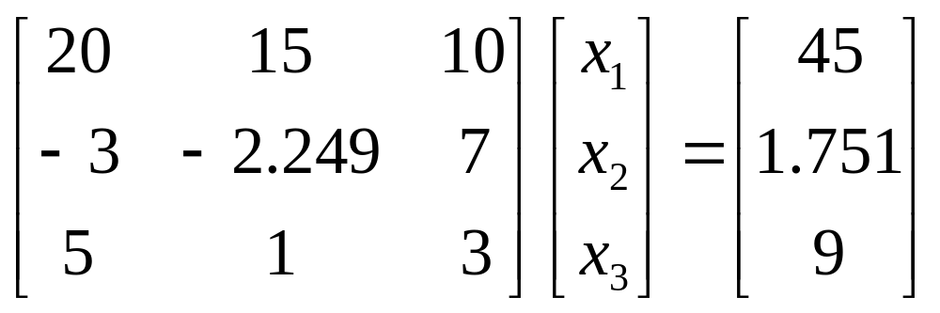
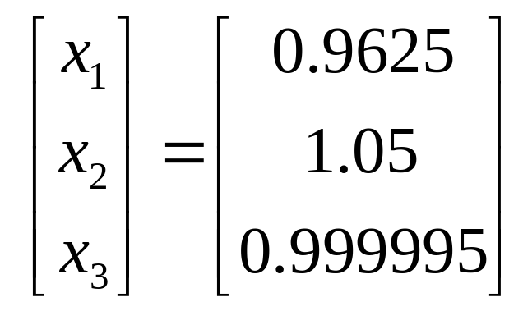
Accuracy of Solution
Solve it on a computer using 6 significant digits with chopping

Slide 4
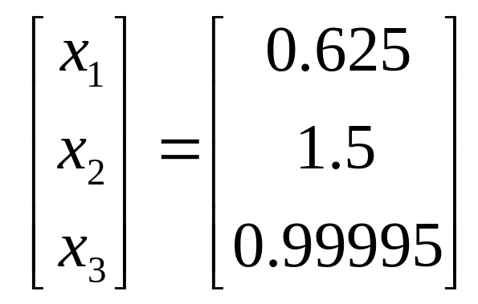
Accuracy of Solution
Solve it on a computer using 5 significant digits with chopping

Slide 5
Well-conditioned and ill-conditioned
What do you mean by ill-conditioned and well-conditioned system of equations?
A system of equations is considered to be well-conditioned if a small change in the coefficient matrix or a small change in the right hand side results in a small change in the solution vector.
A system of equations is considered to be ill-conditioned if a small change in the coefficient matrix or a small change in the right hand side results in a large change in the solution vector.

Slide 6
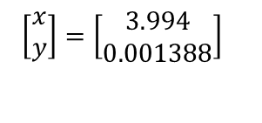
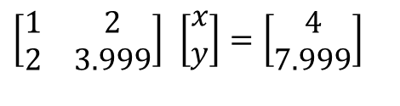
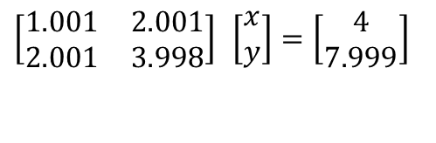
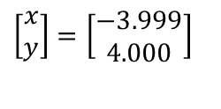
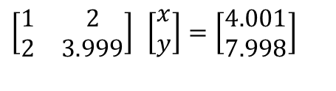
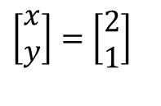
Is this system of equations well-conditioned or ill-conditioned?
$$\left[\begin{matrix}1 & 2 \\ 2 & 3.999\end{matrix}\right] \left[\begin{matrix}x \\ y\end{matrix}\right]=\left[\begin{matrix}4 \\ 7.999\end{matrix}\right]$$
$$\left[\begin{matrix}x \\ y\end{matrix}\right]=\left[\begin{matrix}2 \\ 1\end{matrix}\right]$$
$$\left[\begin{matrix}1 & 2 \\ 2 & 3.999\end{matrix}\right] \left[\begin{matrix}x \\ y\end{matrix}\right]=\left[\begin{matrix}4.001 \\ 7.998\end{matrix}\right]$$
$$\left[\begin{matrix}x \\ y\end{matrix}\right]=\left[\begin{matrix}−3.999 \\ 4.000\end{matrix}\right]$$
$$\left[\begin{matrix}1.001 & 2.001 \\ 2.001 & 3.998\end{matrix}\right] \left[\begin{matrix}x \\ y\end{matrix}\right]=\left[\begin{matrix}4 \\ 7.999\end{matrix}\right]$$
$$\left[\begin{matrix}x \\ y\end{matrix}\right]=\left[\begin{matrix}3.994 \\ 0.001388\end{matrix}\right]$$

Slide 7
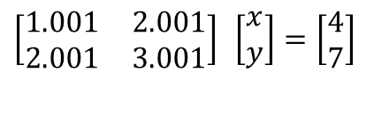
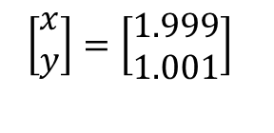
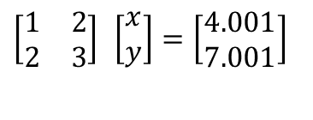
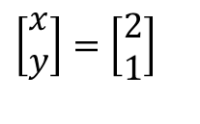
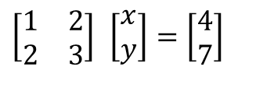
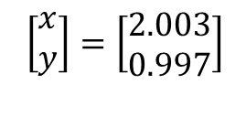
Is this system of equations well-conditioned or ill-conditioned?
$$×$$
$$×$$
$$\left[\begin{matrix}1 & 2 \\ 2 & 3\end{matrix}\right] \left[\begin{matrix}x \\ y\end{matrix}\right]=\left[\begin{matrix}4 \\ 7\end{matrix}\right]$$
$$\left[\begin{matrix}x \\ y\end{matrix}\right]=\left[\begin{matrix}2 \\ 1\end{matrix}\right]$$
$$\left[\begin{matrix}1 & 2 \\ 2 & 3\end{matrix}\right] \left[\begin{matrix}x \\ y\end{matrix}\right]=\left[\begin{matrix}4.001 \\ 7.001\end{matrix}\right]$$
$$\left[\begin{matrix}x \\ y\end{matrix}\right]=\left[\begin{matrix}1.999 \\ 1.001\end{matrix}\right]$$
$$\left[\begin{matrix}1.001 & 2.001 \\ 2.001 & 3.001\end{matrix}\right] \left[\begin{matrix}x \\ y\end{matrix}\right]=\left[\begin{matrix}4 \\ 7\end{matrix}\right]$$
$$\left[\begin{matrix}x \\ y\end{matrix}\right]=\left[\begin{matrix}2.003 \\ 0.997\end{matrix}\right]$$

Slide 8

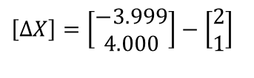
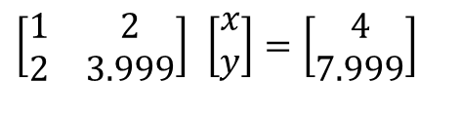

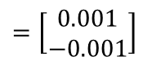
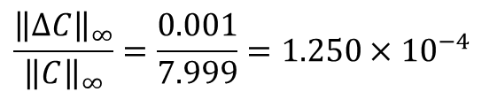

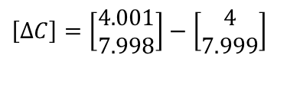
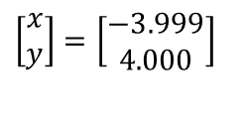
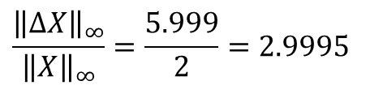
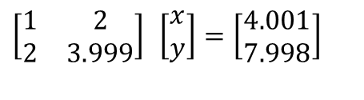
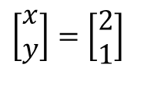


How does norm help in finding conditioning of the matrix?
$$\left[\begin{matrix}1 & 2 \\ 2 & 3.999\end{matrix}\right] \left[\begin{matrix}x \\ y\end{matrix}\right]=\left[\begin{matrix}4 \\ 7.999\end{matrix}\right]$$
$$\left[\begin{matrix}x \\ y\end{matrix}\right]=\left[\begin{matrix}2 \\ 1\end{matrix}\right]$$
$${\left\|C\right\|}_{∞}=7.999$$
$${\left\|X\right\|}_{∞}=2$$
$$\left[\begin{matrix}1 & 2 \\ 2 & 3.999\end{matrix}\right] \left[\begin{matrix}x \\ y\end{matrix}\right]=\left[\begin{matrix}4.001 \\ 7.998\end{matrix}\right]$$
$$\left[\begin{matrix}x \\ y\end{matrix}\right]=\left[\begin{matrix}−3.999 \\ 4.000\end{matrix}\right]$$
$$\left[ΔC\right]=\left[\begin{matrix}4.001 \\ 7.998\end{matrix}\right]−\left[\begin{matrix}4 \\ 7.999\end{matrix}\right]$$
$$=\left[\begin{matrix}0.001 \\ −0.001\end{matrix}\right]$$
$${\left\|ΔC\right\|}_{∞}=0.001$$
$$\left[ΔX\right]=\left[\begin{matrix}−3.999 \\ 4.000\end{matrix}\right]−\left[\begin{matrix}2 \\ 1\end{matrix}\right]$$
$$=\left[\begin{matrix}−5.999 \\ 3.000\end{matrix}\right]$$
$${\left\|ΔX\right\|}_{∞}=5.999$$
$$\frac{{\left\|ΔC\right\|}_{∞}}{{\left\|C\right\|}_{∞}}=\frac{0.001}{7.999}=1.250×10^{−4}$$
$$\frac{{\left\|ΔX\right\|}_{∞}}{{\left\|X\right\|}_{∞}}=\frac{5.999}{2}=2.9995$$

Slide 9

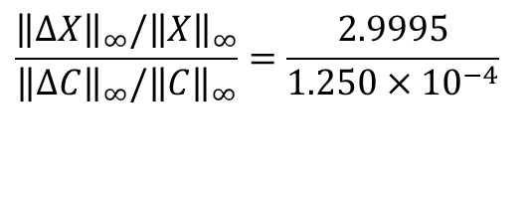
How does norm help in finding conditioning of the matrix?
$$\frac{{\left\|ΔX\right\|}_{∞}/{\left\|X\right\|}_{∞}}{{\left\|ΔC\right\|}_{∞}/{\left\|C\right\|}_{∞}}=\frac{2.9995}{1.250×10^{−4}}$$
$$=23993$$

Slide 10
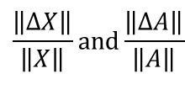
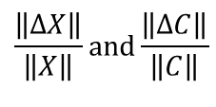
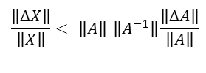
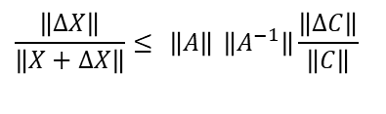
Identifying well-conditioned and ill conditioned system of equations
There is a relationship that exists between
and between
These relationships are
$$\frac{\left\|ΔX\right\|}{\left\|X\right\|}\text{and}\frac{\left\|ΔC\right\|}{\left\|C\right\|}$$
$$\frac{\left\|ΔX\right\|}{\left\|X\right\|}\text{and}\frac{\left\|ΔA\right\|}{\left\|A\right\|}$$
$$\frac{\left\|ΔX\right\|}{\left\|X+ΔX\right\|}≤ \left\|A\right\| \left\|A^{−1}\right\|\frac{\left\|ΔC\right\|}{\left\|C\right\|}$$
$$\frac{\left\|ΔX\right\|}{\left\|X\right\|}\underline{<} \left\|A\right\| \left\|A^{−1}\right\|\frac{\left\|ΔA\right\|}{\left\|A\right\|}$$

Slide 11

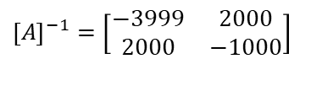

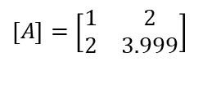



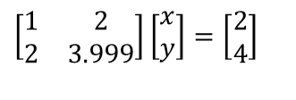
How many sig digits can I trust in my solution?
$$\left[\begin{matrix}1 & 2 \\ 2 & 3.999\end{matrix}\right]\left[\begin{matrix}x \\ y\end{matrix}\right]=\left[\begin{matrix}2 \\ 4\end{matrix}\right]$$
How many significant digits can I trust in the solution of the above system of equations?
$$\left[A\right]=\left[\begin{matrix}1 & 2 \\ 2 & 3.999\end{matrix}\right]$$
$${\left[A\right]}^{−1}=\left[\begin{matrix}−3999 & 2000 \\ 2000 & −1000\end{matrix}\right]$$
$${\left\|A\right\|}_{∞}=5.999$$
$${\left\|A^{−1}\right\|}_{∞}=5999$$
$$Cond\left(A\right)={\left\|A\right\|}_{∞}{\left\|A^{−1}\right\|}_{∞}$$
$$=5.999×5999.4$$
$$=35990$$

Slide 12

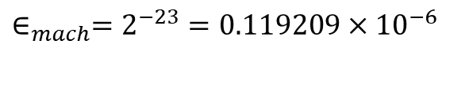


How many sig digits can I trust in my solution? (cont)
Assuming single precision with 23 bits used for the magnitude of mantissa for real numbers, the machine epsilon is
Comparing it with
So two significant digits are at least correct in the solution vector as
$$∈_{mach}=2^{−23}=0.119209×10^{−6}$$
$$Cond(A)×∈_{mach}=35990×0.119209×10^{−6}=0.4290×10^{−2}$$
$$0.5×10^{−m}$$
$$0.4290×10^{−2}≤0.5×10^{−m}$$
$$m\underline{<}2$$

