Slide 1
Simultaneous Linear Equations and Matrix Algebra
Major: All Engineering Majors
Author(s): Autar Kaw
http://nm.MathForCollege.com
Transforming Numerical Methods Education for STEM Undergraduates

Slide 2
Inverse of a Matrix

Slide 3
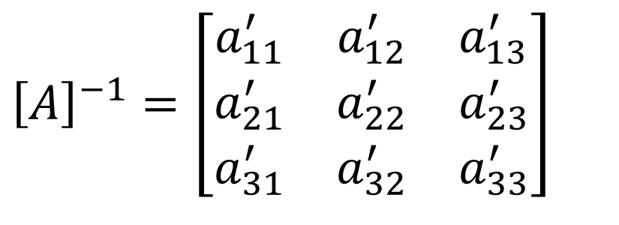
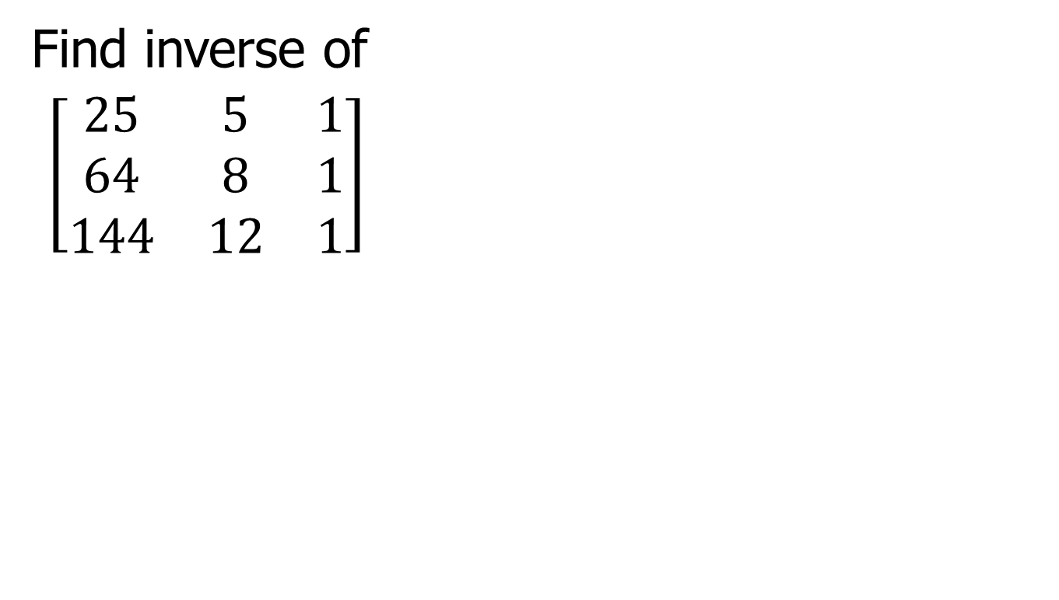
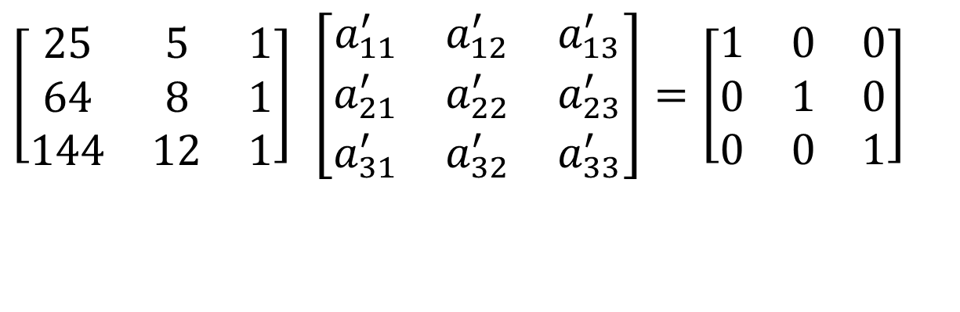
Find Inverse of Matrix
Find inverse of
$\left[\begin{matrix}25 & 5 & 1 \\ 64 & 8 & 1 \\ 144 & 12 & 1\end{matrix}\right]$
$${\left[A\right]}^{−1}=\left[\begin{matrix}a_{11}^{′} & a_{12}^{′} & a_{13}^{′} \\ a_{21}^{′} & a_{22}^{′} & a_{23}^{′} \\ a_{31}^{′} & a_{32}^{′} & a_{33}^{′}\end{matrix}\right]$$
$$\left[\begin{matrix}25 & 5 & 1 \\ 64 & 8 & 1 \\ 144 & 12 & 1\end{matrix}\right] \left[\begin{matrix}a_{11}^{′} & a_{12}^{′} & a_{13}^{′} \\ a_{21}^{′} & a_{22}^{′} & a_{23}^{′} \\ a_{31}^{′} & a_{32}^{′} & a_{33}^{′}\end{matrix}\right]=\left[\begin{matrix}1 & 0 & 0 \\ 0 & 1 & 0 \\ 0 & 0 & 1\end{matrix}\right]$$

Slide 4
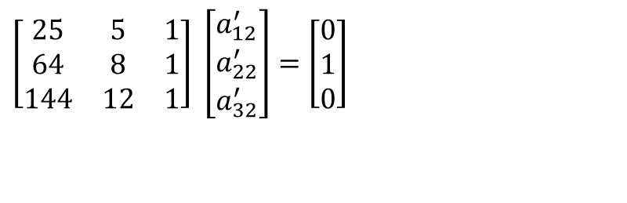
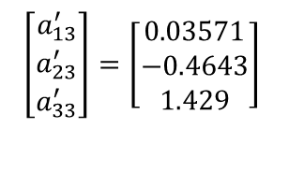
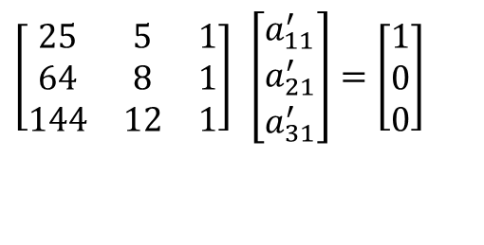
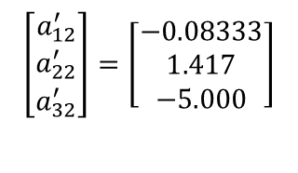
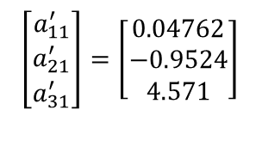
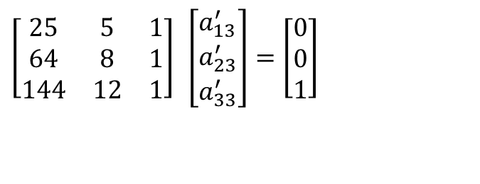
Setting up equations to find inverse
$$\left[\begin{matrix}25 & 5 & 1 \\ 64 & 8 & 1 \\ 144 & 12 & 1\end{matrix}\right] \left[\begin{matrix}a_{11}^{′} \\ a_{21}^{′} \\ a_{31}^{′}\end{matrix}\right]=\left[\begin{matrix}1 \\ 0 \\ 0\end{matrix}\right]$$
$$\left[\begin{matrix}a_{11}^{′} \\ a_{21}^{′} \\ a_{31}^{′}\end{matrix}\right]=\left[\begin{matrix}0.04762 \\ −0.9524 \\ 4.571\end{matrix}\right]$$
$$\left[\begin{matrix}25 & 5 & 1 \\ 64 & 8 & 1 \\ 144 & 12 & 1\end{matrix}\right] \left[\begin{matrix}a_{12}^{′} \\ a_{22}^{′} \\ a_{32}^{′}\end{matrix}\right]=\left[\begin{matrix}0 \\ 1 \\ 0\end{matrix}\right]$$
$$\left[\begin{matrix}a_{12}^{′} \\ a_{22}^{′} \\ a_{32}^{′}\end{matrix}\right]=\left[\begin{matrix}−0.08333 \\ 1.417 \\ −5.000\end{matrix}\right]$$
$$\left[\begin{matrix}25 & 5 & 1 \\ 64 & 8 & 1 \\ 144 & 12 & 1\end{matrix}\right] \left[\begin{matrix}a_{13}^{′} \\ a_{23}^{′} \\ a_{33}^{′}\end{matrix}\right]=\left[\begin{matrix}0 \\ 0 \\ 1\end{matrix}\right]$$
$$\left[\begin{matrix}a_{13}^{′} \\ a_{23}^{′} \\ a_{33}^{′}\end{matrix}\right]=\left[\begin{matrix}0.03571 \\ −0.4643 \\ 1.429\end{matrix}\right]$$

Slide 5
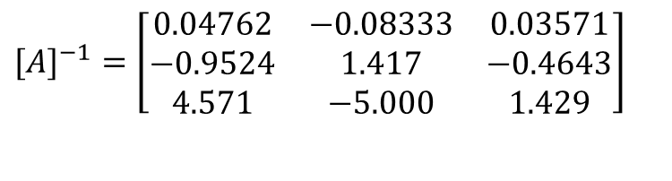
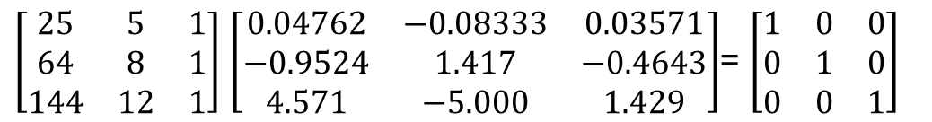
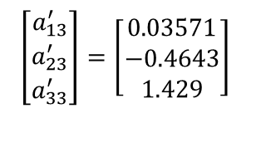
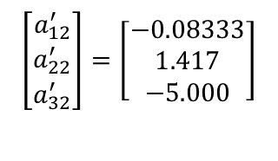
Putting the solutions in matrix
$$\left[\begin{matrix}a_{11}^{′} \\ a_{21}^{′} \\ a_{31}^{′}\end{matrix}\right]=\left[\begin{matrix}0.04762 \\ −0.9524 \\ 4.571\end{matrix}\right]$$
$$\left[\begin{matrix}a_{12}^{′} \\ a_{22}^{′} \\ a_{32}^{′}\end{matrix}\right]=\left[\begin{matrix}−0.08333 \\ 1.417 \\ −5.000\end{matrix}\right]$$
$$\left[\begin{matrix}a_{13}^{′} \\ a_{23}^{′} \\ a_{33}^{′}\end{matrix}\right]=\left[\begin{matrix}0.03571 \\ −0.4643 \\ 1.429\end{matrix}\right]$$
$$[A]^{−1}=\left[\begin{matrix}0.04762 & −0.08333 & 0.03571 \\ −0.9524 & 1.417 & −0.4643 \\ 4.571 & −5.000 & 1.429\end{matrix}\right]$$
$\left[\begin{matrix}25 & 5 & 1 \\ 64 & 8 & 1 \\ 144 & 12 & 1\end{matrix}\right]$ $\left[\begin{matrix}0.04762 & −0.08333 & 0.03571 \\ −0.9524 & 1.417 & −0.4643 \\ 4.571 & −5.000 & 1.429\end{matrix}\right]$= $\left[\begin{matrix}1 & 0 & 0 \\ 0 & 1 & 0 \\ 0 & 0 & 1\end{matrix}\right]$

Slide 6
THE END

Slide 7
Naïve Gauss Elimination Steps

Slide 8
Naïve Gaussian Elimination
A method to solve simultaneous linear equations of the form [A][X]=[C]
Two steps
1. Forward Elimination
2. Back Substitution

Slide 9
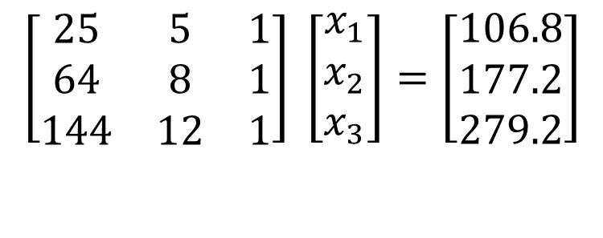
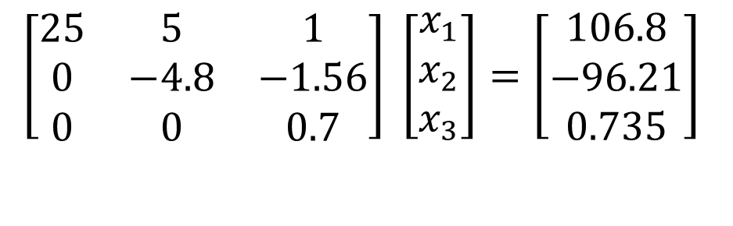
Forward Elimination
The goal of forward elimination is to transform the coefficient matrix into an upper triangular matrix
$$\left[\begin{matrix}25 & 5 & 1 \\ 64 & 8 & 1 \\ 144 & 12 & 1\end{matrix}\right] \left[\begin{matrix}x_{1} \\ x_{2} \\ x_{3}\end{matrix}\right]=\left[\begin{matrix}106.8 \\ 177.2 \\ 279.2\end{matrix}\right]$$
$$\left[\begin{matrix}25 & 5 & 1 \\ 0 & −4.8 & −1.56 \\ 0 & 0 & 0.7\end{matrix}\right] \left[\begin{matrix}x_{1} \\ x_{2} \\ x_{3}\end{matrix}\right]=\left[\begin{matrix}106.8 \\ −96.21 \\ 0.735\end{matrix}\right]$$

Slide 10
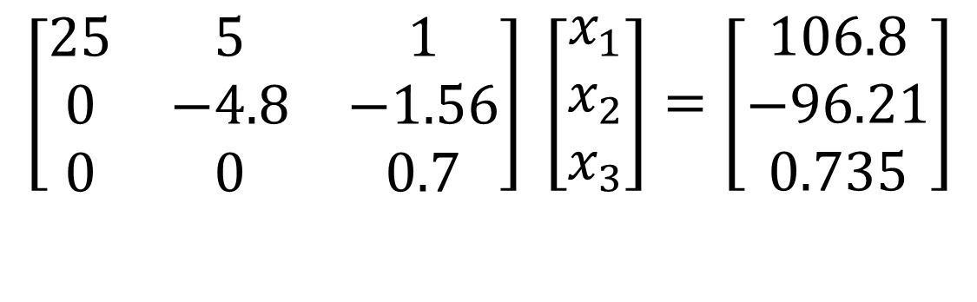
Back Substitution
Solve each equation starting from the last equation
$$\left[\begin{matrix}25 & 5 & 1 \\ 0 & −4.8 & −1.56 \\ 0 & 0 & 0.7\end{matrix}\right] \left[\begin{matrix}x_{1} \\ x_{2} \\ x_{3}\end{matrix}\right]=\left[\begin{matrix}106.8 \\ −96.21 \\ 0.735\end{matrix}\right]$$

Slide 11
THE END

Slide 12
Determinant of a Square Matrix Using Naïve Gauss Elimination
Notes:
12

Slide 13
Theorem of Determinants
If a multiple of one row of [A]_{nxn} is added or subtracted to another row of [A]_{nxn} to result in [B]_{nxn} then det(A)=det(B)
Notes:
13

Slide 14
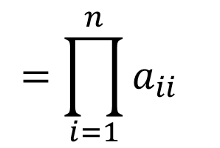
Theorem of Determinants
The determinant of an upper triangular, lower triangular or diagonal matrix [A]_{nxn} is given by
$$\text{det}\left(A\right)=a_{11}×a_{22}×...×a_{ii}×...×a_{nn}$$
$$=\prod_{i=1}^{n}{a_{ii}}$$
Notes:
14

Slide 15
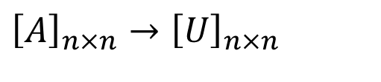
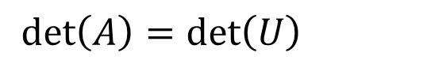
Forward Elimination of a Square Matrix
Using forward elimination to transform [A]_{nxn} to an upper triangular matrix, [U]_{nxn}.
$${\left[A\right]}_{n×n}→{\left[U\right]}_{n×n}$$
$$\det\left(A\right)=\det\left(U\right)$$
Notes:
15

Slide 16
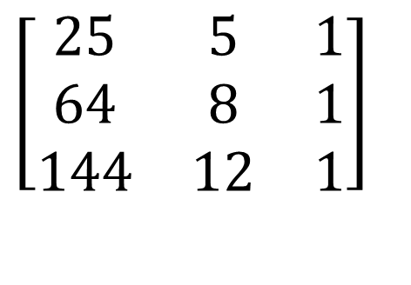
Using Naive Gaussian Elimination method, find the determinant of the following square matrix.
$$\left[\begin{matrix}25 & 5 & 1 \\ 64 & 8 & 1 \\ 144 & 12 & 1\end{matrix}\right]$$
Notes:
16

Slide 17
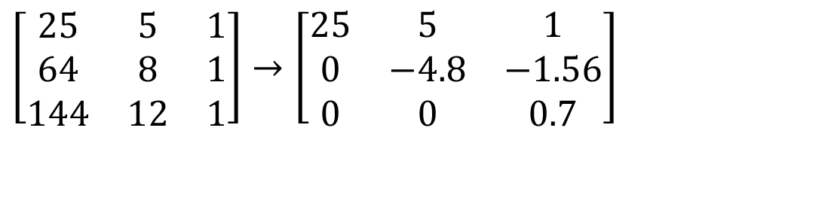
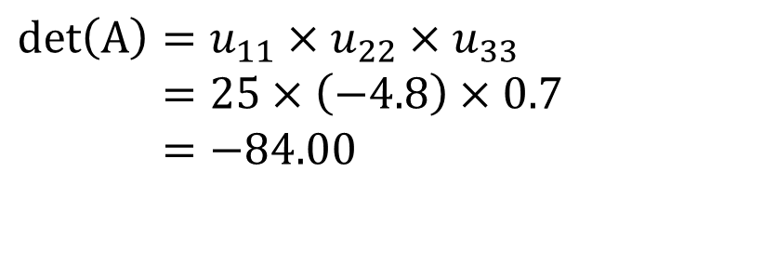
Finding the Determinant
After forward elimination steps
$$\left[\begin{matrix}25 & 5 & 1 \\ 64 & 8 & 1 \\ 144 & 12 & 1\end{matrix}\right]→\left[\begin{matrix}25 & 5 & 1 \\ 0 & −4.8 & −1.56 \\ 0 & 0 & 0.7\end{matrix}\right]$$
.
$$\text{det}\left(A\right)=u_{11}×u_{22}×u_{33} \\ =25×\left(−4.8\right)×0.7 \\ =−84.00$$
Notes:
17

Slide 18
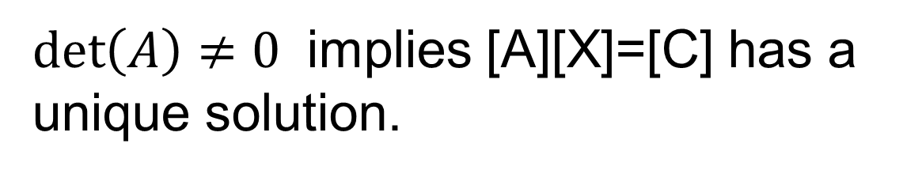
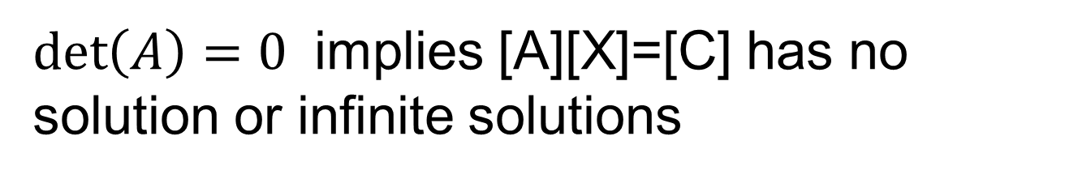
What does det(A)=0 and det(A)≠0 mean for [A][X]=[C]
$\det\left(A\right)=0$ implies [A][X]=[C] has no solution or infinite solutions
$\det\left(A\right)≠0$ implies [A][X]=[C] has a unique solution.

Slide 19
THE END

Slide 20
Naïve Gauss Elimination Pitfalls

Slide 21
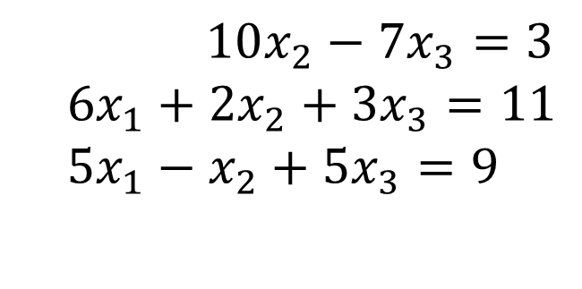
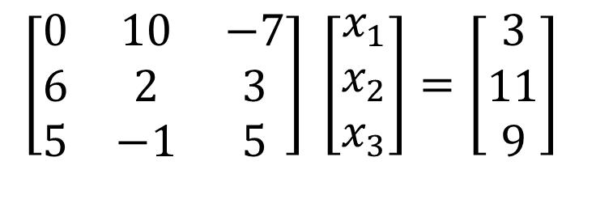
Pitfall#1. Division by zero
$10x_{2}−7x_{3}=3$
$$6x_{1}+2x_{2}+3x_{3}=11 \\ 5x_{1}−x_{2}+5x_{3}=9$$
$$\left[\begin{matrix}0 & 10 & −7 \\ 6 & 2 & 3 \\ 5 & −1 & 5\end{matrix}\right] \left[\begin{matrix}x_{1} \\ x_{2} \\ x_{3}\end{matrix}\right]=\left[\begin{matrix}3 \\ 11 \\ 9\end{matrix}\right]$$

Slide 22
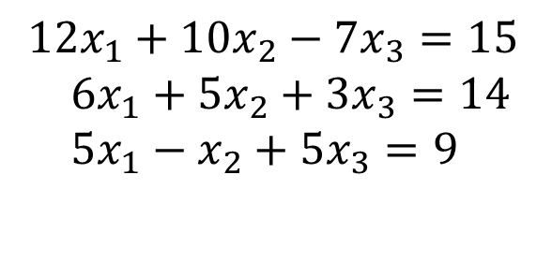
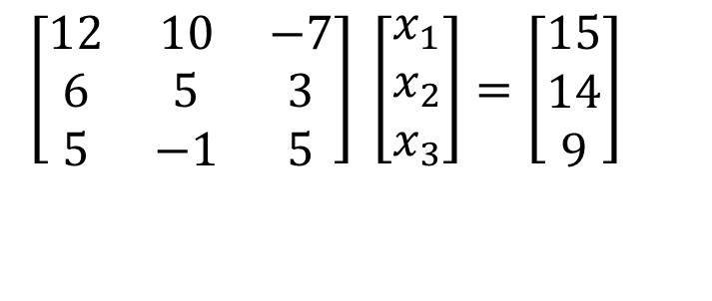
Is division by zero an issue here?
$$12x_{1}+10x_{2}−7x_{3}=15 \\ 6x_{1}+5x_{2}+3x_{3}=14 \\ 5x_{1}−x_{2}+5x_{3}=9$$
$$\left[\begin{matrix}12 & 10 & −7 \\ 6 & 5 & 3 \\ 5 & −1 & 5\end{matrix}\right] \left[\begin{matrix}x_{1} \\ x_{2} \\ x_{3}\end{matrix}\right]=\left[\begin{matrix}15 \\ 14 \\ 9\end{matrix}\right]$$

Slide 23
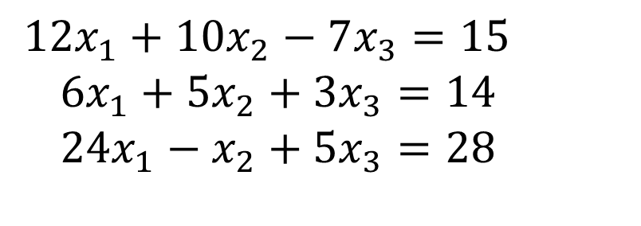
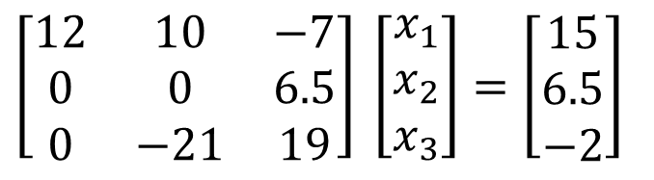
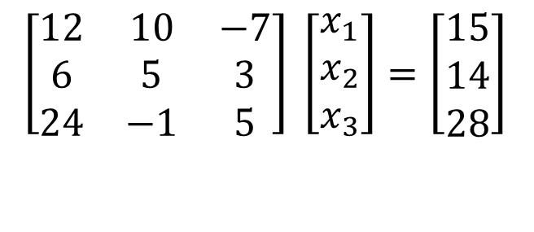
Is division by zero an issue here? YES
$$12x_{1}+10x_{2}−7x_{3}=15 \\ 6x_{1}+5x_{2}+3x_{3}=14 \\ 24x_{1}−x_{2}+5x_{3}=28$$
$$\left[\begin{matrix}12 & 10 & −7 \\ 6 & 5 & 3 \\ 24 & −1 & 5\end{matrix}\right] \left[\begin{matrix}x_{1} \\ x_{2} \\ x_{3}\end{matrix}\right]=\left[\begin{matrix}15 \\ 14 \\ 28\end{matrix}\right]$$
$$\left[\begin{matrix}12 & 10 & −7 \\ 0 & 0 & 6.5 \\ 0 & −21 & 19\end{matrix}\right] \left[\begin{matrix}x_{1} \\ x_{2} \\ x_{3}\end{matrix}\right]=\left[\begin{matrix}15 \\ 6.5 \\ −2\end{matrix}\right]$$
Division by zero is a possibility at any step of forward elimination

Slide 24
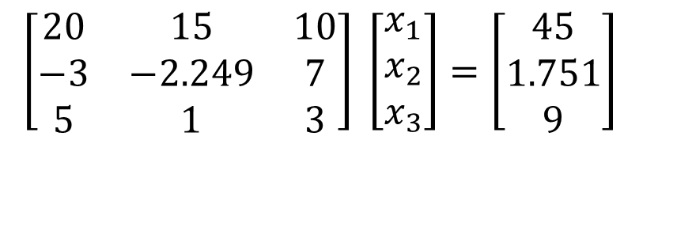
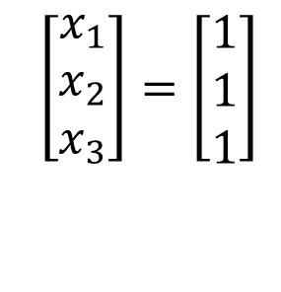
Pitfall#2. Large Round-off Errors
$$\left[\begin{matrix}20 & 15 & 10 \\ −3 & −2.249 & 7 \\ 5 & 1 & 3\end{matrix}\right] \left[\begin{matrix}x_{1} \\ x_{2} \\ x_{3}\end{matrix}\right]=\left[\begin{matrix}45 \\ 1.751 \\ 9\end{matrix}\right]$$
Exact Solution
$$\left[\begin{matrix}x_{1} \\ x_{2} \\ x_{3}\end{matrix}\right]=\left[\begin{matrix}1 \\ 1 \\ 1\end{matrix}\right]$$

Slide 25
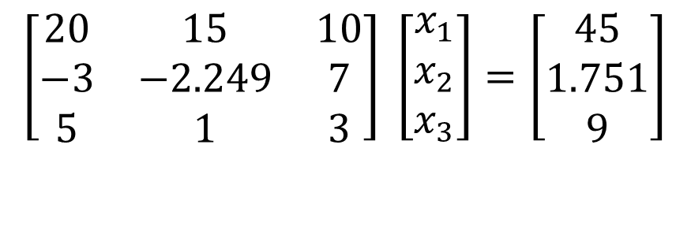
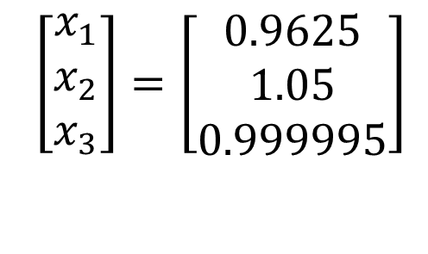
Pitfall#2. Large Round-off Errors
$$\left[\begin{matrix}20 & 15 & 10 \\ −3 & −2.249 & 7 \\ 5 & 1 & 3\end{matrix}\right] \left[\begin{matrix}x_{1} \\ x_{2} \\ x_{3}\end{matrix}\right]=\left[\begin{matrix}45 \\ 1.751 \\ 9\end{matrix}\right]$$
Solve it on a computer using 6 significant digits with chopping
$$\left[\begin{matrix}x_{1} \\ x_{2} \\ x_{3}\end{matrix}\right]=\left[\begin{matrix}0.9625 \\ 1.05 \\ 0.999995\end{matrix}\right]$$

Slide 26
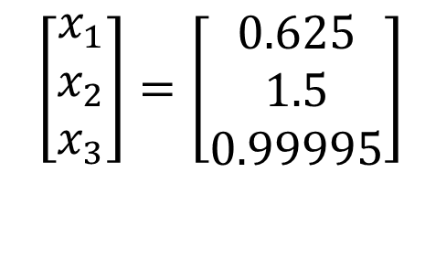
Pitfall#2. Large Round-off Errors
$$\left[\begin{matrix}20 & 15 & 10 \\ −3 & −2.249 & 7 \\ 5 & 1 & 3\end{matrix}\right] \left[\begin{matrix}x_{1} \\ x_{2} \\ x_{3}\end{matrix}\right]=\left[\begin{matrix}45 \\ 1.751 \\ 9\end{matrix}\right]$$
Solve it on a computer using 5 significant digits with chopping
$$\left[\begin{matrix}x_{1} \\ x_{2} \\ x_{3}\end{matrix}\right]=\left[\begin{matrix}0.625 \\ 1.5 \\ 0.99995\end{matrix}\right]$$
Is there a way to reduce the round off error?

Slide 27
Avoiding Pitfalls
Increase the number of significant digits
Decreases round-off error
Does not avoid division by zero

Slide 28
Avoiding Pitfalls
Use Gaussian Elimination with Partial Pivoting
Avoids division by zero
Reduces round off error

Slide 29
THE END

Slide 30
Gauss Elimination with Partial Pivoting

Slide 31
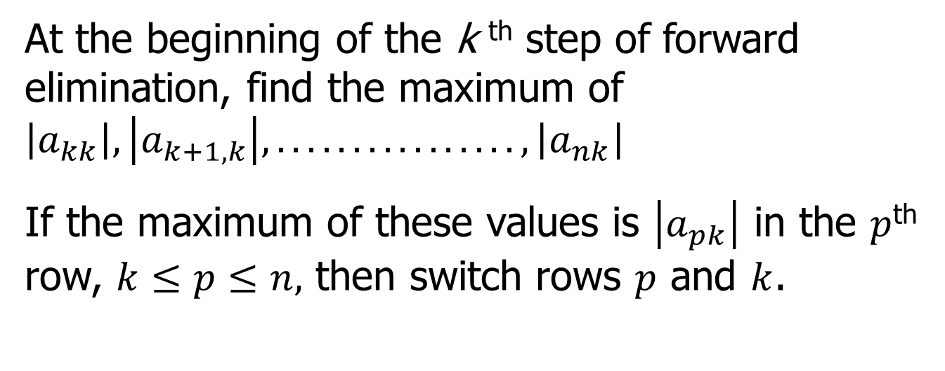
What is Different About Partial Pivoting?
At the beginning of the k ^{th} step of forward elimination, find the maximum of $\left|a_{kk}\right|,\left|a_{k+1,k}\right|,................,\left|a_{nk}\right|$
If the maximum of these values is $\left|a_{pk}\right|$ in the $p$^{th} row, $k≤p≤n,$ then switch rows $p$ and $k$.

Slide 32
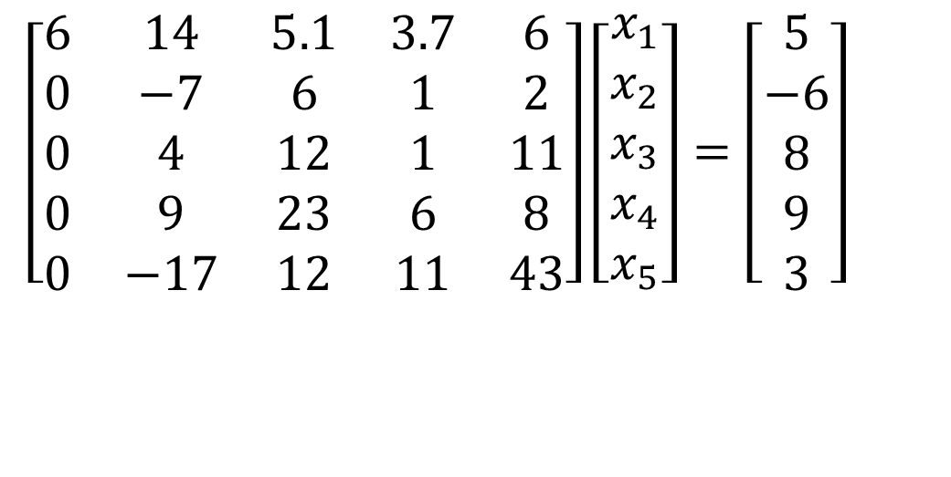
Example (2nd step of FE)
$$\left[\begin{matrix}6 & 14 & 5.1 & 3.7 & 6 \\ 0 & −7 & 6 & 1 & 2 \\ 0 & 4 & 12 & 1 & 11 \\ 0 & 9 & 23 & 6 & 8 \\ 0 & −17 & 12 & 11 & 43\end{matrix}\right]\left[\begin{matrix}x_{1} \\ x_{2} \\ x_{3} \\ x_{4} \\ x_{5}\end{matrix}\right]=\left[\begin{matrix}5 \\ −6 \\ 8 \\ 9 \\ 3\end{matrix}\right]$$
Which two rows would you switch?

Slide 33
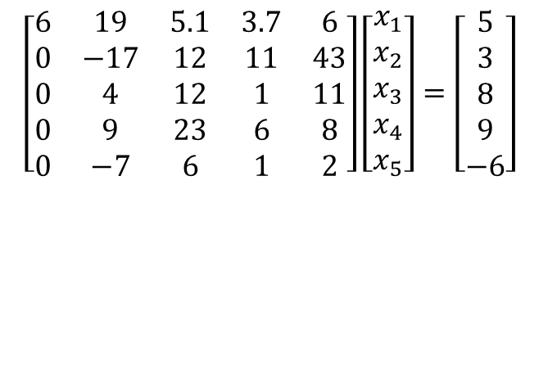
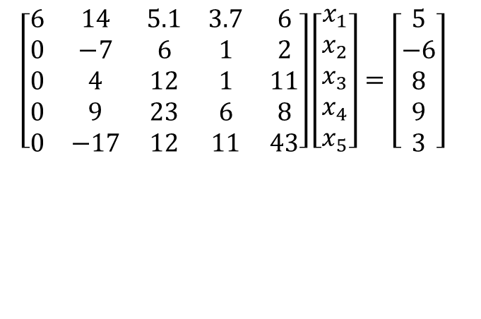
Example (2nd step of FE)
$$\left[\begin{matrix}6 & 14 & 5.1 & 3.7 & 6 \\ 0 & −7 & 6 & 1 & 2 \\ 0 & 4 & 12 & 1 & 11 \\ 0 & 9 & 23 & 6 & 8 \\ 0 & −17 & 12 & 11 & 43\end{matrix}\right]\left[\begin{matrix}x_{1} \\ x_{2} \\ x_{3} \\ x_{4} \\ x_{5}\end{matrix}\right]=\left[\begin{matrix}5 \\ −6 \\ 8 \\ 9 \\ 3\end{matrix}\right]$$
$$\left[\begin{matrix}6 & 19 & 5.1 & 3.7 & 6 \\ 0 & −17 & 12 & 11 & 43 \\ 0 & 4 & 12 & 1 & 11 \\ 0 & 9 & 23 & 6 & 8 \\ 0 & −7 & 6 & 1 & 2\end{matrix}\right]\left[\begin{matrix}x_{1} \\ x_{2} \\ x_{3} \\ x_{4} \\ x_{5}\end{matrix}\right]=\left[\begin{matrix}5 \\ 3 \\ 8 \\ 9 \\ −6\end{matrix}\right]$$

Slide 34
Gaussian Elimination with Partial Pivoting
A method to solve simultaneous linear equations of the form [A][X]=[C]
Two steps
1. Forward Elimination
2. Back Substitution

Slide 35
THE END

Slide 36
Gauss Elimination with Partial Pivoting Example

Slide 37
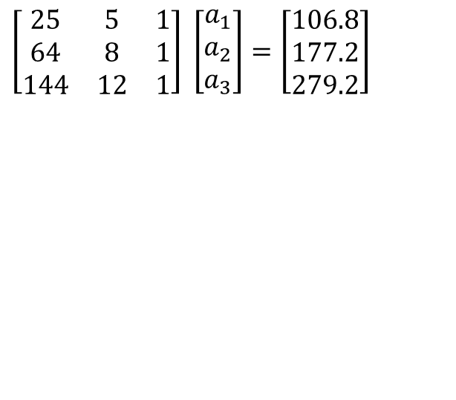
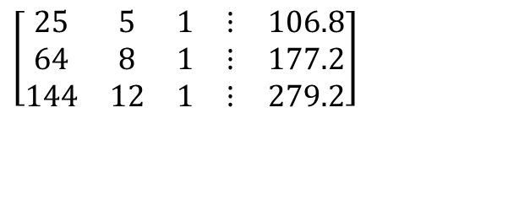
Solve the following set of equations by Gaussian elimination with partial pivoting
$$\left[\begin{matrix}25 & 5 & 1 \\ 64 & 8 & 1 \\ 144 & 12 & 1\end{matrix}\right] \left[\begin{matrix}a_{1} \\ a_{2} \\ a_{3}\end{matrix}\right]=\left[\begin{matrix}106.8 \\ 177.2 \\ 279.2\end{matrix}\right]$$
$$\left[\begin{matrix}25 & 5 & 1 & ⋮ & 106.8 \\ 64 & 8 & 1 & ⋮ & 177.2 \\ 144 & 12 & 1 & ⋮ & 279.2\end{matrix}\right]$$
Notes:
37

Slide 38
Forward Elimination
Notes:
38

Slide 39
Number of Steps of Forward Elimination
Number of steps of forward elimination is
(n−1)=(3−1)=2

Slide 40

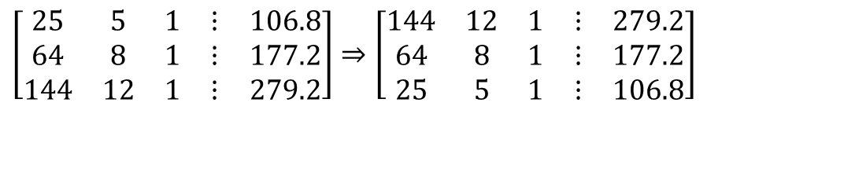
Forward Elimination: Step 1
Examine absolute values of first column, first row
and below.
$$\left|\text{25}\right|,\left|64\right|,\left|144\right|$$
Largest absolute value is 144 and exists in row 3.
Switch row 1 and row 3.
$$\left[\begin{matrix}25 & 5 & 1 & ⋮ & 106.8 \\ 64 & 8 & 1 & ⋮ & 177.2 \\ 144 & 12 & 1 & ⋮ & 279.2\end{matrix}\right]⇒\left[\begin{matrix}144 & 12 & 1 & ⋮ & 279.2 \\ 64 & 8 & 1 & ⋮ & 177.2 \\ 25 & 5 & 1 & ⋮ & 106.8\end{matrix}\right]$$

Slide 41
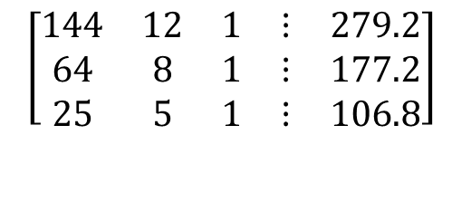
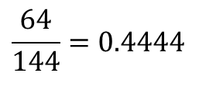
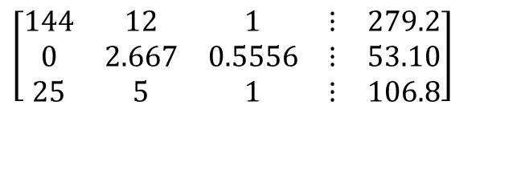
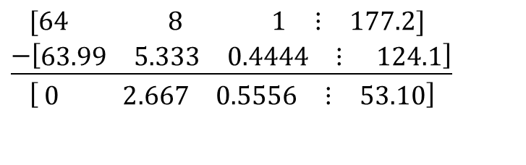
Forward Elimination: Step 1 (cont.)
$$\left[\begin{matrix}144 & 12 & 1 & ⋮ & 279.2 \\ 64 & 8 & 1 & ⋮ & 177.2 \\ 25 & 5 & 1 & ⋮ & 106.8\end{matrix}\right]$$
Divide Equation 1 by 144 and
multiply it by 64, .
$$\frac{64}{144}=0.4444$$
$$\left[\begin{matrix}144 & 12 & 1 & ⋮ & 279.2\end{matrix}\right]×0.4444=\left[\begin{matrix}63.99 & 5.333 & 0.4444 & ⋮ & 124.1\end{matrix}\right]$$
.
$$\left[\begin{matrix}\text{64} & \text{ 8} & _{ }\text{ 1} & ⋮ & \text{177.2}\end{matrix}\right] \\ \underline{−\left[\begin{matrix}\text{63.99} & \text{5.333} & \text{0.4444} & ⋮ & \text{ 124.1}\end{matrix}\right]} \\ \left[ \begin{matrix}0 & 2.667 & 0\text{.5556} & ⋮ & 53.10\end{matrix}\right]$$
Subtract the result from Equation 2
Substitute new equation for Equation 2
$$\left[\begin{matrix}144 & 12 & 1 & ⋮ & 279.2 \\ 0 & 2.667 & 0.5556 & ⋮ & 53.10 \\ 25 & 5 & 1 & ⋮ & 106.8\end{matrix}\right]$$
Notes:
41

Slide 42
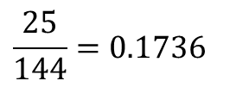
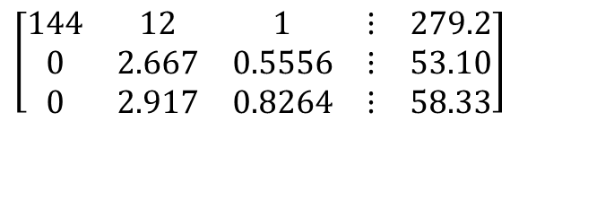
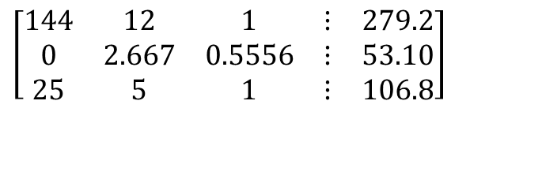

Forward Elimination: Step 1 (cont.)
$$\left[\begin{matrix}144 & 12 & 1 & ⋮ & 279.2 \\ 0 & 2.667 & 0.5556 & ⋮ & 53.10 \\ 25 & 5 & 1 & ⋮ & 106.8\end{matrix}\right]$$
Divide Equation 1 by 144 and
multiply it by 25, .
$$\frac{25}{144}=0.1736$$
$$\left[\begin{matrix}\text{144} & 12 & 1 & ⋮ & \text{279.2}\end{matrix}\right]×0.1736=\left[\begin{matrix}25.00 & 2.083 & 0.1736 & ⋮ & 48.47\end{matrix}\right]$$
.
$$\left[\begin{matrix}\text{25} & \text{ 5} & _{ }\text{ 1} & ⋮ & \text{106.8}\end{matrix}\right] \\ \underline{−\left[\begin{matrix}\text{25} & \text{2.083} & \text{0.1736} & ⋮ & \text{48.47}\end{matrix}\right]} \\ \left[ \begin{matrix}0 & 2.917 & 0.8264 & ⋮ & 58.33\end{matrix}\right]$$
Subtract the result from Equation 3
Substitute new equation for Equation 3
$$\left[\begin{matrix}144 & 12 & 1 & ⋮ & 279.2 \\ 0 & 2.667 & 0.5556 & ⋮ & 53.10 \\ 0 & 2.917 & 0.8264 & ⋮ & 58.33\end{matrix}\right]$$
Notes:
42

Slide 43


Forward Elimination: Step 2
Examine absolute values of second column, second row
and below.
$$\left|2.667\right|,\left|\text{2.917}\right|$$
Largest absolute value is 2.917 and exists in row 3.
Switch row 2 and row 3.
$$\left[\begin{matrix}144 & 12 & 1 & ⋮ & 279.2 \\ 0 & 2.667 & 0.5556 & ⋮ & 53.10 \\ 0 & 2.917 & 0.8264 & ⋮ & 58.33\end{matrix}\right]⇒\left[\begin{matrix}144 & 12 & 1 & ⋮ & 279.2 \\ 0 & 2.917 & 0.8264 & ⋮ & 58.33 \\ 0 & 2.667 & 0.5556 & ⋮ & 53.10\end{matrix}\right]$$

Slide 44




Forward Elimination: Step 2 (cont.)
Divide Equation 2 by 2.917 and
multiply it by 2.667,
$$\left[\begin{matrix}144 & 12 & 1 & ⋮ & 279.2 \\ 0 & 2.917 & 0.8264 & ⋮ & 58.33 \\ 0 & 2.667 & 0.5556 & ⋮ & 53.10\end{matrix}\right]$$
$$\frac{2.667}{2.917}=0.9143.$$
$$\left[\begin{matrix}0 & \text{2.917} & \text{0.8264} & ⋮ & \text{58.33}\end{matrix}\right]×0.9143=\left[\begin{matrix}0 & 2.667 & 0.7556 & ⋮ & 53.33\end{matrix}\right]$$
$$\left[\begin{matrix}0 & \text{2.667} & \text{0.5556} & ⋮ & \text{ 53.10}\end{matrix}\right] \\ \underline{−\left[\begin{matrix}0 & \text{2.667} & \text{0.7556} & ⋮ & \text{ 53.33}\end{matrix}\right]} \\ \left[\begin{matrix}0 & 0 & −0.2 & ⋮ & −0.23\end{matrix}\right]$$
.
Subtract the result from Equation 3
$$\left[\begin{matrix}144 & 12 & 1 & ⋮ & 279.2 \\ 0 & 2.917 & 0.8264 & ⋮ & 58.33 \\ 0 & 0 & −0.2 & ⋮ & −0.23\end{matrix}\right]$$
Substitute new equation for Equation 3
Notes:
44

Slide 45
Back Substitution
Notes:
45

Slide 46


Back Substitution
$$\left[\begin{matrix}144 & 12 & 1 & ⋮ & 279.2 \\ 0 & 2.917 & 0.8264 & ⋮ & 58.33 \\ 0 & 0 & −0.2 & ⋮ & −0.23\end{matrix}\right]⇒\left[\begin{matrix}144 & 12 & 1 \\ 0 & 2.917 & 0.8264 \\ 0 & 0 & −0.2\end{matrix}\right] \left[\begin{matrix}a_{1} \\ a_{2} \\ a_{3}\end{matrix}\right]=\left[\begin{matrix}279.2 \\ 58.33 \\ −0.23\end{matrix}\right]$$
Solving for a₃
$$−0.2a_{3}=−0.23 \\ a_{3}=\frac{−0.23}{−0.2} \\ =\text{1.15}$$
Notes:
46

Slide 47


Back Substitution (cont.)
$$\left[\begin{matrix}144 & 12 & 1 \\ 0 & 2.917 & 0.8264 \\ 0 & 0 & −0.2\end{matrix}\right] \left[\begin{matrix}a_{1} \\ a_{2} \\ a_{3}\end{matrix}\right]=\left[\begin{matrix}279.2 \\ 58.33 \\ −0.23\end{matrix}\right]$$
Solving for a₂
$$2.917a_{2}+0.8264a_{3}=58.33 \\ a_{2}=\frac{58.33−0.8264a_{3}}{2.917} \\ =\frac{58.33−0.8264×1.15}{2.917} \\ =\text{19.}67$$
Notes:
47

Slide 48


Back Substitution (cont.)
$$\left[\begin{matrix}144 & 12 & 1 \\ 0 & 2.917 & 0.8264 \\ 0 & 0 & −0.2\end{matrix}\right] \left[\begin{matrix}a_{1} \\ a_{2} \\ a_{3}\end{matrix}\right]=\left[\begin{matrix}279.2 \\ 58.33 \\ −0.23\end{matrix}\right]$$
$$144a_{1}+12a_{2}+a_{3}=279.2 \\ a_{1}=\frac{279.2−12a_{2}−a_{3}}{144} \\ =\frac{279.2−12×19.67−1.15}{144} \\ =0.2917$$
Notes:
48

Slide 49


Gaussian Elimination with Partial Pivoting Solution
$$\left[\begin{matrix}25 & 5 & 1 \\ 64 & 8 & 1 \\ 144 & 12 & 1\end{matrix}\right] \left[\begin{matrix}a_{1} \\ a_{2} \\ a_{3}\end{matrix}\right]=\left[\begin{matrix}106.8 \\ 177.2 \\ 279.2\end{matrix}\right]$$
$$\left[\begin{matrix}a_{1} \\ a_{2} \\ a_{3}\end{matrix}\right]=\left[\begin{matrix}0.2917 \\ 19.67 \\ 1.15\end{matrix}\right]$$
Notes:
49

Slide 50


