Slide 1
LU Decomposition
Major: All Engineering Majors
Authors: Autar Kaw
http://nm.mathforcollege.com
Transforming Numerical Methods Education for STEM Undergraduates

Slide 2
LU Decomposition
How can this be used?
Given [A][X] = [C]
Decompose [A] into [L] and [U]
Solve [L][Z] = [C] for [Z]
Solve [U][X] = [Z] for [X]

Slide 3
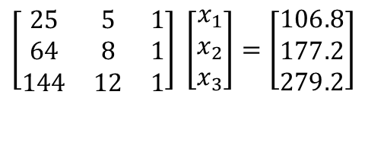
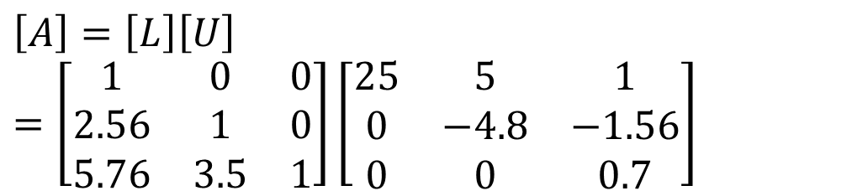
Using LU Decomposition to solve SLEs
Solve the following set of linear equations using LU Decomposition
$$\left[\begin{matrix}25 & 5 & 1 \\ 64 & 8 & 1 \\ 144 & 12 & 1\end{matrix}\right] \left[\begin{matrix}x_{1} \\ x_{2} \\ x_{3}\end{matrix}\right]=\left[\begin{matrix}106.8 \\ 177.2 \\ 279.2\end{matrix}\right]$$
Using the procedure for finding the [L] and [U] matrices
$$\left[A\right]=\left[L\right]\left[U\right]=\left[\begin{matrix}1 & 0 & 0 \\ 2.56 & 1 & 0 \\ 5.76 & 3.5 & 1\end{matrix}\right]\left[\begin{matrix}25 & 5 & 1 \\ 0 & −4.8 & −1.56 \\ 0 & 0 & 0.7\end{matrix}\right]$$

Slide 4

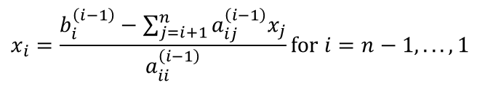
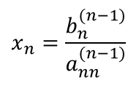
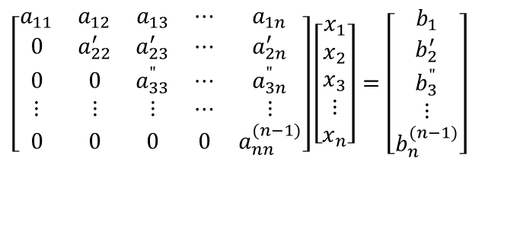
Time Taken by Back Substitution
n = length(B);
X(n)=B(n)/A(n,n)
for i=n-1:-1:1
X(i) = B(i);
for j=(i+1):1:n
X(i) = X(i) - A(i, j)*X(j);
end
X(i) = X(i)/A(i, i);
end
$$\left[\begin{matrix}a_{11} & a_{12} & a_{13} & ⋯ & a_{1n} \\ 0 & a_{22}^{′} & a_{23}^{′} & ⋯ & a_{2n}^{′} \\ 0 & 0 & a_{33}^{"} & ⋯ & a_{3n}^{"} \\ ⋮ & ⋮ & ⋮ & ⋯ & ⋮ \\ 0 & 0 & 0 & 0 & a_{nn}^{(n−1)}\end{matrix}\right]\left[\begin{matrix}x_{1} \\ x_{2} \\ x_{3} \\ ⋮ \\ x_{n}\end{matrix}\right]=\left[\begin{matrix}b_{1} \\ b_{2}^{′} \\ b_{3}^{"} \\ ⋮ \\ b_{n}^{(n−1)}\end{matrix}\right]$$
$$x_{n}=\frac{b_{n}^{(n−1)}}{a_{nn}^{(n−1)}}$$
$$x_{i}=\frac{b_{i}^{\left(i−1\right)}−\sum_{j=i+1}^{n}{a_{ij}^{\left(i−1\right)}x_{j}}}{a_{ii}^{\left(i−1\right)}}\text{for} i=n−1,...,1$$
Back Substitution CT
$$CT|_{BS}=T\left(4n^{2}+12n\right)$$

Slide 5
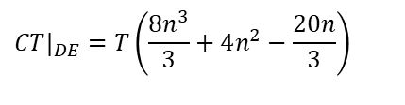

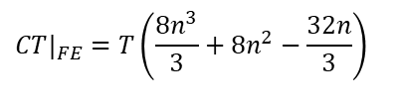


Is LU Decomposition better than Gaussian Elimination?
Solve [A][X] = [B]
T = clock cycle time and nxn = size of the matrix
Forward Elimination
Decomposition to LU
$$CT|_{FE}=T\left(\frac{8n^{3}}{3}+8n^{2}−\frac{32n}{3}\right)$$
$$CT|_{DE}=T\left(\frac{8n^{3}}{3}+4n^{2}−\frac{20n}{3}\right)$$
Back Substitution
Forward Substitution
$$CT|_{BS}=T\left(4n^{2}+12n\right)$$
$$CT|_{FS}=T\left(4n^{2}−4n\right)$$
Back Substitution
$$CT|_{BS}=T\left(4n^{2}+12n\right)$$

Slide 6
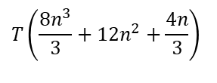
Is LU Decomposition better than Gaussian Elimination?
To solve [A][X] = [B]
Time taken by methods
T = clock cycle time and nxn = size of the matrix
So both methods are equally efficient.
Gaussian Elimination | LU Decomposition
$$T\left(\frac{8n^{3}}{3}+12n^{2}+\frac{4n}{3}\right)$$
$$T\left(\frac{8n^{3}}{3}+12n^{2}+\frac{4n}{3}\right)$$

Slide 7
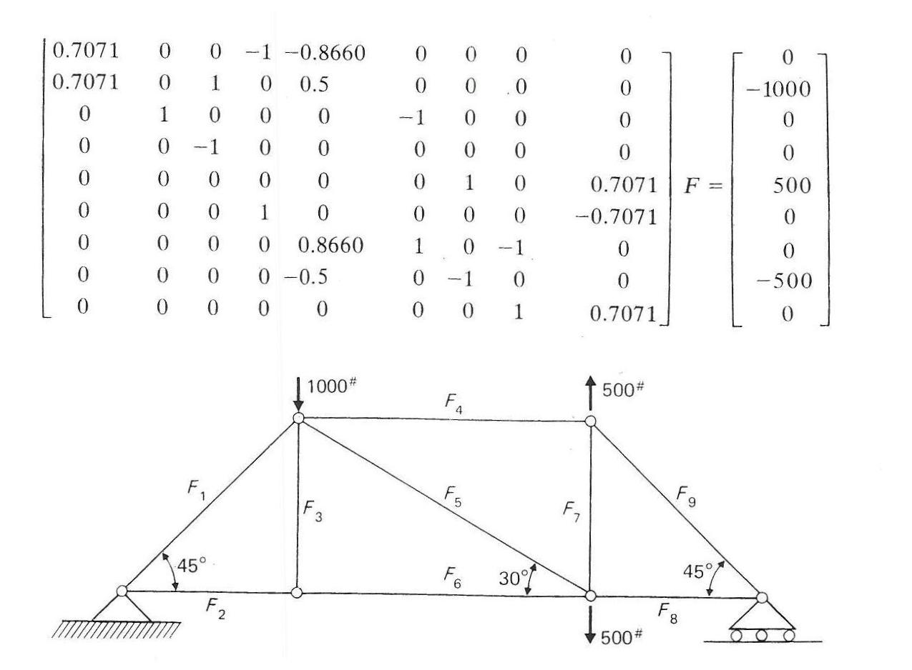
Truss Problem

Slide 8
Finding the inverse of a square matrix
The inverse [B] of a square matrix [A] is defined as
[A][B] = [I] OR [B][A] = [I]

Slide 9
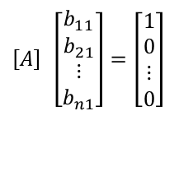
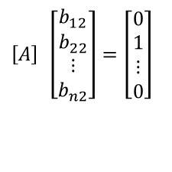
Finding the inverse of a square matrix
How can LU Decomposition be used to find the inverse?
[A][B] = [I]
First column of [B] Second column of [B]
$$\left[A\right] \left[\begin{matrix}b_{11} \\ b_{21} \\ ⋮ \\ b_{n1}\end{matrix}\right]=\left[\begin{matrix}1 \\ 0 \\ ⋮ \\ 0\end{matrix}\right]$$
$$\left[A\right] \left[\begin{matrix}b_{12} \\ b_{22} \\ ⋮ \\ b_{n2}\end{matrix}\right]=\left[\begin{matrix}0 \\ 1 \\ ⋮ \\ 0\end{matrix}\right]$$
The remaining columns in [B] can be found in the same manner

Slide 10
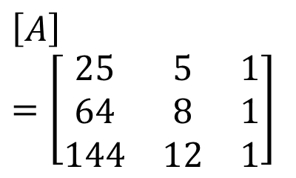
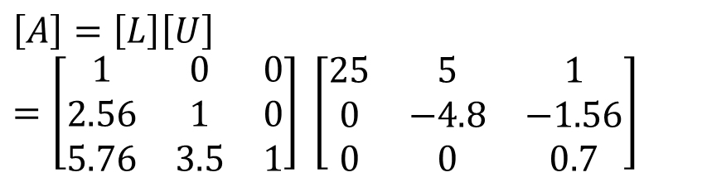
Example: Inverse of a Matrix
Find the inverse of a square matrix [A]
$$\left[A\right]=\left[\begin{matrix}25 & 5 & 1 \\ 64 & 8 & 1 \\ 144 & 12 & 1\end{matrix}\right]$$
Using the decomposition procedure, the [L] and [U] matrices are found to be
$$\left[A\right]=\left[L\right]\left[U\right]=\left[\begin{matrix}1 & 0 & 0 \\ 2.56 & 1 & 0 \\ 5.76 & 3.5 & 1\end{matrix}\right] \left[\begin{matrix}25 & 5 & 1 \\ 0 & −4.8 & −1.56 \\ 0 & 0 & 0.7\end{matrix}\right]$$

Slide 11
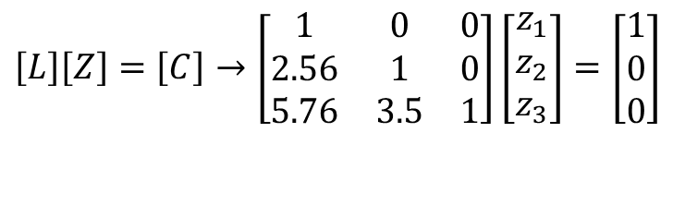
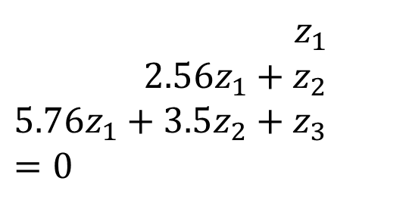
Example: Inverse of a Matrix
Solving for the each column of [B] requires two steps
Solve [L] [Z] = [C] for [Z]
Solve [U] [X] = [Z] for [X]
$$\left[L\right]\left[Z\right]=\left[C\right]→\left[\begin{matrix}1 & 0 & 0 \\ 2.56 & 1 & 0 \\ 5.76 & 3.5 & 1\end{matrix}\right]\left[\begin{matrix}z_{1} \\ z_{2} \\ z_{3}\end{matrix}\right]=\left[\begin{matrix}1 \\ 0 \\ 0\end{matrix}\right]$$
Step 1:
This generates the equations:
$$z_{1}=1 \\ 2.56z_{1}+z_{2}=0 \\ 5.76z_{1}+3.5z_{2}+z_{3}=0$$

Slide 12
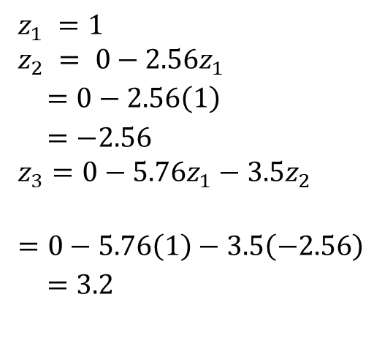
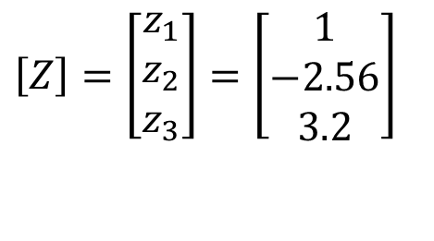
Example: Inverse of a Matrix
Solving for [Z]
$$z_{1} =1 \\ z_{2} = 0−2.56z_{1} \\ =0−2.56\left(1\right) \\ =−2.56 \\ z_{3}=0−5.76z_{1}−3.5z_{2} \\ =0−5.76\left(1\right)−3.5\left(−2.56\right) \\ =3.2$$
$$\left[Z\right]=\left[\begin{matrix}z_{1} \\ z_{2} \\ z_{3}\end{matrix}\right]=\left[\begin{matrix}1 \\ −2.56 \\ 3.2\end{matrix}\right]$$

Slide 13
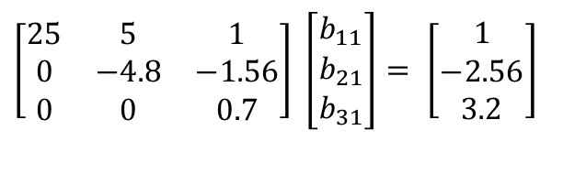
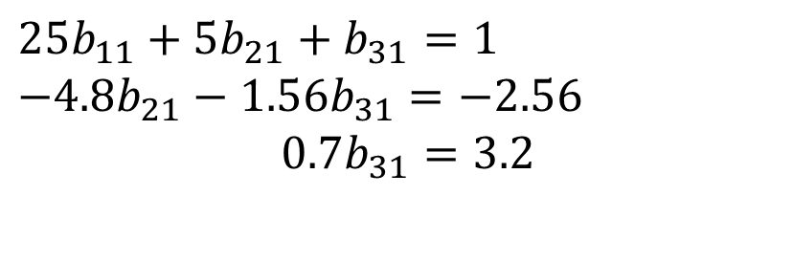
Example: Inverse of a Matrix
$$\left[\begin{matrix}25 & 5 & 1 \\ 0 & −4.8 & −1.56 \\ 0 & 0 & 0.7\end{matrix}\right] \left[\begin{matrix}b_{11} \\ b_{21} \\ b_{31}\end{matrix}\right]= \left[\begin{matrix}1 \\ −\text{2.56} \\ \text{3.2}\end{matrix}\right]$$
Solving [U][X] = [Z] for [X]
$$25b_{11}+5b_{21}+b_{31}=1 \\ −4.8b_{21}−1.56b_{31}=−2.56 \\ 0.7b_{31}=3.2$$

Slide 14
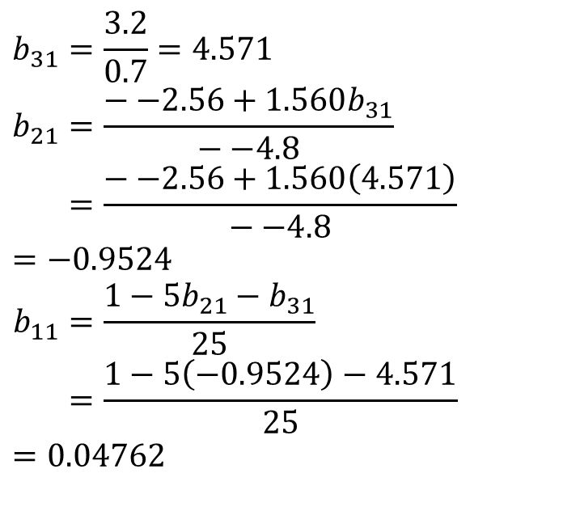
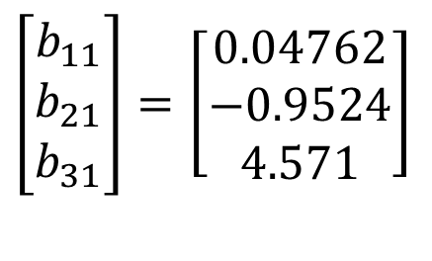
Example: Inverse of a Matrix
Using Backward Substitution
$$b_{31}=\frac{3.2}{0.7}=4.571 \\ b_{21}=\frac{−−2.56+1.560b_{31}}{−−4.8} \\ =\frac{−−2.56+1.560\left(4.571\right)}{−−4.8} =−0.9524 \\ b_{11}=\frac{1−5b_{21}−b_{31}}{25} \\ =\frac{1−5\left(−0.9524\right)−4.571}{25}=0.04762$$
So the first column of the inverse of [A] is:
$$\left[\begin{matrix}b_{11} \\ b_{21} \\ b_{31}\end{matrix}\right]=\left[\begin{matrix}0.04762 \\ −0.9524 \\ 4.571\end{matrix}\right]$$

Slide 15
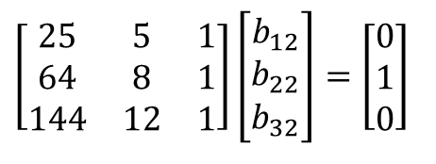
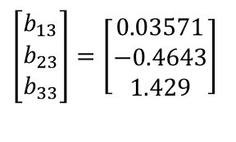
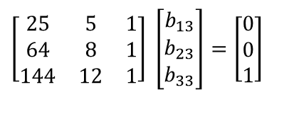
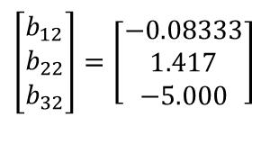
Example: Inverse of a Matrix
Repeating for the second and third columns of the inverse
Second Column Third Column
$$\left[\begin{matrix}25 & 5 & 1 \\ 64 & 8 & 1 \\ 144 & 12 & 1\end{matrix}\right]\left[\begin{matrix}b_{12} \\ b_{22} \\ b_{32}\end{matrix}\right]=\left[\begin{matrix}0 \\ 1 \\ 0\end{matrix}\right]$$
$$\left[\begin{matrix}25 & 5 & 1 \\ 64 & 8 & 1 \\ 144 & 12 & 1\end{matrix}\right] \left[\begin{matrix}b_{13} \\ b_{23} \\ b_{33}\end{matrix}\right]=\left[\begin{matrix}0 \\ 0 \\ 1\end{matrix}\right]$$
$$\left[\begin{matrix}b_{12} \\ b_{22} \\ b_{32}\end{matrix}\right]=\left[\begin{matrix}−0.08333 \\ 1.417 \\ −5.000\end{matrix}\right]$$
$$\left[\begin{matrix}b_{13} \\ b_{23} \\ b_{33}\end{matrix}\right]=\left[\begin{matrix}0.03571 \\ −0.4643 \\ 1.429\end{matrix}\right]$$

Slide 16
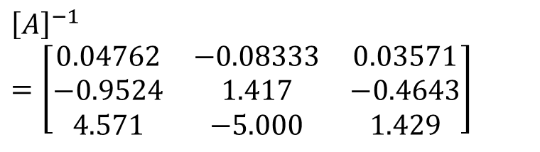
Example: Inverse of a Matrix
The inverse of [A] is
$${\left[A\right]}^{−1}=\left[\begin{matrix}0.04762 & −0.08333 & 0.03571 \\ −0.9524 & 1.417 & −0.4643 \\ 4.571 & −5.000 & 1.429\end{matrix}\right]$$
To check your work do the following operation
[A][A]⁻¹ = [I] = [A]⁻¹[A]

Slide 17
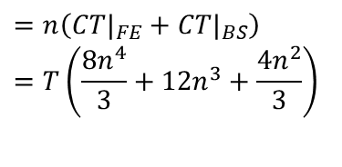
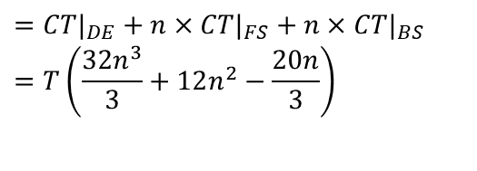
To find inverse of [A]
Time taken by Gaussian Elimination Time taken by LU Decomposition
$$=n\left(CT|_{FE}+CT|_{BS}\right) \\ =T\left(\frac{8n^{4}}{3}+12n^{3}+\frac{4n^{2}}{3}\right)$$
$$=CT|_{DE}+n×CT|_{FS}+n×CT|_{BS} \\ =T\left(\frac{32n^{3}}{3}+12n^{2}−\frac{20n}{3}\right)$$

Slide 18
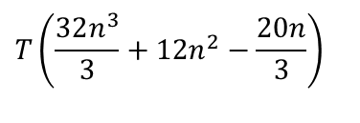
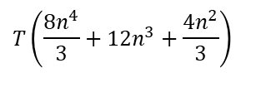
To find inverse of [A]
Time taken by Gaussian Elimination Time taken by LU Decomposition
$$T\left(\frac{8n^{4}}{3}+12n^{3}+\frac{4n^{2}}{3}\right)$$
$$T\left(\frac{32n^{3}}{3}+12n^{2}−\frac{20n}{3}\right)$$
Table 1 Comparing computational times of finding inverse of a matrix using LU decomposition and Gaussian elimination.
n | 10 | 100 | 1000 | 10000
CT|_{inverse GE} / CT|_{inverse LU} | 3.288 | 25.84 | 250.8 | 2501
For large n, CT|_{inverse GE} / CT|_{inverse LU} ≈ n/4

