Slide 1
LU Decomposition
Major: All Engineering Majors
Authors: Autar Kaw
http://numericalmethods.eng.usf.edu
Transforming Numerical Methods Education for STEM Undergraduates

Slide 2

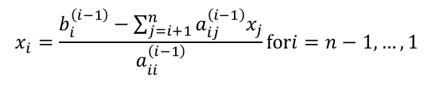
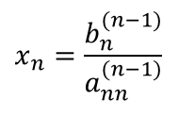
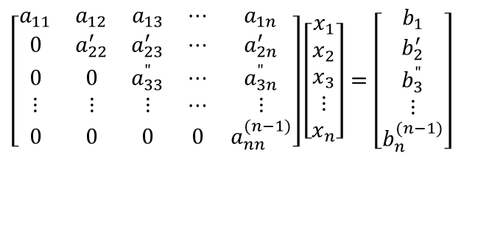
Time Taken by Back Substitution
n = length(B);
X(n)=B(n)/A(n,n)
for i=n-1:-1:1
X(i) = B(i);
for j=(i+1):1:n
X(i) = X(i) - A(i, j)*X(j);
end
X(i) = X(i)/A(i, i);
end
$$\left[\begin{matrix}a_{11} & a_{12} & a_{13} & ⋯ & a_{1n} \\ 0 & a_{22}^{′} & a_{23}^{′} & ⋯ & a_{2n}^{′} \\ 0 & 0 & a_{33}^{"} & ⋯ & a_{3n}^{"} \\ ⋮ & ⋮ & ⋮ & ⋯ & ⋮ \\ 0 & 0 & 0 & 0 & a_{nn}^{(n−1)}\end{matrix}\right]\left[\begin{matrix}x_{1} \\ x_{2} \\ x_{3} \\ ⋮ \\ x_{n}\end{matrix}\right]=\left[\begin{matrix}b_{1} \\ b_{2}^{′} \\ b_{3}^{"} \\ ⋮ \\ b_{n}^{(n−1)}\end{matrix}\right]$$
$$x_{n}=\frac{b_{n}^{(n−1)}}{a_{nn}^{(n−1)}}$$
$$x_{i}=\frac{b_{i}^{\left(i−1\right)}−\sum_{j=i+1}^{n}{a_{ij}^{\left(i−1\right)}x_{j}}}{a_{ii}^{\left(i−1\right)}}\text{for}i=n−1,…,1$$
Back Substitution CT
$$CT|_{BS}=T\left(4n^{2}+12n\right)$$

Slide 3
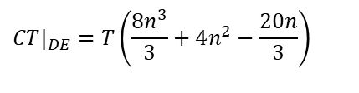

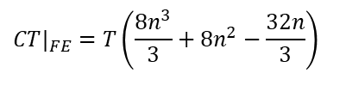


Is LU Decomposition better than Gaussian Elimination?
Solve [A][X] = [B]
T = clock cycle time and nxn = size of the matrix
Forward Elimination
Decomposition to LU
$$CT|_{FE}=T\left(\frac{8n^{3}}{3}+8n^{2}−\frac{32n}{3}\right)$$
$$CT|_{DE}=T\left(\frac{8n^{3}}{3}+4n^{2}−\frac{20n}{3}\right)$$
Back Substitution
Forward Substitution
$$CT|_{BS}=T\left(4n^{2}+12n\right)$$
$$CT|_{FS}=T\left(4n^{2}−4n\right)$$
Back Substitution
$$CT|_{BS}=T\left(4n^{2}+12n\right)$$

Slide 4
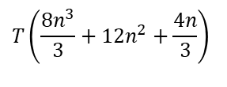
Is LU Decomposition better than Gaussian Elimination?
To solve [A][X] = [B]
Time taken by methods
T = clock cycle time and nxn = size of the matrix
So both methods are equally efficient.
Gaussian Elimination | LU Decomposition
$$T\left(\frac{8n^{3}}{3}+12n^{2}+\frac{4n}{3}\right)$$
$$T\left(\frac{8n^{3}}{3}+12n^{2}+\frac{4n}{3}\right)$$

Slide 5
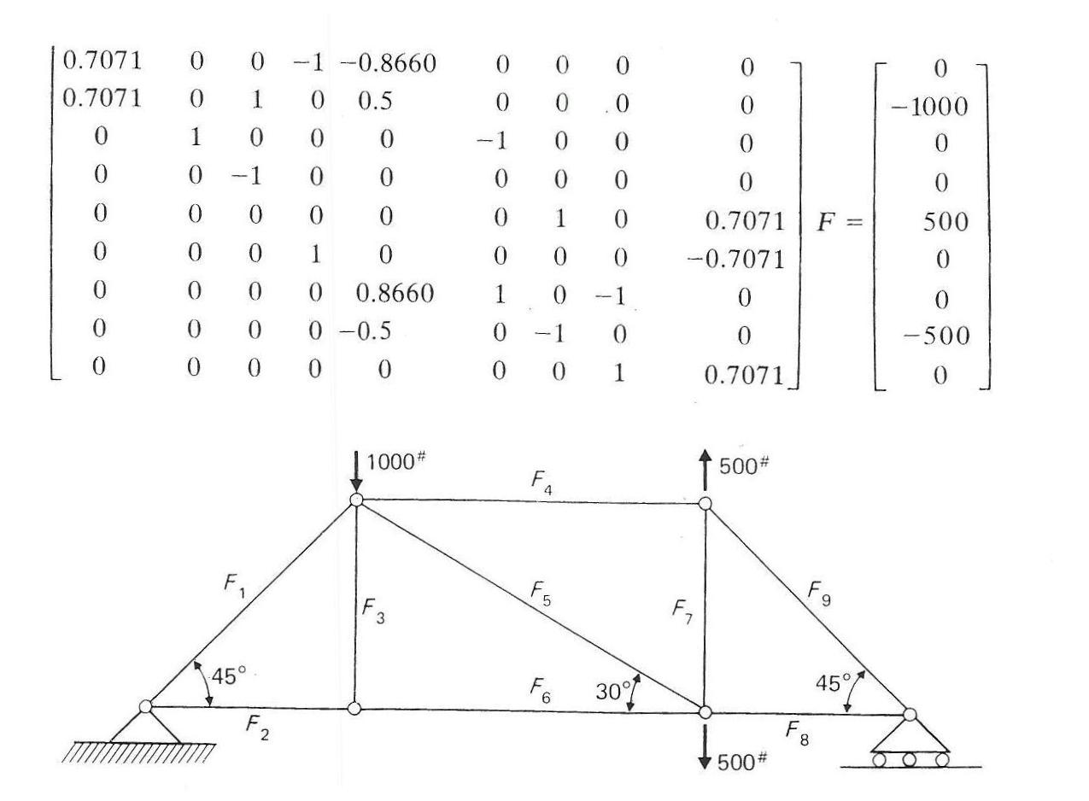
Truss Problem

Slide 6
Finding the inverse of a square matrix
The inverse [B] of a square matrix [A] is defined as
[A][B] = [I] OR [B][A] = [I]

Slide 7
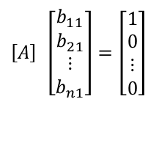
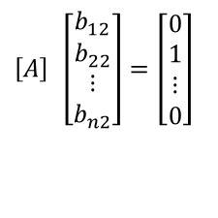
Finding the inverse of a square matrix
How can LU Decomposition be used to find the inverse?
[A][B] = [I]
First column of [B] Second column of [B]
$$\left[A\right] \left[\begin{matrix}b_{11} \\ b_{21} \\ ⋮ \\ b_{n1}\end{matrix}\right]=\left[\begin{matrix}1 \\ 0 \\ ⋮ \\ 0\end{matrix}\right]$$
$$\left[A\right] \left[\begin{matrix}b_{12} \\ b_{22} \\ ⋮ \\ b_{n2}\end{matrix}\right]=\left[\begin{matrix}0 \\ 1 \\ ⋮ \\ 0\end{matrix}\right]$$
The remaining columns in [B] can be found in the same manner

Slide 8
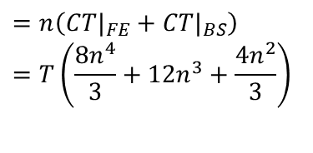
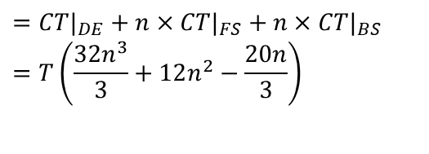
To find inverse of [A]
Time taken by Gaussian Elimination Time taken by LU Decomposition
$$=n\left(CT|_{FE}+CT|_{BS}\right) \\ =T\left(\frac{8n^{4}}{3}+12n^{3}+\frac{4n^{2}}{3}\right)$$
$$=CT|_{DE}+n×CT|_{FS}+n×CT|_{BS} \\ =T\left(\frac{32n^{3}}{3}+12n^{2}−\frac{20n}{3}\right)$$

Slide 9
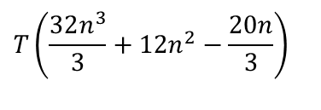
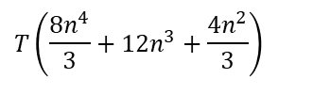
To find inverse of [A]
Time taken by Gaussian Elimination Time taken by LU Decomposition
$$T\left(\frac{8n^{4}}{3}+12n^{3}+\frac{4n^{2}}{3}\right)$$
$$T\left(\frac{32n^{3}}{3}+12n^{2}−\frac{20n}{3}\right)$$
Table 1 Comparing computational times of finding inverse of a matrix using LU decomposition and Gaussian elimination.
n | 10 | 100 | 1000 | 10000
CT|_{inverse GE} / CT|_{inverse LU} | 3.288 | 25.84 | 250.8 | 2501
For large n, CT|_{inverse GE} / CT|_{inverse LU} ≈ n/4

