Slide 1
Programming Review
EML3041: Computational Methods
1

Slide 2
Main concepts
Sequential programming
Conditions (if-end; if-else-end)
Loops (for-end; while-end)
Functions

Slide 3
Some common MATLAB functions
Find cos of 60 degrees
Val=cos(60*pi/180), Val=cosd(60)
Find ln(5)
Val=log(5)
Find e^{1.3}
Val=exp(1.3)
Go ahead and try sin(90º), sin⁻¹(0.5)

Slide 4
Caution
The MATLAB snippets given here may need editing for strings to run in MATLAB.
For example, the single quotes ‘ and ’ have to be replaced with a straighter single quote '

Slide 5
Some important MATLAB statements
disp disp(‘My name is Slim Shady’) fprintf a=12.4; b=12 fprintf(‘\n Value of a=%g and b=%g’,a,b) % Search help for %g, %e, %f, %s two lines statement syms x func=x^2-3*x+ ... 4 | comment % Project One – EML3041 sections %% Problem One help % do this in command window help syms

Slide 6
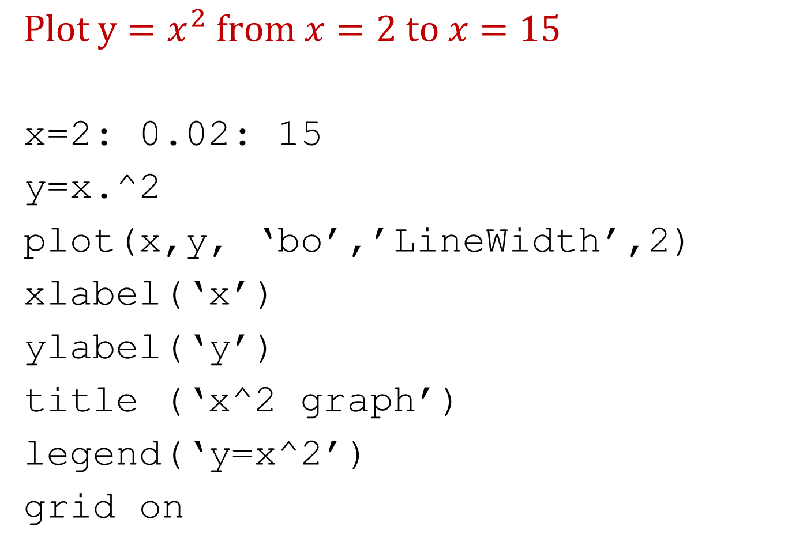
Plotting
$$Plot y=x^{2} from x=2 to x=15$$
x=2: 0.02: 15
y=x.^2
plot(x,y, ‘bo’,’LineWidth’,2)
xlabel(‘x’)
ylabel(‘y’)
title (‘x^2 graph’)
legend(‘y=x^2’)
grid on

Slide 7
Some common mistakes
Using single letter names for variables
Filenames such as program 2.m or just 2.m or cos.m
Using “ ; ” while first writing the program
Using reserved words, e.g. “length” for a variable
Not commenting the program
Not breaking a problem into smaller parts
Not following the format of given sample project
Not writing separate programs to learn single tasks

Slide 8

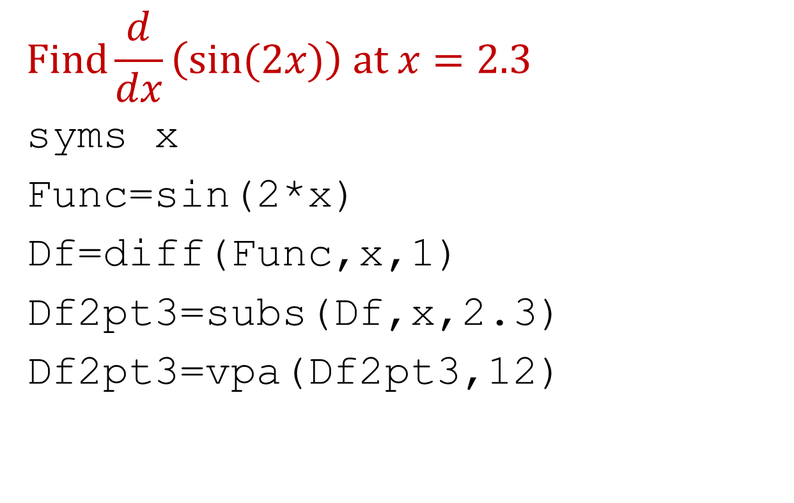
Differentiate a function
$$Find\frac{d}{dx}\left(sin⁡(2x)\right) at x=2.3$$
syms x
Func=sin(2*x)
Df=diff(Func,x,1)
Df2pt3=subs(Df,x,2.3)
Df2pt3=vpa(Df2pt3,12)
$$Find\frac{d^{2}}{{dx}^{2}}\left(\ln\left(x^{2}\right)\right) at x=2.5$$

Slide 9
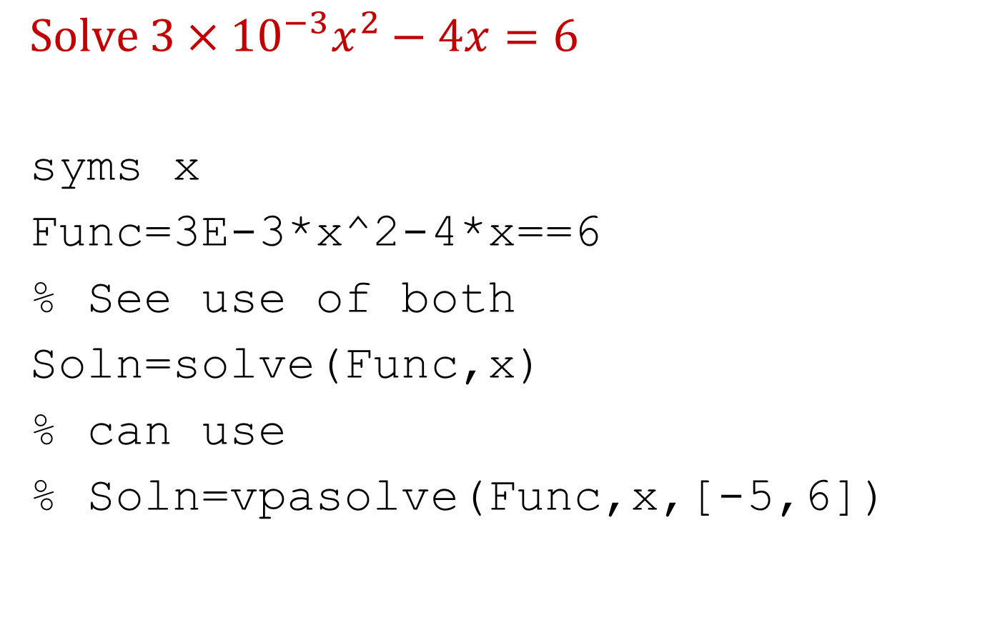
Solve a nonlinear equation
$$Solve 3×{10}^{−3}x^{2}−4x=6$$
syms x
Func=3E-3*x^2-4*x==6
% See use of both
Soln=solve(Func,x)
% can use
% Soln=vpasolve(Func,x,[-5,6])
$$Solve x^{2} −x=6;Choose positive root only$$

Slide 10
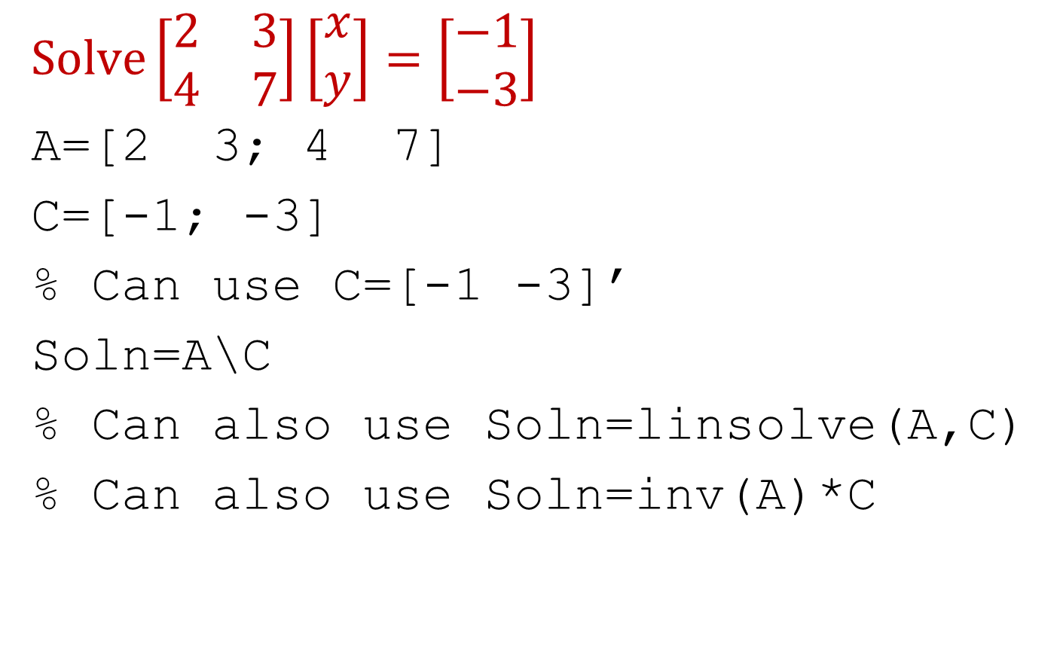
Simultaneous linear equations
$$Solve\left[\begin{matrix}2 & 3 \\ 4 & 7\end{matrix}\right]\left[\begin{matrix}x \\ y\end{matrix}\right]=\left[\begin{matrix}−1 \\ −3\end{matrix}\right]$$
A=[2 3; 4 7]
C=[-1; -3]
% Can use C=[-1 -3]’
Soln=A\C
% Can also use Soln=linsolve(A,C)
% Can also use Soln=inv(A)*C
$$Solve 2x+3y=12;3x+2y=60$$

Slide 11
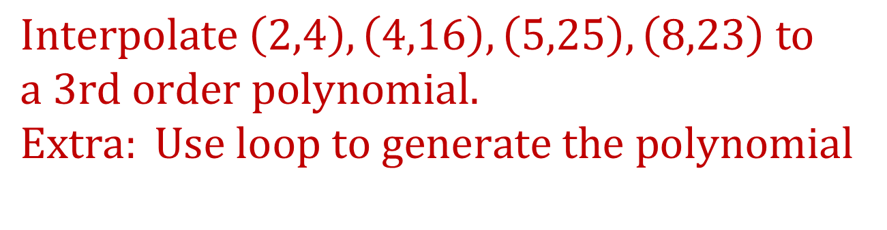
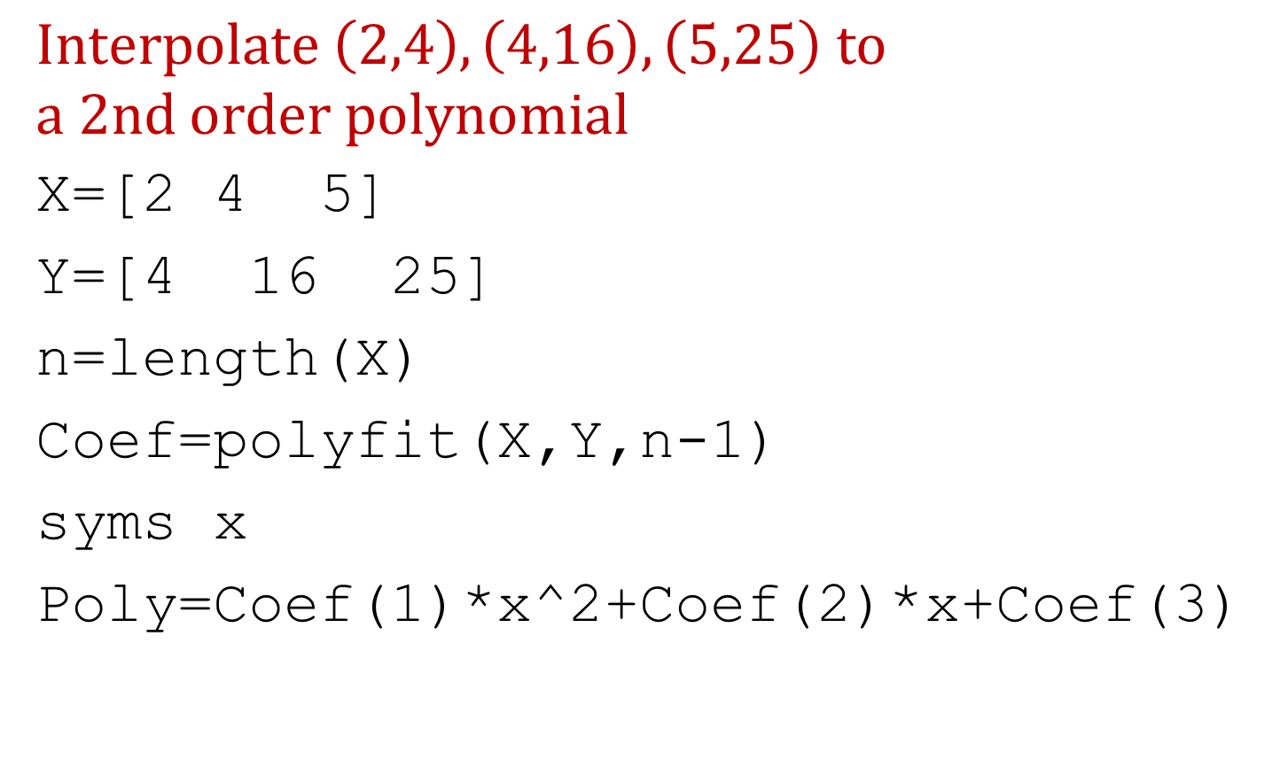
Interpolation
$$Interpolate \left(2,4\right),\left(4,16\right),\left(5,25\right) to$$
$$a 2nd order polynomial$$
X=[2 4 5]
Y=[4 16 25]
n=length(X)
Coef=polyfit(X,Y,n-1)
syms x
Poly=Coef(1)*x^2+Coef(2)*x+Coef(3)
$$Interpolate \left(2,4\right),\left(4,16\right),\left(5,25\right), \left(8,23\right) to$$
$$a 3rd order polynomial.$$
$$Extra: Use loop to generate the polynomial$$

Slide 12
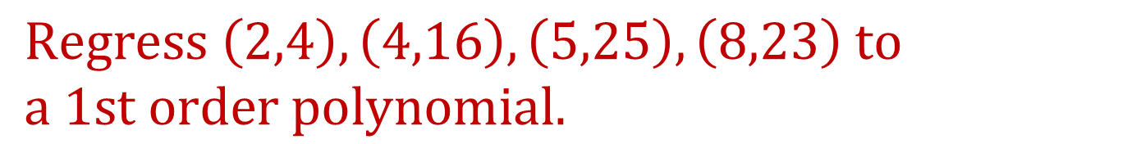
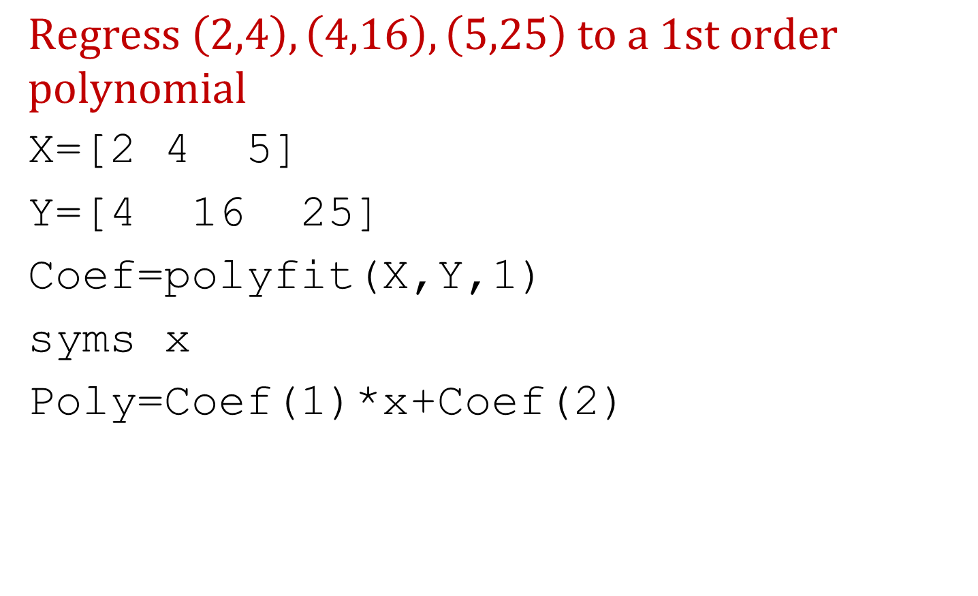
Regression
$$Regress \left(2,4\right),\left(4,16\right),\left(5,25\right) to a 1st order$$
$$polynomial$$
X=[2 4 5]
Y=[4 16 25]
Coef=polyfit(X,Y,1)
syms x
Poly=Coef(1)*x+Coef(2)
$$Regress \left(2,4\right),\left(4,16\right),\left(5,25\right), \left(8,23\right) to$$
$$a 1st order polynomial.$$

Slide 13
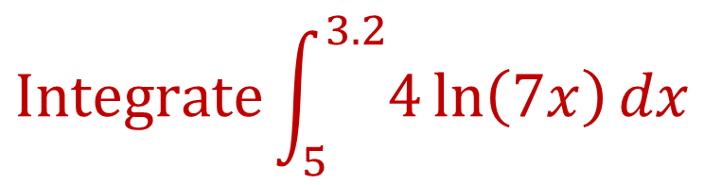
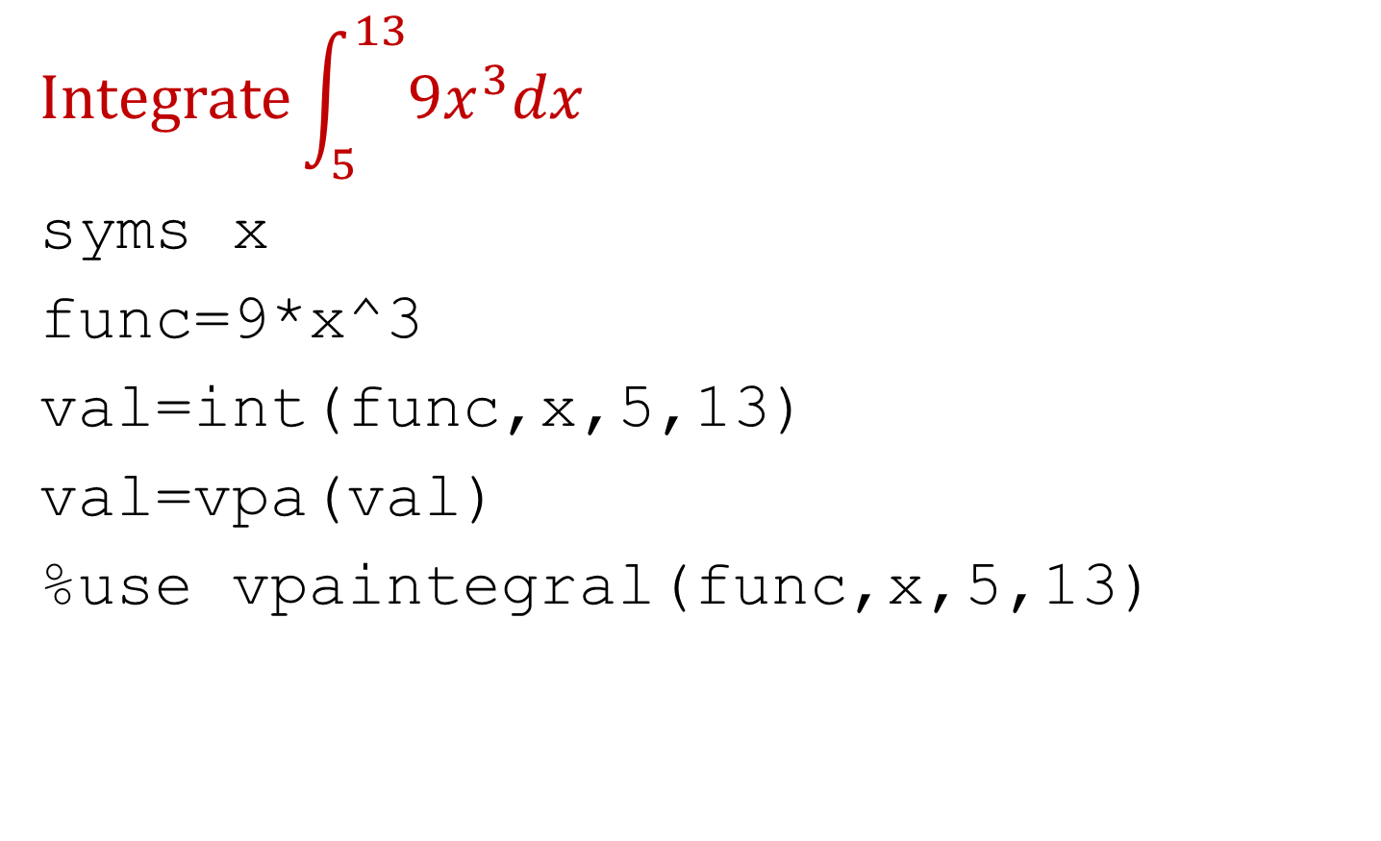
Solve an integral
$$Integrate\int_{5}^{13}{{9x}^{3}dx}$$
syms x
func=9*x^3
val=int(func,x,5,13)
val=vpa(val)
%use vpaintegral(func,x,5,13)
$$Integrate\int_{5}^{3.2}{4\ln\left(7x\right)dx}$$

Slide 14
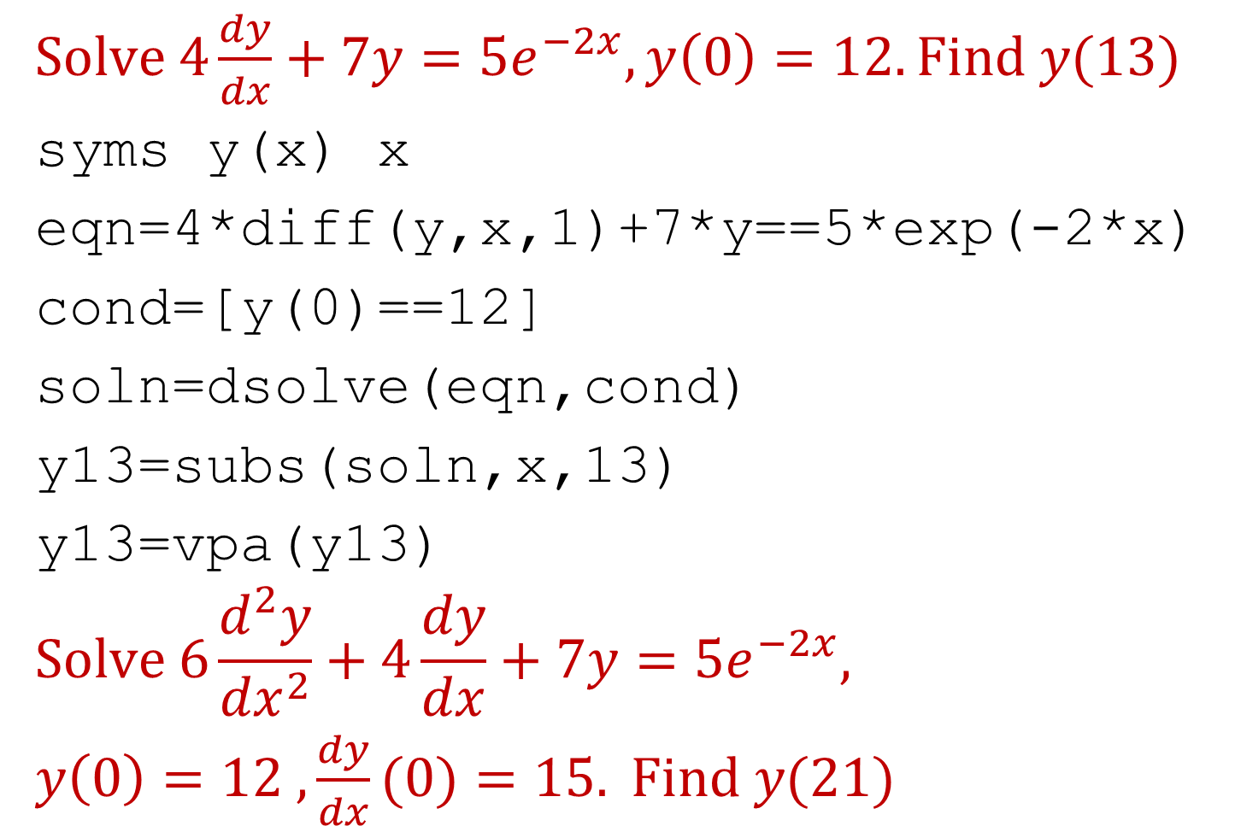
Solve ordinary differential equations
$Solve 4\frac{dy}{dx}+7y=5e^{−2x}, y\left(0\right)=12. Find y(13)$
syms y(x) x
eqn=4*diff(y,x,1)+7*y==5*exp(-2*x)
cond=[y(0)==12]
soln=dsolve(eqn,cond)
y13=subs(soln,x,13)
y13=vpa(y13)
$$Solve 6\frac{d^{2}y}{{dx}^{2}}+4\frac{dy}{dx}+7y=5e^{−2x},$$
$y\left(0\right)=12 ,\frac{dy}{dx}(0)=15. Find y(21)$

Slide 15
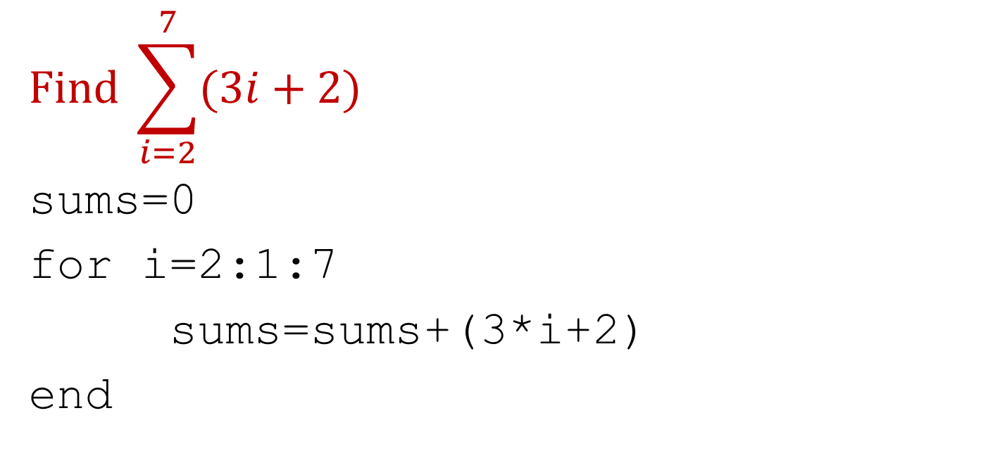
Find the sum of a series (example of loop)
$$Find \sum_{i=2}^{7}{(3i+2)}$$
sums=0
for i=2:1:7
sums=sums+(3*i+2)
end

Slide 16
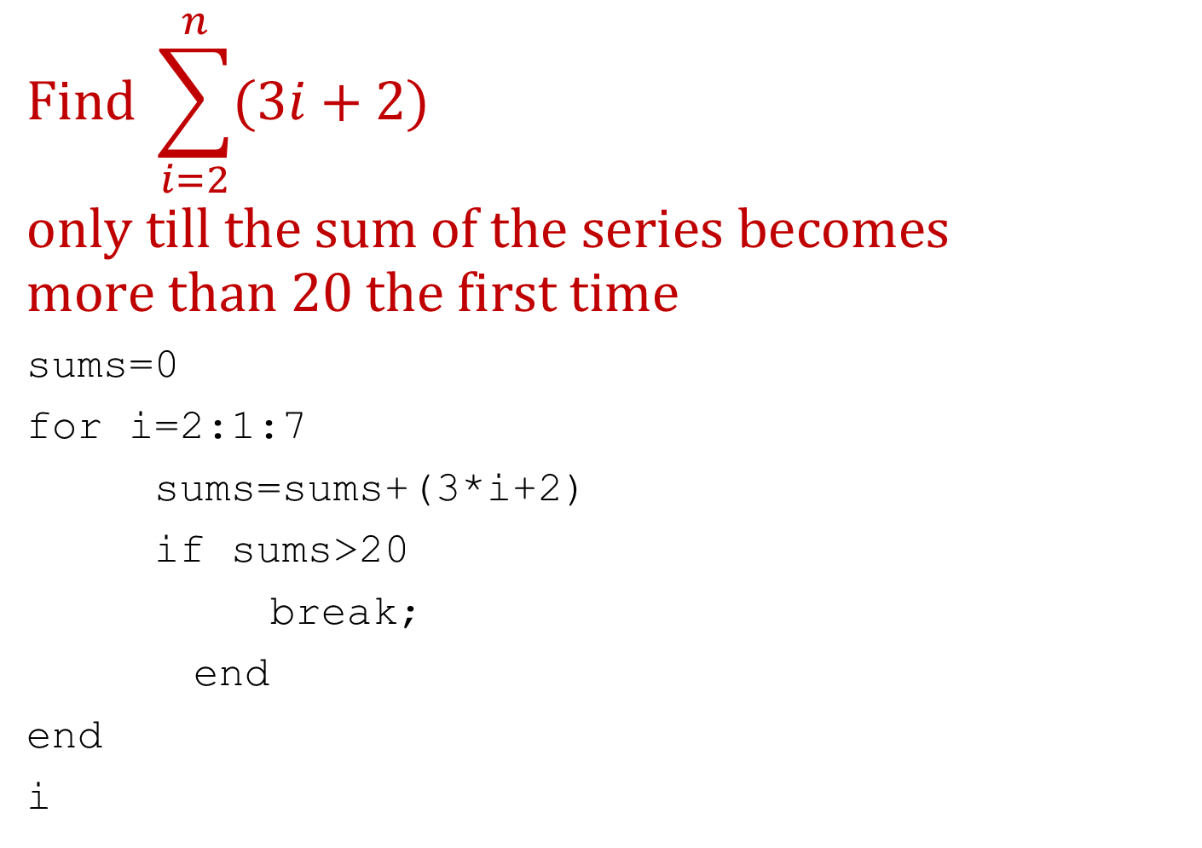
Find the sum of a series (example of break)
$$Find \sum_{i=2}^{n}{(3i+2)}$$
$$only till the sum of the series becomes$$
$$more than 20 the first time$$
sums=0
for i=2:1:7
sums=sums+(3*i+2)
if sums>20
break;
end
end
i

Slide 17
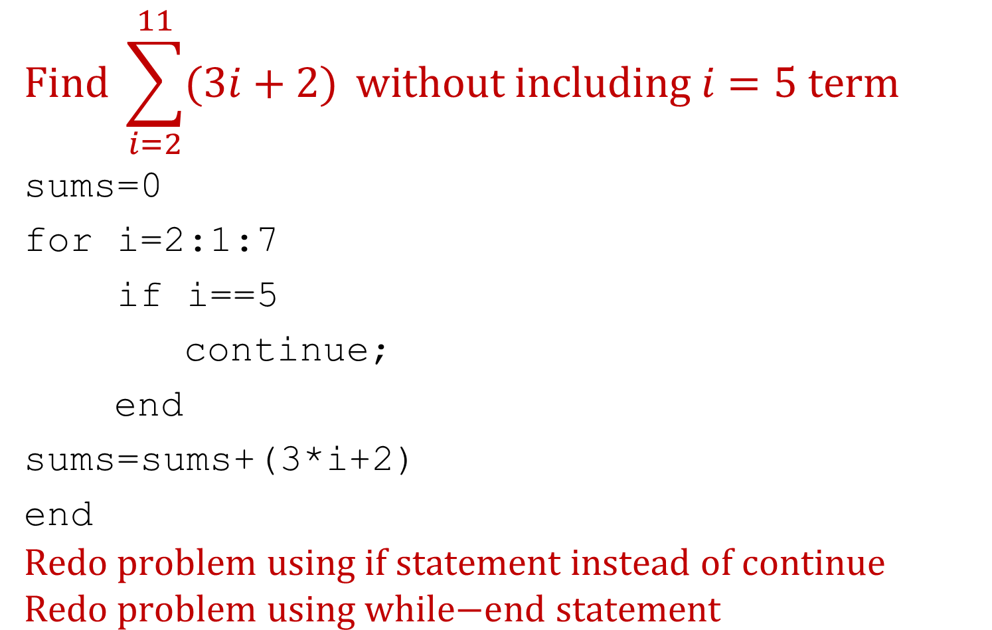
Find the sum of a series (example of continue)
$$Find \sum_{i=2}^{11}{(3i+2)} without including i=5 term$$
sums=0
for i=2:1:7
if i==5
continue;
end
sums=sums+(3*i+2)
end
$$\text{Redo} \text{problem} \text{using} \text{if} \text{statement} \text{instead} \text{of} \text{continue}$$
$$\text{Redo} \text{problem} \text{using} \text{while}\text{−}\text{end} \text{statement}$$

Slide 18
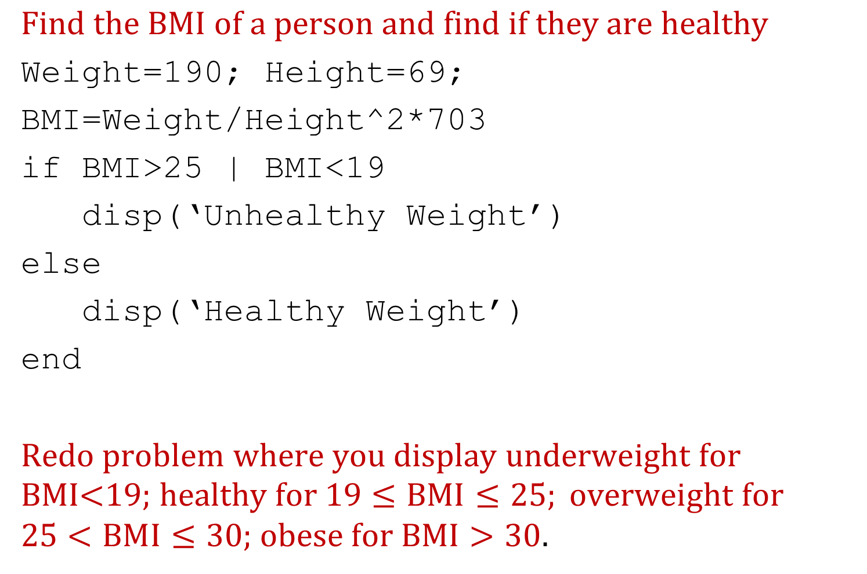
BMI problem (example of if-end)
$$Find the BMI of a person and find if they are healthy$$
Weight=190; Height=69;
BMI=Weight/Height^2*703
if BMI>25 | BMI<19
disp(‘Unhealthy Weight’)
else
disp(‘Healthy Weight’)
end
$\text{Redo} \text{problem} \text{where} \text{you} \text{display} \text{underweight} \text{for} \text{BMI}\text{<19; }\text{healthy} \text{for}\text{ 19}≤BMI≤25; \text{overweight} \text{for}\text{ 25}<BMI≤30;$ $\text{obese} \text{for} BMI>30$.

Slide 19
Resources
How do I do that in the MATLAB series? This series is highly helpful when you are doing the projects for the course: https://autarkaw.org/2020/12/22/how-do-i-do-that-in-matlab-for-usf-students/
Class lectures in EML3035 when I used to teach it as a 1-credit hour course: http://www.eng.usf.edu/~kaw/class/EML3035/lectures.htm
Here are some lecture videos freely available from Vanderbilt University: https://autarkaw.org/2020/05/08/need-help-with-programming-in-matlab/
For help on commands, either enter help in command window or go to https://www.mathworks.com/help/matlab/index.html

