Slide 1
Gaussian Elimination
Major: All Engineering Majors
Author(s): Autar Kaw
http://nm.MathForCollege.com
Transforming Numerical Methods Education for STEM Undergraduates

Slide 2
Naïve Gaussian Elimination
A method to solve simultaneous linear equations of the form [A][X]=[C]
Two steps
1. Forward Elimination
2. Back Substitution

Slide 3
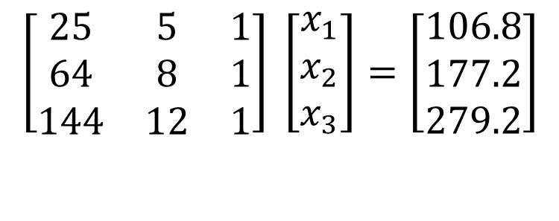
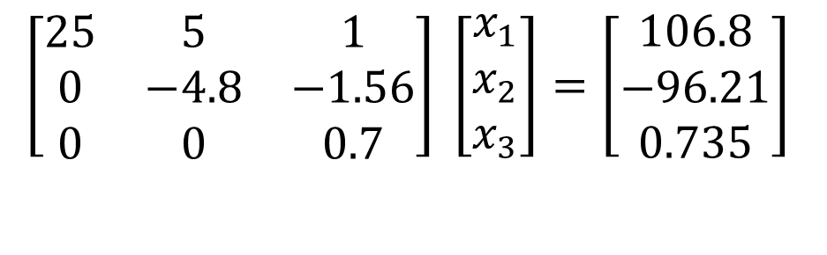
Forward Elimination
The goal of forward elimination is to transform the coefficient matrix into an upper triangular matrix
$$\left[\begin{matrix}25 & 5 & 1 \\ 64 & 8 & 1 \\ 144 & 12 & 1\end{matrix}\right] \left[\begin{matrix}x_{1} \\ x_{2} \\ x_{3}\end{matrix}\right]=\left[\begin{matrix}106.8 \\ 177.2 \\ 279.2\end{matrix}\right]$$
$$\left[\begin{matrix}25 & 5 & 1 \\ 0 & −4.8 & −1.56 \\ 0 & 0 & 0.7\end{matrix}\right] \left[\begin{matrix}x_{1} \\ x_{2} \\ x_{3}\end{matrix}\right]=\left[\begin{matrix}106.8 \\ −96.21 \\ 0.735\end{matrix}\right]$$

Slide 4
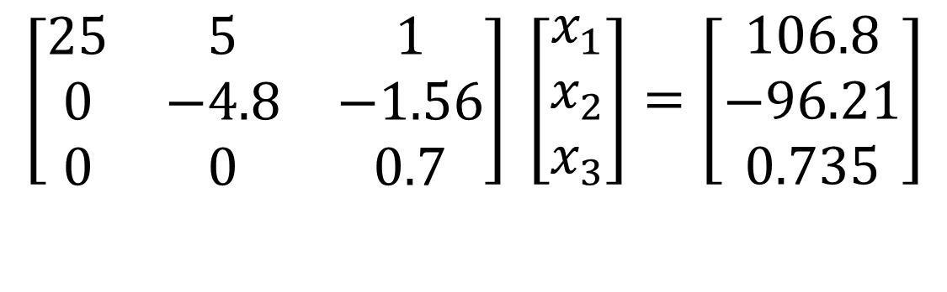
Back Substitution
Solve each equation starting from the last equation
$$\left[\begin{matrix}25 & 5 & 1 \\ 0 & −4.8 & −1.56 \\ 0 & 0 & 0.7\end{matrix}\right] \left[\begin{matrix}x_{1} \\ x_{2} \\ x_{3}\end{matrix}\right]=\left[\begin{matrix}106.8 \\ −96.21 \\ 0.735\end{matrix}\right]$$

Slide 5
THE END

Slide 6
Determinant of a Square Matrix
Using Naïve Gauss Elimination
Example
Notes:
6

Slide 7
Theorem of Determinants
If a multiple of one row of [A]_{nxn} is added or subtracted to another row of [A]_{nxn} to result in [B]_{nxn} then det(A)=det(B)
Notes:
7

Slide 8
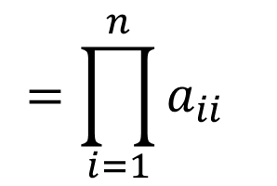
Theorem of Determinants
The determinant of an upper triangular, lower triangular or diagonal matrix [A]_{nxn} is given by
$$\text{det}\left(A\right)=a_{11}×a_{22}×...×a_{ii}×...×a_{nn}$$
$$=\prod_{i=1}^{n}{a_{ii}}$$
Notes:
8

Slide 9
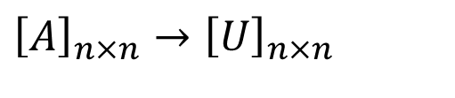
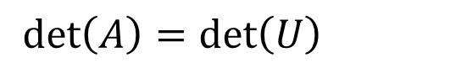
Forward Elimination of a Square Matrix
Using forward elimination to transform [A]_{nxn} to an upper triangular matrix, [U]_{nxn}.
$${\left[A\right]}_{n×n}→{\left[U\right]}_{n×n}$$
$$\det\left(A\right)=\det\left(U\right)$$
Notes:
9

Slide 10
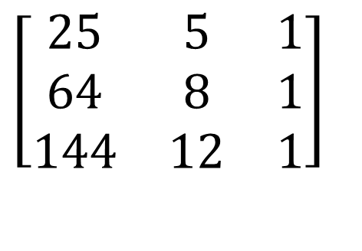
Example
Using Naive Gaussian Elimination method, find the determinant of the following square matrix.
$$\left[\begin{matrix}25 & 5 & 1 \\ 64 & 8 & 1 \\ 144 & 12 & 1\end{matrix}\right]$$
Notes:
10

Slide 11
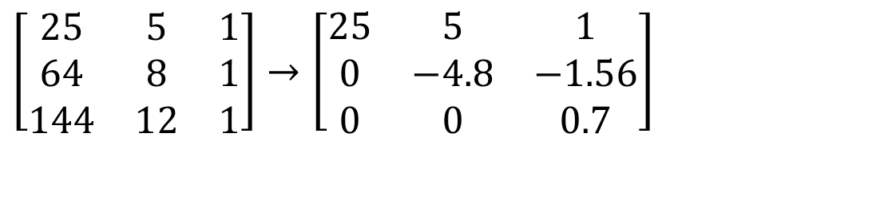
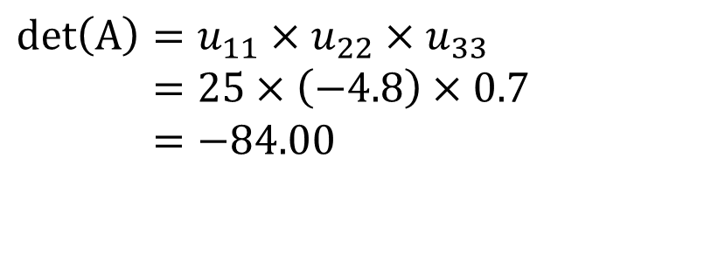
Finding the Determinant
After forward elimination steps
$$\left[\begin{matrix}25 & 5 & 1 \\ 64 & 8 & 1 \\ 144 & 12 & 1\end{matrix}\right]→\left[\begin{matrix}25 & 5 & 1 \\ 0 & −4.8 & −1.56 \\ 0 & 0 & 0.7\end{matrix}\right]$$
.
$$\text{det}\left(A\right)=u_{11}×u_{22}×u_{33} \\ =25×\left(−4.8\right)×0.7 \\ =−84.00$$
Notes:
11

Slide 12
THE END

Slide 13
Naïve Gauss Elimination Pitfalls

Slide 14
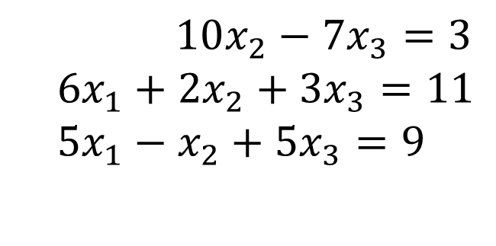
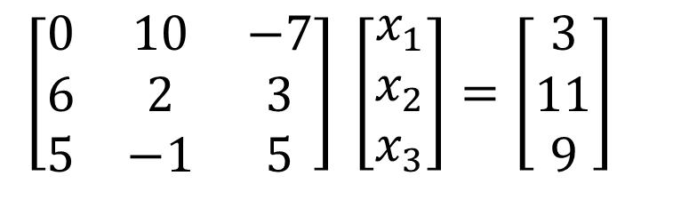
Pitfall#1. Division by zero
$10x_{2}−7x_{3}=3$
$$6x_{1}+2x_{2}+3x_{3}=11 \\ 5x_{1}−x_{2}+5x_{3}=9$$
$$\left[\begin{matrix}0 & 10 & −7 \\ 6 & 2 & 3 \\ 5 & −1 & 5\end{matrix}\right] \left[\begin{matrix}x_{1} \\ x_{2} \\ x_{3}\end{matrix}\right]=\left[\begin{matrix}3 \\ 11 \\ 9\end{matrix}\right]$$

Slide 15
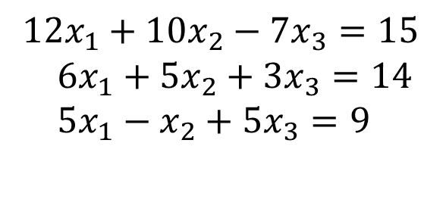
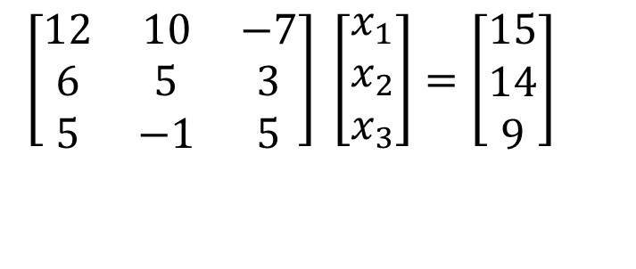
Is division by zero an issue here?
$$12x_{1}+10x_{2}−7x_{3}=15 \\ 6x_{1}+5x_{2}+3x_{3}=14 \\ 5x_{1}−x_{2}+5x_{3}=9$$
$$\left[\begin{matrix}12 & 10 & −7 \\ 6 & 5 & 3 \\ 5 & −1 & 5\end{matrix}\right] \left[\begin{matrix}x_{1} \\ x_{2} \\ x_{3}\end{matrix}\right]=\left[\begin{matrix}15 \\ 14 \\ 9\end{matrix}\right]$$

Slide 16
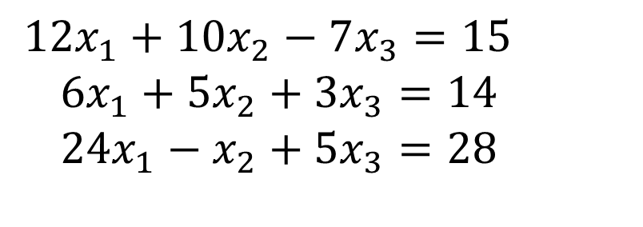
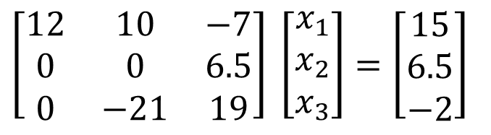
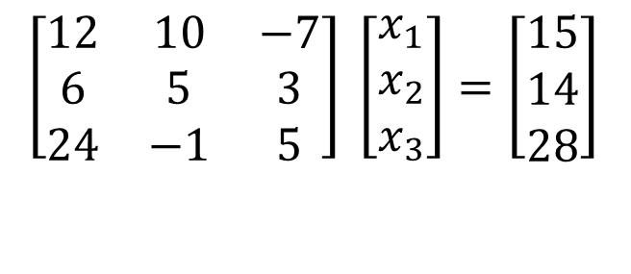
Is division by zero an issue here? YES
$$12x_{1}+10x_{2}−7x_{3}=15 \\ 6x_{1}+5x_{2}+3x_{3}=14 \\ 24x_{1}−x_{2}+5x_{3}=28$$
$$\left[\begin{matrix}12 & 10 & −7 \\ 6 & 5 & 3 \\ 24 & −1 & 5\end{matrix}\right] \left[\begin{matrix}x_{1} \\ x_{2} \\ x_{3}\end{matrix}\right]=\left[\begin{matrix}15 \\ 14 \\ 28\end{matrix}\right]$$
$$\left[\begin{matrix}12 & 10 & −7 \\ 0 & 0 & 6.5 \\ 0 & −21 & 19\end{matrix}\right] \left[\begin{matrix}x_{1} \\ x_{2} \\ x_{3}\end{matrix}\right]=\left[\begin{matrix}15 \\ 6.5 \\ −2\end{matrix}\right]$$
Division by zero is a possibility at any step of forward elimination

Slide 17
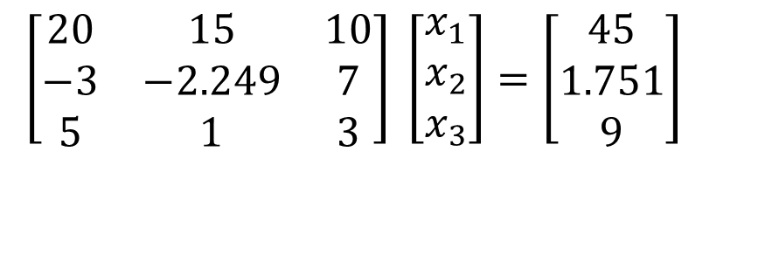
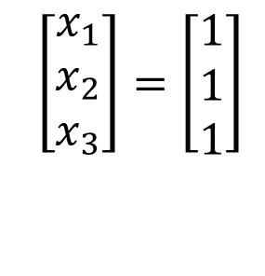
Pitfall#2. Large Round-off Errors
$$\left[\begin{matrix}20 & 15 & 10 \\ −3 & −2.249 & 7 \\ 5 & 1 & 3\end{matrix}\right] \left[\begin{matrix}x_{1} \\ x_{2} \\ x_{3}\end{matrix}\right]=\left[\begin{matrix}45 \\ 1.751 \\ 9\end{matrix}\right]$$
Exact Solution
$$\left[\begin{matrix}x_{1} \\ x_{2} \\ x_{3}\end{matrix}\right]=\left[\begin{matrix}1 \\ 1 \\ 1\end{matrix}\right]$$

Slide 18
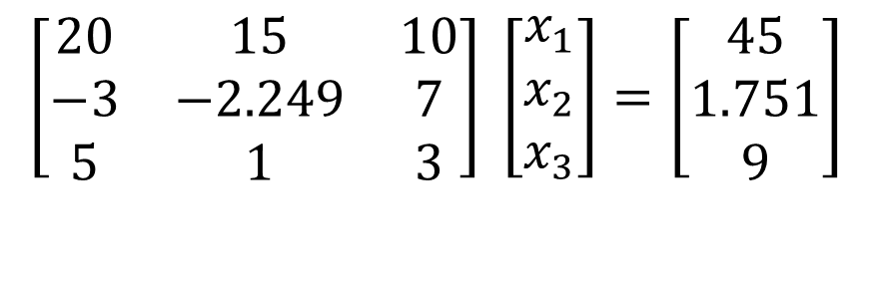
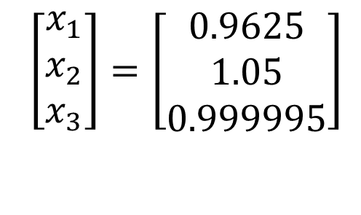
Pitfall#2. Large Round-off Errors
$$\left[\begin{matrix}20 & 15 & 10 \\ −3 & −2.249 & 7 \\ 5 & 1 & 3\end{matrix}\right] \left[\begin{matrix}x_{1} \\ x_{2} \\ x_{3}\end{matrix}\right]=\left[\begin{matrix}45 \\ 1.751 \\ 9\end{matrix}\right]$$
Solve it on a computer using 6 significant digits with chopping
$$\left[\begin{matrix}x_{1} \\ x_{2} \\ x_{3}\end{matrix}\right]=\left[\begin{matrix}0.9625 \\ 1.05 \\ 0.999995\end{matrix}\right]$$

Slide 19
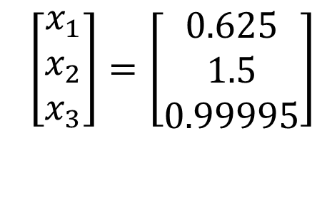
Pitfall#2. Large Round-off Errors
$$\left[\begin{matrix}20 & 15 & 10 \\ −3 & −2.249 & 7 \\ 5 & 1 & 3\end{matrix}\right] \left[\begin{matrix}x_{1} \\ x_{2} \\ x_{3}\end{matrix}\right]=\left[\begin{matrix}45 \\ 1.751 \\ 9\end{matrix}\right]$$
Solve it on a computer using 5 significant digits with chopping
$$\left[\begin{matrix}x_{1} \\ x_{2} \\ x_{3}\end{matrix}\right]=\left[\begin{matrix}0.625 \\ 1.5 \\ 0.99995\end{matrix}\right]$$
Is there a way to reduce the round off error?

Slide 20
Avoiding Pitfalls
Increase the number of significant digits
Decreases round-off error
Does not avoid division by zero

Slide 21
Avoiding Pitfalls
Use Gaussian Elimination with Partial Pivoting
Avoids division by zero
Reduces round off error

Slide 22
THE END

Slide 23
Gauss Elimination with Partial Pivoting http://nm.MathForCollege.com

Slide 24
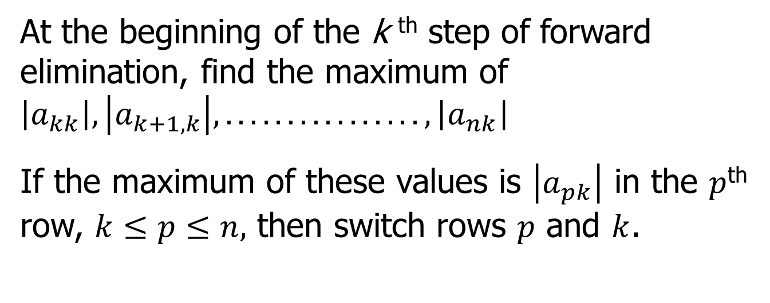
What is Different About Partial Pivoting?
At the beginning of the k ^{th} step of forward elimination, find the maximum of $\left|a_{kk}\right|,\left|a_{k+1,k}\right|,................,\left|a_{nk}\right|$
If the maximum of these values is $\left|a_{pk}\right|$ in the $p$^{th} row, $k≤p≤n,$ then switch rows $p$ and $k$.

Slide 25
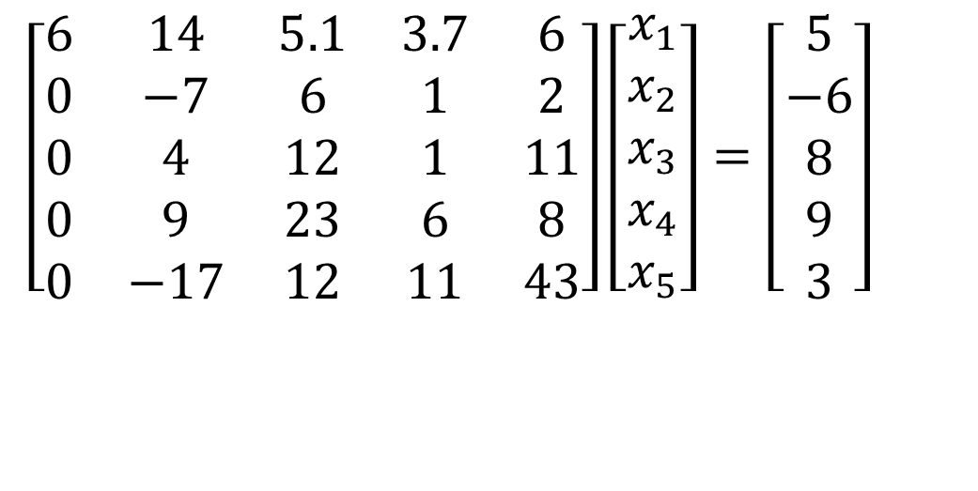
Example (2nd step of FE)
$$\left[\begin{matrix}6 & 14 & 5.1 & 3.7 & 6 \\ 0 & −7 & 6 & 1 & 2 \\ 0 & 4 & 12 & 1 & 11 \\ 0 & 9 & 23 & 6 & 8 \\ 0 & −17 & 12 & 11 & 43\end{matrix}\right]\left[\begin{matrix}x_{1} \\ x_{2} \\ x_{3} \\ x_{4} \\ x_{5}\end{matrix}\right]=\left[\begin{matrix}5 \\ −6 \\ 8 \\ 9 \\ 3\end{matrix}\right]$$
Which two rows would you switch?

Slide 26
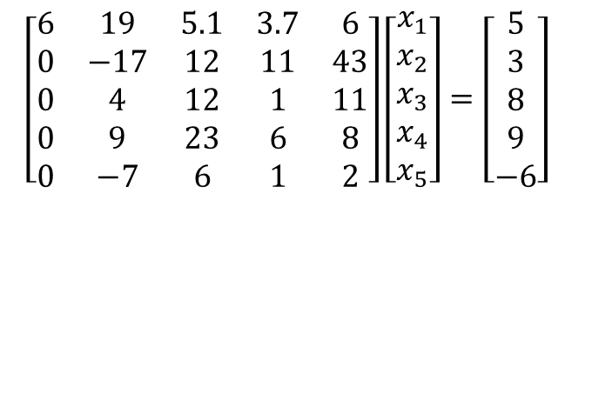
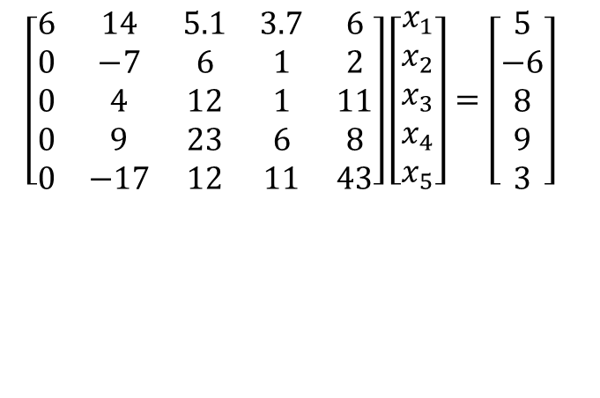
Example (2nd step of FE)
$$\left[\begin{matrix}6 & 14 & 5.1 & 3.7 & 6 \\ 0 & −7 & 6 & 1 & 2 \\ 0 & 4 & 12 & 1 & 11 \\ 0 & 9 & 23 & 6 & 8 \\ 0 & −17 & 12 & 11 & 43\end{matrix}\right]\left[\begin{matrix}x_{1} \\ x_{2} \\ x_{3} \\ x_{4} \\ x_{5}\end{matrix}\right]=\left[\begin{matrix}5 \\ −6 \\ 8 \\ 9 \\ 3\end{matrix}\right]$$
$$\left[\begin{matrix}6 & 19 & 5.1 & 3.7 & 6 \\ 0 & −17 & 12 & 11 & 43 \\ 0 & 4 & 12 & 1 & 11 \\ 0 & 9 & 23 & 6 & 8 \\ 0 & −7 & 6 & 1 & 2\end{matrix}\right]\left[\begin{matrix}x_{1} \\ x_{2} \\ x_{3} \\ x_{4} \\ x_{5}\end{matrix}\right]=\left[\begin{matrix}5 \\ 3 \\ 8 \\ 9 \\ −6\end{matrix}\right]$$

Slide 27
Gaussian Elimination with Partial Pivoting
A method to solve simultaneous linear equations of the form [A][X]=[C]
Two steps
1. Forward Elimination
2. Back Substitution

Slide 28
THE END

Slide 29
Gauss Elimination with Partial Pivoting Example

Slide 30
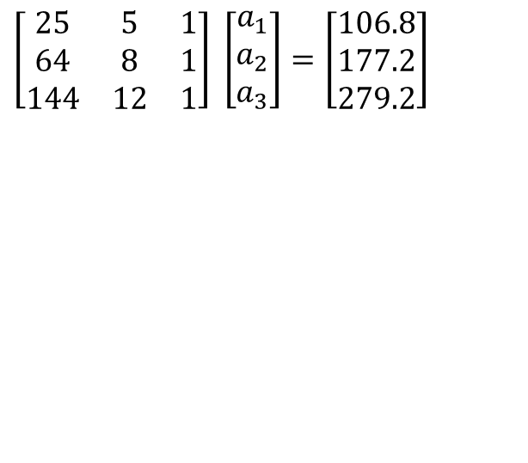
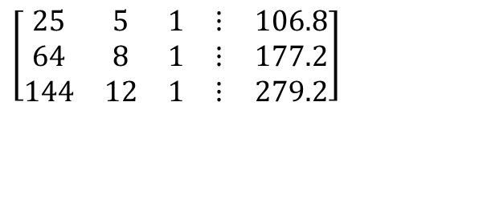
Solve the following set of equations by Gaussian elimination with partial pivoting
$$\left[\begin{matrix}25 & 5 & 1 \\ 64 & 8 & 1 \\ 144 & 12 & 1\end{matrix}\right] \left[\begin{matrix}a_{1} \\ a_{2} \\ a_{3}\end{matrix}\right]=\left[\begin{matrix}106.8 \\ 177.2 \\ 279.2\end{matrix}\right]$$
$$\left[\begin{matrix}25 & 5 & 1 & ⋮ & 106.8 \\ 64 & 8 & 1 & ⋮ & 177.2 \\ 144 & 12 & 1 & ⋮ & 279.2\end{matrix}\right]$$
Notes:
30

Slide 31
Forward Elimination
Notes:
31

Slide 32
Number of Steps of Forward Elimination
Number of steps of forward elimination is
(n−1)=(3−1)=2

Slide 33

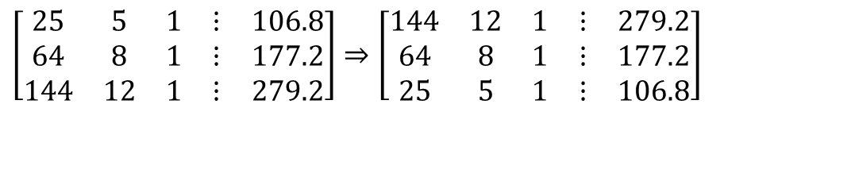
Forward Elimination: Step 1
Examine absolute values of first column, first row
and below.
$$\left|\text{25}\right|,\left|64\right|,\left|144\right|$$
Largest absolute value is 144 and exists in row 3.
Switch row 1 and row 3.
$$\left[\begin{matrix}25 & 5 & 1 & ⋮ & 106.8 \\ 64 & 8 & 1 & ⋮ & 177.2 \\ 144 & 12 & 1 & ⋮ & 279.2\end{matrix}\right]⇒\left[\begin{matrix}144 & 12 & 1 & ⋮ & 279.2 \\ 64 & 8 & 1 & ⋮ & 177.2 \\ 25 & 5 & 1 & ⋮ & 106.8\end{matrix}\right]$$

Slide 34
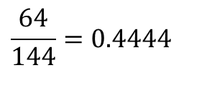
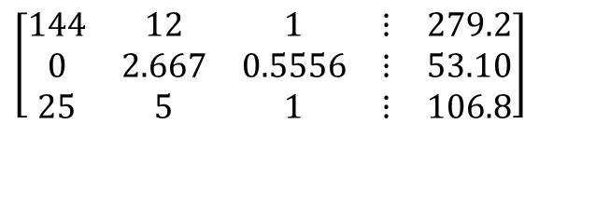
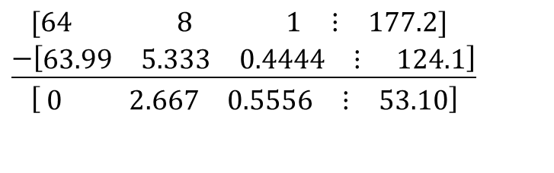
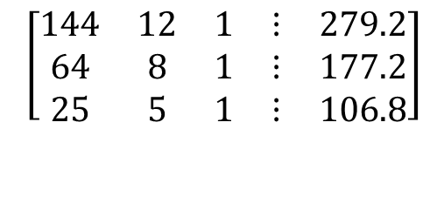
Forward Elimination: Step 1 (cont.)
$$\left[\begin{matrix}144 & 12 & 1 & ⋮ & 279.2 \\ 64 & 8 & 1 & ⋮ & 177.2 \\ 25 & 5 & 1 & ⋮ & 106.8\end{matrix}\right]$$
Divide Equation 1 by 144 and
multiply it by 64, .
$$\frac{64}{144}=0.4444$$
$$\left[\begin{matrix}144 & 12 & 1 & ⋮ & 279.2\end{matrix}\right]×0.4444=\left[\begin{matrix}63.99 & 5.333 & 0.4444 & ⋮ & 124.1\end{matrix}\right]$$
.
$$\left[\begin{matrix}\text{64} & \text{ 8} & _{ }\text{ 1} & ⋮ & \text{177.2}\end{matrix}\right] \\ \underline{−\left[\begin{matrix}\text{63.99} & \text{5.333} & \text{0.4444} & ⋮ & \text{ 124.1}\end{matrix}\right]} \\ \left[ \begin{matrix}0 & 2.667 & 0\text{.5556} & ⋮ & 53.10\end{matrix}\right]$$
Subtract the result from Equation 2
Substitute new equation for Equation 2
$$\left[\begin{matrix}144 & 12 & 1 & ⋮ & 279.2 \\ 0 & 2.667 & 0.5556 & ⋮ & 53.10 \\ 25 & 5 & 1 & ⋮ & 106.8\end{matrix}\right]$$
Notes:
34

Slide 35
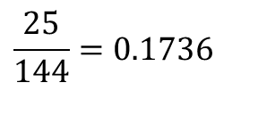
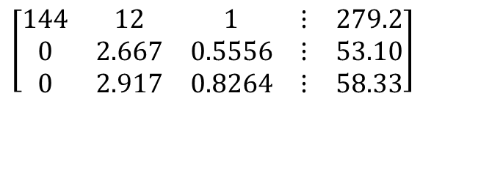
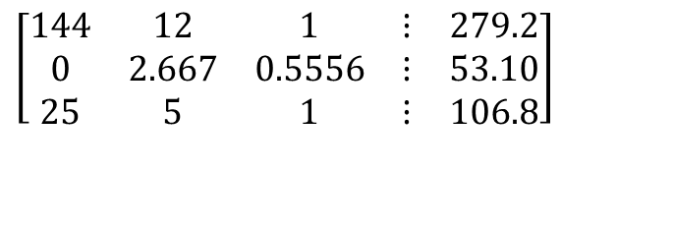
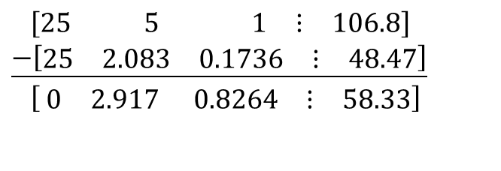
Forward Elimination: Step 1 (cont.)
$$\left[\begin{matrix}144 & 12 & 1 & ⋮ & 279.2 \\ 0 & 2.667 & 0.5556 & ⋮ & 53.10 \\ 25 & 5 & 1 & ⋮ & 106.8\end{matrix}\right]$$
Divide Equation 1 by 144 and
multiply it by 25, .
$$\frac{25}{144}=0.1736$$
$$\left[\begin{matrix}\text{144} & 12 & 1 & ⋮ & \text{279.2}\end{matrix}\right]×0.1736=\left[\begin{matrix}25.00 & 2.083 & 0.1736 & ⋮ & 48.47\end{matrix}\right]$$
.
$$\left[\begin{matrix}\text{25} & \text{ 5} & _{ }\text{ 1} & ⋮ & \text{106.8}\end{matrix}\right] \\ \underline{−\left[\begin{matrix}\text{25} & \text{2.083} & \text{0.1736} & ⋮ & \text{48.47}\end{matrix}\right]} \\ \left[ \begin{matrix}0 & 2.917 & 0.8264 & ⋮ & 58.33\end{matrix}\right]$$
Subtract the result from Equation 3
Substitute new equation for Equation 3
$$\left[\begin{matrix}144 & 12 & 1 & ⋮ & 279.2 \\ 0 & 2.667 & 0.5556 & ⋮ & 53.10 \\ 0 & 2.917 & 0.8264 & ⋮ & 58.33\end{matrix}\right]$$
Notes:
35

Slide 36

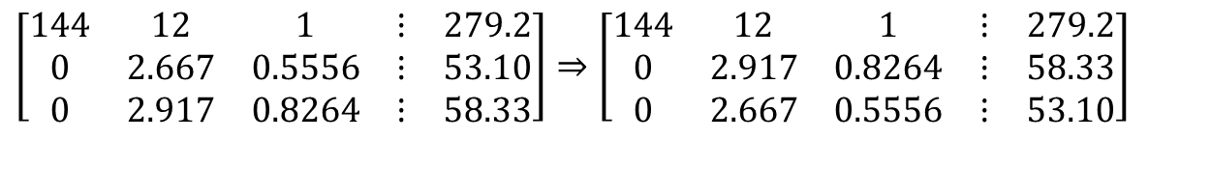
Forward Elimination: Step 2
Examine absolute values of second column, second row
and below.
$$\left|2.667\right|,\left|\text{2.917}\right|$$
Largest absolute value is 2.917 and exists in row 3.
Switch row 2 and row 3.
$$\left[\begin{matrix}144 & 12 & 1 & ⋮ & 279.2 \\ 0 & 2.667 & 0.5556 & ⋮ & 53.10 \\ 0 & 2.917 & 0.8264 & ⋮ & 58.33\end{matrix}\right]⇒\left[\begin{matrix}144 & 12 & 1 & ⋮ & 279.2 \\ 0 & 2.917 & 0.8264 & ⋮ & 58.33 \\ 0 & 2.667 & 0.5556 & ⋮ & 53.10\end{matrix}\right]$$

Slide 37
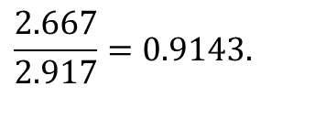
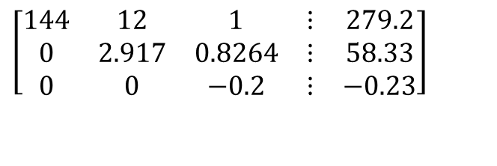
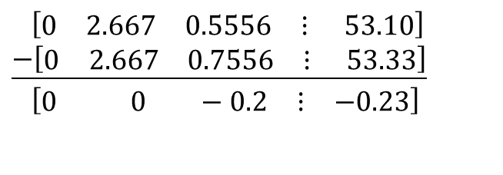
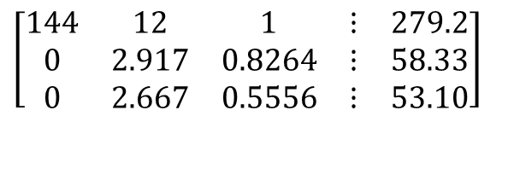
Forward Elimination: Step 2 (cont.)
Divide Equation 2 by 2.917 and
multiply it by 2.667,
$$\left[\begin{matrix}144 & 12 & 1 & ⋮ & 279.2 \\ 0 & 2.917 & 0.8264 & ⋮ & 58.33 \\ 0 & 2.667 & 0.5556 & ⋮ & 53.10\end{matrix}\right]$$
$$\frac{2.667}{2.917}=0.9143.$$
$$\left[\begin{matrix}0 & \text{2.917} & \text{0.8264} & ⋮ & \text{58.33}\end{matrix}\right]×0.9143=\left[\begin{matrix}0 & 2.667 & 0.7556 & ⋮ & 53.33\end{matrix}\right]$$
$$\left[\begin{matrix}0 & \text{2.667} & \text{0.5556} & ⋮ & \text{ 53.10}\end{matrix}\right] \\ \underline{−\left[\begin{matrix}0 & \text{2.667} & \text{0.7556} & ⋮ & \text{ 53.33}\end{matrix}\right]} \\ \left[\begin{matrix}0 & 0 & −0.2 & ⋮ & −0.23\end{matrix}\right]$$
.
Subtract the result from Equation 3
$$\left[\begin{matrix}144 & 12 & 1 & ⋮ & 279.2 \\ 0 & 2.917 & 0.8264 & ⋮ & 58.33 \\ 0 & 0 & −0.2 & ⋮ & −0.23\end{matrix}\right]$$
Substitute new equation for Equation 3
Notes:
37

Slide 38
Back Substitution
Notes:
38

Slide 39
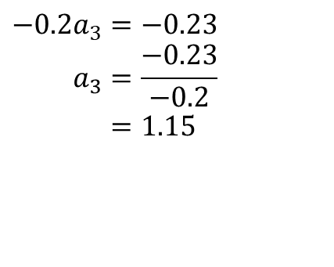
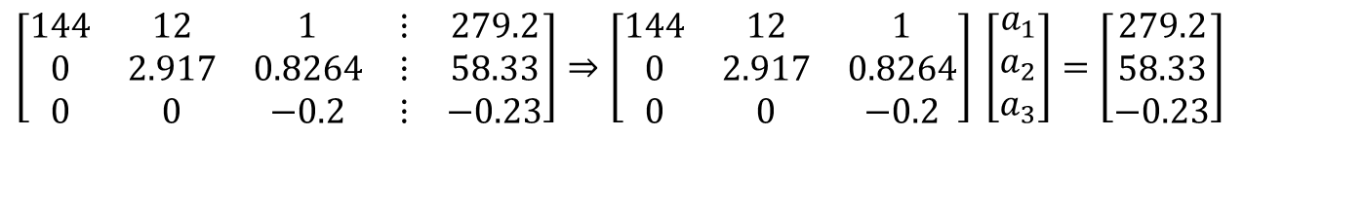
Back Substitution
$$\left[\begin{matrix}144 & 12 & 1 & ⋮ & 279.2 \\ 0 & 2.917 & 0.8264 & ⋮ & 58.33 \\ 0 & 0 & −0.2 & ⋮ & −0.23\end{matrix}\right]⇒\left[\begin{matrix}144 & 12 & 1 \\ 0 & 2.917 & 0.8264 \\ 0 & 0 & −0.2\end{matrix}\right] \left[\begin{matrix}a_{1} \\ a_{2} \\ a_{3}\end{matrix}\right]=\left[\begin{matrix}279.2 \\ 58.33 \\ −0.23\end{matrix}\right]$$
Solving for a₃
$$−0.2a_{3}=−0.23 \\ a_{3}=\frac{−0.23}{−0.2} \\ =\text{1.15}$$
Notes:
39

Slide 40
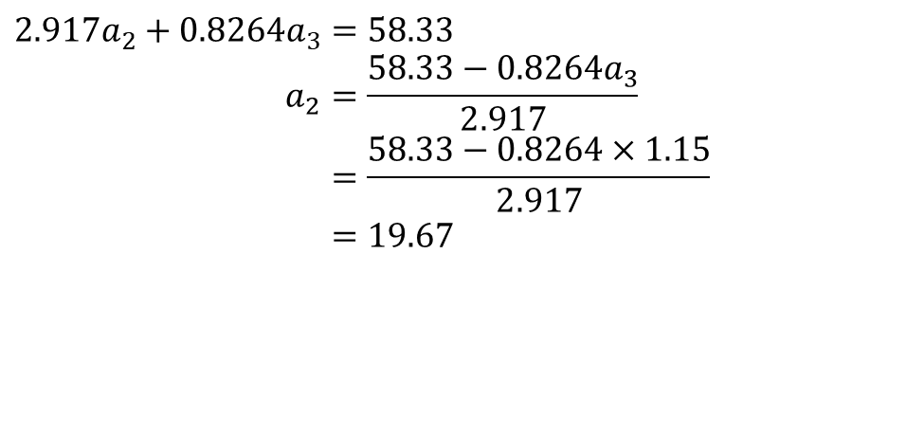
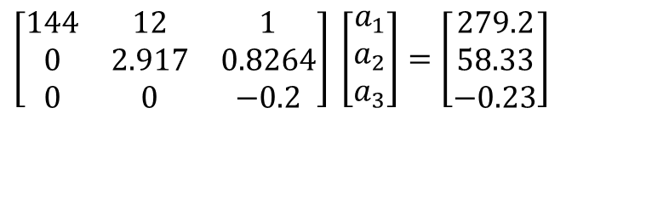
Back Substitution (cont.)
$$\left[\begin{matrix}144 & 12 & 1 \\ 0 & 2.917 & 0.8264 \\ 0 & 0 & −0.2\end{matrix}\right] \left[\begin{matrix}a_{1} \\ a_{2} \\ a_{3}\end{matrix}\right]=\left[\begin{matrix}279.2 \\ 58.33 \\ −0.23\end{matrix}\right]$$
Solving for a₂
$$2.917a_{2}+0.8264a_{3}=58.33 \\ a_{2}=\frac{58.33−0.8264a_{3}}{2.917} \\ =\frac{58.33−0.8264×1.15}{2.917} \\ =\text{19.}67$$
Notes:
40

Slide 41
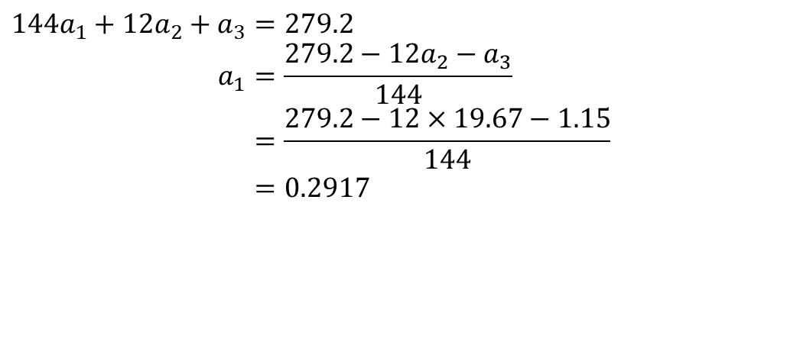
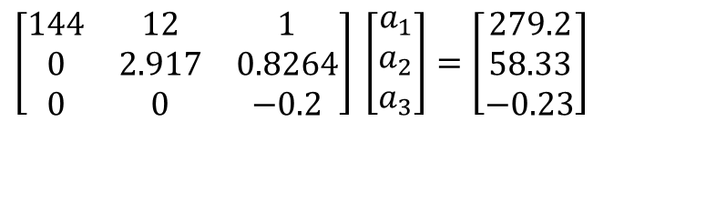
Back Substitution (cont.)
$$\left[\begin{matrix}144 & 12 & 1 \\ 0 & 2.917 & 0.8264 \\ 0 & 0 & −0.2\end{matrix}\right] \left[\begin{matrix}a_{1} \\ a_{2} \\ a_{3}\end{matrix}\right]=\left[\begin{matrix}279.2 \\ 58.33 \\ −0.23\end{matrix}\right]$$
Solving for a₁
$$144a_{1}+12a_{2}+a_{3}=279.2 \\ a_{1}=\frac{279.2−12a_{2}−a_{3}}{144} \\ =\frac{279.2−12×19.67−1.15}{144} \\ =0.2917$$
Notes:
41

Slide 42
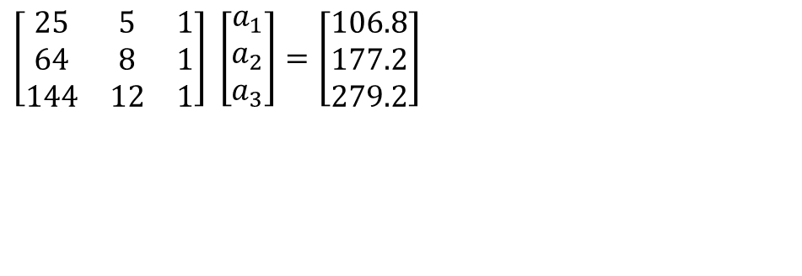
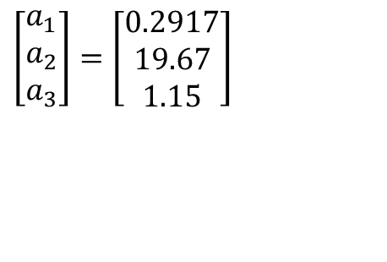
Gaussian Elimination with Partial Pivoting Solution
$$\left[\begin{matrix}25 & 5 & 1 \\ 64 & 8 & 1 \\ 144 & 12 & 1\end{matrix}\right] \left[\begin{matrix}a_{1} \\ a_{2} \\ a_{3}\end{matrix}\right]=\left[\begin{matrix}106.8 \\ 177.2 \\ 279.2\end{matrix}\right]$$
$$\left[\begin{matrix}a_{1} \\ a_{2} \\ a_{3}\end{matrix}\right]=\left[\begin{matrix}0.2917 \\ 19.67 \\ 1.15\end{matrix}\right]$$
Notes:
42

Slide 43

Like what you see. Tell your friends. Subscribe to the NumericalMethodsGuy Channel – our goal is to reach 100,000 subscribers.

